Slide 1
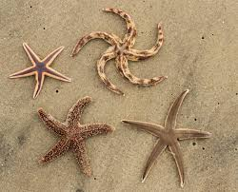
starfish
By Holly

Slide 2
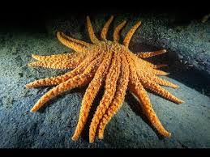
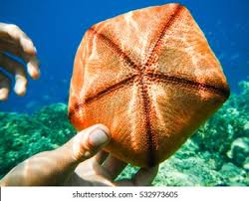
There is this starfish called the Gibbous Starlet starfish and is also shaped as a pentagon. That just shows that not all starfish are shaped as a star. Also while some have 5 arms other species can have up to 40.

Slide 3
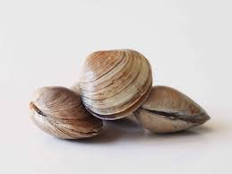
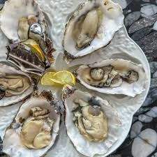
Diet
Most starfish love to eat clams, oysters and mussels. Starfish eat by extruding their stomach outside their bodies through their mouth to digest food externally.

Slide 4
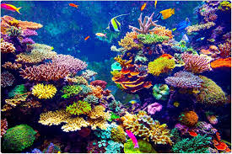

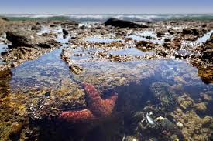
Habitat
They live in a lot of oceans but mostly in coral reefs or shallow tidal pools.

Slide 5
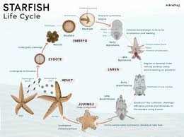
Life Span
Did you know starfishes can live up to 35 years in the wild but need specialized care to live long in aquariums.

Slide 6
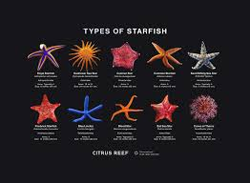
Species
There are a lot of different species of starfish like pink pacific star, massive sunflower sea star, crown-of-thorns and up to about 1,600 to over 2,000 more.

