Slide 1

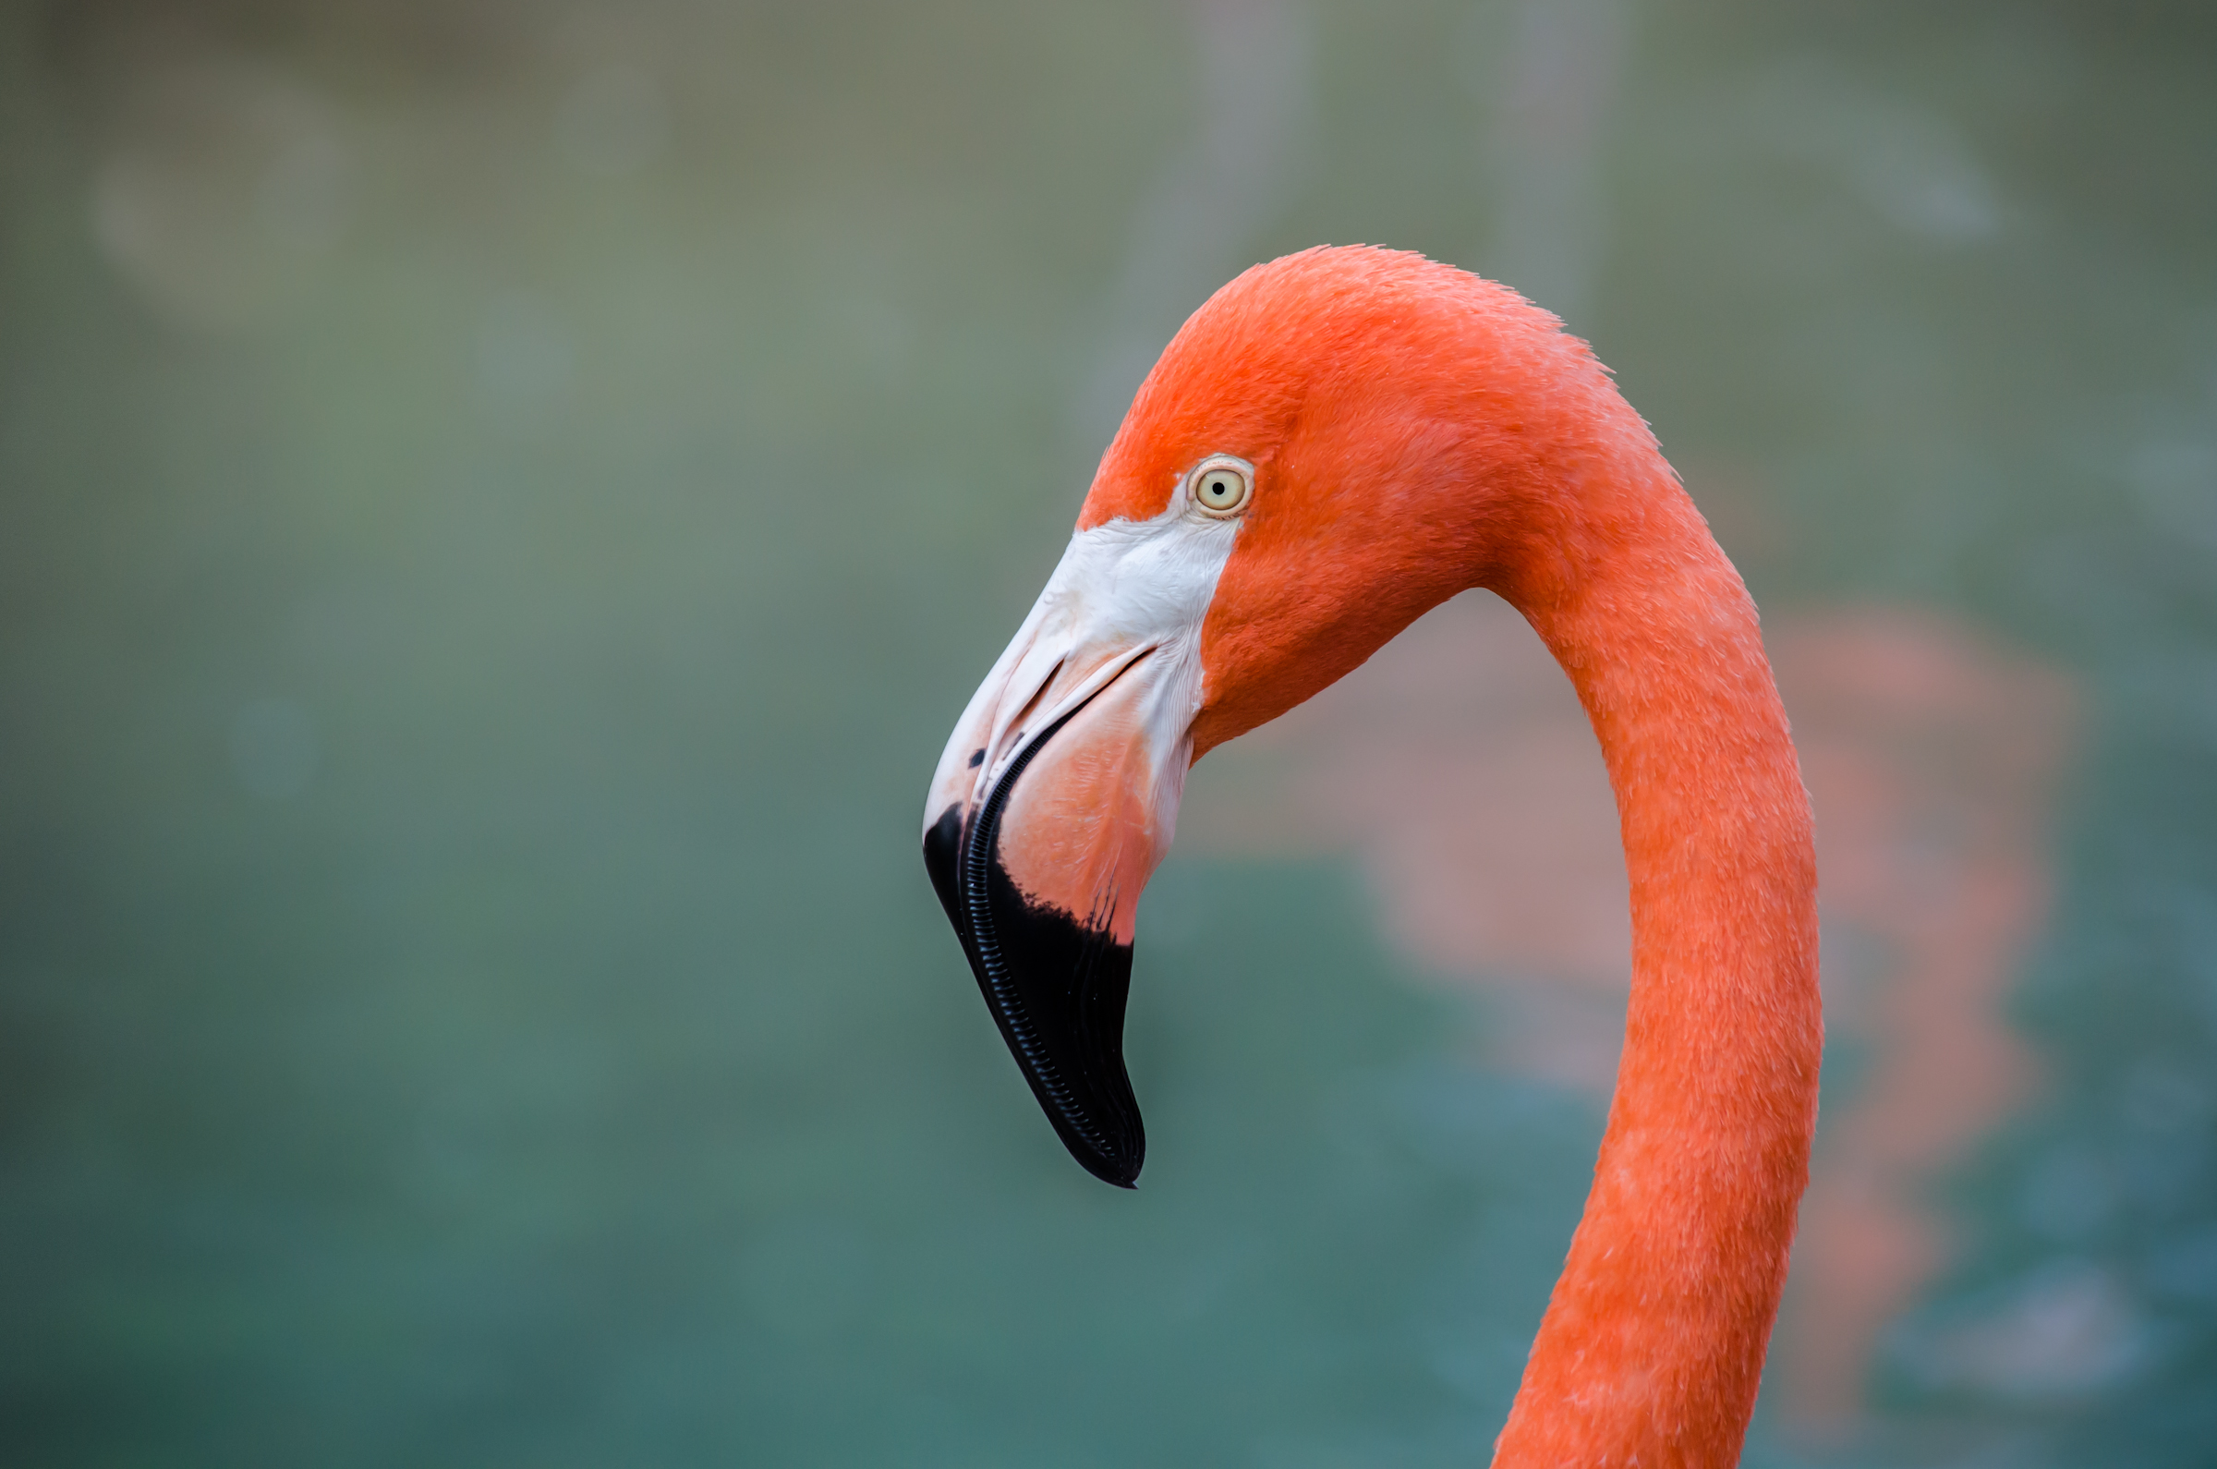
Flamingos
Ely Vincent

Slide 2
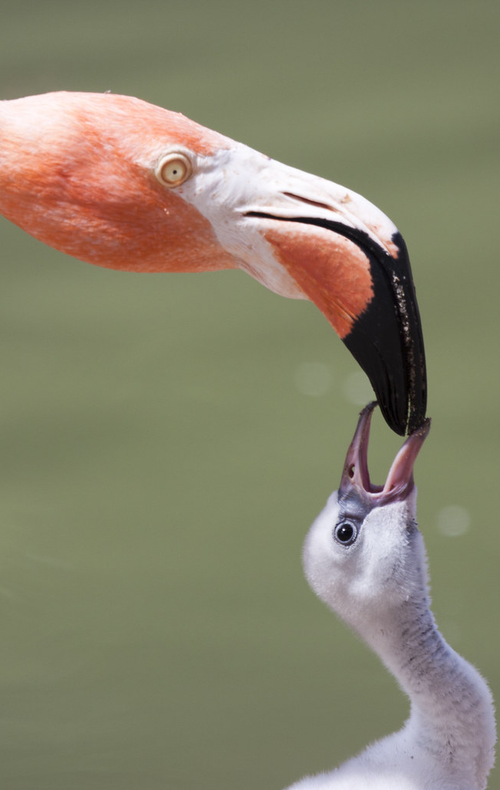
What are flamingos?
Flamingos are a type of bird, quite a large bird. There scientific name is Phoenicopterus they are a type of wading bird which is a water bird with long legs. There are only six species of flamingos, the Lesser flamingo, the Greater flamingo, the Chilean flamingo, Caribbean flamingo, Andean flamingo and James’s flamingo.
This Photo by Unknown Author is licensed under CC BY-NC-ND

Slide 3
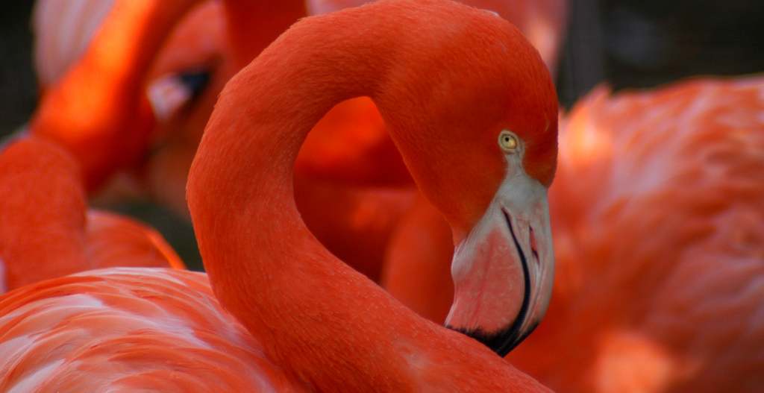
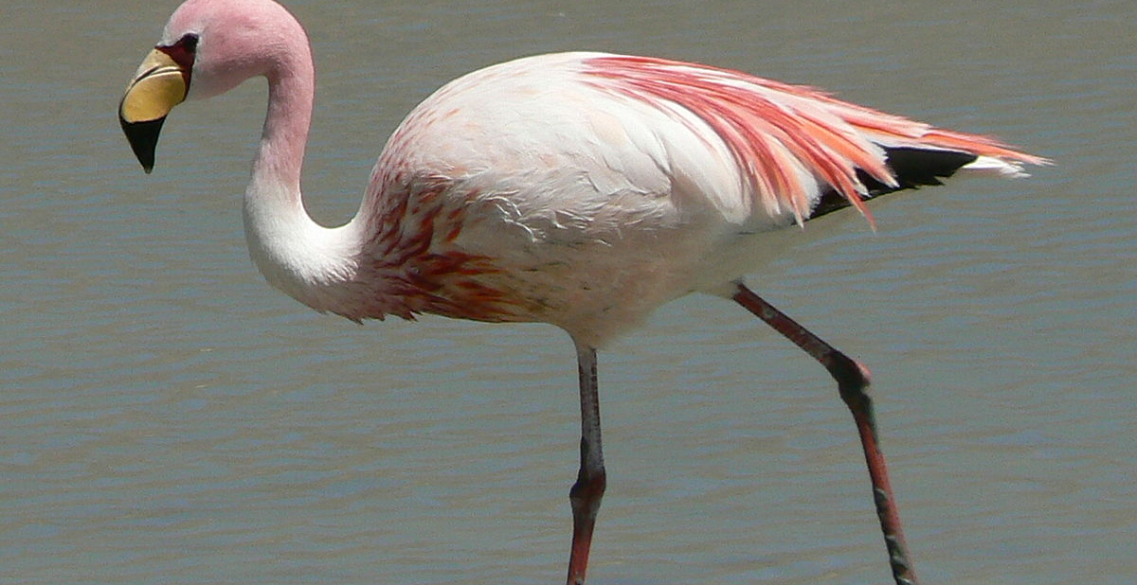
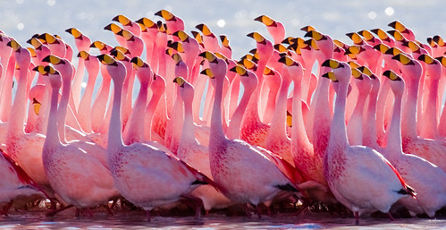
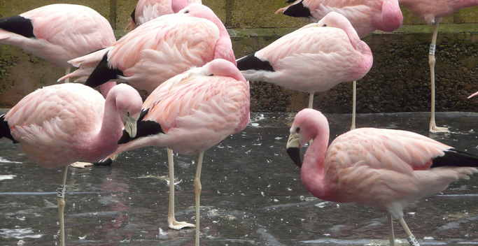
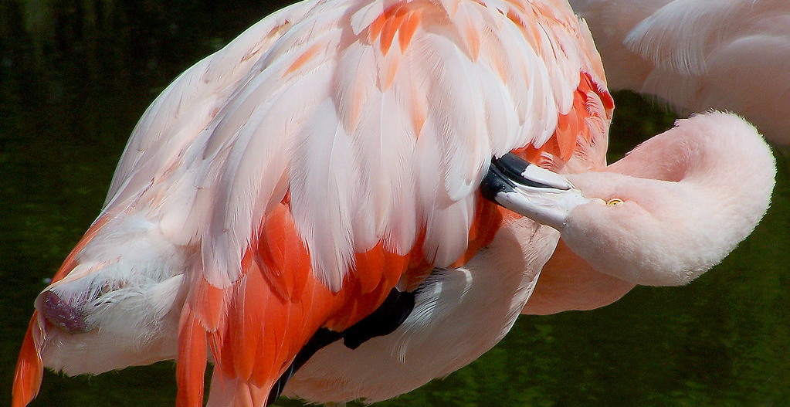
Types of Flamingo
Greater flamingo
Lesser flamingo
James’s flamingo
Caribbean flamingo
Andean flamingo
Chilean flamingo

Slide 4
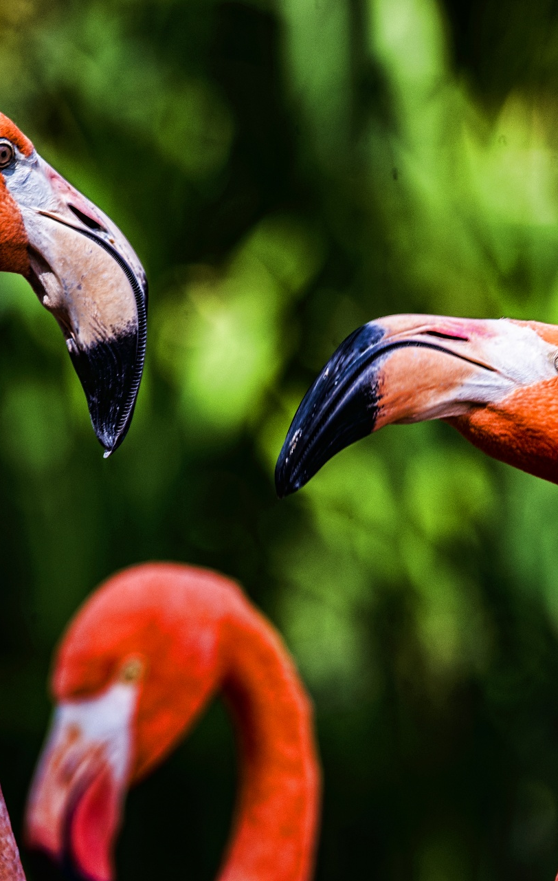
Physical appearance
Flamingos are born white and covered in feathers, they kind of look like small swans but with pink legs and beak. As they grow older the will grow progressively more pink until they're fully grown, they’re face is white and the tip of their beak is generally black, they have long bendy neck. They come in more colours than just pink though they can be more or less white orange dark and light shades of pink.

Slide 5
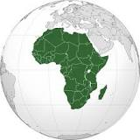
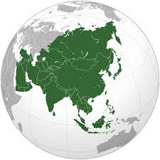
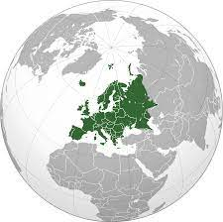
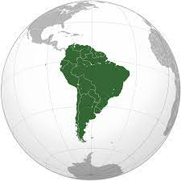
Habitat
Africa
In Africa there's the Lesser and Greater flamingo
A flamingos habitat is in Africa, Asia, Europe and South America. They like large alkaline or saline lakes, which the saline lakes are salty lakes whilst the alkaline lakes are the same with potassium carbonates and sodium chloride. The lakes the flamingos are usually in have little vegetation. They can also be found in mangrove swamps, sandy islands in the intertidal zone which is where the ocean meets the land in the middle of the high and low tides.
Asia
In Asia the Greater Flaming is here
Europe
Once again the Greater flamingo is found here
South America
The Chilean flamingo lives here as well as the James’s, Andean and the Caribbean flamingo

Slide 6
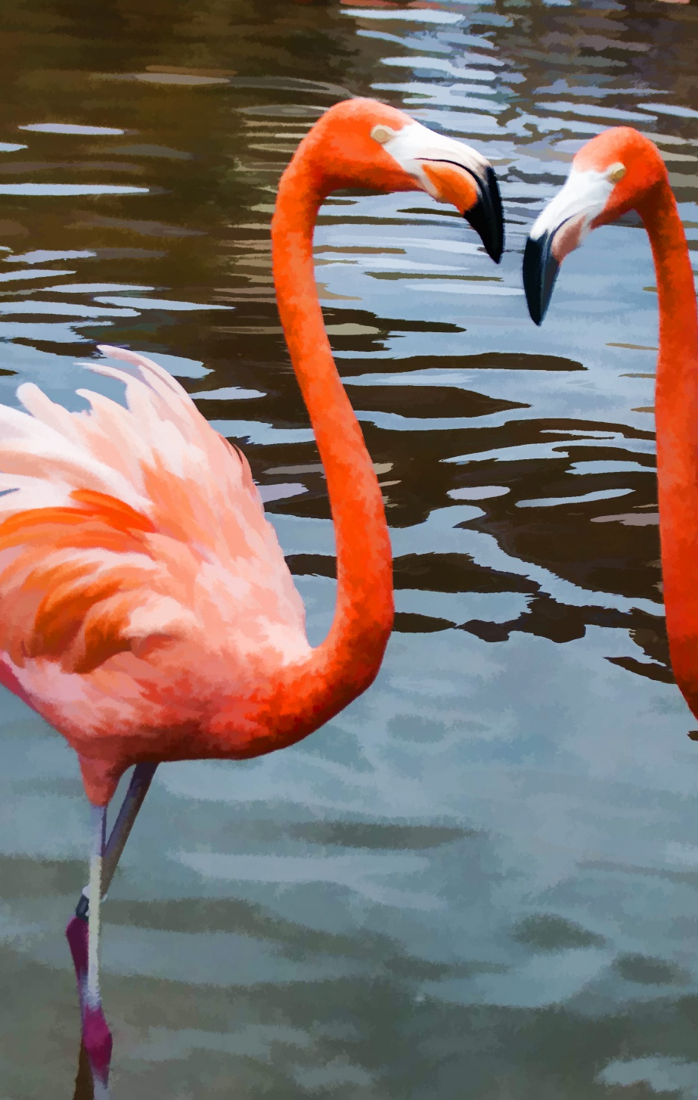
What they eat
Flamingos eat a wide range of algae, small seeds and crustations, flys, and other plants that grow in shallow waters because of this diet it makes their feathers become a pink colour, although the way they eat is by sticking their head underneath the water and snapping up the good stuff.

Slide 7
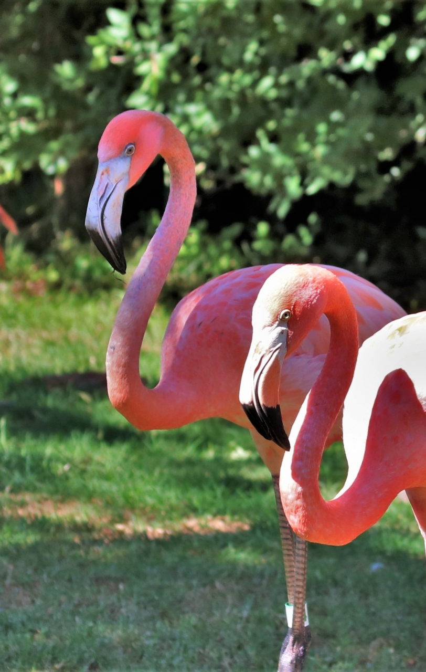
Behaviours
They spend most of their day doing normal things like resting, eating and bathing, but they also do this thing called preening, witch is distributing an oil over their body which is what waterproofs their feathers. They can also fly up to 500 kilometres in only one day! And stand on one leg for hours!

Slide 8
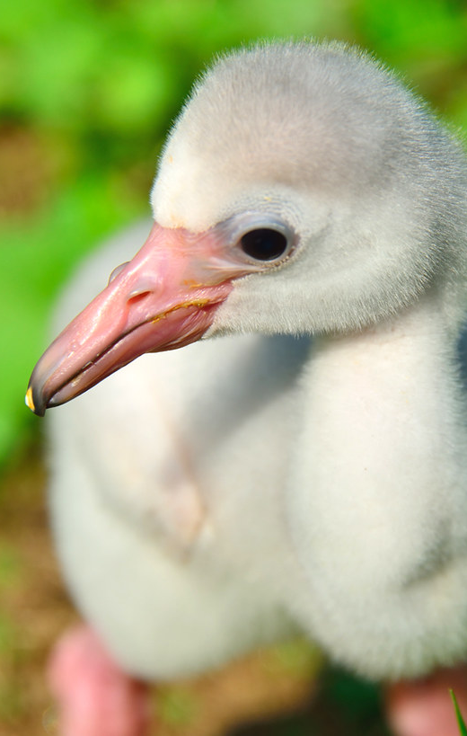
Reproduction
When a male and female meet the dance in search of a partner to see if they are made for each other or not, flamingos that can switch quickly between dance moves are more likely to find a mate. The soon to be parents help each other to build a nest where they lay an egg, then the egg gets incubate for about 28 days, the chick hatch's grows up and repeats the proses.

Slide 9
Population
33.9k
21.5k
320k
2.2m
200k
Andean flamingo
Caribbean flamingo
Greatter flamingo
Lesser flamingo
Chilean flamingo

Slide 10
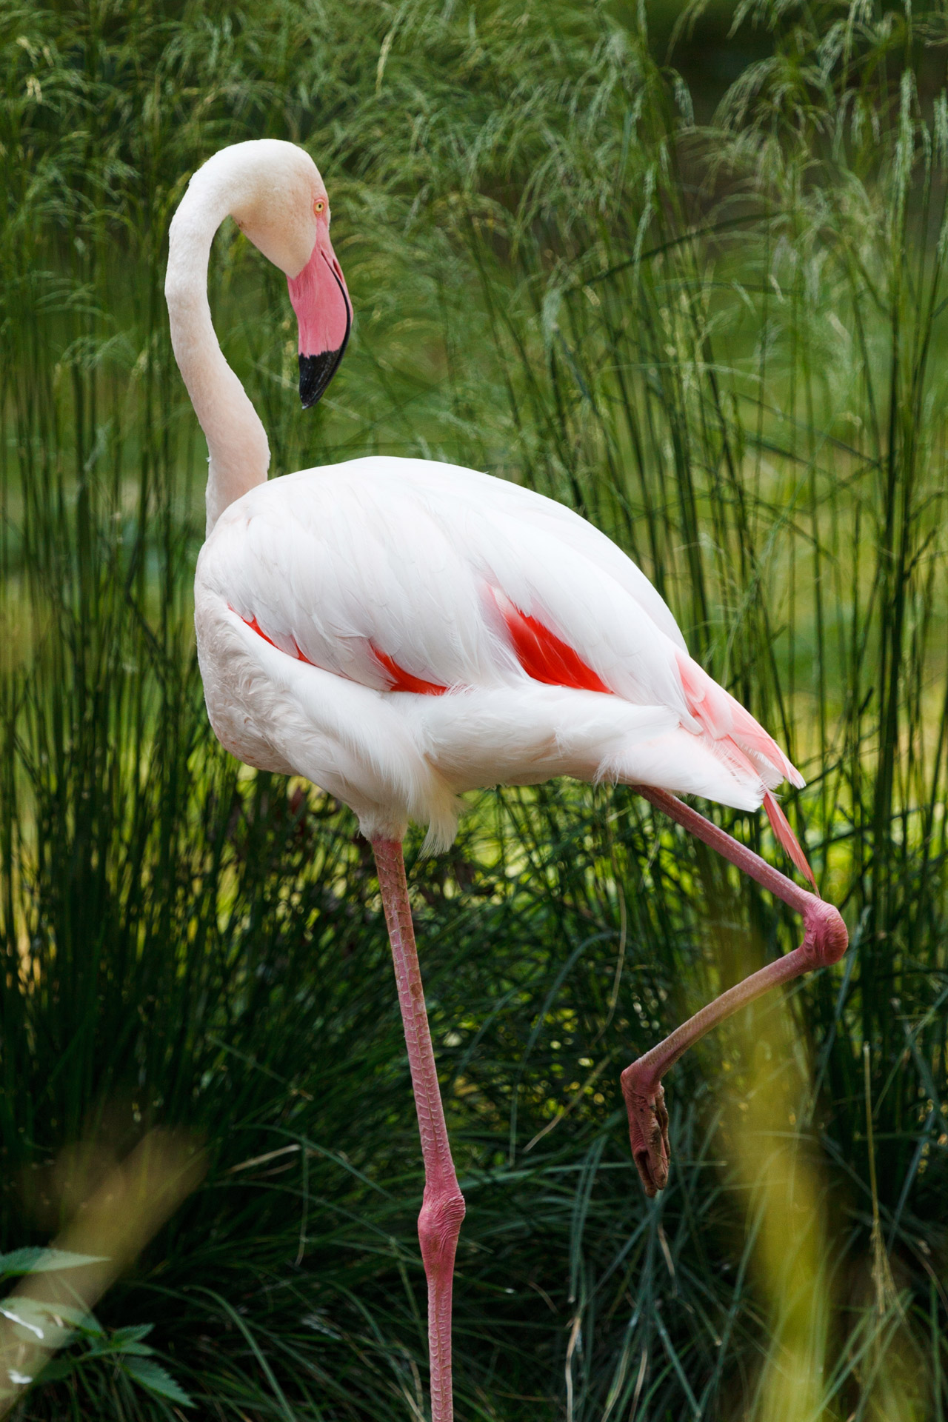
Status and threats
The complete population of the flamingo is 2.77 million flamingos! And they have least concern for being endangered, although that doesn't stop the threats, its mostly just habitat loss, but that’s human expansion, so the bigger of a need for housing the less habitat there is for any animal not just flamingos.

