Slide 1
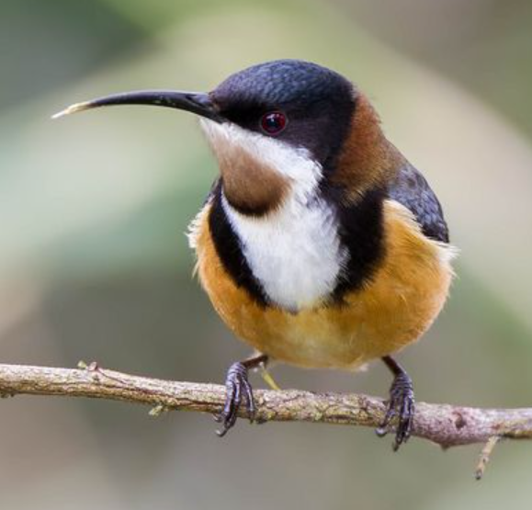
Eastern Spinebill
We
chose the
Eastern Spinebill because we
saw it in our
school

Slide 2
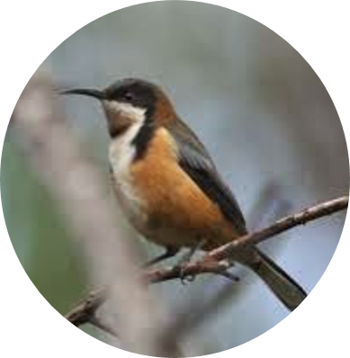
What it looks like.
Long curves beak.
Red eye.
Orange belly.
brown spot on it throat.

Slide 3
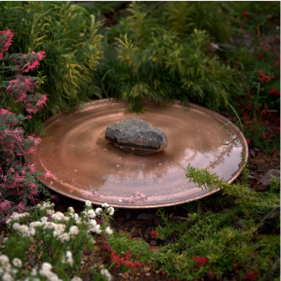
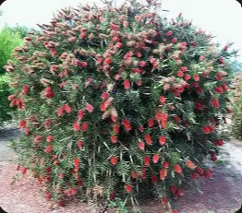
What it needs to thrive
Eastern Spinebills thrive in environments with:
Nectar from native flowers
Clean shallow water
Dense shrubs for shelter, finding food and nesting

Slide 4
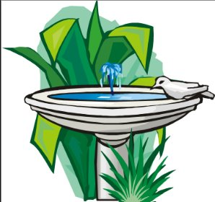
What is missing in our school?
Things missing in our school for the Eastern spine bill include
Clean shallow water

Slide 5
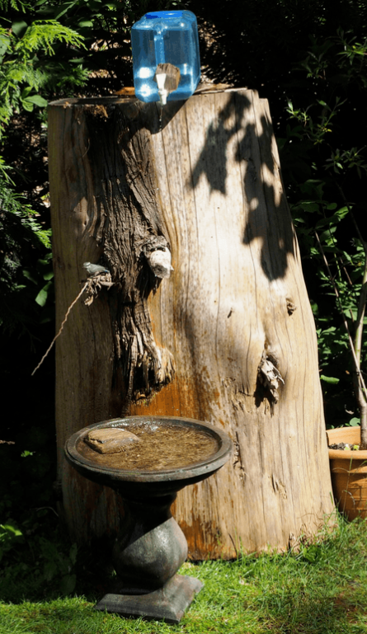
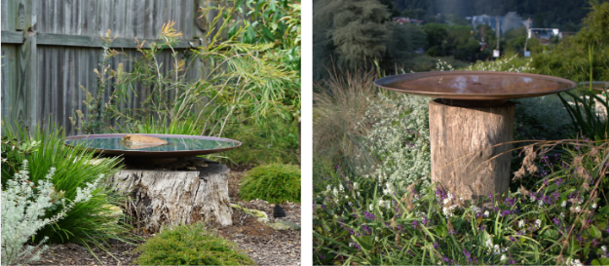
Our solution
We plan to make water stations around the school grounds.

Slide 6
Our solution
Shallow watering stations
Water stations must be shallow to stop
small birds from drowning.
A rock can be placed into the water to
help birds climb out.

Slide 7
Our solution
Elevated shallow watering station
Watering stations will be placed
above the ground to help birds
keep watch for predators like
cats and foxes.

Slide 8
Our solution
Dripping reservoir
A dripping reservoir placed above the water station helps birds find water by hearing the dripping sound when they cannot see it.

Slide 9
Resources and references
Birdlife Australia
Australian Natural Museum
Backyard Buddies
DIY – How To Make A Quick And Easy Birdbath Drip That Has Birds Flocking To It – West Coast Notebook​
How To Make a Homemade Birdbath Dripper for Your Yard (2026) | Today's Homeowner

