Slide 1
CAT 2: Exploration Folio in Adobe Photoshop
Piper Roberts

Slide 2
Core concepts
The core concept I am exploring in my artwork is the representation of emotions in celebrities, specifically Audrey Hepburn, using colour as a powerful visual language.
Celebrities are often idolized to the point of dehumanization, viewed as flawless or unfeeling icons rather than real people. With society’s growing acceptance of celebrities showing vulnerability, this concept resonates with the shifting cultural perception that even the most admired figures experience complex emotions.
In Photoshop, I used a duotone effect as the primary technique, pairing specific colours with certain emotions to capture the essence of the human experience in a visually compelling way. This technique aligns with my themes by allowing colour to communicate the emotional depth beneath a celebrity’s polished image, thus making them appear more relatable. Through this approach, I aim to evoke a range of emotions, such as joy, sadness, nostalgia, and introspection, encouraging viewers to see beyond the celebrity facade and connect with their humanity. The main image that comes to mind is a layered, duotone portrait of Audrey Hepburn, where each colour layer hints at a different emotion or state of mind, inviting viewers to experience a more intimate portrayal of an iconic figure.

Slide 3
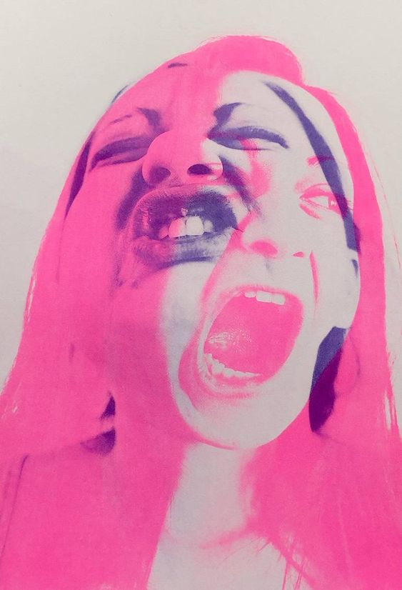
Artistic inspiration 1
Conversations In Riso 001 - Limited Edition Print
Naomi Vona
Italy
https://www.saatchiart.com/en-au/art/Printmaking-Conversations-In-Riso-001-Limited-Edition/
I chose Naomi Vona’s artwork because of its intense emotional expression, conveyed through layered faces and bold colours. This style inspires me to explore emotions in my work by layering images and using vibrant colours to capture complex feelings. Doing so allows me to create an expressive, engaging portrait that evokes a strong emotional response.

Slide 4
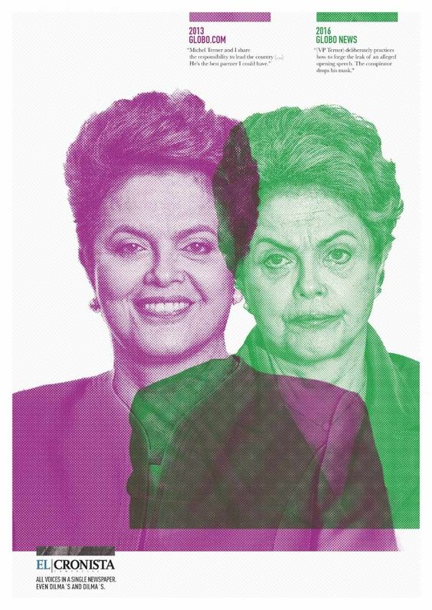
Artistic inspiration 2
'Dilma, Hillary, Trump’
June 2016.
El Cronista
https://www.adsoftheworld.com/campaigns/dilma
I chose this artwork by El Cronista for its powerful depiction of contrasting public personas over time, shown through layered imagery and contrasting colours. This inspired me to explore themes of change and duality from a celebrity standpoint, possibly by layering different versions of a subject to represent different emotions, periods, or perspectives. This style can communicate complex narratives and shifts in identity within a single image.

Slide 5
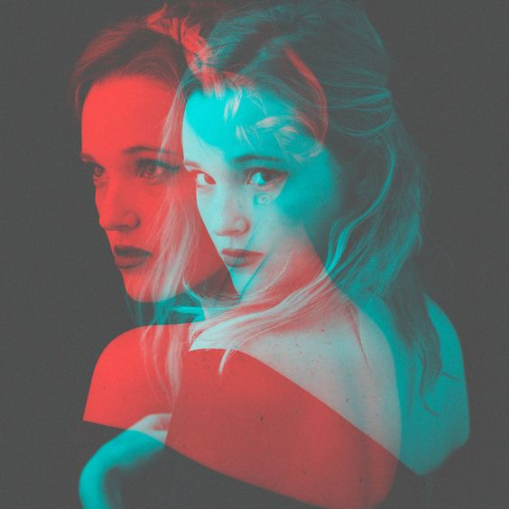
Artistic inspiration 3
RECENT - Jason Gaskins Photography
https://au.pinterest.com/pin/323062973283669618/
I chose this artwork by Jason Gaskins as the layered duotone effect reflects my interest in exploring multiple facets of identity, emotion, or time within a single composition. The use of overlapping, contrasting colours allows for a visual dialogue between different aspects of a subject, symbolizing internal conflicts, changes, or dual perspectives. This approach can help me convey the complexity of the human experience and allow viewers to see a new side of a person.

Slide 6
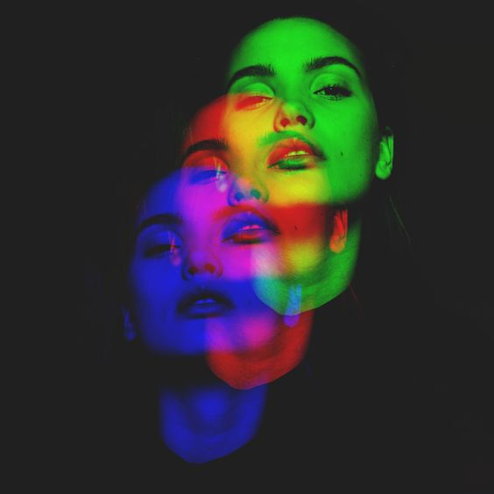
Subject matter
In my final artwork, I will explore the theme of celebrity vulnerability by using an iconic image of Audrey Hepburn layered with multiple photos to create a duotone effect. By layering her image in contrasting colours, I aim to reveal different facets of her personality and emotions, making her appear more relatable and human rather than an untouchable star. The duotone effect will visually express the idea of duality—the public persona versus the private self—showing that even celebrities experience complex emotions hidden beneath their public images.
I chose Audrey Hepburn as the subject because she is widely recognized and admired, often seen as a symbol of elegance and grace. However, by adding layered, expressive elements, I want to disrupt this polished image and suggest a more complex, emotional side to her. This approach links to my core concept of humanizing celebrities, encouraging viewers to see past the idealized images and recognise the vulnerability and emotions that make them human, just like anyone else.
Here is an example image similar to my vision:
https://au.pinterest.com/pin/666884657358113904/

Slide 7
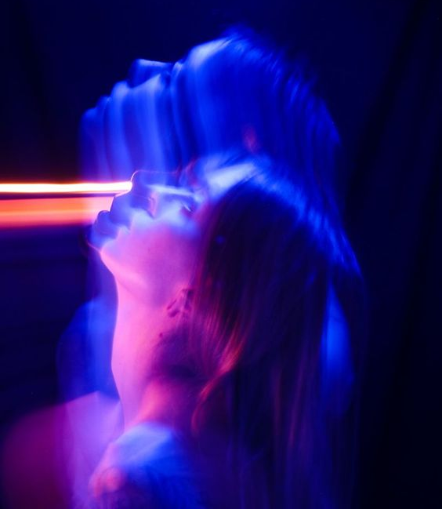
Aesthetic qualities
The main aesthetic qualities in my final artwork will center around a rich yet restrained duotone colour palette, carefully chosen to evoke a spectrum of human emotions. Each colour will represent a different emotional layer, from warmth and softness to intensity and melancholy, capturing the complexity of the celebrity’s inner life. The limited palette emphasizes the duality of emotions, allowing me to play with contrasts—light and dark, vibrant and muted—that mirror the contrasting public and private personas of the celebrity.
By layering colours and images, I aim to create a depth that goes beyond a traditional portrait, inviting viewers to look deeper into the image and discover the multifaceted humanity of the subject. The overlapping colours and forms create a sense of movement and fluidity, suggesting that emotions are not static but continuously shifting. This approach disrupts the idealized, flawless image often associated with celebrities, grounding them in a more authentic, relatable human experience.
Here is an example image similar to my vision:
https://www.instagram.com/p/CMVFmSojGjL/?igshid=1fvf74k8lsb2q&epikdj0yJn

Slide 8
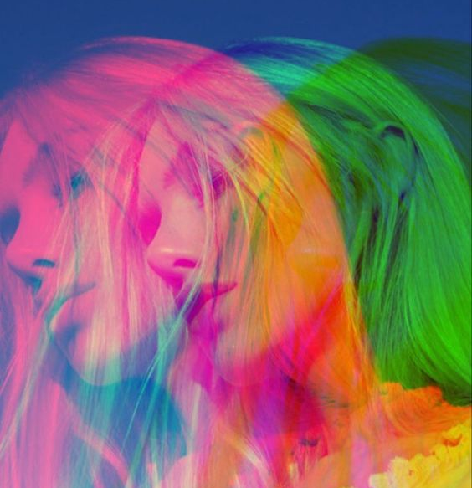
Main Techniques
The main Photoshop technique I will use in my final artwork is the duotone effect, where I layer two or more contrasting colours over multiple images to create depth and emotional impact. Additionally, I will experiment with layer blending modes to combine multiple versions of the same image with slight shifts or variations in size, form and colour to create a layered look that visually represents complex, overlapping emotions.
I chose these techniques because the duotone effect allows me to communicate different emotions through colour in a simplified yet powerful way, aligning with my theme of humanizing celebrities. By combining the duotone effect with layering, I can suggest the multi-dimensional nature of emotions, revealing a more relatable, vulnerable side of the celebrity. These techniques highlight my core concept of breaking down the "perfect" celebrity image and allowing viewers to see a more genuine, human side, bridging the gap between celebrity and ordinary person.
Here is an example image similar to my vision:
https://au.pinterest.com/pin/1196337403123677/

Slide 9
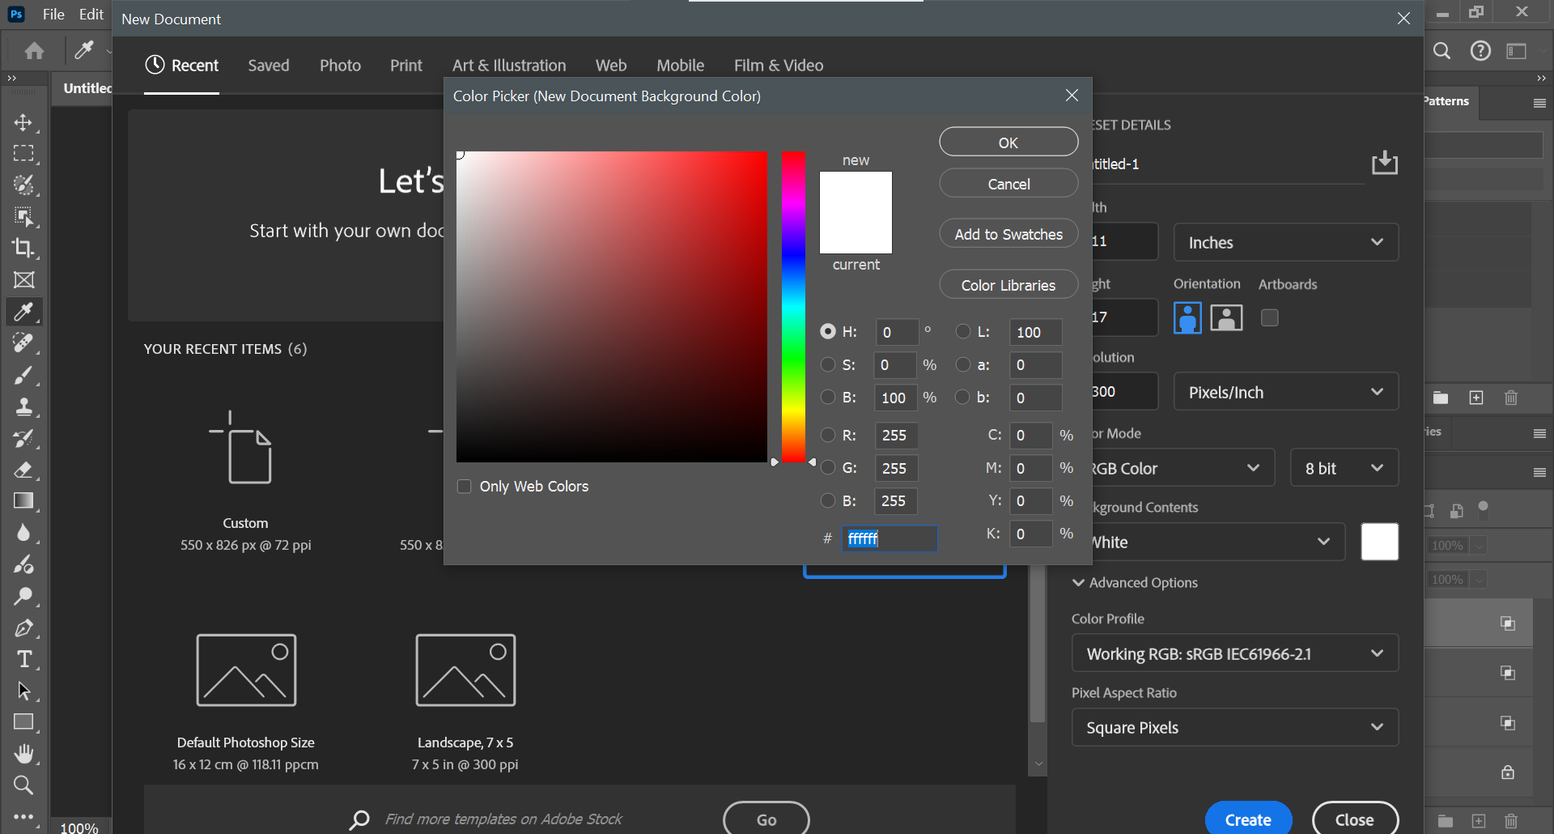
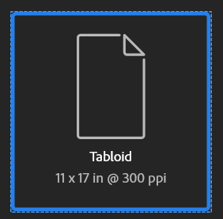
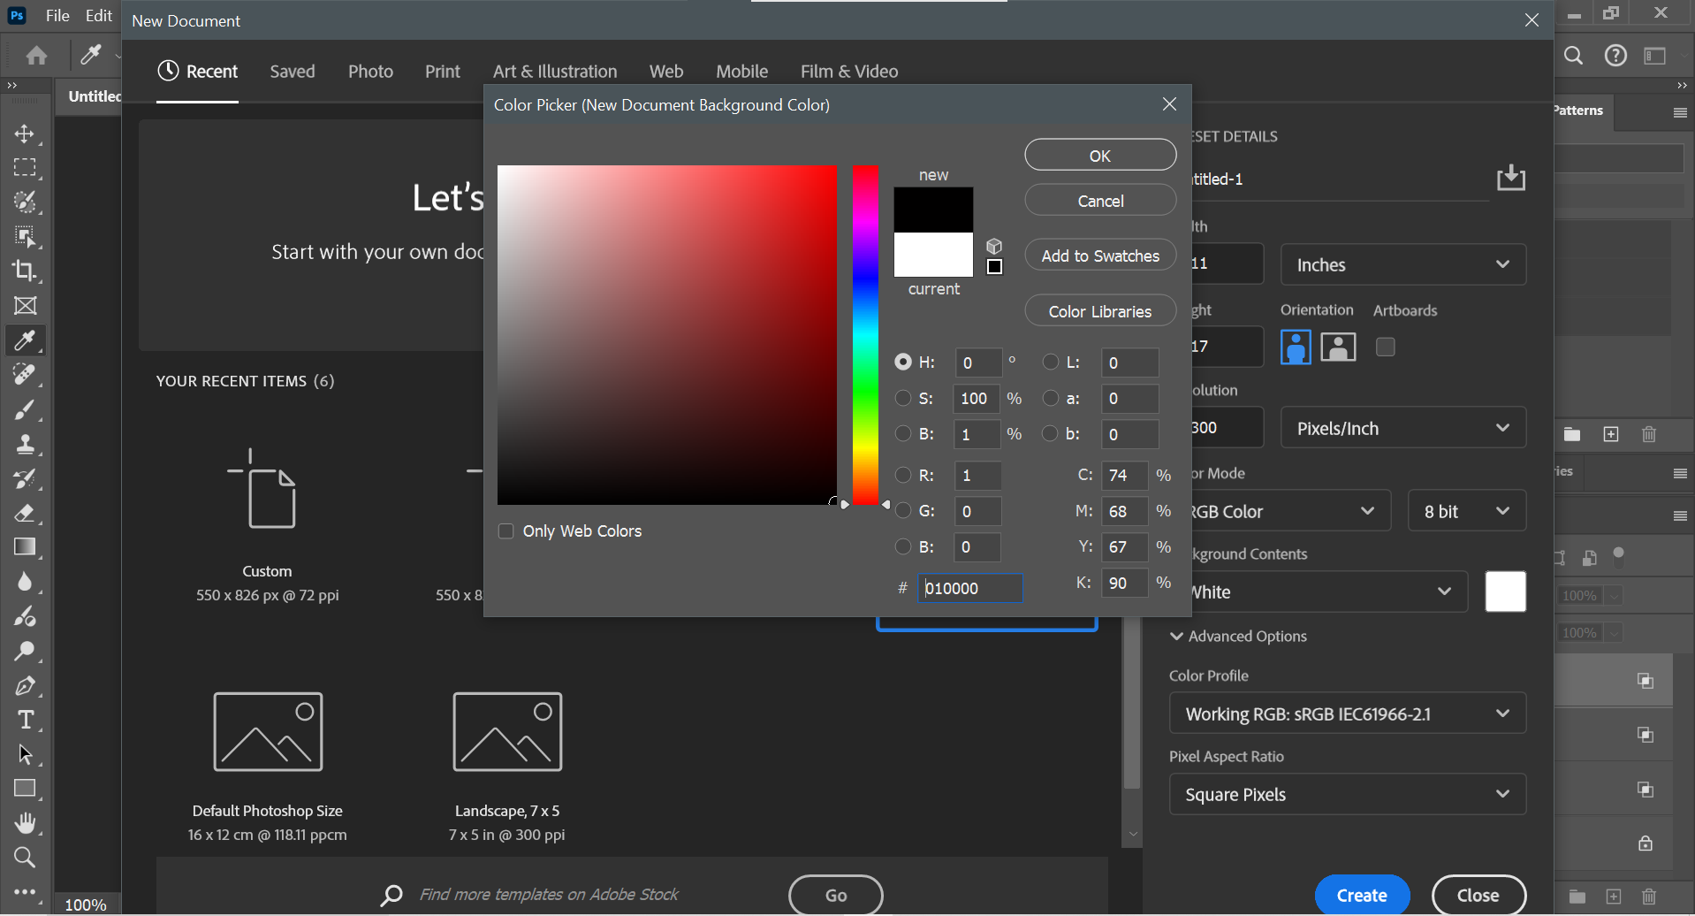
documentation
Start by selecting a document preset (I chose a portrait style document)
Then select the background colour of the document and change it to black

Slide 10
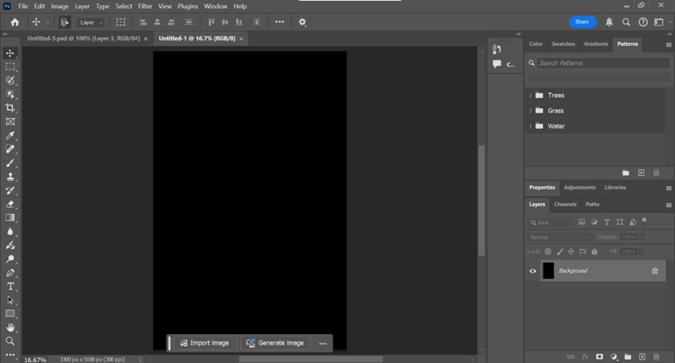
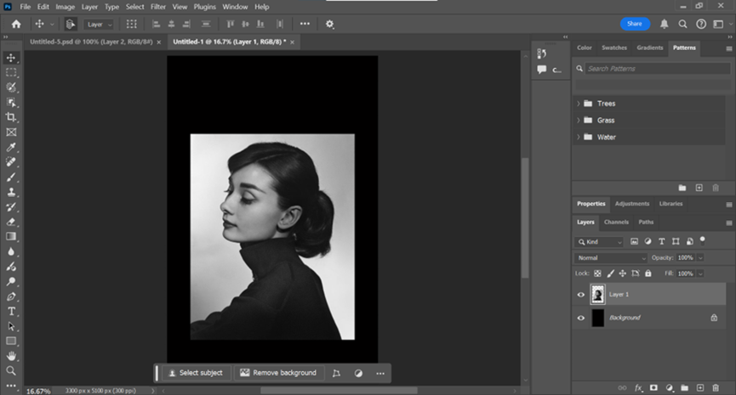
documentation
Now that you have created the base for your artwork choose a photo you wish to insert (I chose Audrey Hepburn) copy and paste the photo into your document.
Once you have pasted your photo in, select the move tool and press Ctrl – T this allows you to move and resize the image any way you like

Slide 11
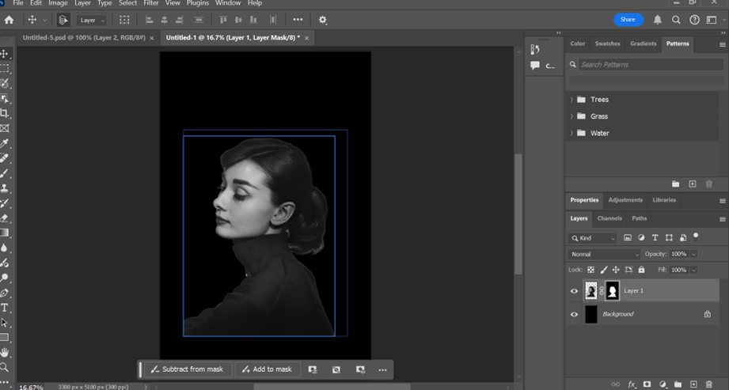
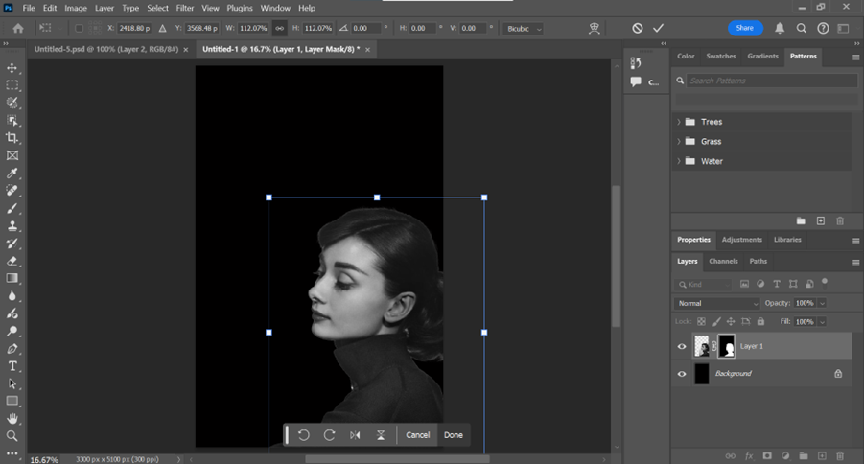
documentation
Now you want to reselect your image using the same move tool and press the remove background button below
Wait for your background to be removed before clicking anywhere else
Once removed press Ctrl – T again and move your image to the desired area on the document.

Slide 12
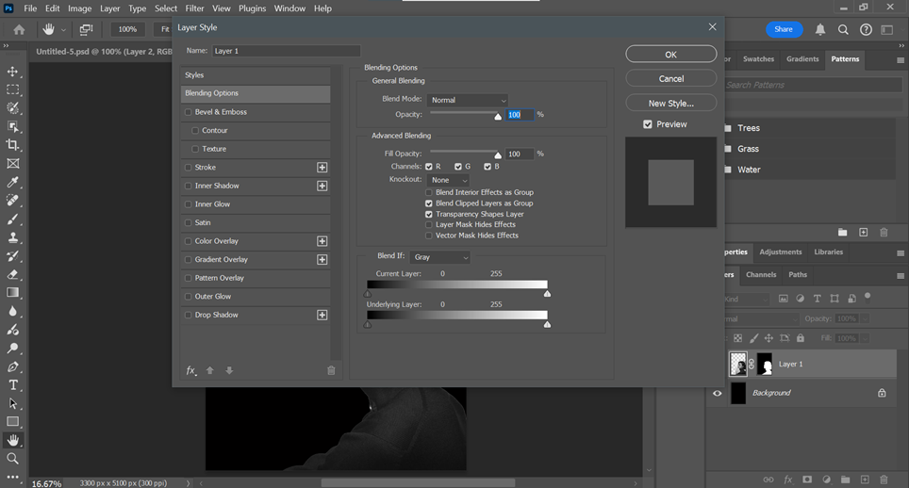
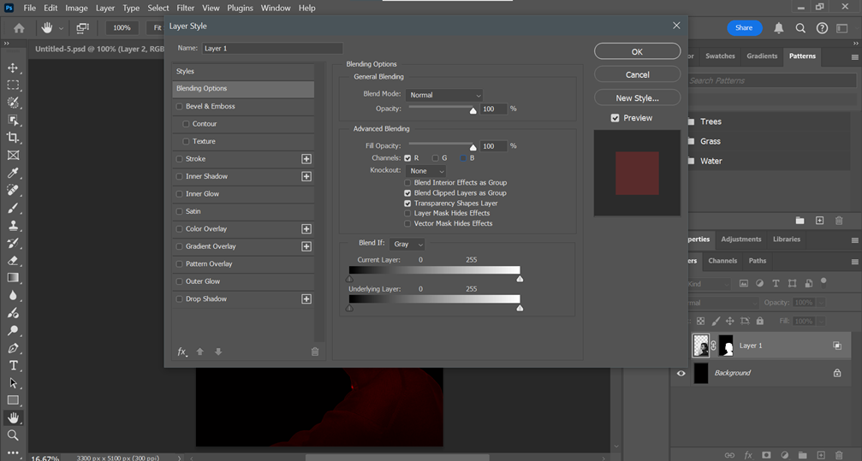
documentation
Now go to your layers tab and double click your image
This should bring up a large tab with blending options
Under advanced blending find the channels tab with the letters (R, G, B)
This represents the colours red, green, and blue.
Deselect the colours you don’t want leaving only 1 or 2 remaining
(I chose for my image to be Red)

Slide 13
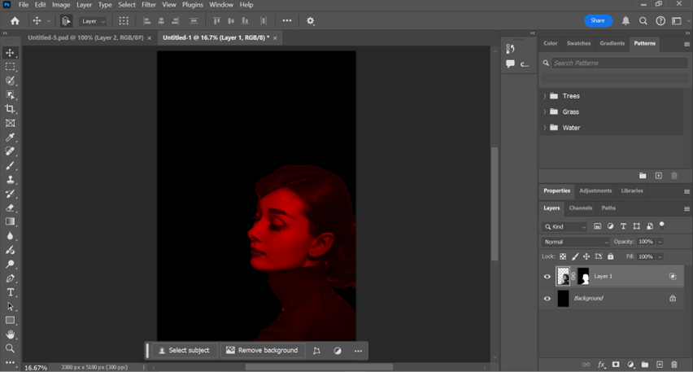
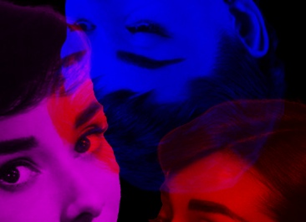
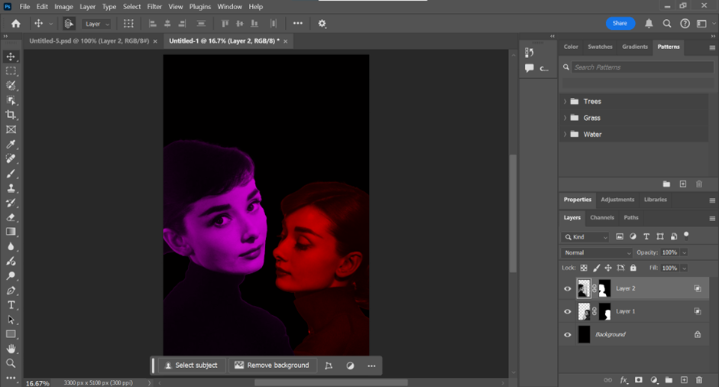
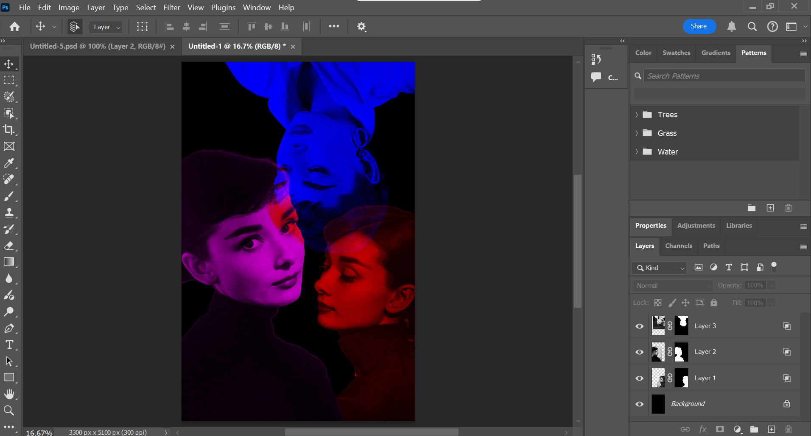
documentation
Now you have completed the first piece for your artwork. Repeat as many times as you want and change the colours you select each time to create a duotone effect (I did it three times and chose the colours blue and magenta)
To see the duotone effect, you must overlap the different images. This provides this effect

Slide 14
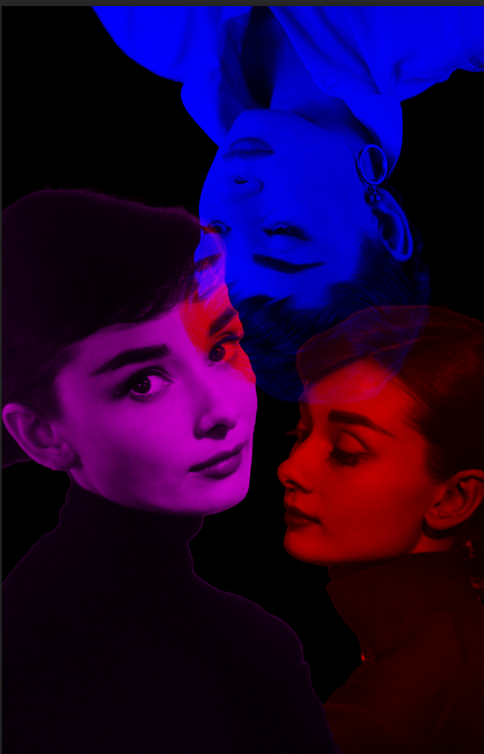
Final artwork

Slide 15
Self Reflection
I believe my final artwork effectively communicates my core concept of humanizing celebrities by revealing the emotions often hidden behind their public personas. The duotone effect with varied colours brings out contrasting emotional states, inviting viewers to see beyond Audrey’s iconic image and connect with her on a more personal level. Each layer and colour suggests a different facet of her personality, symbolizing the range of feelings and vulnerabilities that even the most admired figures experience. By breaking down the "perfect" celebrity image, I hope the artwork encourages viewers to recognise the humanity within those we often place on pedestals.
As I created this piece, I found that the layering and colour choices worked particularly well in capturing the complexity I aimed to convey. The blending modes and masking techniques in Photoshop allowed me to control how each colour and layer interacted, which brought a sense of depth and movement to the piece. Experimenting with these tools was rewarding and provided me with greater control over the emotional atmosphere of the artwork. I also had the chance to deepen my understanding of Photoshop's adjustment layers, helping me to fine-tune the balance between colours and contrast, which added to the overall cohesiveness of the final image.
If I were to approach a similar project in the future, I would experiment with additional techniques, like adding textures or playing more with opacity, to bring out even more layers of meaning. I might also consider using a wider range of colours or layering more photos on top of the subject to add more complexity and intrigue. This project has given me a strong foundation in creating expressive, layered imagery, and I look forward to using the skills I have learnt in the future.

