Slide 1
Cyberbullying- What to do.

Slide 2
Learning intentions
Recognise and identify incidences of cyberbullying and identify its various types, styles and forms.
Identify support services
Promote help seeking

Slide 3
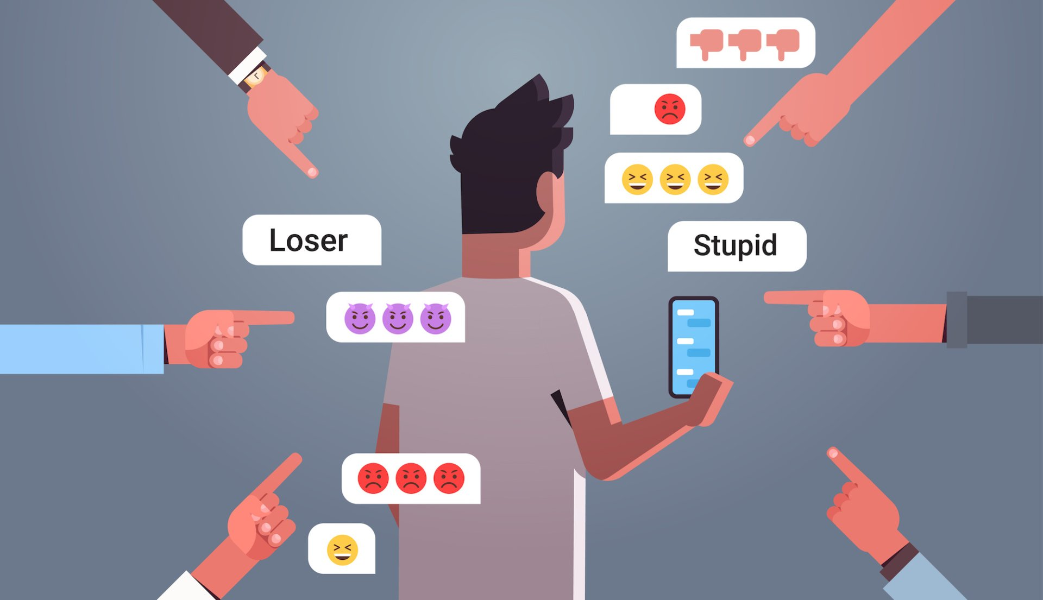
What is cyberbullying?
• hurting your feelings through mean online posts, comments or messages
• spreading lies about you
• sharing something online that will makes you feel bad, like a photo or video that you don’t want anyone to see
• threatening to do any of the above.
**Cyberbullying only needs to happen once to be called cyberbullying as it can easily be shared

Slide 4
Types of cyberbullying
Trolling-When someone deliberately comments or posts something online with the intent to upset or fight with others. Trolling is only cyberbullying when it’s done with the intention to cause harm.
Outing- When someone shares private information about someone else without their permission, such as revealing someone’s gender or sexual identity online.
Cancelling -When a person’s social media accounts are boycotted, ostracised (excluded from the social group) or shunned (ignored) when other’s think they've acted in an unacceptable way. This isn’t always cyberbullying but becomes cyberbullying if it’s used to exclude or isolate others.

Slide 5
Types of cyberbullying
Doxing-When someone deliberately shares someone's personal identity, such as their real name or address, online without their permission.
Excluding-Leaving someone out deliberately, including uninviting them to online groups, conversations or events.
Flaming-Sending direct insults to upset someone online.
Fraping When someone uses someone’s else's account to post inappropriate content.
Masquerading-When someone makes a fake account with the sole purpose of cyberbullying someone.
Dissing-Spreading info in public posts or in DMs (direct messages) in order to ruin someone else’s reputation or their relationships with others.

Slide 6
What to do
Stay calm- Cyberbullying can trigger a lot of emotions. It's important you don't panic or retaliate as sometimes that can make things worse. It's always a good idea to respond when you are feeling calmer and have a clear mind.
Screenshot- Take screenshots. It's important to keep the evidence if you have to report. If you find you keep looking at the screenshots or that having these saved are bad for your mental health, send a copy to someone you trust (e.g. a parent) and then delete your own copy.
Shut it down- You can block the person and report the cyberbullying to the game, site or app it occurs on. In most cases, cyberbullying is against their terms and conditions of use and should be removed. (Make sure you only block or delete someone after you’ve taken screenshots).
If you are unhappy with the response you get or the cyberbullying is not removed after being reported, you can also report it to eSafety. Report online harm | eSafety Commissioner
Support- Report the cyberbullying to more than one trustworthy adult and keep on talking to them until the situation is resolved. You could talk to a parent, a teacher, your school counsellor, another family member and Kids Helpline.

Slide 7
Take a stand- Be an upstander
Standing up for someone who is being cyberbullied is an incredibly powerful thing to do. This is known as being an upstander
Reach out to the person being bullied. Check in with them to see if they are ok and let them know what’s happening to them is not cool.
Call out bad behaviour online. This could look like posting a comment or meme saying that you don’t agree with the cyberbullying. 80% of young people wished someone would have stood up for them when they were cyberbullied. (Research)
Report it – most games, apps and sites have easy ways to report cyberbullying. Report online harm | eSafety Commissioner
Check in with a trusted adult so they know what's going on. This could be a school staff member, parent, older sibling or a counsellor.

Slide 8
Sites for support
To report Report online harm | eSafety Commissioner
For Kids-Kids | eSafety Commissioner
For young people Young People | eSafety Commissioner
Kids Helpline | Phone Counselling Service | 1800 55 1800

Slide 9
Questions

