Slide 1


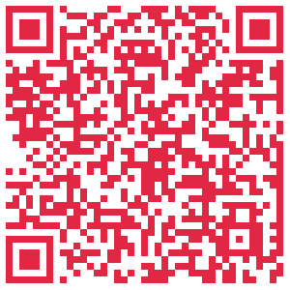
YEAR 12
Year 12 Online Information Evening
20 October 2026
5:30pm – 6:30pm
Year 12 is almost over, what happens next? Take the leap from secondary school to university!
Join us for an Information Session where we'll cover:
Course options
Understanding ATAR outcomes & University offers
Using alternative pathways & Cert IV
Application processes
Key dates
Fees & Scholarships
Orientation
...and much more!
Scan for more information, or visit
murdoch.edu.au/events

