Slide 1
STILL LIFE
7A ART 2023
Ms Briffa

Slide 2
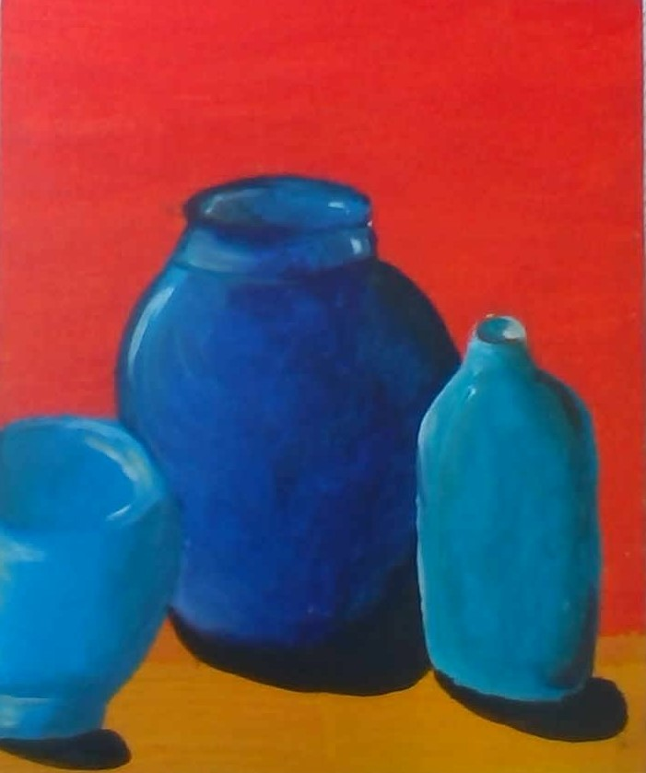
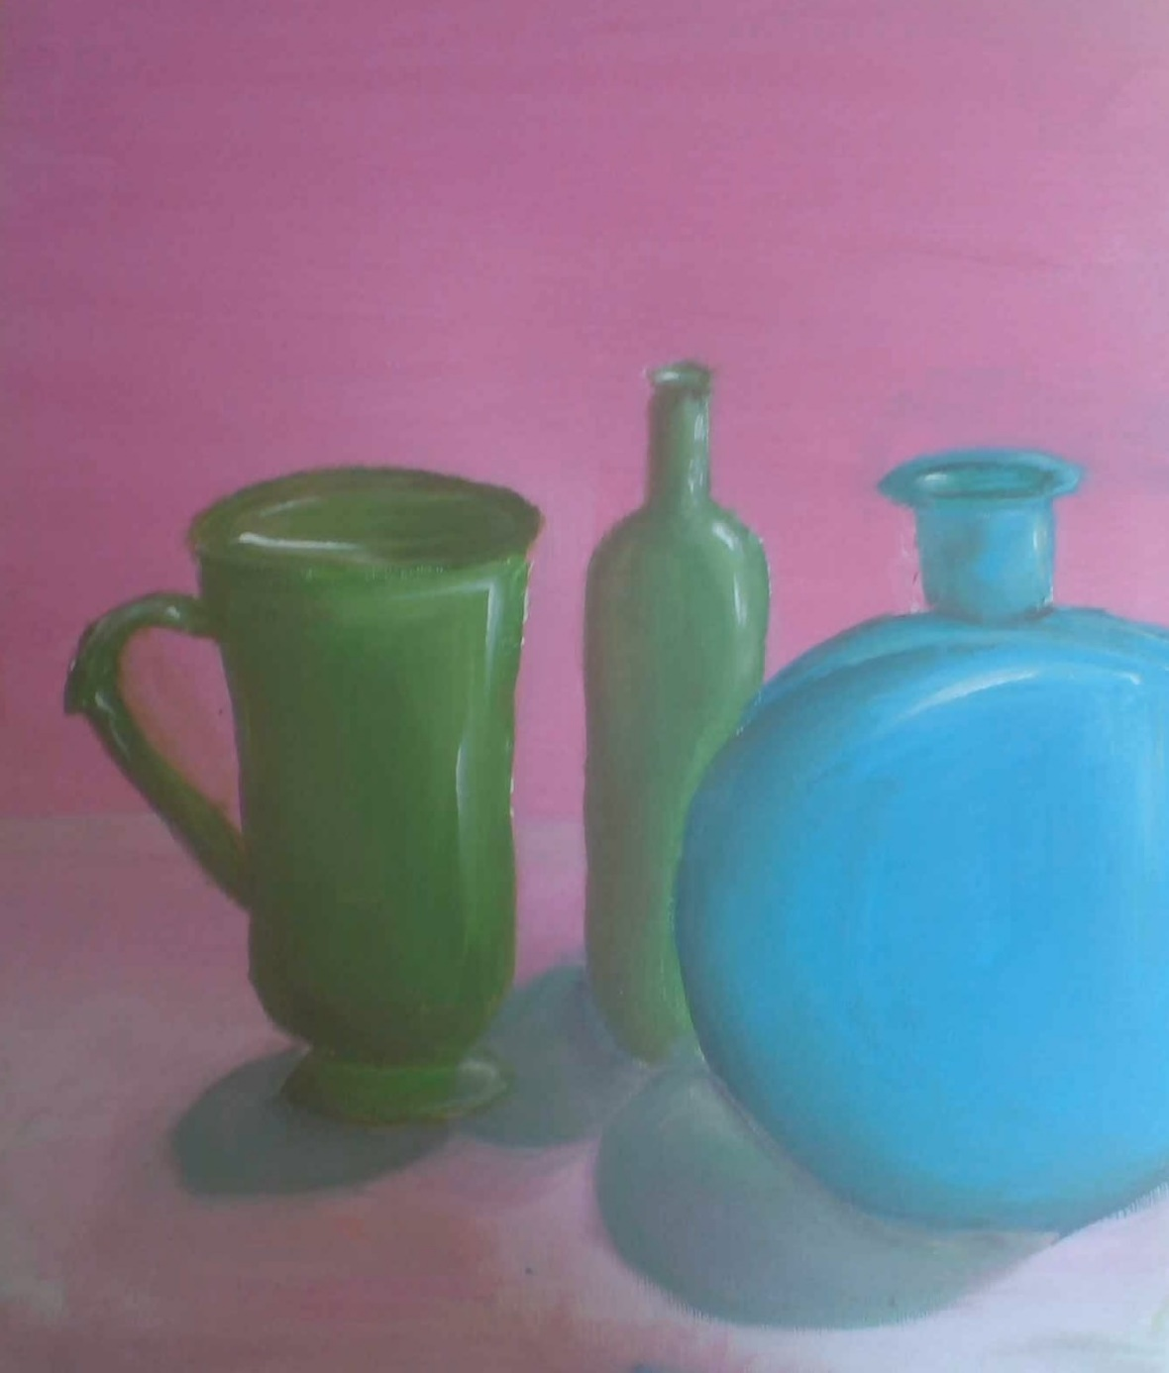
HARRY ALICE

Slide 3
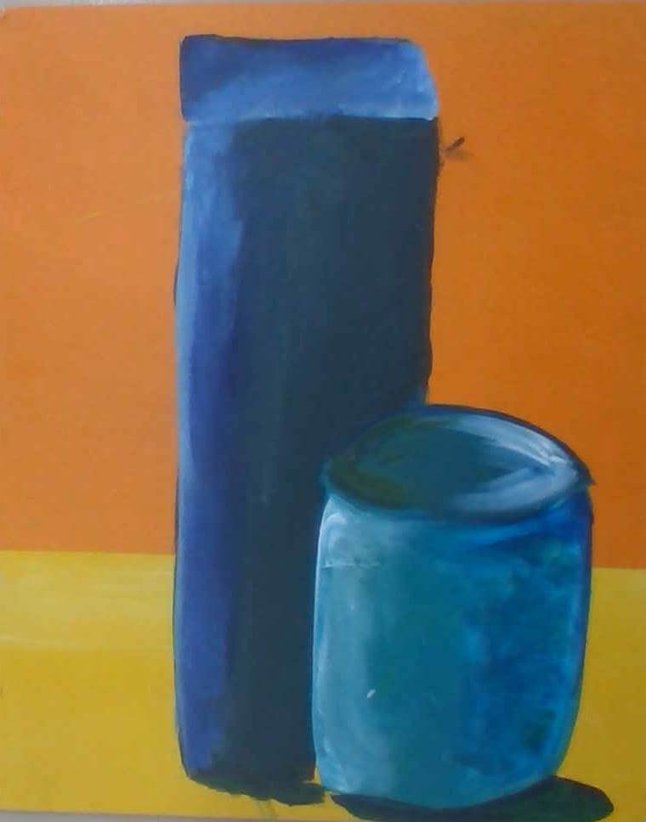
CINAR KEIBOD

Slide 4
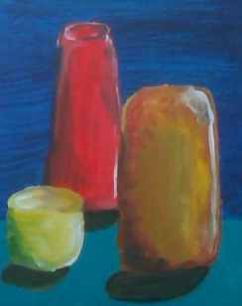
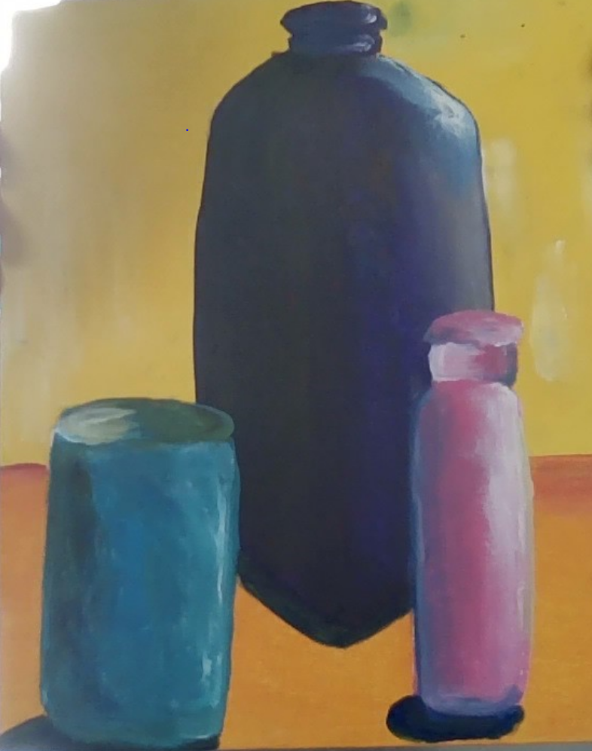
NICOLAS ETHAN S

Slide 5
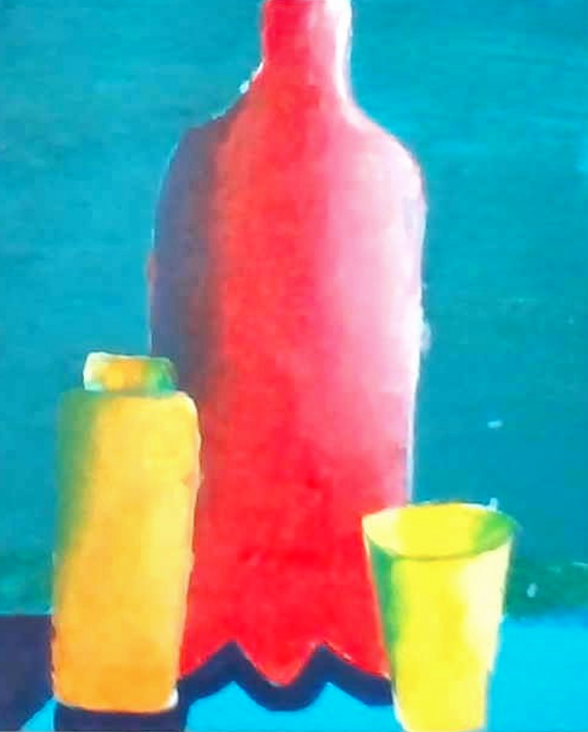
NOAH ASHIFA

Slide 6
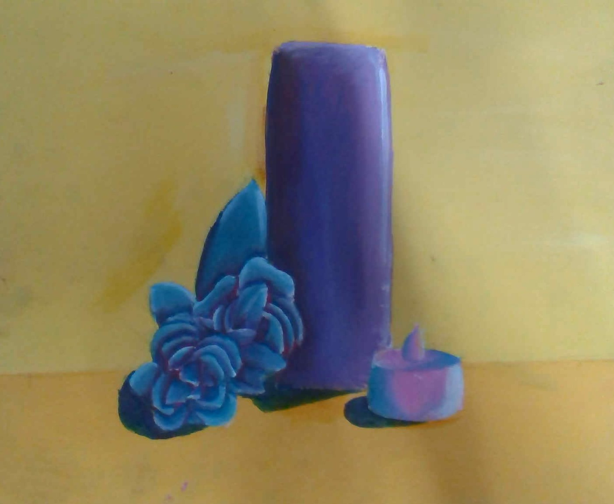
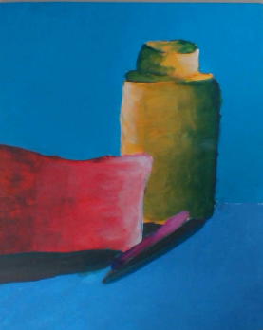
TIANA PHRYNE

Slide 7
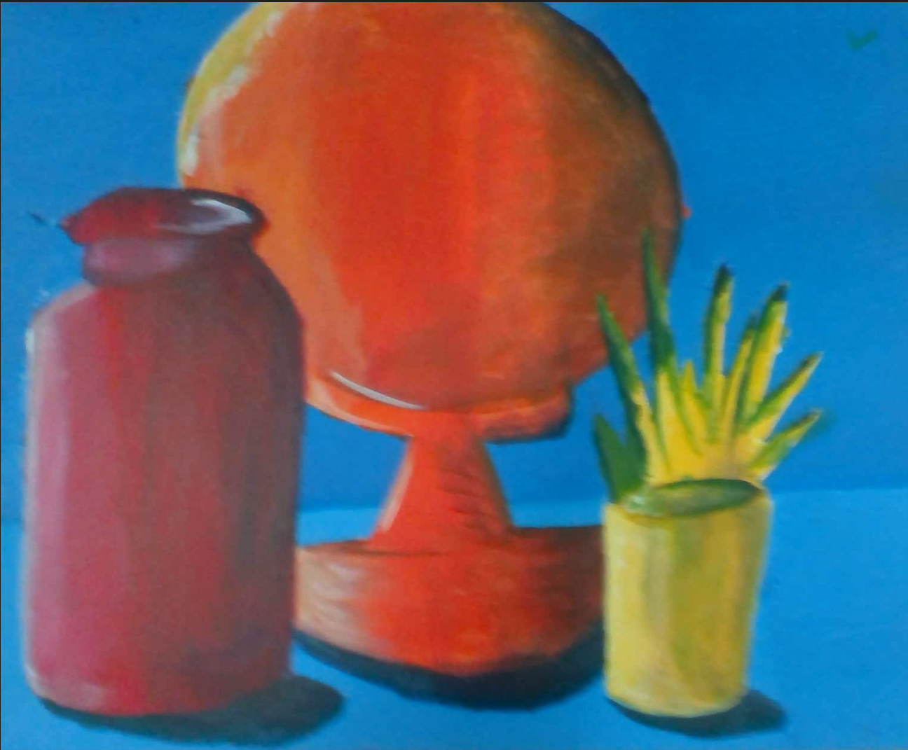
IMMY DANIEL

Slide 8
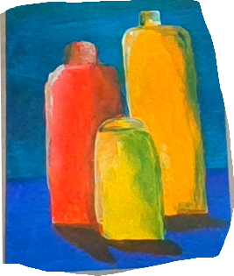
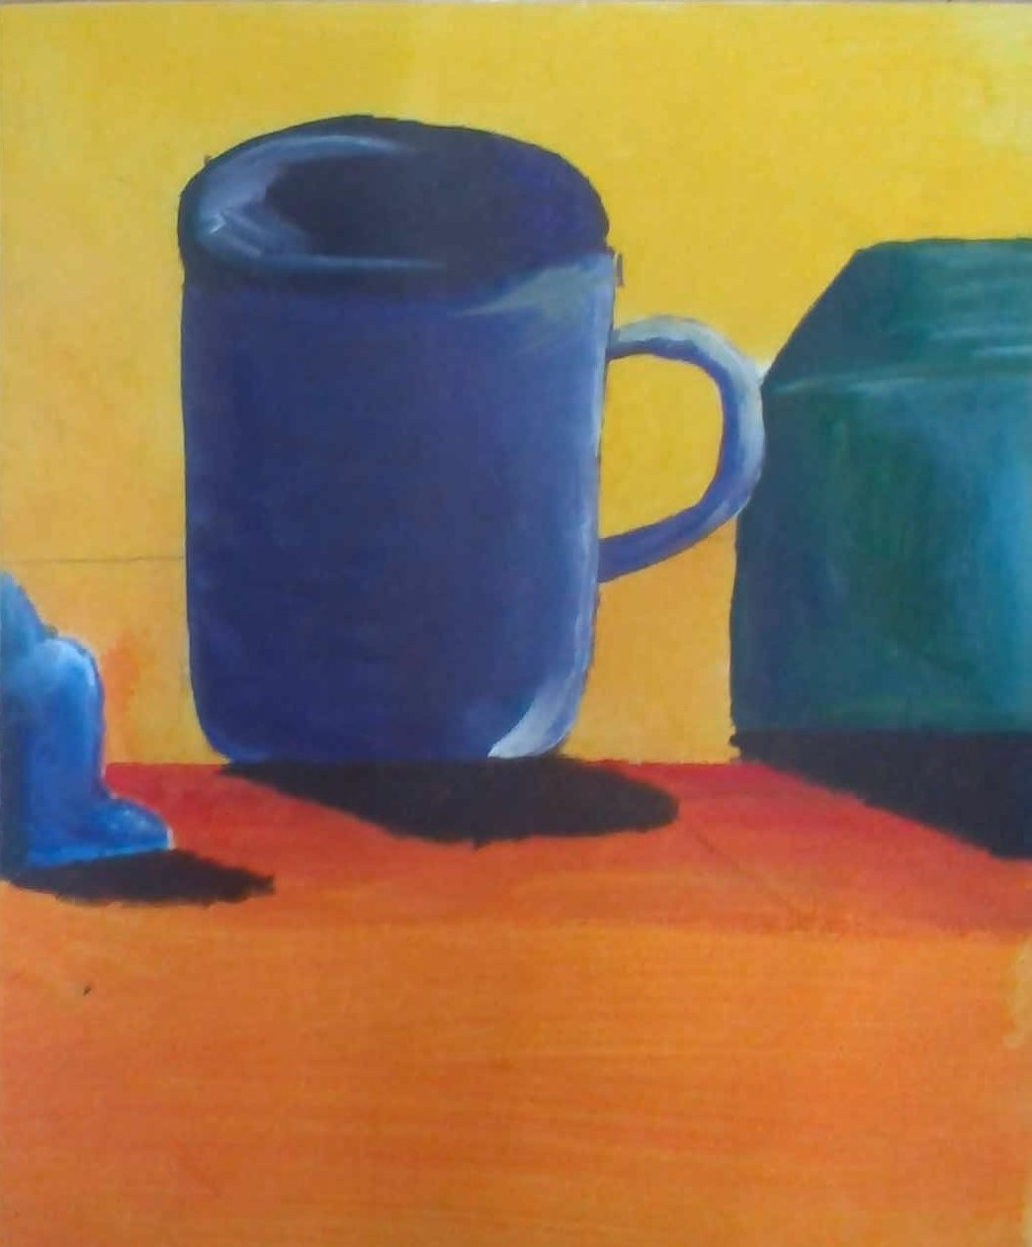
MYREN JAYDEN

Slide 9
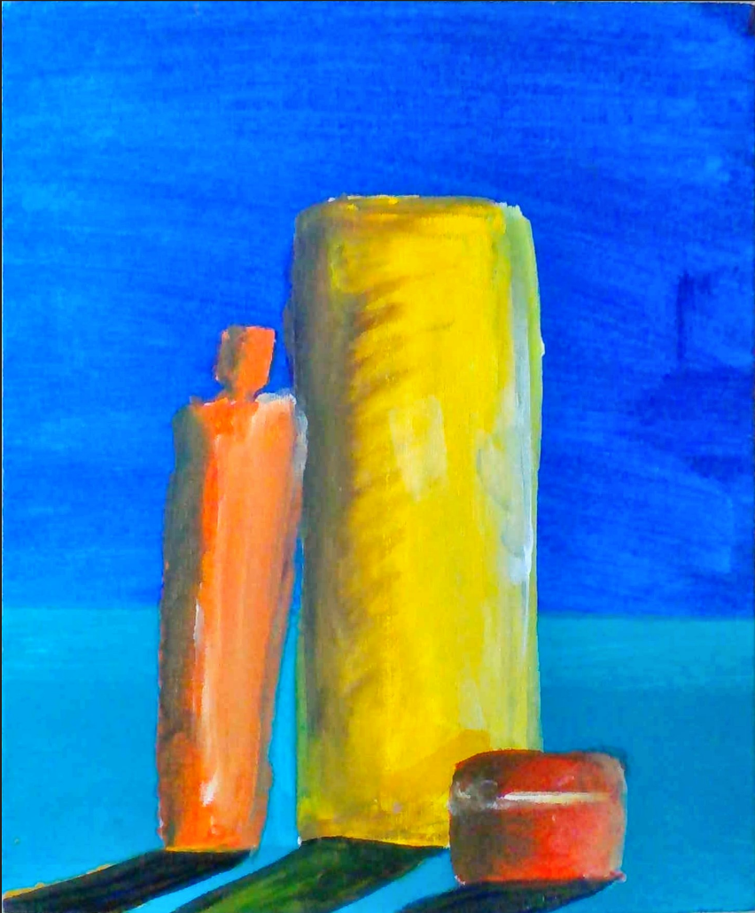
VICTOR TYCE

Slide 10
EMILY KIANA

Slide 11
Well Done 7A Ms Briffa ☺

