Slide 1
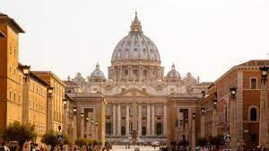
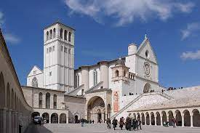
EMERGING LEADERS and WORLD YOUTH DAY 2023

Slide 2
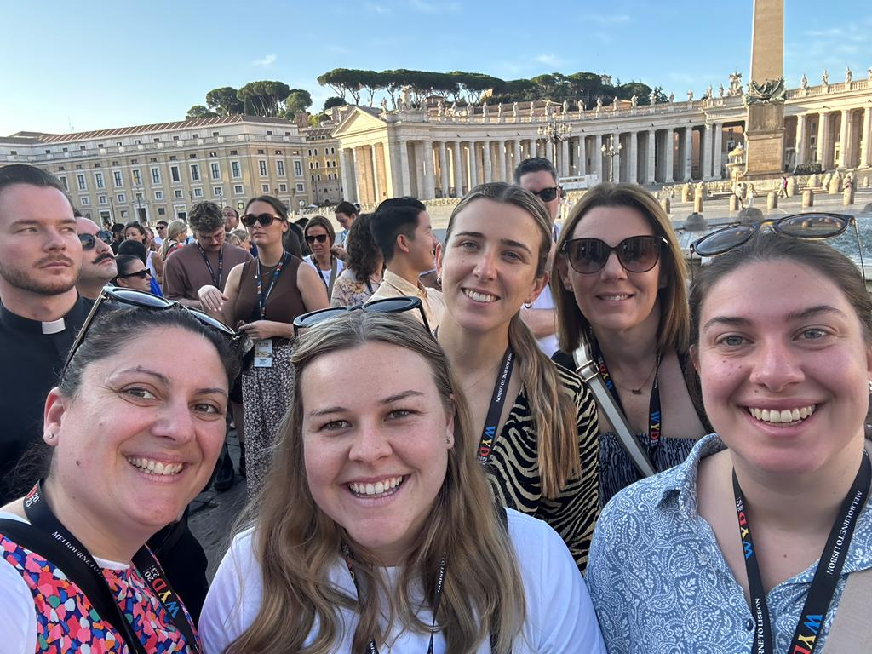
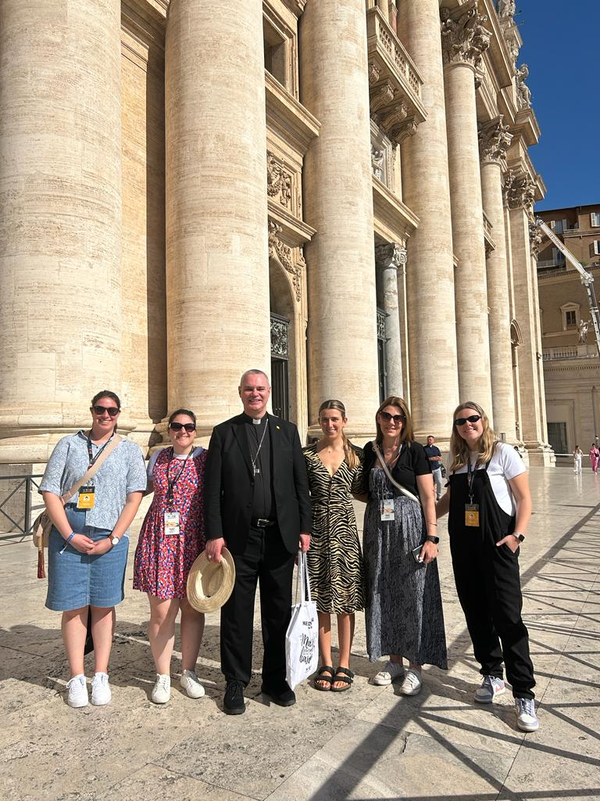
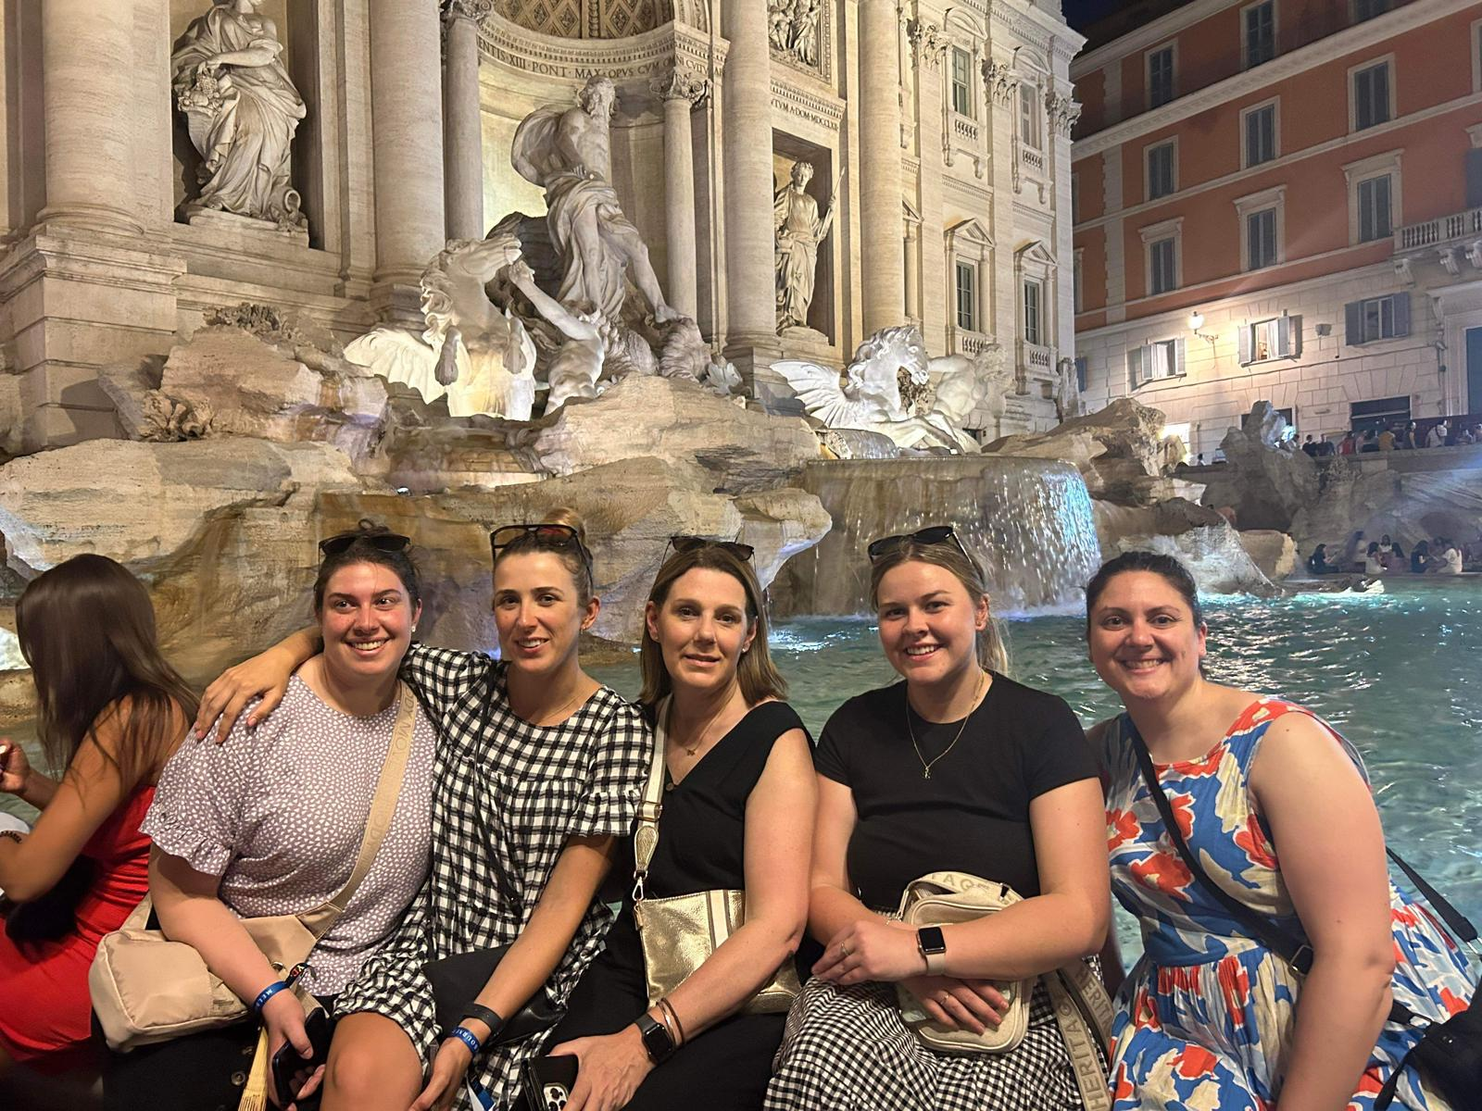
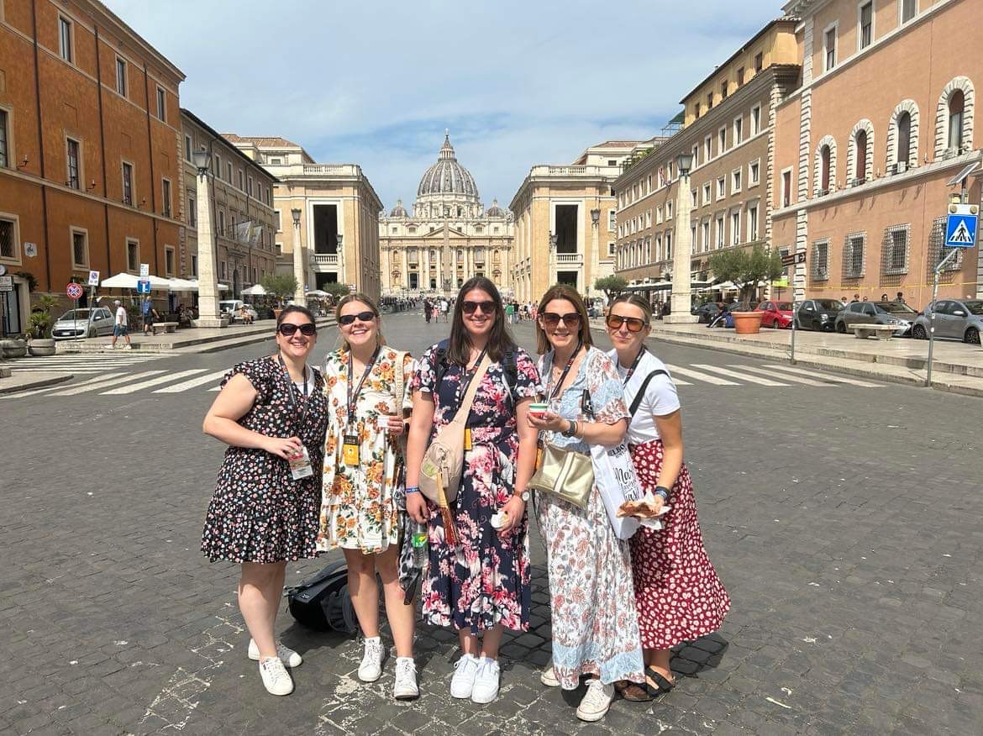
Our Group

Slide 3
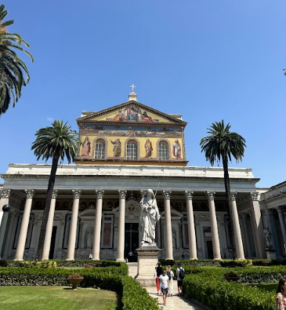
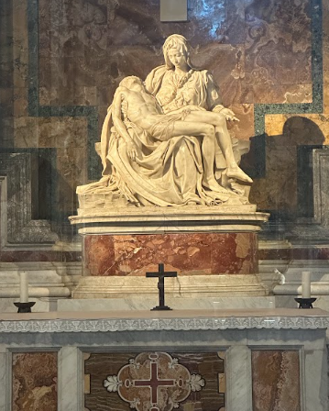
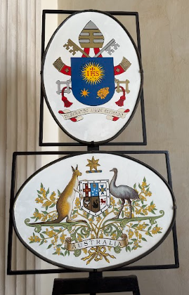
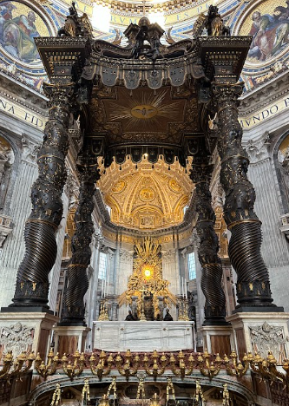
Rome
Saint Peter’s Basilica, Vatican City
La Pieta, Sculpture by Michelangelo, Vatican City
Basilica of Saint Paul Outside the Wall
Ambassador’s Residence
Notes:
Our trip started off with 5 days in the beautiful city of Rome. We spent our days immersing ourselves in the rich history of the eternal city. We visited beautiful basilicas and celebrated Mass is some of the most breathtaking places.Our days were filled with busy schedules of visiting different sites and listening to insightful lectures from Archbishops, Priests, Sisters and Ambassadors. We were invited to the Australian Ambassador’s house in Rome this was such an incredible experience.

Slide 4
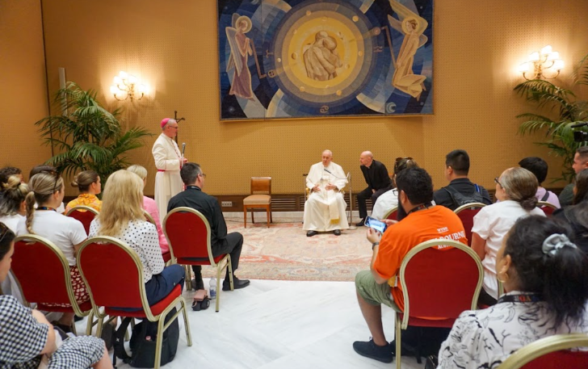
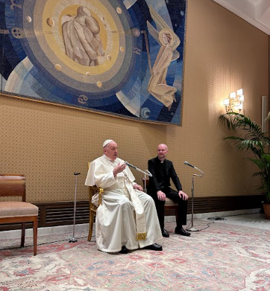
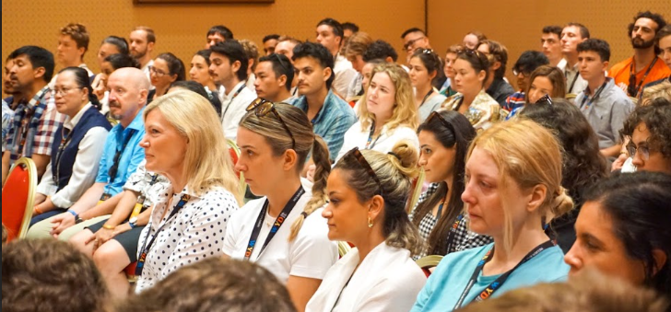
Meeting Blessed Pope Francis
Notes:
One of the highlights to our Rome trip was getting to meet the Blessed Pope Francis. Our meeting with him was a surprise, that day all we knew was that we were visiting the Vatican. We sat down in a large room with rows of chairs. It wasn’t until it was announced that we should put our phones away, and we were told that we ‘probably knew what was about to happen’ that we realised we were about the meet the Pope.
He was incredibly humble and kind. He sat with our group for an hour and let us ask him many different questions as he provided insightful answers and thoughtful advice. At the end of our meeting with him, he blessed us all and gifted us each with a set of rosary beads. One of the key messages that stood out to me was ‘"the only time that we are allowed to look down upon others: is when we are offering to help them up." He said to us ’The main message I want to get across is that the Lord is always by your side – always. Even in the most difficult moments, he is always with us. He never tires of walking with us!

Slide 5
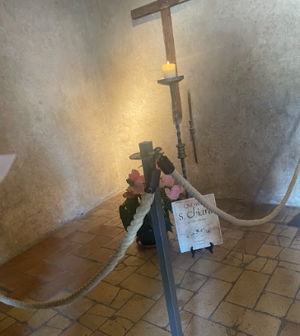
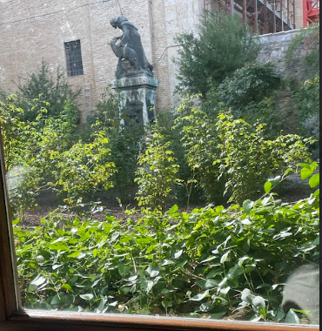
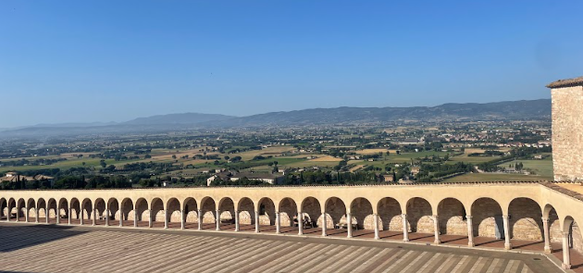
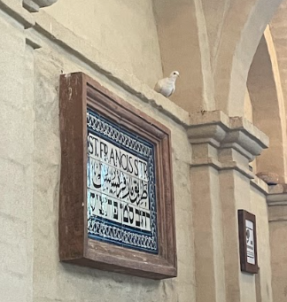
Assisi
Notes:
After the hot and busy hustle and bustle of Rome, we set off by bus for 3 hours to Assisi. It was almost as if time had slowed down. This is what I thought Italy would be like, rolling hills and beautiful vineyards the view was breathtaking, accompanied by the sounds of loud church bells.
Assisi was meant to be a reset before we dived into the chaos of Portugal World youth day. It was so nice to just stroll at our own pace, eat amazing food and have some retail therapy taking in the sights and sounds of magic. Assisi was one of my favourite places because it reminded me to slow down and realise why I am here, and what has lead to this moment.
Some of the photos here are of Saint Claires final resting place, The garden is one of the miracles of Saint francis- they all grew with no sharp thorns and they all stay the same size and dont die. We spoke to one of the workers their who was about 80 years old and he said he has seen these rose bushes since he was a little boy 75 years ago and they have not changed once. During our visit we spoke a lot about the holy spirit and it was unbelievable that during that time a white dove that symbolises peace and the holy spirit flew into the hallway when we were taking photos.

Slide 6
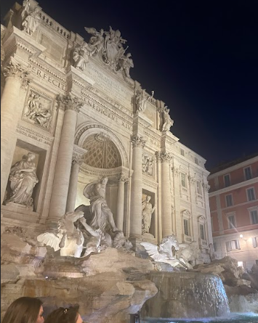
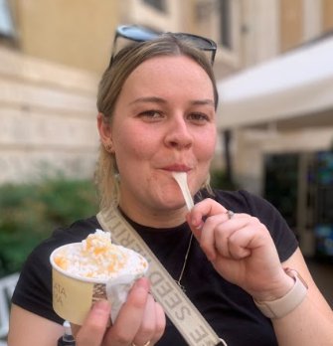
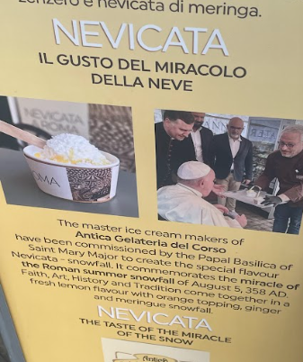
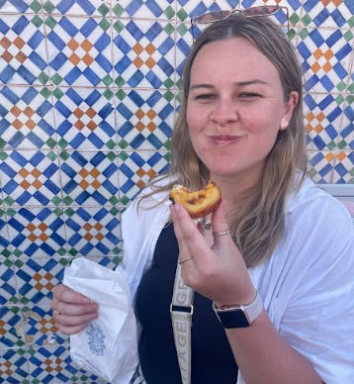
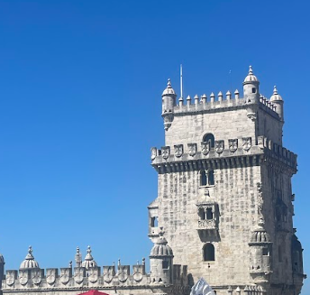
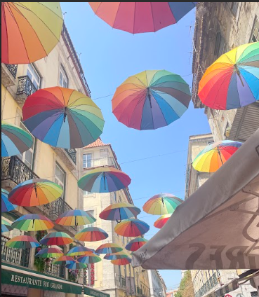
Sights
The Trevi fountain at night
Snow miracle ice cream
Belem tower and the best portuguese tarts in portugal !!
Pink Lane
Notes:
I think we all felt like we were going 100 miles an hour over there and that we barely stopped, we did get to see so many beautiful churches and sacred spots but we also were lucky enough to see some great historical sights and eat amazing food too! Some of my favourite spots were The Trevi fountain, Michelangelo’s Sistine chapel, The Colosseum, the tower of Belem in portugal where they sell the best portuguese tarts in Portugal (thanks for the recommendations) Pink lane filled with rainbow umbrellas and an Icecream shop that was blessed by Pope francis as the icecream symbolises the miracle of snowfall in summer time in 358AD in Rome the icecream was lemon gelato and there was meringue on top to symbolise the snowfall.

Slide 7
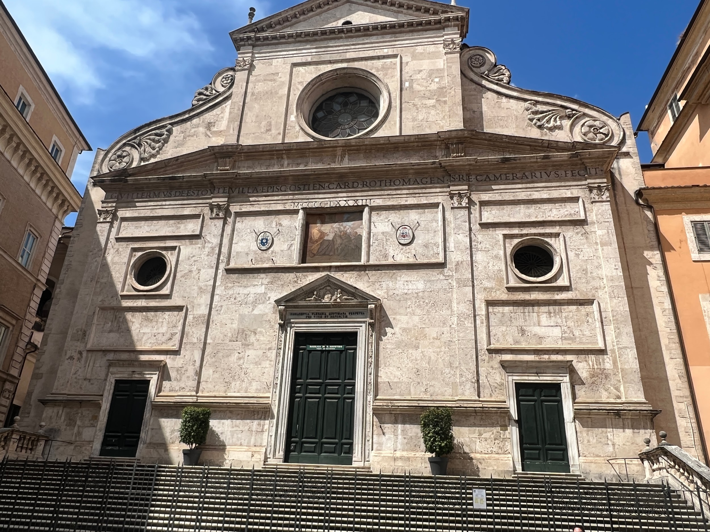
St Augustine’s Church in Rome
Notes:
This is the Church of St Augustine. We went to visit it twice but it was closed. This church is in the centre of Rome.
We went to visit is as it is the name of our Church. As we could not get into the Church we went across the road to a small shop that had religious items in it. We were so sad that we could not go inside. We even pleaded with the little man at the front of the Church and told him we had come all the way from Australia but it was no use. We were not going in as mass was already in progress.

Slide 8
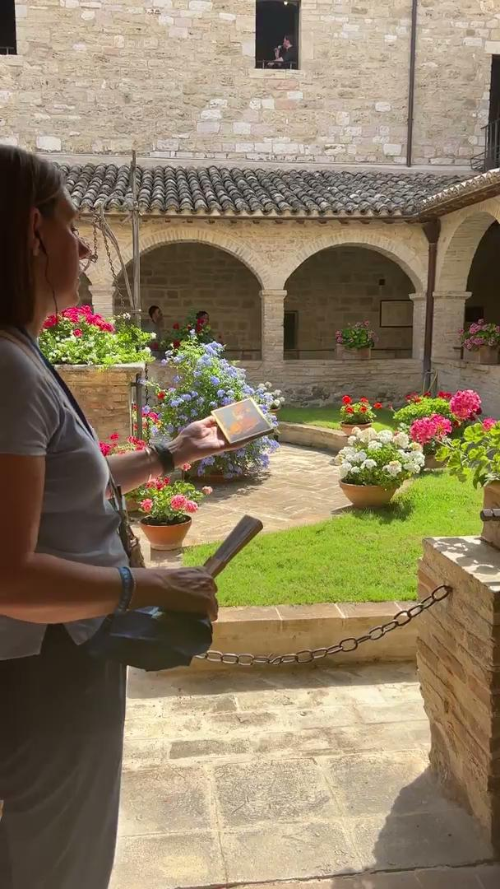
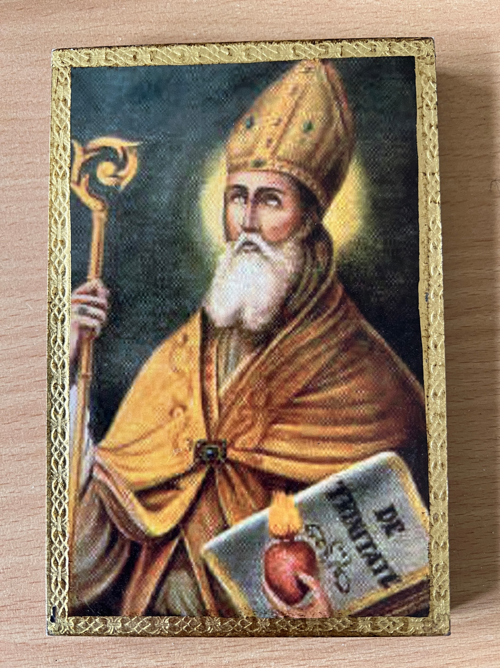
Archbishop Peter blessed the icon of
St Augustine while we were in Assisi.
Notes:
I bought this icon as a memento of our trip and to have something about St Augustine at our school. It is a beautiful icon image of St Augustine showing him as the doctor of the church holding a staff and one of his books. It has been hand painted and we will have it displayed in the office soon. While we were in Assisi I asked the Bishop to bless the icon. He agreed and bless it on the beautiful garden at San Damiano.

Slide 9
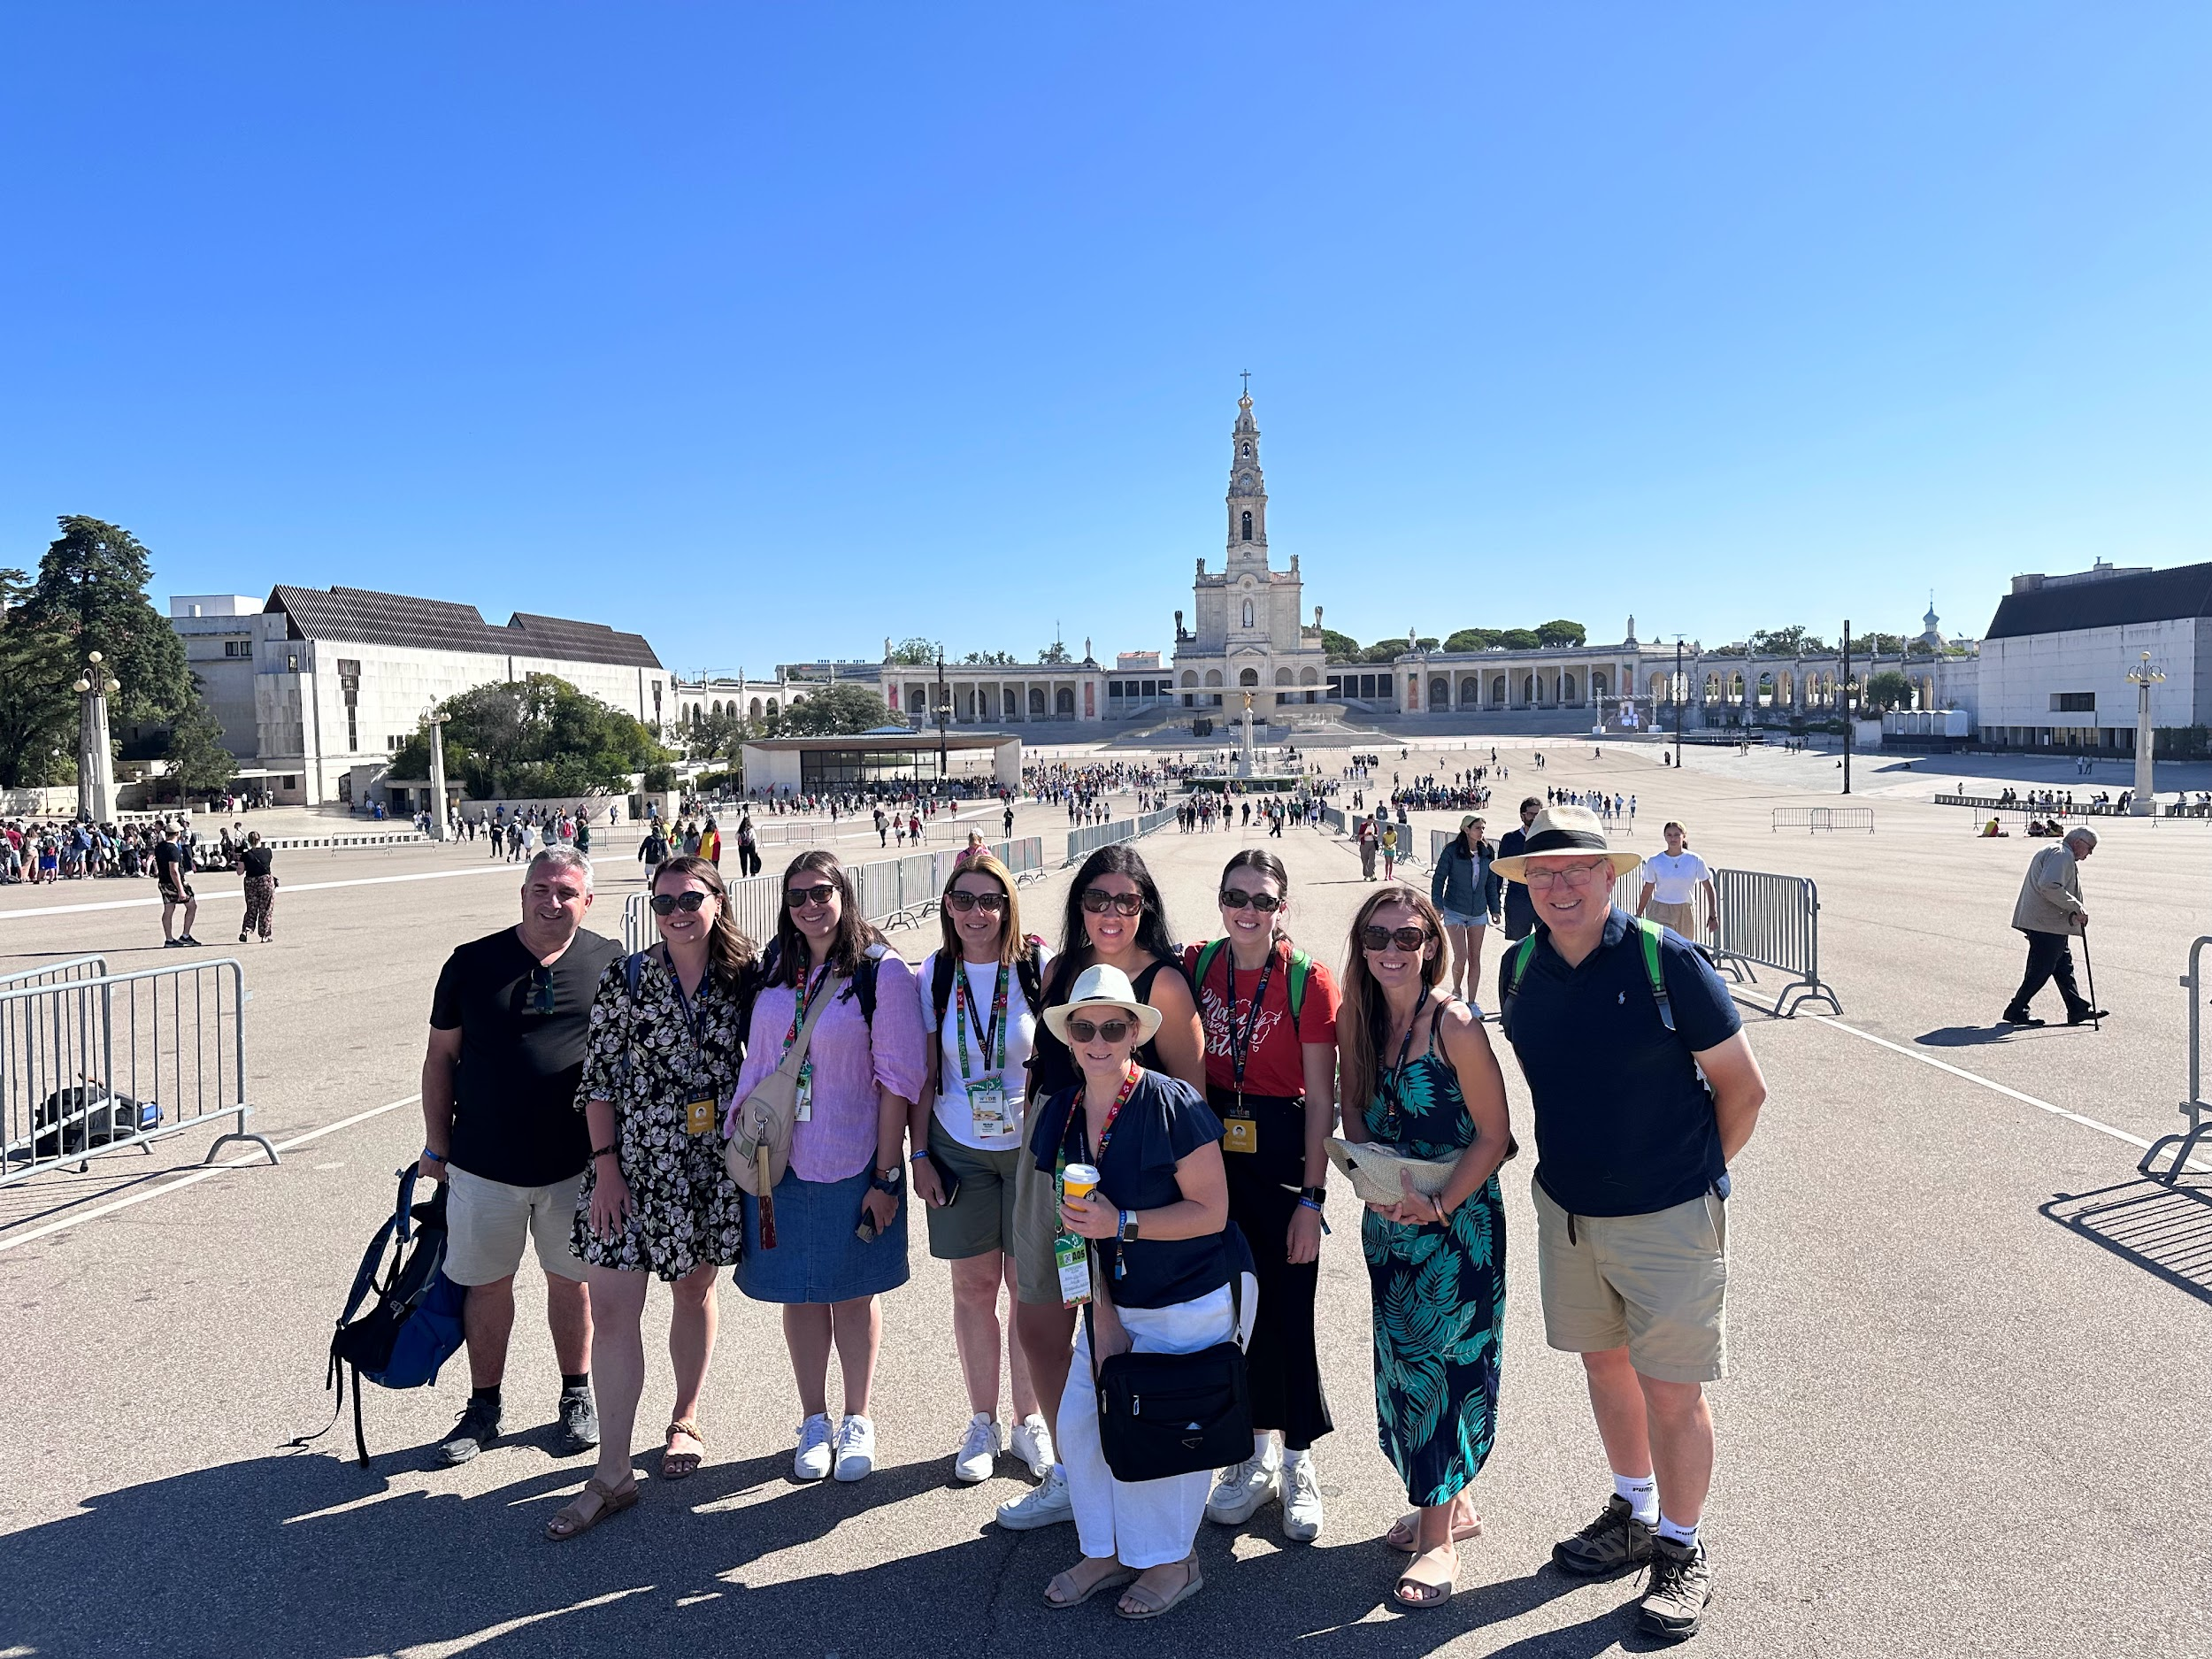
The Fatima Crew
Notes:
We caught a coach about 6:30am and travelled for 2 hours to get to Fatima. It was very early when we arrived so it was quiet and calm. Fatima is a very peaceful and spiritual place. You could feel we were in a special place. We all felt very connected and grateful to be there as it was not on our original itinerary. As the morning progressed the space became very crowded and packed with pilgrims in search of a miracle.
Fatima is where some children saw an apparition of Mary. Lucia Santos, and her two cousins, Jacinta and Francisco Marto. The apparition is believed to have appeared at the town of Fatima, Portugal on the thirteenth day of six consecutive months in 1917, starting on May 13.
I felt so lucky to have had this experience with my fellow pilgrims and we now have a special bond that we will never forget. I loved seeing people so open with their faith and they were not afraid to express their love for God.

Slide 10
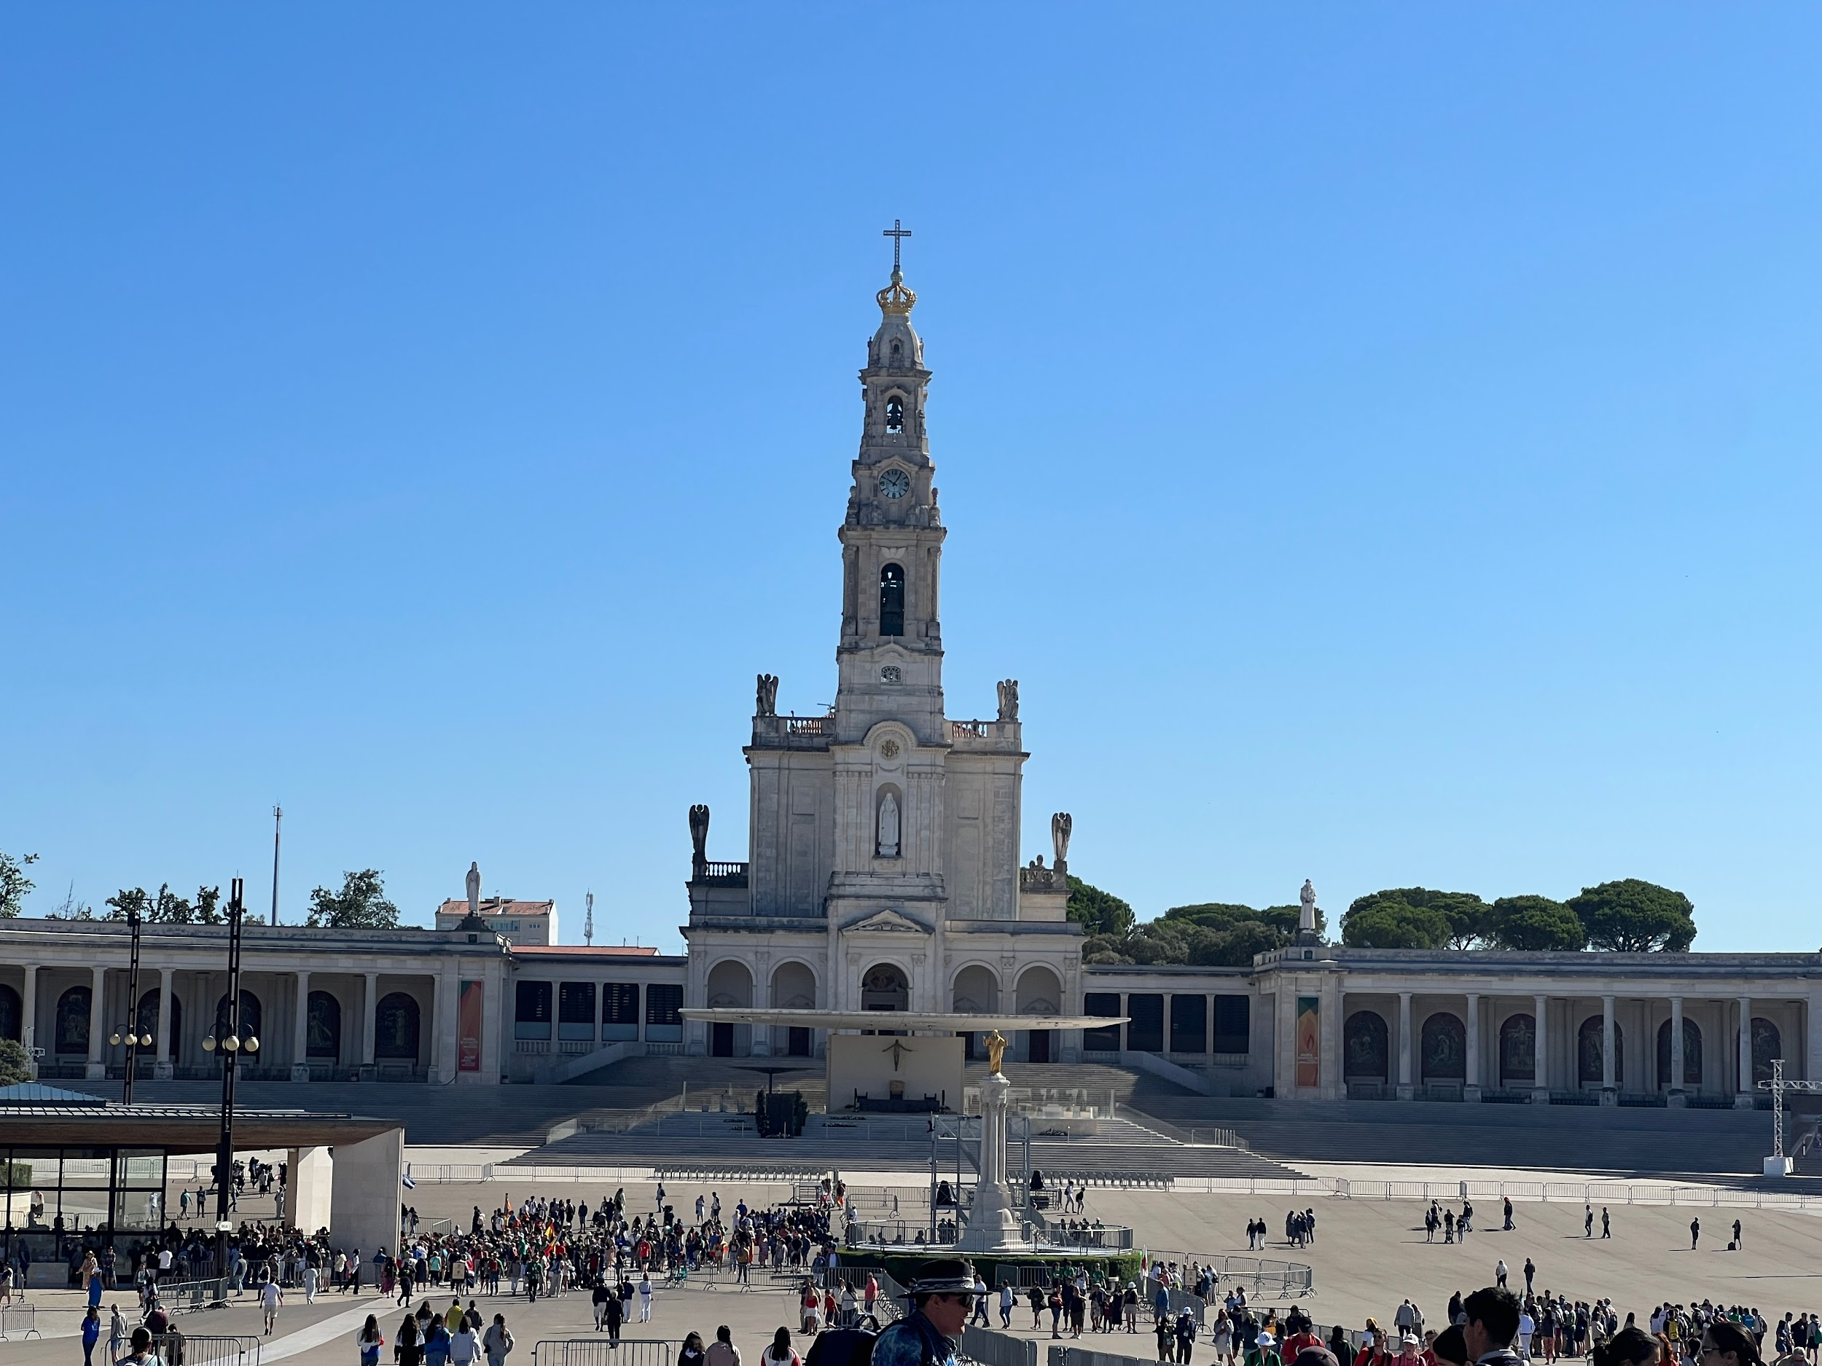
Basilica of Our Lady of the Rosary of Fatima
Notes:
This is the beautiful church called the Basilica of Our Lady of the Rosary in Fatima. This CHurch sits up on a hill welcoming us all. As the day progressed, the crowds grew and the grounds became full of faithful followers. There was a feeling of hope, faith and desire for God to hear our prayers and intentions. Being in such a holy place where Christians have gathered for over 100 years made me feel that I was part of something very special. I felt like God was with me and listening to my prayers.

Slide 11
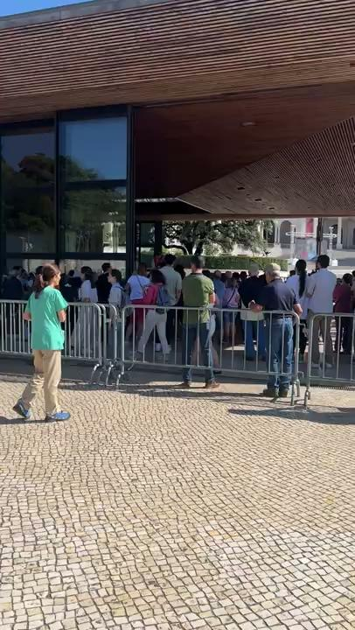
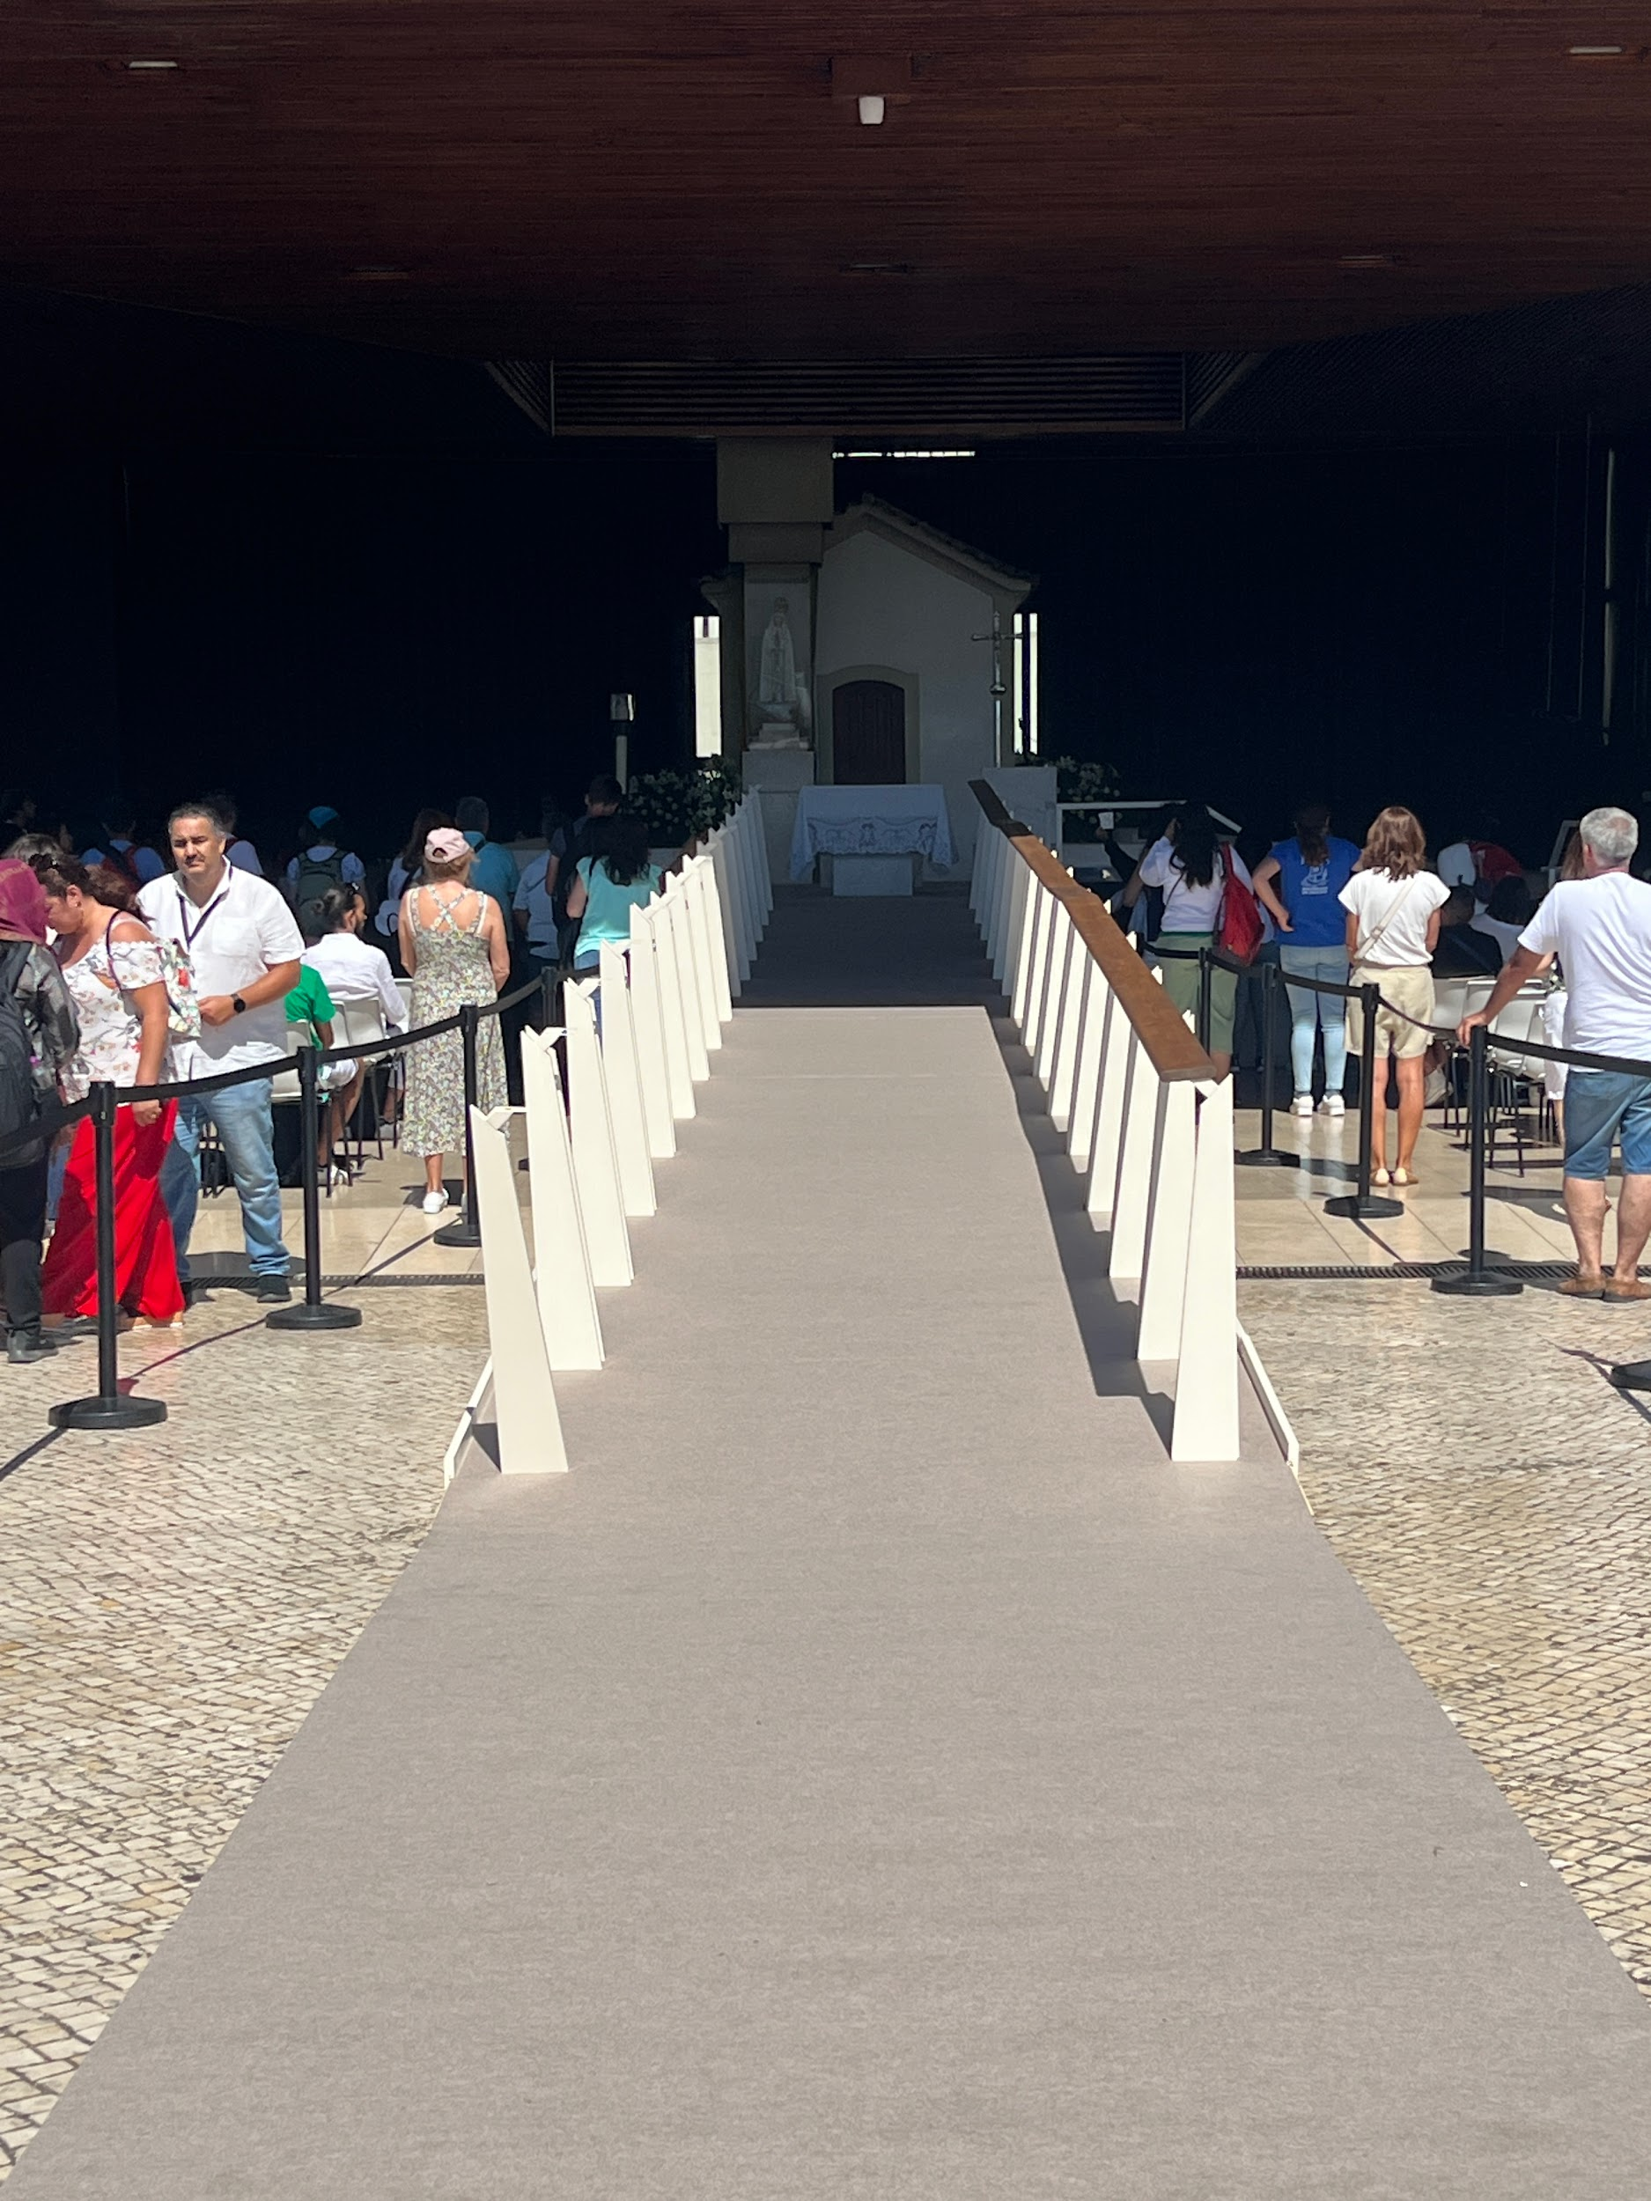
Notes:
This is the Chapel of Apparitions. It is the actual site where the children saw Mary all those years ago. The day we were there , there was a little boy from Australia leading the Rosary. There were thousands of people gathering to say the Rosary and it was a very moving experience. Some people were moved to tears as they said the rosary.

Slide 12
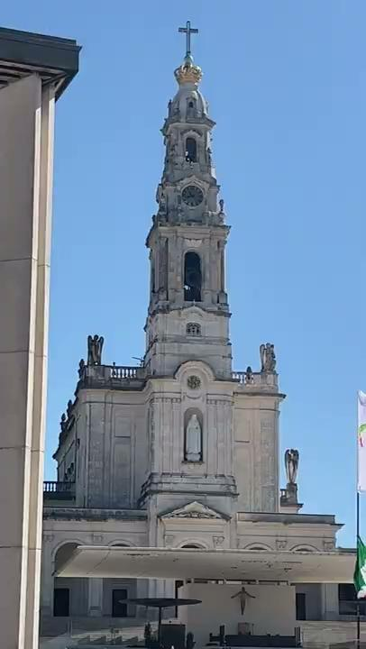
This is the Basilica
Of Our Lady of Fatima.
It is in Portugal.
You can hear the beautiful
bells that ring throughout
the town.
Notes:
This is the basilica and you can hear the bells chiming from the bell tower. You can hear the bells ringing from miles away. It was beautiful to watch the people gathering stop and listen to the chimes of the bells.

Slide 13
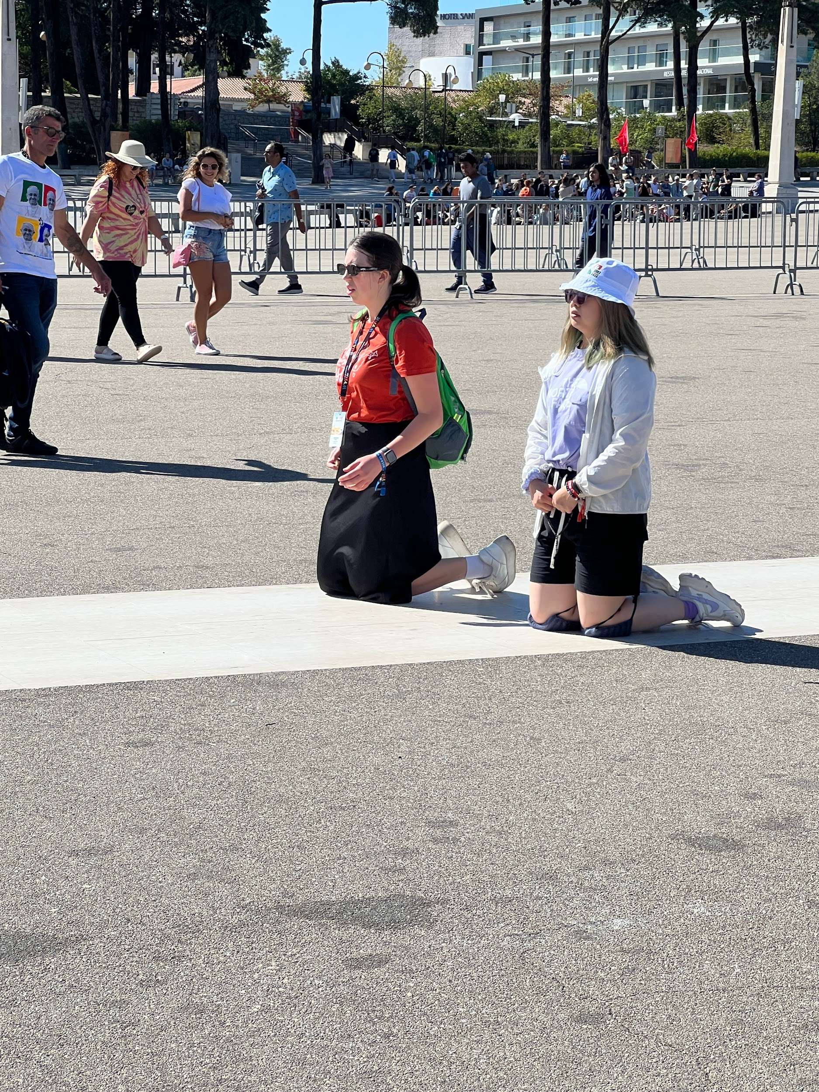
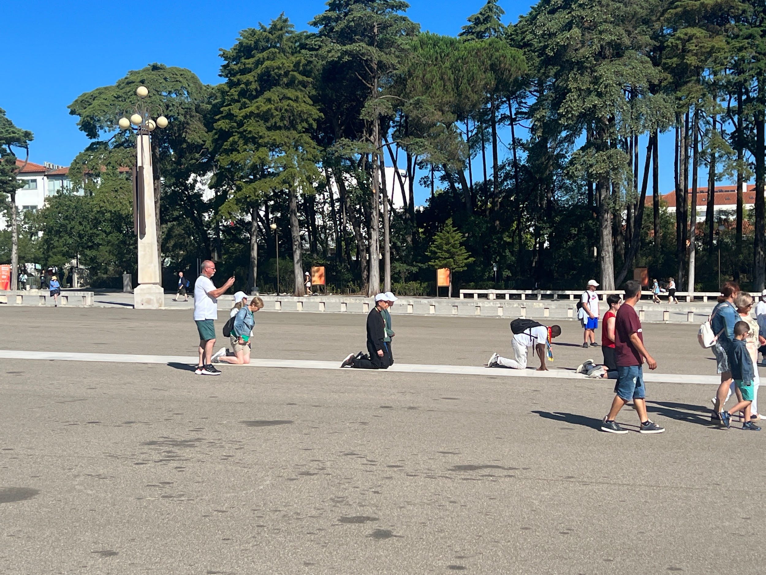
Notes:
People make pilgrimages to Fatima to pray for a miracle and as an act of Penance. Many people kneel and pray the Rosary as they follow a 600m trail. This day was quite warm and the ground was hot but this did not deter people from finishing this pilgrimage. Once they had finished their knees were sore, blistered and bleeding but they felt a sense of accomplishment and hope that their prayers and intentions would be heard by God. One lady said that ’This was nothing compared to what Jesus had to endure on the cross’.

Slide 14
World Youth Day
Weekend
5th and 6th August 2023

Slide 15
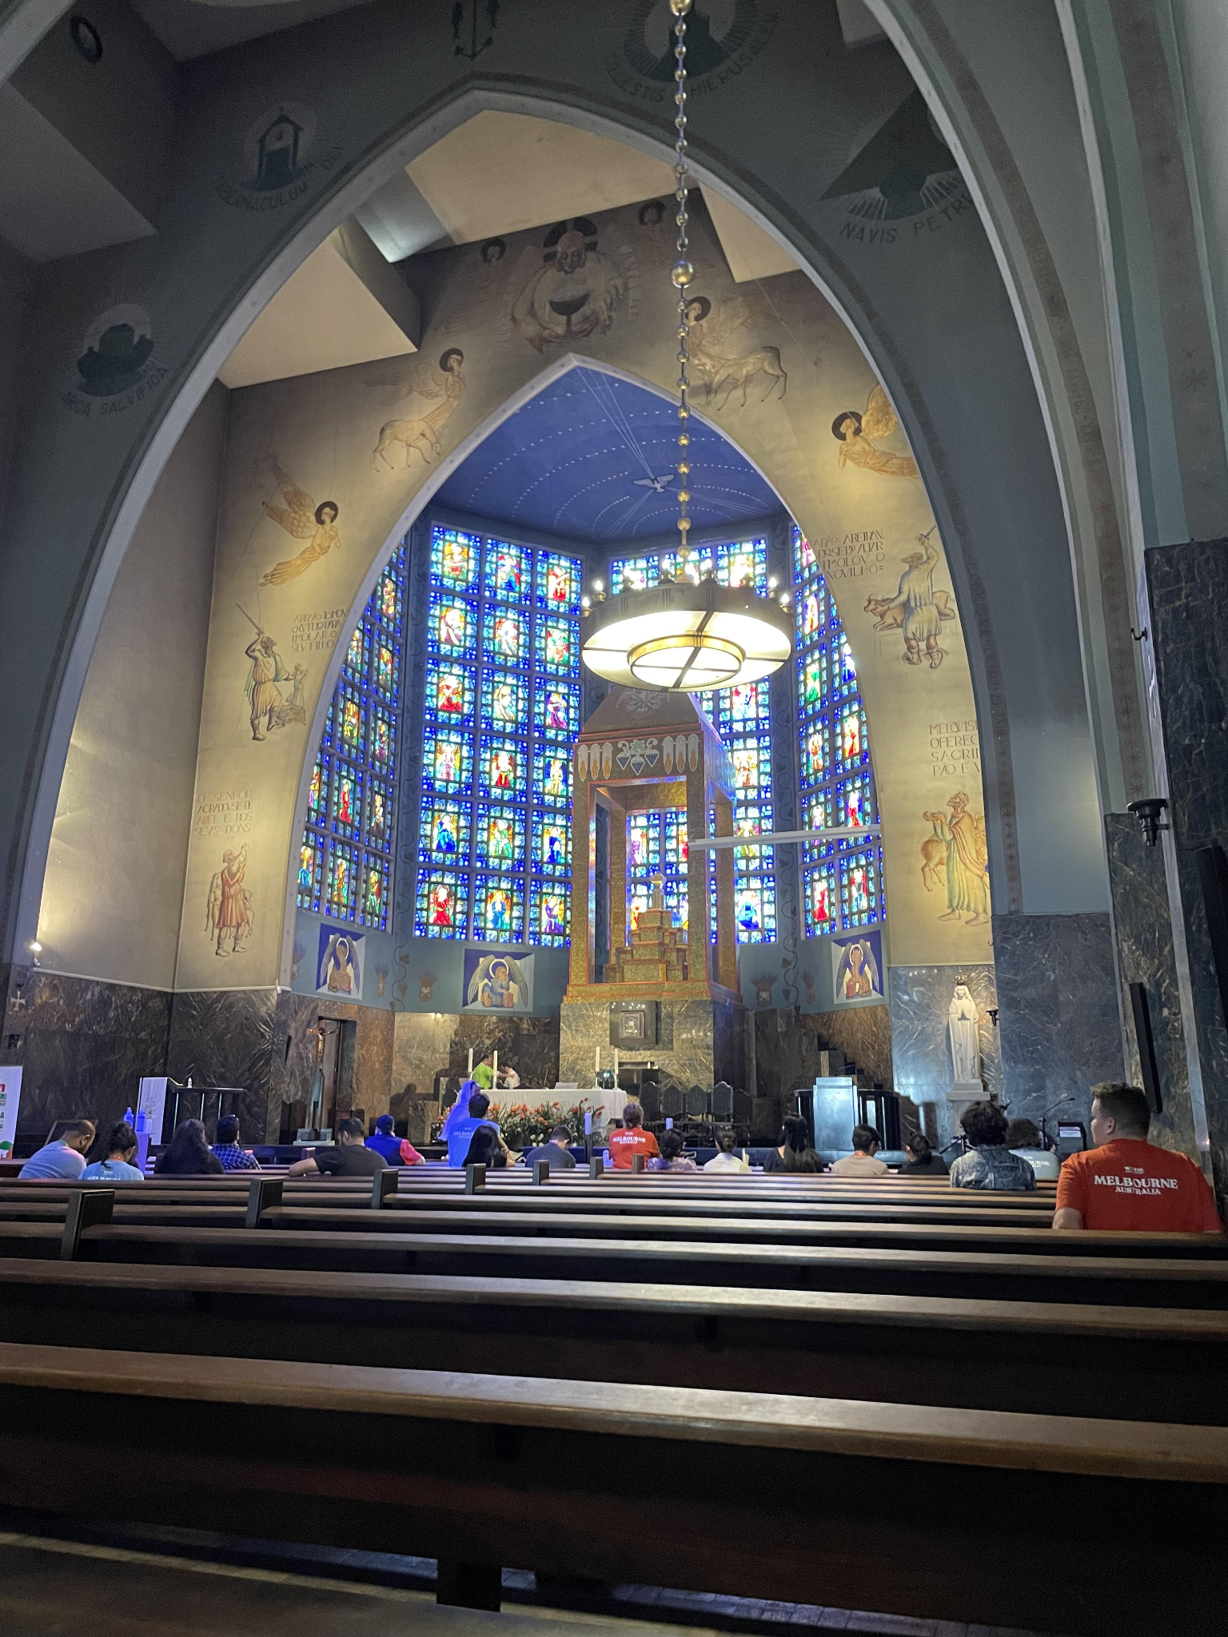
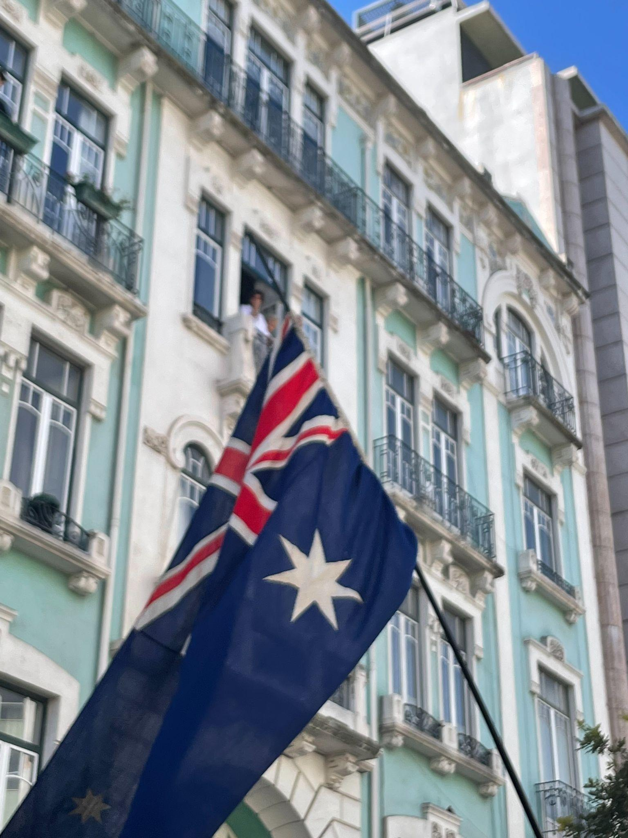
Saturday- The Morning Mass and Blessing
The Saturday morning offered opportunities to reflect and prepare for the big walk ahead with our small groups.
The Melbourne Pilgrims spent a hour together at Mass at the Church of Our Lady of Fatima.
Archbishop Peter blessed us for our journey ahead.
Notes:
The World Youth Day Weekend finally arrived.
Saturday started with an early morning and breakfast in our small groups. It was an opportunity for us to sit together and pray, as well as discuss our intentions for the weekend ahead.
We were fortunate enough to share Mass together with the other pilgrimage groups from Melbourne at a local church ‘Our Lady of Fatima’. We received a special blessing from Archbishop Peter Comensoli as he wished us well for our journey ahead.

Slide 16
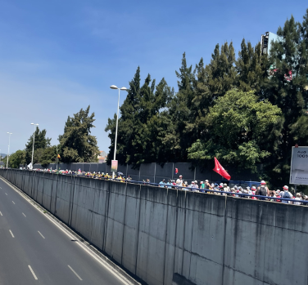
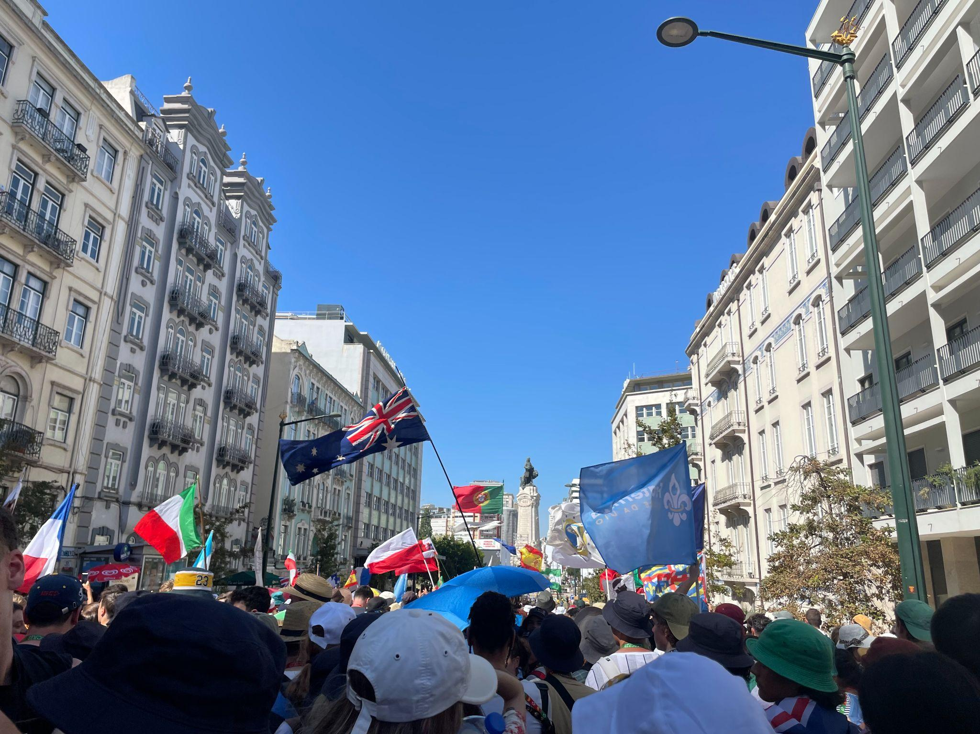
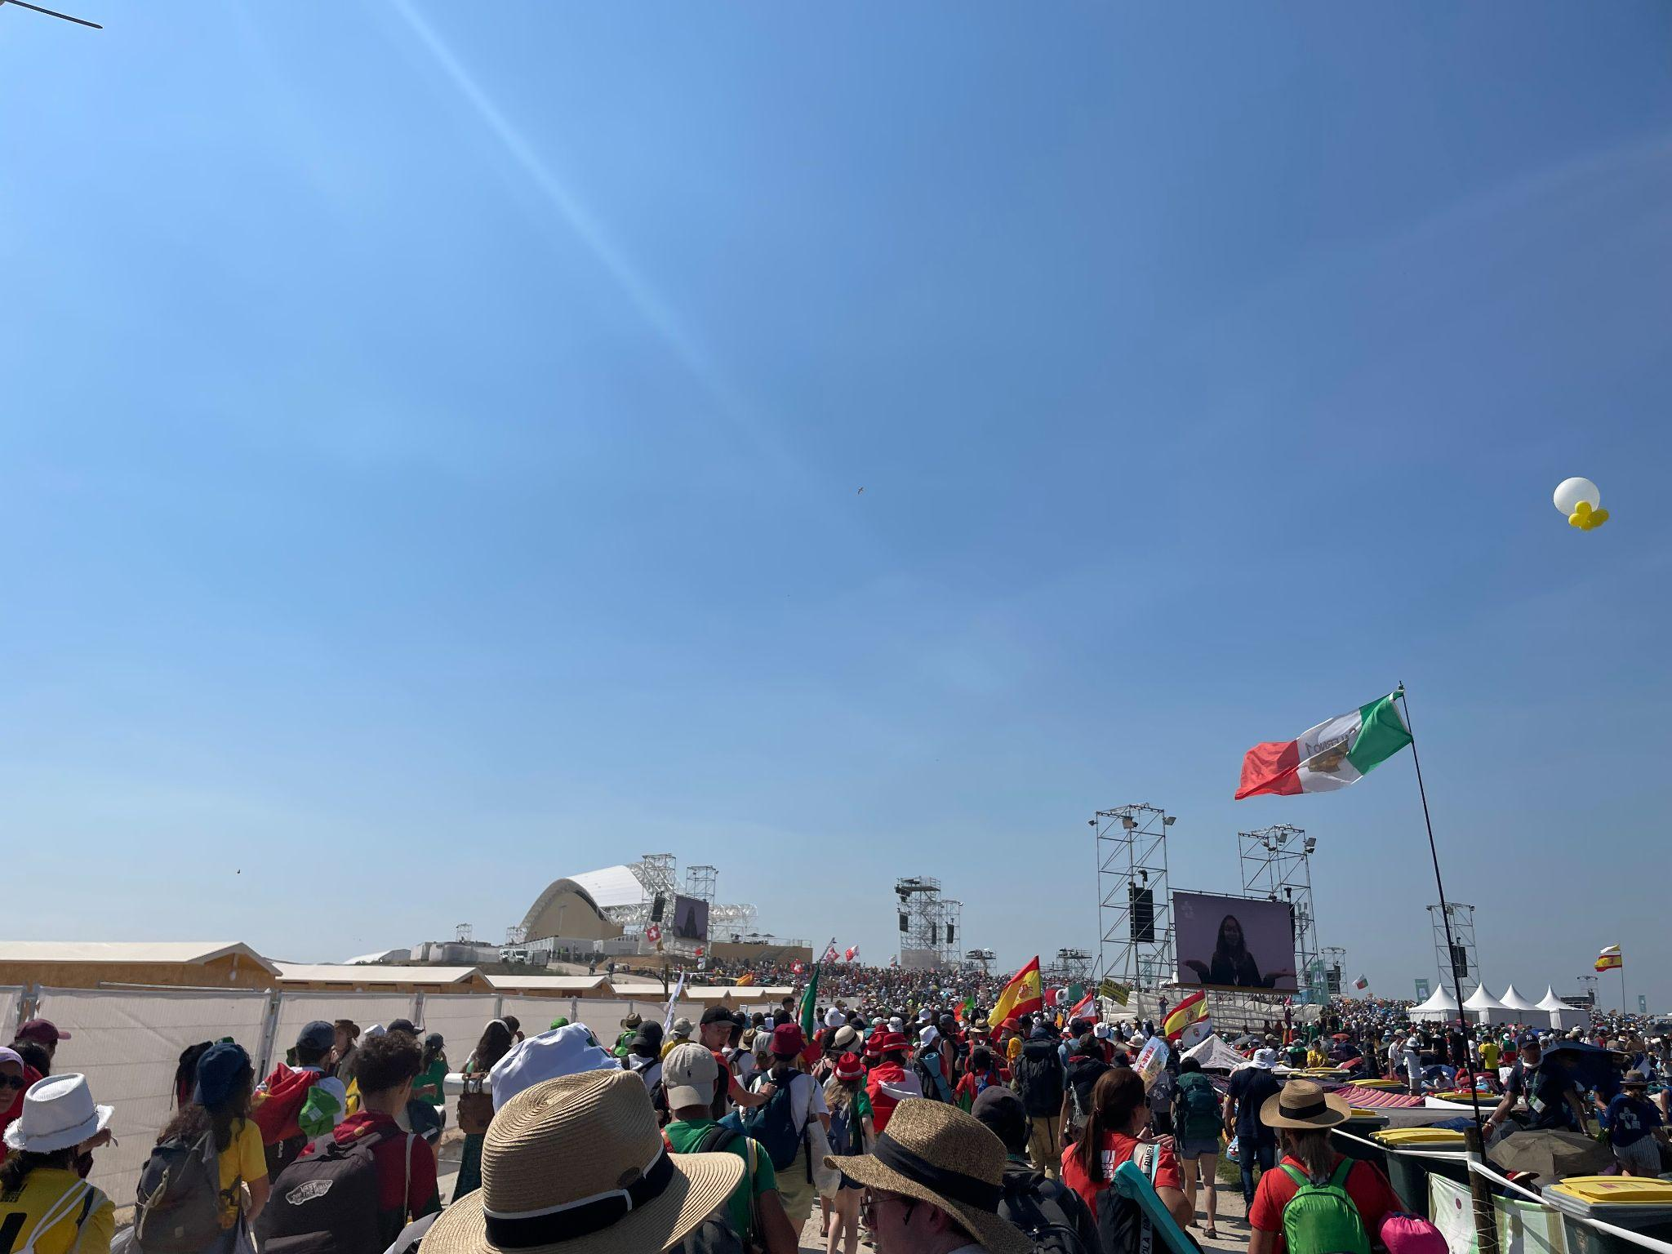
Saturday- The Pilgrimage Walk
We walked over 12km to the Closing Mass located at Tejo Park.
Hundreds of thousands of people from different countries waved their flags, sand songs and prayed.
We were all excited to see the Holy Father.
Notes:
We had all been told from previous World Youth Day events that the pilgrimage walk was not going to be easy. The weather reached a top of 35 degrees with full sunshine. We had to carry everything we needed for the weekend. A heavy backpack with sleeping bags, two days worth of food and plenty of water. As a group we travelled 12km to our WYD Mass location, Tejo Park. The walk, even though it was long and uncomfortable, was such a lovely opportunity to get to know the other pilgrims in our group. Many other pilgrims from other countries were travelling alongside us, waving flags and singing songs of prayer. I just remember seeing faces of complete strangers and noticing that everyone was happy. They have travelled around the world like us to be here and celebrate Mass with the Holy Father.

Slide 17
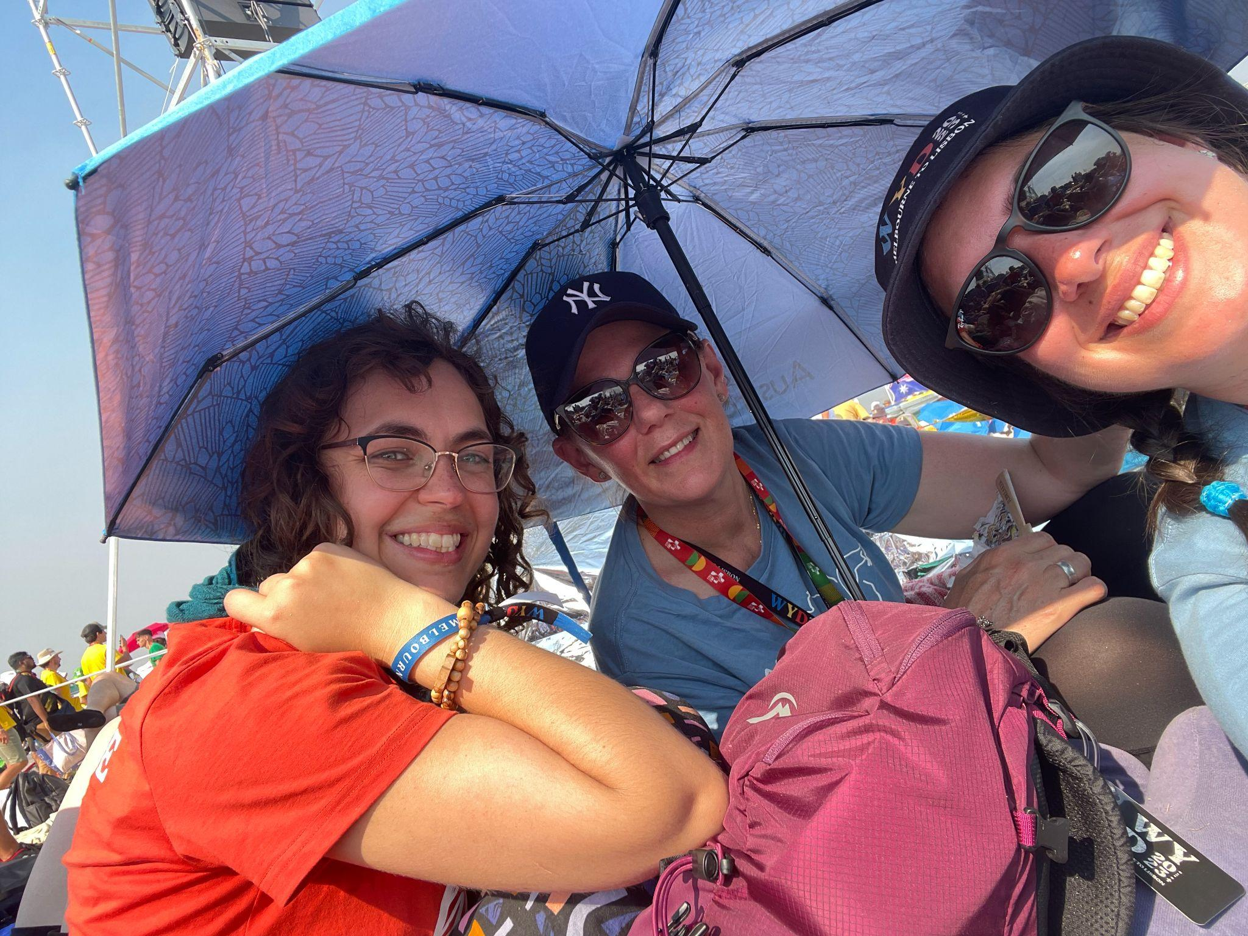
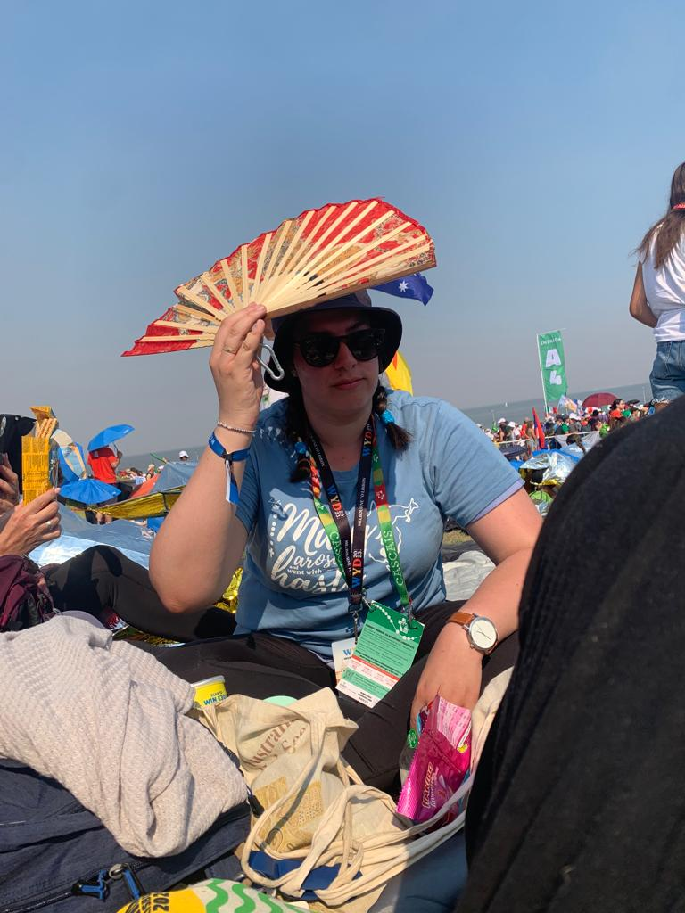
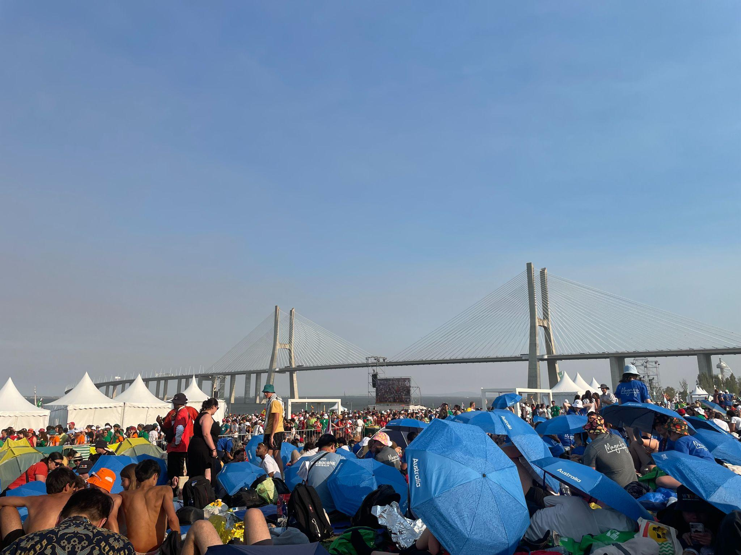
Saturday- Tejo Park
After 7 hours of walking we finally arrived.
Tejo Park was filled with many pilgrims celebrating and eating together.
It was very hot and everyone was very tired.
We could see a beautiful view of the bridge Vasco da Gama.
Notes:
After nearly 7 hours of walking, we finally arrived at Tejo Park. I was beyond tired, my legs and feet were weak, there were hundreds of thousands of people squeezing past each other, finding their way through the crowd. It was overwhelming and I did think ‘how am I going to make it through this?’ A small burst of energy came over me and I continued, like the Holy Spirit encouraging me to have courage and keep going. We finally found a small space to rest and place our belongings in our assigned spaces. It was no bigger than a square metre, enough to roll out a sleeping bag. We spent a few hours composing ourselves and resting. There was also a time to pray, listen to music, dance and take in the beautiful view of Vasco da Gama Bridge.

Slide 18
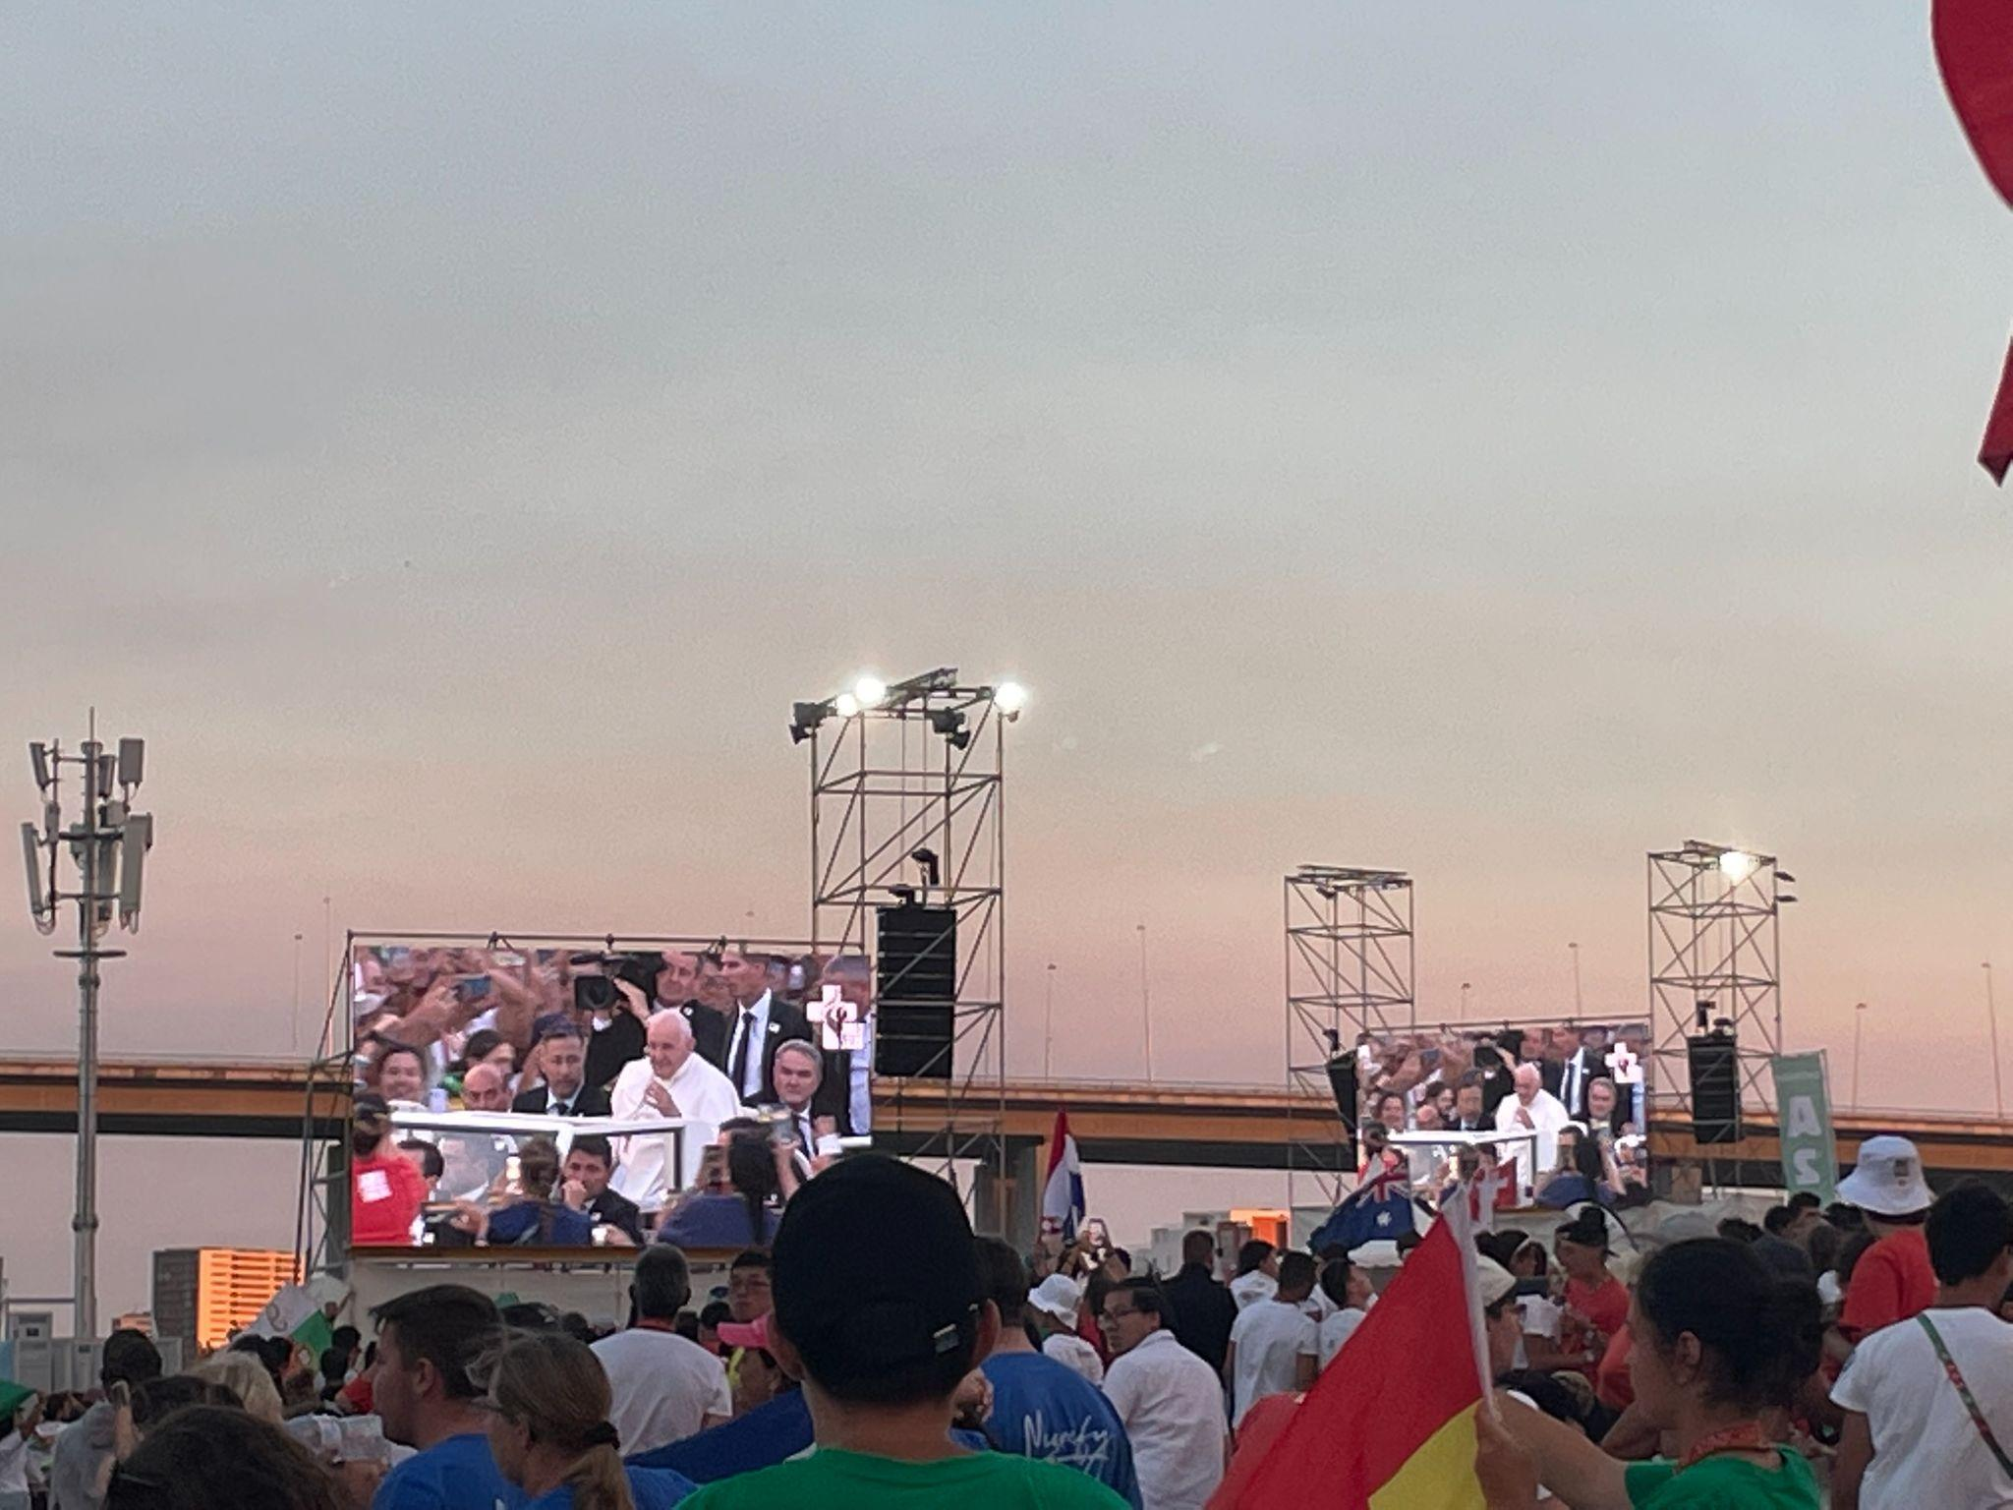
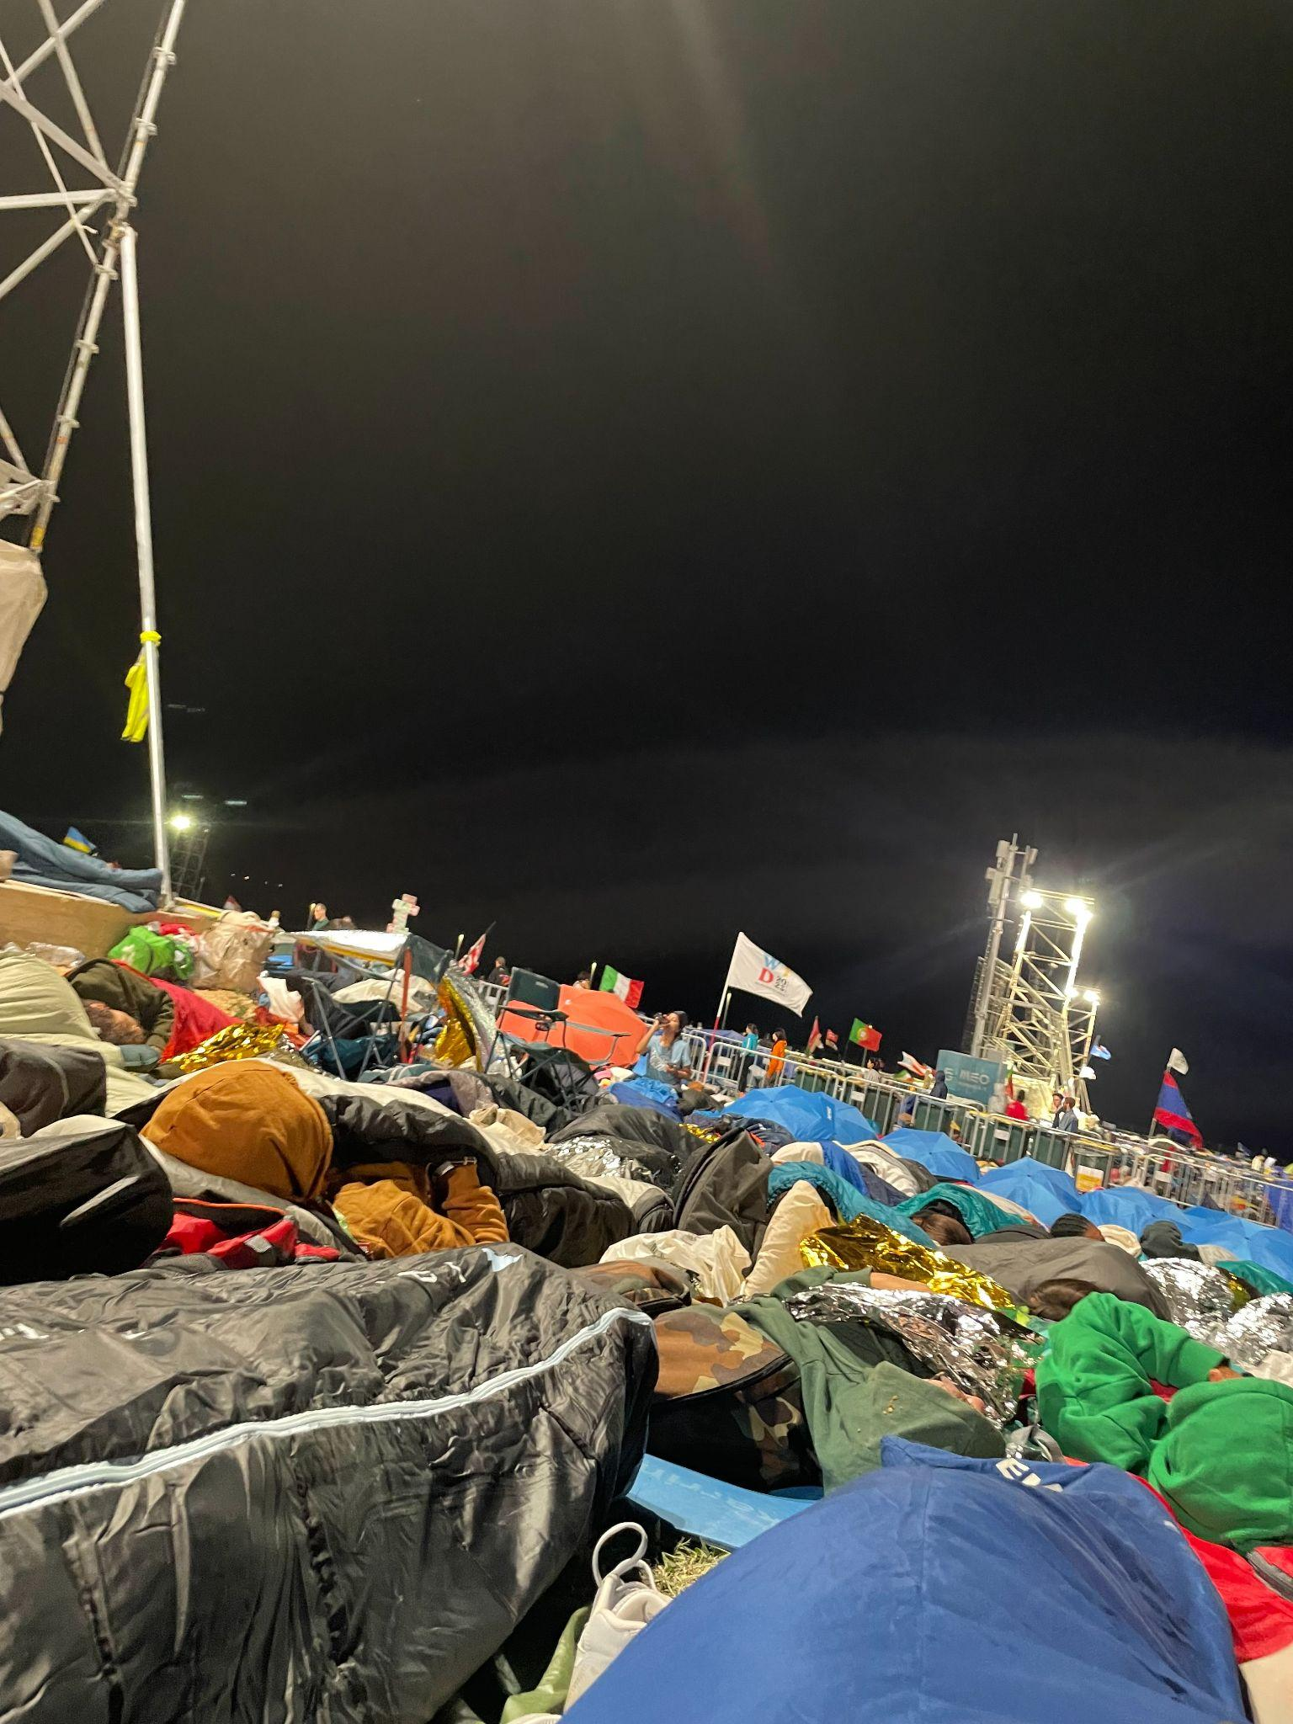
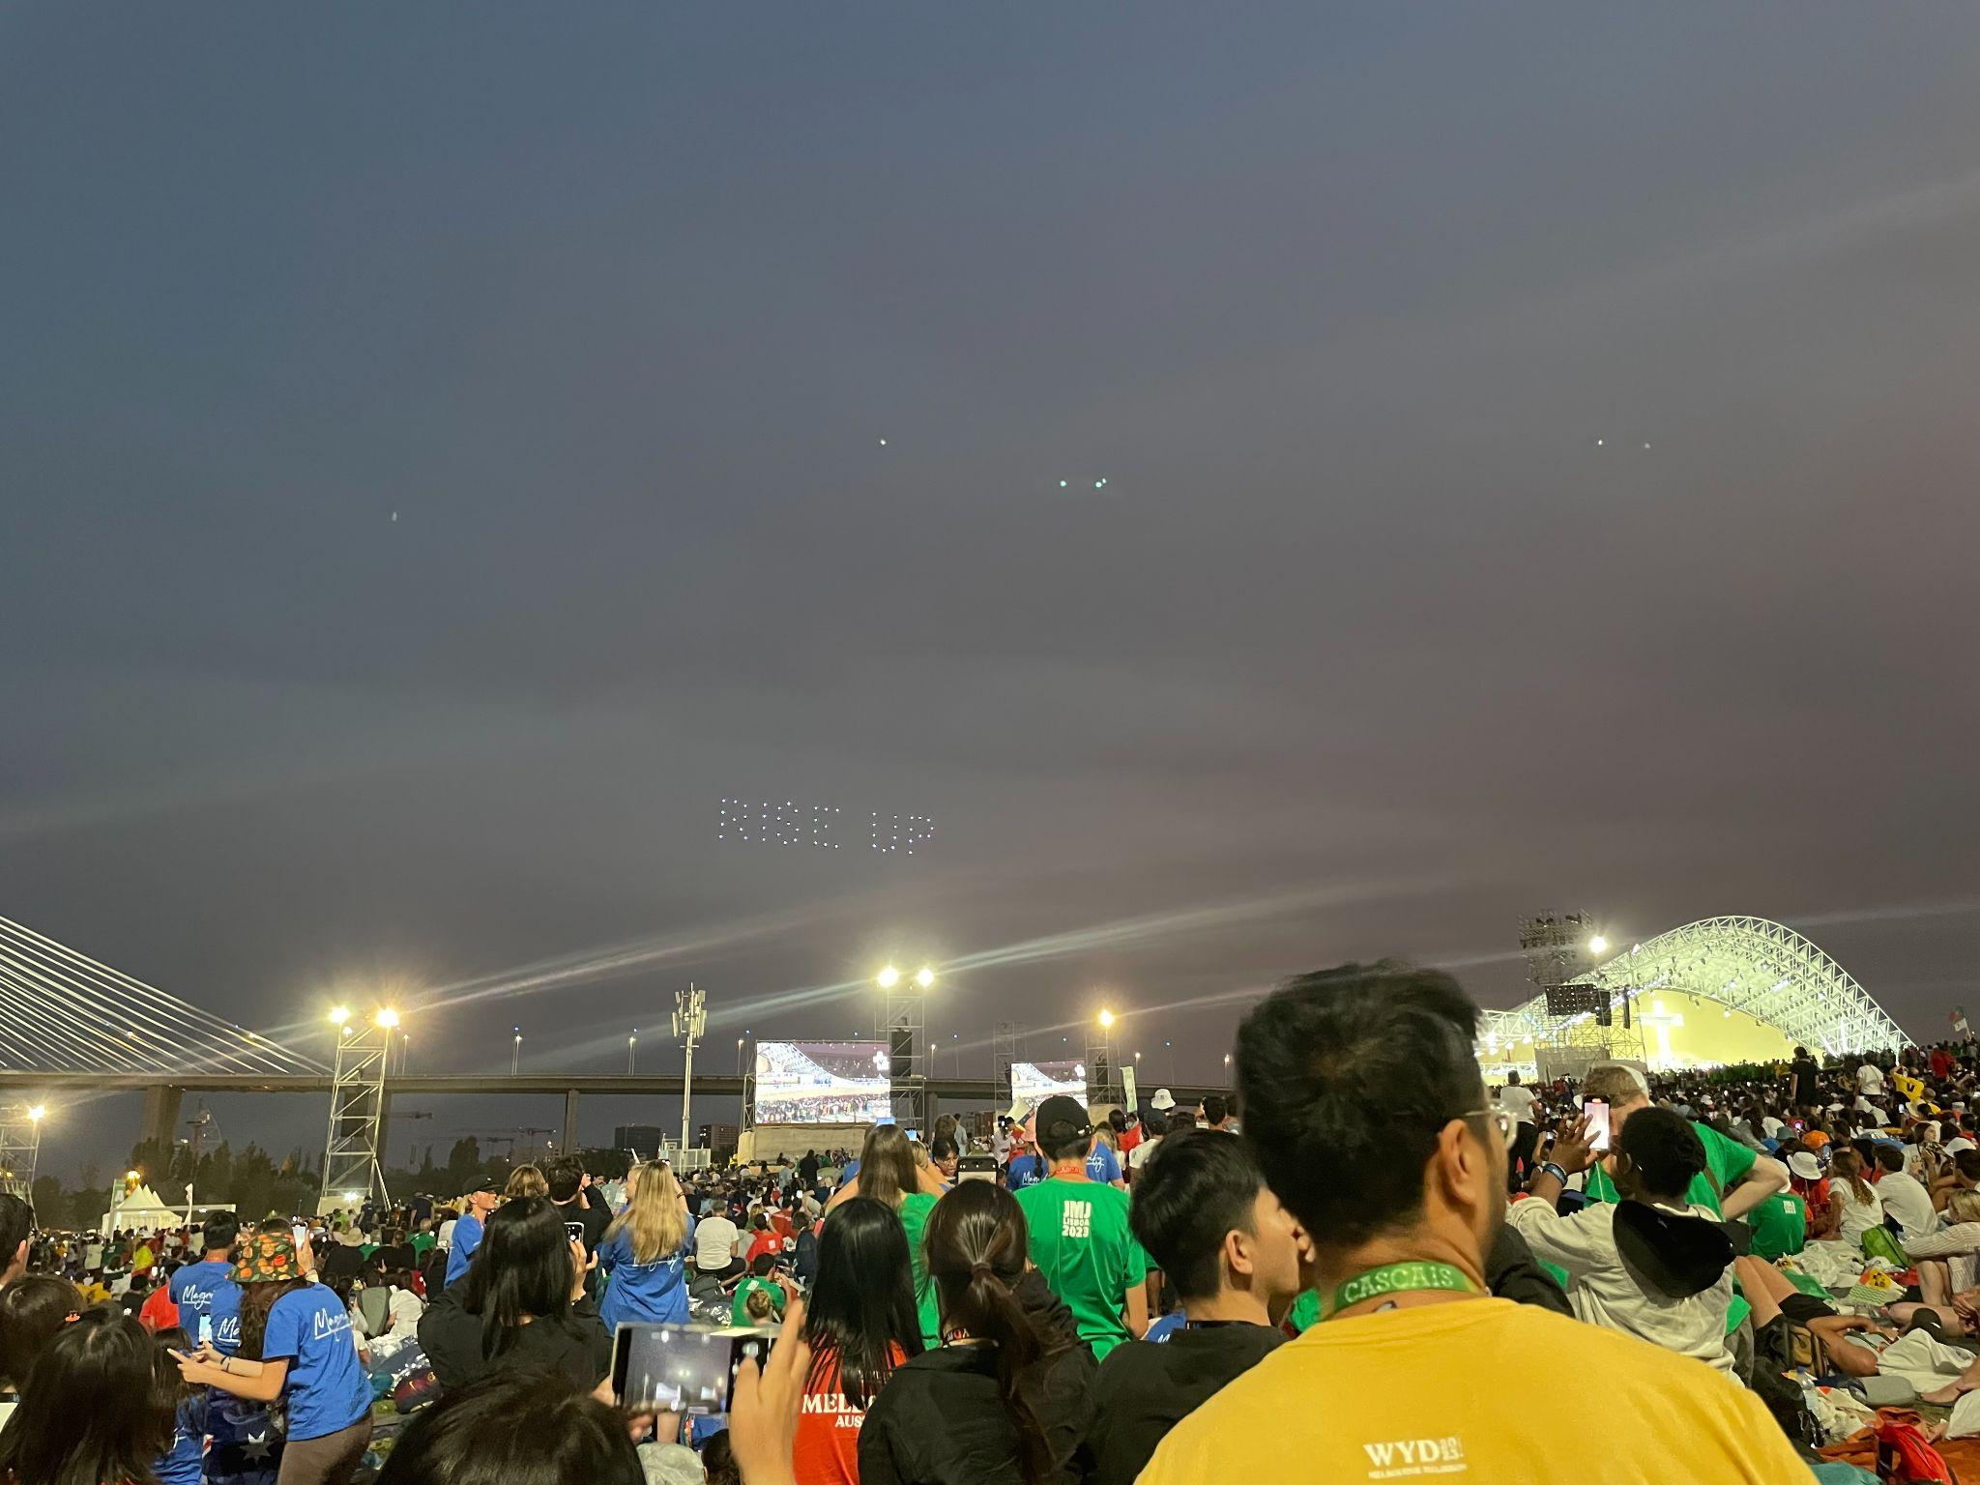
Saturday- Vigil Mass with Pope Francis
“You have all met here today to seek the message of Christ, do not keep it for yourselves, but bring it to others” -Pope Francis
Notes:
As the evening approached, the weather cooled down and we were preparing ourselves for the Evening Vigil and the Arrival of Pope Francis. Drone light shows happened throughout the night with special words to encourage the crowd. It was such a lovely peaceful time as we listened to The Holy Fathers message for the World Youth. He spoke of the underlying message and theme of the event from The Gospel of Luke “Mary arose and went with haste”, when Mary found out she was pregnant with Jesus and immediately told her cousin Elizabeth. The Holy Father said that Love is what makes us do the things we do, and that we do it for others. He said to the crowd “You have all met here today to seek the message of Christ, do not keep it for yourselves, but bring it to others”. Such a beautiful and strong message that faith can be spread around the world.
By 1am, the crowd quieted down and prepared for a well deserved rest.

Slide 19
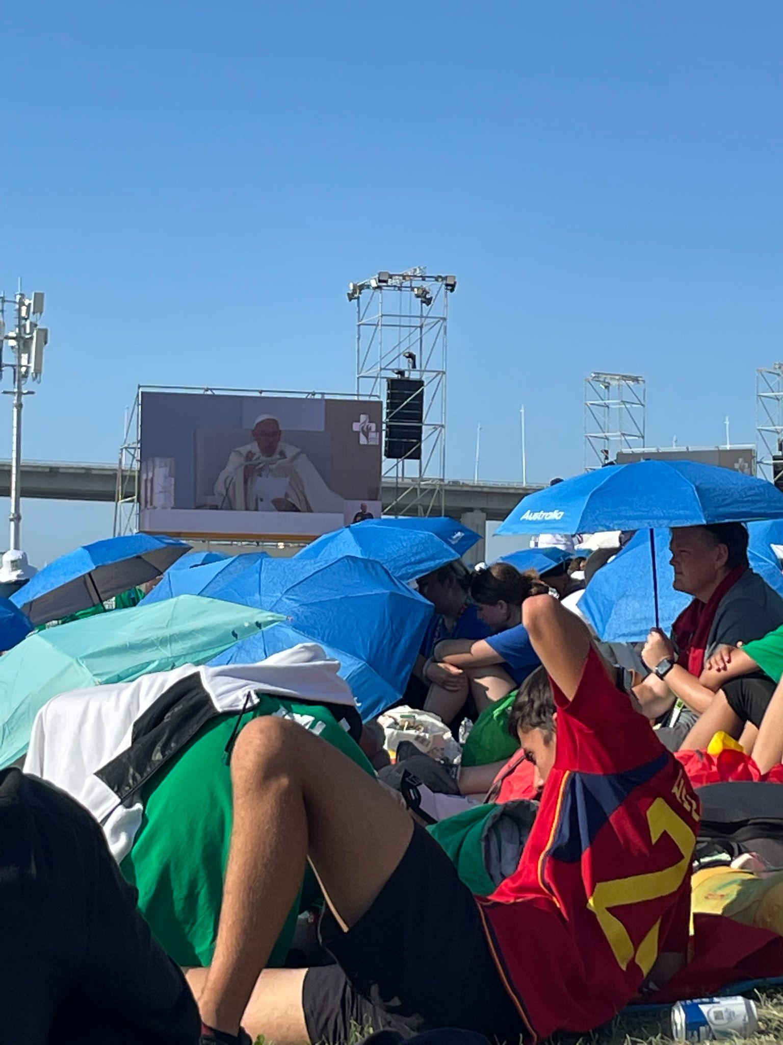
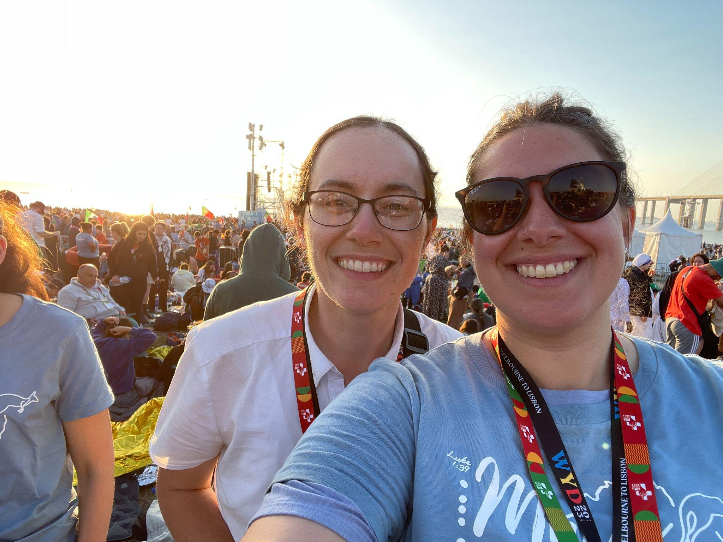
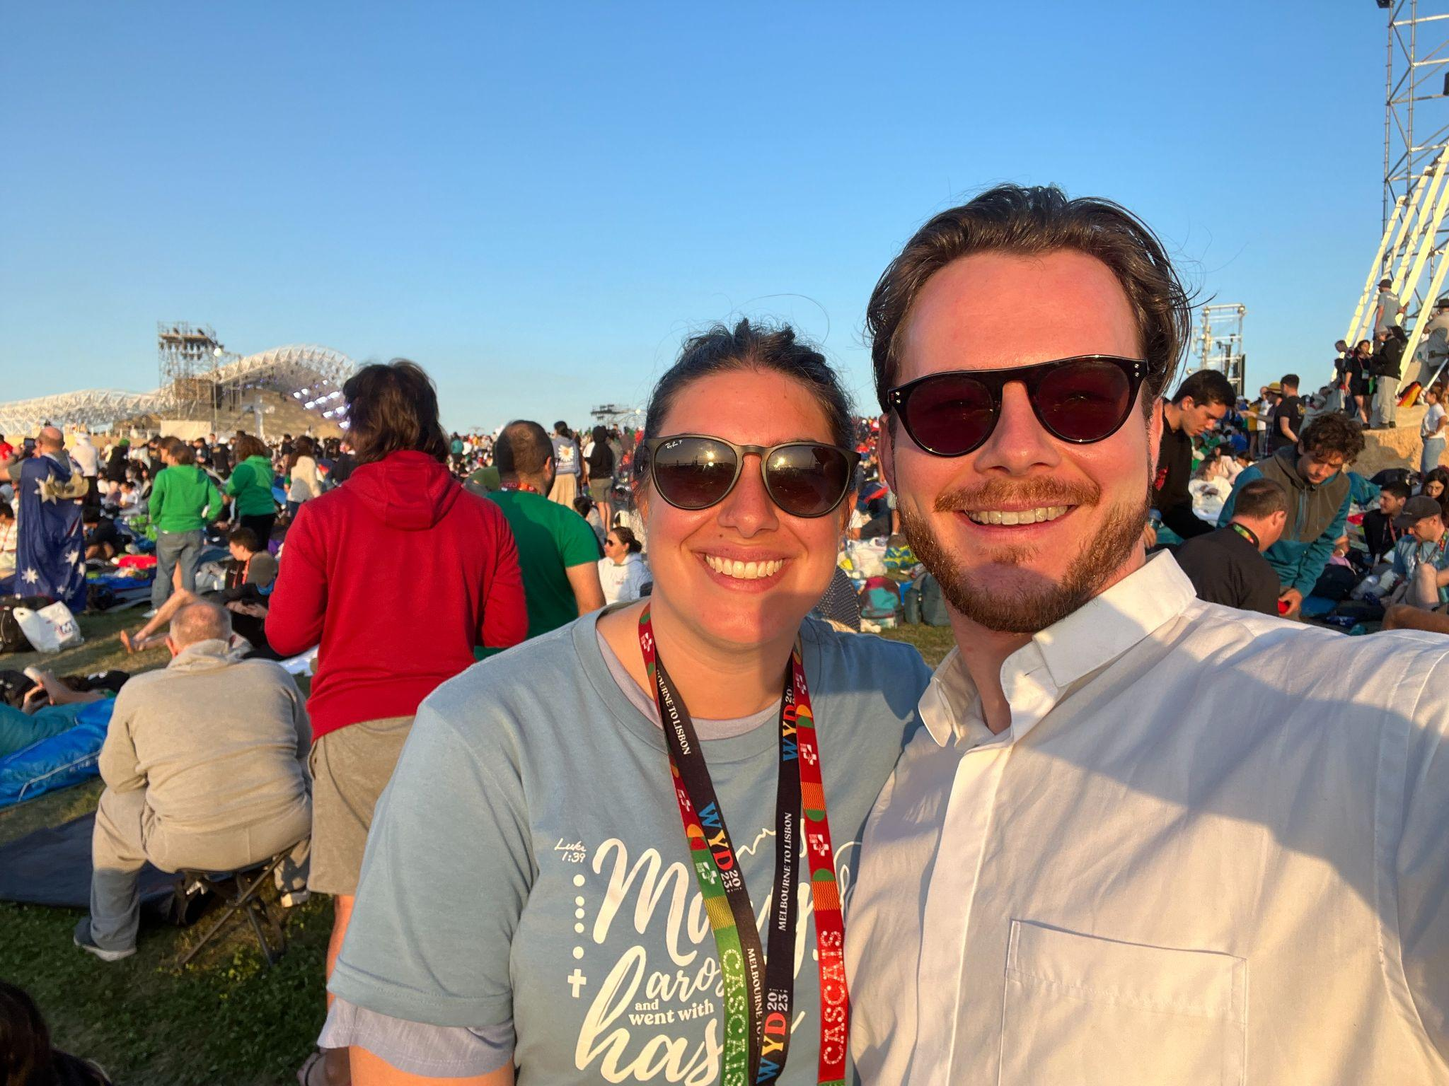
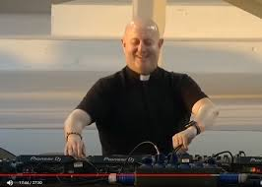
Sunday- The Beautiful morning
1 million pilgrims were woken up by DJ Father Guilherme
The Mass began at 9am with the Holy Father, Thousands of Bishops and and special guests.
The Mass was spoken in many languages for all to hear.
Notes:
6:30am the sun began to rise and we were all woken by an interesting alarm that echoed across the park. Father Guilherme (gil-er-me) a priest and DJ from Portugal played well known church hymns including ‘Aleluia’ with a techno twist. It was a very fun way to start the day for the important Closing Mass.
At 9am, the Mass began. Alongside the Holy Father, thousands of bishops from all around the world and special guests took part in the Mass.The Mass was spoken in so many different languages so that everyone could feel a part of the special event. English, Italian, Portuguese, Spanish, Japanese and Korean. Over 1 million pilgrims celebrated Mass that Sunday.

Slide 20
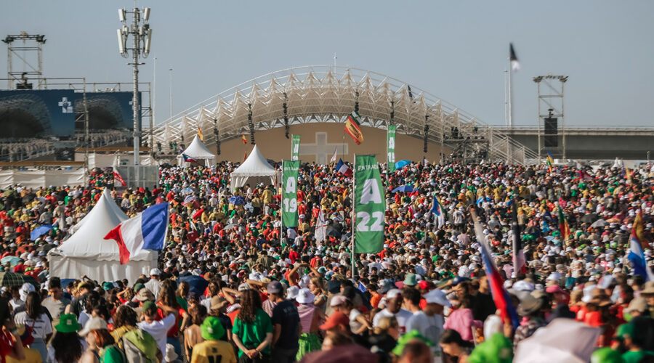
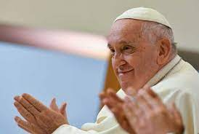
Sunday- Reflecting on Pope Francis’ Homily
“To shine, To listen, and to be Unafraid”
Notes:
During the Holy Father’s Homily and words from the Gospel of Matthew, he mentioned three verbs which I still think about today: “To shine, To listen, and to be Unafraid”
To shine:- It is important that we continue to love others and all that we do, otherwise the light will extinguish and not shine bright.
To listen:- When we listen, it is important that we are present for all the people in our lives. We also need to listen to the words of Jesus in the Gospel, as he will show us the way.
To be unafraid:- It is a challenge to find courage, to try something new, even though you think people will make fun of you if you fail or make a mistake. Pope Francis says, do what you can even though it may take time. Use the people around us who love us to be your guide.
I have returned from our pilgrimage constantly recalling and reflecting on a once in a lifetime experience. The millions of people who travelled far and wide to be a part of the World Youth Day experience was a powerful and truly amazing sight of how strong the Catholic faith can be. I am blessed and honoured to be a part of that! I am also so grateful to meet some amazing people in our Emerging Leaders Group, maintain that connection professionally and personally.

