Slide 1
Aetium Business opportunity
Aetium
The world is counting on you
Project overview | March 2024

Slide 2
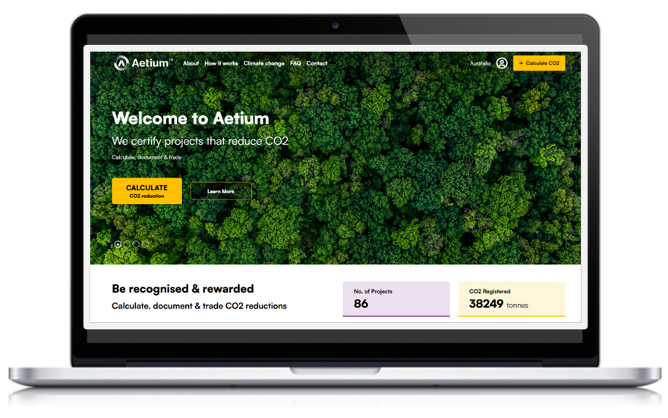
Aetium Introduction
World’s first end-to-end CO2 offset solution:- connecting CO2 reducers to CO2 buyers
CO2 Reducers
Aetium Platform
Offset Buyers
Aetium has developed a NEW and independent technology platform that rewards incremental community-led CO2 reductions. This platform securely connects CO2 reducers with CO2 offset buyers.
Solar Electric Vehicle Forestry
Individuals
Business
Benefit:
Reliably calculate, certify and monetise CO2 reducing investments: including solar, electric vehicles and forests.
Generate tradeable CO2 offsets that can be sold or retired.
Easily validate Scope-1 ESG reporting.
Benefit:
Online marketplace for quality CO2 offsets for individuals or businesses who want to securely reduce their CO2 footprint.
Access to quality, traceable Australian CO2 offsets on a simple to use platform.
Utilising the power of technology, smaller projects can be registered which unlocks $68.4m of genuine CO2 reductions in the Australian offset market by FY27, altering the way society and business incentivise climate action.
Commercial in confidence

Slide 3
Why is Aetium unique?
First of a kind |  | Mass adoption |  | Monetary incentive |  | Defensible & transparent |  | Scalable |  | Climate “Buy-In”
Utilises technology to cost-effectively validate CO2 reductions for small projects. |  | Low certification price makes the registration of small projects possible. |  | Investments in CO2 reductions can be converted into TCUs that can be sold. |  | We utilise technology and AI to validate and tokenise CO2 reductions. |  | We open a NEW and transparent CO2 offset market to millions of CO2 offset buyers. |  | We create a scalable “green market” that allows even more people to take action.
Certification and annual project monitoring for $24.95 per project.
Unlocks +4 million CO2 reducers allowing recognition and financial reward for making CO2 reducing investments.
Creates circular investment process that financially rewards CO2 reducers, thereby allowing even more people to contribute to CO2 reduction.
Retrospective 12-month certification utilising science-backed modelling, AI and blockchain technology. Project details and calculations are visible for all to see.
Solves shortage of quality Australian CO2 offsets. Online exchange makes access to CO2 offsets easier that ever before.
End-to-End process enables millions of Australians to take incremental climate action. Single register clearly shows who is taking action.
Commercial in confidence

Slide 4
The Aetium model
Technology platform that monetises CO2 reductions of community-led CO2 projects – connecting reducers to offset buyers
CO2 Reducers
Registration Portal
Certification
Exchange Portal
Offset Buyers
$TCU
Blockchain
Blockchain
Blockchain
For individuals and business
Simple to register online
Monetise climate actions
Easily calculate CO2 reduction
Issue a public digital certificate
Non-fungible
12-month validation
Issue public digital certificate
Create tradable offset (TCU)
Get paid for CO2 reduction
Buy, sell or retire offsets
View offset credentials
Blockchain protected register
Buy quality offsets
Demonstrate climate action
Commercial in confidence

