Slide 1
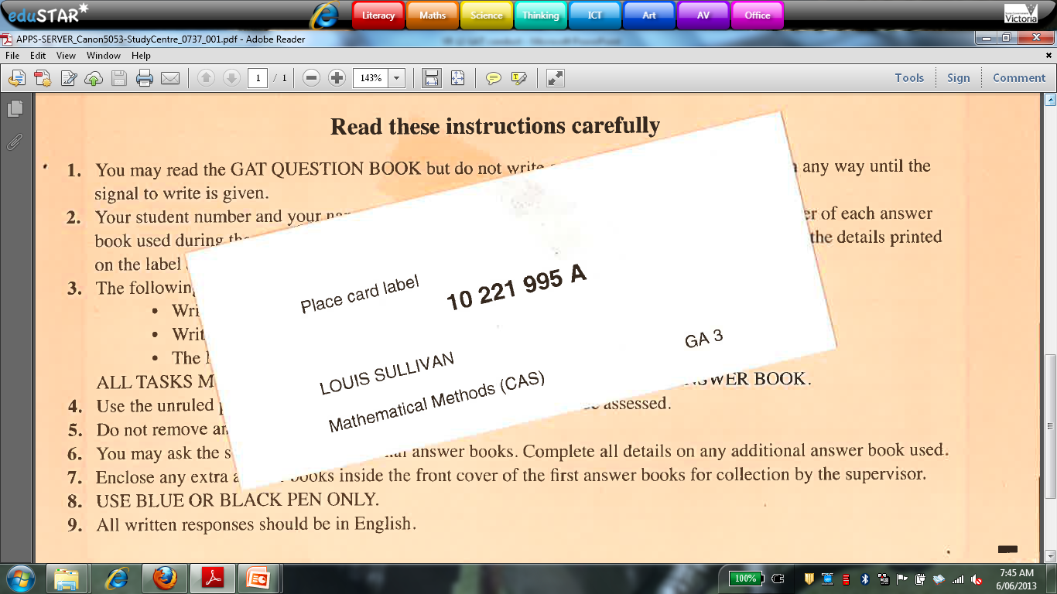
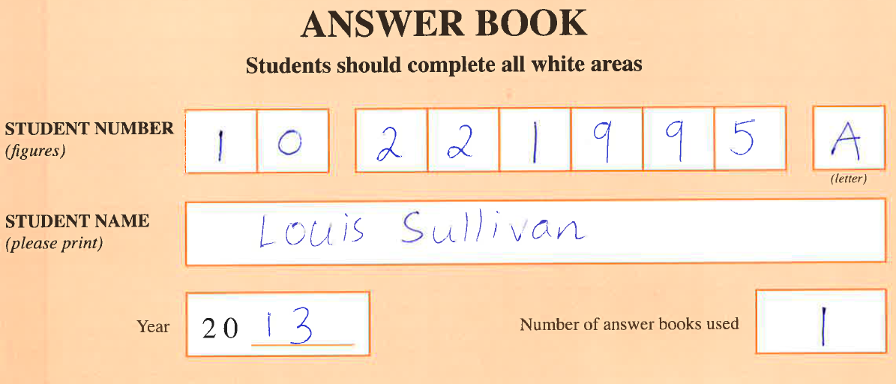
VCAA STUDENT NUMBER
Make sure you carefully print your student number on your
exam paper/script book. This number appears on a card that
will be at the table that you sit your exam.

Slide 2

EXAM CONDUCT
Supervisors have the right to check materials brought by students into the examination room and remove any non-compliant material (eg. mobiles) for the duration of the examination.
During reading time a student may study the directions for the examination, the question book and consult a dictionary or use a calculator.
A student must not begin to write or mark their paper or response material in any way, until the announcement that writing time has commenced.

Slide 3
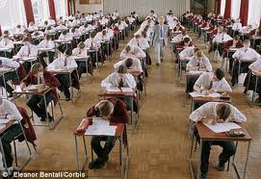
EXAM CONDUCT
Responses to examination questions must be entered on the examination response books and/or answer sheets provided. Notes and other markings made elsewhere on the response materials will not be assessed.
Our school policy is that a student must stay for the entire writing time.
All students must cease writing when instructed to do so by the supervisor and must not leave their place until directed by the supervisor.
Students must remain silent and in their places until all response materials have been collected. When all response materials are collected the supervisor will give the direction for students to leave the room.

Slide 4



BOTTLED WATER
The VCAA approves students bringing bottled water into an
examination room with the following conditions:
• The water is in a clear plastic bottle (all labels removed).
• The water bottle has a secure lid.
• The capacity of the bottle is no more than 1500 ml.
• Water bottles must not be placed on the desk at anytime.
• Water bottles must not be refilled during the examination.
• Water bottles must not be shared between students.

Slide 5
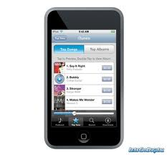
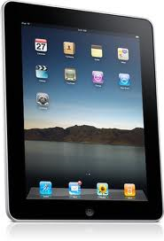
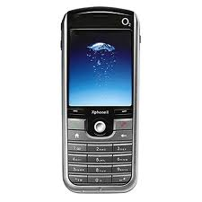
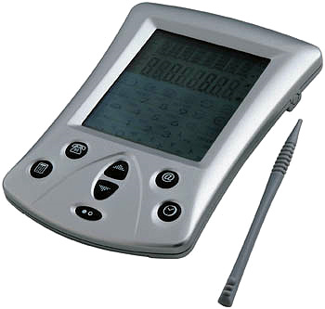
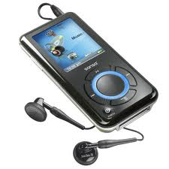
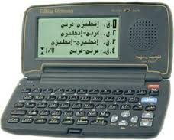
MOBILE PHONES AND OTHER ELECTRONIC DEVICES
Mobile phones and other unauthorised electronic communication devices, such as organisers, iPods, iPads, MP3 players, electronic dictionaries and computerised pens, stopwatches and watches, which are capable of storing, receiving or transmitting information or electronic signals are not permitted in an examination room under normal written examination conditions. Confiscated mobile phones and other devices may be held for up to three months.

Slide 6
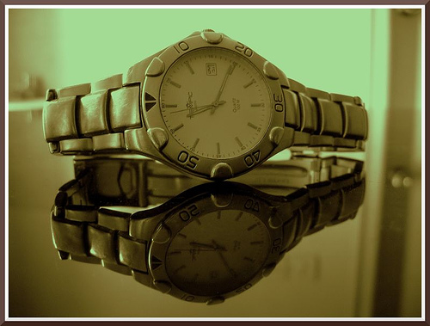
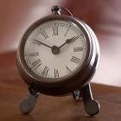
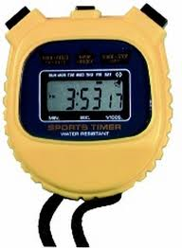
WATCHES
Students will not be permitted to wear watches of any type during an examination. All watches must be removed and placed at the top of the student’s table/desk, where they can be seen clearly and easily by supervisors.
Where there is any doubt about the functions of any watch displayed, supervisors are authorised to direct students to remove the watch from the table/desk for the duration of the examination.
Stopwatches or watches with special functions such as an alarm or stopwatch are not permitted in the examination room.

