Slide 1
Canberra Excursion, 2022
By Olivia Hoy

Slide 2
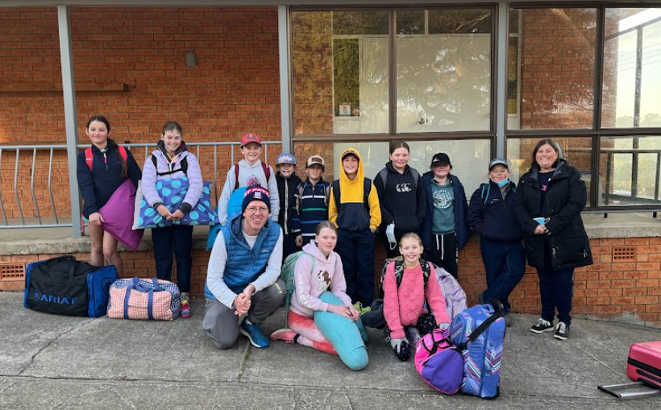
Day 1: At School

Slide 3
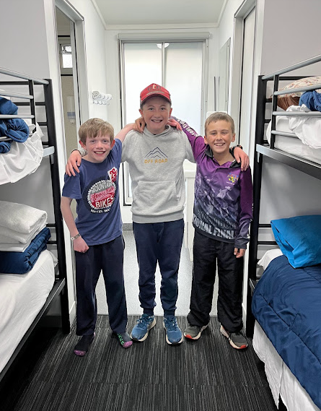
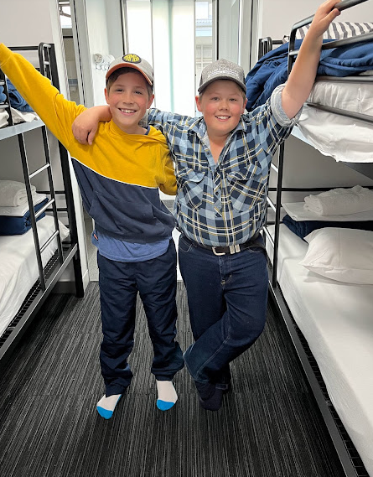
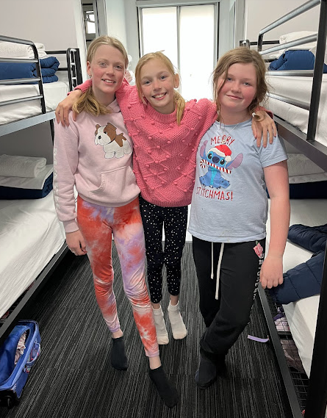
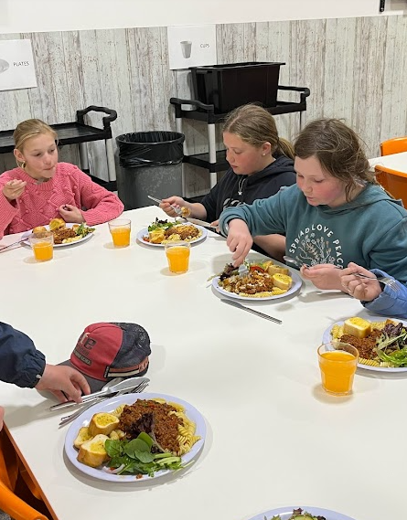
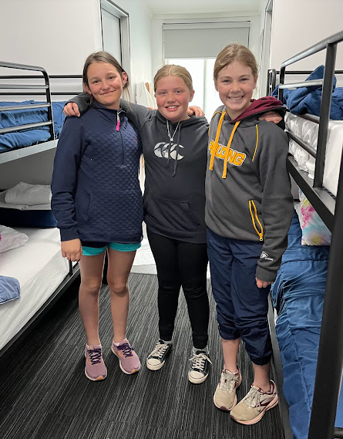
Arrival at Canberra Park
Dinner at Canberra Park

Slide 4
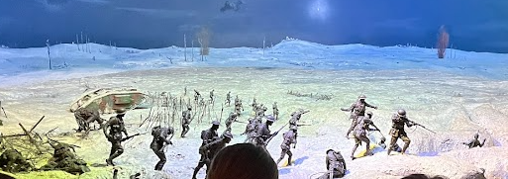
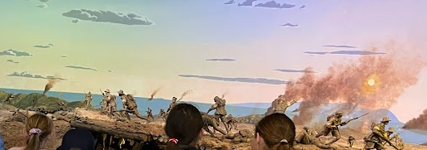
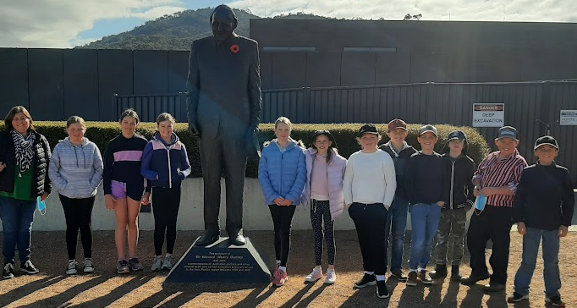
2nd day in Canberra
On our second day in Canberra we went to the War Memorial. The War Memorial is where they keep all the history from wars where there has been Australian involvement. There are real machines and dioramas of what happened.

Slide 5
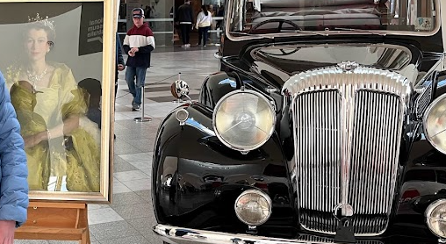
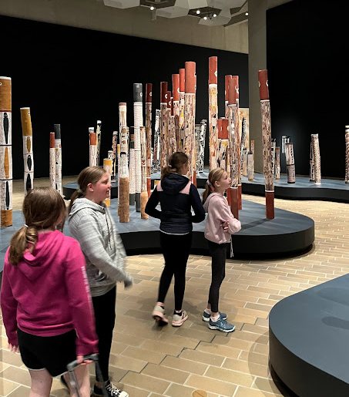
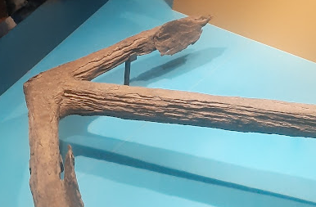
National Museum of Australia
The National Museum of Australia… full of art and sculptures, it was great fun! We even saw the car that Queen Elizabeth rode in when she visited Australia. There was also lots of historical artefacts in the gallery which had great significance to Australia, for example Mathew Flinder’s anchor and Aboriginal hunting tools.
The Queen’s car

Slide 6
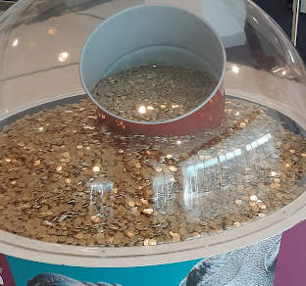
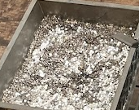
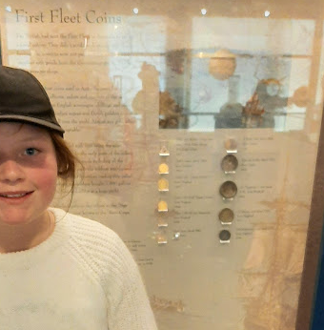
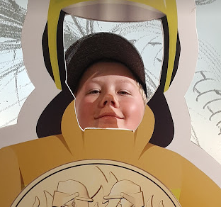
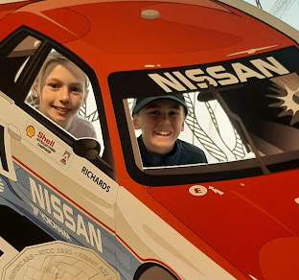
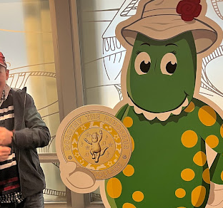
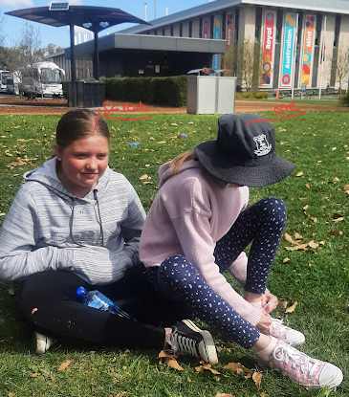
The Royal Australian Mint
The Mint was a great experience. We saw all of the different coins and how they are made in different shapes and sizes.
We also learnt about the value and how much all of it is worth. Before we went inside The Mint we had lunch and I got tired of sitting on the ground so I sat on Sarah’s knee…

Slide 7
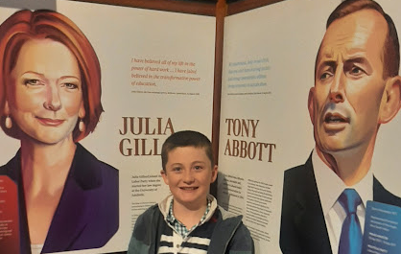
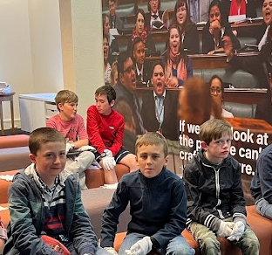
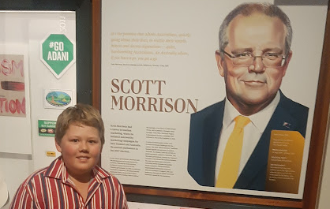
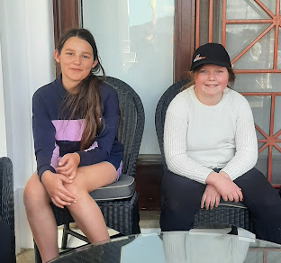
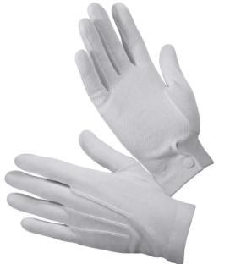
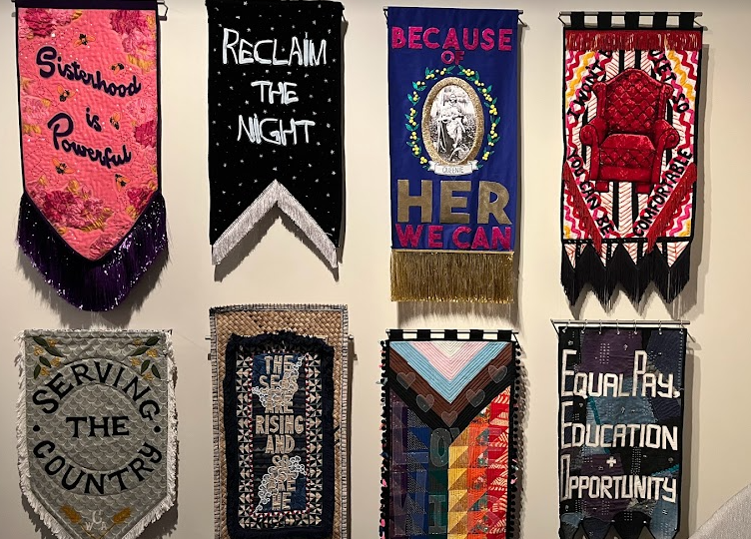
Museum of Australian Democracy
The Museum of Australian Democracy is actually the Old Parliament House… it is an old version of the new Parliament House. Inside, we had to wear white gloves like these ones.
to protect all the artefacts from dirt or smudges.

Slide 8
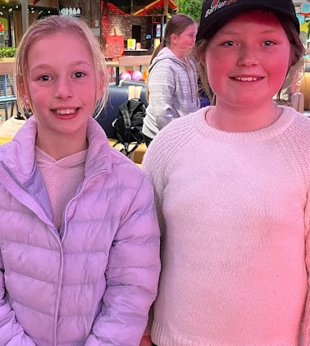
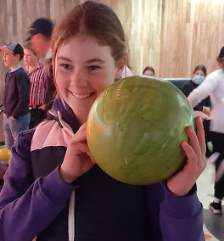
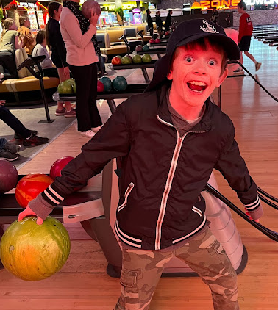
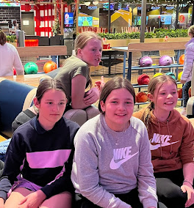
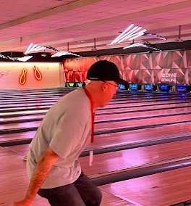
Bowling
That night, Lorrie (our bus driver) drove us to ZONE BOWLING.
Here are some great pictures we took that night…

Slide 9
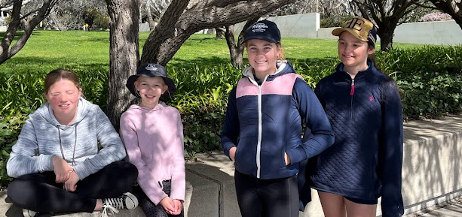
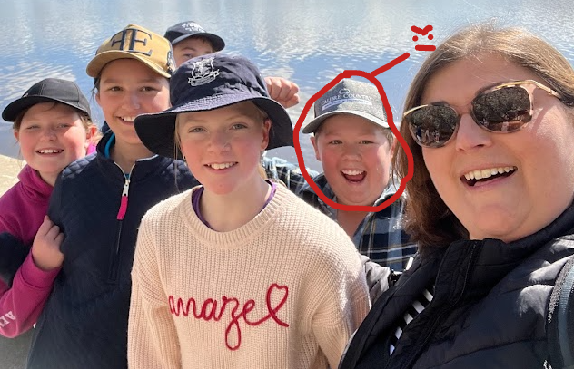
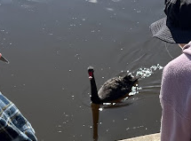
Day 3: Walk around Lake Burley Griffin
For our third day in Canberra, we started off the morning with a nice, quiet walk around Lake Burley Griffin. All the sights were fantastic! So was the wildlife… like the pretty trees that were covered in lovely, white blossoms.
There was also some beautiful black swans gliding around in the water.

Slide 10
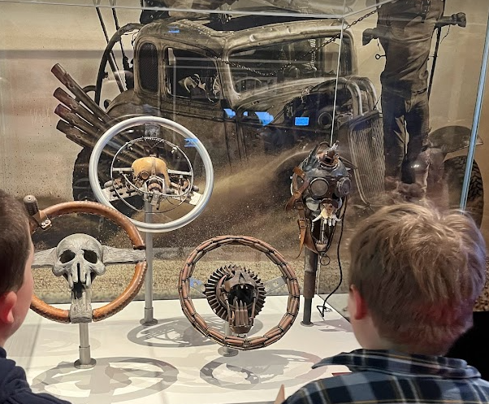
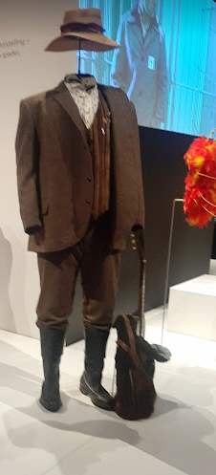
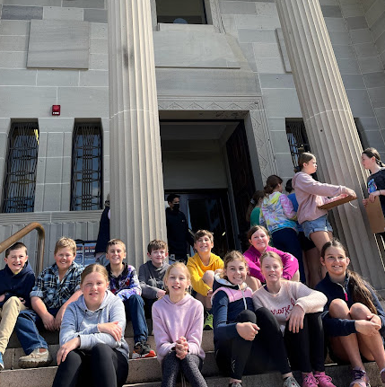
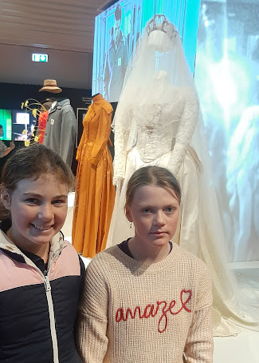
National Film and Sound Archive
The National Film and Sound Archive was quite interesting, as we found many great and entertaining films, like Crocodile Dundee and Mad Max. We also saw some costumes from actual films like The Sapphires.

Slide 11
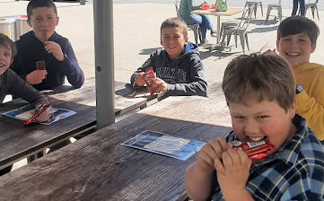
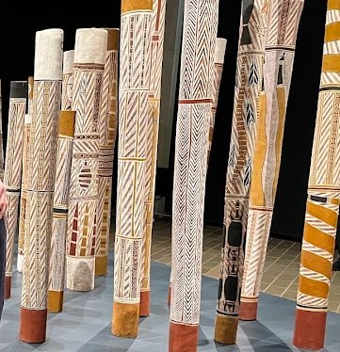
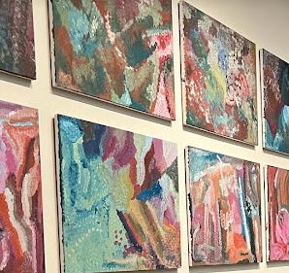
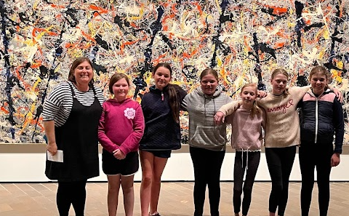
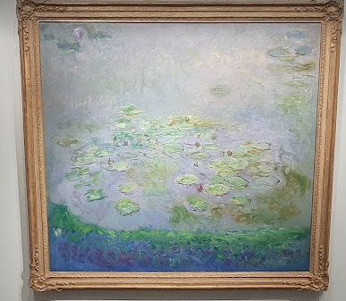
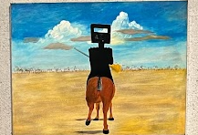
National Gallery
The National Gallery was where many famous and priceless artworks are found. We learnt that the ‘Blue Poles’ was worth 500 million dollars in Australian currency. We were supposed to stay exactly one metre away from the paintings, so that the paintings wouldn't get smudged or ruined.
The boys got KitKat

Slide 12
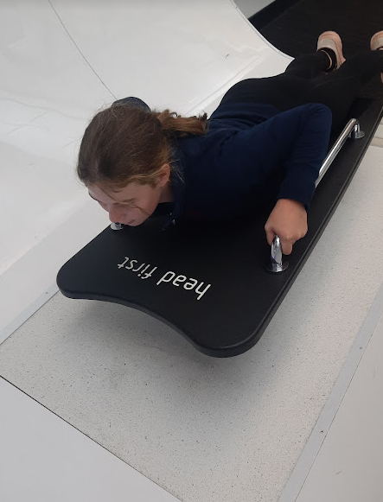
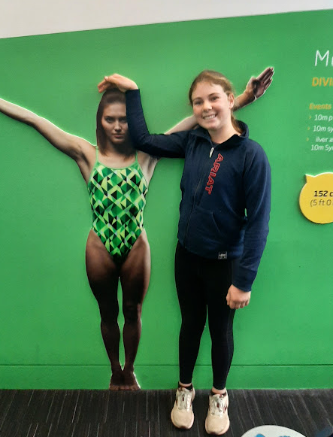
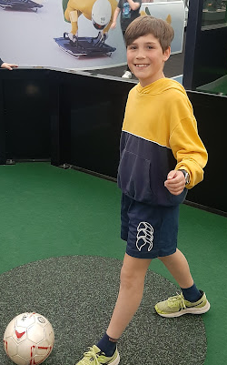
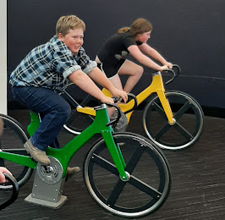
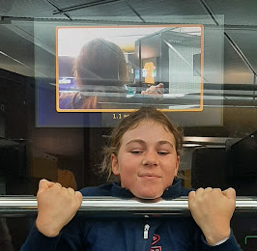
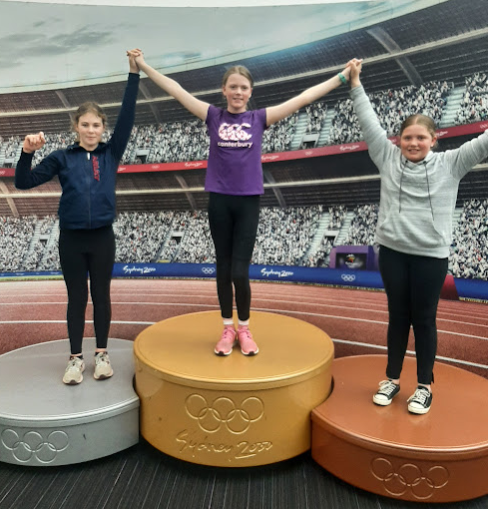
AIS
The AIS was so much fun…
It is where all the Australian athletes train for the Olympics and international competitions. We experienced how it felt to train like them in a training room designed for kids and school children.

Slide 13
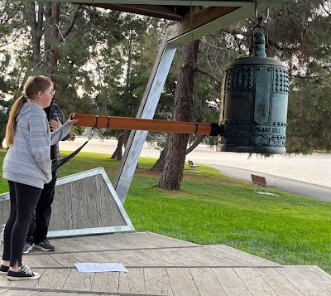
Rotary Peace Pole
The Peace Pole is a very important pole… they have been planted all around Australia! The Canberra Rotary club set off to find at least 100 peace poles, but in the end guess how many they found? 207
We were lucky enough to get to ring the giant bell beside the peace pole,The bell made a very loud ‘DONG!!!’ that could be heard from a mile away.

Slide 14
Day 4: Mount Ainslie Lookout
Mount Ainslie lookout was an unforgettable place, we had our own personal tour around with Mr Hyatt, also known as the possum spotter. It was one of the most extraordinary views I had ever seen in my life… You could see all of Canberra and its amazing sights, buildings and monuments!

Slide 15
Parlament House
Parliament House was huge and fancy…! It was surrounded by many beautiful water features that are used to muffle voices. We were invited inside but first we had to go through security…
Luckily most of us were fine… except for Connor?!?

Slide 16
National Abortetum
The National Aboretum is where they keep rare plants and trees for study. There was also a playground that we played on.

Slide 17
Questacon
Just when I thought the excursion couldn’t get any better… we visited Questacon! Questacon was my favourite place on the whole excursion.
Do you remember at the National Gallery how the St Pats Boys got kitkats? Well… Mr Hyatt bought us something even better…
Mr Hyatt got all of the St Pats girls cakes…!

