Slide 1
Storyboard
By Sarah from St Albans Secondary College

Slide 2
This storyboard will show what I do in my everyday life. My life can be different to yours in many ways, however, it can also have similarities to yours. My storyboard will show what I do on Wednesday, Friday and Saturday. I hope you enjoy!

Slide 3
Waking Up and Getting Ready (Extremely slowly, EVERY MORNING)
I wake up at 7:30 in the morning. I don’t see why we have to wake up early just to get to school. Thanks to waking up early, I have an annoying habit of waking up early, even on the holidays and weekends. That’s right, on the holidays! I blame school for that. Anyway, my mum or dad wakes me up, so there’s no need for an alarm clock. Even so, I stay in bed until 7:40. When I decide to get out of bed, I roll out and normally hit my foot on the ladder of my bunk bed.
Go away….. I’m awake…
A new day… Another early start…

Slide 4
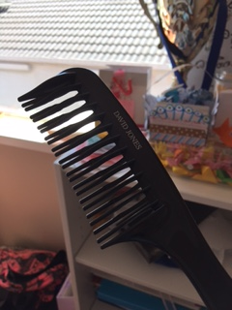
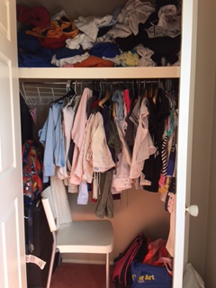
My eyes are half open when I go to the bathroom. To wake myself up I splash cold water onto my face. I spend ten seconds combing my hair, toss the comb aside and then get changed while reading a book. I tie up my hair and brush my teeth. When I check the clock, normally it is 7:55, and I realise I have to get a move on.
My comb. My hair broke my old comb somehow, and my other one mysteriously disappeared… (under the couch. Whoops!)
The cupboard in my room where my clothes are located. I really should clean it a little…

Slide 5
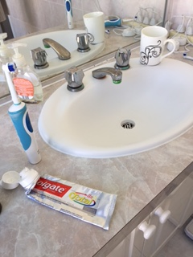
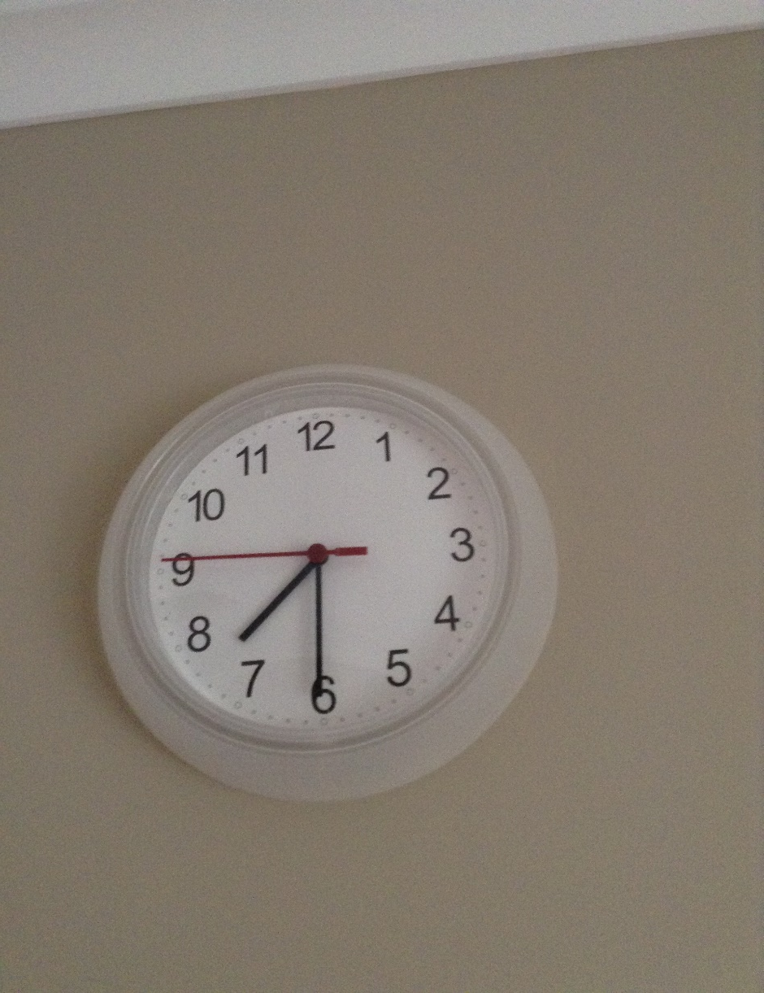
My toothbrush
Where I brush my teeth.
My clock showing when I’m supposed to wake up

Slide 6
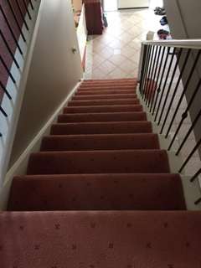
Breakfast!
Afterwards, I run down the stairs (not too fast, I once fell down that way) and eat breakfast, slowly. You should know that I do EVERYTHING slowly, from eating to walking. I eat toast with Nutella on weekdays. On weekends, I eat rice with egg. I used to watch videos on my laptop while eating, but now we aren’t allowed because we go too slowly. I put my lunch (spring rolls, yum!) into my bag and clip my water bottle onto the strap. Then I drink milk (It doesn’t make me taller, I’ve been having one glass three times a day, I’m still short…).
Rice with fried egg! I eat this on weekends.
The stairs! I counted fourteen stairs.

Slide 7
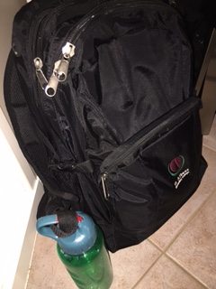
My schoolbag. It’s usually big and heavy, so when my bag is light, I feel like I am forgetting something.

Slide 8
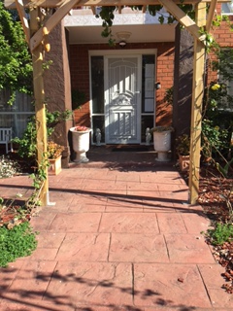
Getting To School (Weekdays)
After breakfast, I get into the car (usually my mum’s car). When we (my twin brother and I) wait for my mum in the car, we use the opportunity to watch videos on our laptops. We leave early because there is almost always traffic on the way to school. My school, St Albans Secondary College is pretty big (in my opinion) and has plenty of students (I don’t know how many, but it’s definitely a lot.). It takes around seven minutes to get there from my house in Cairnlea, but a little bit longer if there is traffic.
The outside of my house.
My mum’s car.

Slide 9
Schooldays… (yup, this is going to be a boring slide…)
After my brother and I are dropped off, we walk to our lockers. The boys’ lockers and the girls’ lockers are separate. The boys’ lockers are outside while the girls’ are inside near the classrooms. The bell for us to go to our lockers is at 8:45. Usually we are early, so I wait around the locker bay until my friends arrive. My locker number is number 30. It’s easy for me to remember because I was born was on the 30th. Other than that, I can recognise my locker because it has my blood on it (from when I cut myself when I was rushing to get my things).
This is where we enter the school. This is not the main school entrance, it is just a quicker way to get to our lockers.

Slide 10
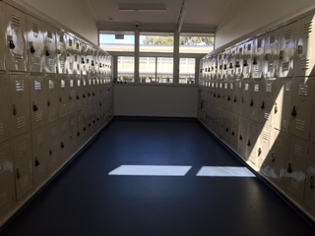
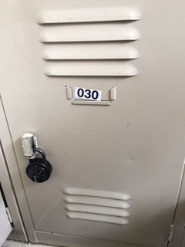
Locker number 30! It looks so boring… Unfortunately, you can’t see the blood in this photo.
The girls’ locker bay. This photo was taken when classes were on, so, as you can see, it’s a little empty… At the start and end of the day, it’s packed!

Slide 11
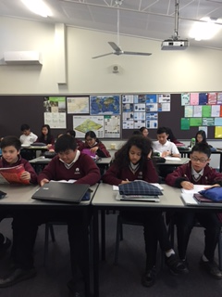
WEDNESDAYS: (In these sections you will see differences between the activities. The start of the day is usually the same, but here things change.)
After my friends come, we gather our pencil cases, textbooks, exercise books and whatever else, and head off to our first class. Our first class is English. I don’t really mind English, but sometimes it can be really dull. My seat is near the door, next to one of my friends. Our English teacher is also our history and geography teacher. Our classroom is in F9, near our lockers.
My class working in our homeroom classroom, 7J.

Slide 12
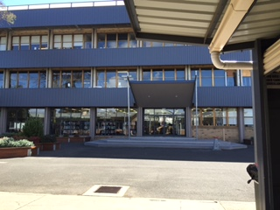
Next up, is maths. Maths… It was never my forte. I don’t really like maths. Sometimes I get confused because of all the numbers and make small, simple mistakes. Our maths classroom is in C7, which we have to climb the stairs to get up to. We have maths almost everyday, so we get daily exercise (I can’t act like I’m pleased about that…).
C7 is somewhere up here!
This is the front of the library. We go here for period four on Thursdays.

Slide 13
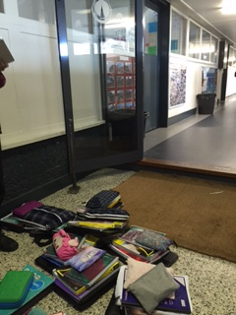
Luckily, afterwards we have recess. So we race down the stairs (well, not me, I‘m too slow…) to our lockers. I normally have no snack so I just talk to my friends while watching them eat (It’s not as creepy as you think). We also get our things for the next two periods and dump them near the lockers. We stay there at snacks and lunch. The people who stay there aren’t all from our class, 7J. Some of my friends are from other classes.
Where we ‘hang out’ most break times.

Slide 14
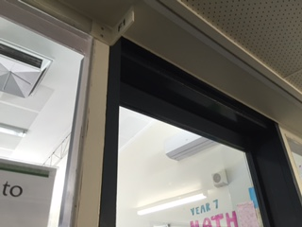
F1, our science classroom.
After snack, we have comprehension, or ACL, for others. My comprehension classroom is R9. Our comprehension classes are made of year 7s from other classes. Only two of my classmates are in my comprehension class. However, I know a few of them from primary school.
After comprehension, we have science. On Wednesdays, we have theory classes, since our classroom isn’t actually a science room. The classroom is F1, and is located just across from our lockers.

Slide 15
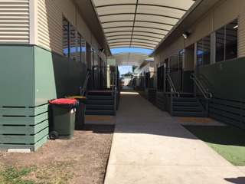
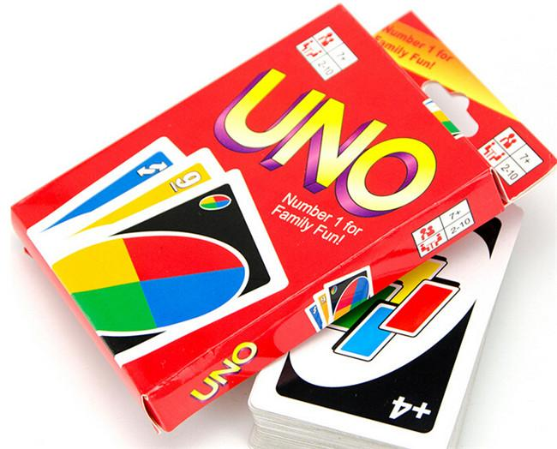
Lunch is one of the best parts of the day. Mostly because we get to eat and relax. My lunch is always either spring rolls or a sandwich with ham. On Mondays, Wednesdays and Fridays, my friends and I go to R1, the games room. We play board games and card games like Monopoly, Uno and Speed. Following lunch, we have PE theory and Learning Manager in F9.
The R Wing, where my comprehension class and the games room is located.
R1, the games room!

Slide 16
Home Time! (and it’s about time!)
Finally, the bell rings and we get to go home. We speed walk to the lockers and pack away our things. The lockers are packed and it always takes ages to get in and out. If I get out earlier than my friends, I wait for them to finish and then we walk together. I wait with two of my friends and my brother outside a building. We get back into the car and sometimes play on our phone. The trip back takes FOREVER because of the traffic. The traffic in the afternoon is even worse than in the morning.
Where we walk to get out of the school.

Slide 17
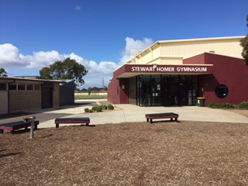
FRIDAYS: (Excluding getting to school, going home, lunch and snack)
On Fridays, two of my classmates and I have guitar lessons together. We also have guitar with someone from another class. Guitar lessons can be in any period, so we have to check our schedules to find out when it is.
Every single period on Friday is a double period. First up, we have double maths. Most of the time, we have tests on Friday. These two periods feel like they last forever…
After recess, we have PE, Physical Education. Our class is the only year seven class during those two periods, so we do warm ups with year 9 and 8 classes. During snack we get changed in the toilets. Others who don’t get changed during that time, get changed when we go into the gym. Before the classes split up and do their own things, we have a warm up together. During these warm ups, our class is usually invisible or targets. Before the bell rings, we get changed back into school uniform.
The last two periods are Japanese. Our classroom is F5. Japanese is one of my favourite subjects (I’m not sure why…). So far, we have learnt greetings, pets and describing them, business cards, classroom instructions and a few other things.
The gym where we do PE.
Part of the oval where we sometimes do sport.

Slide 18
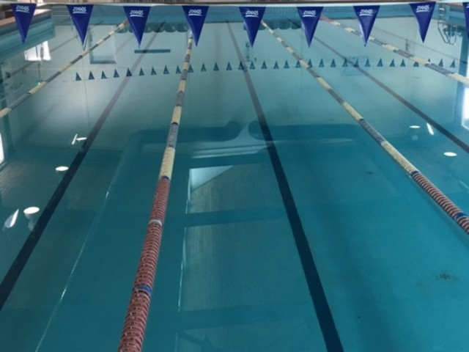
Extra Activities (after school)
WEDNESDAYS:
After school, my two brothers and I have tennis lessons. We play at Avondale Heights Tennis Club. In winter, it is dark and the lights have to be on.
FRIDAYS:
After dinner, we go swimming at East Keilor Leisure Centre. We have swimming on Tuesdays, Thursdays and Fridays. Our coach makes us swim for one and a half hour. After the main part we have time trials, when we try to beat our previous times and race each other. In spring, we have races where we try to beat each other, with the one with the best scores earning a trophy (I’ve already gotten it once!).
My tennis racket. My brother’s one looks the same, so I had to write my name on mine.
The swimming pool.

Slide 19
Dinner!
For dinner we usually have different things, but whatever we eat usually has rice or noddles with it. At dinner, I get to watch my brother stuff his face with food, and if I’m lucky, I sneak a book behind my bowl to read while eating. Before and after dinner I try to finish my homework. I try to finish it all as fast as I can, so I can watch videos on my laptop.
After dinner, sometimes I have to practice either piano or guitar for thirty minutes. I am in grade five for piano, after passing the exam for grade four (Before my older brother, I should mention…).
The piano that I practice on.

Slide 20
Sleep (and prepare to wake up early again)
At last, it’s night and we get to go to bed. My usual sleeping time is at 10. Well, I’m supposed to go to bed at 10, but I stay up until 11 in bed, reading (or just lying there). Before that, I eat apple, yogurt, and then drink milk. Afterwards I brush my teeth and dive onto my bed.

Slide 21
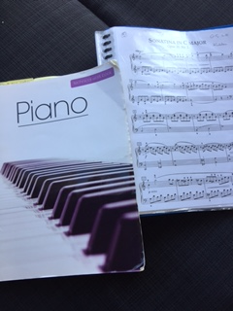
Saturdays (My least favourite day…)
In the morning, I wake up (You guessed it, I woke up EARLY, AGAIN.). But I wake up early for a reason. Two words: Tennis. Competition. On these days, I pray for rain, lots of it. I hope that there will be a washout and that I won’t have to play. Yet, it’s never happened. It rained on the way to the tennis club, but then it stopped (and started and stopped. Yes, it’s like it’s teasing me.). Currently, my team is on the bottom of the leader board. We’ve won ONCE. It’s kind of depressing, if you think of it that way.
After lunch, I have piano lessons, near my tennis club. It lasts thirty minutes, but feels like forever. After that I just have a regular day (The rest of the day is so relaxing after that…).
My two piano books. I am currently learning a song with five pages.

