Slide 1
Child Safe Standard 4:
Families and communities are informed and involved in promoting child safety
and wellbeing
“Where there is no guidance, a people falls but in an abundance of counsellors, there is safety.”
Proverbs 11:14
Reviewed: January 2026
Notes:
Add your specific school details

Slide 2

Acknowledgement of Country:
MACS Care acknowledges that MACS offices and Catholic schools in the Archdiocese of Melbourne are situated on the lands of the five language groups that make up the Kulin Nation.
In delivering the work of MACS Care, we recognise Aboriginal people of these lands as the first custodians, who have raised and nurtured Aboriginal children for tens of thousands of years, from before colonisation and from here after.
We further acknowledge the enduring care and cultural responsibility Aboriginal people have held for their children, families and the future generations to follow. In this we pay our respects to Elders past and present.

Slide 3


Agenda:
1:
  Background into Child Safe Standards
2:
  Exploration of Child Safe Standard 4:
  Application in a Catholic context
3:
  Group activity
4:
Minimum requirements and practical examples for your school
5:
  Second activity and CCYP video
6:
  Additional resources and information

Slide 4
Content Considerations:
Today’s training may include discussion related to child abuse and harm that may be distressing or uncomfortable. Participants are encouraged to look after themselves and are free to step out of needed and alternatively, support services and resources are available via MACS Employee Assistance Program (EAP), in addition to:
Sexual Assault Crisis Line – a service for anyone who has experienced past or recent sexual assault 1800 806 292​​
1800Respect – domestic, family and sexual violence counselling service 1800 737 732​​
Lifeline – mental health or crisis support 13 11 14​​
13 YARN – culturally safe and specific crisis support line 13 92 76​
Qlife – peer support and referral for members of the LGBTIQ+ community 1800 184 527

Slide 5
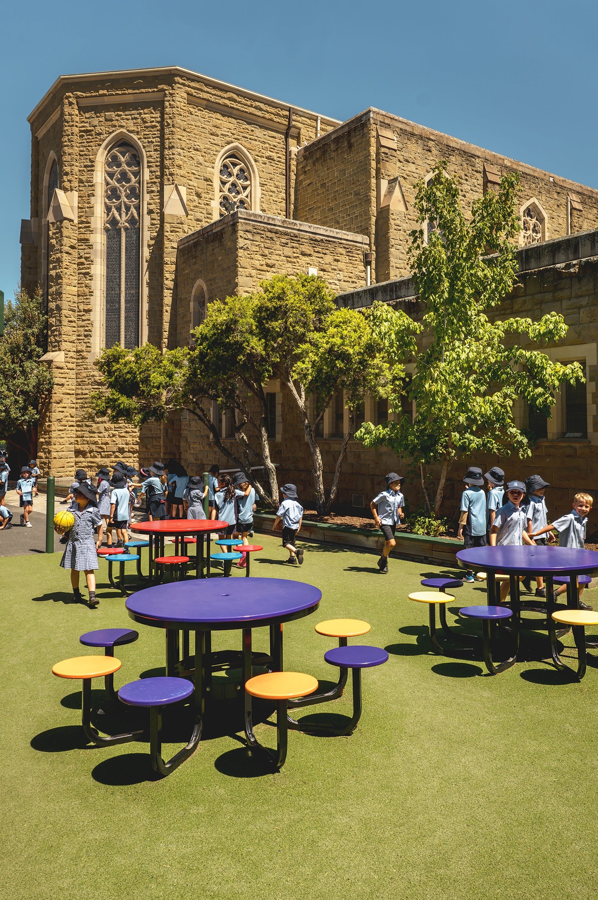
Background into the 11 Child Safe Standards
The 11 Child Safe Standards were expanded in 2022, noting the new standards provide greater clarity and practical steps required by schools to meet each standard as a legal obligation. ​
ALL Standards are mandatory.
This arose after numerous inquires conducted into child abuse such as the National Royal Commission into Institutional Responses to Child Sex Abuse and the Betrayal of Trust parliamentary inquiry in Victoria. These highlighted a need for better systems and processes to prevent and respond to child abuse. Schools cannot assume that child abuse does not and cannot happen within their school or school community. ​
​
The new standards aim to:
Promote cultural change​
Consistent practice ​
Ensure safeguarding
Let’s take a closer look at CSS4 and discuss..

Slide 6

What is Child Safe Standard 4?
Let’s take a deep dive into CSS4
“Families and communities are informed and involved in promoting child safety and wellbeing”
Children are safest when families, schools and communities work together. The Royal Commission into Institutional Responses to Child Sexual Abuse, along with the United Nations Children’s Fund (UNICEF) and a myriad of other accredited publications note that strong family, carer and community partnerships lead to early identification of risk, greater cultural
safety and inclusion, increased learning outcomes and stronger wellbeing.
When families, communities and schools don’t work in partnership, children
and young people may experience:
Feeling unsafe or unsupported
Lower sense of belonging
Inconsistent messages about safety and expectations
Reduced wellbeing and learning outcomes
Isolation and disconnection

Slide 7
Group Activity 1:

Slide 8

Activity: involving families and communities
In small groups discuss (5mins):
Why do you think it is important for families and communities to be informed and involved in promoting child safety and wellbeing?
How can Gospel values such as love, justice, and compassion guide the way we engage families in promoting child safety and wellbeing?
Activity: (10 mins):
What does involving families and communities look like?
How can we engage families and communities?
Why is it important to involve families and communities?
If time permits, select one person from the group to share your responses.

Slide 9
Minimum requirements of CSS 4:

Slide 10

In complying with Child Safe Standard 4 a school must, at a minimum, ensure:
4.1 Families participate in decisions affecting their child.
4.2 The organisation engages and openly communicates with families and the community about its child safe approach and relevant information is accessible.
4.3 Families and communities have a say in the development and review of the organisation’s policies and practices.
4.4 Families, carers and the community are informed about the organisation’s operations and governance.

Slide 11
In practice:

Slide 12


Families participate in decisions affecting their child
4.1:
Surveys
Run termly or semester feedback surveys to gather parent/carer input on school programs, safety initiatives, and classroom experiences. Summarise results to inform decisions. Share the results with the school community.
Share your MACSSIS data!
Co-Design Plans
Where possible, invite families to co-develop Individual Learning Plans (ILPs), wellbeing plans, or behaviour support plans, with clear goal-setting and regular review meetings.
Ensure school pro-formas for these plans have space for family consultation.
Is there an ongoing agenda item dedicated to child safety on your parent/carer advisory groups or equivalent?
Dialogue
Hold structured parent-teacher-student meetings where families can discuss learning progress, wellbeing concerns, and safety needs, and document agreed actions.
Advisory Groups
Form family/carer advisory committees to provide input on upcoming programs, policies, or school projects, ensuring representation from diverse cultural and linguistic backgrounds. Consider translators to create greater opportunity for participation.

Slide 13

The organisation engages and openly communicates with families and the community about its child safe approach and relevant information is accessible
4.2:
Clear Information
Provide clear child safety information in multiple formats. Ensure translated copies are available online and in-person in languages other than English.
Accessibility
Ensure materials are accessible and culturally appropriate. Consider if there are groups within your community that would benefit from having communication translated into languages other than English and/or translators at information sessions
POLICY
Ensure your public facing policies and procedures are publicly available and easy to locate for all relevant community groups. E.g. school website, newsletter, etc.
Child Safety & Wellbeing Policy
PROTECT Protocols
Code of Conduct (Staff, Child Safety, Parent/Carer)
Behaviour Management Policy
Updates
Regularly share child safety initiatives and successes. Consider a dedicated Child Safe Newsletter Section. Send updates about initiatives.
If families or communities wish to raise a concern related to child safety, are they clear on where to go?
E.g., electronic AND paper-based forms
Notes:
Show of hands?

Slide 14
Families and communities have a say in the development and review of the organisation’s policies and practices
4.3:
Policy Committees
Invite parents and carers to sit on review panels for anti-bullying, inclusion, digital safety, and child safe policies, ensuring diverse perspectives are included.
Consultation
Conduct focus groups or online consultations for families and local community members when drafting new policies, with clear feedback loops explaining how input will be used.
Workshops
Organise policy co-design sessions where families and staff collaboratively examine draft policies, discuss scenarios, and recommend amendments.
Responsive Policies
Review and revise policies annually based on feedback, survey results, incident trends, or community input, and communicate changes back to families clearly.
Use the ‘Engaging Families in Child Safety Procedures’ document to support you.

Slide 15
Families, carers and the community are informed about the organisation’s operations and governance
4.4:
Forums
Host community information evenings or open-school forums where families can ask questions, observe school processes, and provide suggestions.
Feedback Channels
Provide multiple, accessible channels for families to raise concerns or suggestions (email, online forms, meetings), with clear timelines and follow-up procedures.
How might you connect with families or communities with limited IT and computer literacy?
Roles
Share a clear organisational chart and contact list so families know which staff and leadership roles are responsible for child safety, wellbeing, and governance oversight. ​
Reports
Publish a plain-language annual report or “Child Safety Snapshot” including governance decisions, child safety initiatives, key outcomes, and upcoming priorities.

Slide 16
Group Activity 2

Slide 17

Activity 2: A Call to Action
“Think, Share, Act”
Think (2–3 minutes): Each staff member writes down one thing they learned about CSS 4 and one idea for how they could involve families more in promoting child safety and wellbeing.
Share (5 minutes): In pairs or small groups, staff share their reflections.
Act (3–5 minutes): Each group identifies one practical step they could take in their classroom, year level, or role to engage families and communities.
Optional Sharing: A few groups share their ideas with the whole staff (if time permits)

Slide 18
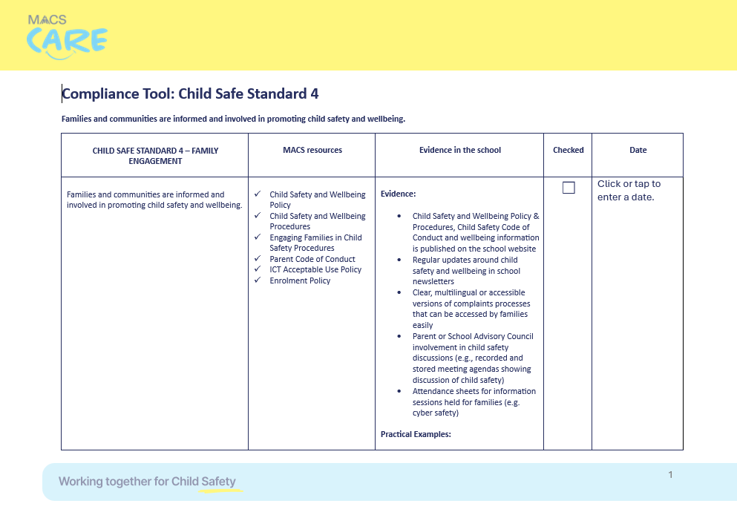
CSS 4 Compliance Check In:
Does your school:
Have an active and up to date Parent/Carer Advisory Group
Have policies and procedures publicly available and widely accessible for families and communities
Implement strategies to engage families and communities and keep them informed where English may be a second language, or experience challenges reading and writing
Include standing items about child safety in parent/carer newsletters
For more details on these items and more, please use the provided Compliance Toolkit for CSS 4.

Slide 19
CSS4 Video (time permitting):

Slide 20

CCYP Video: An overview on CSS4
Notes:
Child Safe Standard 4 - An overview

Slide 21
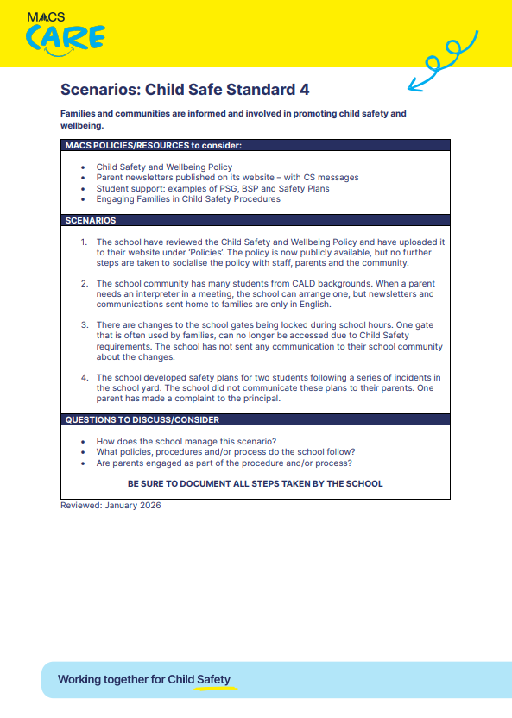
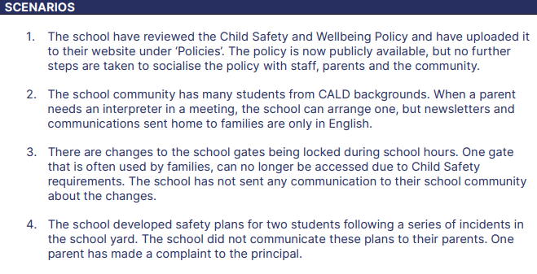
Optional:
Realistic school-based scenarios, related to each of the Child Safe Standards.
Access now via the MACS Care microsite under each Child Safe Standard.

Slide 22
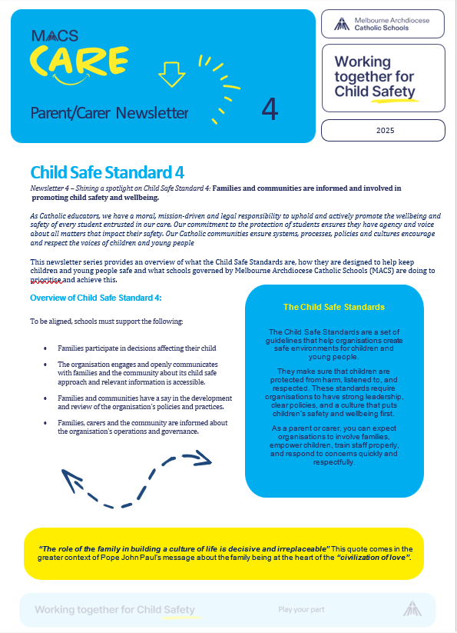
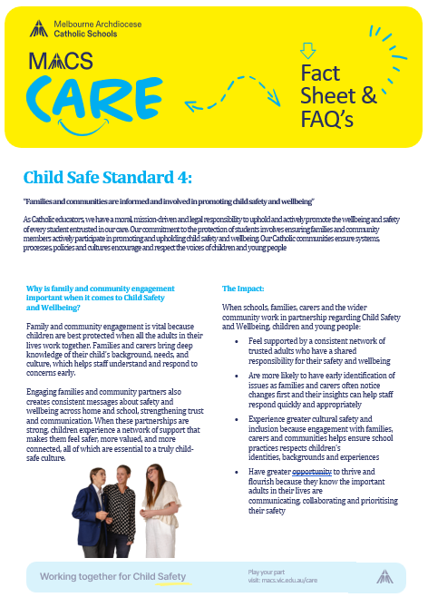
Additional Resources:
The MACS Care microsite provides additional templates for CSS4 and helpful websites under the ‘Discovery Zone’ tab!
TIP: Use the MACS Care Parent/Carer newsletter (left) to engage families and communities in relation to child safety within your context.

Slide 23

Loving God, strengthen the bond between our school and the families who share in the care of every child.
Guide us to communicate openly, listen deeply, and work side by side to protect their safety and wellbeing.
May our partnership grow in trust and unity, creating a community where every young person is cherished and supported.
Amen.
Closing Prayer:

