Slide 1

Year 10 Product Design & Technology
Fusion 360

Slide 2
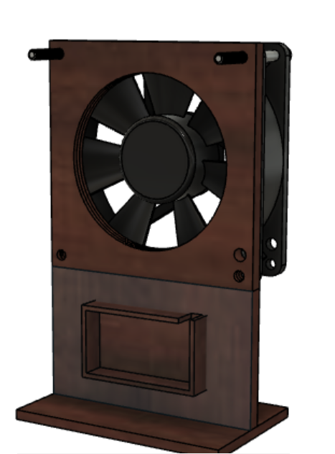
Fan holder by Zach MEAKIN

Slide 3
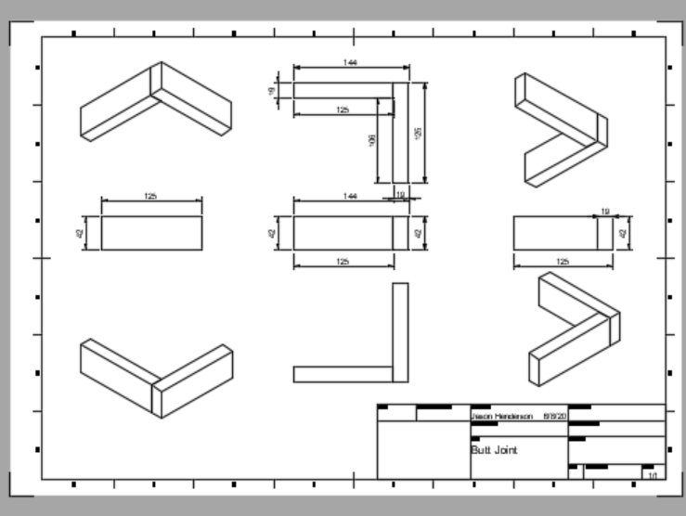
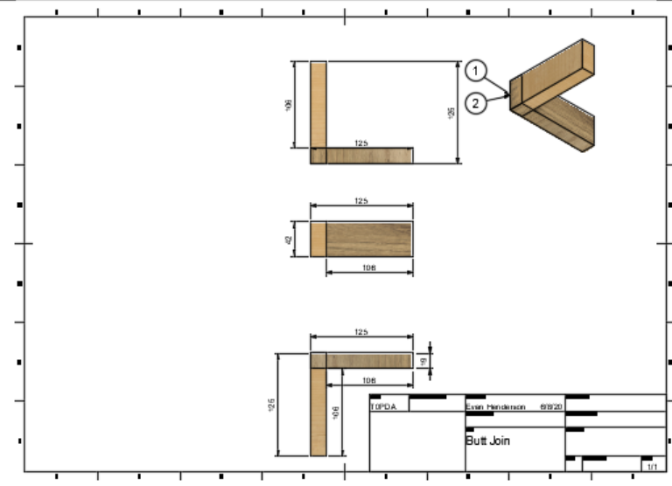
Working drawings by
Even Henderson
Jason Henderson

Slide 4
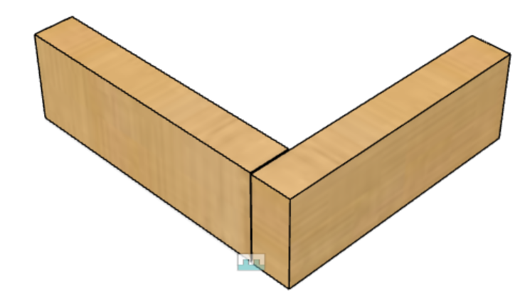
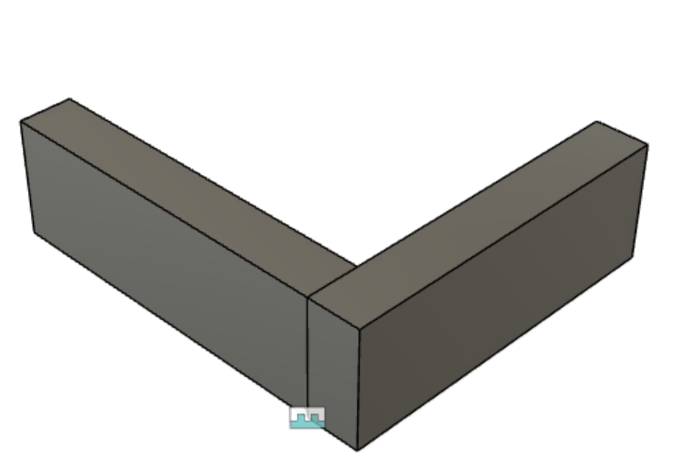
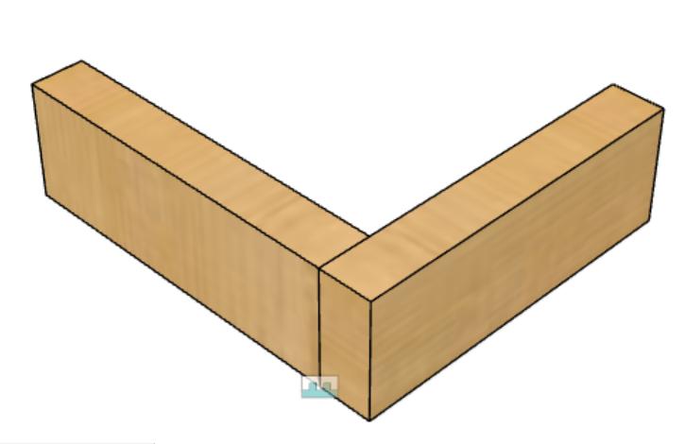
Butt joint by:
Izayah Howson
Dylan Bailey
Connor Weetman

Slide 5
Year 9 Product Design & Technology
Fusion 360 – 3D modelling

Slide 6
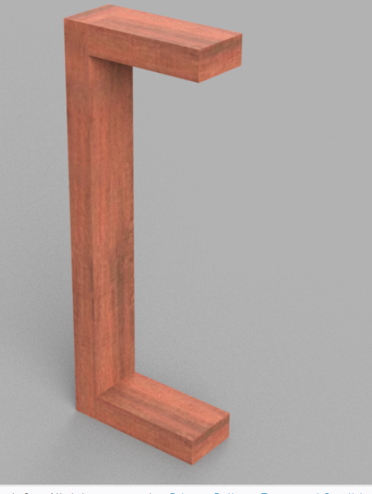
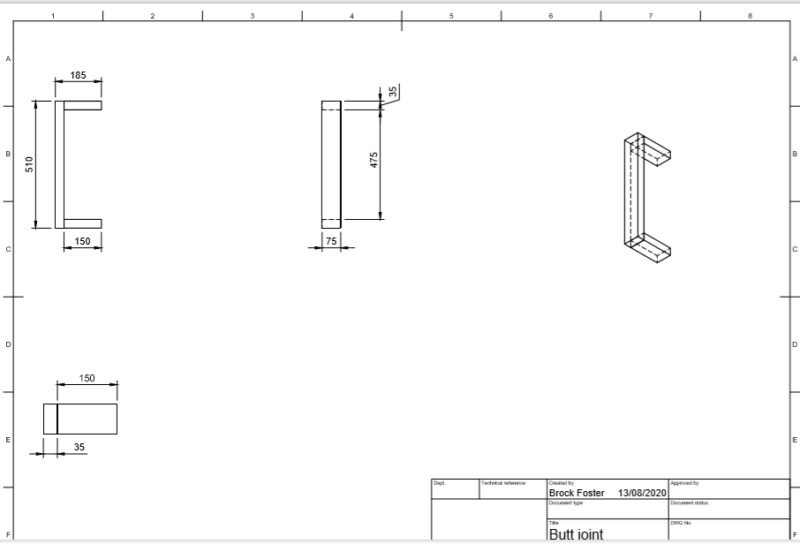
Fusion 360 skills by
Brock Foster

Slide 7
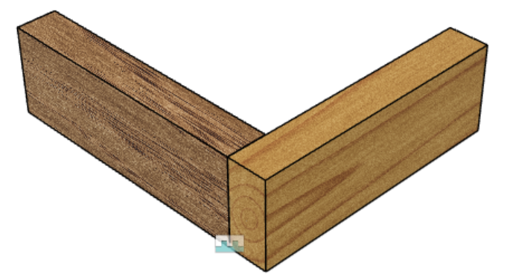
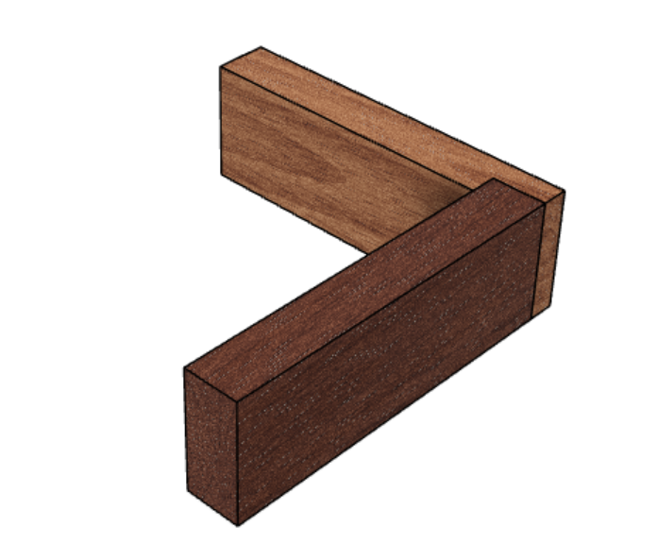
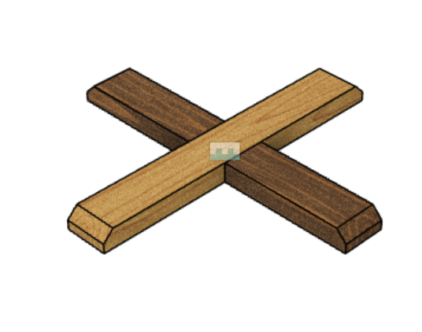
A range of wooden joints by Aleana SAAB

Slide 8
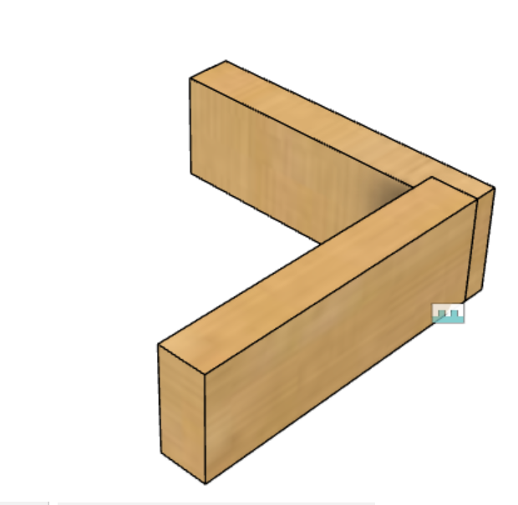
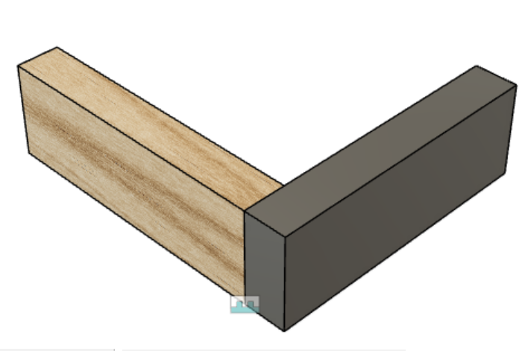
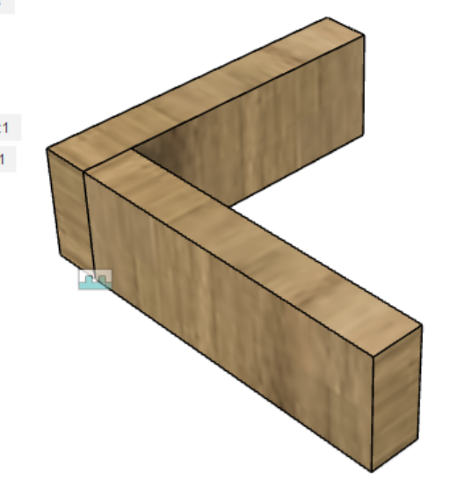
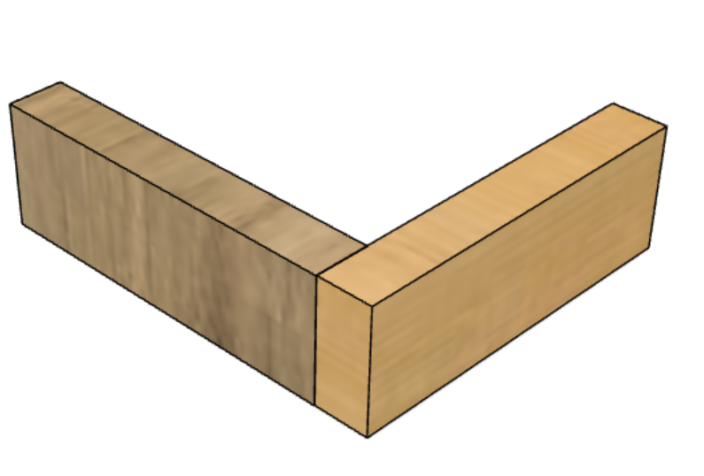
Butt/rebate joints on Fusion 360 by :
Jake McMillan
Tulio Tapper
Elijah Keam
Luke Marshmen

