Slide 1



^{UNDERSTANDING THE ATAR}
MR KLUSKE
Deputy Principal
Learning and Teaching
YEAR OF COMPASSION 2024

Slide 2
^{UNDERSTANDING THE ATAR}
Before we even try to understand the ATAR – how do you qualify for an ATAR?
You must achieve study scores in at least 4 Unit 3/4 VCE studies, and one must be English.
So those of you here tonight who are in Year 11 but undertaking a Unit 3/4 study sequence will not qualify for an ATAR this year.
YEAR OF COMPASSION 2024

Slide 3
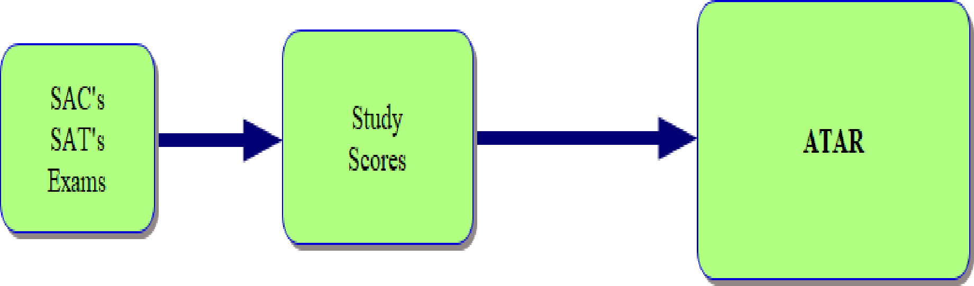
In its most simple form, the below graphic explains how the ATAR happens.
Of course, it’s not that simple, and you need to understand that there is a bit more to it.
YEAR OF COMPASSION 2024

Slide 4
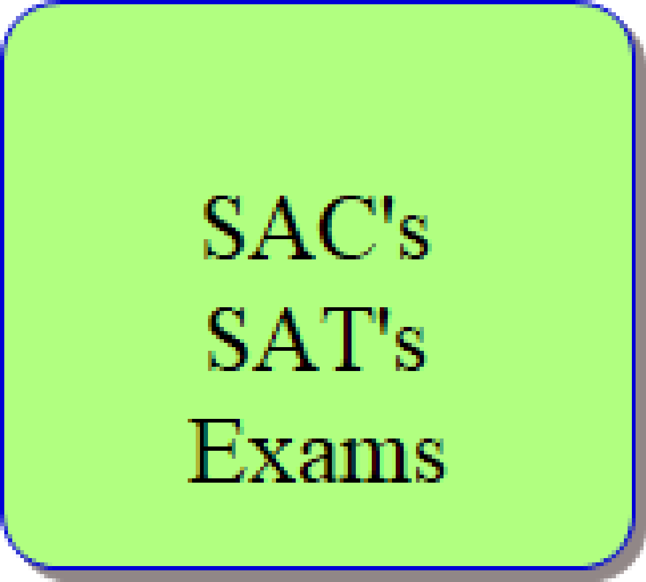
Let's look at Box 1 from the previous graphic – SAC’s, SAT’s, Exams.
Each VCE Unit 3/4 sequence of subjects will have, at the very least, School Assessed Coursework (SAC’s) and Exams that contribute to your study score. Some subjects will also have School Assessed Tasks (SAT’s).
At the end of your Unit 3/4 sequence, you will receive a study score between 0 and 50 (for each subject) based on your SAC’s, Exams (and SAT’s if included).
YEAR OF COMPASSION 2024

Slide 5
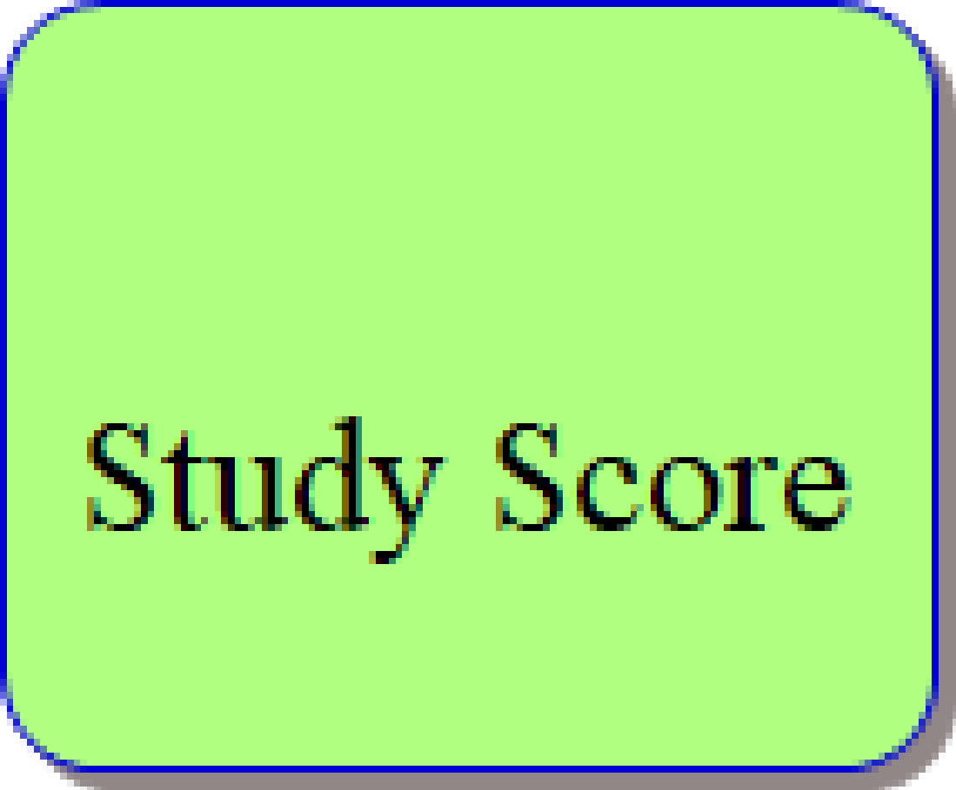
However, before your study scores are used to create an ATAR, there is “scaling” of subjects.
YEAR OF COMPASSION 2024

Slide 6
Every year, the scaling for each subject is slightly different, but it doesn’t usually change too much. Some subjects like Specialist Mathematics always scale up, so if your raw score in 2023 were 30, your scaled score would be 43. If your raw score were 35, your scaled score would have been 48. Other subjects like English, don’t scale much at all, while some subjects like Further Mathematics, actually scale down, so if your raw score in 2023 were 30, your scaled score would have been 27.
This is meant to balance the fact that some subjects are harder than others to do well in.
YEAR OF COMPASSION 2024

Slide 7
Some subjects, like Languages other than English, are given extra scaling because the government wants to give students an additional incentive to study them (in this case, so that we can do business etc., with people from overseas who don’t speak English).
So, a raw score of 25 in Italian in 2023 would have given you a scaled score of 32, and a study score of 30 would have given you a scaled score of 37.
YEAR OF COMPASSION 2024

Slide 8
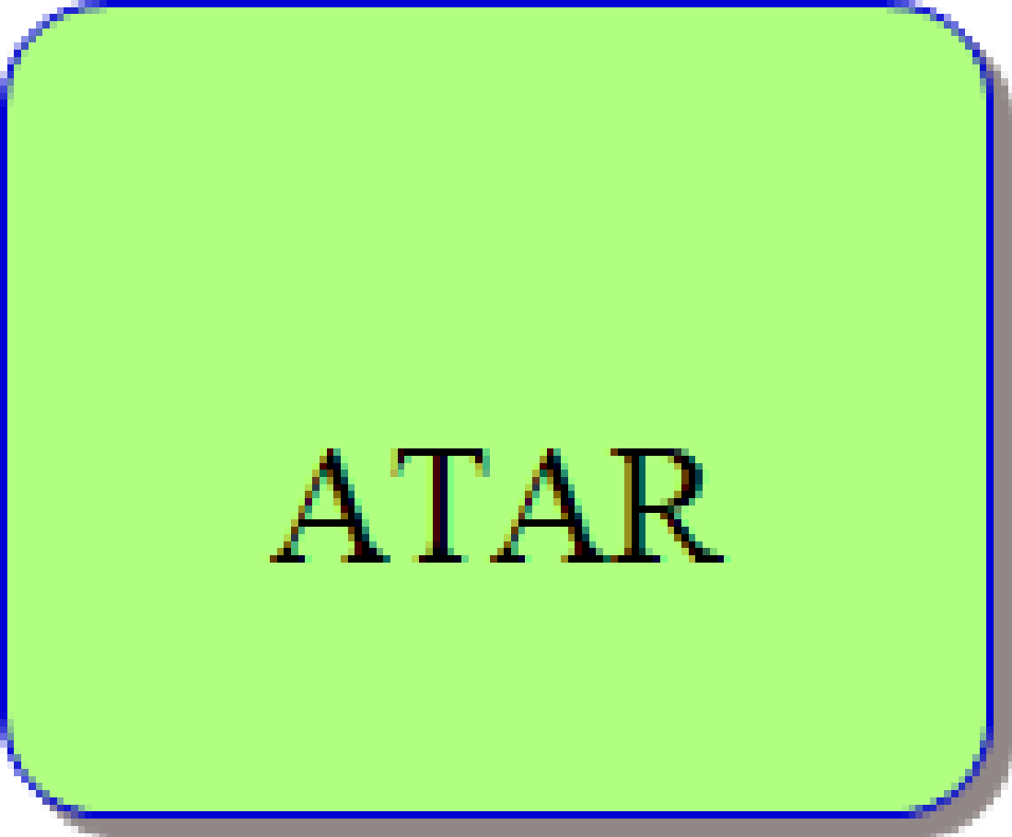
So once your scaled scores for all Unit 3/4 sequence subjects are worked out, including any that you completed in Year 11, your English score plus your next best three scaled scores are added together plus 10% of any additional Unit 3/4 sequence (up to another 2) to create what is called your aggregate.
Each student is then ranked against every other student in Victoria, and your ATAR is this rank.
YEAR OF COMPASSION 2024

Slide 9
Year | Study | GA1(Unit 3) | GA2 (Unit 4) | GA3 (Exam) | Study Score | Scales Score | 2022 Aggregate Contribution
2023 | English | A | A | B | 35 | 34 | 34
2023 | Vis Comm & Design | A+ | A+ | A+ | 40 | 38 | 38
2023 | General Mathematics | A+ | A+ | A+ | 40 | 38 | 38
2023 | Psychology | A | A+ | A+ | 40 | 39 | 39
2023 | Health & Human Development | A+ | A | A | 35 | 31 | 31 (3.1)
2022 | Dance | A | D | B+ | 30 | 28 | 28 (2.8)
Aggregate |  |  |  |  |  |  | 154.9
2023 ATAR (Rank) |  |  |  |  |  |  | 89.9

Slide 10
The ATAR is reported as a number between 0.00 and 99.95 with increments of 0.05. A student with an ATAR of 75.00 has achieved VCE results above 75% of the population of the relevant age group.
So, the Australian Tertiary Admissions Rank is a number between 0 and 99.5 that tells you where you rank against all other Year 12 students in Victoria – you are effectively in a big competition with all the other 52,000 Year 12 students in the state.
YEAR OF COMPASSION 2024

Slide 11
The ATAR allows tertiary institutions to competitively rank students who have completed different combinations of VCE studies. It is calculated by VTAC solely for use by institutions for admission to tertiary studies.
YEAR OF COMPASSION 2024

Slide 12
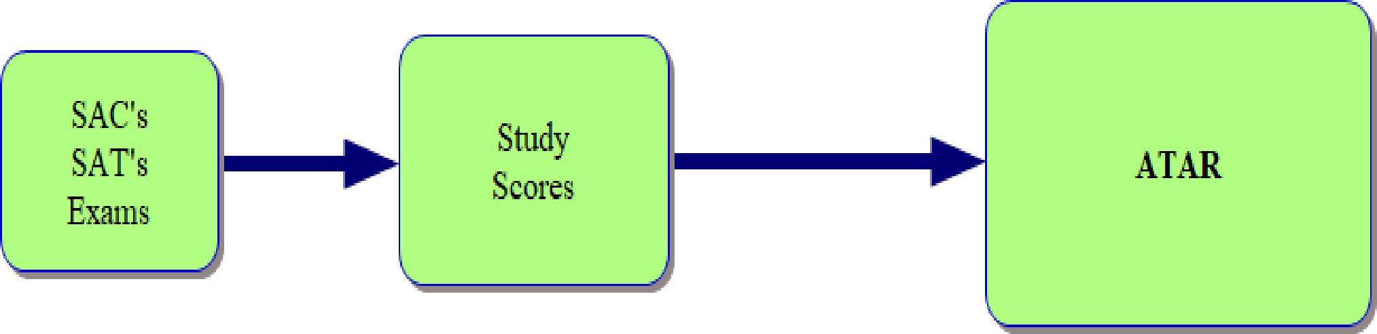
^{SUMMARY}
Your SAC'S, SAT’s and Exams become your study scores (raw then scaled).
Which are added together to become your aggregate.
Which is used to create your ranking (ATAR).
YEAR OF COMPASSION 2024

Slide 13
^{ATAR CALCULATORS}
Using an ATAR Calculator can be a way of indicating the approximate level at which you would need to perform in all of your subjects to get your desired or required ATAR to gain direct entry to your course of study.
https://atar-calculator.deakin.edu.au/
https://vce.atarcalc.com
YEAR OF COMPASSION 2024

Slide 14
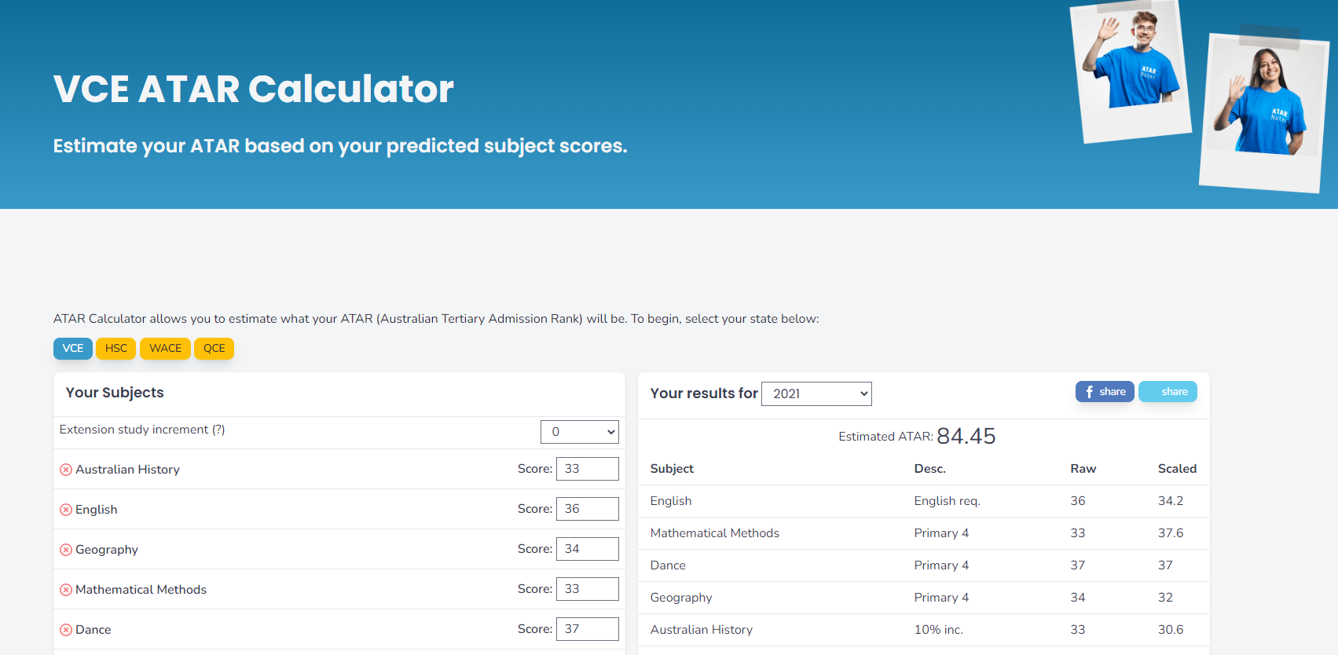
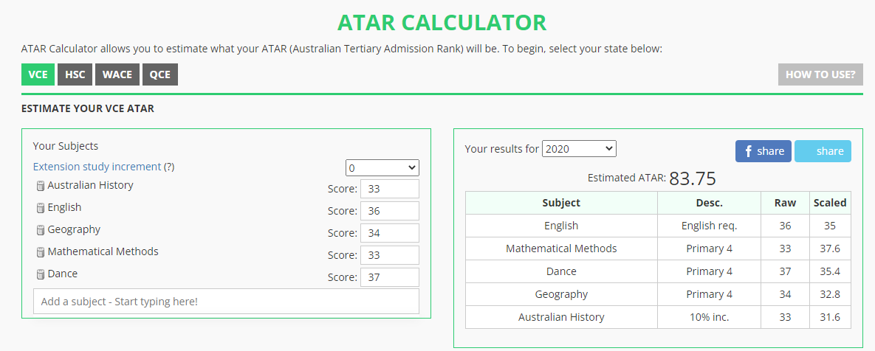
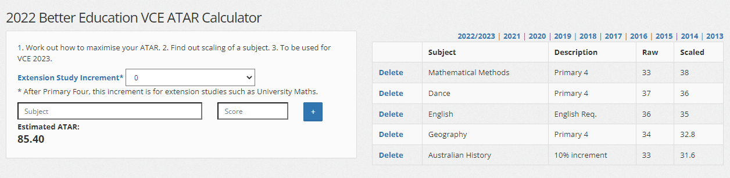

Slide 15
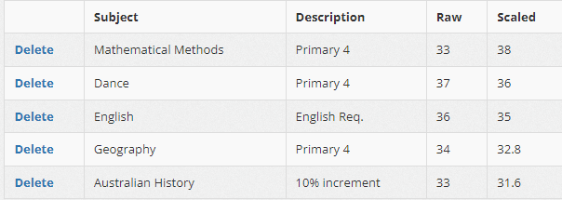


Slide 16
There are many different “ATAR Calculators” available online, but these are only a guide. These only give an indication of the required level of performance based on data from the previous year.
It is important to bear in mind that the ACTUAL ATAR in any given year is a direct product of the level of performance of the Year 12 cohort nationwide in that year.
The only “Official ATAR” is that provided by VTAC in any given year.
YEAR OF COMPASSION 2024

Slide 17
^{REMEMBER}
The ATAR:
Is not a grade! Is not a mark! It is a rank!
An ATAR of 50 does not indicate a pass - everyone who receives an ATAR has passed the VCE.
The ATAR is not a reflection of you as a person - it is simply a rank that Tertiary Institutions use to enter some of their courses. The ATAR is just one of many criteria and factors considered as part of the selection process for these Tertiary Institutions.
YEAR OF COMPASSION 2024

