Slide 1

Parent Information Session
Year 5/6

Slide 2
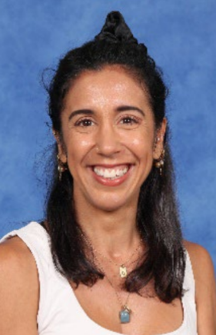
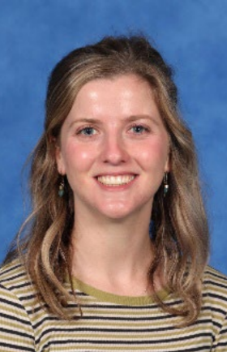
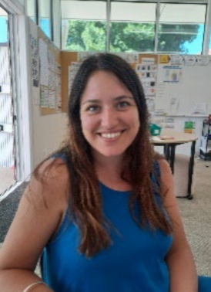
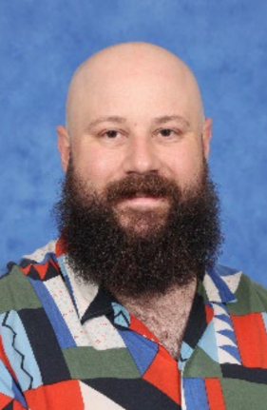
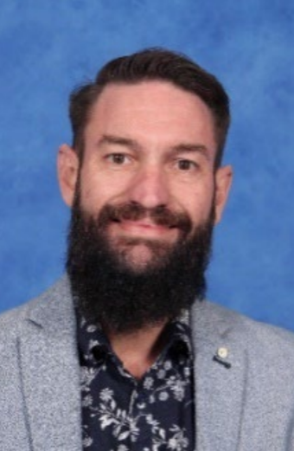
Team 56
Clara
Kaya
Flor
Simon
Graeme

Slide 3

Communication Flowchart
Teachers
The teachers are the first point of contact. Contact for day to day questions, updates or concerns.
Learning Community Leader
Contact LCL when requiring further support. This may include, setting up formal meetings, wellbeing, targeted support.
If the issue has not been resolved at the previous levels, or if it involves a school-wide concern (e.g., bullying, major academic challenges, safety), the Principal or Assistant Principal should be contacted.
Principals

Slide 4





The Learning Community Leader
Learning Community Leaders primary role is to Build Effective Professional Learning Teams that support and develop the teachers and students within their team.
Running morning
Writing/ Maths programs (with teachers)
Leading Newlands Planning Model in all subject areas
Visibility in cohort classrooms and supporting teachers with individual students when needed
Mentoring and coaching classroom teachers
Before & After school yard duty ensuring visibility to Parent Cohort Community
Notes:
This year, we’re excited to introduce Learning Community Leaders who are now assigned to each cohort, making things even more connected and collaborative! In the past, we had subject-based leaders like the Literacy Leader or Numeracy Leader, but these roles sometimes felt a little disconnected from the classroom. With our new approach, the focus is all about building stronger relationships and creating a more hands-on impact in coaching, mentoring, and supporting both teachers and students. It’s all about teamwork and making learning even more exciting!
In 2025, our goal is all about tapping into the strengths of each team and individual teachers, facilitating planning sessions for greater impact, and really focusing on the unique needs of each cohort. Our Learning Community Leaders are at the heart of this mission, building strong teams, running our before school writing and math programs (along with other passionate teachers), and leading the Newlands Planning Model across all subjects.
They’ll be in the classrooms, supporting teachers, and working side-by-side with them through mentoring, coaching, and collaborative teaching. It’s all about making sure both teachers and students thrive and grow together!

Slide 5
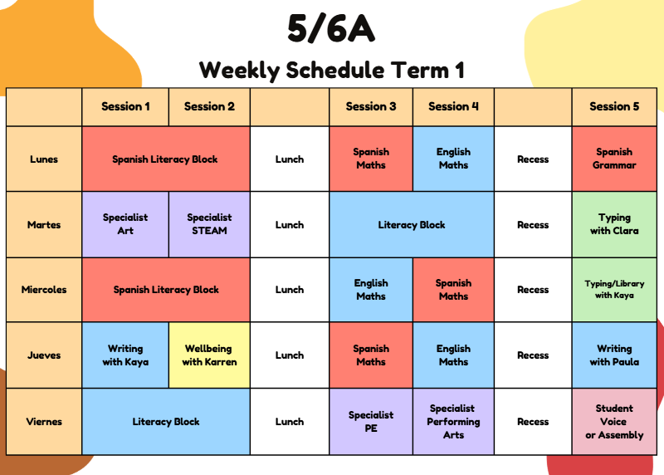
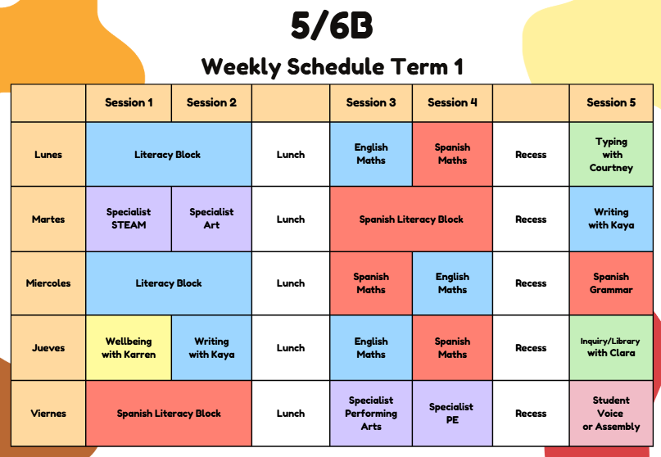
56AB Master Weekly Timetable
Snack time is at around 10.00. Please, fruit and veg only!

Slide 6
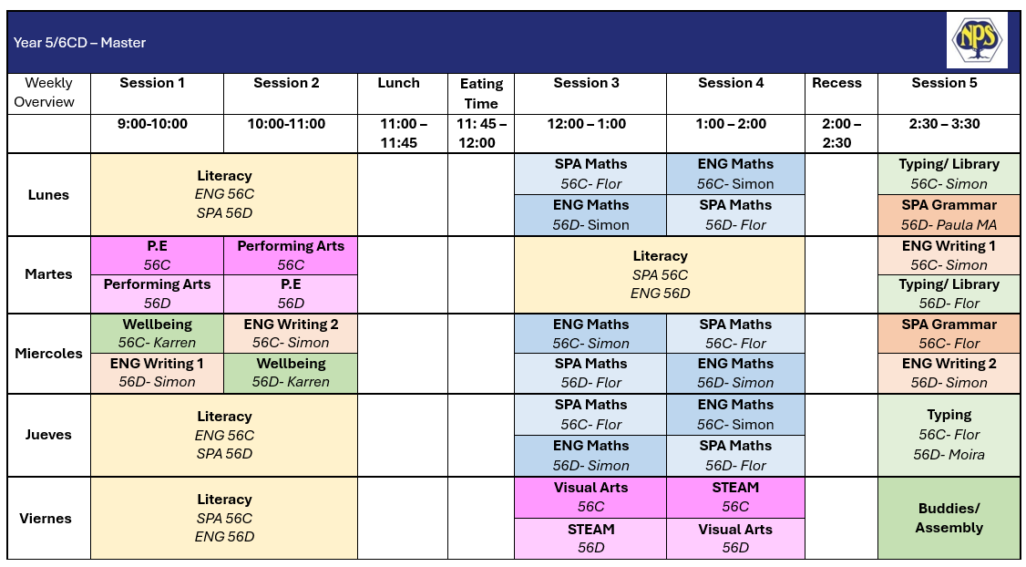
56CD Master Timetable

Slide 7
Soft Start
8.50 – 9am students enter learning space.
It´s an opportunity to have informal conversations and quick check-ins with teachers.
Students are expected to walk into the classroom, put their bags away and read in silence until 9.00.
Once the bell goes, students put their books away and get their Facts on Fire sheets ready.
After FOF, we start with Circle Time where we go through the day, special events in the week, we check in with each other.
Start of the lesson.

Slide 8
Groupings
We have fluid groups in the 56 area.
Next term, we might shuffle groups within learning spaces.
Students have the opportunity to work with different classmates.
Tiered model for Maths in Term 2 will also mean our students are re grouped to target their individual needs.

Slide 9

Laptops and personal items
Students are expected to charge their laptops at home.
Students have already signed an ICT contract and an ICT code of conduct.
Gadgets are allowed but if they are not being used appropriately, students will be asked to put them in their bag.
We are currently using a program called Typing Club which the children are welcome to use at home.

Slide 10
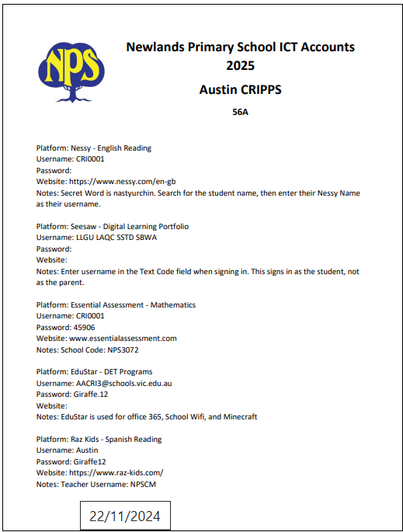
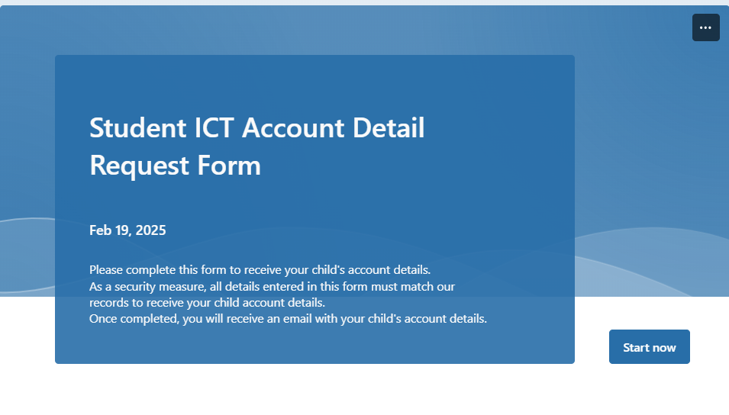
Student ICT Account Details
Student ICT account details are emailed at the start of each school year.
You can also request your child’s account details by completing the Student ICT Account Details Form on the school's website.
Please contact the classroom teacher if you are having trouble signing in to any platforms.

Slide 11

Home Learning- Writing
Teachers will assign persuasive and narrative prompts on Elastik as homework.​
It is expected that students will engage in writing for an hour a week at home. This could be the production of a text each week, or work towards a text that students work on for a prolonged period.
Students are encouraged to engage in writing of many genres and text types.​
Teachers will check these activities periodically to process feedback. ​
Please message Simon or Kaya if your you'd like feedback processed sooner or additional prompts to be assigned.​
Used in school to determine cohort and student learning needs.
Used in school to support academic judgements.
Provides personalised feedback in 10 different dimensions of Writing.
Utilizes rubric-based assessment so students can see their next steps.
Aligned to NAPLAN and soon to be aligned to Victorian Curriculum also.

Slide 12

Home Learning- Mathematics
Students are expected to engage in 'My Numeracy' on Essential Assessment for 1 hour a week.​
Teachers will assign assessments topically matched to the Mathematical concepts that are being learned at school​.
Assessments are to be completed at home with support from parents only for language.​
Once assessments are completed, Essential Assessment provide goals and supportive activities for students work on through 'My Numeracy'.
Used in school to support academic judgements
Provides responsive and targeted learning goals
Provides supportive activities matched to goals, Victorian Curriculum, and Mathematics Proficiencies

Slide 13

Home Learning- Reading
Reading
Students are expected to read at home 20 – 30 minutes every day.
Parents are strongly encouraged to talk with their child about the texts they are reading as well as read to and with their child.
Each class visits the library once a fortnight on even weeks
  56C- Monday
  56D- Tuesday
  56A- Wednesday
  56B- Thursday

Slide 14
Parent Helper Program
Expectation:
Support students by listening to them read. No teaching required—just encouragement! If comfortable, ask simple comprehension questions. This term, we may ask you to read our class novel Can You See Me to give students some extra exposure to that text (and it's a great book!)
Logistics:
Teachers will provide you with a list of students to work with and books will be provided.
Routine:
Arrive at the office to sign in. Meet us in the classroom and we will set you up in our break-out spaces.
Thank you! Your time makes a huge difference in building student confidence and reading fluency. We truly appreciate your support!

Slide 15
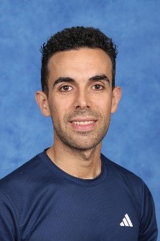
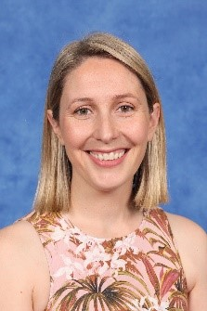
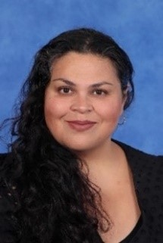
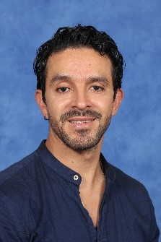
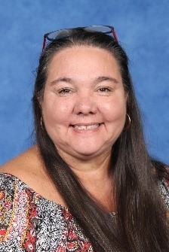
Specialist Team
Raul
Raema
Margaret
Felipe
Karren

Slide 16






Specialists
Specialist teachers can be messaged on Sentral
Specialist Program: HPE, STEAM, ART, MUSIC and Wellbeing
Whole School Events
Interschool Sports Competition – timetable changes
 | Tuesday |  | Friday |  | Wednesday | Thursday
 | 9-10 | 10-11 | 12-1 | 1-2 | 9-10 | 10-11
Clara | ART | STEAM | HPE | MUSIC | WELLBEING
Kaya | STEAM | ART | MUSIC | HPE |  | WELLBEING
Simon | HPE | MUSIC | ART | STEAM | WELLBEING
Florencia | MUSIC | HPE | STEAM | ART |  | WELLBEING
Notes:
🔵 Health & Physical Education (HPE) – Encourages students to stay active, develop movement skills, and learn about their bodies. Through fun games and sports, we promote teamwork, well-being, and healthy habits for life.
🟢 STEAM (Science, Technology, Engineering, Art & Mathematics) – Students explore science and technology through hands-on experiments, coding with robots, and designing creative solutions. Art is integrated into their projects, fostering innovation and problem-solving.
🎨 Visual Arts – Students express themselves through different mediums like painting, drawing, clay, sculpture, and textiles. They learn about famous artists, art movements, and showcase their work around the school, with a Biannual Art Show in October.
🎵 Music & Dance – Focuses on foundational music skills through instrument practice, group collaboration, and cultural exploration. Younger students explore sound contrasts (loud/soft, high/low), while older students build on their musical creativity and expression.
💛 Wellbeing – Helps students develop resilience, positive self-talk, and coping strategies. Using programs like the Resilience Project and Berry Street, we engage in fun activities and teamwork to build confidence, kindness, and emotional strength.
🔵 HPE – Keeps students active while building movement skills, teamwork, and healthy habits through fun games and sports.
🟢 STEAM – Combines science, technology, coding, and design with hands-on experiments and creative problem-solving.
🎨 Art – Explores painting, drawing, sculpture, and textiles while learning about artists and showcasing student work.
🎵 Music & Dance – Develops musical skills through instrument practice, group collaboration, and creative expression.
💛 Wellbeing – Focuses on resilience, confidence, and emotional strength through engaging activities and teamwork.
EVENTS
Term 1: Ride2School Day, Specialist Day Celebration. Term 2: Colour Run. Term 3: Athletics Carnival. Term 4: Art Show, swimming program (explain this year the swimming program is only for year 6s)

Slide 17

NAPLAN
Wednesday 12th March
Writing Year 5 - 11:15
Thursday 13th March
Reading - Year 5 - 11:15
Monday 17th March
Language Conventions
Year 5 - 11:15
Tuesday 18th March
Mathematics
Year 5 - 11:15
All students are encouraged to participate in NAPLAN.
If families want to withdraw their child, please send an email to the school.
Week 6 – Student will participate in NAPLAN Practice Tests – If you have withdrawn your child, they will not participate in the practice tests.

Slide 18
Buddies Program
Foundation and Year 6s
It´s starting today!
Each student in the 56 cohort will have buddy or group of Buddies.
We will get together every other Friday and do a range of activities.
The main purposes are to develop our 56 students' leadership skills and to foster a sense of belonging among the Preppies.
It also gives them confidence to have a familiar face in the playground and someone they can turn to.
It is very heartwarming to see the little ones running towards and hugging their big buddies :)

Slide 19
Year 7 Transition
Beginning of Term 2, you will be sent a form to complete with your 1st, 2nd and 3rd preference for High School.
Forms will be sent to your 1st preference and you will be notified by us whether your child has been accepted or whether a application will be sent to your second preference.

Slide 20

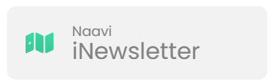


School / Parent Communication
  School Communication
  Payment and Permissions
  Absence Management
  Notifications and Notices
  Parent/Teacher Interview Booking.
  Access to School Calendar
  Semester Reports
  Published weekly (Friday)​
  Essential school-based communication​
  Upcoming events, classroom news, community news, school initiatives and ensures families stay up to date with essential and current happenings at Newlands.
Ensure urgent/timely communication via the office
  Payment and Permissions
  Absence Management
  Communicate medical/health care plans
  Visibility into learning experience to support and celebrate learning.
  Assessment posts/recording.
Notes:
Sentral -
School Communication: Send and receive messages from your child’s homeroom, specialist teachers, and LCL
Payment and Permissions: Provide permission and make payments for camps, excursions, and incursions.
Absence Management: Easily communicate and respond to unexplained absences, as well as submit future absence requests.
Notifications and Notices: Receive timely notifications for community events, absence alerts, and school notices sent directly to your device.
Parent/Teacher Interview Booking.
Access to School Calendar: View and sync the school calendar with your phone to keep track of important dates and events.
Semester Reports: Stay informed by viewing your child’s individual learning plans and end-of-semester reports.

Slide 21

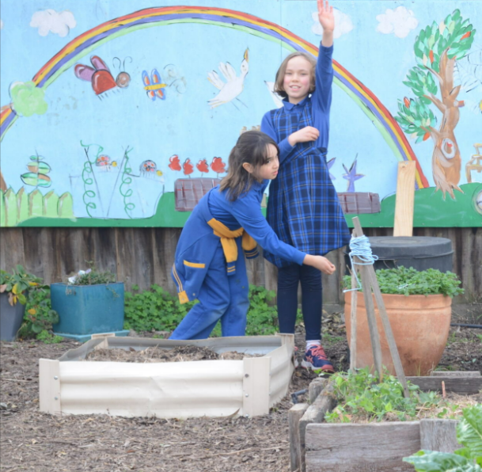
Uniform, Hats and
Lost Property
Lost Property
Located in c block outside the STEAM classroom.
Hats
Hats are compulsory to wear in term 1 and 4. We are setting up a Wellbeing hub where students can go if they don't have a hat.
Uniform
Ensure all uniform/ personal items are clearly labelled

Slide 22
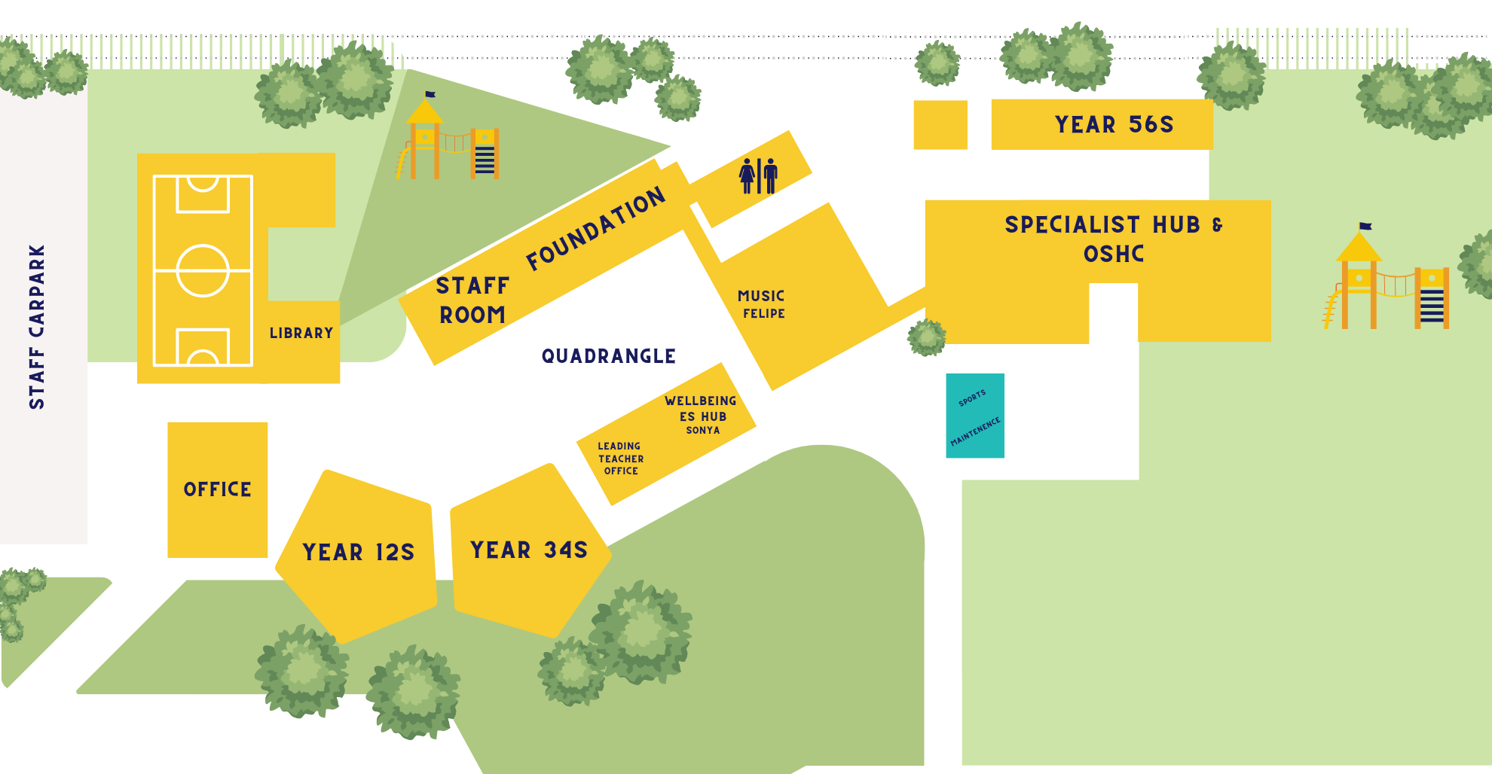
Play Areas
Out of Bounds

Slide 23
Attendance
Student Late Arrivals
Students that arrive at school later than 9:15 am, must sign in at the office. If a student arrives between 9:00 and 9:15am are to be marked as present by the classroom teacher.
All students who are late to school or are collected early are required to sign out at the office.
If your child is leaving early, we ask that it not between 3:00- 3:30 or during playtime.

Slide 24


Reporting / Parent Teacher Interviews
Termly Parent Teacher Interviews
Reports published Semester 1 and Semester 2
Alternate between Spanish and English teacher
Term 1 with both teachers​
Term 2-4 with one teacher

Slide 25





Camps, Excursions and Incursions
  Term 1
  Term 2
  Term 4
Week 9 – 26th March
Week 1 – 6th – 9th October
Week 4 – Week 8 - Fridays
Term 3 - TBC

Slide 26
Local Excursions / Photography
A Permission Slip has been published on Sentral to obtain consent for all local excursion and photography that may take place in 2025.​
If you do not want to give consent for local excursions, please indicate this on the Sentral Permission Slip. ​
Local excursions may include walking local kindergartens, parks and community spaces. ​
Parents and Caregivers will be notified of any upcoming local excursion beforehand. ​
You may withdraw consent for local excursions at point in the year by calling the school on (03) 9354 2928 or emailing the school at newlands.ps@education.vic.gov.au.

Slide 27
Community Events
NAPLAN week 7 and 8
Parent teachers interview Friday 28th March
School photos March 31st
Cultural week assembly 4th April 1:30 –2:30
Bilingual Fiesta 4th April 3-6
Last day of the term 4th April School finishes at 2:30

Slide 28
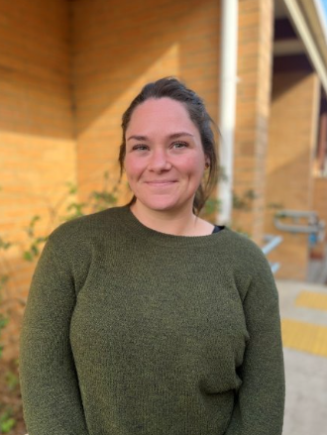
Outside of School Hours Care
Newlands Primary School offers a nationally accredited before and after school care program.
Care is provided from 7:00am until 8.50am each day, and until 6:00 pm after school from Monday to Friday.
OSHC Phone Number: 0491 273 710
You are able to book in advance for the whole term, or book in casually.
Registrations are be completed online. The link can be found on our website.
Most families are eligible for a fee reduction through the child care subsidy system.
Example Activities: Arts and craft, sport, cooking, relaxation and quiet corners.

Slide 29

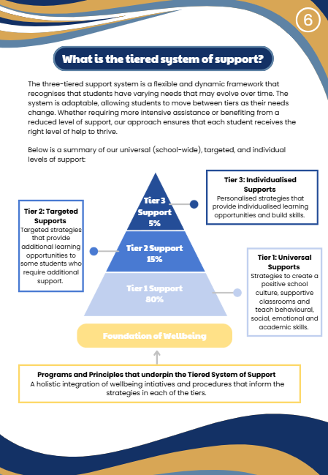
Supporting Your Childs
Wellbeing at School

Slide 30
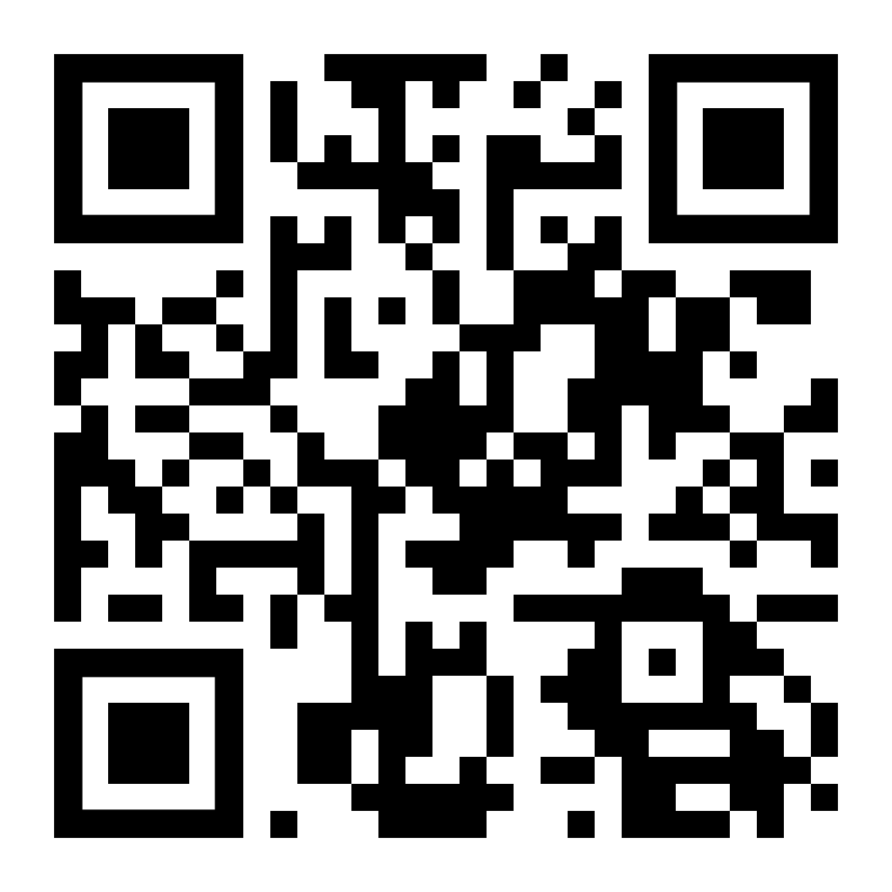
Parent Involvement
Sub-Committees
Parent & Friends Association - Community Events & Fundraising
Education Sub-Committee
Buildings and Grounds Sub-Committee
Finance Sub-Committee (School Council Members Only)
OSHC Sub-Committee
Reconciliation Action Plan Group (RAP)
Spanish Sub Committee
School Council

Slide 31

2026 Sibling Enrolments
If your child is currently in kindergarten and will be joining us next year, please complete the enrolment form on our school website, and send it to the school via email or directly to the office.

Slide 32
Want to Know more about Learning at NPS?
Who: Parents and families interested in knowing more about teaching and learning at Newlands are invited to a presentation.
What: A presentation from our Learning Community Leaders regarding:
Instructional Model
Assessments / Rubrics
Tiered Learning Model
When: Thursday, 20th of March
Where: Staffroom

Slide 33
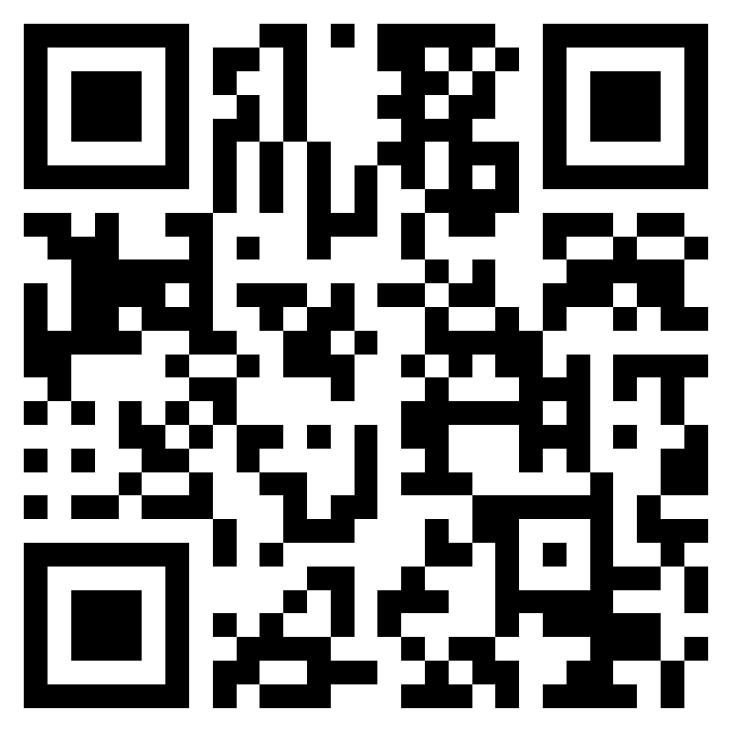
Further Questions
If you have a question that hasn't been addressed, please ask away in the QR code.
All responses will be published in next weeks newsletter.

