Slide 1
How Can human vision be enhanced?
Gladys Mpakame

Slide 2
Study Design dot points
Distinguish between short-sightedness and long-sightedness, and explain their correction by concave and convex lenses, respectively
Investigate and explain the treatment of cataract blindness including the use of intraocular lenses
Investigate the operation of the bionic eye

Slide 3
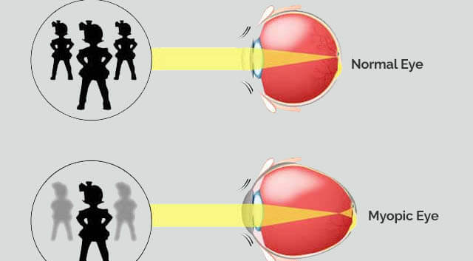
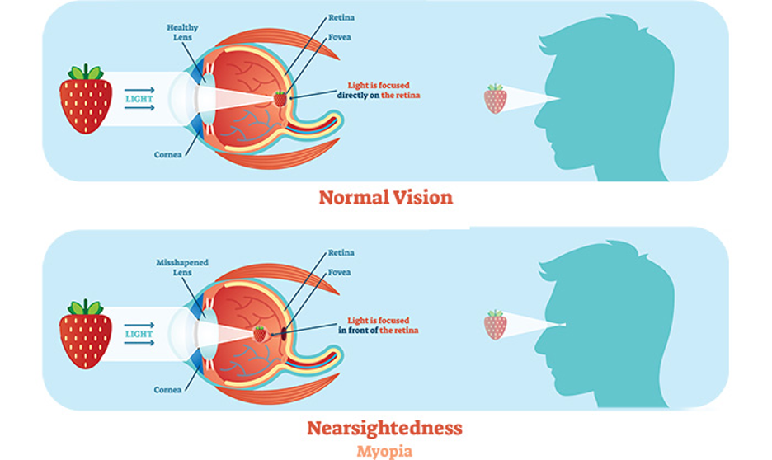
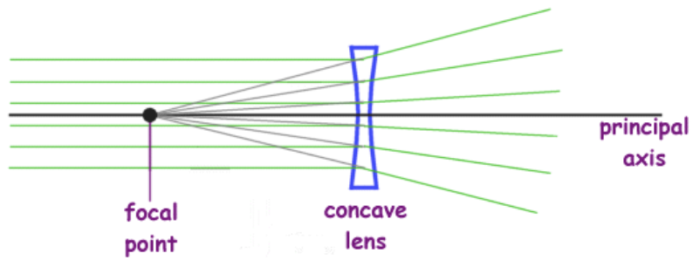
Short-sightedness
Short-sightedness (myopia): inability to produce clear image of distant objects while closer objects appear clear due to a combination of genetic and environmental factors.
Light doesn’t focus on the light sensitive tissue (retina) at the back of the eye correctly but instead light rays focus just in front of the retina causing distant items to appear blurred.
Can happen due to to bulging cornea or elongated eyeball. Bulging corneas refract light more than usual thus images of distant objects form in front of the retina. If eyeball is elongated the retina is placed at a further distance and the image of distant objects form in front of the retina. When images form in front of the retina, they are not focused and nerve cells detect a blurry image.
Concave (diverging) lenses are used to correct myopia. Rays of light that pass through the lens diverge. Lenses bend light that pass through them. Concave lenses are made with the outer edges curving inwards, so parallel light rays diverge so they appear to come from a point behind the lens – the focal point. Placing concave lenses in front of a short-sighted eye reduces the refraction of light and lengthens the focal length, so that the image is formed on the retina.

Slide 4
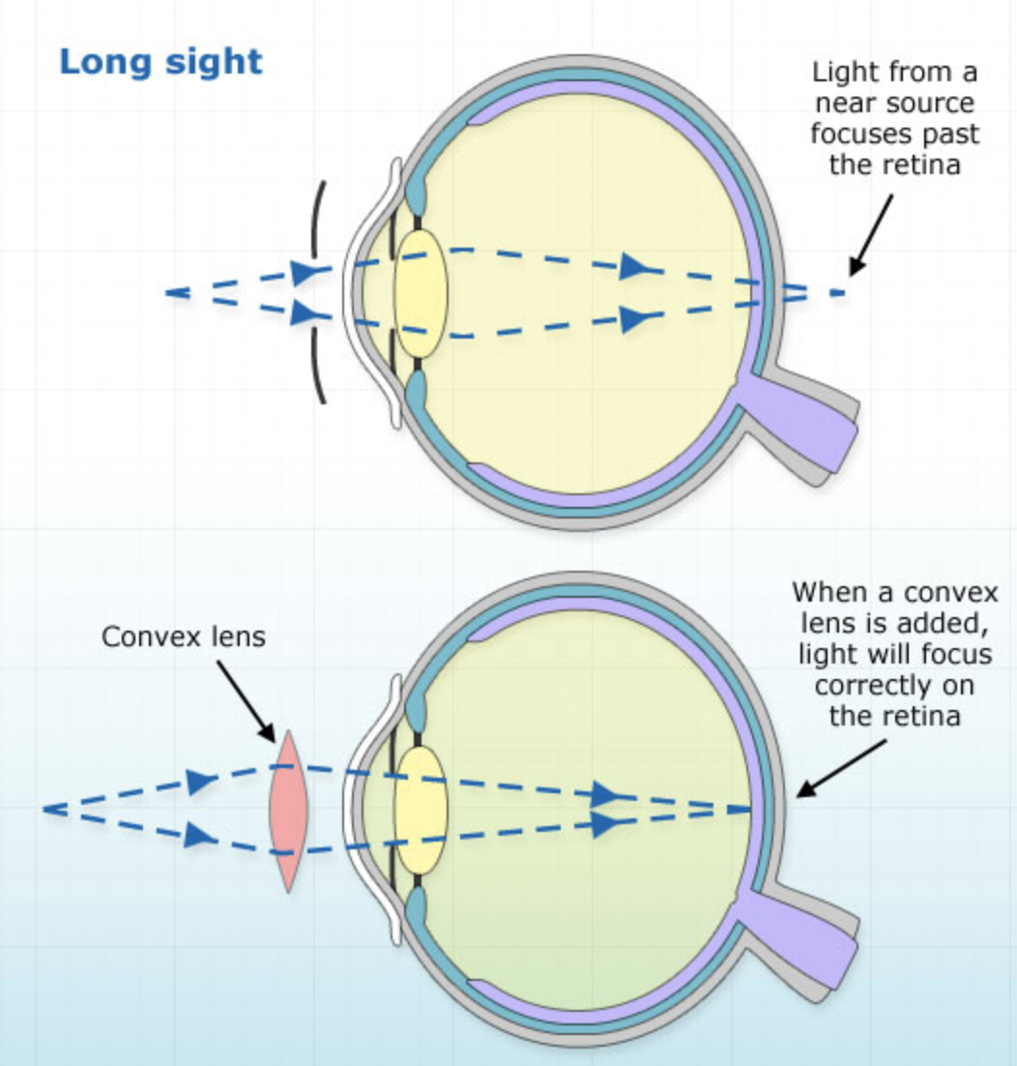
Long-sightedness
Long-sightedness (hypermetropia) affects the ability to see nearby objects whilst usually still being able to see distant objects.
Occurs when light entering the eye focuses behind the retina instead of on the retina, blurring the image. This may be due to the eye not having enough power to focus properly or due to a shorter than normal eyeball.
The eye lens naturally tries to accommodate by becoming more rounded in attempt to bring light into focus on the retina. People with hypermetropia cannot fully accommodate, causing blurred vision. The eyeball is too short, the cornea is too flat (so bends light rays less), or the lens cannot become round enough (lacks power).
Placing a convex lens to correct hypermetropia in the light path before the eye lens, the focal point can be shifted so the light from the near object focuses on a retina to produce a clear image. Convex lenses bend light rays inwards to give additional focusing power to the eye.

Slide 5
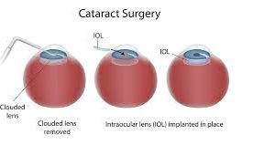
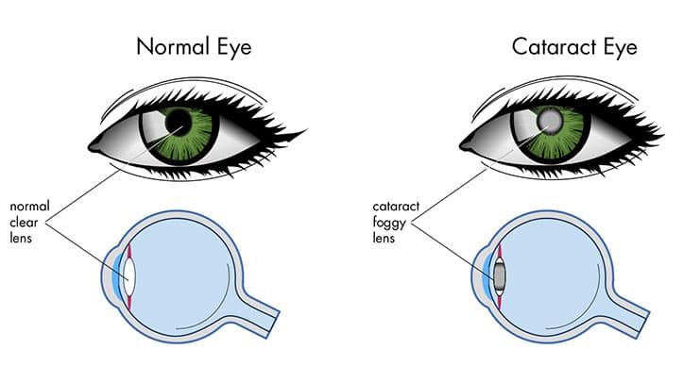
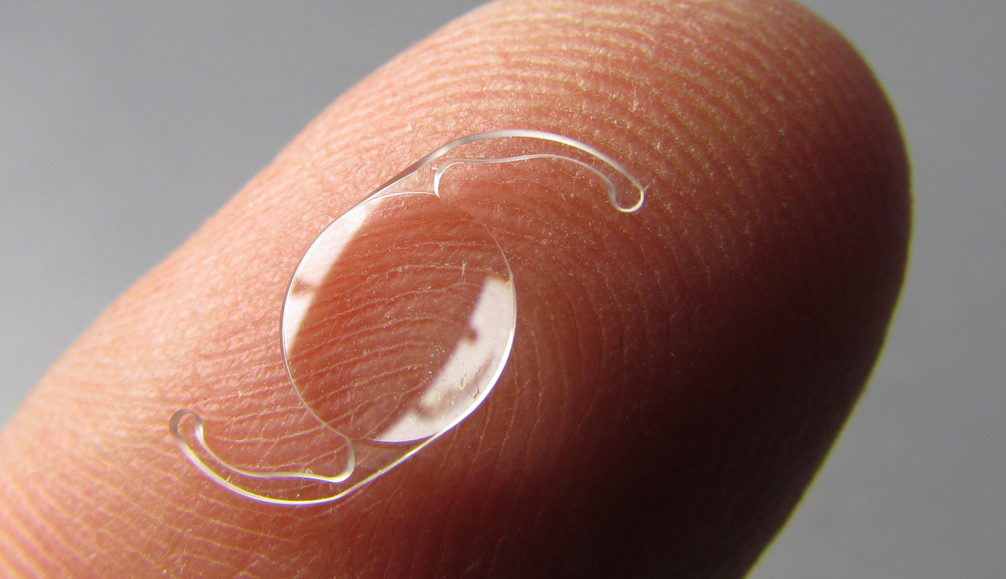
Cataract blindness
Cataract is a clouding of the clear lens in the eye causing vision impairment.
Occurs when the proteins in the lens of the eye clump together, making the lens cloudy. Light is unable to pass through the clumps of proteins easily and over time gets bigger and thicker, making seeing more difficult.
When cataracts interferes with daily activities, doctors may suggest cataract surgery. An intraocular lens is a tiny, artificial lens for the eye used to treat cataracts. During cataract surgery the eye’s natural lens is replaced with the intraocular lens. The lens refracts light rays that enter the eye, correcting vision. They are designed to fir perfectly inside the lens capsule for the best chance of correct focus and clear vision.
There are different types of intraocular lenses:
Monofocal: provide clear vision at one set focal length, usually long distance.
Monovision: allows you to see up close with one eye while seeing clearly at a distance with the other eye.
Toric: for astigmatism (vision problem caused by error in shape of cornea).

Slide 6
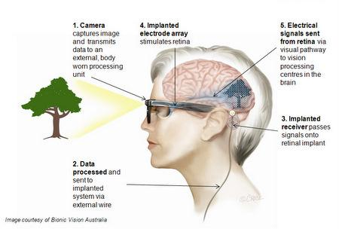
The bionic eye
A visual prosthesis –device that can use electrical or light energy to stimulate visual impulses to assist in restoring a sense of vision which are currently under development. They are unable to restore complete vision or give sight to the blind. To be used, the individual must have been able to see in the past for the bionic eye to work.
The bionic eye consists of both implanted and body worn components. The patient wears glasses with a small video camera on the side. The live feed from the camera is processed and transmitted through an implanted microchip to an electrode array placed in a naturally occurring pocket behind the retina. The electrodes stimulate remaining cells in the retina, to produce a sense of vision like a normal functioning eye.
Different bionic eye models aim at different target areas. The only approved and available bionic eyes currently are retinal implants.
Limitations: bionic eyes do not restore sight. Current bionic impacts only have 60 electrodes and around a million electrodes are needed to see clearly. They provide enough sight to read large-print books and cross the street. The patients see little flashes of light that help detect edges, outlines and movement to aid in navigation and object identification.

Slide 7
Bibliography
Johns Hopkins Medicine, 2021. Catarcts. [Online] Available at: https://www.hopkinsmedicine.org/health/conditions-and-diseases/cataracts [Accessed 16 October 2021].
Preproom, n.d. Physics > Short and Long sight. [Online] Available at: https://www.preproom.org/info-library/printer-friendly.aspx?t1=1&t2=11&t3=0&t4=0 [Accessed 18 October 2021].
Skalicky, S., 2019. What ate the different types of lens for cataract surgery?. [Online] Available at: https://www.drsimonskalicky.com.au/blog/what-are-the-different-types-of-lens-for-cataract-surgery/ [Accessed 16 October 2021].
The University of Melbourne, 2021. Bionic eye design and vision. [Online] Available at: https://biomedical.eng.unimelb.edu.au/neuroengineering/bionic-eye [Accessed October 2021].
UNSW Engineering, n.d. Bionic eye implant. [Online] Available at: https://www.unsw.edu.au/engineering/biomedical-engineering/research/research-areas/bionics/bionic-eye-implant [Accessed October 2021].
Vedantu, 2021. Convex Lens. [Online] Available at: https://www.vedantu.com/physics/convex-lens [Accessed 17 October 2021].
Bibliography
Australian College of Optometry, 2020. Development of a bionic eye. [Online] Available at: https://www.aco.org.au/development-of-a-bionic-eye/ [Accessed October 2021].
Bionics Institute, 2021. Bionic eye. [Online] Available at: https://www.bionicsinstitute.org/bionic-eye [Accessed 12 October 2021].
Carr, B. J. & Stell, W. K., 2017. The science behind myopia. [Online] Available at: https://www.ncbi.nlm.nih.gov/books/NBK470669/ [Accessed 17 October 2021].
CERA, 2019. The future of Australia's bionic eye. [Online] Available at: https://www.cera.org.au/the-future-of-australias-bionic-eye/ [Accessed 13 October 2021].
Gould Vision, 2021. What are concave lenses?. [Online] Available at: https://gouldvision.com/blog/what-are-concave-lenses/ [Accessed 18 October 2021].

