Slide 1
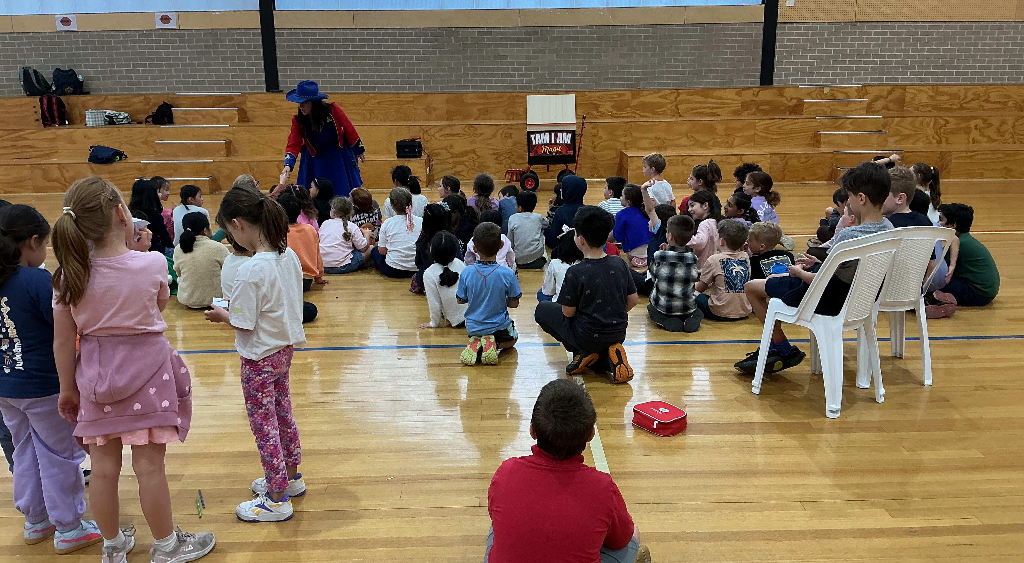
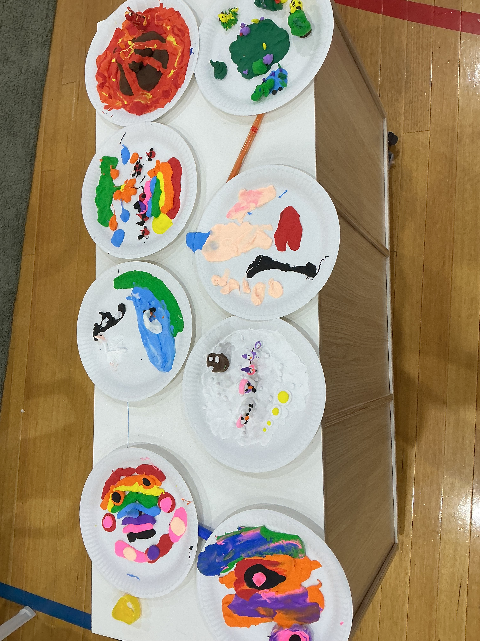
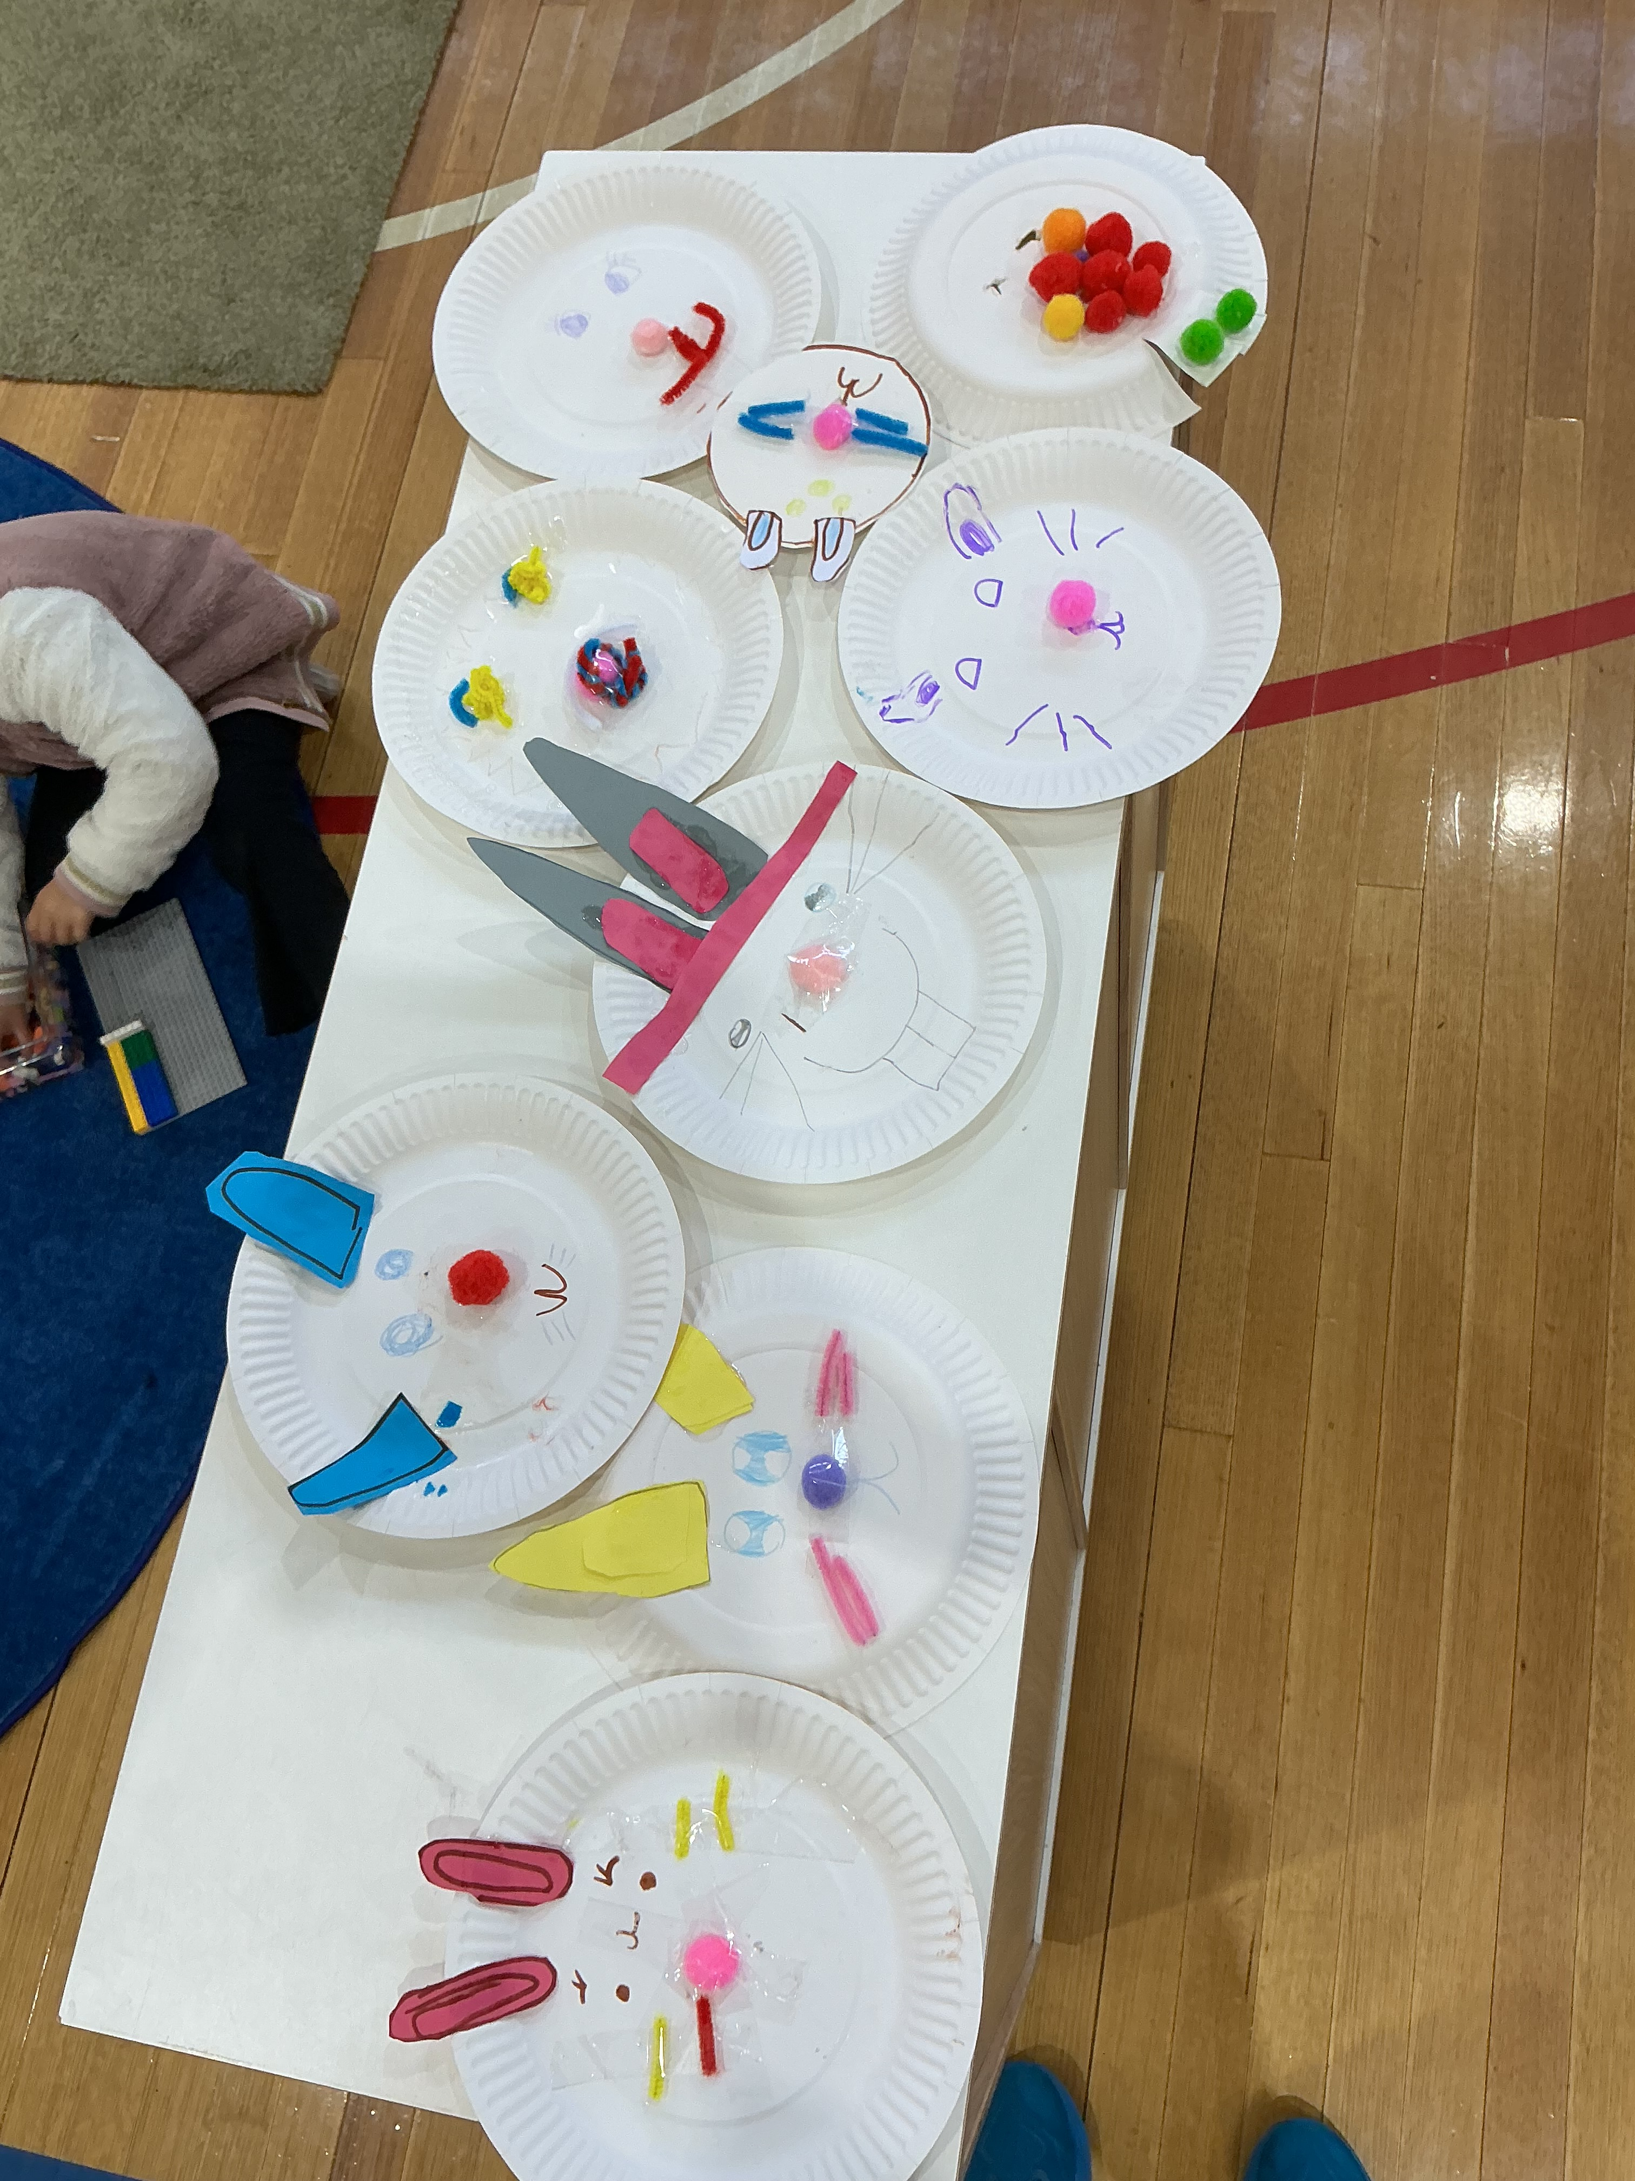
CARNEGIE TEAMKIDS
What a term it has been!
YAY! School holidays are here again, and we are stepping into two weeks full of super exciting at TeamKids Carnegie. Following high demand, we are thrilled to introduce our cooking club these holidays with an “around the world” theme, where our mini chefs will make delicious treats like spring rolls, dumplings and pasta. With the footy season ending, we have plenty of high energy active games planned alongside a vast range of crafts for all including kite designing, clay gardens, super fun space creations.
Our actioned packed schedule kicks off daily from 7-6:30, though we will be closed for the AFL Grand Final on the 25th. With our first week being super active please ensure all children have enclosed shoes.
With the energy high in week two, please ensure a spare change of clothes for the colour run day as we anticipate getting SUPER messy!
TeamKids will be providing breakfast, morning tea and afternoon tea and request families to ensure children have a packed lunch for each day.
Reminder: Excursions will be leaving earlier these holidays; it is imperative that you arrive by 9.
Soccer Club
Dance Club
Cooking club
Vac Cooking Club W1
21st and 24th of September
Vac Cooking Club W2
28th of September and 2nd of October
0413 791 023
carnegiepssenior@teamkids.com.au
1300 035 000
info@teamkids.com.au

