Slide 1
Learner Profiles, Self Regulation & Student Agency

Slide 2
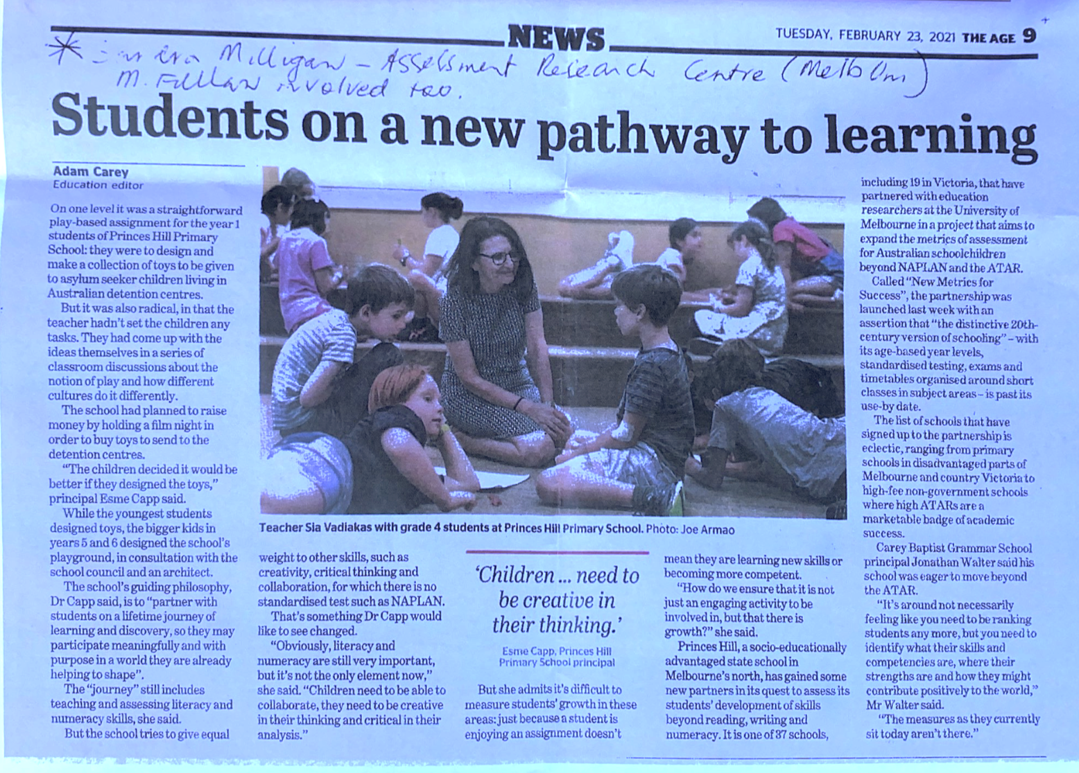
‘Children… need to be creative in their thinking.’
“Children need to be able to collaborate, they need to be creative in their thinking and critical in their analysis”
Dr Capp said “Partner with students on a lifetime journey of learning and discovery, so they may participate with purpose in a world they are already helping to shape”.
Article from the Age, 23 February, 2021

Slide 3
BBPS
Learner Profiles, Self Regulation & Student Agency:
What’s all this talk about learner profiles in grades 3-6? In this session, our teachers will share with you the research behind our focus on self-regulation and how we use this knowledge to plan learning and teaching in the classroom.

Slide 4
Learner Profiles

Slide 5
What does the research say?
A learner’s profile is the combination of strengths or weaknesses among and between the different types of intelligences.
The value of a learner profile stems from its lack of focus on more traditional views of high, medium, and low achieving children, as all areas in which a child may achieve are considered and valued. Instead of looking at a child as simply capable or not capable of learning, the profile of intelligences takes into consideration how a child learns best and what sorts of products and processes children may engage with to reflect their learning.
Most people, according to Howard Gardner (who developed the Multiple intelligence in 1983), have jagged profiles. This refers to a profile in which a student processes some types of information better than other types.

Slide 6
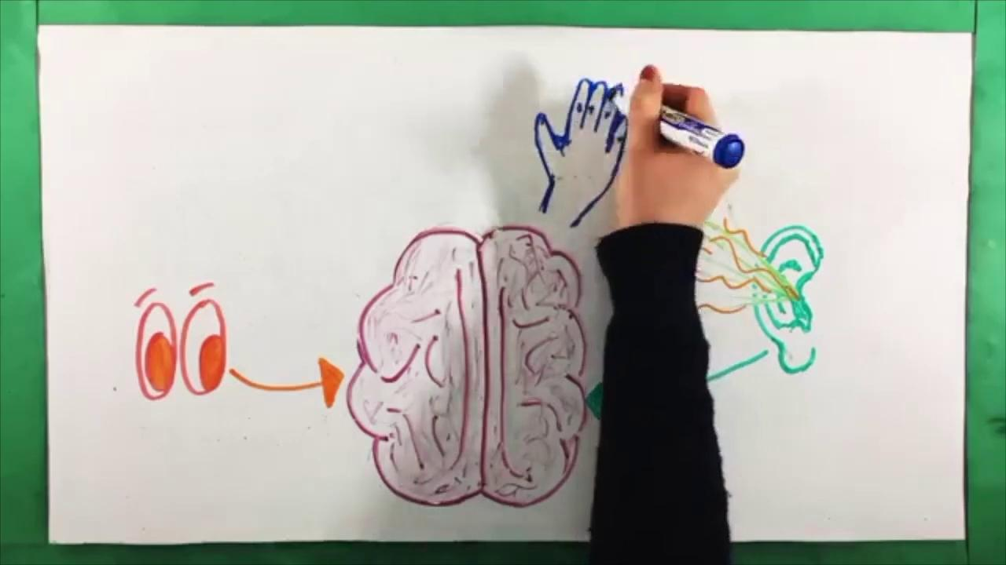
Your turn… grab a piece of paper and pen and find out what type of learner you are!

Slide 7
“If we know our learning style it means we can make learning and memorising new information much quicker and easier for ourselves”

Slide 8
What might the purpose be for our students?
Our students will have the knowledge, skills and understandings about themselves as learners, in order to take ownership of their learning journey.
Our students will not see themselves as “smart or “not smart," rather they will understand “how they are smart" (Rettig, 2005, p. 255).

Slide 9
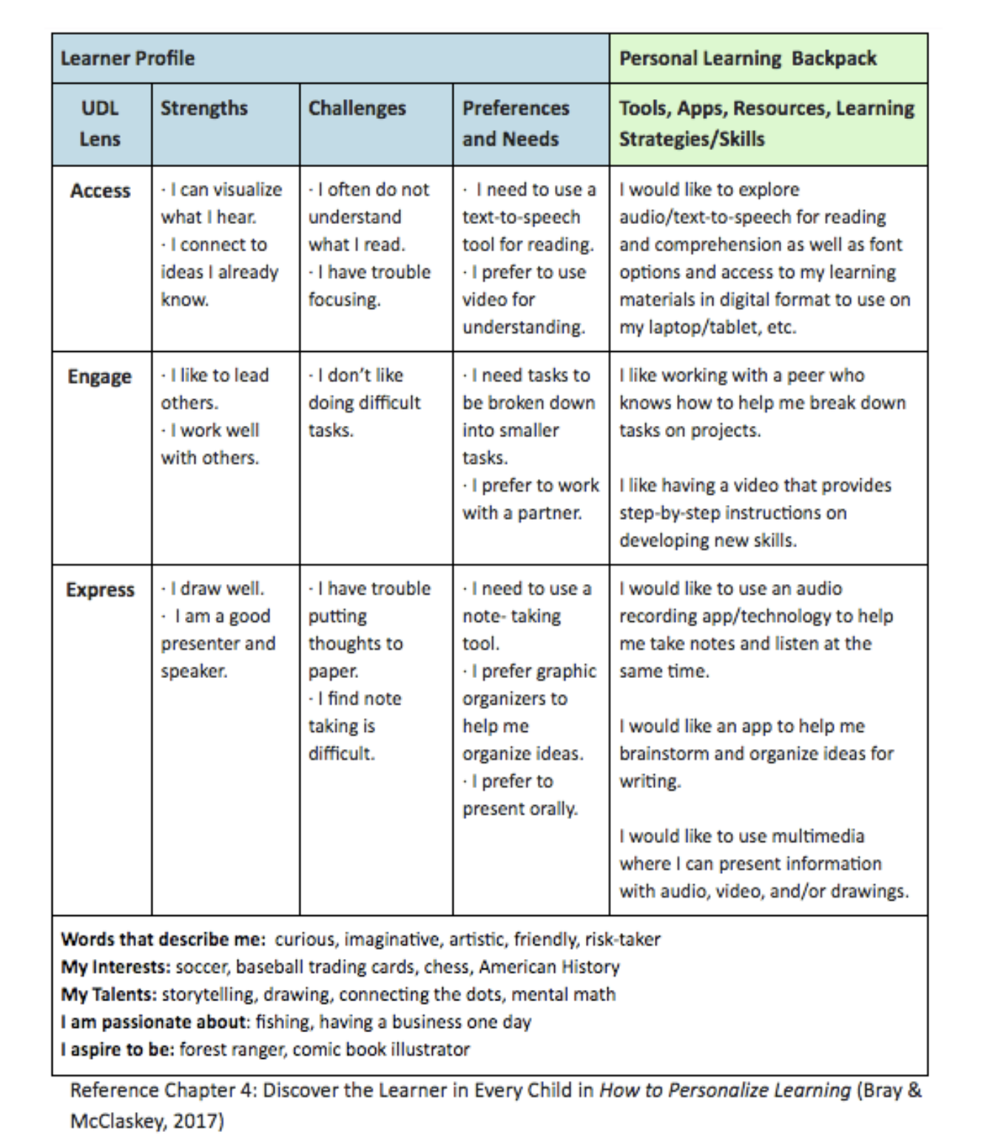
What might Learner Profiles look like at BBPS?
Access = What type of learner are you? (visual, kinesthetic, audio)
Engage = How do you work best? (on your own, teams, be the leader, be given the information, find the information self. Environment)
Express = How to you want to show your learning (creative, visuals, vidoes, written, presentations, drama)
Exploring themselves as learners and how they best access, engaged and express their learning.
Passion projects are a great way for students to explore themselves as learners...

Slide 10
What might Learner Profiles look like at BBPS?

Slide 11
What might Learner Profiles look like at BBPS?
Learner Profiles at BBPS enrich our understandings of the diversity of learning and learners.
Learner Profiles empower our students to understand different ways of approaching learning.

Slide 12
Self regulation

Slide 13
What does the research say?
There is a consensus that self-regulation is an important component of:
Motivation
Academic achievement
Development of lifelong learners
Importantly, providing students with knowledge and skills about how to self-regulate their learning helps them to self-initiate motivational, behavioural, and metacognitive activities in order to take ownership of their learning (Zimmerman, 1998).

Slide 14
What might the purpose be for our students?
Self-regulation shifts this emphasis onto the learner, requiring them to be active participants in their learning.
When students become more active and responsible for their learning, they set goals for themselves, complete expected asks and review their completed work to determine what they have learned.
At BBPS we are want to work in a partnership with our students, by enabling them to take control and responsibility of their learning, become more independent and engaged.

Slide 15
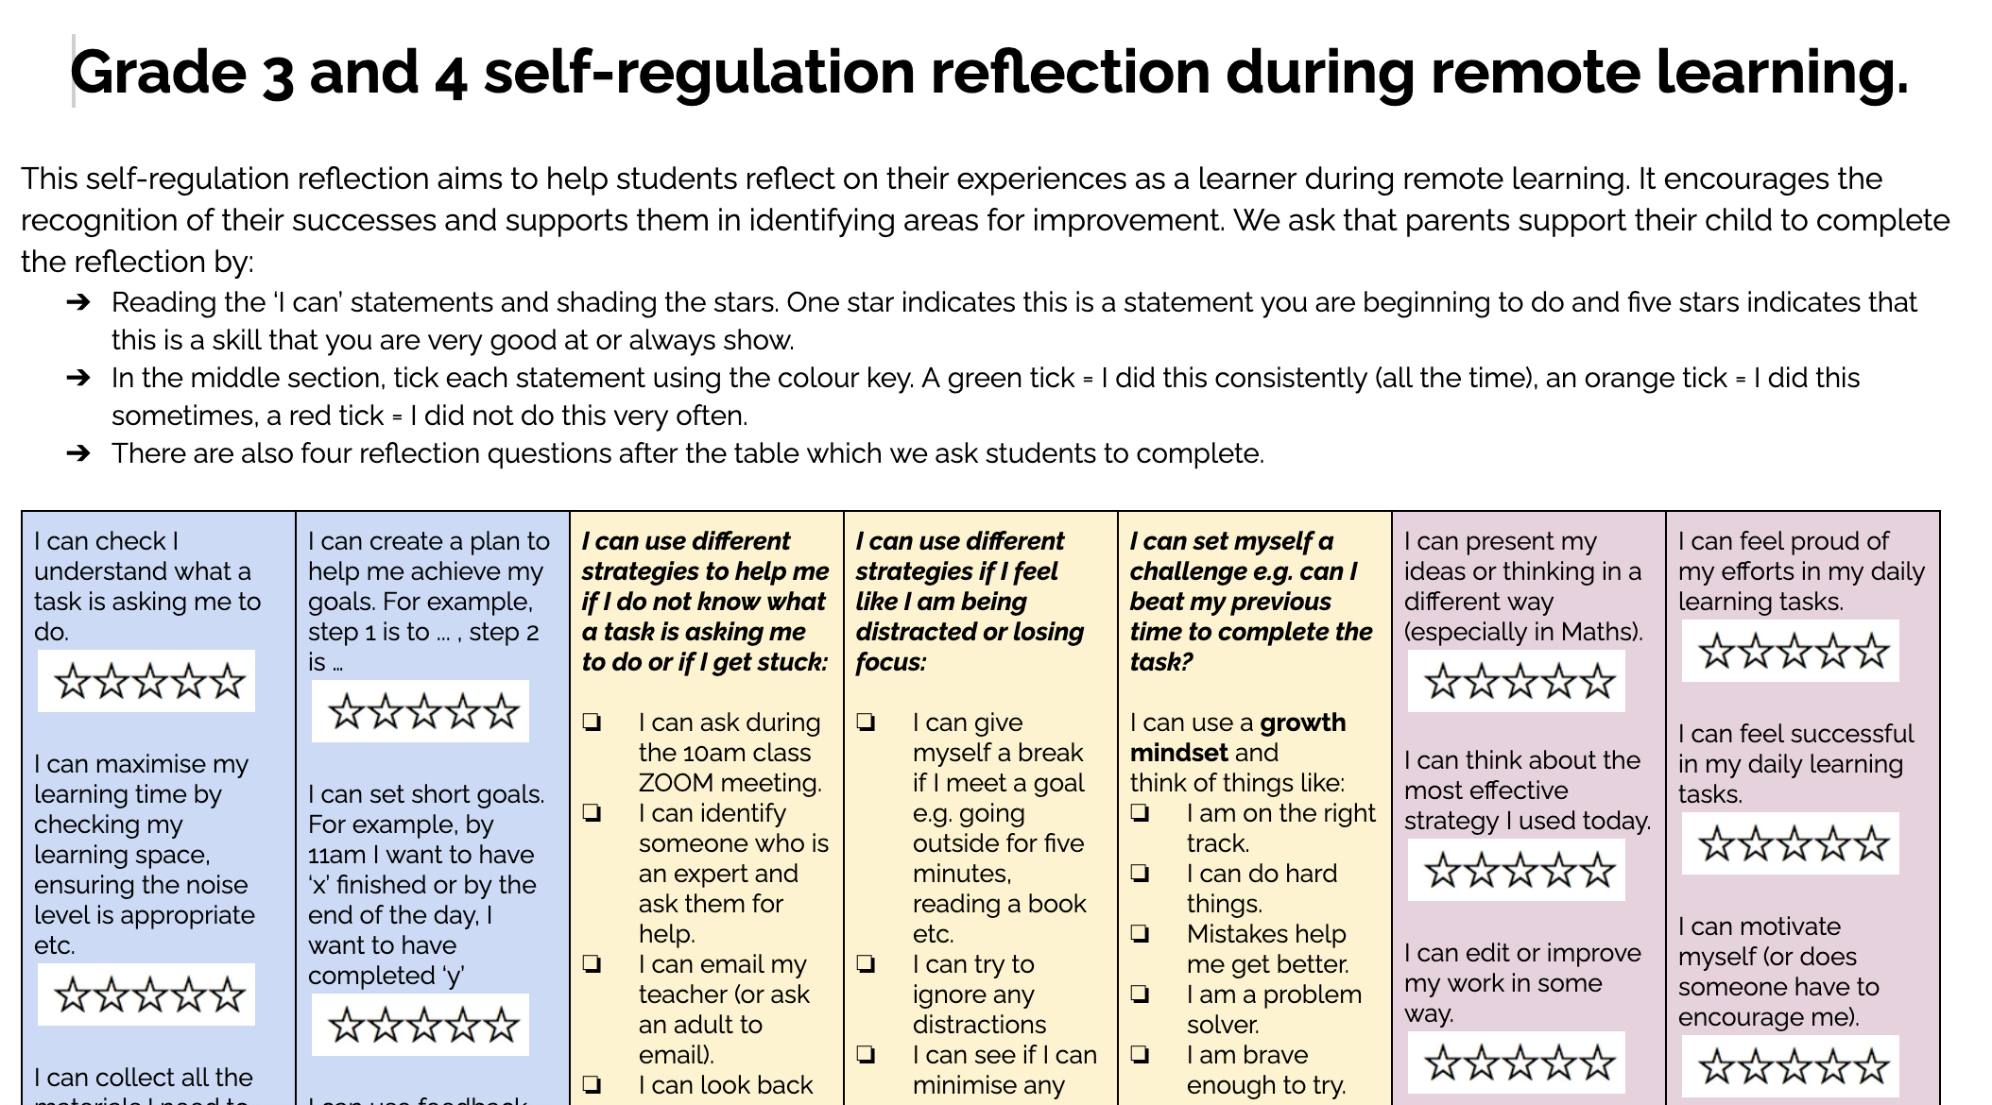
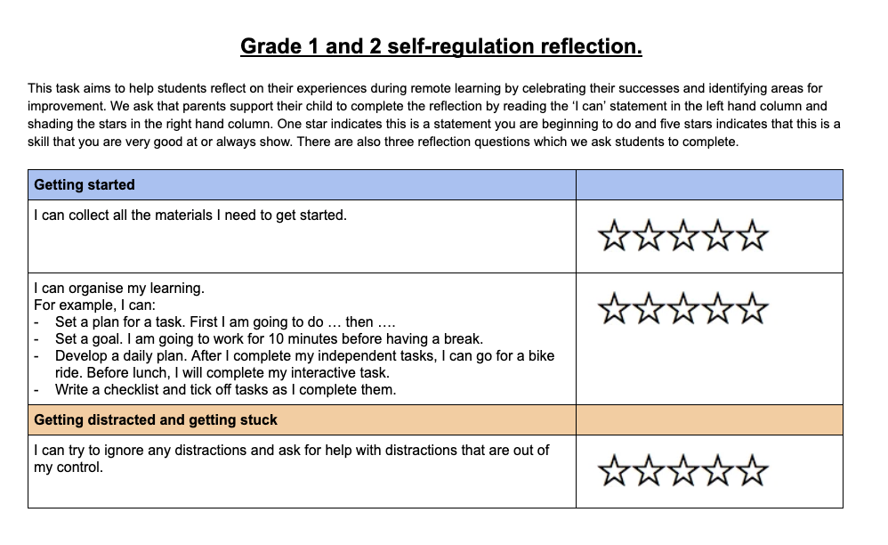
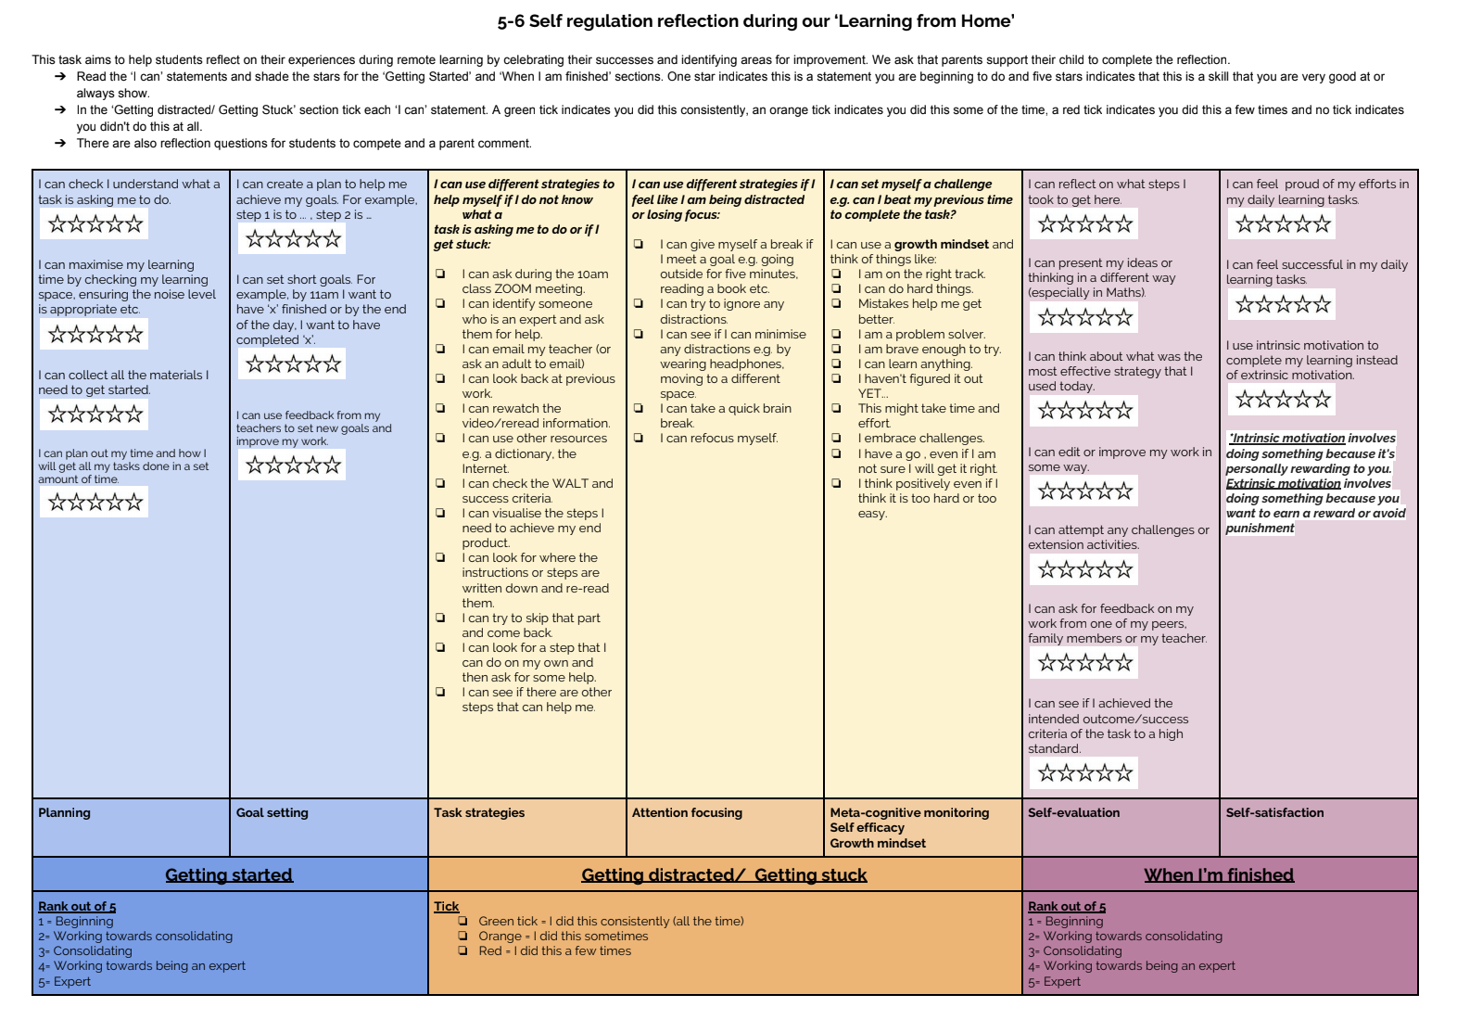
What might self regulation look like at BBPS?

Slide 16
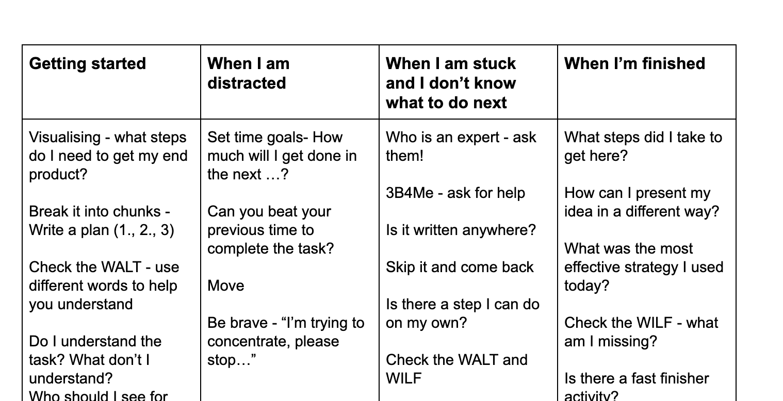
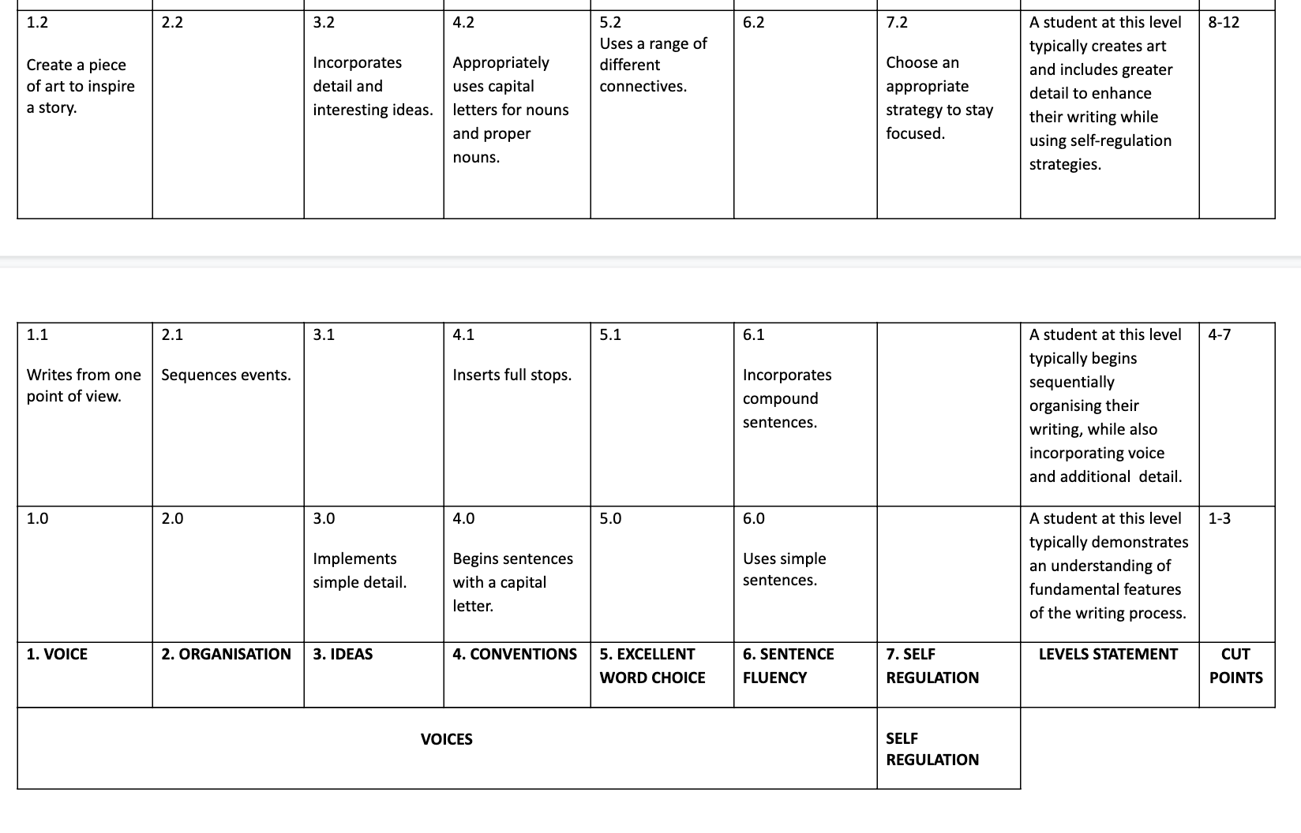
What might self regulation look like at BBPS?

Slide 17
Student Agency

Slide 18
What does the research say?

Slide 19
What might the purpose be for our students?
A sense of personal integrity implies a respect and appreciation for the unique attributes of the individual. It follows that embracing the value of individual uniqueness inevitably requires an appreciation for diversity in individuality within a classroom and is of central significance in every learning context. Secondly, a strong sense of efficacy is vital to a sense of agency. Simply put, a student with efficacy can act and will act with effect. Students have efficacy when they are empowered to take strategic steps to accomplish their goals (Johnston 2004)
A sense of agency allows room for, as Carol Dweck wrote in 2006, the sense of “not-yetness,” the sense that expertise and mastery are attributes that are built over time through persistence in the face of failure, and through drawing on the expertise and knowledge of those around us to compile the knowledge, understandings, and skills needed to achieve the successes we strive for as individuals.
An educational strategy that actively seeks and values student choice and voice fans the embers of student agency through building a sense of efficacy. The choices we open to students must be authentic choices through which students can see that their opinions and—most importantly—their actions can have a real impact on themselves and the world around them.

Slide 20
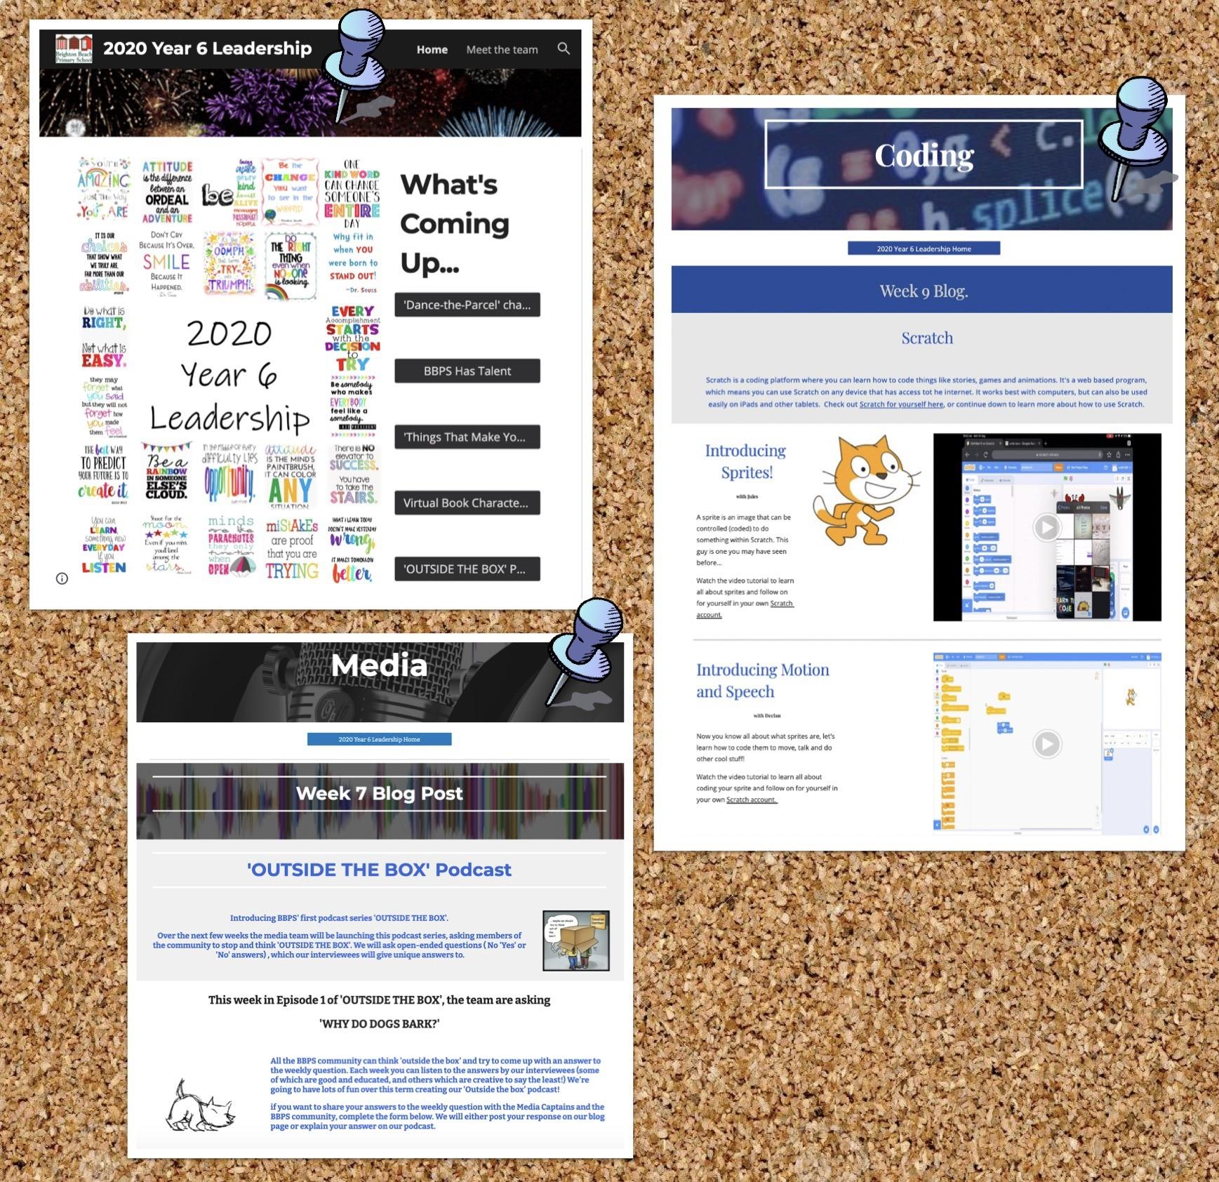
What might student voice and agency look like at BBPS?
Grade 6 Leadership program

Slide 21
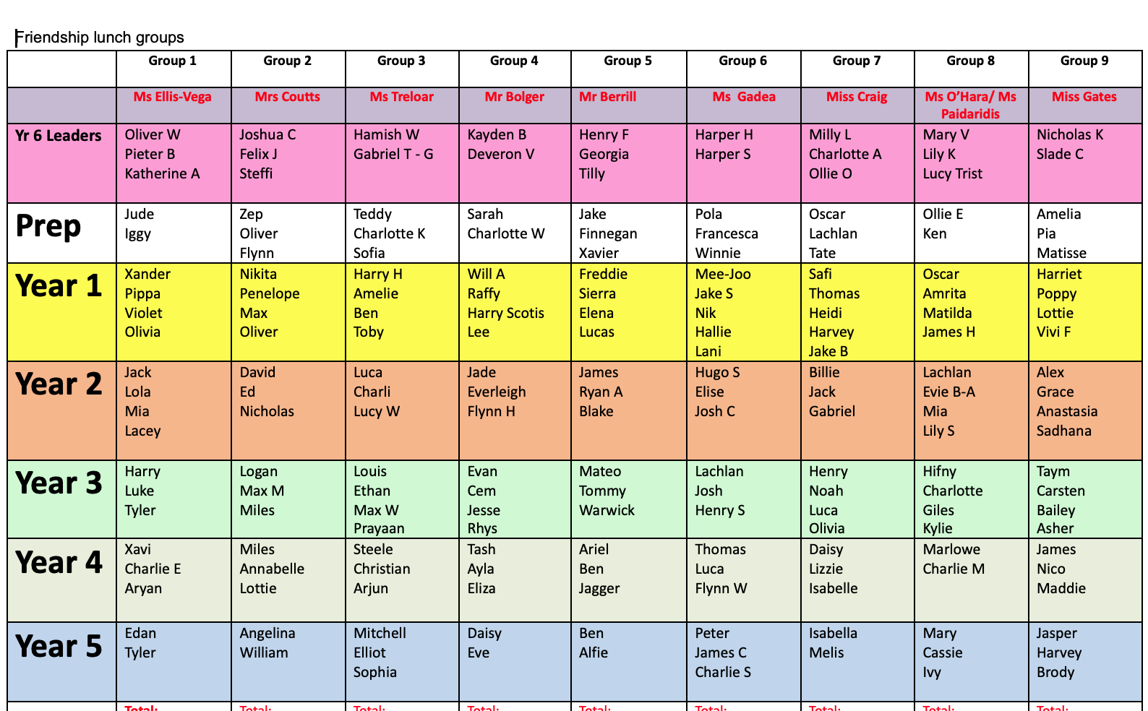
What might student voice and agency look like at BBPS?
Grade 6 Leadership program
Whole School Friendship lunches/events

Slide 22
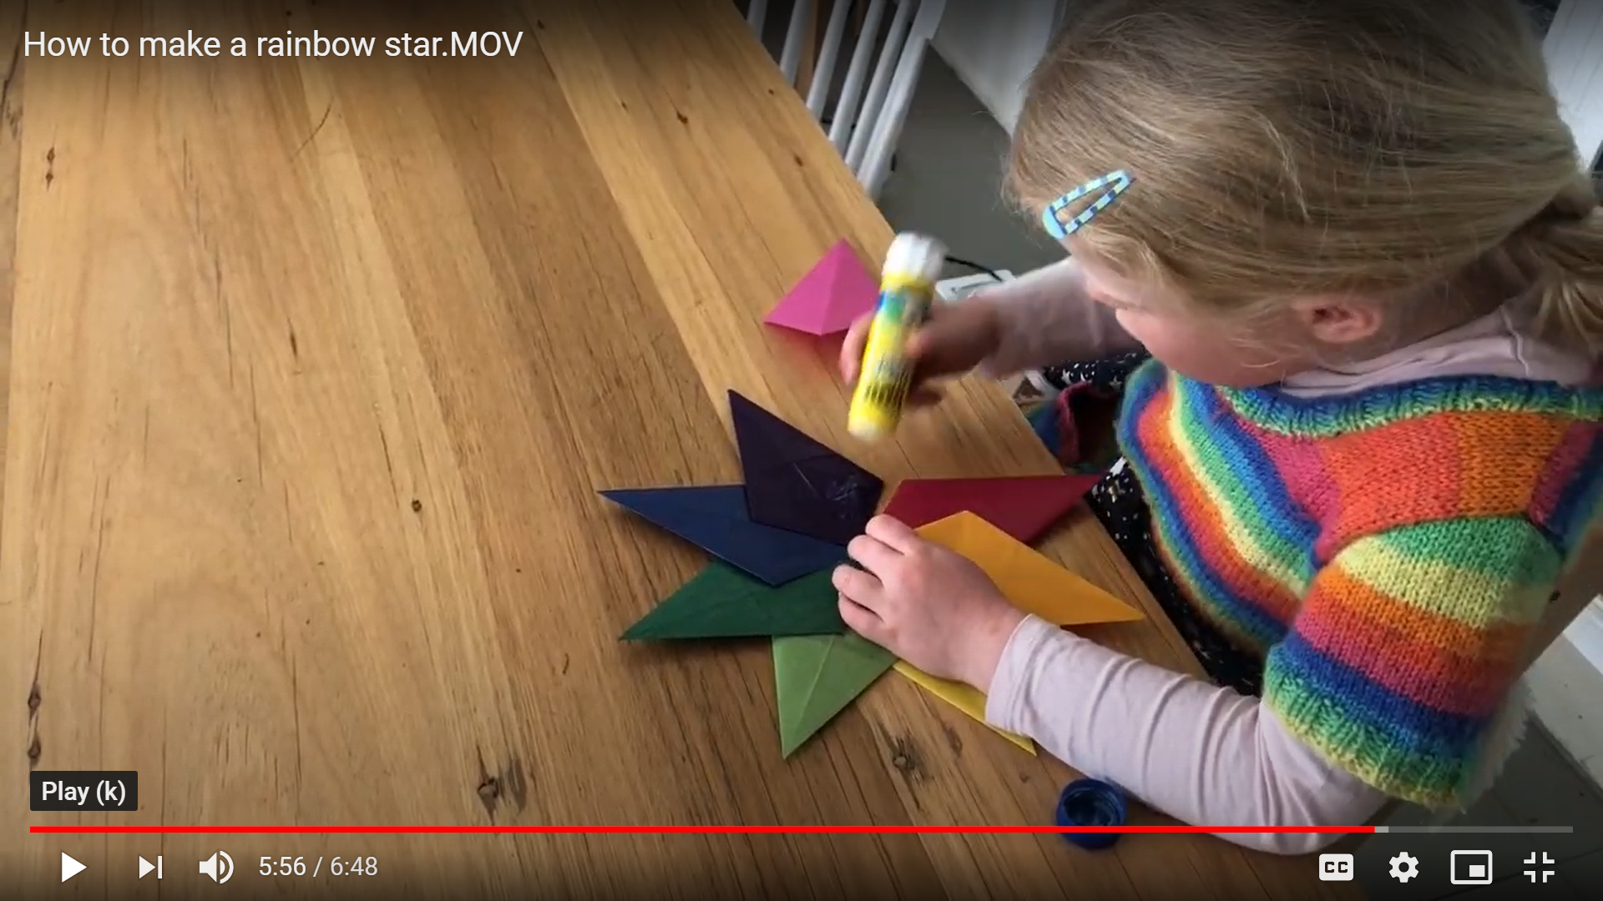
What might student voice and agency look like at BBPS?
Grade 6 Leadership program
Whole School Friendship lunches
Student Led Sessions

Slide 23
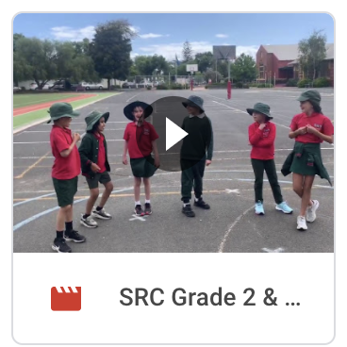
What might student voice and agency look like at BBPS?
Grade 6 Leadership program
Whole School Friendship lunches
Student Led Sessions
SRC

Slide 24
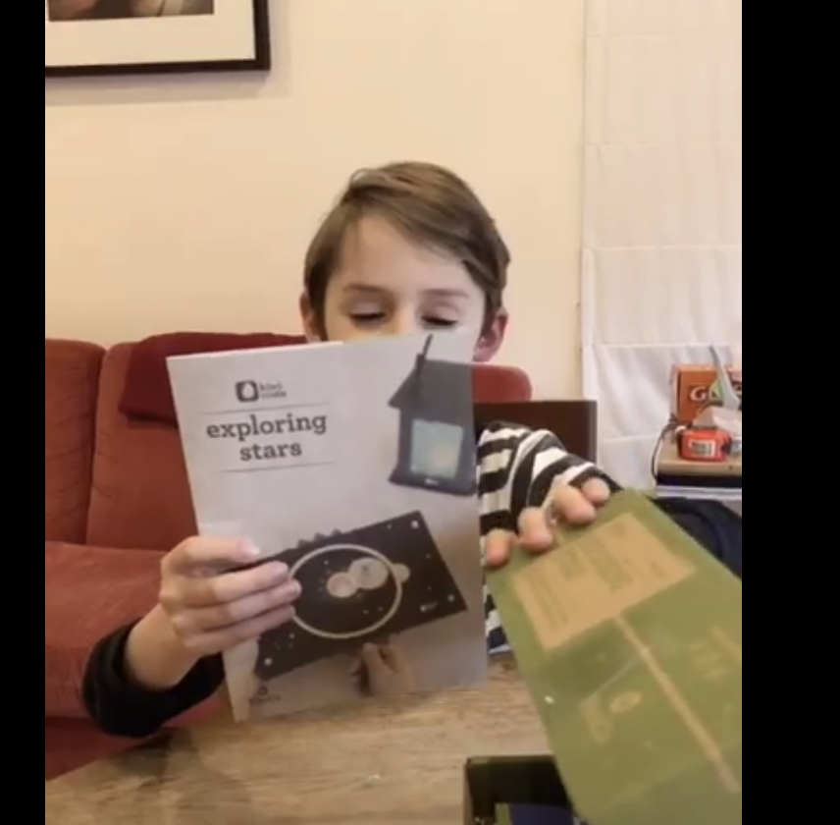
What might student voice and agency look like at BBPS?
Grade 6 Leadership program
Whole School Friendship lunches
Student Led Sessions
SRC
Passion Projects

Slide 25
What might student voice and agency look like at BBPS?
Grade 6 Leadership program
Whole School Friendship lunches
Student Led Sessions
SRC
Passion Projects
Student focus group surveys
What did you learn about yourself?

Slide 26
So what?
Ultimately, through using learner profiles as a tool in our toolbelt we are able to help our learners better understand themselves as learners and give them a sense of empowerment over how they can best learn. This is the first step in understanding that they have agency over their learning and other aspects of their schooling life.
Through our program of student agency we embed a stance of reflection and evaluation, constantly reflecting on our learner profiles and our roles within our school community to refine and adjust our individual learning goals with our students.
At BBPS we aspire to equip our learners with the knowledge that learning is a journey and some things may change over time but our goal of understanding ourselves as learners and how we can best position ourselves as lifelong learners as a part of a global learning community.

Slide 27
Any questions…

