Slide 1
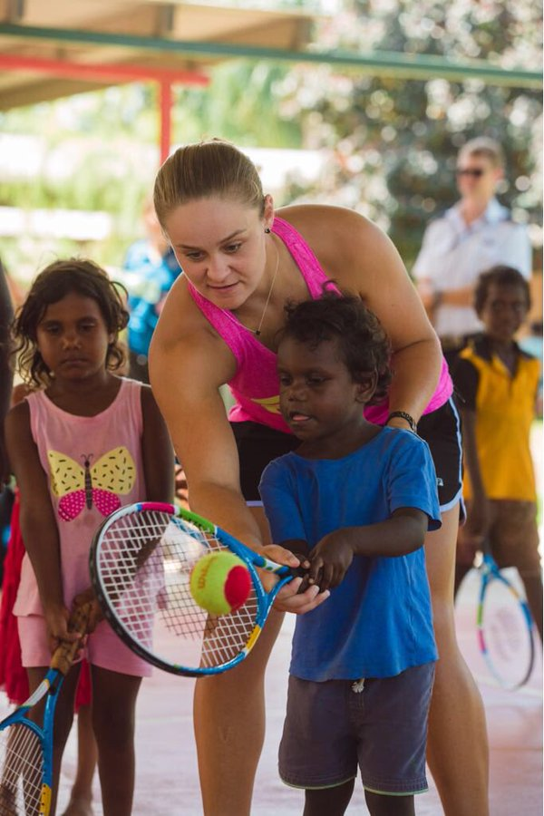
ASH BARTY

Slide 2
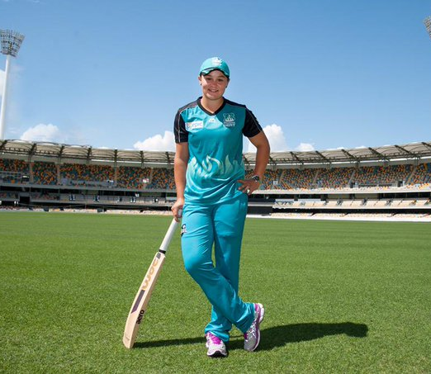
PLACE OF BIRTH
Ashleigh Barty (born 24 April 1996) is an Australian professional tennis player and former cricketer

Slide 3
PERSONAL INFORMATION
Barty was born in Ipswich, Queensland and grew up in Springfield, Queensland. She has an Indigenous Australian background through her father.
With Aborigine blood from her father, Robert, who is from the Ngarigo community of indigenous people.

Slide 4
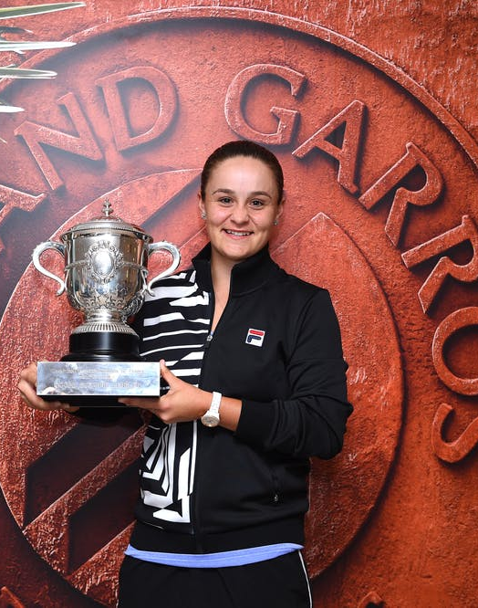
ACHIEVEMENTS
She is currently ranked world No. 1 in singles by the Women's Tennis Association (WTA). She is the second Australian WTA singles No. 1 after fellow Australian player Evonne Goolagong Cawley. Barty has won five singles titles and ten doubles titles on the WTA Tour. Of her wins, she has won one Grand Slam singles title at the 2019 French Open and one Grand Slam doubles title at the 2018 US Open with partner CoCo Vandeweghe.

Slide 5
ACHIEVEMENTS
Ashleigh Barty has achieved her childhood dream to be named the world’s top female player.
Barty took the world No.1 ranking* after winning the Birmingham WTA title on Sunday, beating her usual doubles partner Julia Goerges 6-3, 7-5.
The 23-year-old French Open champion has now achieved the same ranking as Evonne Goolagong Cawley — another indigenous Australian — who held the world top spot for a fortnight in 1976.
Only four Australians other than Barty have held the No.1 crown since computer rankings were introduced in 1973 — Goolagong Cawley, John Newcombe, Pat Rafter and Lleyton Hewitt.

Slide 6
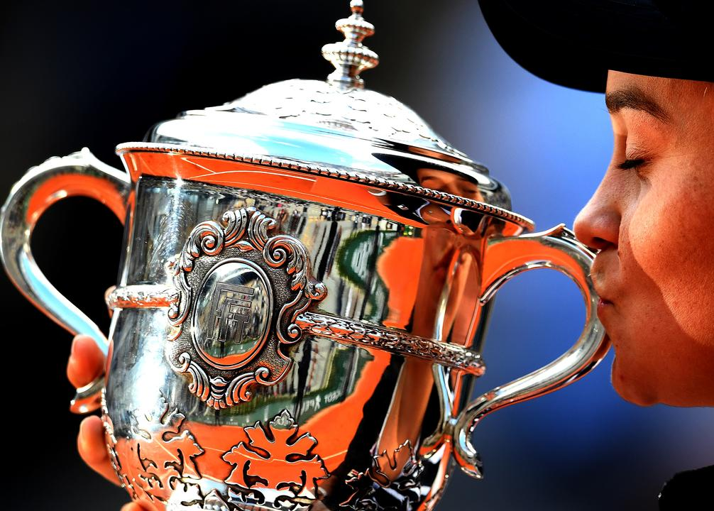
INTERESTING FACTS
Ash Barty is mad about The Richmond Tigers.
She has an Indigenous background.
She has earnt US$18,699,180 – 23rd all time in earnings.

Slide 7
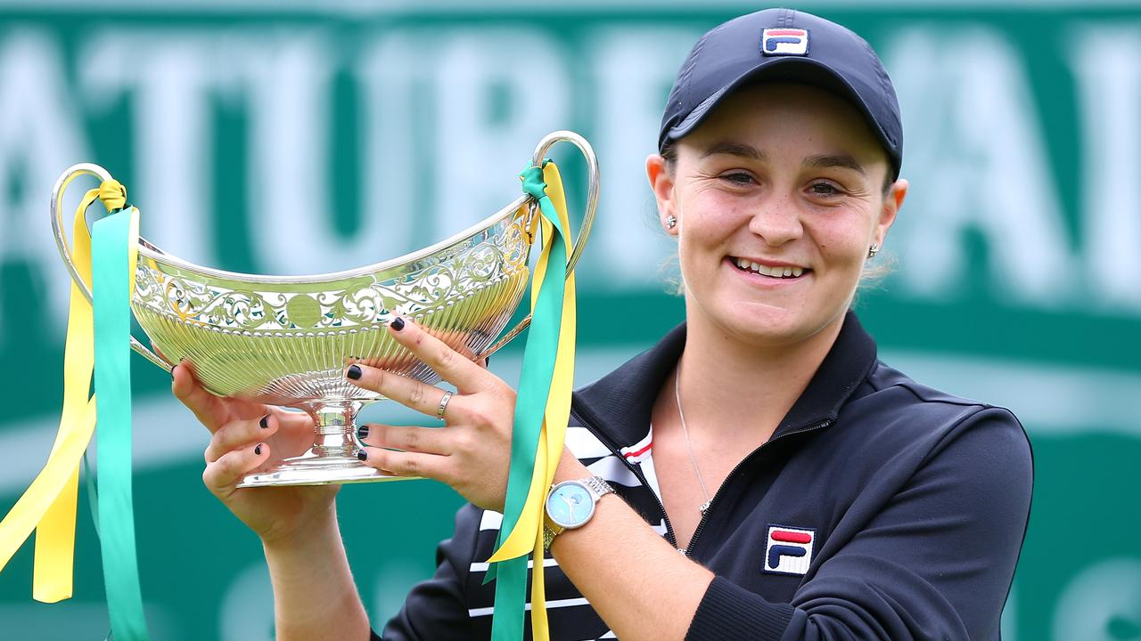
HOW ASH BARTY INSPIRES ME.
That she as achieved her dream to be the world’s best women’s tennis player
She’s a nice person

Slide 8
REFERENCES
https://kids.kiddle.co/Ashleigh_Barty#:~:text=Ashleigh%20Barty%20(born%2024%20April,tennis%20player%20and%20former%20cricketer.&text=She%20is%20the%20second%20
https://www.rolandgarros.com/en-us/article/5-things-you-need-to-know-about-ashleigh-barty-summer-2019
https://www.kidsnews.com.au/sport/australias-ashleigh-barty-crowned-worlds-no1-female-player-after-taking-birmingham-title/news-story/f5bb8657c5b65238ed3287813666ff5c

Slide 9
THE END

