Slide 1
Acknowledgement of Country
“We would like to acknowledge the Wurundjeri people, the Traditional Owners of the land on which we are gathered and pay our respects to their Elders both past, present and emerging.”

Slide 2
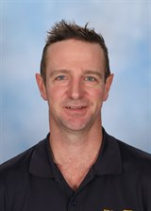
Head of Middle School
Mr BOND

Slide 3
Head of Middle School Mr Bond
Welcome Back
High Expectations
Uniform Passes
School Values

Slide 4
Examination Period
Very Important Period for Y12
2 Years of lockdown and Remote Learning
College Values of Respect and Care/Compassion
Take note of roped off areas and signs to ‘be quiet’

Slide 5
400 Building Out of Action
DATE | DAY | START TIME | END TIME | EXAMINATION
27-Oct-21 | Wednesday | 09:00AM | 12:15PM | EN01 - English
29-Oct-21 | Friday | 02:00PM | 03:45PM | MA07 - Further Mathematics
1-Nov-21 | Monday | 02:00PM | 03:45PM | MA07 - Further Mathematics
3-Nov-21 | Wednesday | 09:00AM | 10:15AM | MA11 - Mathematical Methods
4-Nov-21 | Thursday | 11:45AM | 02:00PM | MA11 - Mathematical Methods

Slide 6
What this means for us?
This means that the 400 Building becomes an exam centre during the exam times (and for a period before and after the exam).
Students cannot use the 400 block during this time.
The doors will need to be locked and students will not be able to use the toilets (these will be used by the Year 12 students during the exam as required).
The lockers that are in the 400 Open Area will need to be moved outside.

Slide 7
Coordinator Contact
Email if not urgent. A coordinator will come and visit you during class time to discuss your issue/concern
If urgent go to the front office and they will call a coordinator to come and visit you up there
There will be no equipment borrowing at all on these dates!

Slide 8
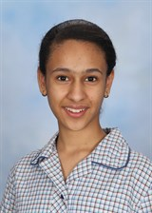
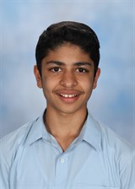
Middle School Captains
Haim
Shaun

Slide 9
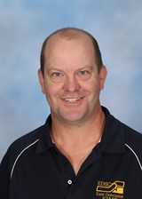
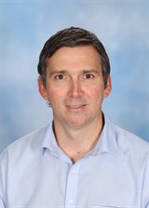
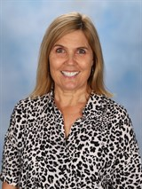
Year 7 Coordination Team
Year 7
Mr SCHWARZ
Year 7
Mr RICKARD
Transition Coordinator
Ms MARCHANT

Slide 10
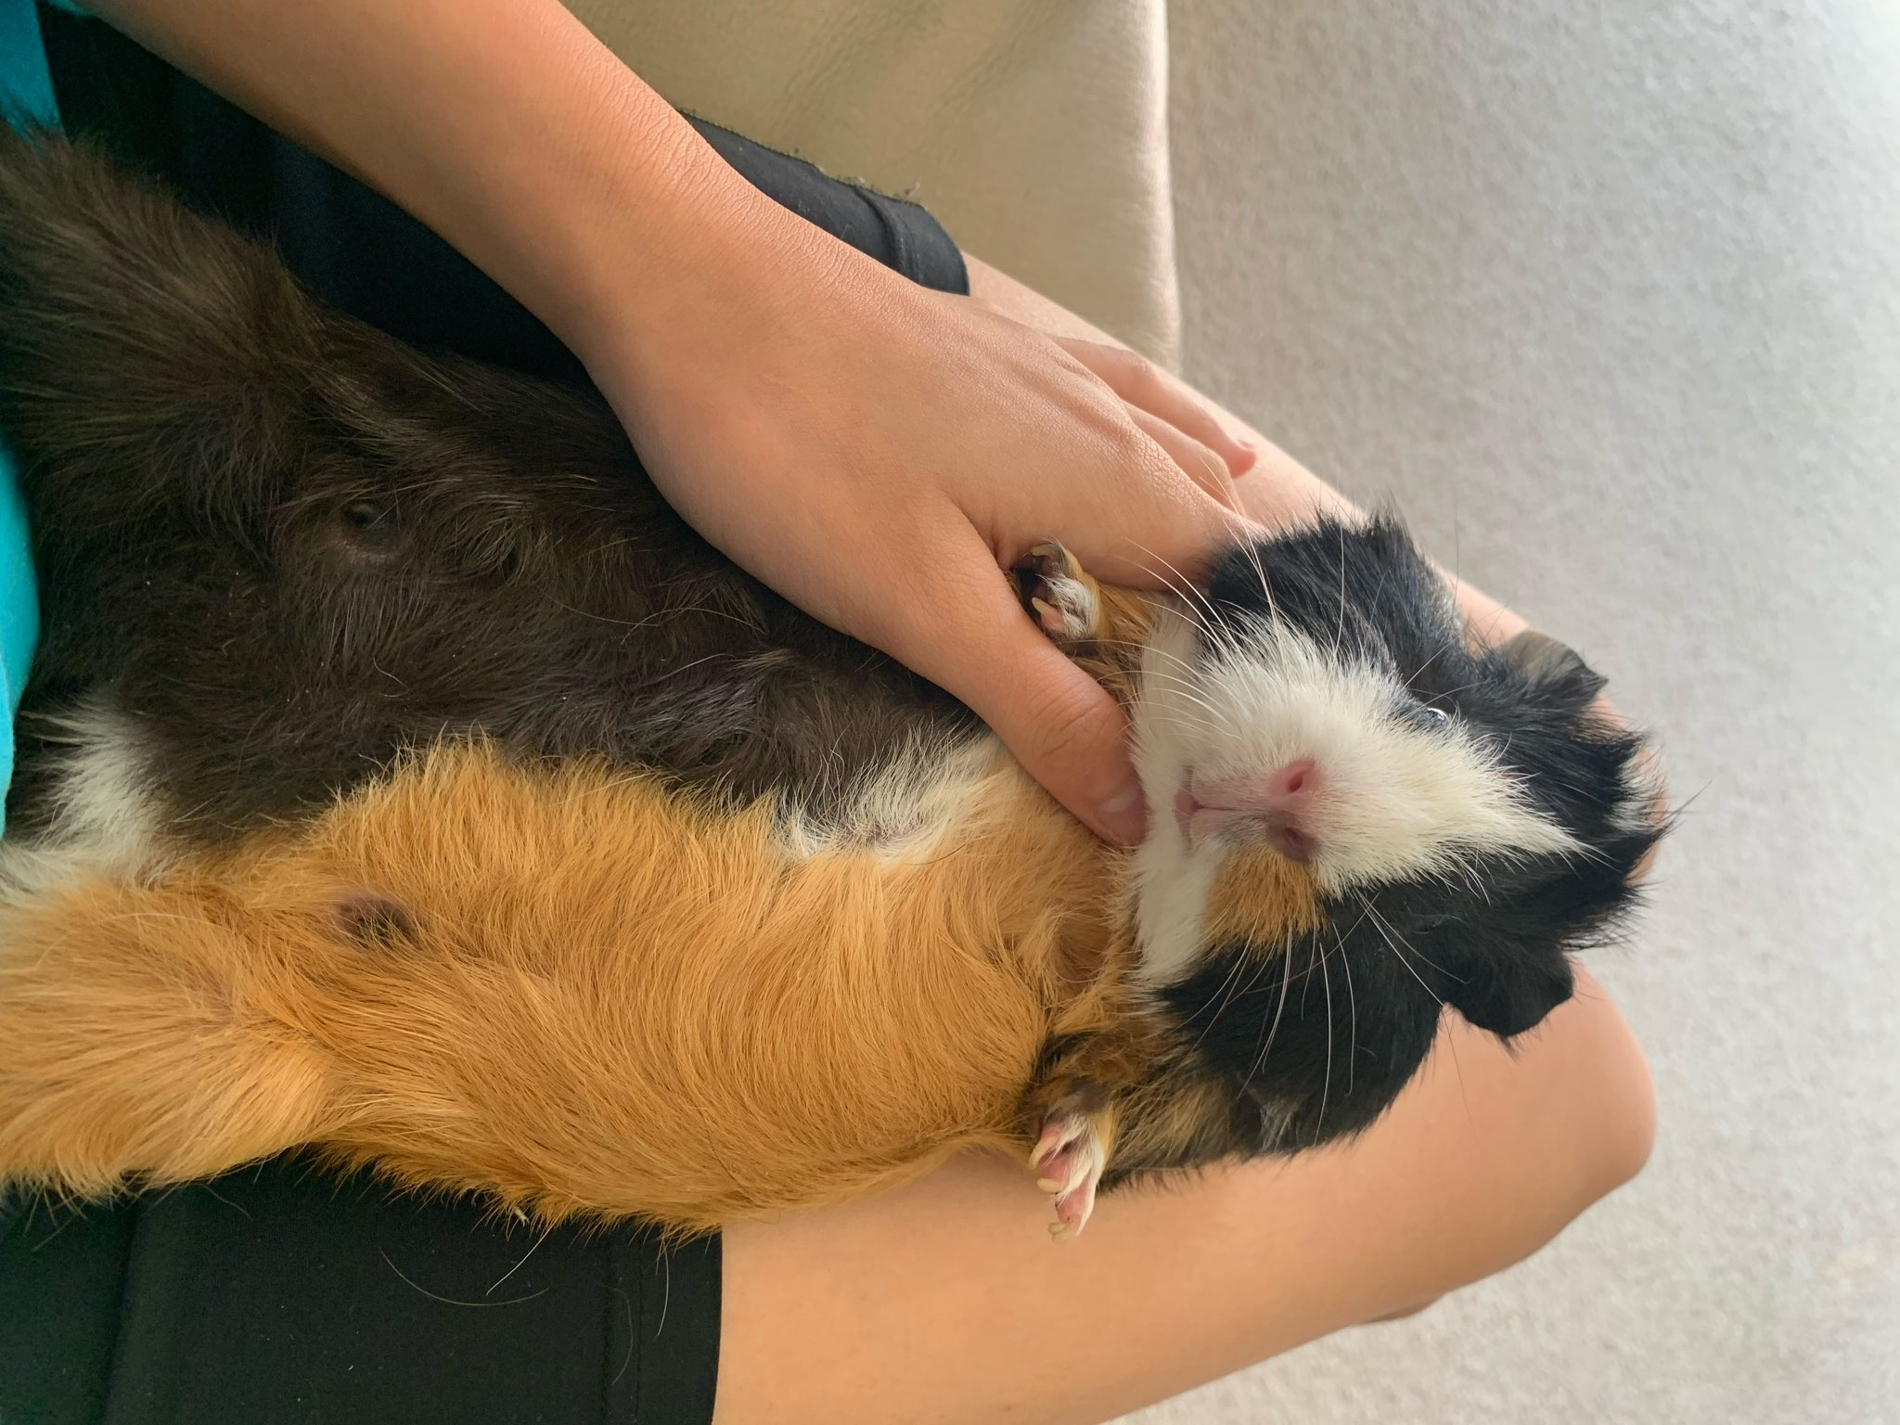
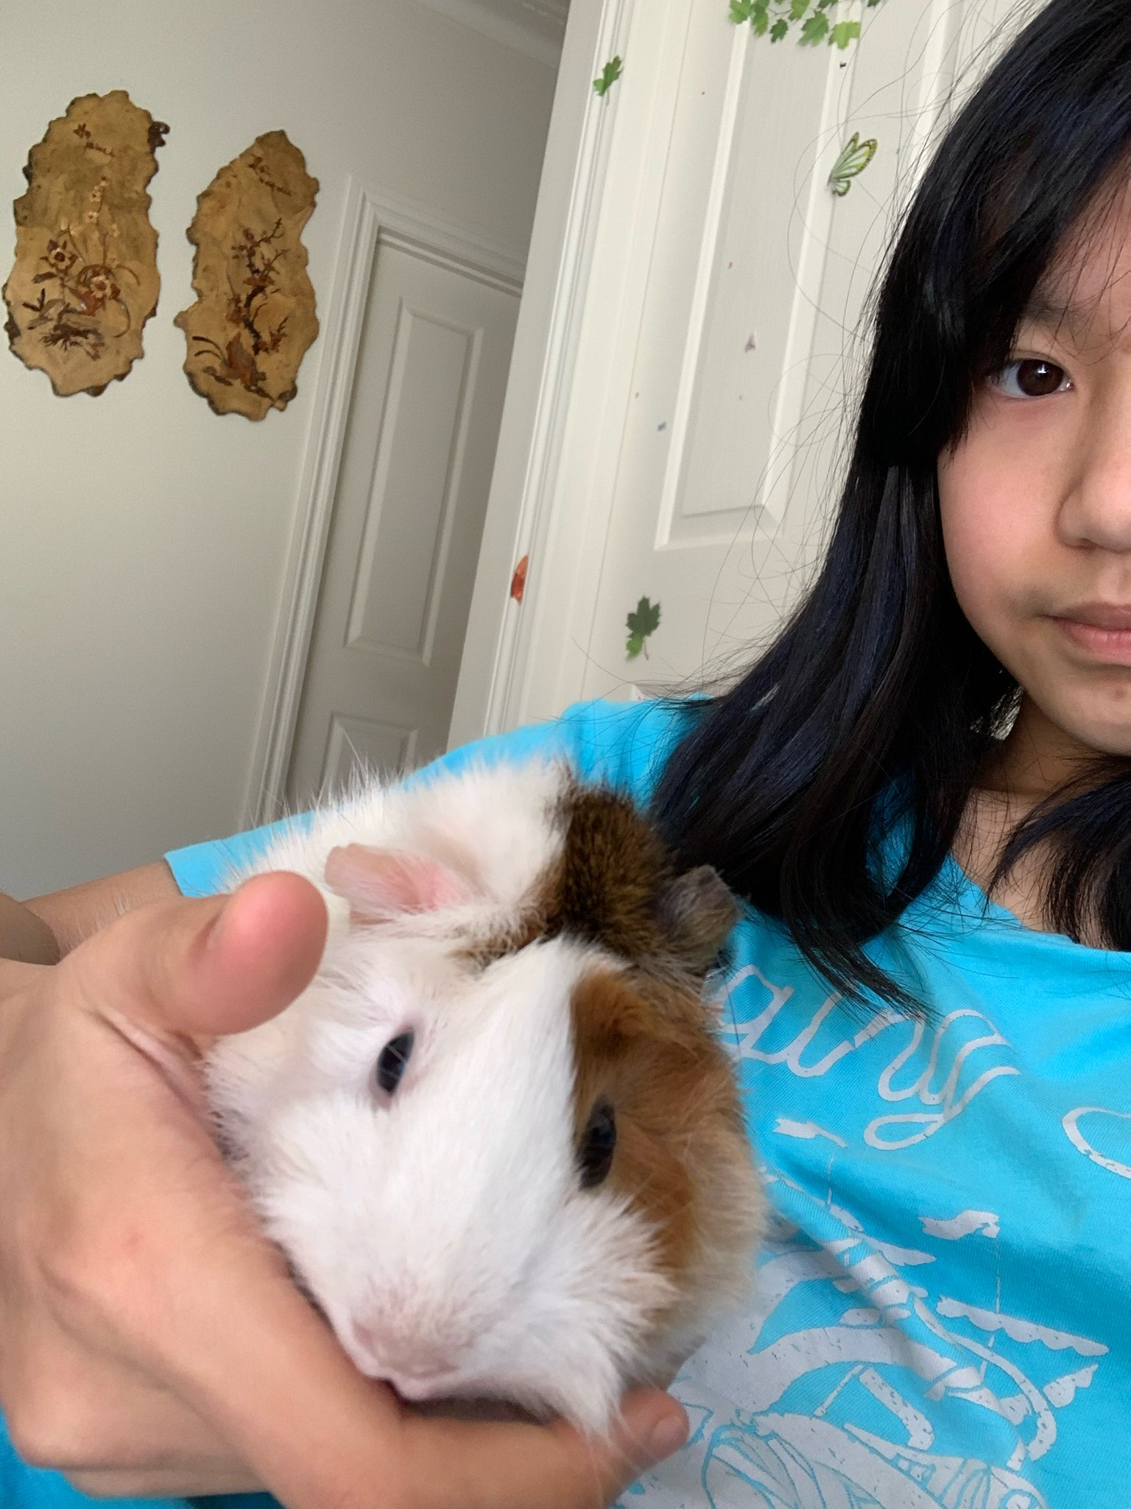
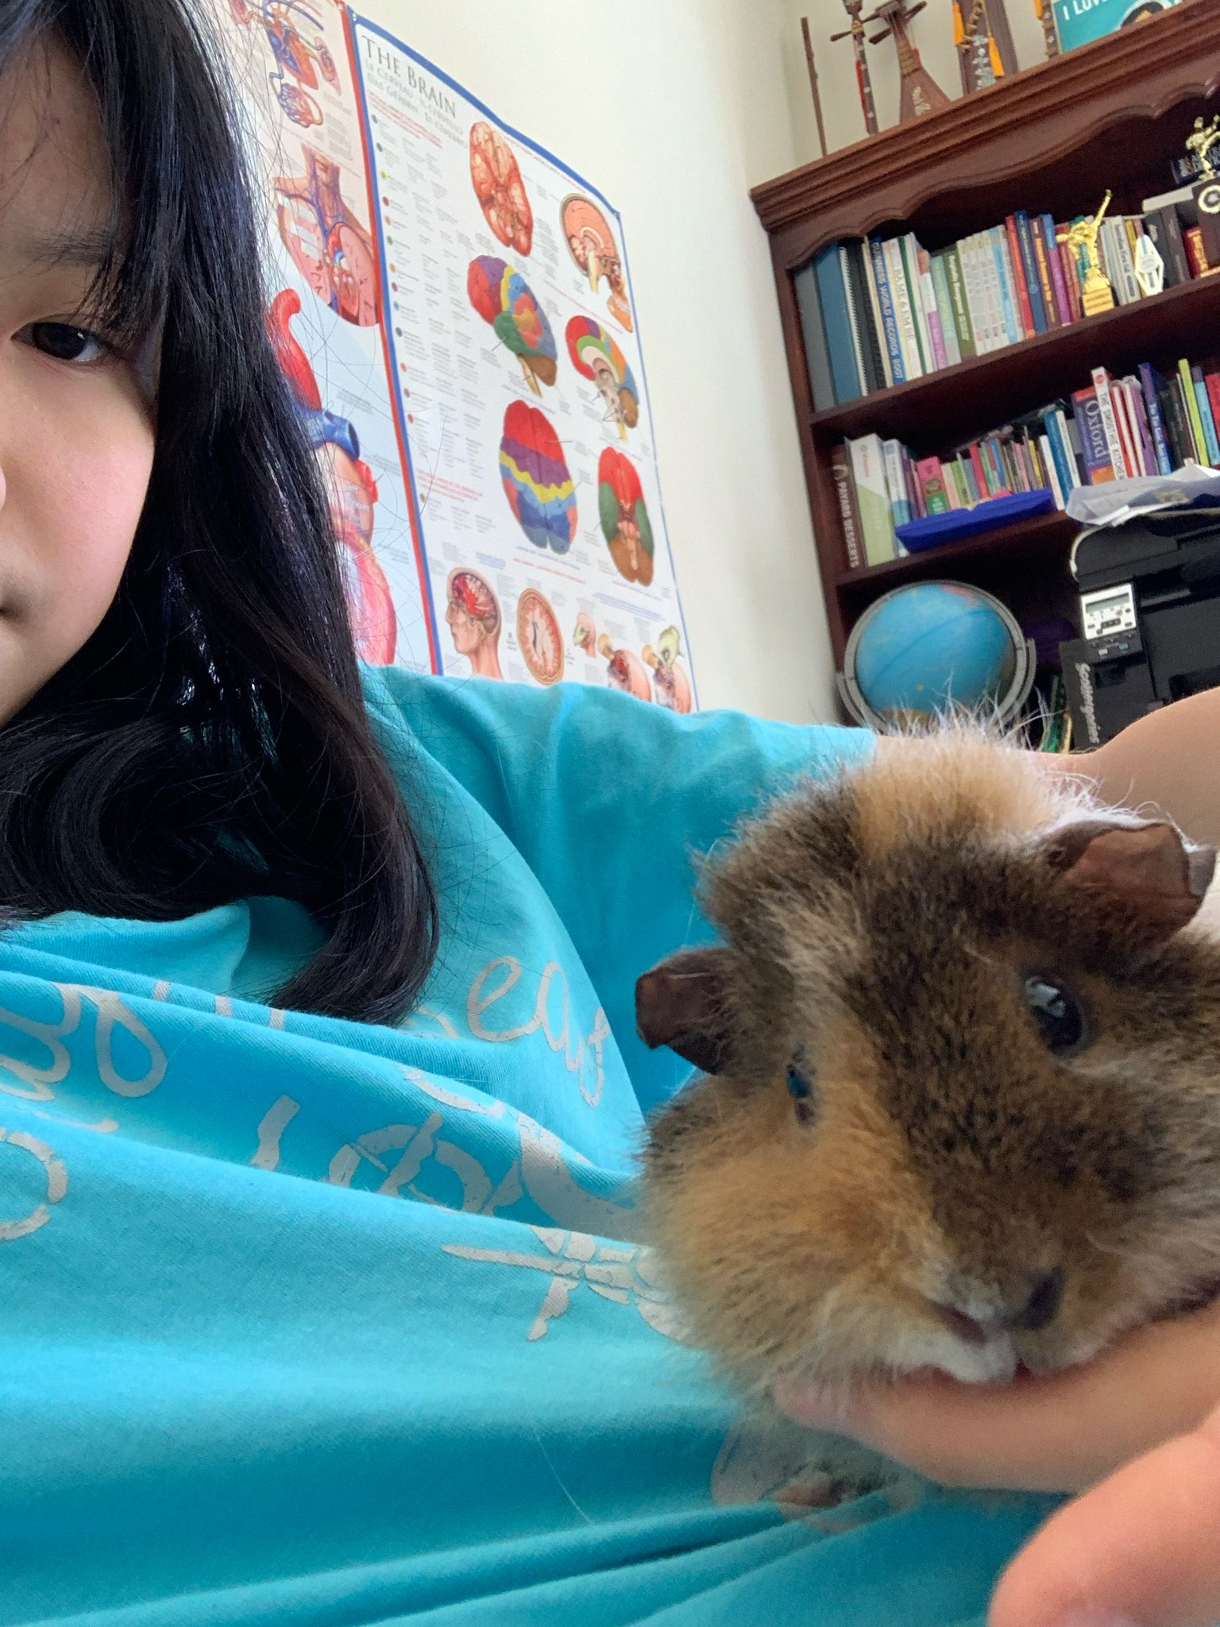
CHALLENGE #1: Cutest Pet
Winner: Chelsea Milko, Toffee & Coffee

Slide 11
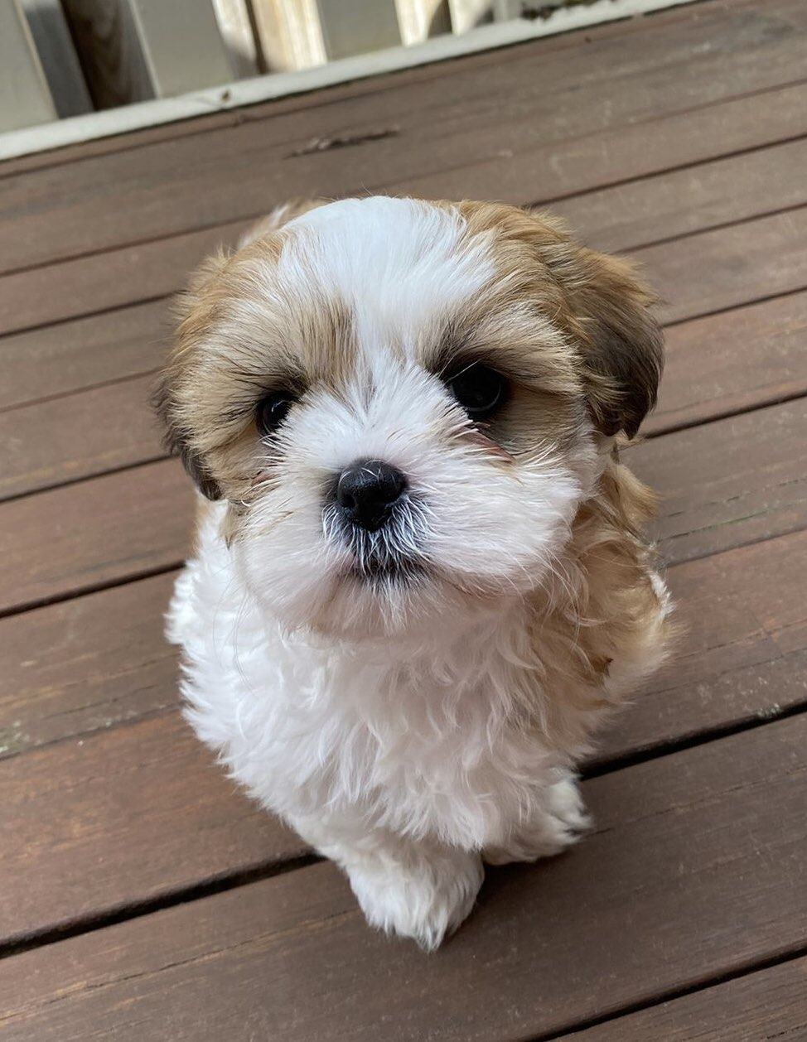
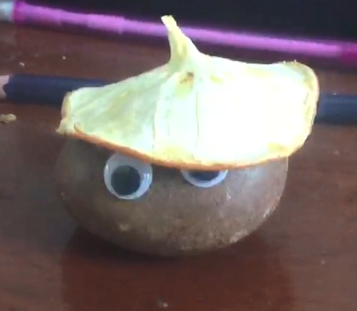
CHALLENGE #1: Cutest Pet
Runner Up: Amanda & Rusty
3rd Place: Charley & Jackson
(Dual) Lareina & Min

Slide 12
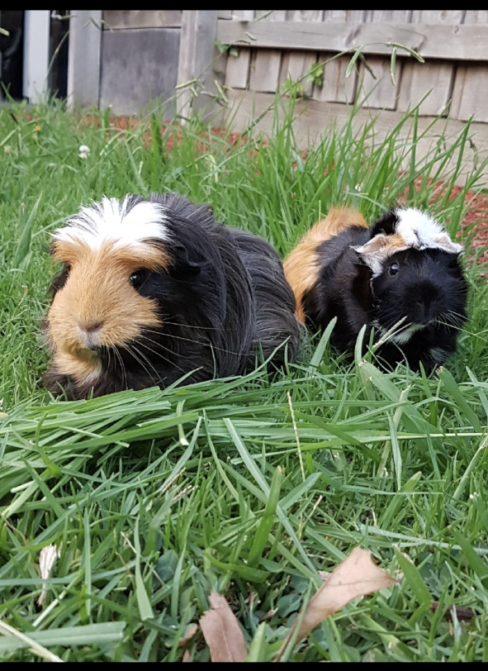
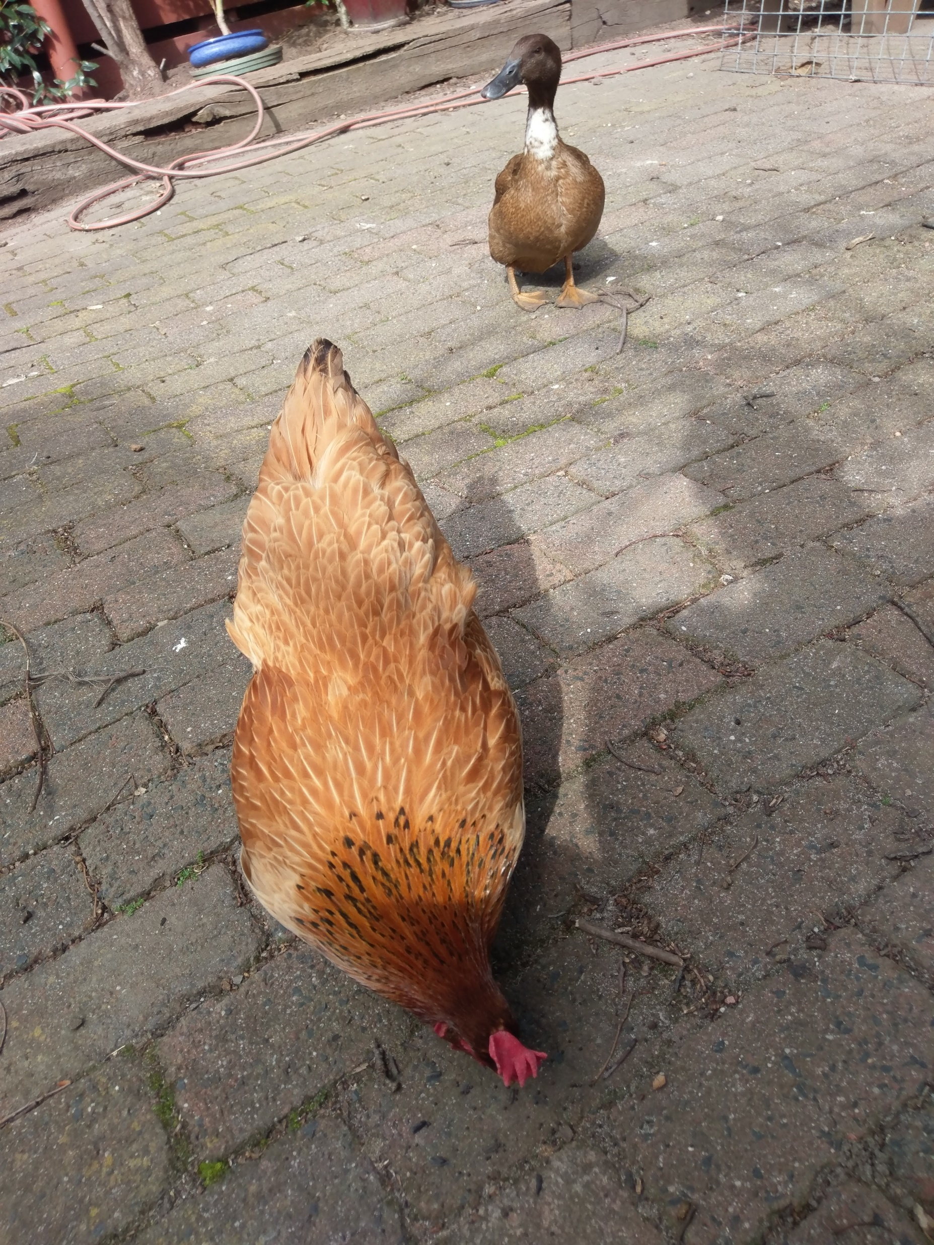
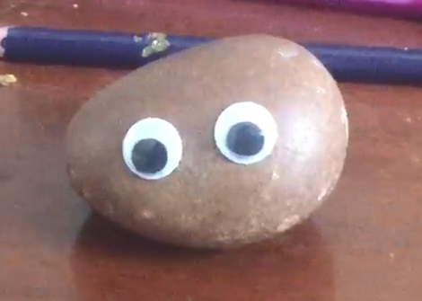
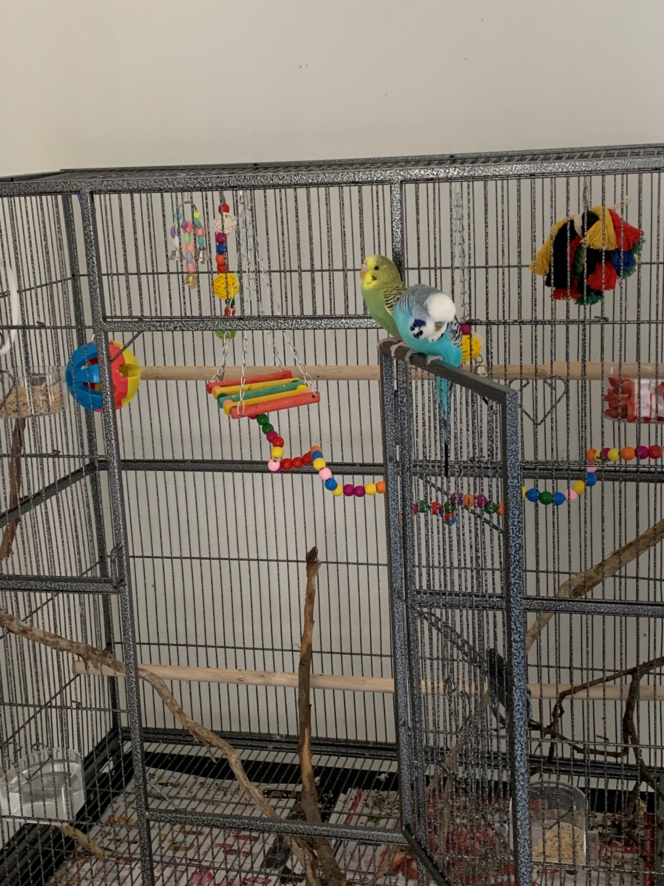
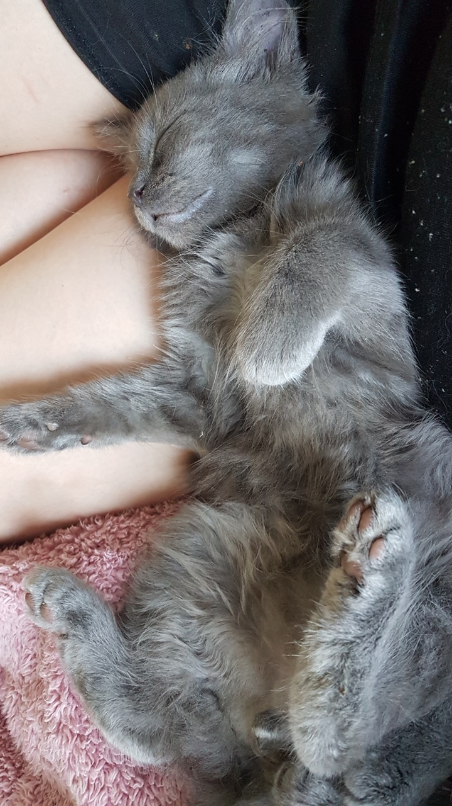
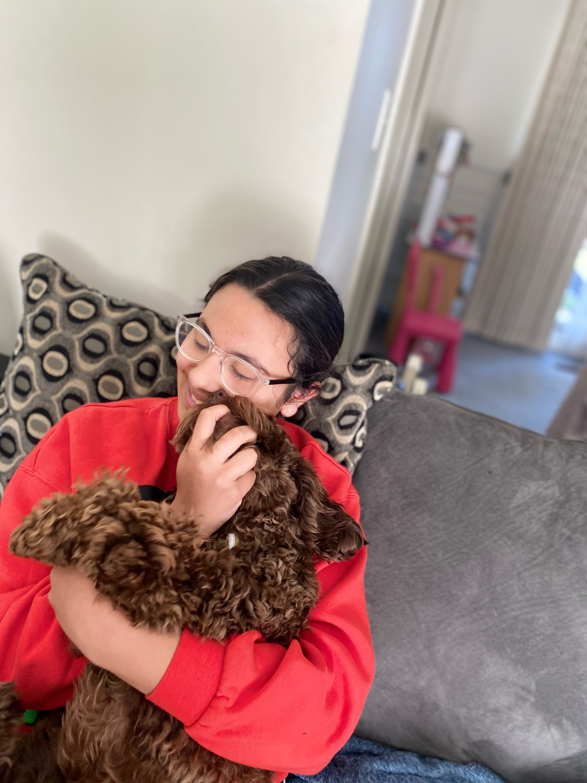
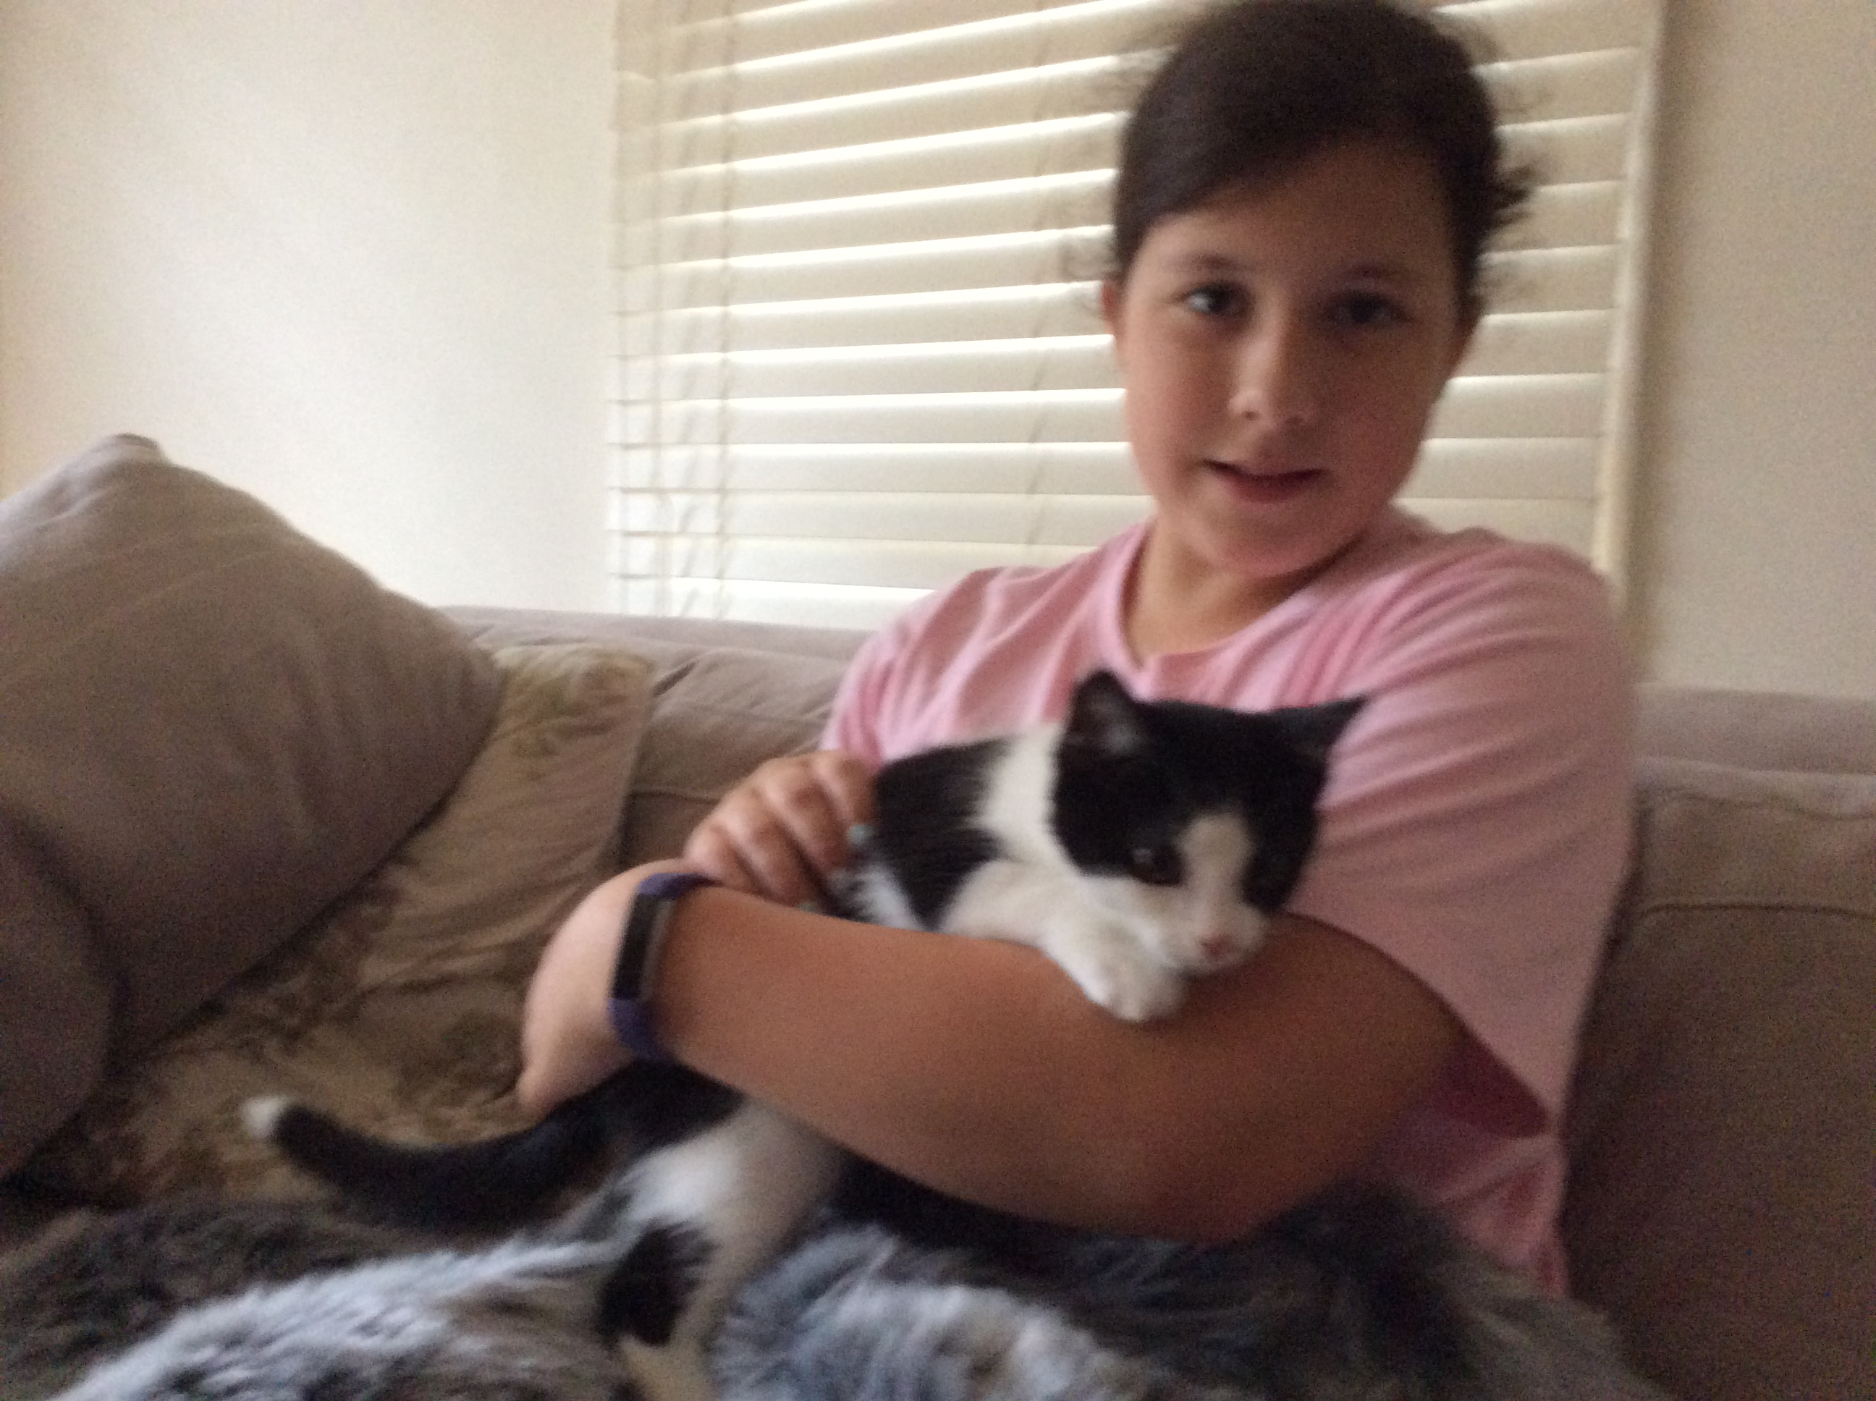
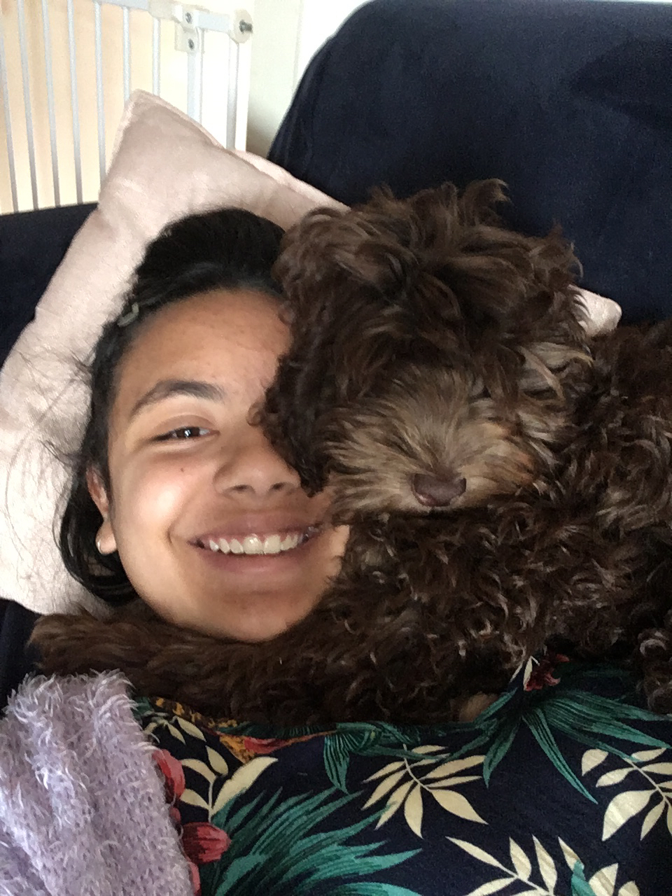
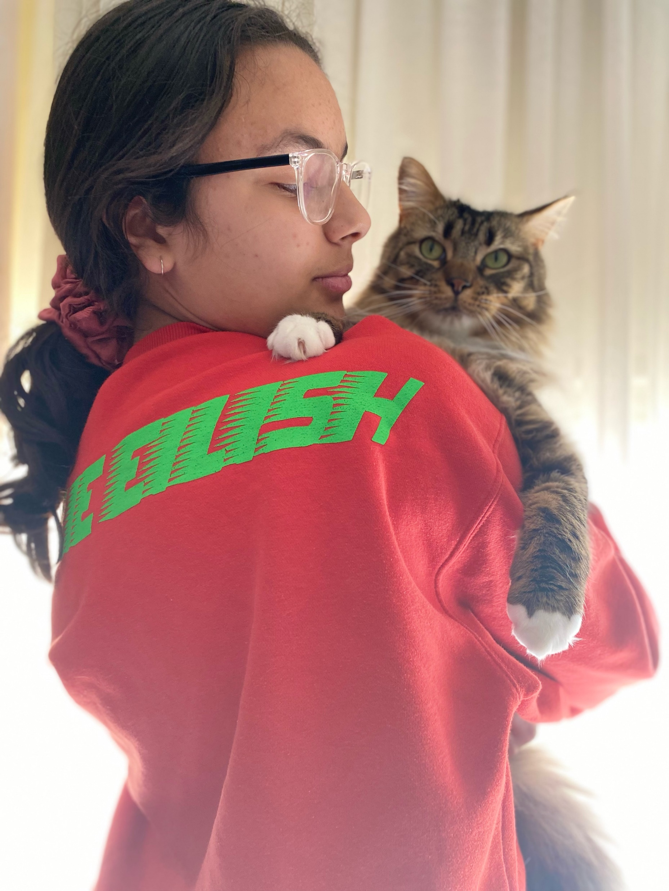
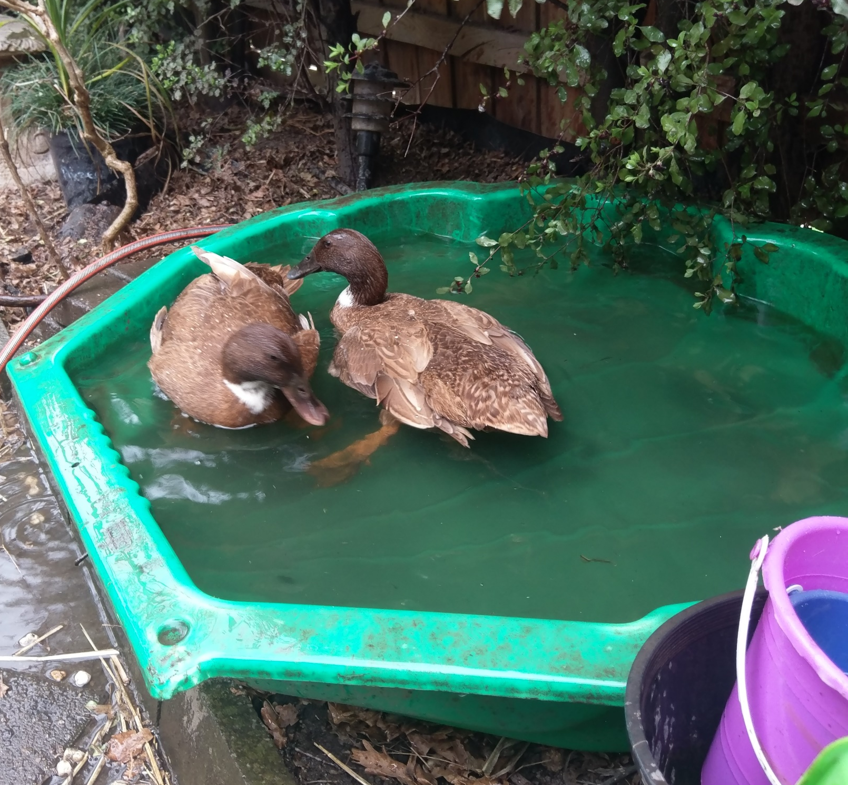
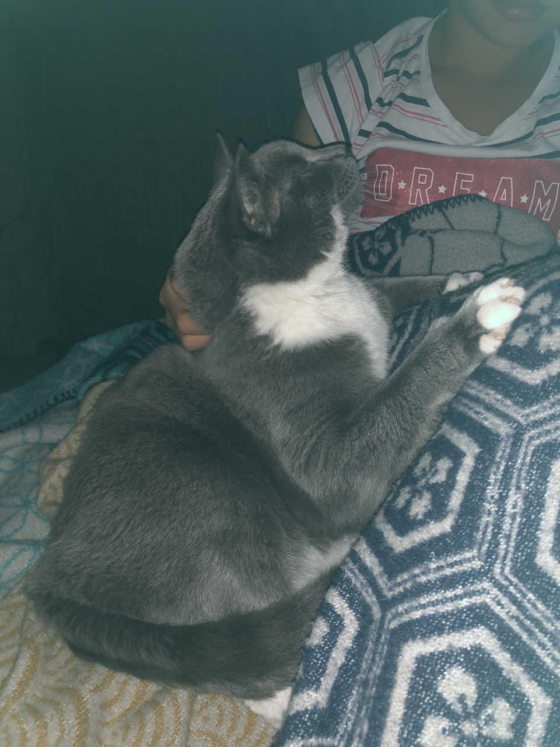
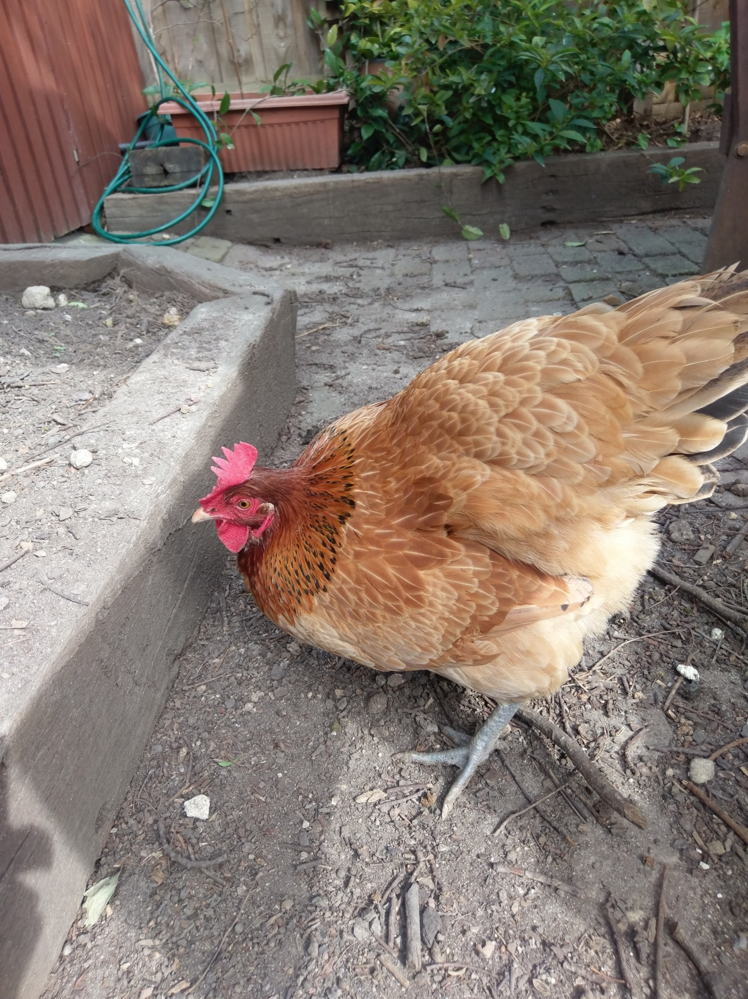

Slide 13
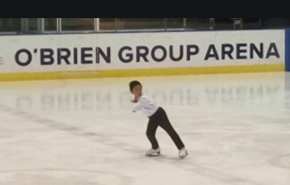
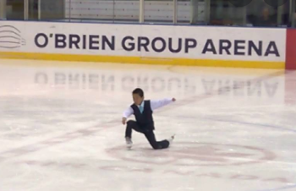
CHALLENGE #2: Trick Shot
Winner: Vinceman
Iceskating tricks
( old video wouldn’t play here – photos instead…..)

Slide 14
CHALLENGE #3: Year 7 Kahoot Quiz
Winner: Bonnie
2nd : Esther
3rd : Menna
4th : Ian
5th : Yicheng

Slide 15
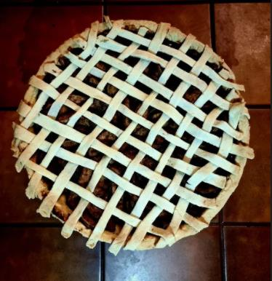
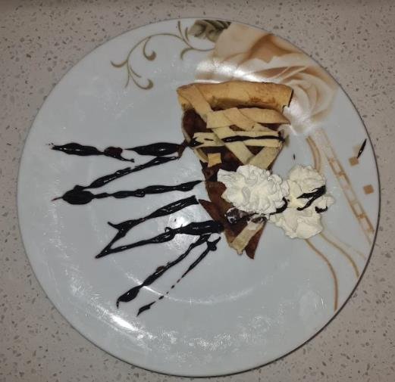
CHALLENGE #4: Creative Culinery
Winner: Malak

Slide 16
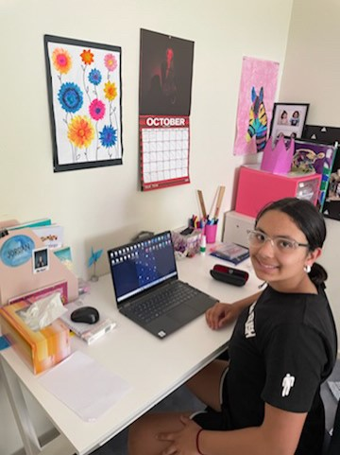
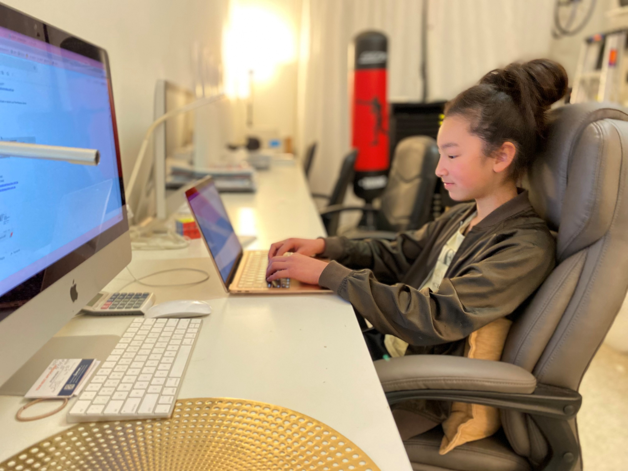
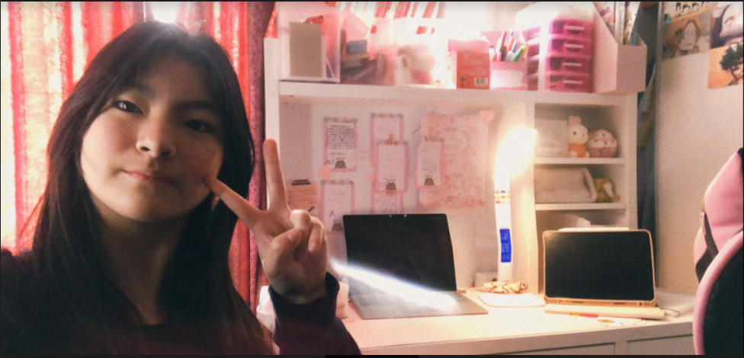
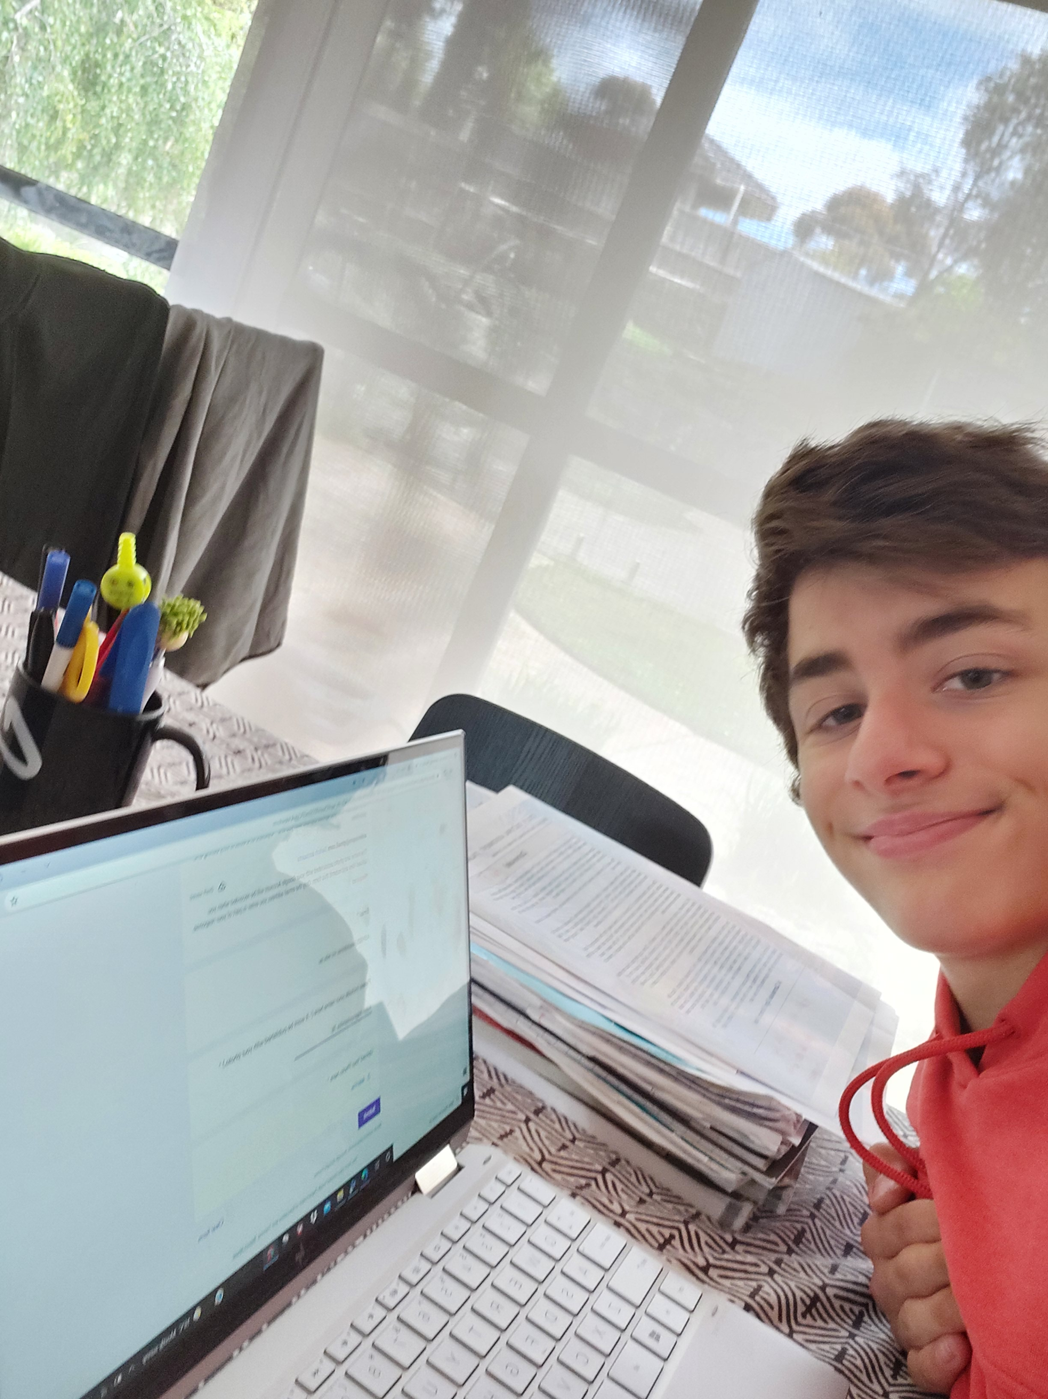
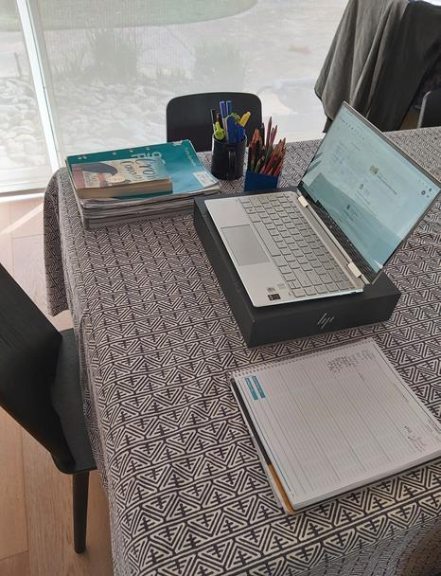
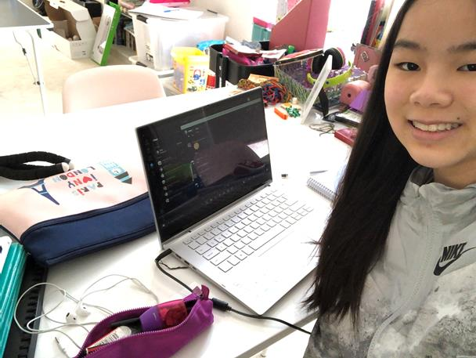
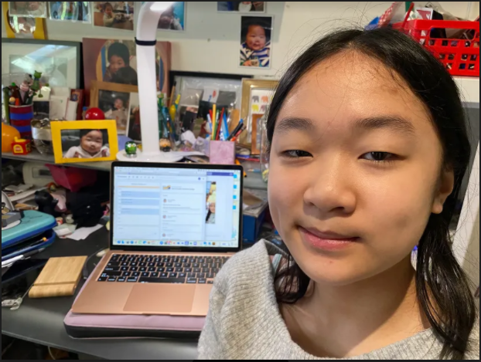
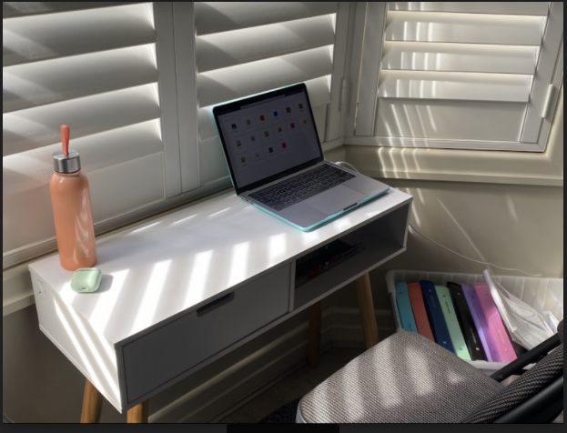
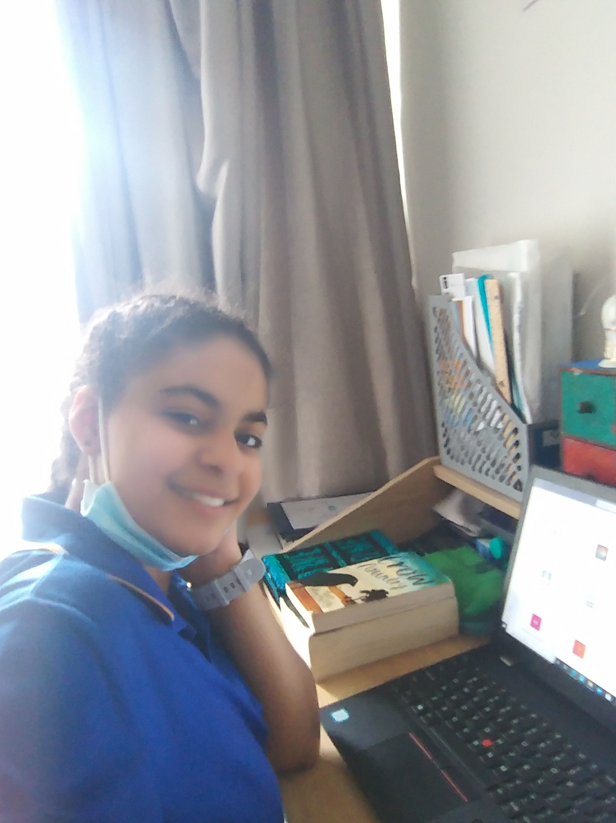
CHALLENGE #5: Remote Learning Setup
Winners:Aayan, Aiden, Amanda, Ariel, Hazel, Isabel, Jordan, Malak & Sienna

Slide 17
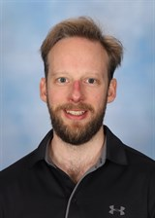
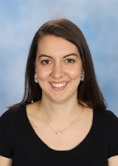
Year 8 Coordination Team
Year 8
Tom NOVAK
Year 8
Lily TRIST

Slide 18
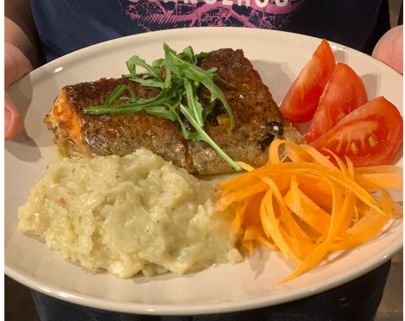
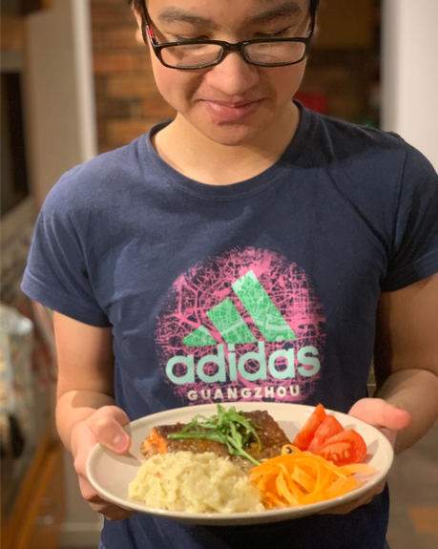
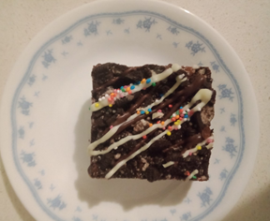
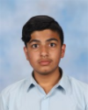
Year 8 Cooking Competition Winners
Savoury: Duc 8B Sautéed Trout with Italian Mashed Potatoes
Sweet: Moosa 8K Chocolate cake with crushed Oreos, fairy sprinkles, and a white chocolate icing
$30 voucher coming your way! Plus prizes for all entrants

Slide 19
Year 8 Welcome Back Design Competition
Well done to everyone who entered! Chocolate and house points coming your way!
See the finalists on display at the Middle School Office and around the lockers.
Congratulations to our winner….

Slide 20
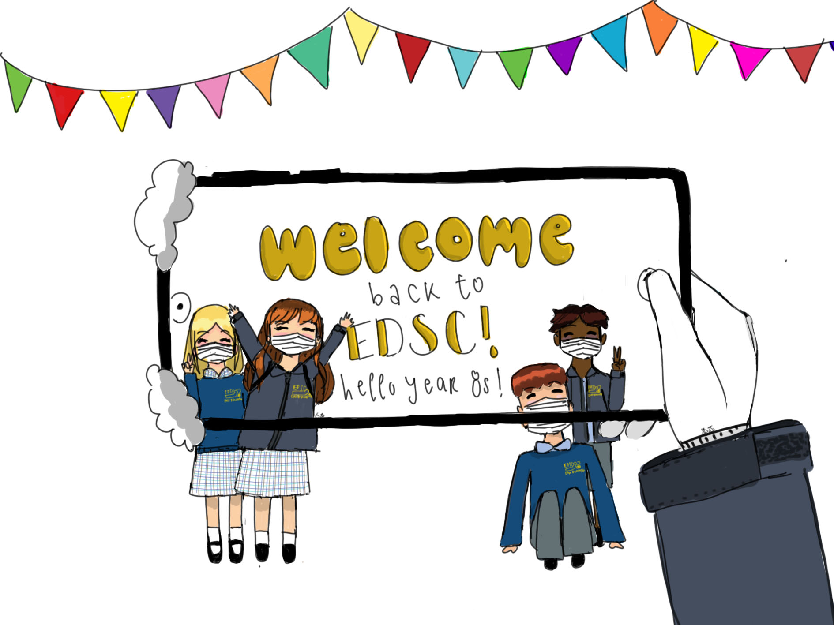
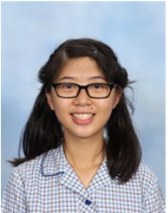
Year 8 Welcome Back Design Competition
Cheryl 8D

Slide 21
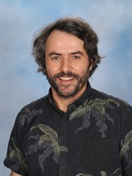
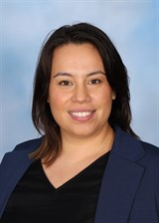
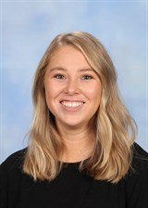
Year 9 Coordination Team
Year 9
Adam ROBB
Year 9
Giulia CATALANO
Mon, Wed, Thu
Year 9
Rebecca (Bec) MORRIS
Tue, Fri

Slide 22
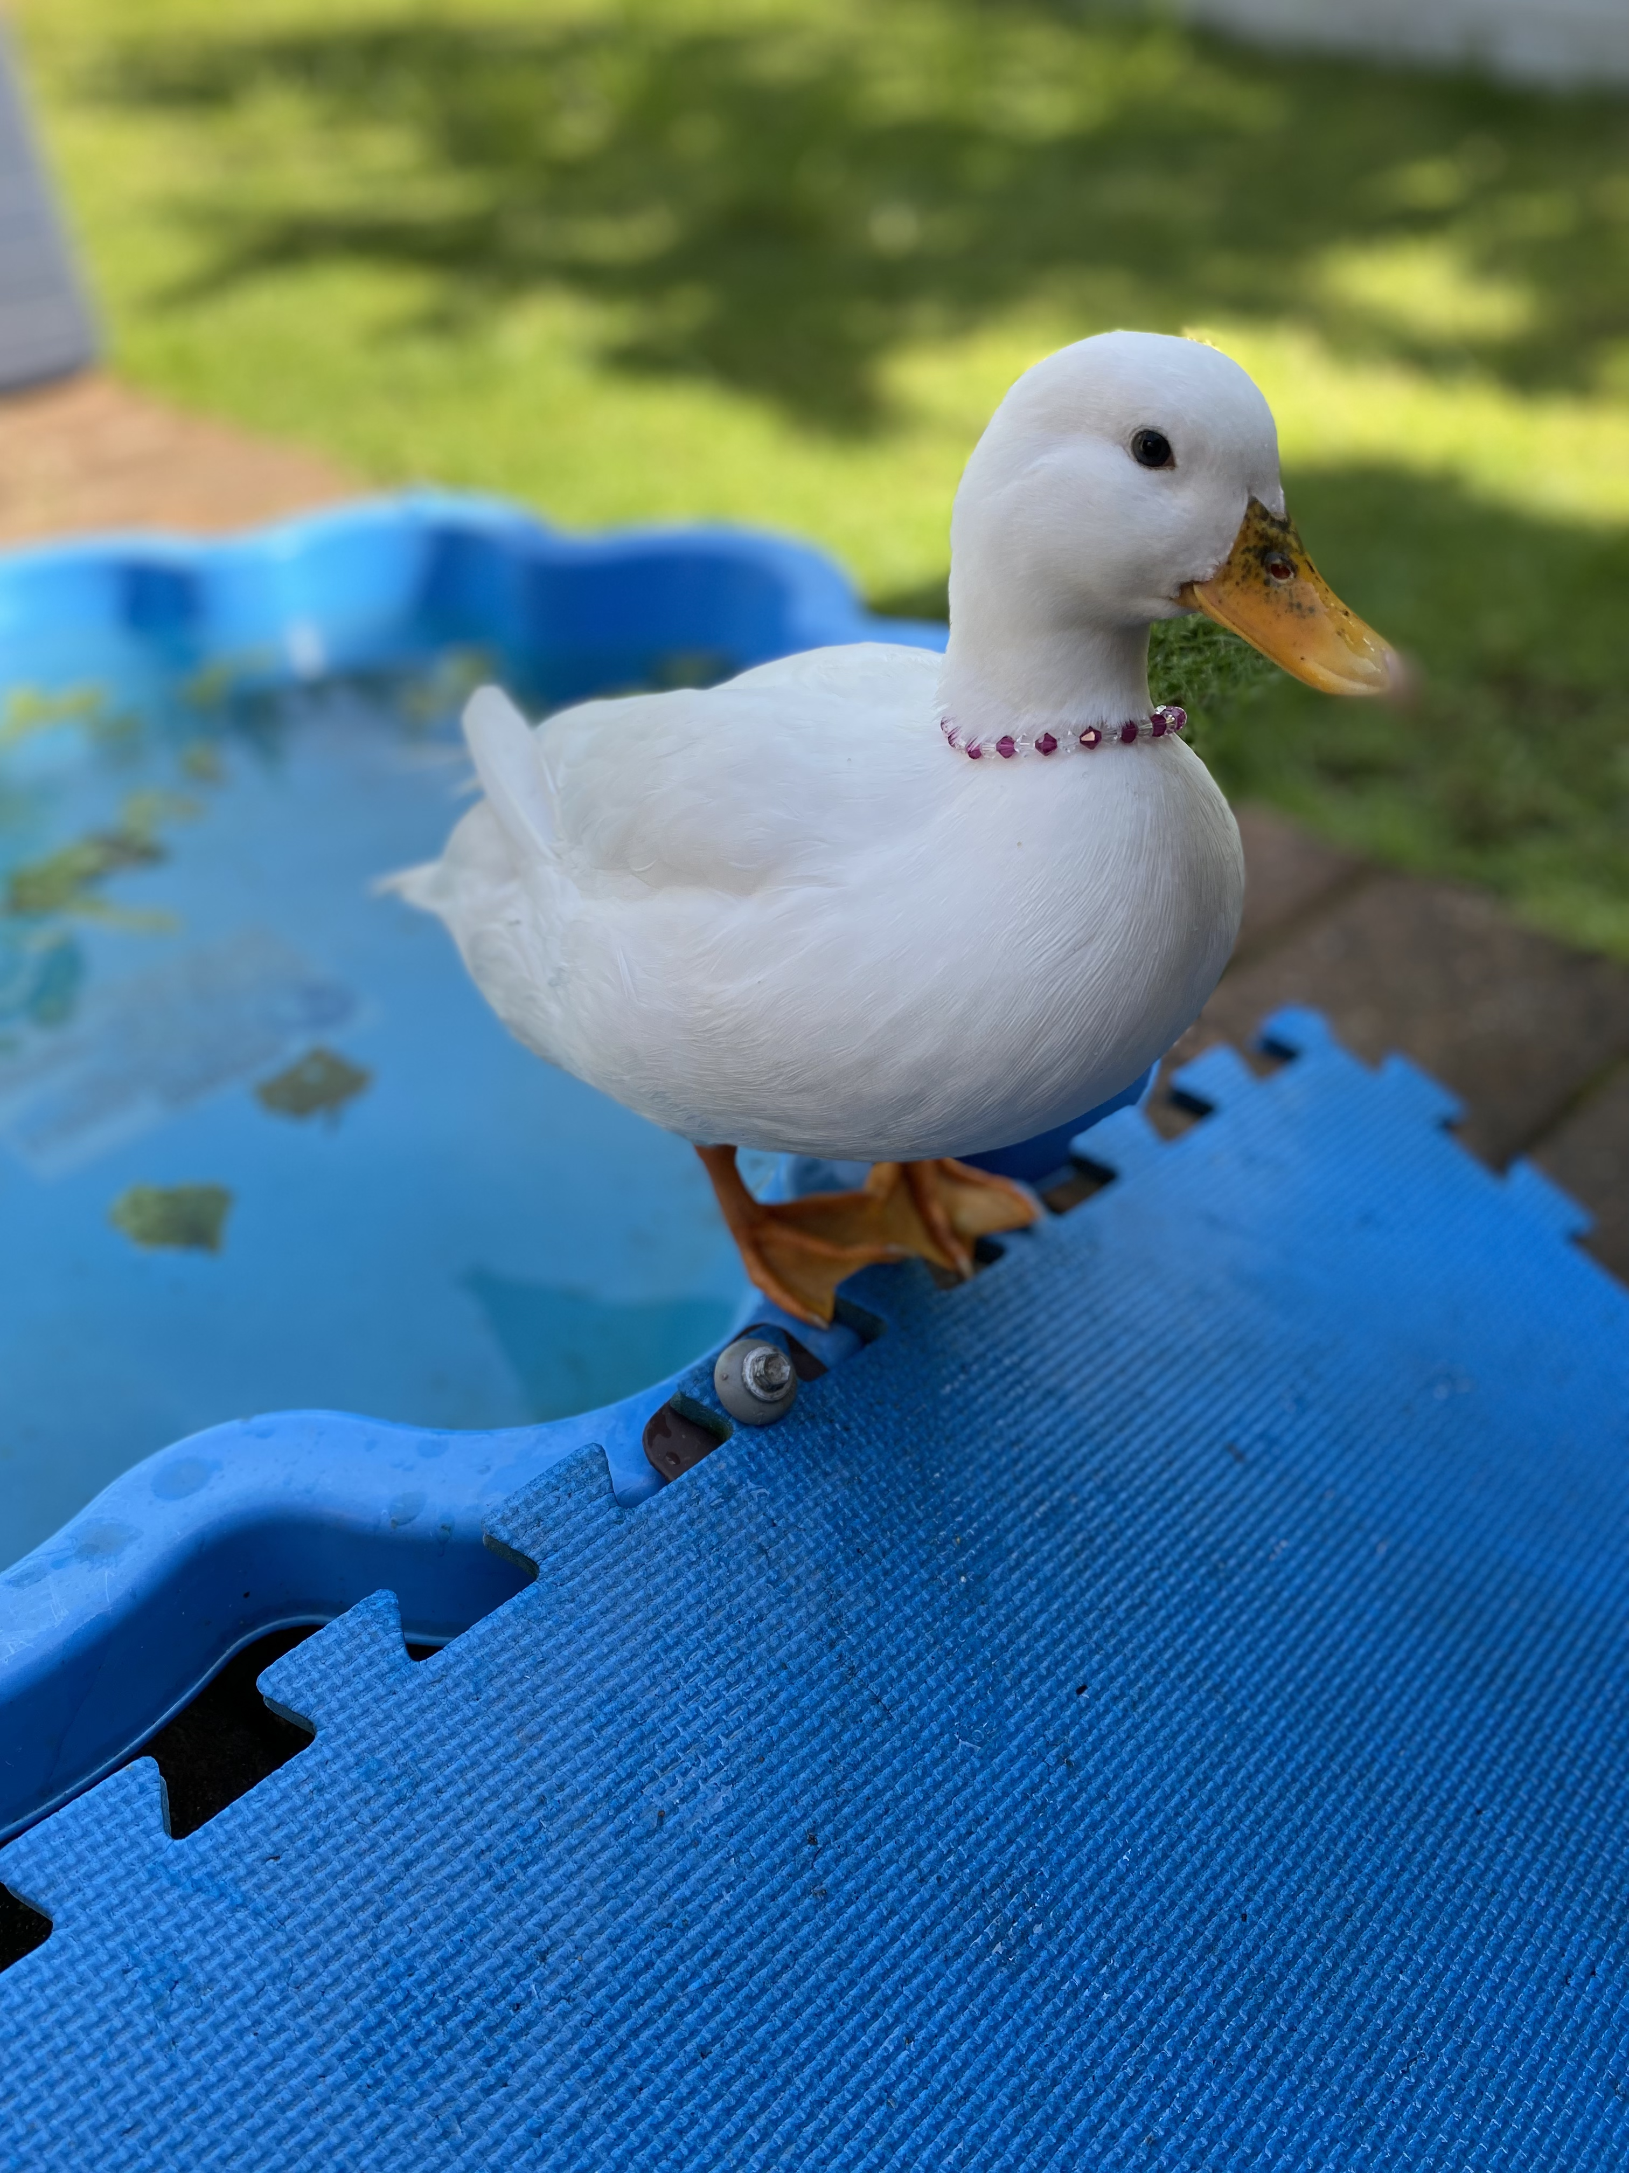
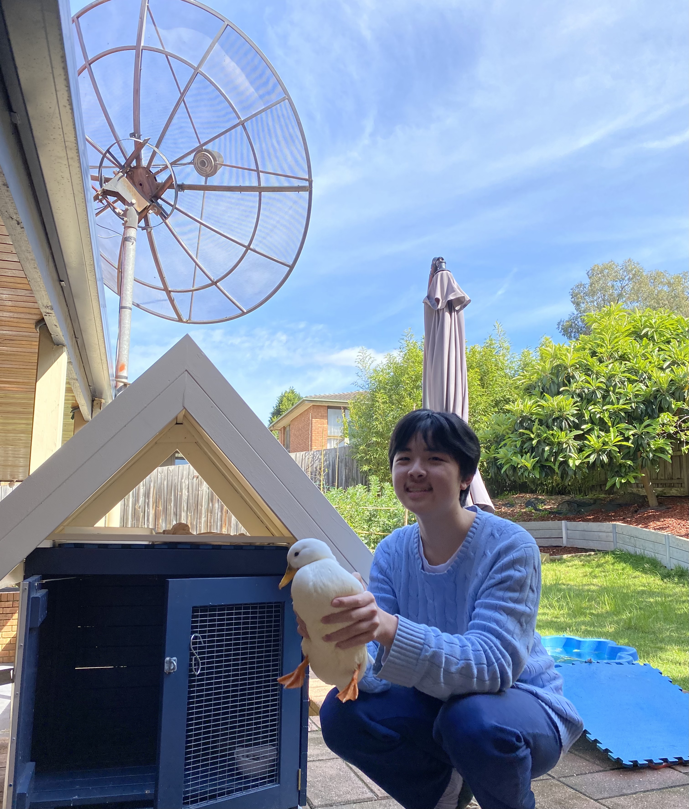
WEEK 1: BEST PET PIC
For this challenge, students were required to submit a photo or video of their pet, including one with them in it so we knew it was their pet!
To be successful in this challenge, students were asked to be imaginative and creative, but most importantly, safe when taking the pic or video.
The WINNER of this challenge is: Jerry and his pet duck.
CONGRATULATIONS JERRY!!!
Notes:
MOI

Slide 23
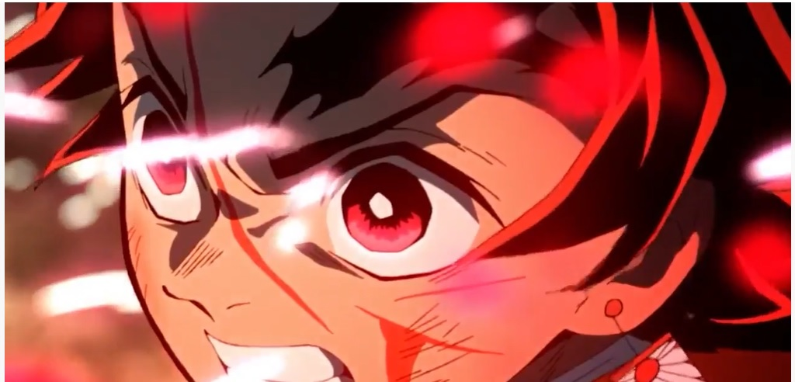
WEEK 2: BEST TIK TOK
For this challenge, students were required to submit the best Tik Tok video.
To be successful in this challenge, students were asked to
lip sync, sing, dance, act or combine any of these things in a video.
The WINNER of this challenge is: Hunter.
CONGRATULATIONS HUNTER!!!
Notes:
MOI

Slide 24
Year 9 Weekly Challenge Reminder
BIG PRIZES TO BE WON. ONE WEEK LEFT TO BE IN IT TO WIN IT!
Week 3: Best kitchen creation (cook or bake something)
Submissions taken by Friday 4pm each week - and winners announced the following week. Check the Year 9 Assembly Team for details and how to enter. (Note: pics need to include YOU in the frame for authentication!)
Notes:
CAT
Major prizes include $30 Uber Eats vouchers
(others also)

Slide 25
Upcoming Events
Compass (vital to keep checking regularly, including emails)
Middle School Leadership Positions 2022 see Ms Murray
Classes 2022/Electives 2022
Week 10 Advance Program and Activities Week
Covid Safe Practices

