Slide 1

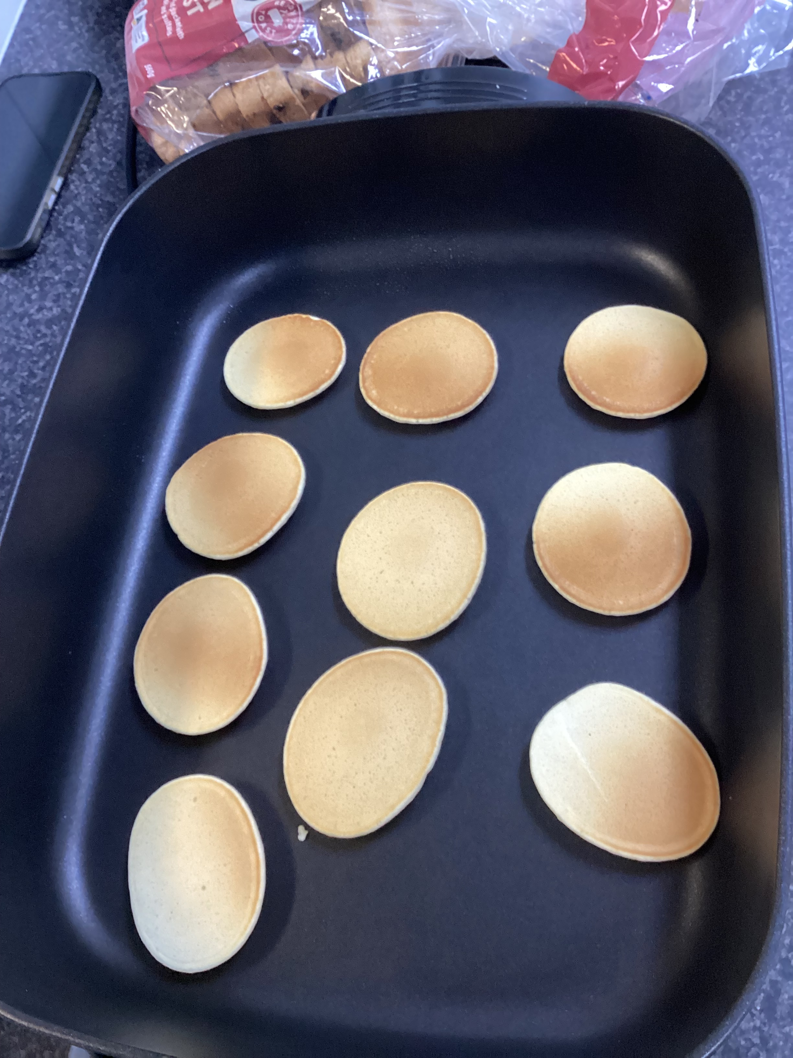
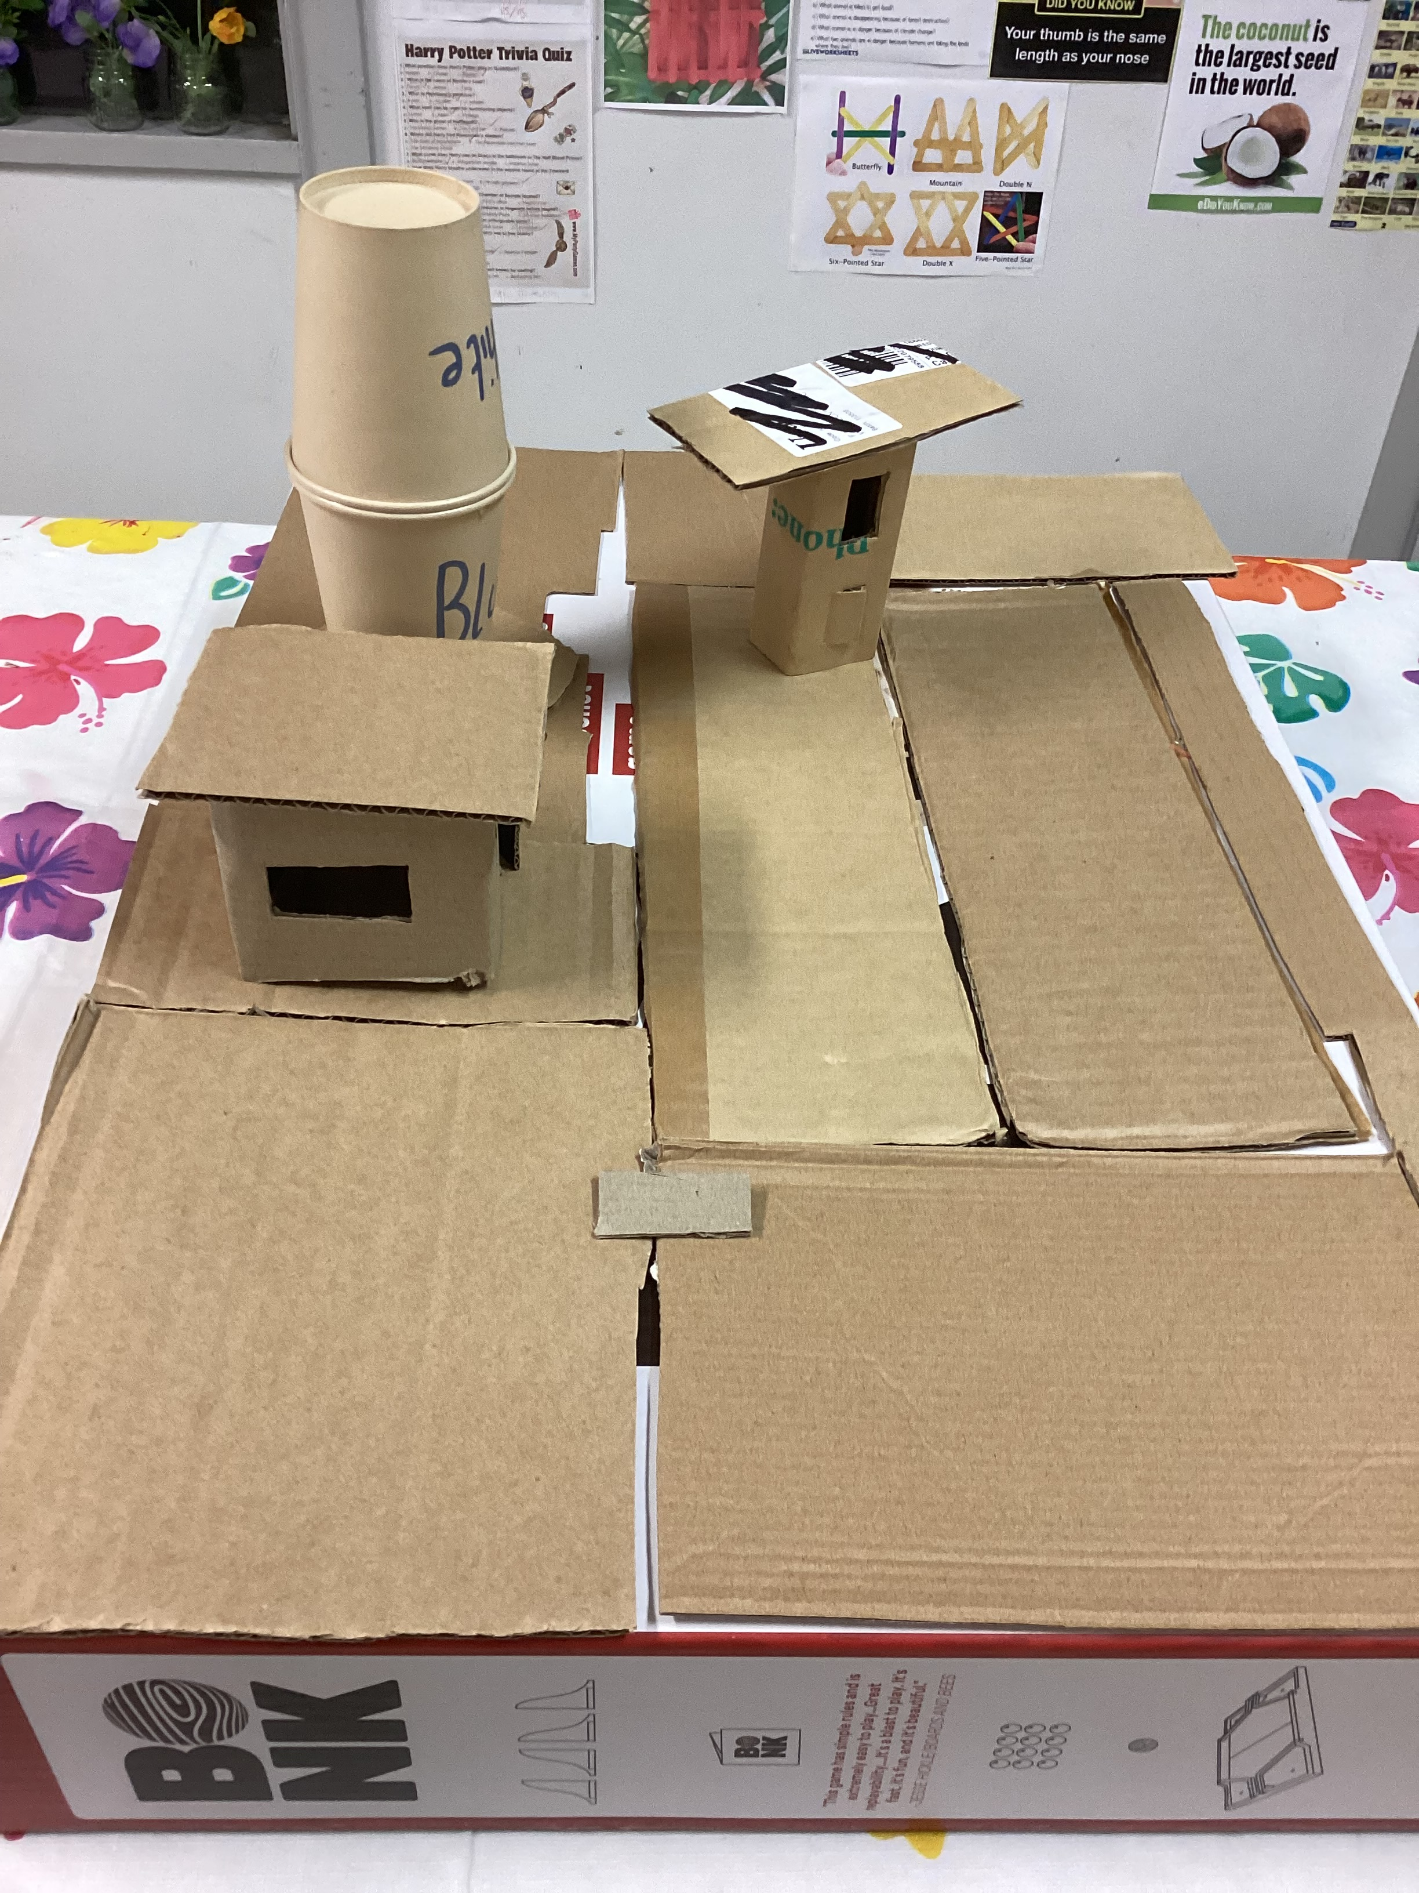
Cheltenham East Team Kids
5
Dear Parents and Guardians,
We hope this newsletter finds you well. We would like to share some exciting updates and important information with you.
1.Pancake Extravaganza: Our Thursday morning pancake sessions have become an instant hit! The children absolutely love them, and we have received numerous requests for another pancake day this week. Due to popular demand, we are thrilled to announce that Pancake Day will return this Thursday. Be sure to mark your calendars and get ready for a delicious morning treat.
2. Junk City Construction: We are pleased to inform you that our Junk City project is well underway. The recyclables collected at our before and after school care program are being put to great use in building up our very own Junk City. We would like to extend an invitation to all families to contribute recyclables from home as well. Your support will not only encourage creativity and resourcefulness among the children but also promote environmental awareness.
3. National Sorry Day - May 26th This day holds immense significance for our nation as we reflect on the healing process for our people. We believe it is essential for children to understand the importance of empathy, compassion, and the power of reconciliation. We will engage in age-appropriate activities to help children grasp the significance of this day and explore ways to contribute to the healing process. Together, we can foster a sense of unity and build a stronger community.
We hope you find these updates helpful and look forward to another wonderful week at our before and after school care program. If you have any questions or suggestions, please do not hesitate to reach out to us. Thank you for your continued support.
Warm regards,
Eric
Reading Club
Musical Theatre Club
Super Sports Club
Reading Club
Super Sports Club
Pancakes Day
25/05/2023
National Sorry Day
26/05/2023
Say Something Nice Day
01/06/2023
0432 299 468
CheltenhamEastPS@teamholiday.com.au
1300 035 000
info@teamkids.com.au

