Slide 1
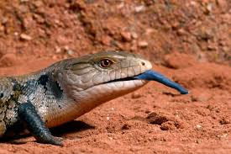
BLUE TONGUE LIZARDS
BY ISAAC

Slide 2

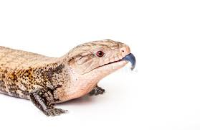
CONTENTS
WHAT THEY ARE 1
THEIR DIET 2
HABITAT 3
HI

Slide 3

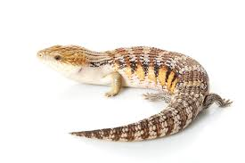
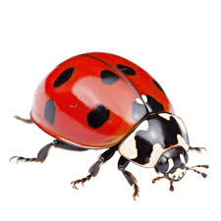
WHAT THEY ARE
BLUE TONGUE LIZARDS ARE A TYPE OF SKINK. BLUE TONGUES ARE VERY SHY AND SLOW. THEY ARE GOOD FOR FIRST TIME REPTILE KEEPERS.
NEARLY THERE
OH NO

Slide 4
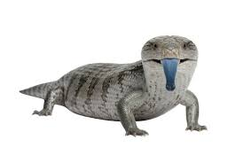
THEIR DIET
THEIR 40–60% leafy greens vegetables 40–50% high quality protein canned dog cat food insects and 10% fruit AND BUGS.
ITS TRUE ☺

Slide 5
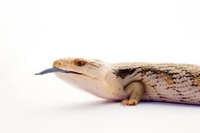
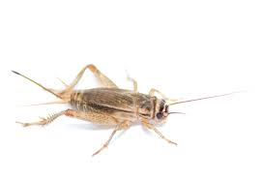

ATTACK !!!!!!!!!

Slide 6
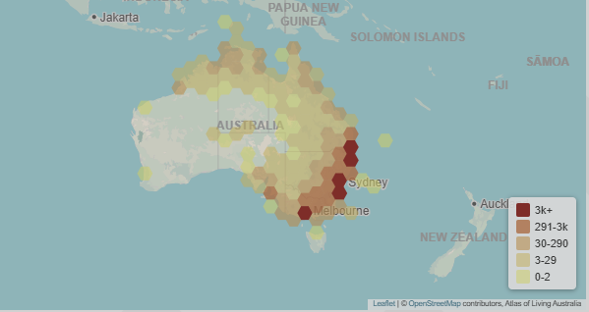
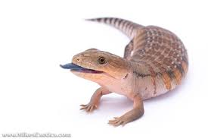
HABITAT
They live in woodlands, arid areas woodlands and grassy areas often found in human impacted areas like gardens.
THAT’S A LOT OF PLACES

Slide 7


