Slide 1
Reading in the Junior level
How to support your children at home

Slide 2
Acknowledgment of country
We would like to acknowledge the traditional custodians of the land in which we are meeting (Zooming) from today, the Boon Wurrung people, and pay respects to elders past, present and emerging.

Slide 3



List what you believe are the most important skills of a proficient reader.
Notes:
Amy
Open forum.
Give one take one.
2 minutes to write list.
Go break out room. Share ideas.
Nominate one person to share back. Collate the list.
Parents

Slide 4
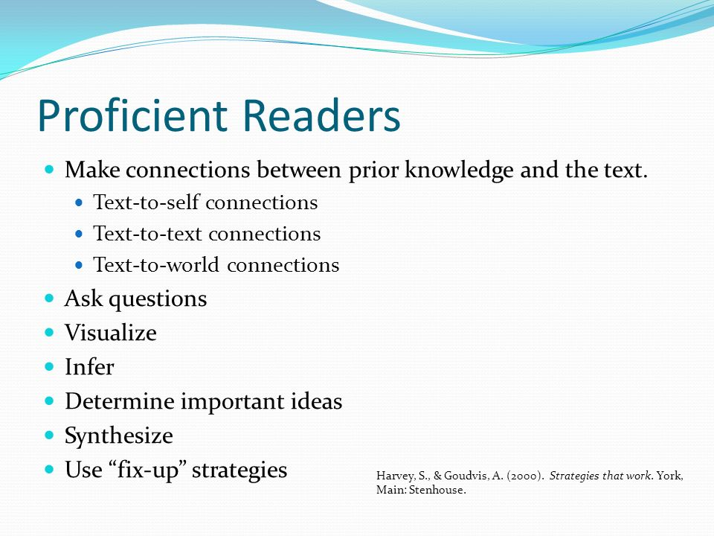
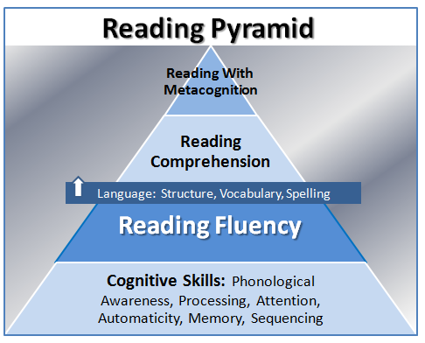
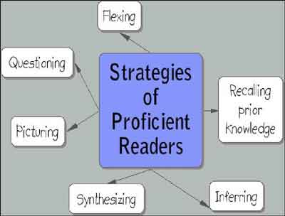
IMPORTANT SKILLS
Notes:
Amy -
Enjoyment
Confidence
Give it a go
Encouragement and support
Access to books
Where they have started and where they are going - trajectory
Strategies as beginner readers , > analytical
This workshop is talking about building a love of reading
How we promote reading and encourage students to foster a love of reading - we need to be careful with how much we balance important skills + interest
Model, praise, scaffolding, authentic/ purposeful teaching
Gradual release of responsibility ( model, I do with you, you do with me, whole class, independent)

Slide 5
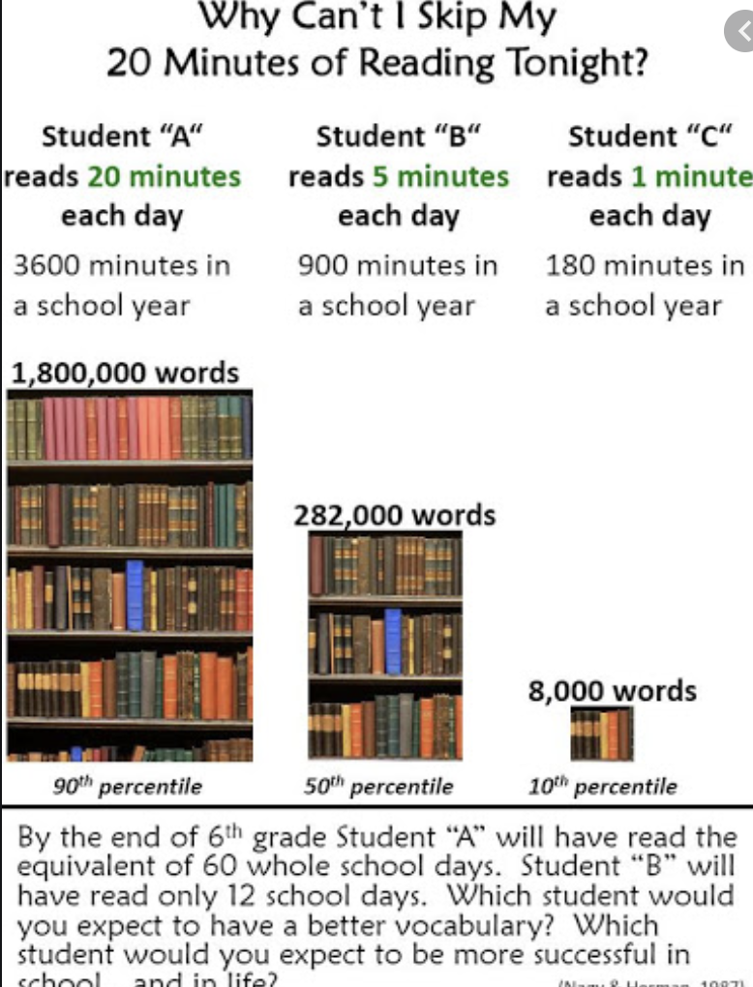
Why daily reading matters!
Mix between read aloud and modelled reading- why it’s important to do both
Reading is directly correlated to increase in vocabulary exposure, improvement in spelling and writing.
“You can be a reader without being a writer but you can't be a writer without being a reader”
Notes:
Amy-
Spelling is very developmental
Correlation between reading and being able to spell and write

Slide 6


Reading is thinking
You have 20 seconds to draw an apple. Share
You now have 20 seconds to draw thinking. Share
What most people draw is a representation of thinking-we need to make it explicit to children that Reading is Thinking and because thinking is entirely inside your head, your thinking needs to be made visible.
We read words with our eyes, but...
We use our brain to make sense of the words that we read.
Notes:
Vanessa

Slide 7
Reading skills

Slide 8
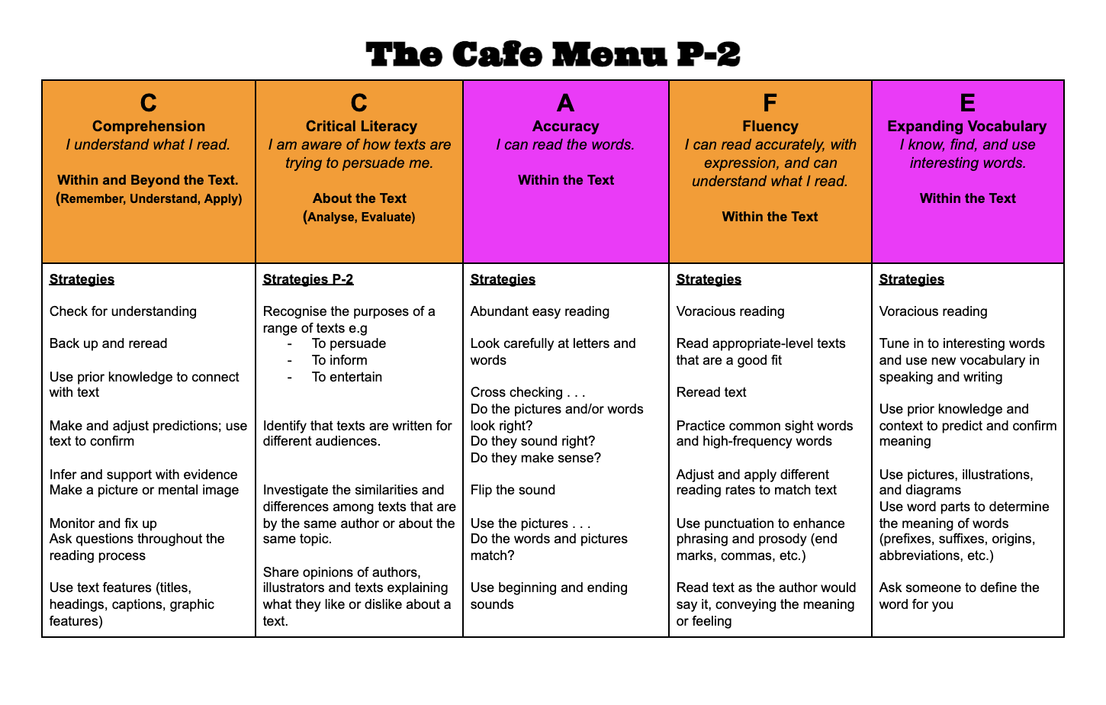
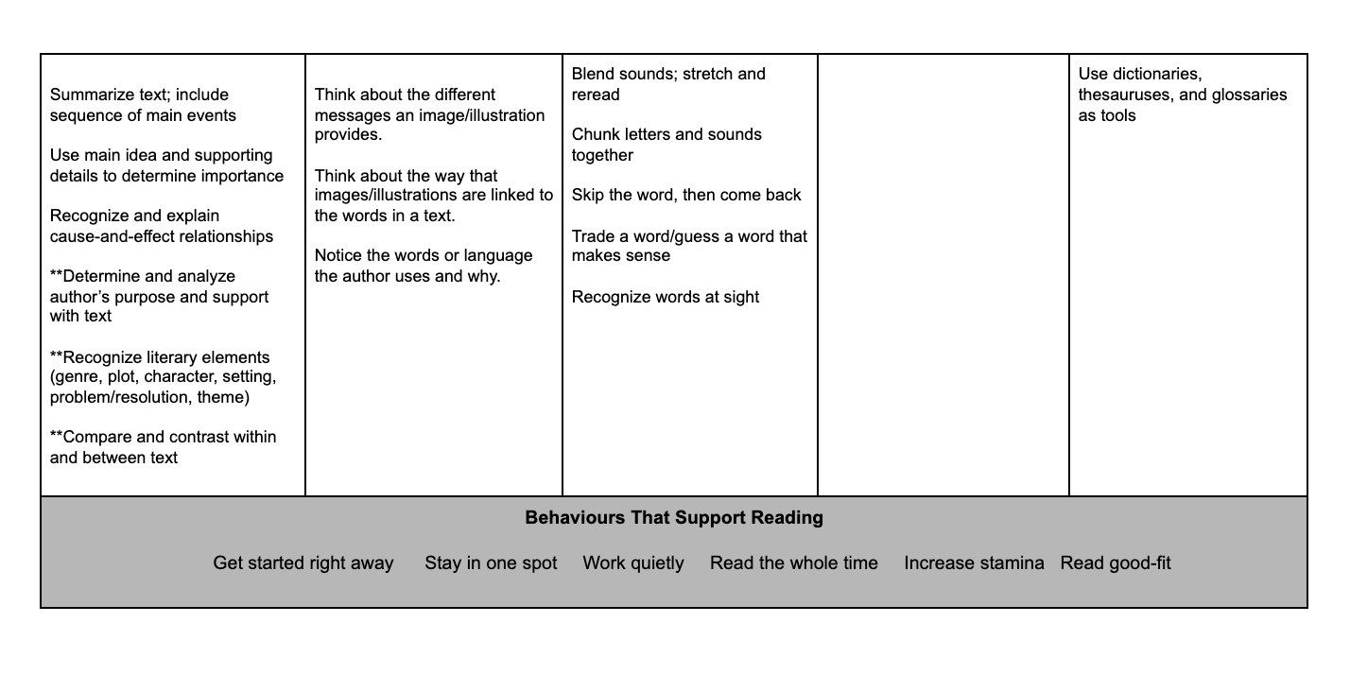
CCAFE- Framework we use with children to support their reading. Focussed on 5 key areas:
Comprehension, Critical Literacy. Accuracy, Fluency and Expanding Vocabulary.
Statements underneath described the skills and strategies required for proficient reading.
Power of Thinking Aloud-you don’t know what you don’t know. Modelling of higher order thinking and discussion around vocabulary is what we call “teaching up”-giving students the tools they need to succeed.
Notes:
Vanessa

Slide 9
Scaffolds and supports to use at home

Slide 10
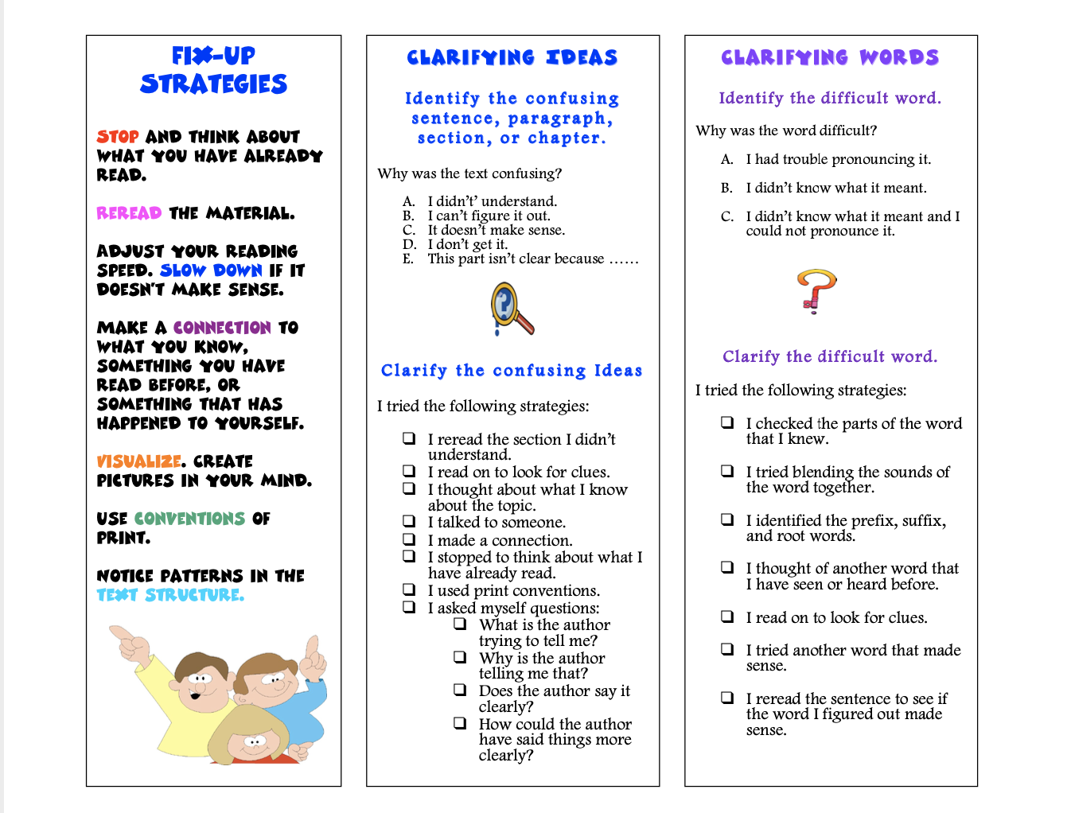
Clarifying strategies to use at home
Notes:
Amy-
these all available and pop them on Drive

Slide 11
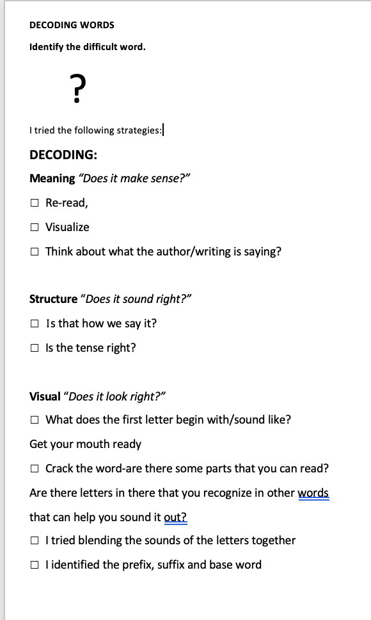
Decoding strategies to use at home
Notes:
Amy-
Decoding is a key skill for learning to read that involves taking apart the sounds in words (segmenting) and blending sounds together.
familiar with decoding strategies that may emphasize the use of picture clues, meaning and self-monitoring
phonological awareness - Students need to be able to hear the differences between two sounds, break a word into its individual sounds and blend those sounds
Syllable Division - unknown word, By locating vowels, then syllable divisions = rab/bit
Looking for familiar spelling patterns - Looking for familiar spelling patterns such as digraphs, blends, or chunks (SMART spelling)
Identifying Affixes, base words and roots - a critical part of reading and spelling more complicated words (re-ject)

Slide 12
Text choice for engagement

Slide 13
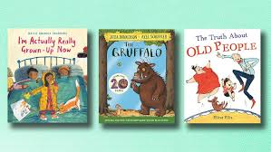

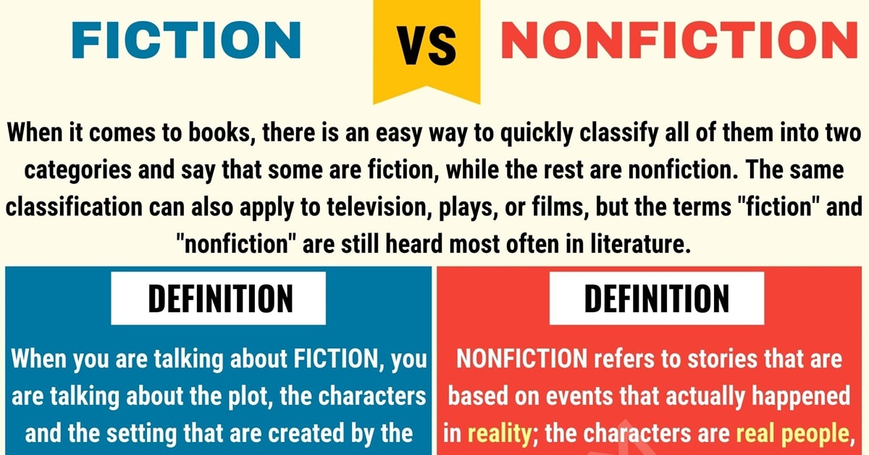
Multi-modal literacies-authentic texts to engage with your children to ensure A BALANCED READING DIET.
Multi-modal print, Digital and Live.
Links to rich texts (picture books)
Documentaries
Recipes
Procedural texts (Lego, recipes etc)
Mix between fiction and non-fiction
WUSHKA (see classroom teacher for login details)
Take-home readers
Importance of STUDENT CHOICE-We want to foster a love for reading. Choice and balance of feedback is crucial.
Notes:
Vanessa -
Young people need to be able to communicate effectively in an increasingly multimodal world. This requires teaching children how to comprehend and compose meaning across diverse, rich, and potentially complex, forms of multimodal text, and to do so using a range of different meaning modes.
Multimodal texts include picture books, text books, graphic novels, comics, and posters, where meaning is conveyed to the reader through varying combinations of visual (still image) written language, and spatial modes.
Digital multimodal texts, such as film, animation, slide shows, e-posters, digital stories, and web pages, convey meaning through combinations of written and spoken language, visual (still and moving image), audio, gestural and spatial modes.
Live multimodal texts, for example, dance, performance, and oral storytelling, convey meaning through combinations of modes such as gestural, spatial, spoken language, and audio.

Slide 14
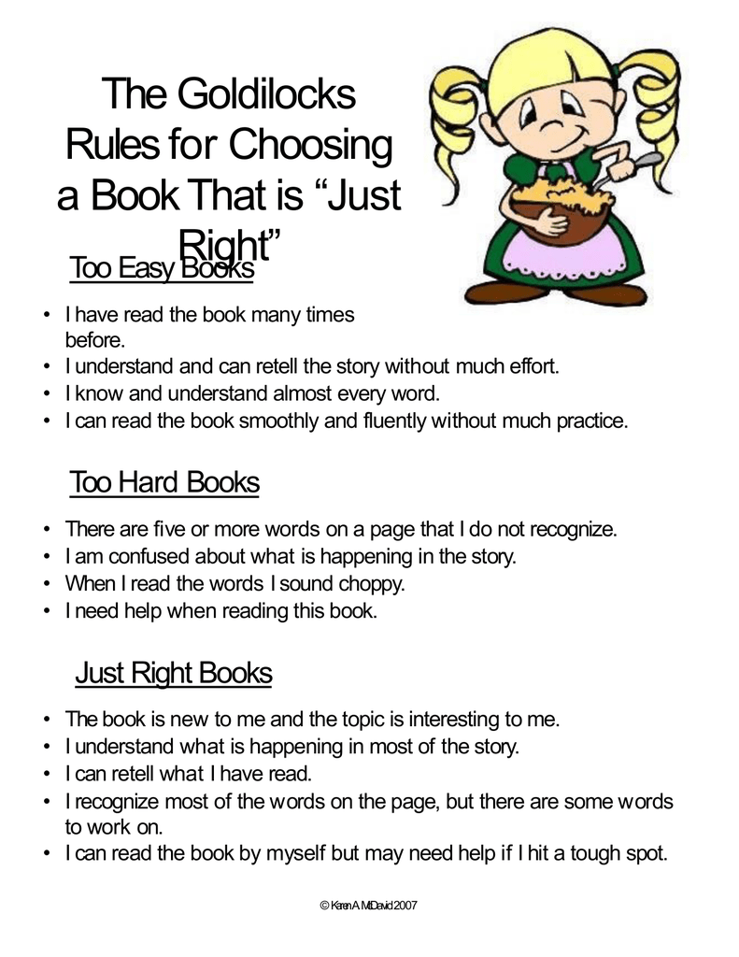
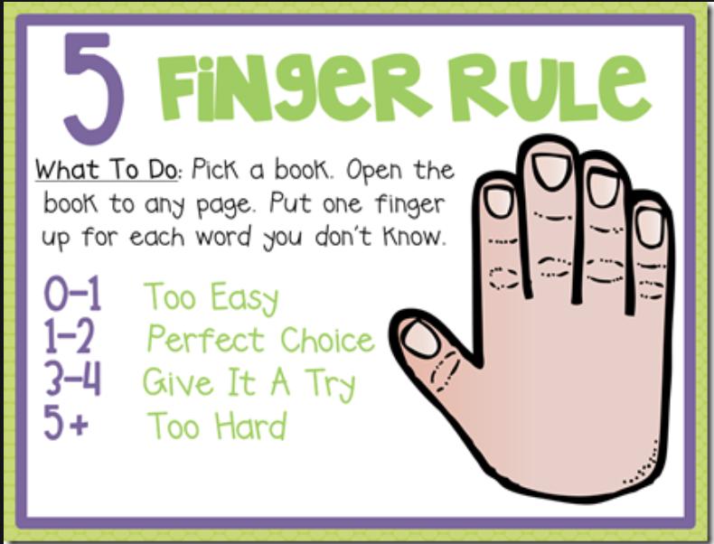
Just right book-how to help kids identify what’s a JR text
HIT-
Multiple exposure. The power of re-reading!
Notes:
Amy
-push that there will be times kids bring book too easy
-stress part learning process
- for learning to be imbedded in our long-term memory, we must be exposed more than 21 times
- re-reading, taking in new information, re-reading for deeper meaning

Slide 15
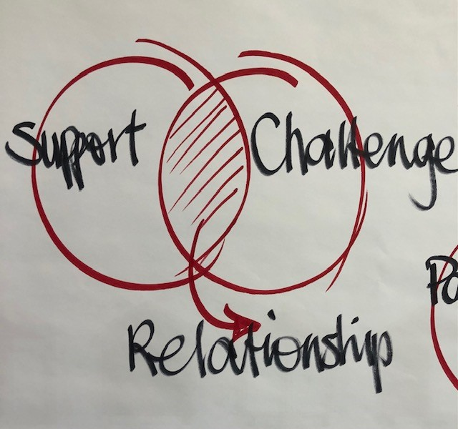
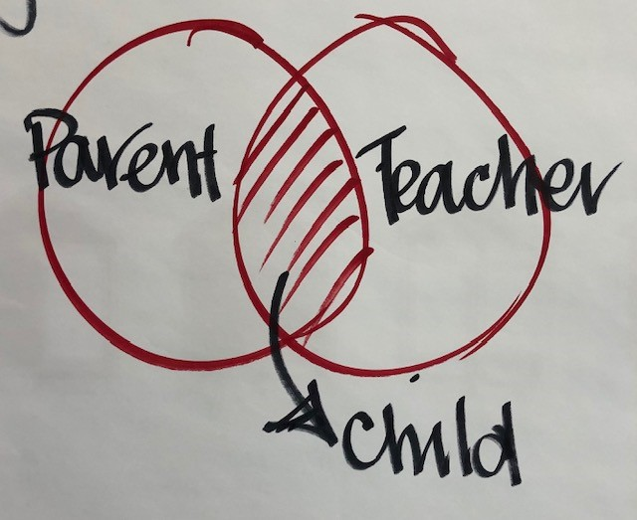
Support and challenge Venn Diagram
The last thing we want is for children to be risk averse.
Notes:
Vanessa and Amy

Slide 16
Summary-so what to do to foster a love of reading?
Reading pyramid - cognitive skills > reading fluency > reading comprehension > metacognition
2. “You can be a reader without being a writer but you can't be a writer without being a reader”
3. Reading IS thinking
4. Clarifying and decoding strategies to use as home
5. Multimodal texts and the importance of a reading diet
6. Just right books to build confidence and expand vocabulary
Notes:
Amy

Slide 17
Questions?

