Slide 1
YEAR 9 ASSEMBLY
Welcome students and parents!
24/5/2024

Slide 2
Doncaster Secondary College acknowledges the Wurundjeri people as the traditional custodians of the land now known as Manningham. We pay our respects to Wurundjeri Elders past and present and value the ongoing contribution to the cultural heritage of Manningham.

Slide 3
What will we cover today
eSafety & Consent
Attendance
Course Selection
Moving into year 10
World Challenge
House Keeping

Slide 4
World Education Program
WEP send high school students to countries all over the world for short term, semester, and year programs. While on exchange, students attend school full-time and live with a host family. They adapt the way of life like a local teenager.
Students experience different customs, improve language skills, and develop personal skills such as confidence, maturity, communication, and global understanding. These skills set students up for success in their future studies and career goals.

Slide 5
eSafety & Consent
What do you consider when you share videos and photos??
Consent means genuine agreement to take part in an activity or for a specific thing to happen.
You should always ask for consent before sharing a photo or video.
If someone asks you to remove a photo or video, you should do it, no questions asked.
If a photo or video of you has been shared without your consent, ask the person who posted it to take it down, review your privacy settings, and make a report if it’s a nude or sexual image or video of you.

Slide 6
Attendance
Goal = All students on 100%
At VCE to pass you MUST have 90% attendance

Slide 8
How can I view my attendance?

Slide 10
Why does attendance matter?
Those with attendance at 90% or above will be prioritised during subject selections.
Subject selections begin in Term 3

Slide 11
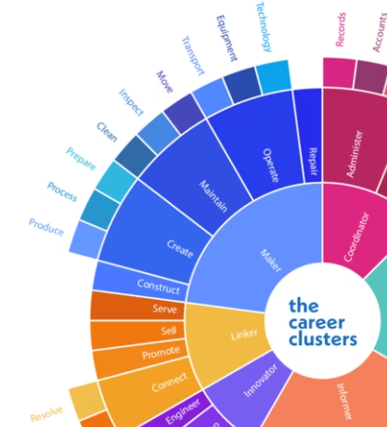
Cluster Day - makerS
The Makers work with their hands as they monitor, build, fix, grow, and maintain. The Makers work with their hands as they monitor, build, fix, grow, and maintain.
The Makers are busy people who keep everything up and running. There are few desk jobs in this Cluster.
Most Makers can be found using specialised equipment, moving between worksites, and using their technical skills alongside their specialised knowledge.

Slide 12
Cluster Day - makerS
Wednesday May 29 Bring your curiosity, questions and enthusiasm
Periods 1 & 2 | Subject Expo and Subject Selection tasks
Periods 3 & 4 | Cluster Day Activities 40 students – Empowered Women in Trades Multiple activities exploring Trades, VET, and more!
Period 5 | Virtual Work Experience activity

Slide 13
VCE Advancement
Requirements, a culmination of:
2024 Term 1 and 2023 Semester 2 reports CAT grade average of B+ and above
Average Victorian Curriculum level of 8.0 across all subjects in 2023 Semester reports and 2024 CATs
Average Victorian Curriculum level of 8.0 in 2024 Term 1 CATs and 8.5 in Term 2 CATs
Embedding or Excelling in Progress Reports for all subjects
90% attendance and above
Maximum of one Non-Submission of Learning Task Chronicle
Above Year 8 standard for 2023's two PAT tests
Completed Morrisby assessment
IF NAPLAN results are out, no more than one 'Developing' proficiency or below.

Slide 14
Welcome to YEAR 10 (nearly)!
You will be working towards your Year 10 Certificate. A minimum of 8 S's in Year 10 is required to be able to complete a full VCE/VM load in 2024.
Progress reports to be above a Beginning
You can receive an N for attendance below 90%.

Slide 15
Choosing the best English for you!

Slide 16
Acceptance into Extension English
If you're interested, put it down! The worst thing that could happen is that you end up in Mainstream English – Still a good course!
B or 70% across all assessment
NAPLAN/ PAT
SEAL not automatic entry

Slide 17
Choosing a science at year 10
All year 10 students MUST complete at least one of these semester length units to satisfy the requirements set out in the Victorian Curriculum F-10. Further information:
NOTE: Students who are considering selecting VCE Bio. Chem, physics will need to do 2 science electives

Slide 18
Choosing a science at year 10 extension science
For students really passionate about science. Enhanced learning opportunities in skills in Biology, Psychology, Chemistry and Physics!
Note: you can do extension science AND Year 10/ Year 11 Science

Slide 19
Choosing a science at year 10 Matter, Energy and Motion Sciences
A student planning to undertake Year 11 Physics and/or Chemistry is strongly advised to take Matter, Energy and Motion Science. It is also recommended that such students study an additional science in Year 10.

Slide 20
Choosing a science at year 10 Science in our World
The Science in our World unit is recommended for students who may be unsure of their pathway and want to keep their options open for VCE.
Students will investigate topics including body systems, global systems with an emphasis on climate patterns and global warming.

Slide 21
Choosing a science at year 10 Life and Social Sciences
A student planning to undertake Year 11 Biology is advised to take Life and Social Sciences. It would also recommended for such students to have studied Matter, Energy and Motion Science.

Slide 22
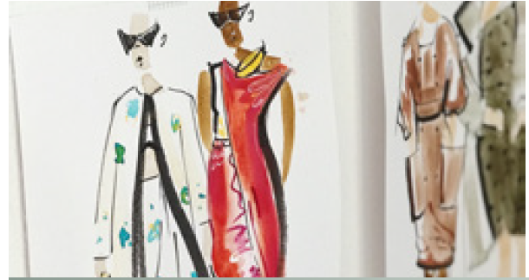
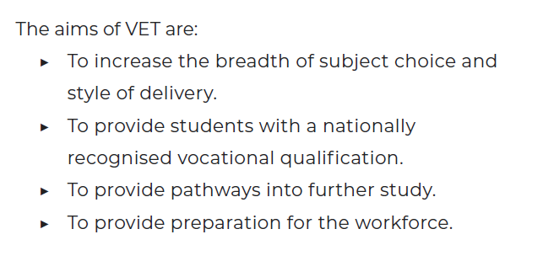
Vocational Education and Training

Slide 23
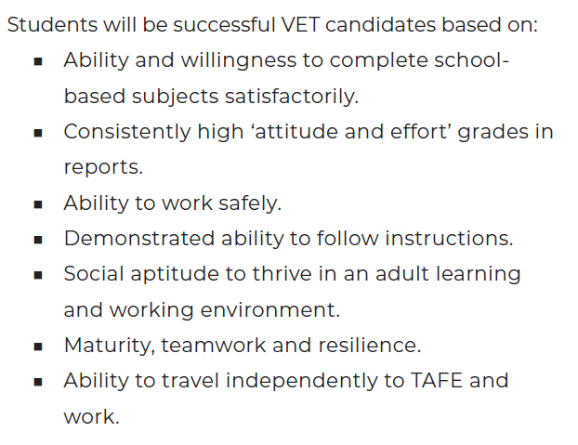
Vocational Education and Training

Slide 24
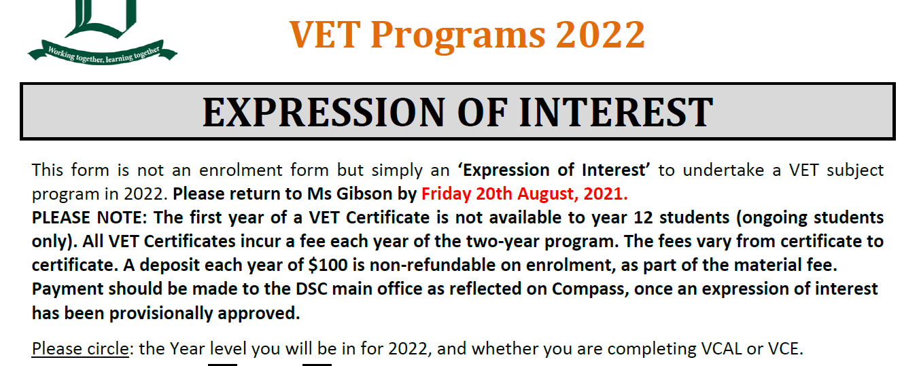
Interested in VET?
Please fill out the VET Application form
Interviews to take place in Term 3
Criteria includes Progress Reports to be at Excelling
Interviews and application forms does not guarantee a place!
Notes:
Oversubscribed

Slide 25
VET Sport, Aquatics and Recreation
Industry specific qualification and an opportunity for VCE Advancement
Students develop the skills and knowledge to deliver sport and recreation services.
Students who complete this program develop the ability to work independently in the industry, using their judgement to effectively complete work activities.

Slide 26
VET Certificate III Sport, Aquatics and Recreation
Topics to cover will include:
recreation session delivery
Coaching
Technology
Officiating
working with diverse people
And much more!

Slide 27
VET Certificate III Sport, Aquatics and Recreation
Great for:
Advancement into VCE OR VCE-VM
Those passionate about sport and looking for industry specific knowledge and skills

Slide 28
VET Certificate III Sport, Aquatics and Recreation
Criteria:
90 per cent attendance Successful completion of English and PE Excelling in Progress Reports An interview may be required

Slide 29
Subject Selection Timeline
NEXT WEEK | ATTEND SUBJECT EXPO AND ASK QUESTIONS TO SENIOR TEACHERS PERIOD 1 AND 2
FUTURE READY | Research subjects and pre-requisites
TERM 3 WEEK 2 | Year 9 Course Counselling
TERM 3 WEEK 3 | Choose your subjects for next year!

Slide 30
Subject Selection Process

Slide 32
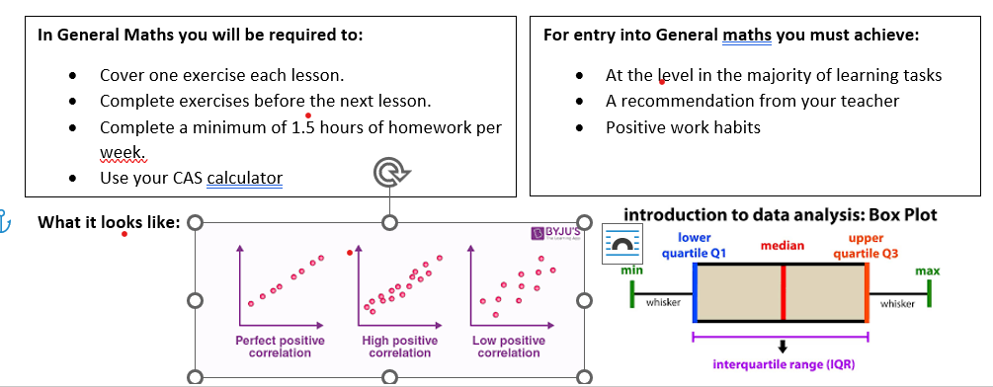
General Maths

Slide 33
Maths Extension
Maths Extension is a study of maths that is complex, abstract, and not commonly used in day-to-day life. Maths extension relates to careers such as engineering, software development, I.T, Medicine, financial management, banking, data analyst, Teaching (maths) and many more
For entry into Maths Extension, you must achieve:
At or above the level in most learning tasks. Embedding or excelling in effort and behaviour.
At or above average in the number and algebra strand. With good attempts at problem solving and reasoning questions.
A recommendation from your teacher based on your current ability, work ethic, staying up to date with classwork, and structuring your work properly.
Requirements
Cover two exercises each lesson.
Complete exercises before the next lesson
Complete a minimum of 3 hours of homework per week.
Show processes when solving problems.

Slide 34
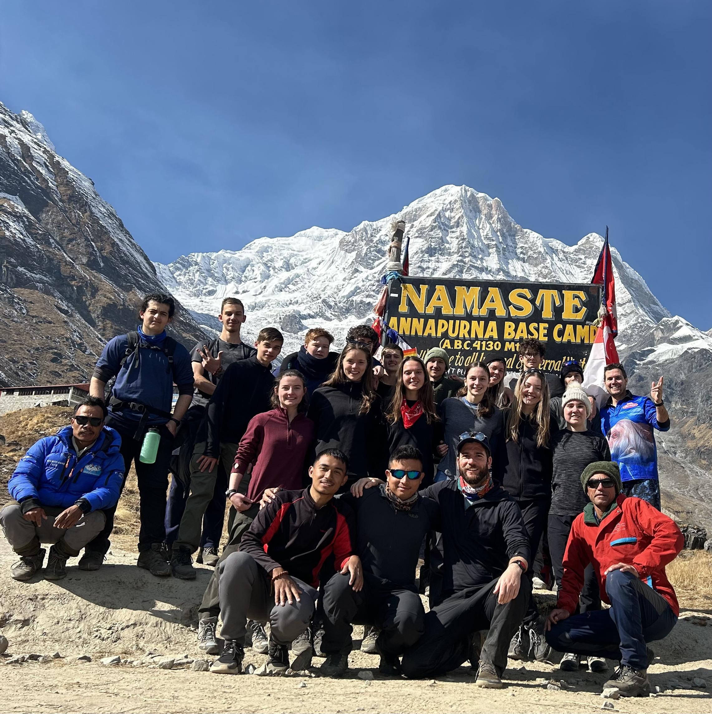
Nepal 2025 World challenge

Slide 35
house keeping
No long sleeves under PE or formal uniform. You will be asked to remove the non-uniform item
If you are leaving during the day for an appointment, you MUST sign out at Middle school and once/if you return, you MUST sign back in
If you arrive late to school (even during recess or lunch) you MUST sign in
Detentions for lunch time and after school will be on your Compass. It is your responsibility to be aware of these.
Late to class – making up the time during lunch

Slide 36
Uniform

Slide 37
THank You
Please wait to be dismissed
Exit from the front left side door
9A
9B
9C
9D
Exit from the back door
9E
9F
9G
9H
Notes:
Staff are very caring and supportive
It is evident that many staff are interested

