Slide 1

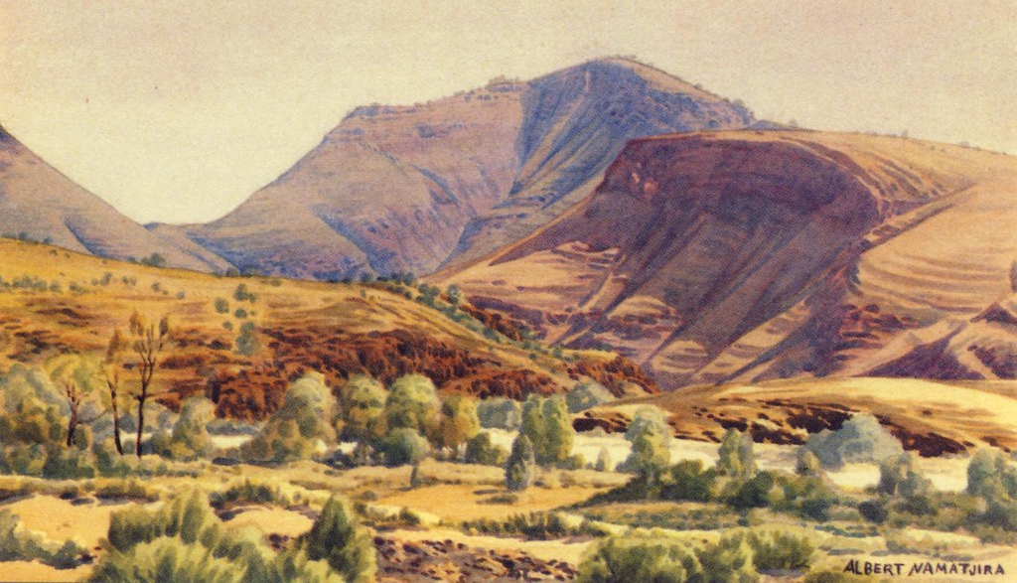
Albert Namatjira
By Klaus Jung

Slide 2
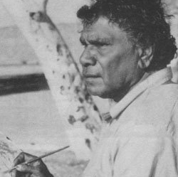
Personal Information
Albert Namatjira
Born 28th July 1902
MacDonald Rangers in Central Australia
Member of the Western Arrernte people.

Slide 3
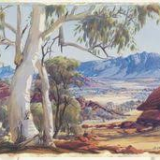
Life Achievements
    Albert Namatjira was a pioneer of contemporary Indigenous Australian art, being the most famous of his generation.
    His water colour paintings of the outback were very different from traditional Aboriginal art.
    His first exhibition was held in Melbourne in 1938

Slide 4
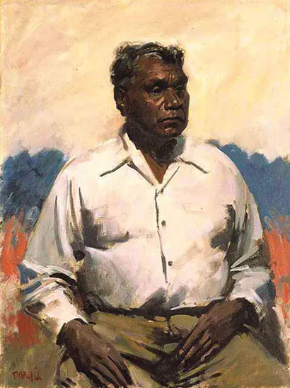
Interesting Facts
    A portrait of Namatjira by William Dargie won the 1956 Archibald Prize, the first painting of an Aboriginal person to win the prize.
    The following year in 1957 he was the first Aboriginal to be granted a restricted Australian citizenship.
    Queen Elizabeth was a huge fan of Namatjira's work, and he was awarded the Queen's Coronation medal. He also met the Queen in Canberra in 1954.

Slide 5
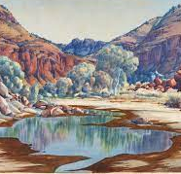
Inspire
I really like art and Namatjira's landscape paintings inspire me.
The trees are detailed and realistic and the soft colours he uses really capture nature.
I think his paintings inspire others like they did me.

Slide 6
References
https://kids.kiddle.co/Albert_Namatjira
https://en.wikipedia.org/wiki/Albert_Namatjira
https://academickids.com/encyclopedia/index.php/Albert_Namatjira
https://nt.gov.au/leisure/arts-culture-heritage/organisations-and-venues/museums-galleries-art-centres/alice-springs/albert-namatjira-gallery

