Slide 1
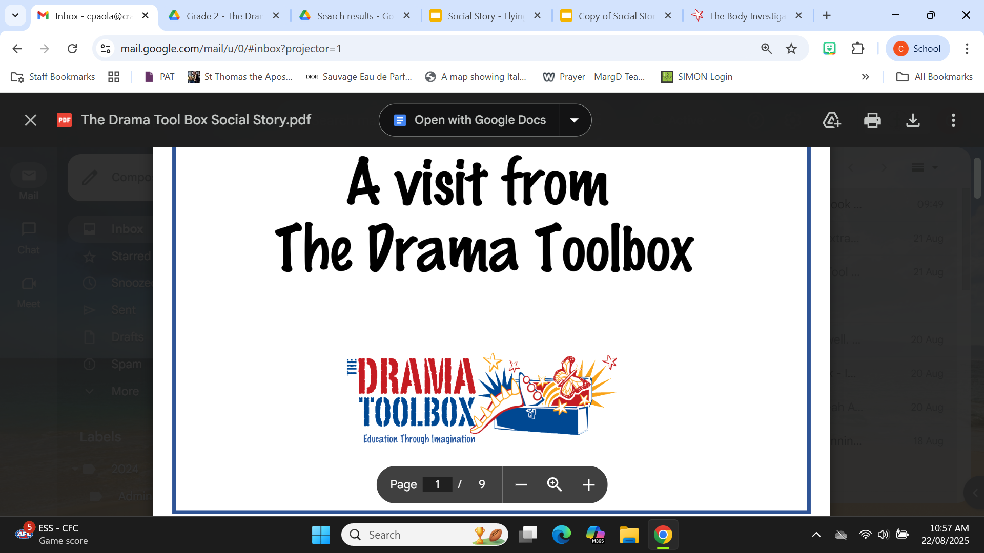

Social Story
Drama Toolbox - A Healthy Body Systems
Incursion
Wednesday 3rd September, 2025
Intentionally Safe, Known, Respected, Heard, Engaged

Slide 2
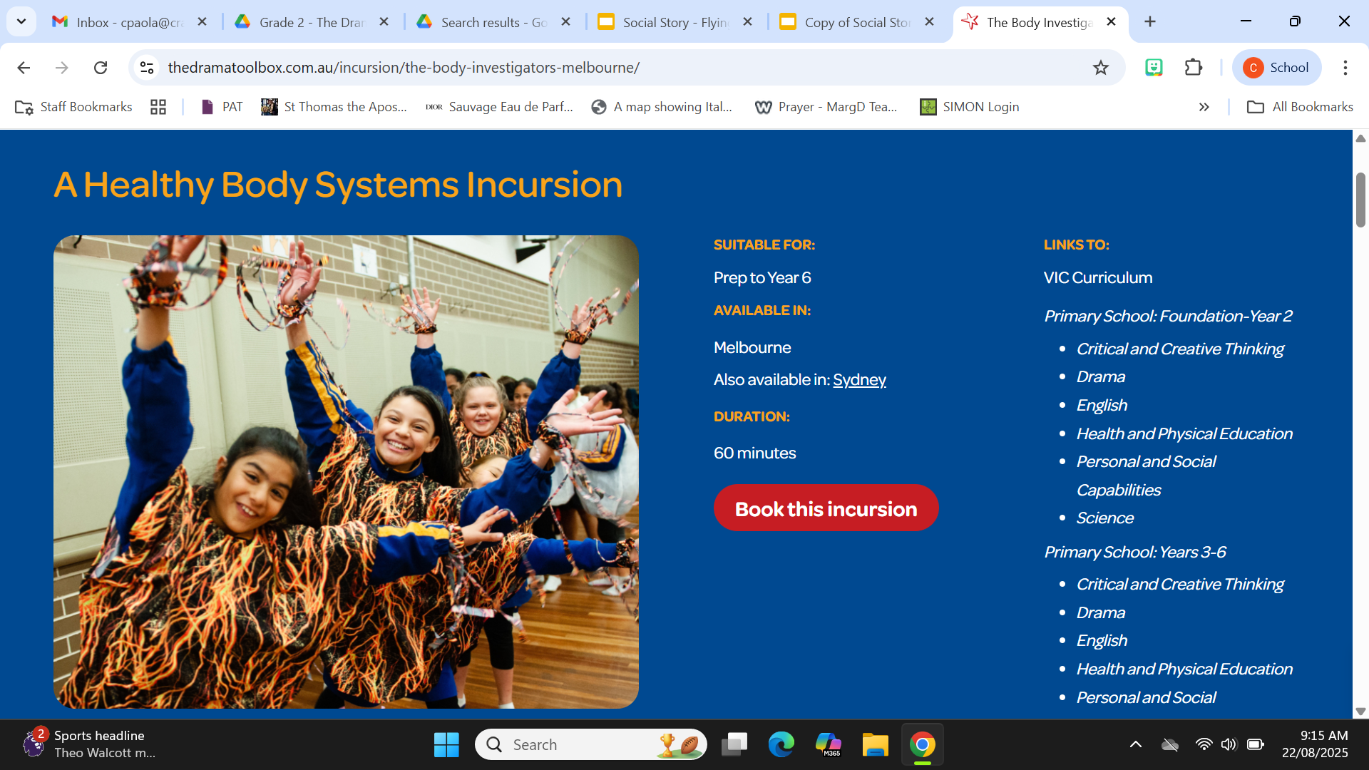
On Wednesday the 3rd of September, the
Drama Toolbox will be visiting us to bring the curriculum to life with the Body Investigators. We will learn how diet, exercise and sleep impact our health.
Intentionally Safe, Known, Respected, Heard, Engaged

Slide 3




The Drama Toolbox will visit each of the Grade 2 classes in the Damascus Community.
The sessions will go for 1 hour each.
2D 9:00am | 2C 10:00am
2B 11:35am | 2A 12:35pm
Intentionally Safe, Known, Respected, Heard, Engaged

Slide 4
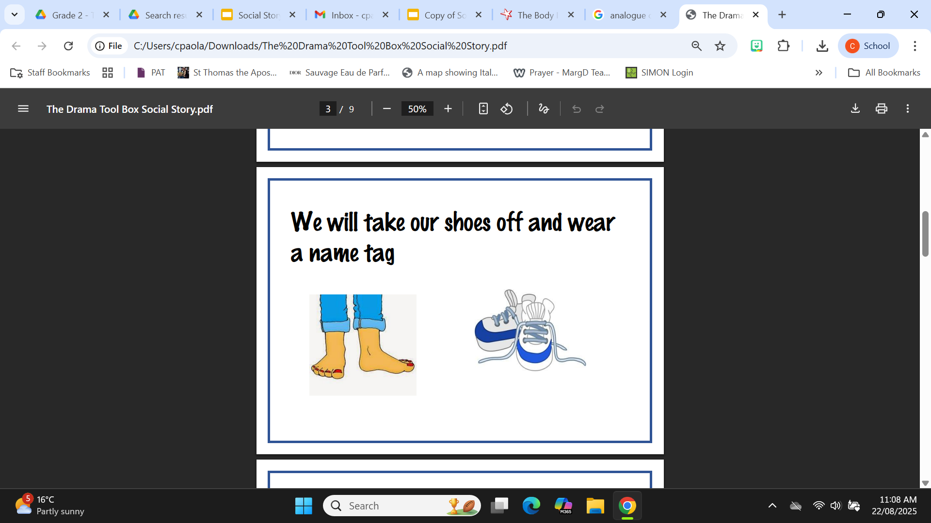
We will wear a name tag and take our shoes off.
Intentionally Safe, Known, Respected, Heard, Engaged

Slide 5
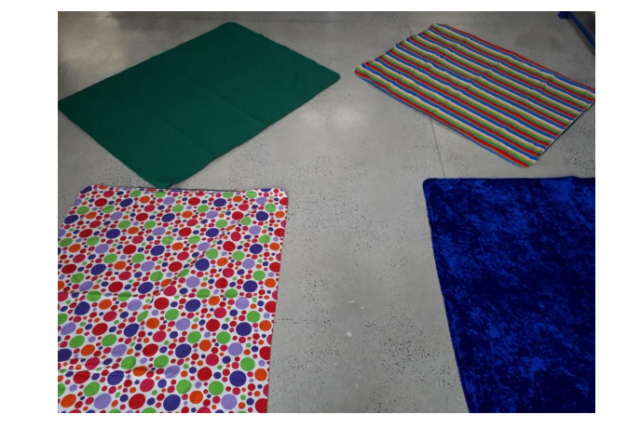
Our room will look different.
There will be mats and costumes on the floor.
Intentionally Safe, Known, Respected, Heard, Engaged

Slide 6
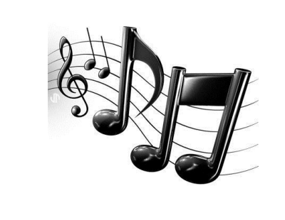
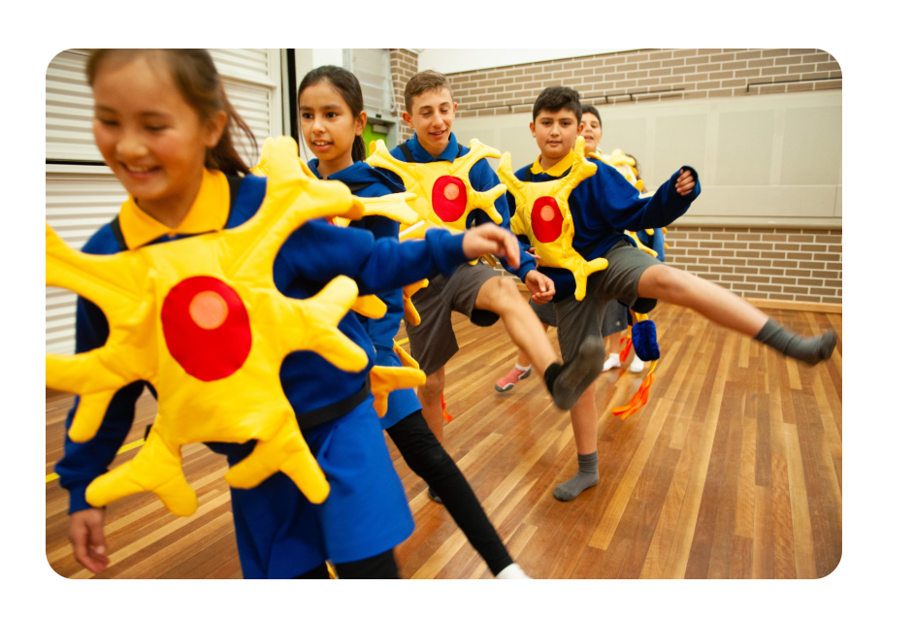
We will be doing some imaginative play, which is called drama.
There will be some music.
Intentionally Safe, Known, Respected, Heard, Engaged

Slide 7
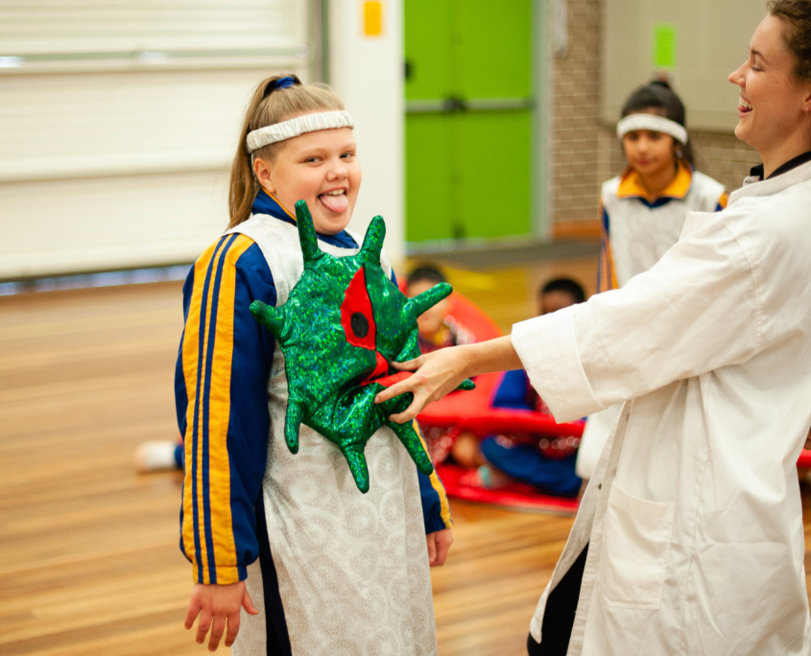
We will be role playing body systems.
We will dress up as brain neurons, red and white blood cells, oxygen and more.
We will enter an unhealthy body through the nose and exit out the rear end (using drama of course).
Intentionally Safe, Known, Respected, Heard, Engaged

Slide 8
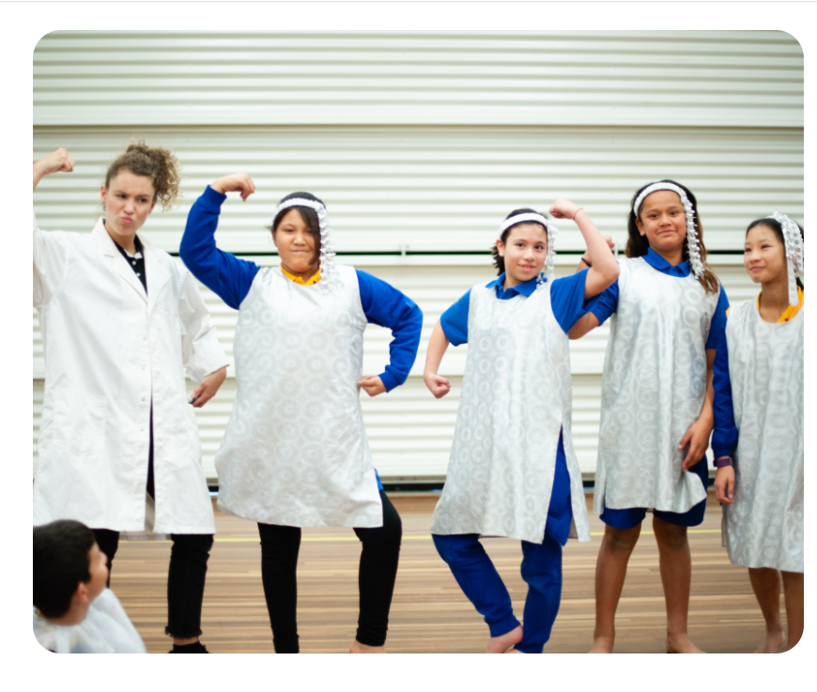
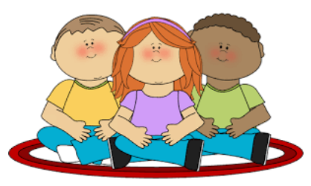
I will listen to instructions.
When the Drama Educator tells me to, I can choose a costume.
We will all dress up.
When it is not our turn, we will sit and watch.
Intentionally Safe, Known, Respected, Heard, Engaged

Slide 9

We will be participating in this incursion, moving around and using our bodies.
We need to show SAFETY.
Intentionally Safe, Known, Respected, Heard, Engaged

Slide 10
We need to
listen to the Drama Educator and our teacher
follow instructions and rules
put up our hands to ask questions and respond to discussions
speak to everyone using our manners of ‘please’ and ‘thank you’.
This shows RESPECT.
Intentionally Safe, Known, Respected, Heard, Engaged

Slide 11
We will have a go at any new learning activity.
We will encourage others and challenge ourselves.
This shows LEARNING.
Intentionally Safe, Known, Respected, Heard, Engaged

Slide 12
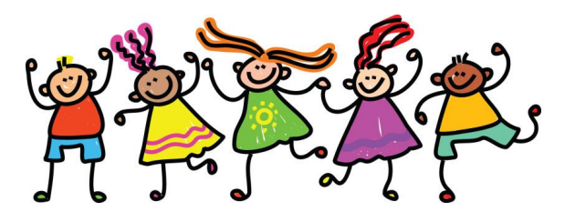
We will take it in turns to show the class what our group can do.
It will be lots of fun.
Intentionally Safe, Known, Respected, Heard, Engaged

Slide 13
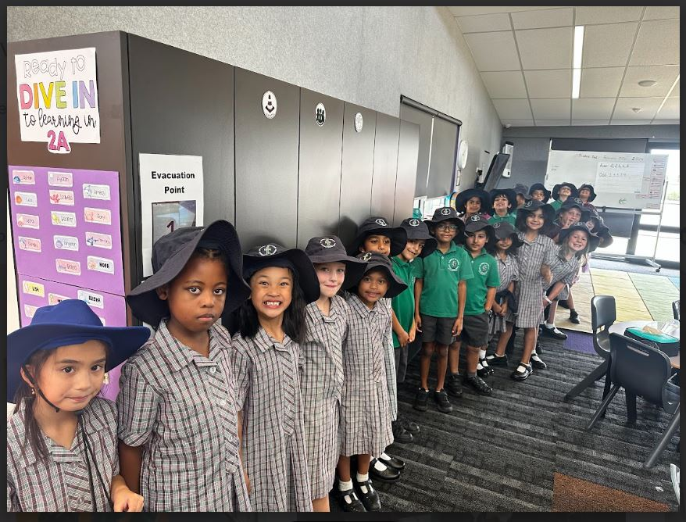
The incursion will be held in the PE portable. We can demonstrate our expectations by moving safely and respectfully to the PE room in one line.
We will line up in our community area in roll order before we go.
Intentionally Safe, Known, Respected, Heard, Engaged

Slide 14
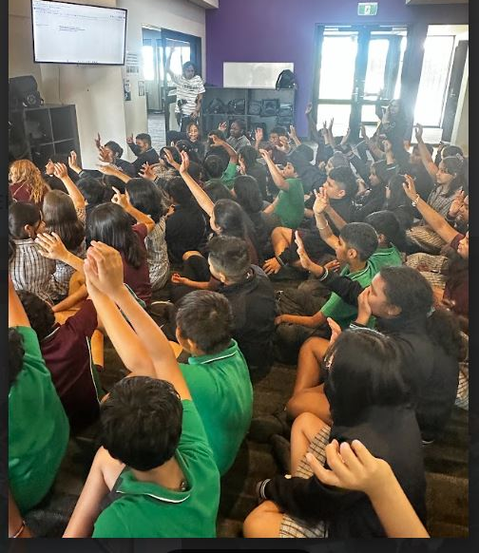
Once we reach the PE room we will walk inside quietly with voices off and will be instructed to sit on the floor in rows with our own class.
If the teachers raise their arm we need to look at the teachers, stop what we are doing, turn our voices off and raise our arm.
Intentionally Safe, Known, Respected, Heard, Engaged

Slide 15
I need to be seated on the floor at all times so that the ones behind can watch the event too.
I need to sit quietly and not interrupt the event by talking to those around me.
It is important for me to be respectful and use good manners. I will not need to clap or cheer or call out.
I will listen and follow directions from our teachers and adults present.
Intentionally Safe, Known, Respected, Heard, Engaged

Slide 16
At the end of the show, one student will be selected to thank the presenters.
I will be directed by our teachers to leave the room in order.
I will walk in roll order back to class to complete a reflection activity.
Intentionally Safe, Known, Respected, Heard, EngagedI

