Slide 1
Applying for tertiary study in 2023

Slide 2
What is the Victorian Tertiary Admissions Centre (VTAC)?
Central point for course applications to Victorian universities, TAFEs and colleges
Central point for special consideration (SEAS) applications and many scholarship applications
VTAC calculates the Australian Tertiary Admission Rank (ATAR) for Victorian Year 12 students
Want to apply interstate? There are tertiary admissions centres for each state and territory
Notes:
Victorian Tertiary Admissions Centre (VTAC) is the central point for applications to Victorian universities, TAFEs, and Independent Tertiary Colleges.
VTAC also calculates the Australian Tertiary Admission Rank (ATAR) for Victorian Year 12 students.
Students won’t be applying individually to each institution when in year 12, but instead submitting one application through VTAC for up to 8 course preferences

Slide 3
In this session…
Researching courses
Applying for courses
Special consideration (SEAS) and scholarships
Getting your results and course offer
Scaling and the ATAR

Slide 4
The VTAC application process – a birds eye view
1 August Applications open
29 September Timely applications close
7 October
SEAS and scholarships close
14 December change of preference closes
12 December Victorian ATAR released
21 December December round offers; change of preference opens again
13 January
January domestic offers
1 February
February domestic round 1
Further rounds Feb
8, 14, 20
Check website for complete listing of dates
Notes:
Check website for complete listing of dates for both domestic and internationals

Slide 5
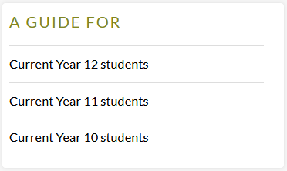
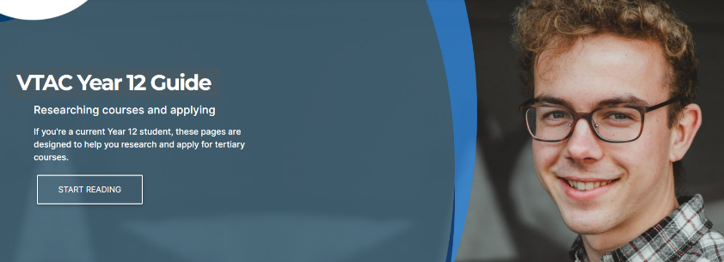
Year level guides
Notes:
Online Guides for each year level – you can get more detailed information about everything you’re hearing in this presentation by going to vtac.edu.au and clicking on the Guide for your year level.

Slide 6
Finding courses

Slide 7
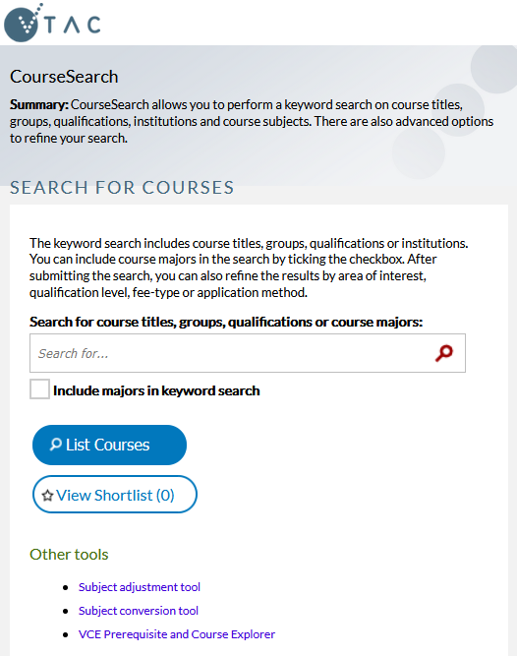
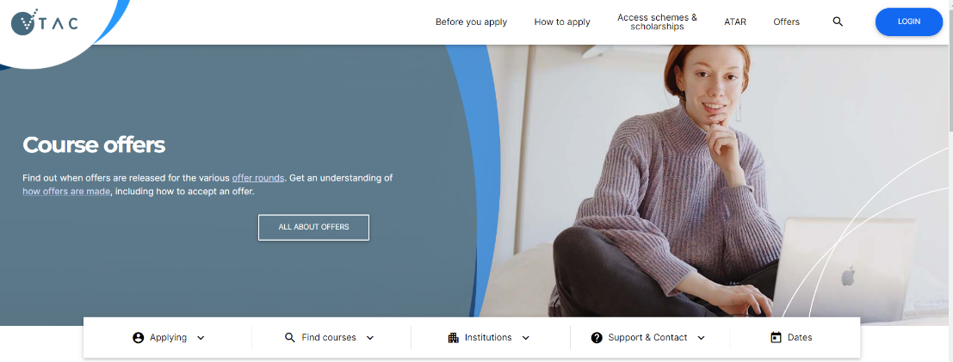
CourseSearch
Compare course information for all tertiary institutions in Victoria
Link from the website
Advanced search options include filtering by institution, area of interest, and qualification level
Notes:
CourseSearch lets you search across all the institutions at once – good for comparing courses
You can link from the website CLICK
Information displayed in CourseSearch is provided by the institution offering the course
2023 CourseSearch is available from late July

Slide 8
Different types of tertiary courses
VET
Cert II-IV
Diploma
Higher Education
Advanced Diploma
Advanced Diploma
Associate Degree
Bachelor Degree
Graduate courses
Notes:
You can list both VET and Higher Ed courses on your VTAC preferences
Current Year 12 students not eligible for Graduate courses
What is a higher education course?
Higher education courses provide professional qualifications with an emphasis on knowledge, theory, personal attributes, and the development of professional and transferable skills. Some courses have fixed vocational outcomes, leading to careers in specific areas, such as accountancy or nursing, while others are ‘generalist’ with more flexible career goals, such as business or science.
Higher education qualifications include:
Bachelor degrees, which take three to four years to complete on a full-time basis.
Associate degrees or Diplomas, which generally require between one and two years full-time study, although some offer an accelerated one-year program. Diplomas may also provide a clear pathway into a degree course.
Postgraduate studies, which can be studied after a Bachelor degree is completed. These include postgraduate degrees, honours, Masters degrees and Doctorates (PhDs).
What is a vocational education and training course (VET)?
Vocational education and training (VET) courses provide trade, para-professional and professional qualifications with an emphasis on practical skills, capabilities and associated knowledge in specific industry areas. You apply for some VET courses through VTAC, while others, like apprenticeships, follow a different process. Visit www.skills.vic.gov.au for additional information on VET courses.
VET qualifications
» Certificates I-II are the most basic qualifications and introduce learners to a vocational field. These courses can also provide a pathway to further learning, particularly for those who have not completed a Year 12 certificate.
» Certificate III-IV courses include trade-level certificates and can lead to skilled employment. Certificate IV courses can be used as a pathway to Diploma level training or higher education courses.
» Diplomas and Advanced Diplomas provide deeper level training and equip learners to undertake advanced skilled or paraprofessional work. They also provide a pathway to higher education and can sometimes provide credit towards an undergraduate degree.
Look out for pathways, e.g. a Diploma which leads on to a Bachelor degree.

Slide 9
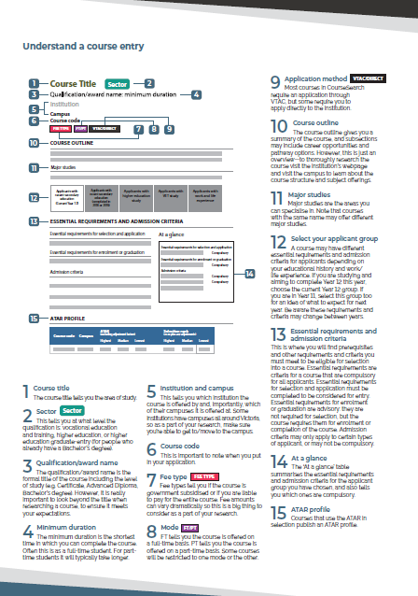
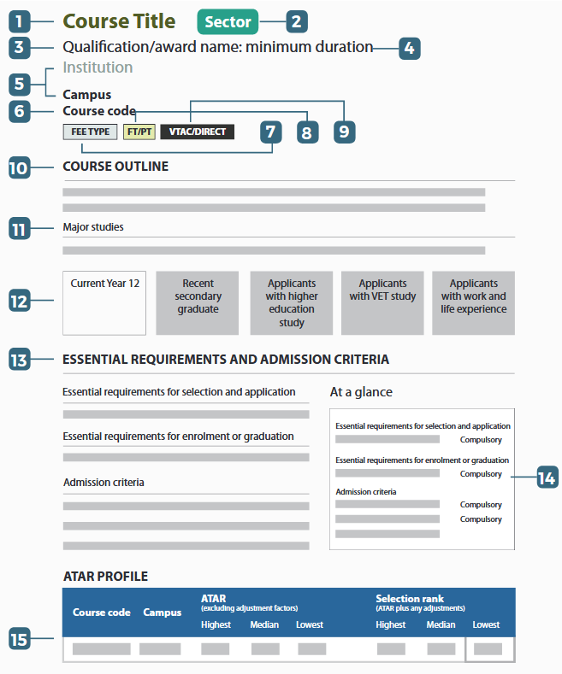
CourseSearch: areas of interest
‘How to use CourseSearch’ fact sheet available at vtac.edu.au
Essential Requirements and Admission Criteria
“What do I have to do to get in?”
ATAR Profile
“How competitive is it to get in?”
Notes:
When you open a course page in CourseSearch, a lot of the information you see is fairly self-explanatory, like the name of the course, which campus it runs at, and so on.
CLICK you can download a fact sheet from the VTAC website which explains all the information in detail.
CLICK but there’s two sections we’ll discuss today: first, the Essential Requirements and Admission Criteria
CLICK secondly, the ATAR profile

Slide 10
What requirements might exist?
Prerequisites
Any VCE subjects you must complete to be eligible for an offer
Interview
Audition
Personal statement
Folio presentation
CASPer test Online test needed for most teaching courses
Subject adjustments Extra points for completing VCE subjects relevant to the course
SEAS Special consideration
Notes:
There’s a whole range of things you might see listed under the Essential Requirements and Admission Criteria.
Whatever the requirements are for a course, you’ll always see these listed in VTAC CourseSearch. Here are some of the most common ones:
CLICK to spotlight in order:
Prerequisites
Subjects that you must have completed to be eligible for selection into a course
CLICK CASPer test
Compulsory online test needed for most teaching and some nursing courses in Victoria
CLICK Subject adjustment
Explain the concept and that these are applied automatically if specified in the course description
CLICK to show all categories again
Information about how to organise e.g. auditions and interviews is found in each course description. Contact the institution if it’s unclear how to complete a requirement.
We’ll talk about SEAS in a bit.

Slide 11
Two types of essential requirements
Essential requirements for selection and application
Prerequisite subjects
Essential requirements for enrolment or graduation
Immunisations
Police check
Working with Children Check
Interview
Audition
Test (e.g. Casper)
Nursing and Midwifery English Language declaration
You need to complete these to apply and receive an offer
You don’t need to complete these until you have successfully received an offer
Notes:
These are just some examples of each type and there may be other requirements under these headings
****Note that if you are applying for a nursing or midwifery course you must complete an English language declaration. The information is in CoureSearch and the link to complete the declaration will appear on your account when you add any nursing or midwifery course to your preferences. It must be completed for you to receive an offer.

Slide 12
Ranking applicants
ATAR
1 | Taylor | 95.00 ATAR
2 | Yang | 90.00 ATAR
3 | Josh | 85.00 ATAR
4 | Riley | 80.00 ATAR
5 | Malik | 75.00 ATAR
6 | Ava | 70.00 ATAR
 | Selection rank
95.00 ATAR
= 95.00 selection rank
1 Taylor
90.00 ATAR +subject adjustment
= 94.00 selection rank
2 Yang
75.00 ATAR
+ SEAS
+ subject adjustment
= 86.00 selection rank
3 Malik
85.00 ATAR
= 85.00 selection rank
4 Josh
80.00 ATAR
= 80.00 selection rank
5 Riley
70.00 ATAR
= 70.00 selection rank
6 Ava
Notes:
Every course has some way of ranking applicants. In this example, they are using the ATAR but also taking into account special consideration and subject adjustments. For a different course they might be starting with e.g. the score from an audition, rather than ATAR.
Let’s go through all six applicants in turn.
CLICK Taylor did not receive any adjustments, so her selection rank is the same as her ATAR, 95.00.
CLICK Yang received a subject adjustment for completing a relevant VCE subject, so her selection rank is higher than her ATAR: 94.00
CLICK Josh did not receive any adjustments, so his selection rank is the same as his ATAR
CLICK Riley did not receive any adjustments, so their selection rank is the same as their ATAR
CLICK Malik received a subject adjustment like Yang but also special consideration through SEAS, so his selection rank is a fair bit higher than his ATAR.
CLICK Ava did not receive any adjustments, so her selection rank is the same as her ATAR
This course had 4 places available for the 6 people applying, so who got the offers?
CLICK the offers went to the applicants with the highest selection rank
If we copy these same offers across to the ATAR list (CLICK), we can see that the people with the highest selection rank were not completely the same as the people with the highest ATAR.

Slide 13
Publishing information (ATAR-based selection only)
ATAR
1 | Taylor | 95.00 ATAR
2 | Yang | 90.00 ATAR
3 | Josh | 85.00 ATAR
4 | Riley | 80.00 ATAR
5 | Malik | 75.00 ATAR
6 | Ava | 70.00 ATAR
 | Selection rank
1 | Taylor | 95.00 ATAR = 95.00 selection rank
2 | Yang | 90.00 ATAR +subject adjustment = 94.00 selection rank
3 | Malik | 75.00 ATAR + SEAS + subject adjustment = 86.00 selection rank
4 | Josh | 85.00 ATAR = 85.00 selection rank
5 | Riley | 80.00 ATAR = 80.00 selection rank
6 | Ava | 70.00 ATAR = 70.00 selection rank
Lowest ATAR to receive an offer
Lowest selection rank to receive an offer
Notes:
So what information gets published about this course to tell you how competitive it was to get in?
CLICK first, the lowest ATAR to successfully receive an offer
CLICK second, the lowest selection rank to successfully receive an offer
Explain why lowest sel. rank is the best number to look at
Remember it’s last year’s data, might change for next year.

Slide 14
Applying

Slide 15
Create a VTAC account
All VTAC applications are completed online
You can create your account from Monday 1 August
Consider opting in for an authorised nominee
You need to provide:
Personal details, including an email address you will continue to use after school
Student number if you’re a current Year 12 so that we can access your results later in the year
Unique Student Identifier (USI) is mandatory for every new higher education student. If you don’t have one go to: Usi.gov.au
Notes:
All applications (i.e., course application, SEAS application, scholarship application) completed online using the one account
You can create an account from 1 August
An authorised nominee can make enquiries to VTAC on your behalf. VTAC cannot discuss your application with anyone except you (not even your parents) unless you have specified an authorised nominee when registering.
Some school email addresses are deactivated by the time offer emails are sent so use an email that you will continue using after school
USI is easy to create or retrieve from the USI website.
NB: Only make one registration.
To correct errors, change the details online or call VTAC. Do not create another registration.
For current Year 12 applicants, use a personal, not school email address
Some school email addresses are deactivated by the time offer emails are sent
Four digit PIN
Lost PINs can be retrieved from the log in form.

Slide 16
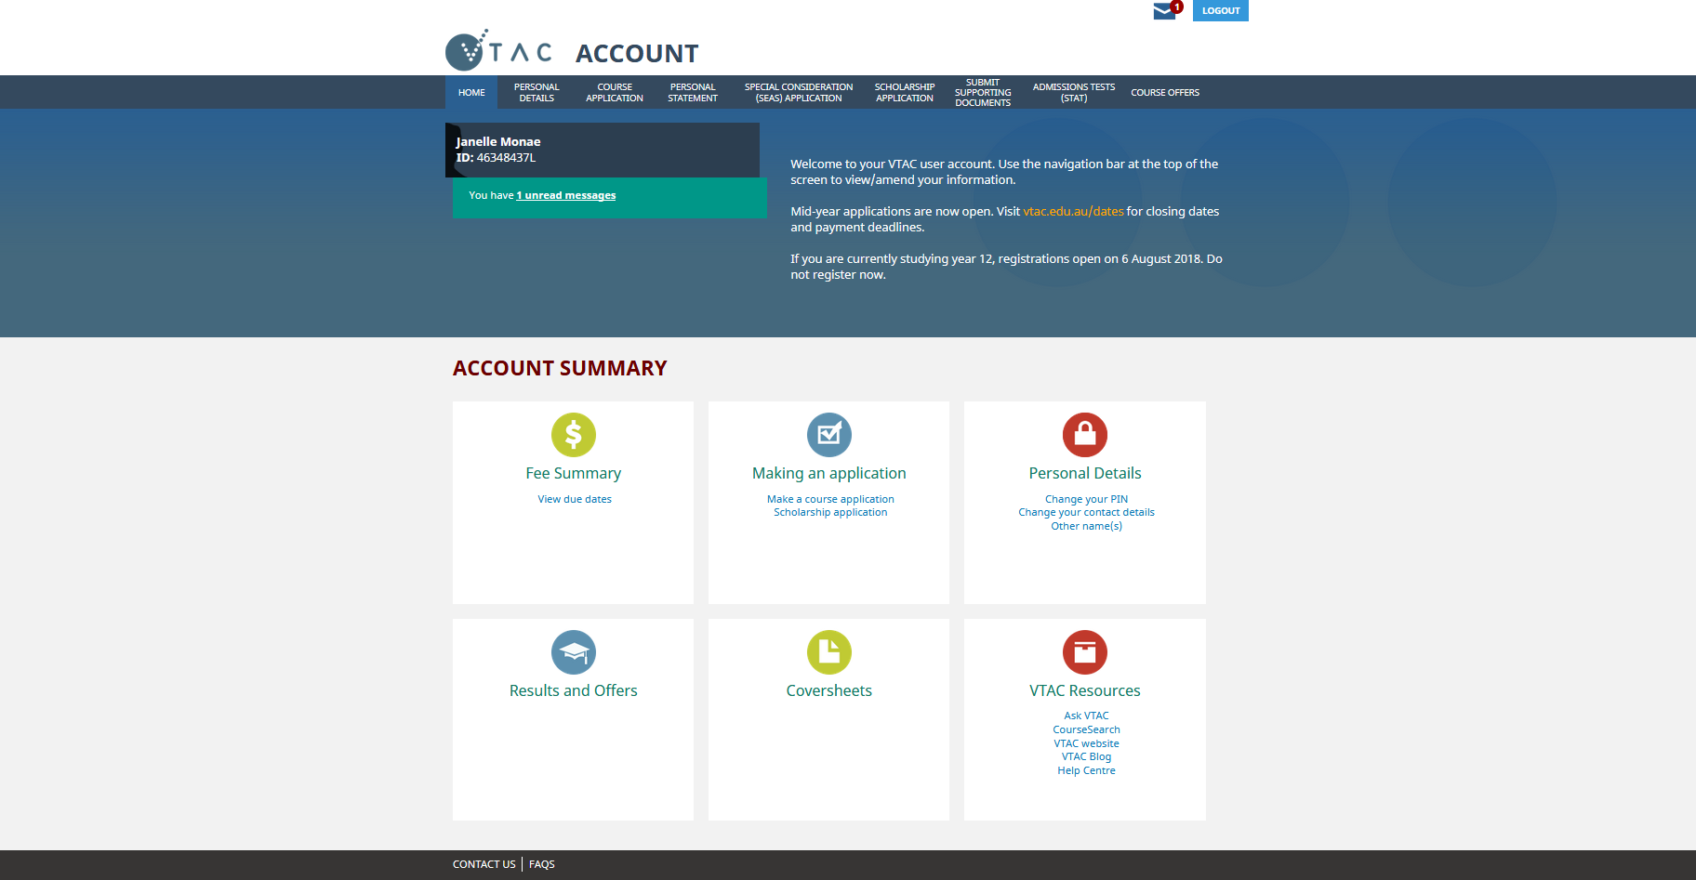
VTAC account
Notes:
This is how the account will look.
Highlight location of message inbox – a copy also sent to email
CLICK once you have a VTAC account, you can go straight on and press “make a course application”

Slide 17
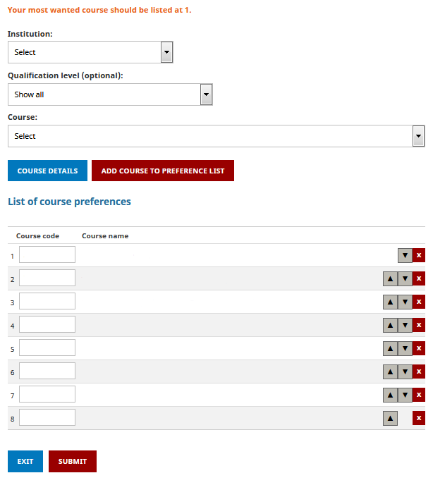
Applying for courses
List up to eight courses/institutions
Preference order – always list courses in the order you want to get into them
To add course preferences: Select institution and/or course or type in the course code.
To move a course on the preference list use the up/down buttons.
To delete a course use the x button.
Notes:
Explain why preference order matters – you won’t find out about lower preference courses
YOU MUST LIST COURSES IN THE ORDER YOU MOST WANT TO STUDY THEM
Be careful with X button – if a course has an early closing date and it is removed after that closing date, it can’t be re-added

Slide 18
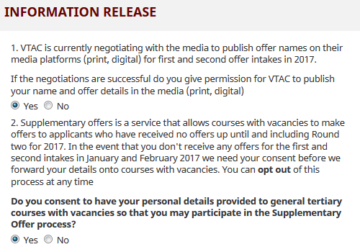
Supplementary offers
No offers in the earlier rounds
Your details released to institutions with places available
If interested, enrol for the course with the institution
They may contact you to suggest a course you hadn’t applied for
Notes:
The supplementary offer process allows courses with vacancies to make offers to certain VTAC applicants who have not previously applied for the course, if they have not received a preference offer in December or January.

Slide 19
Changing your preferences
After applying, you can change your course preferences as much as you like while change of preference is open
The first deadline is 14 December in time for the December offer round
You can change preferences between offer rounds
It’s important to try to get your preferences right in time for the December round to maximise your chance of getting into the course you want.
Notes:
No limits or extra fees for change of preference.

Slide 20
SEAS (special consideration) and Scholarships

Slide 21
Special Entry Access Scheme (SEAS)
SEAS is the special consideration program used by most tertiary institutions in Victoria
Filling out a single SEAS application will cover all of your eligible preferences
Relates to circumstances beyond your control which have negatively affected your education
Also includes: Category 1 (Personal Information and Location) – everyone should apply
SEAS allows selection officers at institutions to grant special consideration for course entry to applicants.
Notes:
A single application for all eligible preferences

Slide 22
SEAS Categories
Category 1: Personal information and location
As simple as ticking a box
All applicants should apply for this category
Category 2: Disadvantaged financial background
Category 3: Disability or medical condition
Category 4: Difficult circumstances
E.g. disruption to living situation, affected by illness or death of relative/friend, natural disaster, refugee status, impact of COVID-19 remote learning
Notes:
Apply for as many categories as relevant to your circumstances, but do not claim the same circumstances under multiple categories
Explain the categories:
Category 1: Personal information and location. This category includes age, living or school location, under-representation of a gender in a course or field of study, recognition as an Indigenous Australian, recognition for being from a non-English speaking background and recognition for being the first in your family to attend tertiary study. Everyone should apply for this category. The box is pre- ticked, you just need to submit.
Category 2: Disadvantaged financial background
Category 3: Disability or medical condition
Category 4: Difficult circumstances: anything else beyond your control which has negatively affected your education and is not already covered by a previous category
For category one no additional information is required, the box is already ticked so just submit. The other three categories do require additional documentation. We’ll go through the evidence requirements for these.

Slide 23
What can SEAS do?
ATAR
1 | Taylor | 95.00 ATAR
2 | Yang | 90.00 ATAR
3 | Josh | 85.00 ATAR
4 | Riley | 80.00 ATAR
5 | Malik | 75.00 ATAR
6 | Ava | 70.00 ATAR
May allow you to gain entry to a course with a lower ATAR than otherwise
Is not a guaranteed entry scheme or reserved quota
Does not exempt you from completing essential requirements and compulsory admission criteria.
You must complete course prerequisites, attend all interviews, sit any required tests, and submit all required folios and forms.
Notes:
Show how in the example from earlier, special consideration through SEAS allowed Malik to get an offer ahead of Riley, even though Malik’s ATAR was lower.

Slide 24
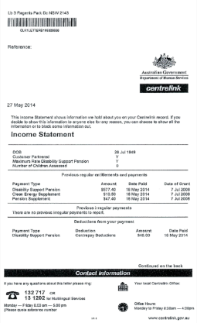
SEAS documentation - category 2 disadvantaged financial background
Documentary evidence of benefit or family tax benefit received by parent/guardian
123456789A
(applicant’s own CRN)
Impact statement
OR
OR
Statement of support
Notes:
CRN only possible if it’s in the applicant’s name
OR documentary evidence if it’s in a parent’s name
OR impact statement and statement of support
Evidence must be no older than 3 months at the time of applications opening.

Slide 25
SEAS documentation – categories 3 & 4
Specific processes for: sexual assault, family violence, homelessness, formal out-of-home care, refugees/asylum seekers, bushfires, and COVID-19 remote learning. Follow the instructions on the SEAS application form.
All other conditions/circumstances:
Impact statement – written by applicant
Statement of support – written by health practitioner or relevant responsible person
Impact statements without an accompanying statement of support will not be considered.
For detailed information about SEAS documentation, visit www.vtac.edu.au
Notes:
For the specific circumstances you can see on the screen , there is more information on the VTAC website about the specific processes and evidence requirements for these.
There is also a specific process for the impact of COVID-19 remote learning. For all other circumstances and/or medical conditions, written statements are required. Check the VTAC website for more detailed information about what to include in these .
There is detailed information and examples online, including a fact sheet that you can give to your supporters to assist them to write a statement of support.
*****

Slide 26
Scholarships
VTAC collects scholarship applications for many institutions
One application, many institutions
Scholarships are not just for academic performance
Many equity scholarships have similar documentation requirements to SEAS
Statements must be submitted separately for each using the correct coversheet.
List of scholarships available on the VTAC website
Including some scholarships which require their own separate application
Notes:
Scholarships are not just for 99.95 students! Everyone should apply.
Advisory deadline for guaranteed document review – if you are able to get your SEAS and scholarship documentation submitted by 16 September, VTAC will review it to check for problems, e.g accidental upload of a blank page, out of date financial document - and let you know if there is a problem, giving you time to resubmit by the SEAS and Scholarships deadline of 7 October.

Slide 27
Results and offers

Slide 28
ATAR and VCE Results released 7am, Monday 12 December 2022
Online
Results app
Mail
Free online access at resultsandatar.vic.edu.au
Free download of joint VCAA/VTAC app: ‘Results and ATAR’
Paid VTAC applicants will receive a printed ATAR statement
Registration required
VCAA student number
Password
Notes:
Registration for the results service (choosing a secure password to access your results) is separate from the VTAC account and application and will be available from Monday 1 August.
Year 11 students wishing to access a result for a year 12 subject they have completed this year do not need to create a VTAC account. They can simply register for the Results and ATAR service.

Slide 29
Offer advice From: VTAC
Enrolment instructions From: Institution
2pm
Accept
Defer
Reject
Next day
Always accept an offer
Accept
Notes:
When offer advice is released, you will receive an email from VTAC which tells you what course you've been offered.
CLICK The same information will also be available online from 2:00 PM. if you gave permission when you applied, it will be in the newspaper the next day
A second email will come straight from the course with instructions on how to CLICK accept (explain), CLICK defer (explain), CLICK or reject (explain).
Advise students to check enrolment deadlines carefully. These are set by institutions so are not all the same.
Enrolment/deferment is done with the institution, not VTAC

Slide 30
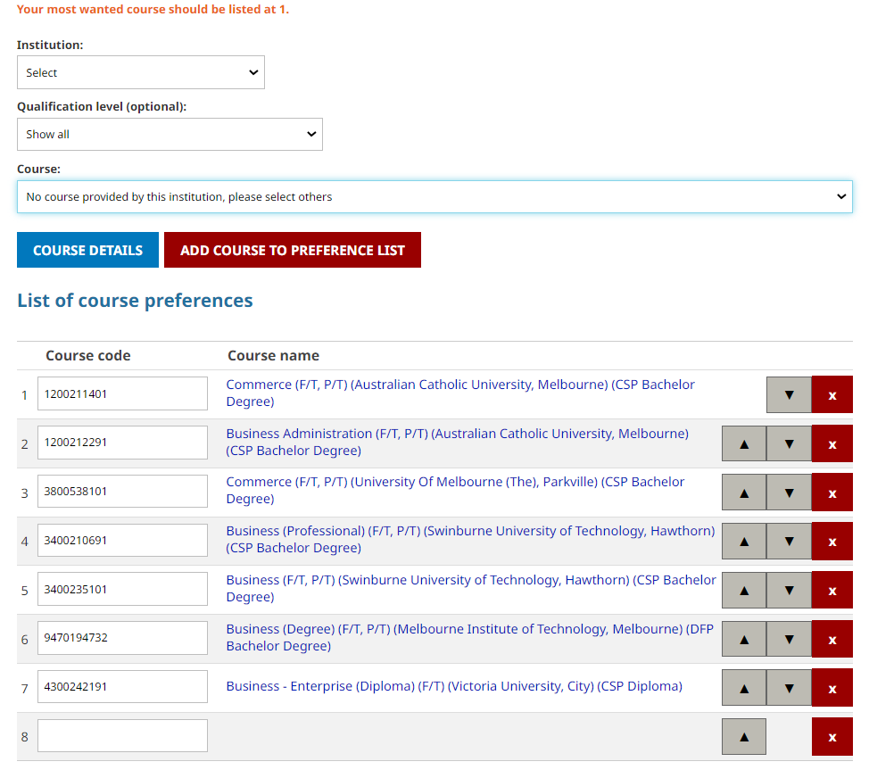
You will be automatically considered for higher preferences
Higher preference courses. Automatically considered in future rounds
Offered course – can’t be removed
but can be moved
Lower preferences.
Not considered unless
moved above offered course.
Notes:
If students are happy with their preferences, they can just leave them alone and they will be automatically considered for any higher preferences.
Otherwise, make sure any new or changed preferences are listed above an offer already received

Slide 31
Six offer rounds
Notes:
The majority of offers are made in the earlier rounds – December and January
This is why the 14 December COP deadline is so important, even though students can keep changing their preferences between rounds.

Slide 32
Scaling and the ATAR

Slide 33
Australian Tertiary Admission Rank (ATAR)
What is it?
How is it calculated?
VTAC receives your study scores from VCAA and scales them for fairness
A tool for tertiary selection based on relative performance in the VCE
It’s a rank, not a score
Your aggregate is calculated from the highest permissible combination of your subjects
The aggregates for everyone are placed in order for conversion to the ATAR, which is a percentile scale
Notes:
The ATAR is just one of many tools used to decide who gets into a course.
It’s not a score for the VCE. You must pass the VCE to be eligible for an ATAR of any number.
We’ll go through these three steps on the following slides.

Slide 34
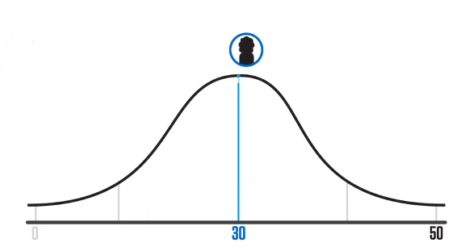
Scaling
Why?
Study scores received from the VCAA are a rank for that particular subject
30 is the average for every study, regardless of how competitive the cohort
How?
By looking at the students undertaking the study this year, and their performance in their other studies
For what?
Scaled scores are used only for the calculation of the ATAR
Prerequisites and subject adjustments are based on raw study scores
Notes:
Scaling:
Is not about difficulty, it is about the strength of competition within the subject
Is based on the results of all Victorian students doing that study this year (not by school, not by class)
Is done fresh every year (scaling report on the VTAC website shows it is relatively stable from year to year)
CLICK to pop up study score normal distribution diagram

Slide 35
The scaling process
Results for all Chemistry students in Victoria:
English | 31.35
Music Performance | 36.62
Further Mathematics | 33.45
Psychology | 28.51
Politics | 34.11
Biology | 33.72
Etc. | 31.52
Average for all studies | 32.75
Chemistry Raw study score average: 30
Chemistry Scaled study score average: 32.75
Notes:
For example, to scale Chemistry, we start off with the raw score of 30, which is the average VCAA score for all subjects when VTAC receives them.
How hard was it to get that 30? (i.e. the average mark)
CLICK To find out, we look at the results of everyone doing Chemistry, and find the average of their results in all their studies, not just Chemistry.
CLICK In this example, Chemistry students performed above average in all their subjects, showing that Chemistry was more competitive – therefore Chemistry scales up this year.
The scaling process is purely about how the students in that subject performed in this particular year. It is not about how hard or how easy the curriculum of that subject is.

Slide 36
Composition of the aggregate
Highest eligible English group subject
Next highest eligible subject
Next highest eligible subject
Next highest eligible subject
10% of next highest (or other increment)
10% of next highest (or other increment)
The “Primary 4” subjects (required to receive an ATAR)
Increments (only if available)
Notes:
You must pass the VCE and have at least four scored subjects including English to qualify for an ATAR.
If available, we will also use up to two more subjects as increments.
If there are seven or more subjects completed, we will use the highest allowable six.
The sum of all of these contributions is called the “aggregate” (total).

Slide 37
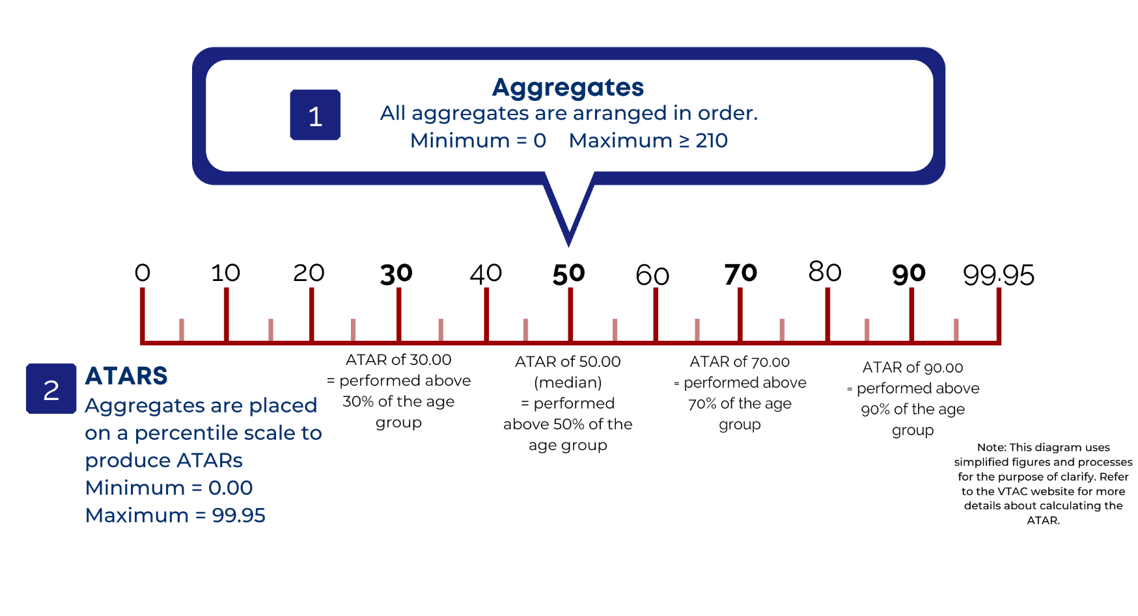
Notes:
The last step is to calculate the ATAR, which is a percentile rank based on the aggregate.
So an ATAR of 50.00 means you have performed better than 50% of the Year 12 age group

Slide 38
Remember: the ATAR isn’t everything
It’s just a tool for getting into (some) tertiary courses
Many courses use criteria instead of, or in addition to, the ATAR
Your selection rank for a particular course may be higher than your ATAR due to published adjustment factors.

Slide 39
Getting support:
At school? Talk to your careers practitioner
Instructions, videos, and fact sheets on the VTAC website: vtac.edu.au
Call VTAC on (03) 9926 1020
Email through your VTAC account
Send VTAC a Facebook message
Notes:
Edit this slide to include any school-specific contact information

