Slide 1
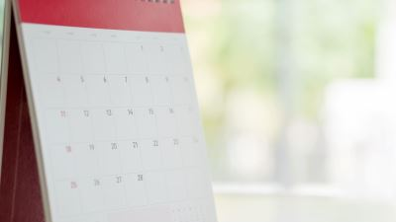
Year 8 DTE 2021
Photoshop Finalists
‘Art vs Language’

Slide 2
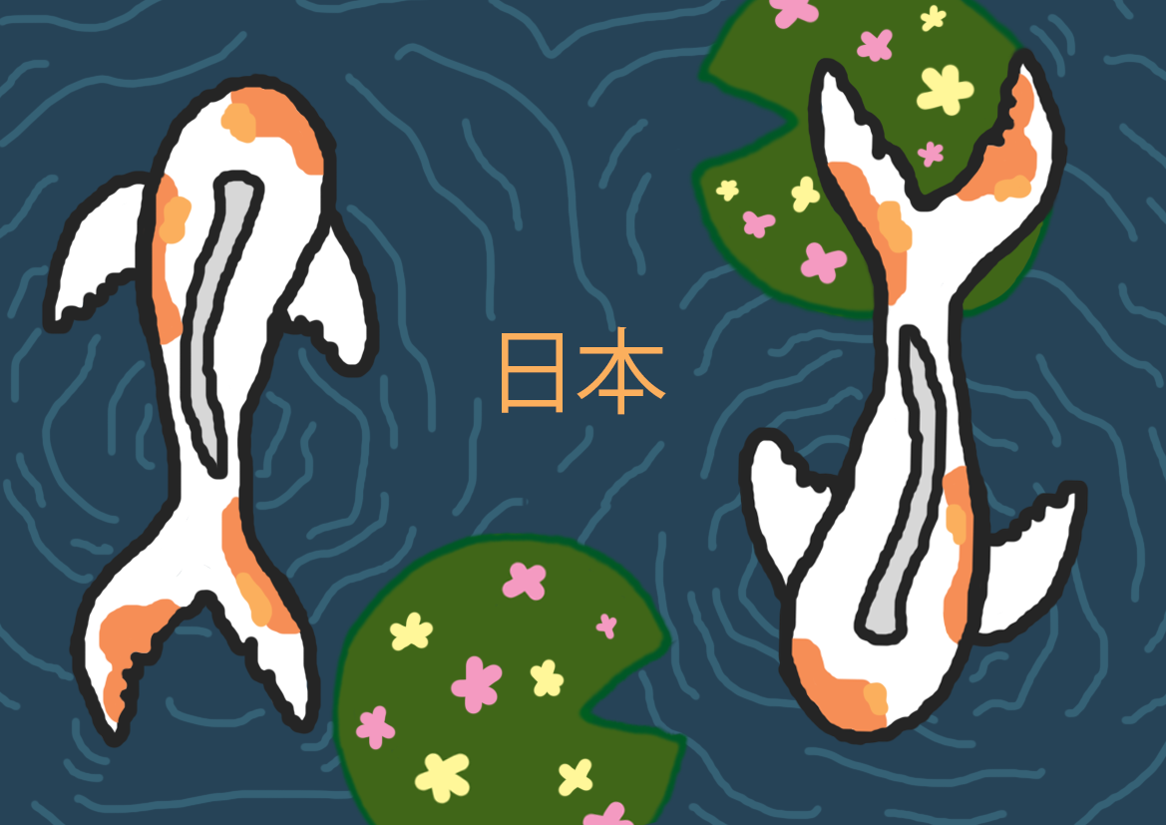
Murphy Johnstone 8/52

Slide 3
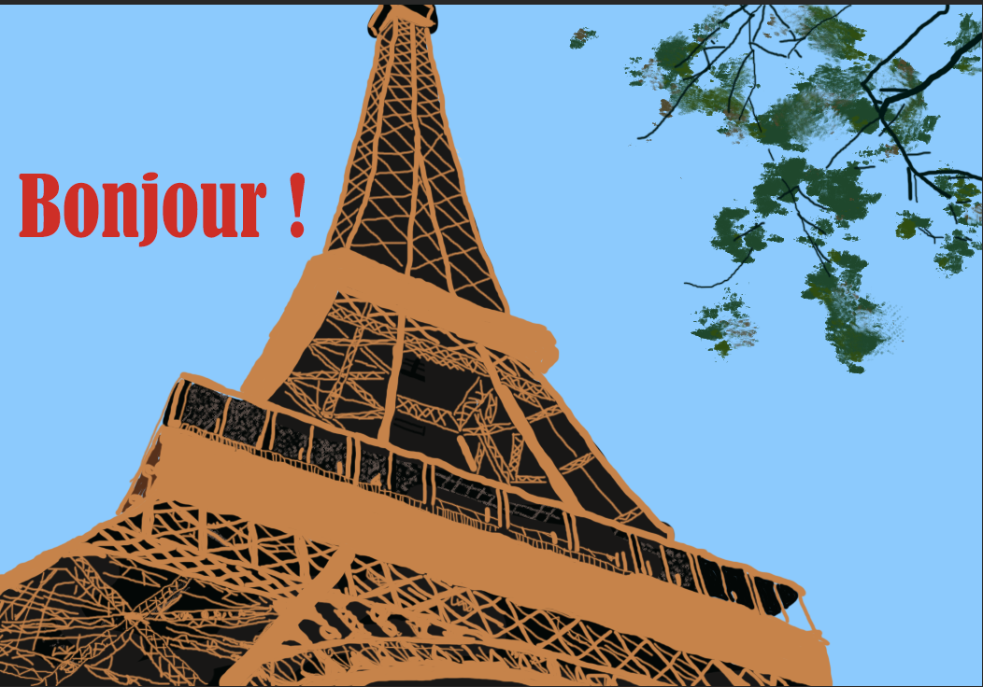
Sarah Lloyd 8/51

Slide 4
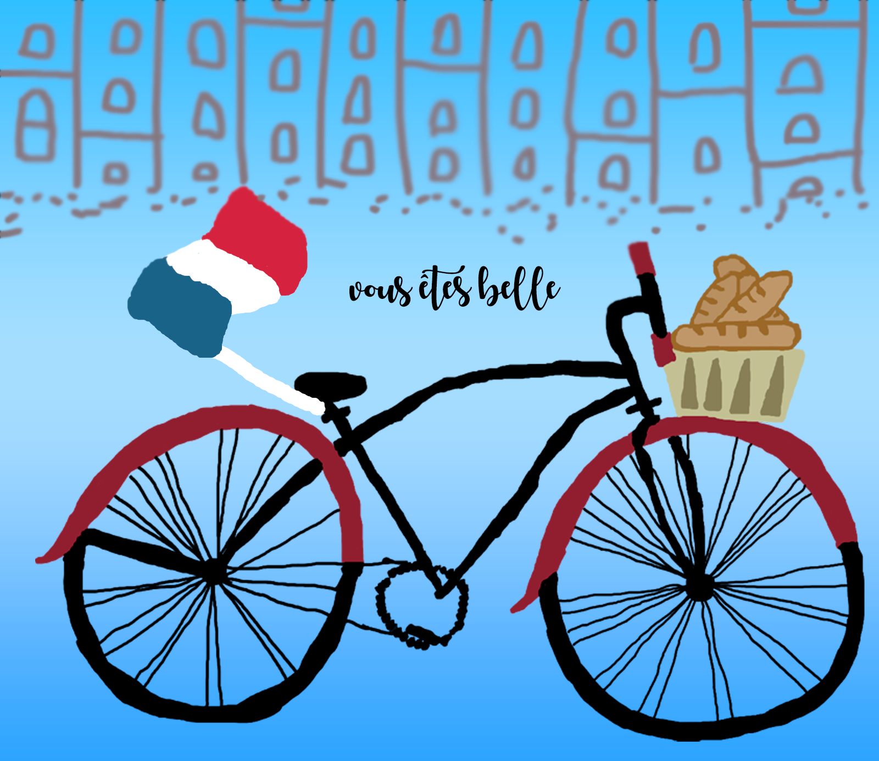
Airlie Smith 8/48

Slide 5
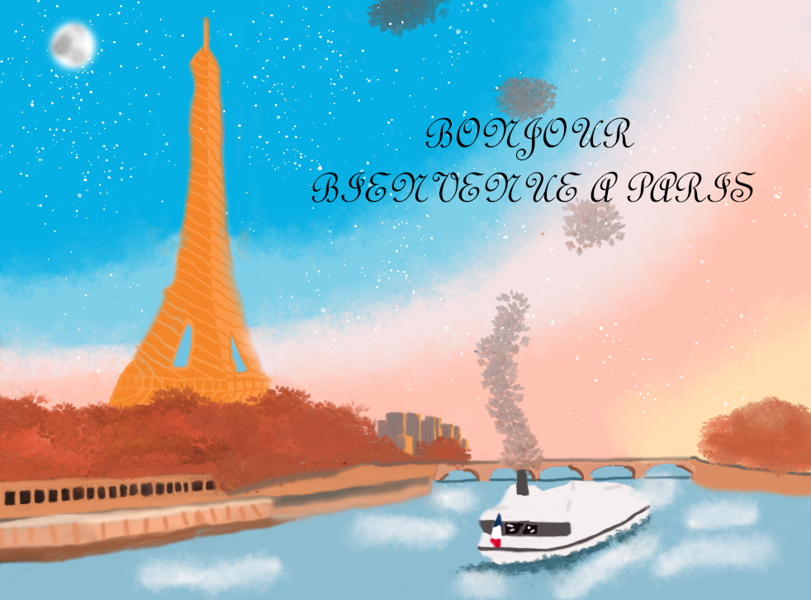
Bailee Drew 8/48

Slide 6
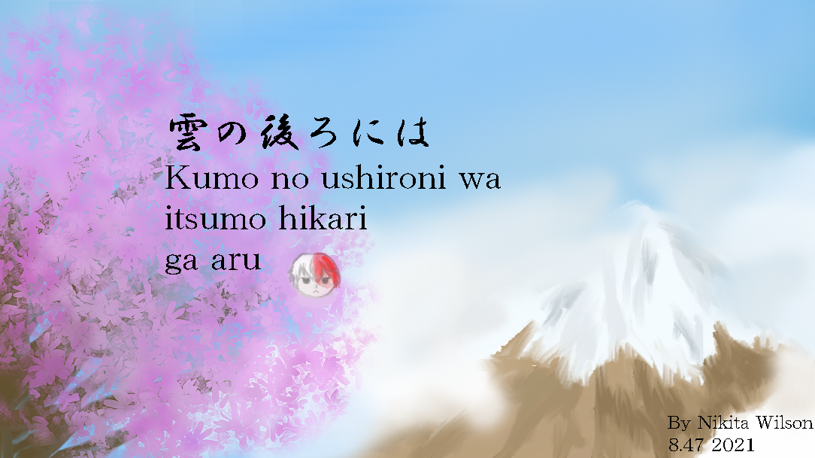
Nikita Wilson 8/47

Slide 7
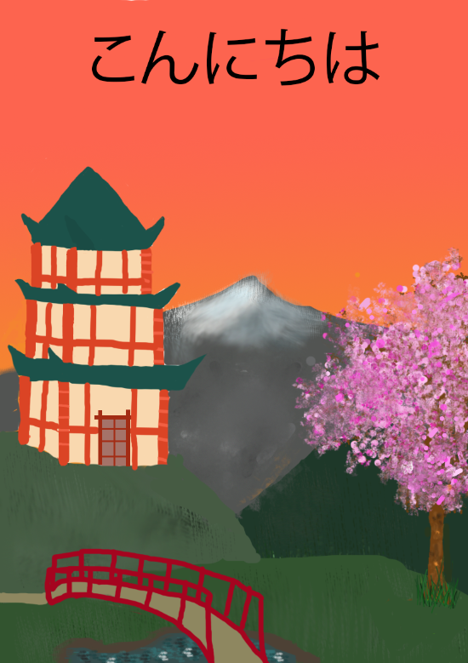
Elizabeth Martin 8/52

Slide 8
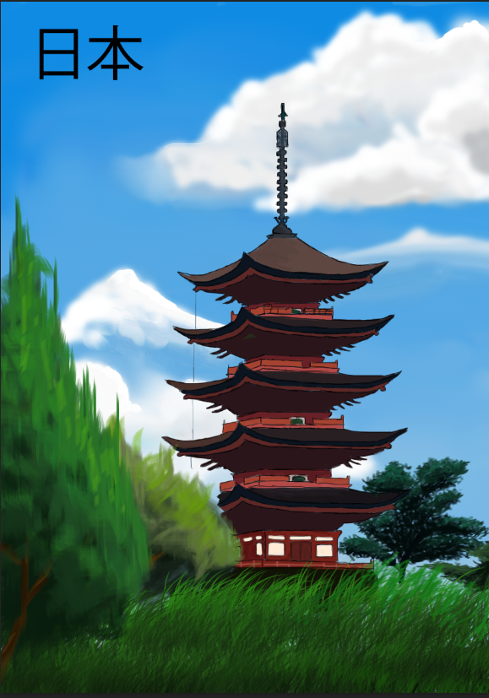
Nikita McFayden 8/45

Slide 9
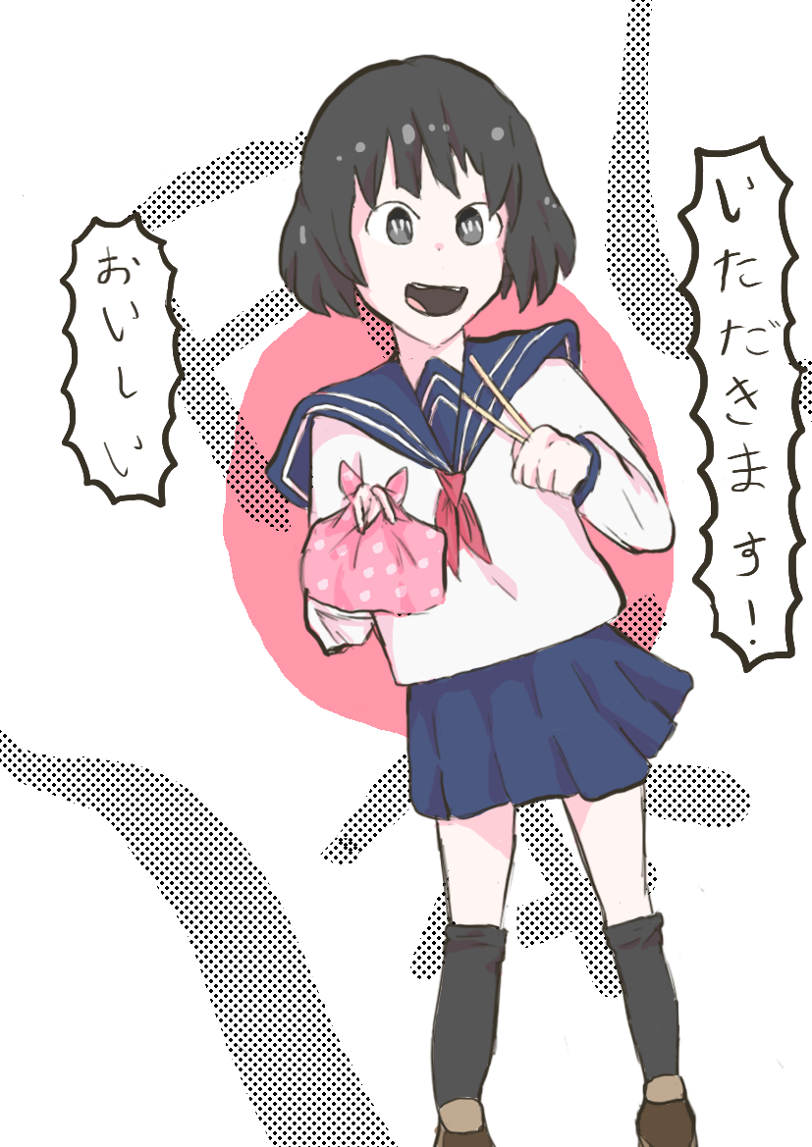
Yzabel Mariano
8/45

Slide 10
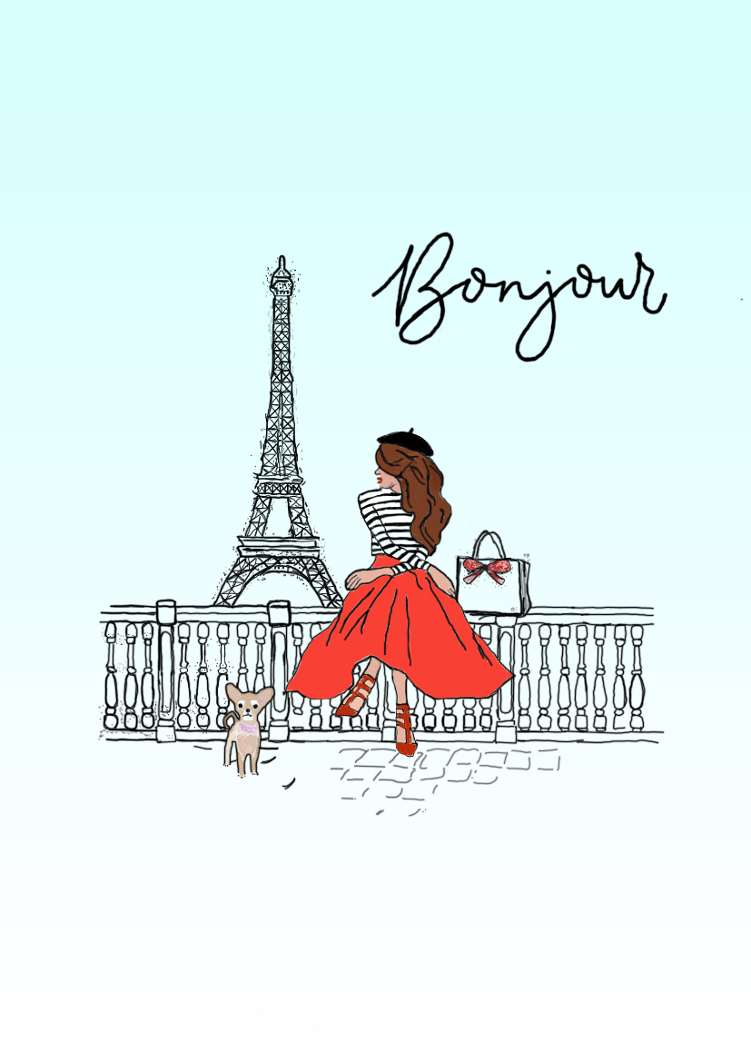
Olivia Robertson
8/45

Slide 11
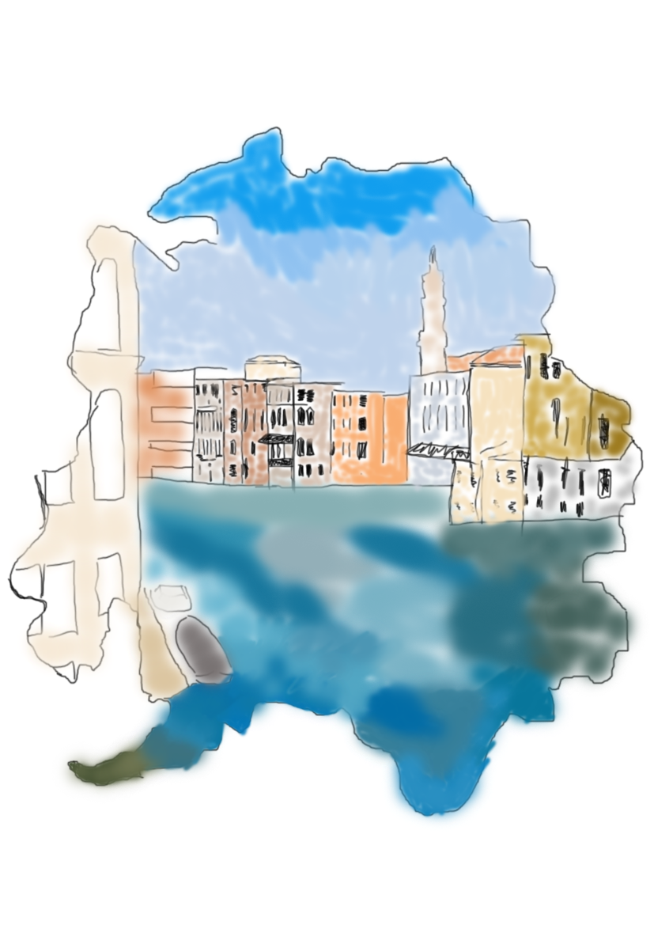
Aysha Nayna
8/51

Slide 12

Taylah Bell
8/47

Slide 13
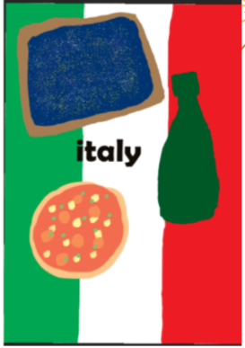
Charlotte Maclean
8/49

Slide 14
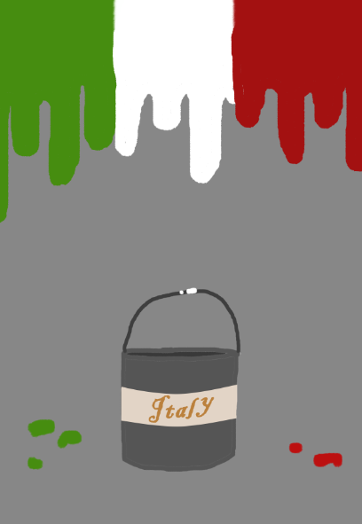
Eva Mollica
8/49

Slide 15
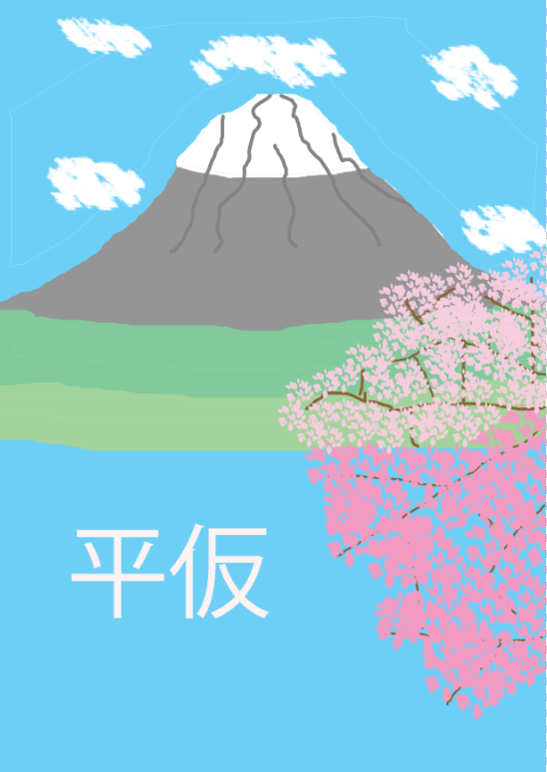
Ella Donnelly
8/49

