Slide 1
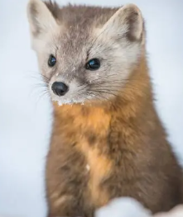
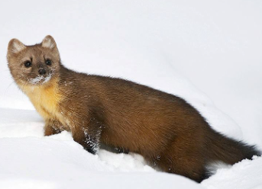
American marten
By Aoife

Slide 2
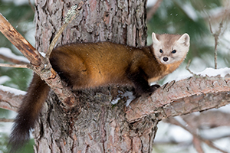
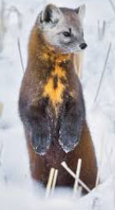

What is a American marten
A American marten is a cute light or dark brown fur with a patch of orange or white on there chest with a fine coat. they are 32-51 cm not including there tail that 14cm long. An American Marten weight about 0.9-1.8kgs, there life span is 0-17 years . There scientific name is ‘ Martes Americanu’. American Martens are in the family of Mustedids and A group of them is called a richness.
Orange
Chest
Patch
White
Chest patch

Slide 3
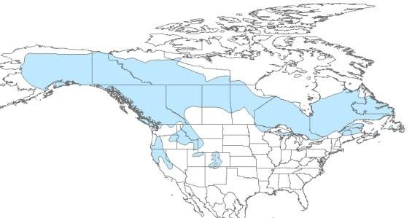
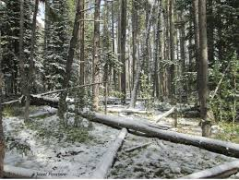

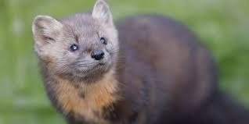
Come see my home
American Martens are a Canada species that live in wood lands. They like it better up high and hunt around mountain streams and sometimes hunt in the water. In there life time they will make serval dens. In the winter they grow special hair in-between there toes called snowshoe for walking in snow.
This is my home
Yay
snowshoe

Slide 4
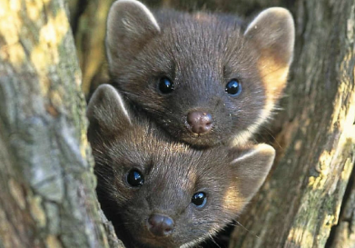
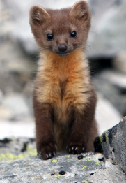
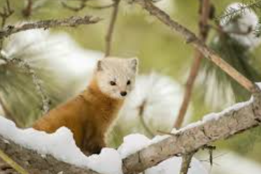
Kits
Kits are the Martens kids name. A American Marten can have 1-5 kits per litter but usually only has 2-4. A baby weighs about 34 grams there mating moth is April and may, when they are born there blind but open there eyes at the first 5-6 weeks after birth.
Hello !!
☺
Can you get of me now

Slide 5
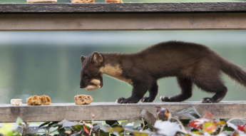
The amazing diet
American Martens have different food choices in summer and autumn. In summer they eat wild strawberry’s, raspberry’s blueberry's etc. in Autumn they eat birds, eggs, insects ,reptiles Amphibians and squirrels.
yummy
What are you eating ?

Slide 6
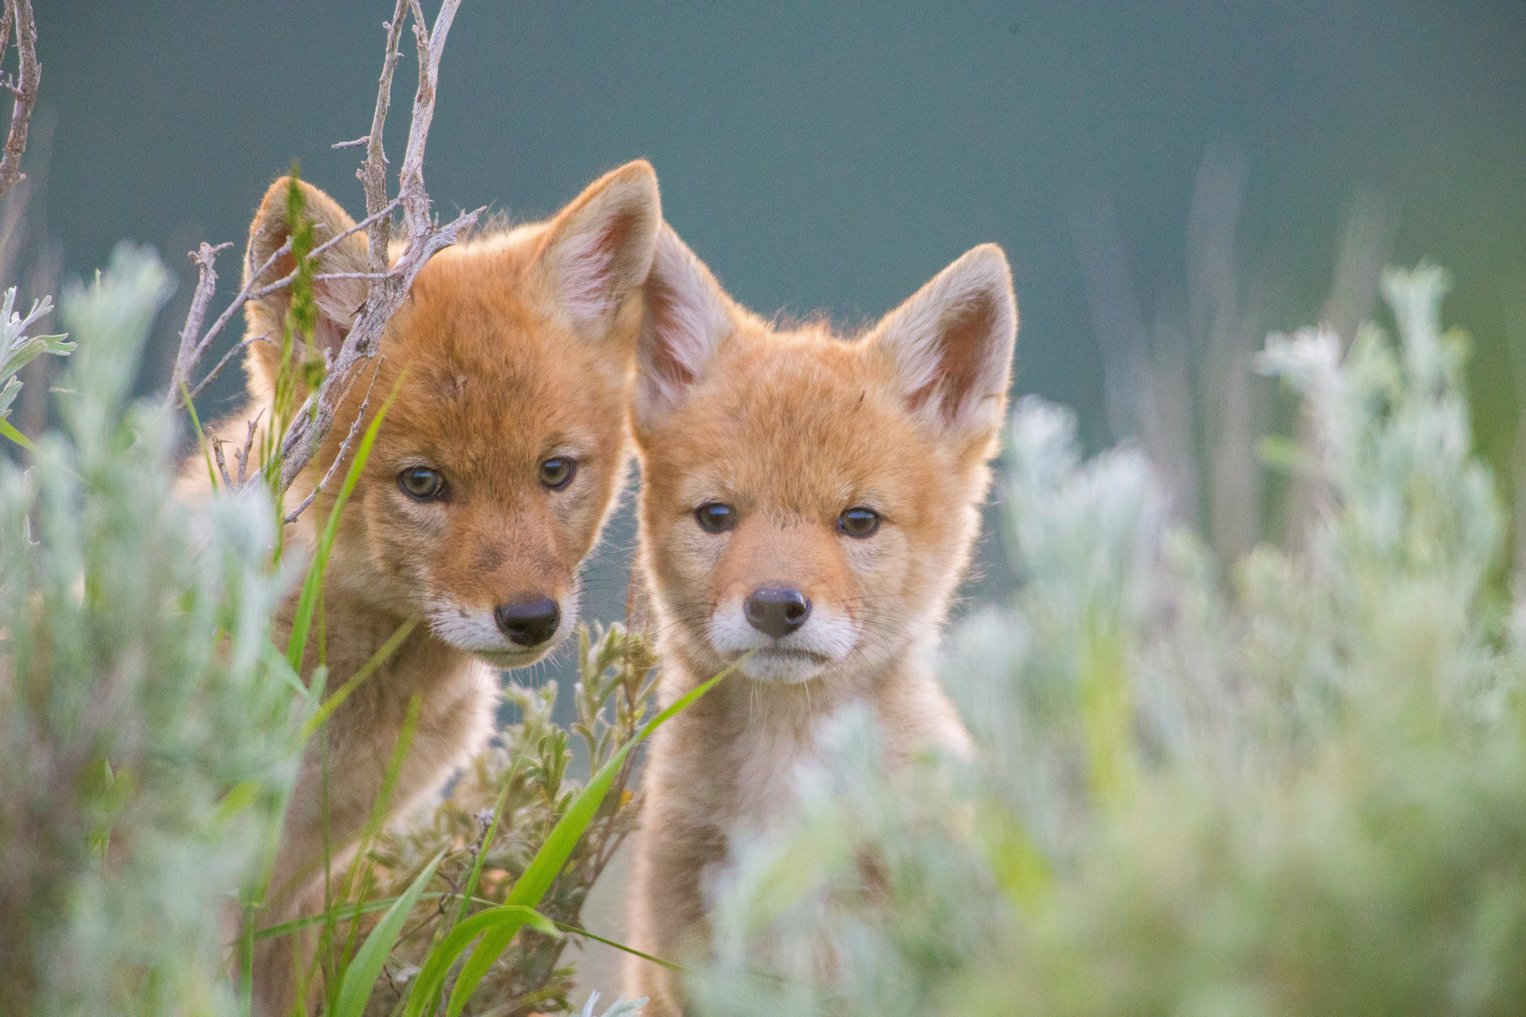
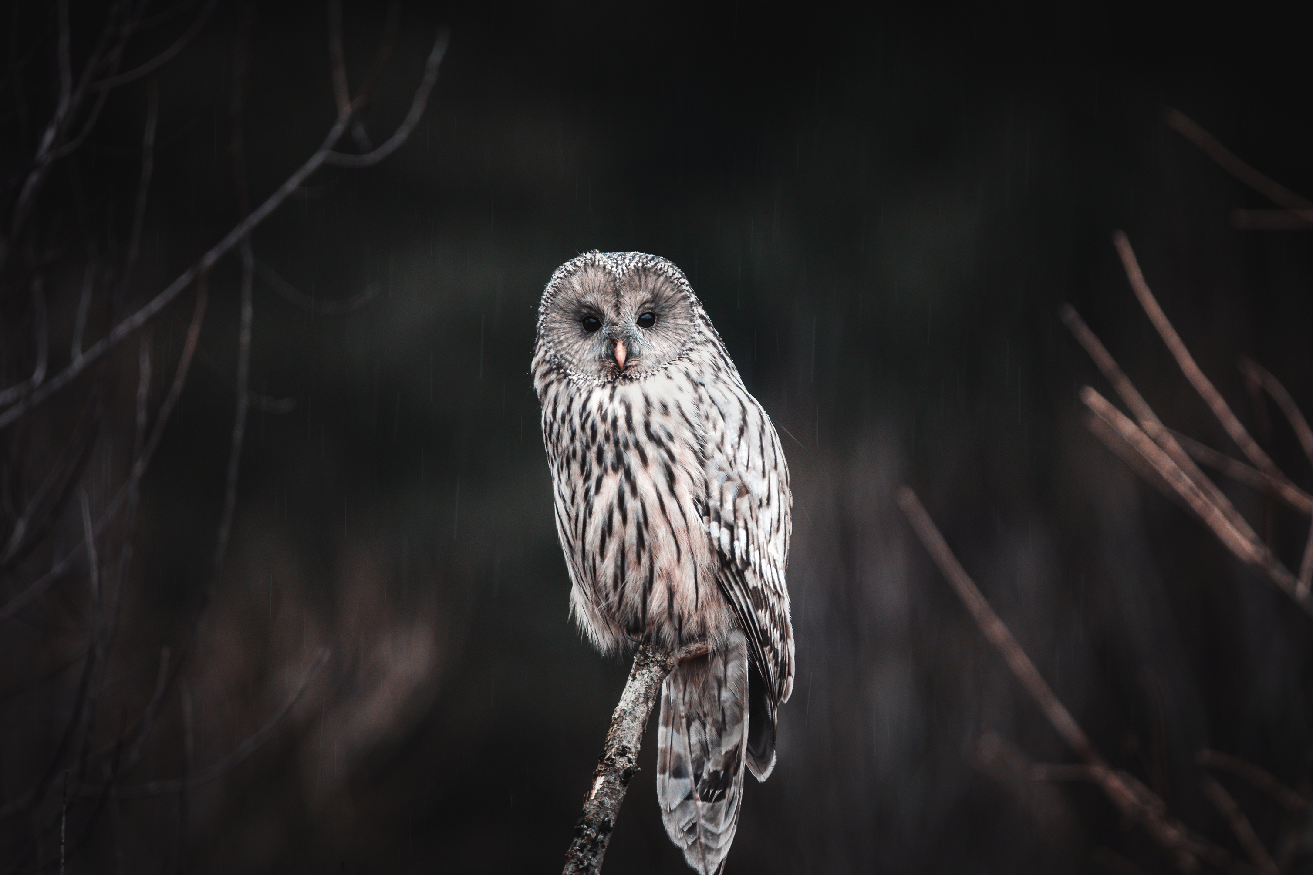
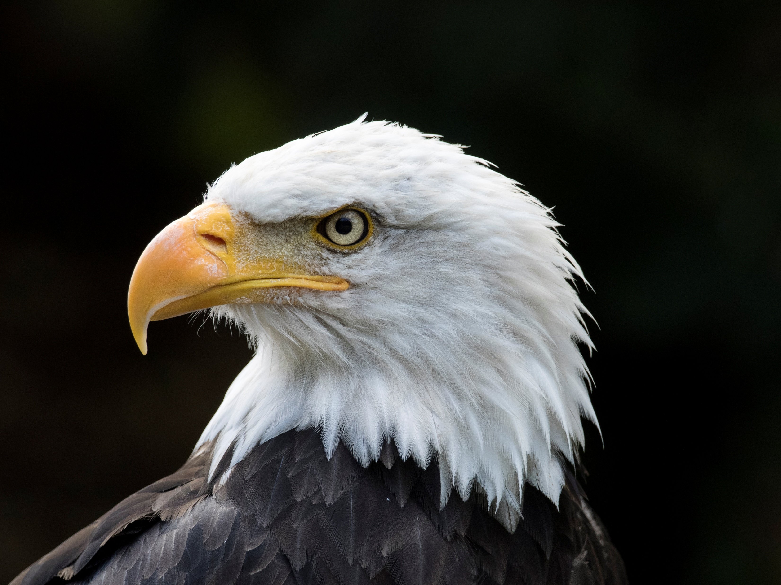
Threats
An American martens Threats are A owls golden eagles fishers coyotes and bobcats these animals have some sort of beef because they what to kill them.
Yeah nah
Don’t eat me !!!

