Slide 1
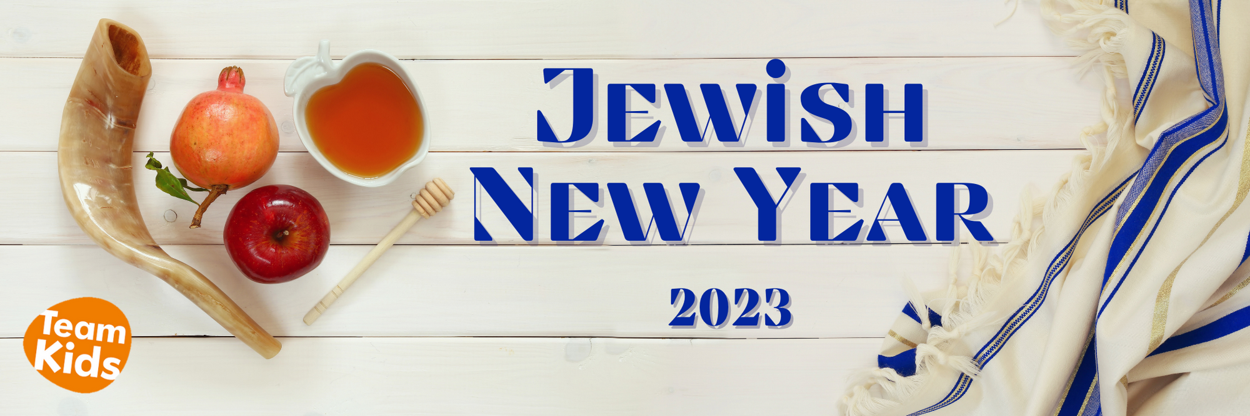



Cheltenham East Team Kids
Dear Parents,
As we approach the last week of Term 3, we wanted to provide you with some exciting updates about our upcoming School Holiday Program! We have a fantastic line-up of activities and adventures planned to keep your children engaged and entertained during the break.
School Holiday Program Highlights:
1.Excursions:
•Moorabbin Air Museum: A thrilling day exploring vintage aircraft and aviation history.
•Bounce Inc and Movie: A day filled with jumping, bouncing, and a movie screening for added fun!
2.Incursions:
•Magic Bubbles: Prepare to be amazed by enchanting bubble magic!
•Mobile Butterfly Enclosure: Get up close and personal with beautiful butterflies.
•Go Yoga-migos: A relaxing and fun yoga session for kids.
•Tie Dye Workshop: Unleash your child's creativity with colorful tie-dye creations.
•Pizza Party: Enjoy making and eating delicious pizzas together.
3.In-House Activities:
•Hives Happenings: Engaging activities right here at our facility to keep your child entertained and learning.
Jewish New Year Celebration:
We'd also like to acknowledge the upcoming Jewish New Year, which falls on September 15th, 2023. If your family observes this holiday, please let us know if there are any special arrangements, we can make to ensure your child's comfort during this time.
Community Information:
Don’t forget to swing by our community stand during drop-off times to browse latest flyers and brochures for exciting local events and resources. Stay connected with your community and discover upcoming activities for your family. We are here to help you make the most of your family’s time in our wonderful neighborhood.
Enjoy your school holiday with your children!☺ See you next Tern!
Warm regards,
Eric
Director of Team Kid Before and After School Care
10
Cooking Club
Origami Club
Game Club
Cooking Club
Origami Club
13th September
Roald Dahl Day
14th September
R U OK? Day
15th September
Jewish New Year
0432 299 468
CheltenhamEastPS@teamholiday.com.au
1300 035 000
info@teamkids.com.au

