Slide 1
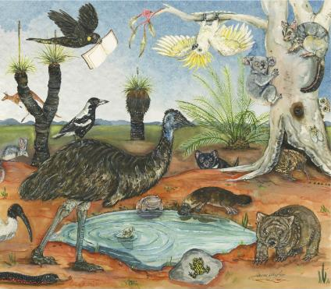
NSW Premier’s
Reading Challenge 2024
PRC information for Years 5-6

Slide 2
What is the Premier’s Reading Challenge (PRC)?
The Premier’s Reading Challenge (PRC) aims to encourage a love of reading for leisure and pleasure in students, and to enable them to experience quality literature. It is not a competition, but a challenge to each student to read, to read more and to read more widely.
NSW Premier’s
Reading Challenge 2024
NSW Premier’s Reading Challenge, 2024

Slide 3
What are the Premier’s Reading Challenge dates?
26th February
to
23rd August 2024
NSW Premier’s
Reading Challenge 2024

Slide 4
PRC
Rules
Students in years 3-10 must read 20 books.
At least 10 must be on the PRC book list.
Up to 10 can be personal choice books.
NSW Premier’s
Reading Challenge 2024

Slide 5
PRC
Rules
For years 3-10, students must read books on their own, however, someone can help choose them.
NSW Premier’s
Reading Challenge 2024

Slide 6
PRC
Rules
Year 3/4
Books can be from the 3-4, 5-6 and 7-9 lists.
Year 5/6
Books can be from the 5-6 and 7-9 lists.
Year 7-10
Books can be from the 5-6 and 7-9 and 9plus lists.
NSW Premier’s
Reading Challenge 2024

Slide 7
PRC
Rules
Series Books on PRC list
5 can be included as PRC books.
Up to 10 can be included as personal choice books.
NSW Premier’s
Reading Challenge 2024

Slide 8
PRC
Rules
Once Completed
Books read after the Challenge closes can count towards next year’s Challenge.
NSW Premier’s
Reading Challenge 2024

Slide 9
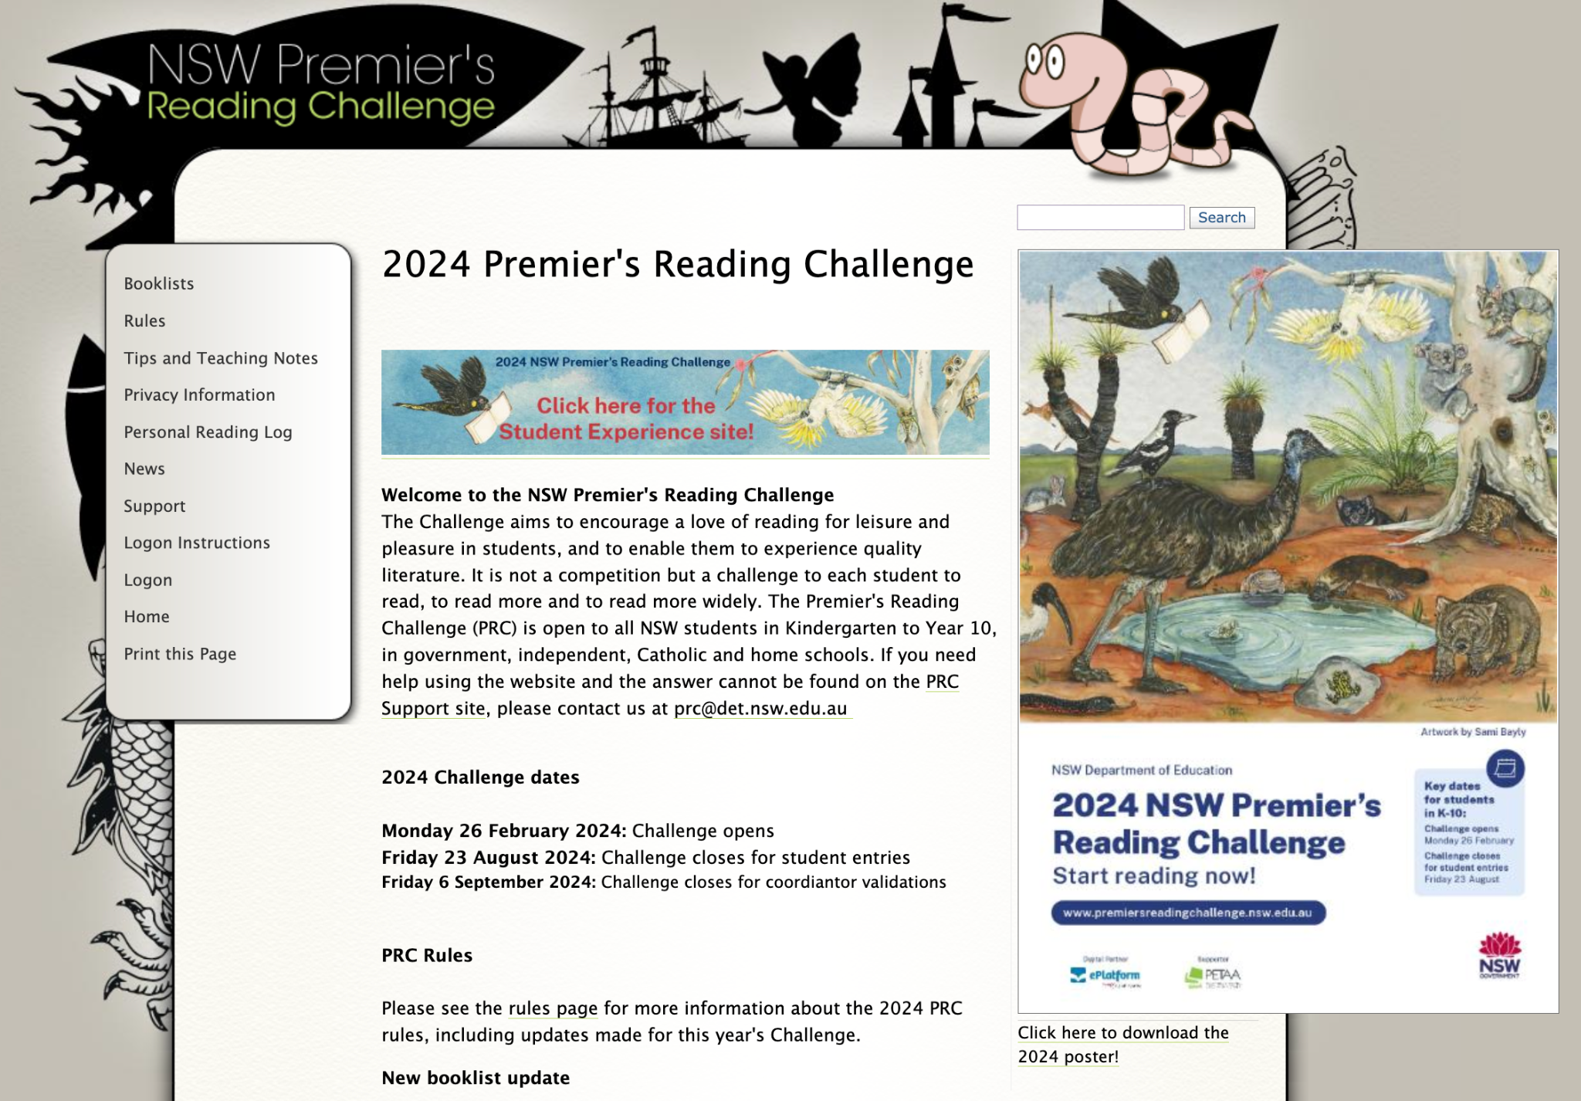
Here is where you can access the PRC student site.
NSW Premier’s
Reading Challenge 2024

Slide 10
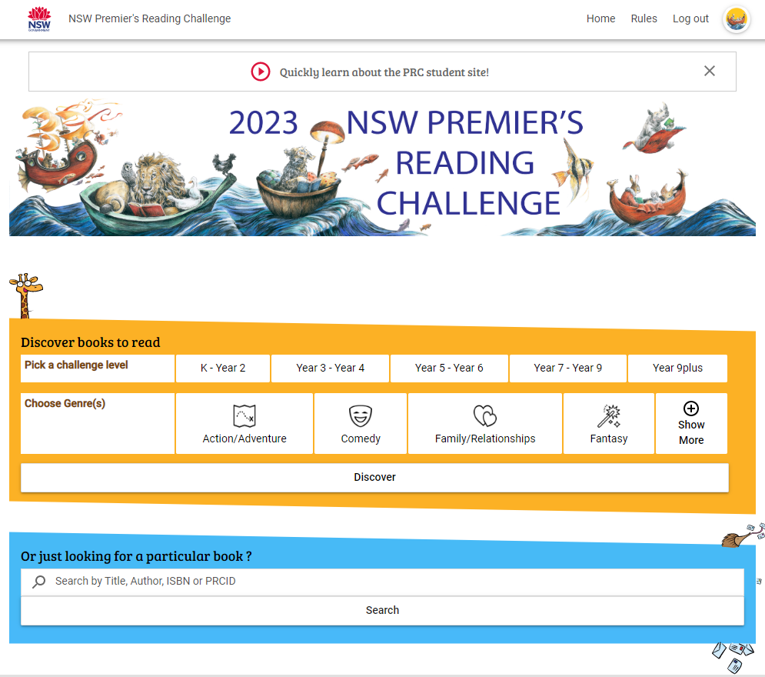
NSW Premier’s
Reading Challenge 2024
This shows that you are logged into the PRC portal.

Slide 11
Here you can search for a PRC book to discover, or see if a book you already have is on the PRC list.
NSW Premier’s
Reading Challenge 2024

Slide 12
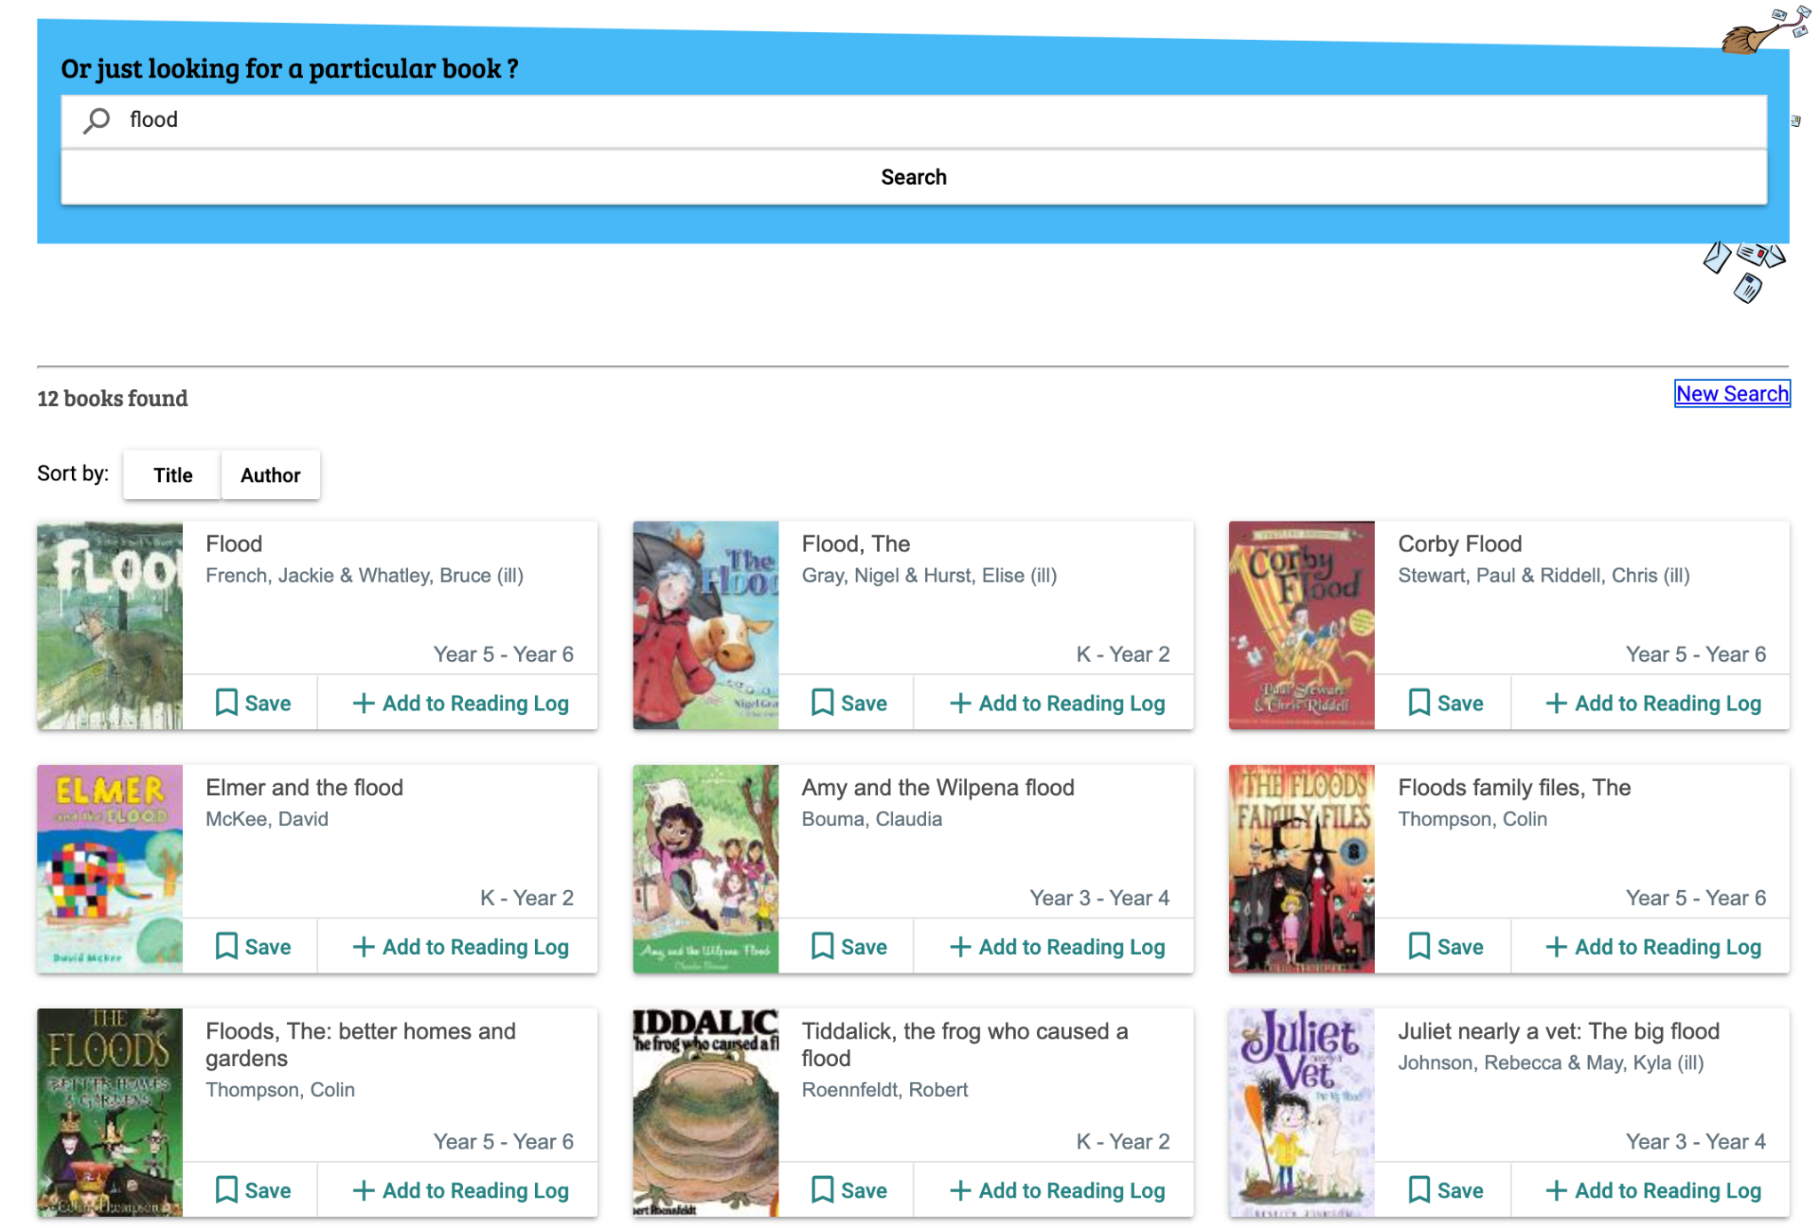
Clicking on the ‘Save’ button, will add the book to your ‘Saved List’ (which is keeping them as books you might like to read at some point). They do not automatically get added to your reading log.
NSW Premier’s
Reading Challenge 2024

Slide 13
Here is where you can add PRC books, by clicking on ‘Add to Reading log’.
NSW Premier’s
Reading Challenge 2024

Slide 14
Click on your icon picture to be taken to your reading log page.
NSW Premier’s
Reading Challenge 2024

Slide 15
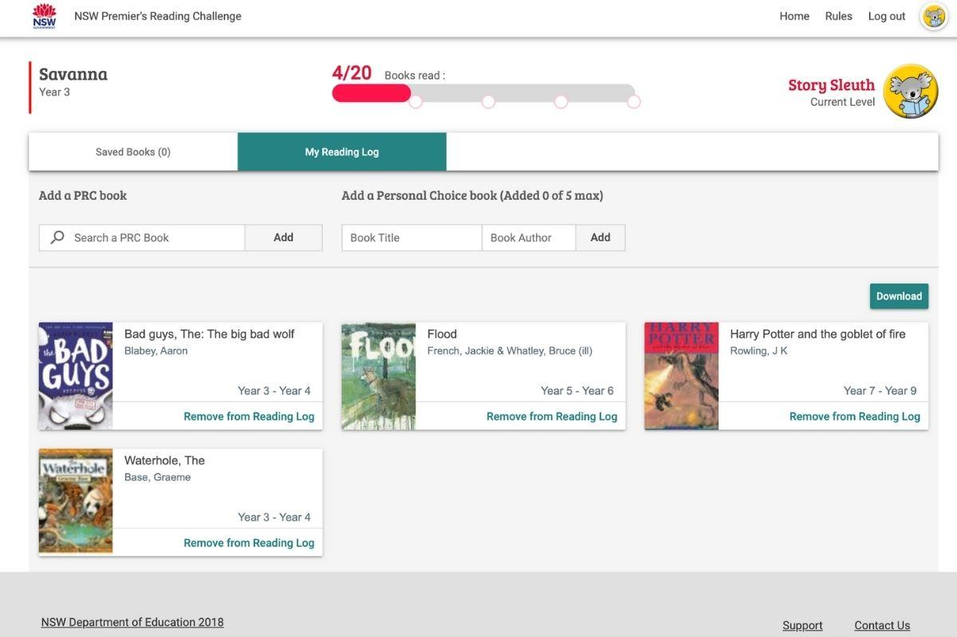
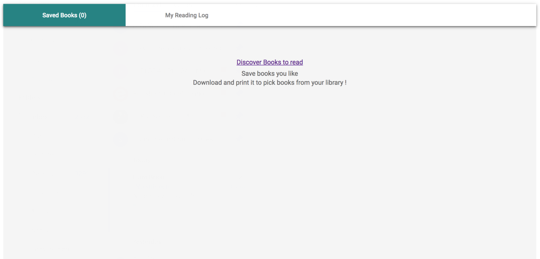
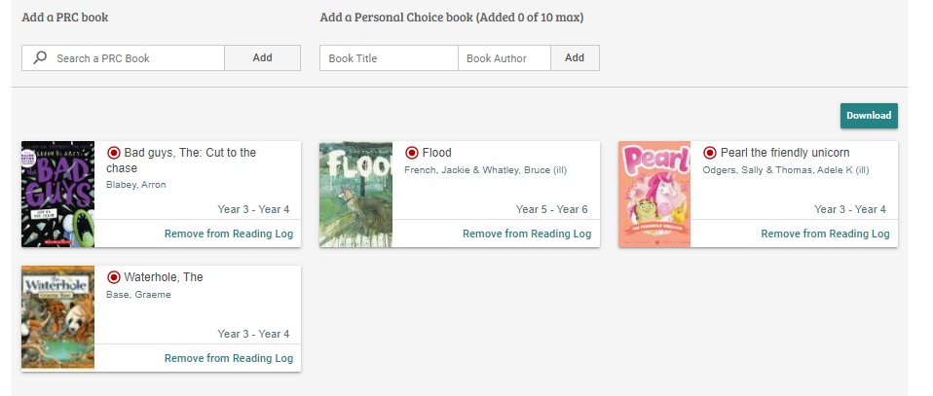
This shows you are in the section where saved books will appear. They do not automatically get added to your reading log.
NSW Premier’s
Reading Challenge 2024

Slide 16
Click on ‘My Reading Log’ to show you reading records.
NSW Premier’s
Reading Challenge 2024

Slide 17
By clicking on ‘My Reading Log’ your reading records should appear, like this.
NSW Premier’s
Reading Challenge 2024

Slide 18
Here is where you can search for a PRC book if you are in your reading log section and not on the homepage.
NSW Premier’s
Reading Challenge 2024

Slide 19
You can always remove a book from your list, if you clicked to add it by mistake.
NSW Premier’s
Reading Challenge 2024

Slide 20
Here is where you enter your personal choice books.
NSW Premier’s
Reading Challenge 2024

Slide 21
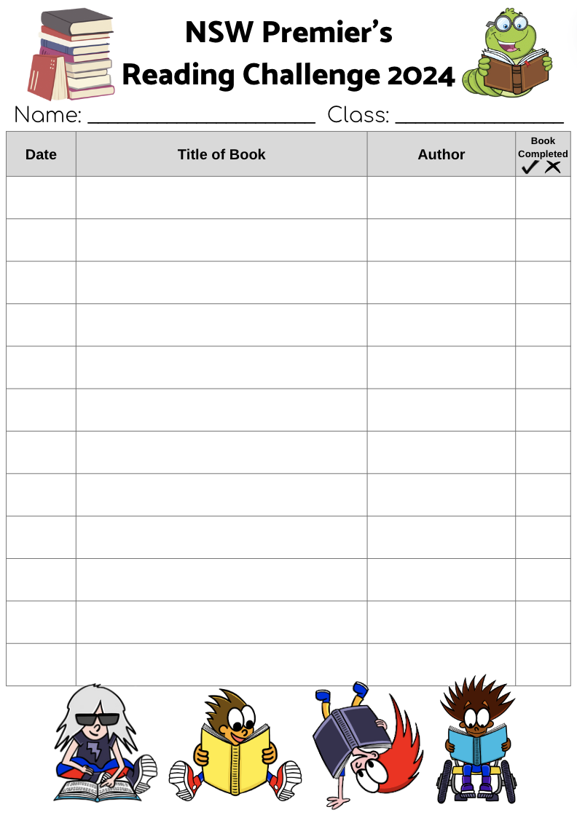
You can keep a record of your books on the reading log.
NSW Premier’s
Reading Challenge 2024

Slide 22
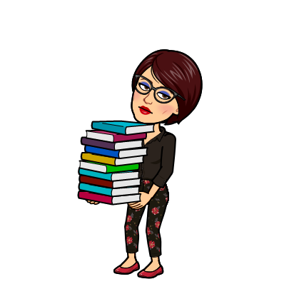
Visit the PRC website for more information:
http://www.premiersreadingchallenge.nsw.edu.au
NSW Premier’s
Reading Challenge 2024
Information/resources provided on the NSW PRC website.

