Slide 1

Parent Information Session
Year 1/2
Notes:
Sophia

Slide 2
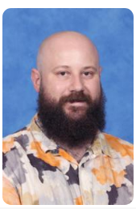
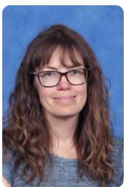
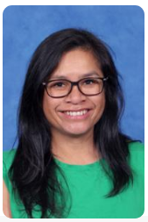
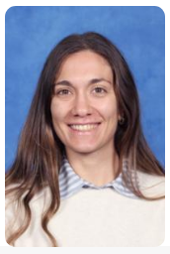
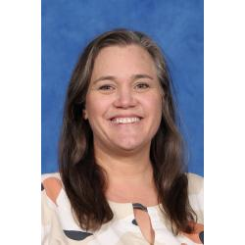
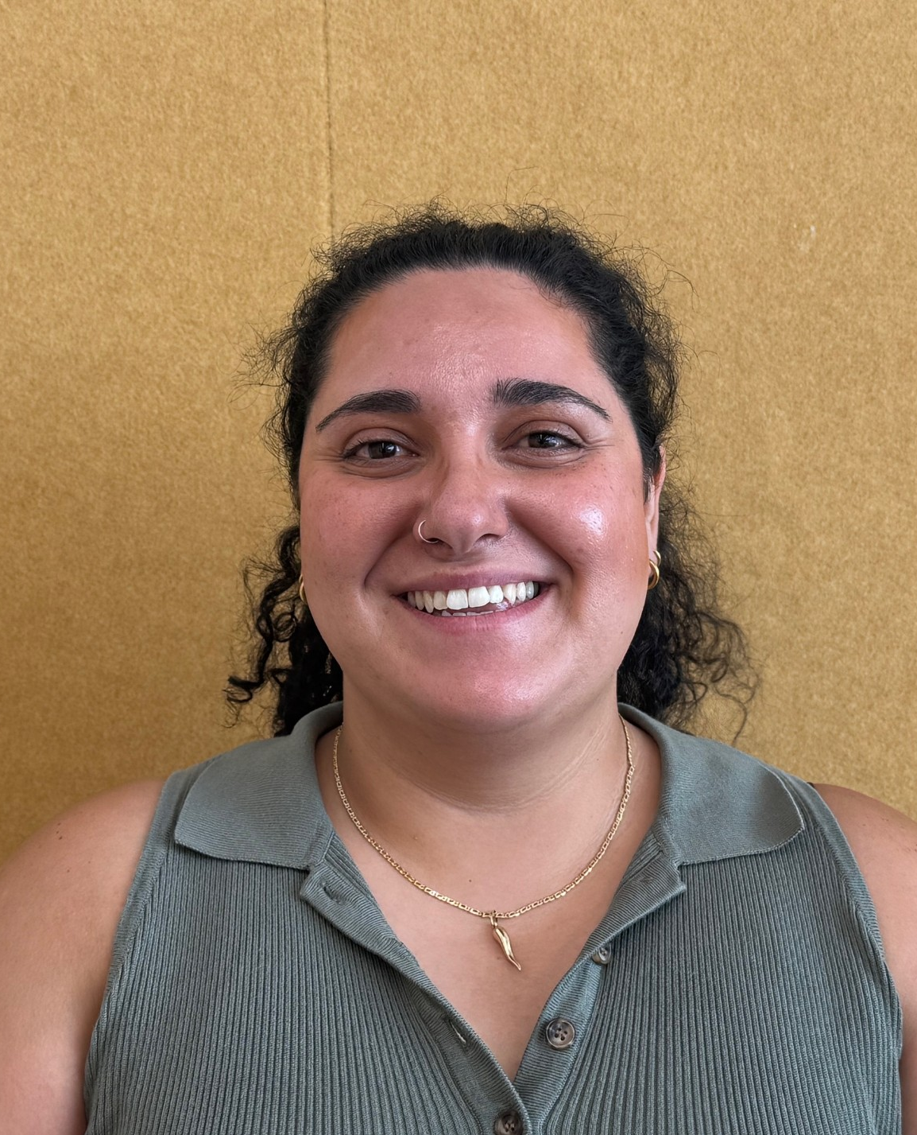
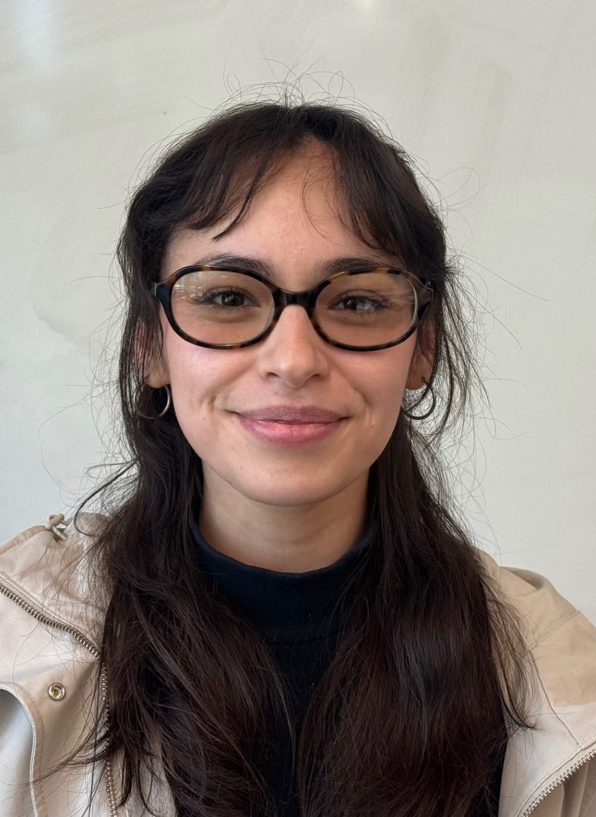
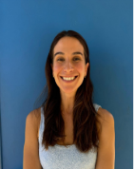
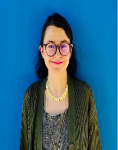
The 1/2 Team
Simon
Christine
Kylee
Paula
Team Leader 12AB
12AB
12CD
12CD
Mel
1/2 LCL
Bianca
Almendra
Juliana
Luisa
12EF
12EF
12Education Support
12 Education Support​
Notes:
Sophia

Slide 3




The Learning Community Leader
The LCL's primary role is to Build Effective Professional Learning Teams that support and develop the teachers and students within their team.
Intervention
Planning
Wellbeing & Behaviour support
Mentoring & Coaching
Lead small group intervention sessions.
Guide and implement the NPS planning/instructional model across all subject areas.
Support students to settle positively each morning and respond early to wellbeing or behavioural needs.
Mentoring and coaching teachers to strengthen practice, confidence and collaboration across the team.
Notes:
Sophia
This year, we’re excited to introduce Learning Community Leaders who are now assigned to each cohort, making things even more connected and collaborative! In the past, we had subject-based leaders like the Literacy Leader or Numeracy Leader, but these roles sometimes felt a little disconnected from the classroom. With our new approach, the focus is all about building stronger relationships and creating a more hands-on impact in coaching, mentoring, and supporting both teachers and students. It’s all about teamwork and making learning even more exciting!
In 2025, our goal is all about tapping into the strengths of each team and individual teachers, facilitating planning sessions for greater impact, and really focusing on the unique needs of each cohort. Our Learning Community Leaders are at the heart of this mission, building strong teams, running our before school writing and math programs (along with other passionate teachers), and leading the Newlands Planning Model across all subjects.
They’ll be in the classrooms, supporting teachers, and working side-by-side with them through mentoring, coaching, and collaborative teaching. It’s all about making sure both teachers and students thrive and grow together!

Slide 4

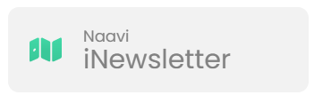


School / Parent Communication
  School Communication
  Payment and Permissions
  Absence Management
  Notifications and Notices
  Parent/Teacher Interview Booking.
  Access to School Calendar
  Semester Reports
  Published weekly (Friday)​
  Essential school-based communication​
  Upcoming events, classroom news, community news, school initiatives and ensures families stay up to date with essential and current happenings at Newlands.
Ensure urgent/timely communication goes via the office
  Payment and Permissions
  Absence Management
  Communicate medical/health care plans
  Visibility into learning experience to support and celebrate learning.
  Assessment posts/recordings.
Notes:
Sentral -
School Communication: Send and receive messages from your child’s homeroom, specialist teachers, and LCL
Payment and Permissions: Provide permission and make payments for camps, excursions, and incursions.
Absence Management: Easily communicate and respond to unexplained absences, as well as submit future absence requests.
Notifications and Notices: Receive timely notifications for community events, absence alerts, and school notices sent directly to your device.
Parent/Teacher Interview Booking.
Access to School Calendar: View and sync the school calendar with your phone to keep track of important dates and events.
Semester Reports: Stay informed by viewing your child’s individual learning plans and end-of-semester reports.

Slide 5

Communication Flowchart
Teachers
The classroom teachers are the first point of contact. Contact for day to day questions, non- urgent updates or concerns.
Learning Community Leader
If you feel like there's an issue or wellbeing concern that requires further support, please reach out to Mel.
If the issue has not been resolved at the previous levels, or if it involves a school-wide concern (e.g., bullying, major academic challenges, safety), the Principal or Assistant Principals should be contacted.
Principals
Notes:
Sophia

Slide 6
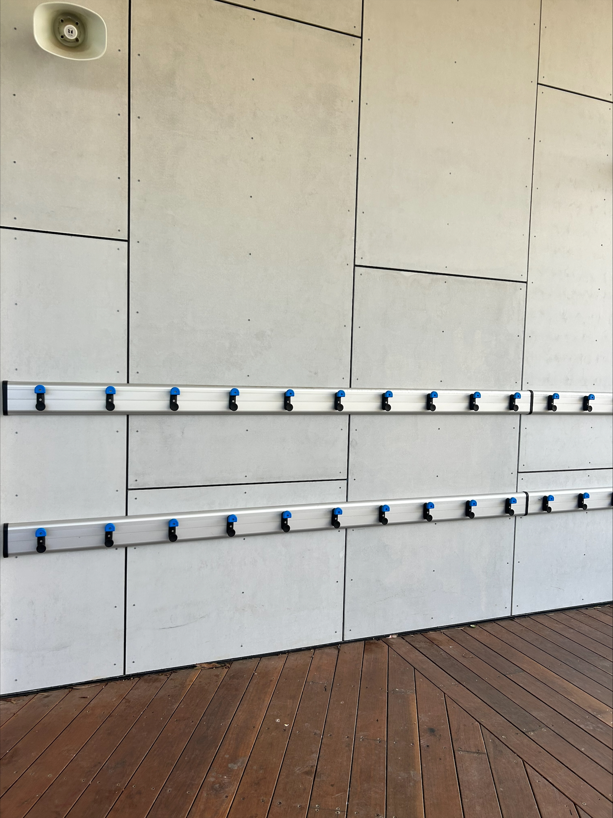
Bags/Lunchboxes
Lisa
Bags
Bags should be on the bag hooks, attached to the classroom your
child starts the day with. In Year 1/2, these hooks are named.
Bags should not be left on the ground.
Lunch boxes
Lunch boxes and drink bottles are to be taken out of bags in the mornings and left in the allocated spaces in the communal room.
Class lunch tubs are labelled.
They will be returned to the student's bags at the end of day in pack up time.
Notes:
Lisa

Slide 7
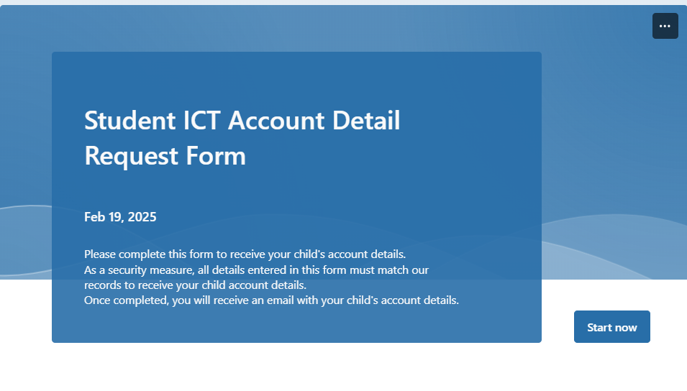
Student ICT Account Details
Student ICT account details are emailed at the start of each school year.
You can also request your child’s account details by completing the Student ICT Account Details Form on the school's website.
Please contact the classroom teacher if you are having trouble signing into any platforms.
Notes:
Angelica

Slide 8
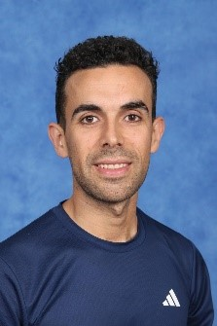
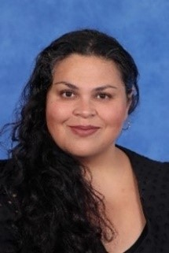
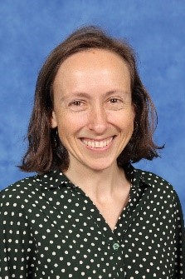
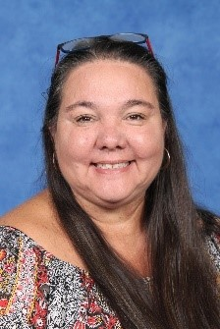
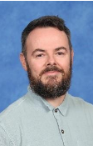






Specialist Team
Margaret
Visual Arts
Rob
Music/Performing Arts
Jess
STEAM
Nerida
Inquiry
Karren
Wellbeing
Raul
HPE
2026 Specialist days are Monday sessions 3, 4 and 5, and Wednesday sessions 1 and 2.​
Specialist teachers can be messaged on Sentral.​
On Monday, pick up at the quadrangle at 3.30pm​.
Whole School Events 2026 ( Whole School Production!)
Notes:
Raema

Slide 9
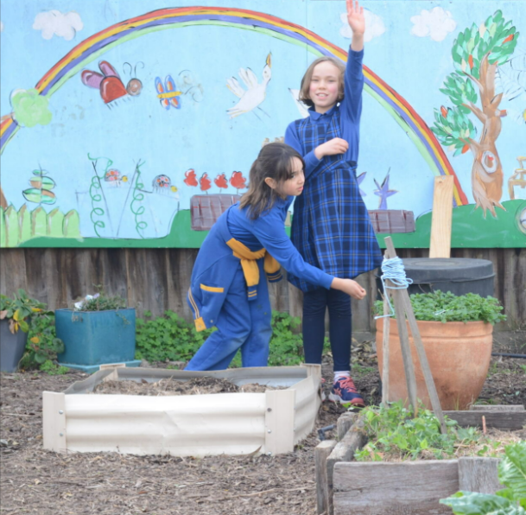

Uniform, Hats and
Lost Property
Lost Property
We will try to returned any named clothing items directly.
Unnamed or unclaimed clothing or items will be moved to C block outside the STEAM classroom, at the end of each week,
Hats
Wide brim or bucket hats
are compulsory to wear
in Term 1 and 4.
Uniform
Ensure all uniform/ personal items are clearly labelled. We encourage runners on PE days.
Notes:
Angelica

Slide 10
Attendance
Morning music will begin at 8:57am, at which time students should move to their classroom door and line up ready to enter.
Classes will commence at 9:00am. To minimise interruptions to learning, please ensure your child is ready and on time.
Student Late Arrivals
Students that arrive at school later than 9:10 am, must sign in at the office. If a student arrives between 9:00 and 9:10am are to be marked as present by the classroom teacher.
All students who are late to school or are collected early are required to sign out at the office.
If your child is leaving early, we ask that it is not between 3:00- 3:30 or during playtime.
Notes:
Sophia

Slide 11
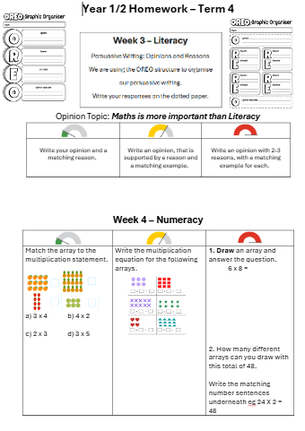
Supporting Learning at Home
(Homework)
Students will bring home a homework page fortnightly.
This will include Literacy and Numeracy tasks that are designed to support and extend their learning at home.
Students will bring home three English books (book-box books, or classroom library texts) and two Spanish books for homework reading. These are to read with your child and to listen to them read aloud to you every day.
Students also have access to online programs that support their learning. RazKids and Nessy are used for Literacy.
The Facts on Fire worksheets, are an optional addition to practise at home.
Homework is designed to build on learning that has already been taught. Your support is most helpful when it focuses on encouraging positive routines and helping students feel confident as they work towards their homework goals.
Notes:
Lisa

Slide 12
Parent Helper Program
A link will be sent out in the newsletter of week 2.
Parent help will begin with reading in English and/or Spanish.
From 9:15am – 10am on Mondays, Tuesdays, Thursdays and Fridays.
Your classroom teacher will provide you with a list of students to read with and listen to, when you arrive for a Parent Helper session.
If for some reason you are unable to come on the day, please contact your classroom teacher through Sentral.
Notes:
Angelica

Slide 13



Parent Teacher Interviews,
Meet the Teacher & Reporting Periods
Term 1
Meet the teacher
Termly Parent Teacher Interviews
Alternate between Spanish and English teacher
Reports published Semester 1 and Semester 2
Term 1 Meet the Teacher (Week 2)
Term 1 PTI with both teachers​
Term 2 – 4 PTI with one teacher
Notes:
Sophia

Slide 14

Camps, Excursions and Incursions
Each term we will have an excursion or an incursion.
This is an opportunity to link our learning to a fun collaborative experience whilst building background knowledge for our students.
Term 1 – Proactivity Incursion (Wednesday 25th February –to be confirmed)
Notes:
Sophia

Slide 15
Local Excursions / Photography
A permission slip will published on Sentral to obtain consent for all local excursion and photography that may take place in 2026.​
If you do not want to give consent for local excursions, please indicate this on the Sentral Permission Slip. ​
Local excursions may include walking to local parks and community spaces. ​
Parents and caregivers will be notified of any upcoming local excursion beforehand. ​
You may withdraw consent for local excursions at any point in the year by calling the school on (03) 9354 2928, or emailing the school at newlands.ps@education.vic.gov.au.
Notes:
Sophia

Slide 16
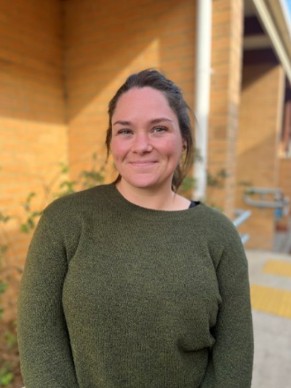
Outside of School Hours Care
Newlands Primary School offers a nationally accredited before and after school care program.
Care is provided from 7:00am until 8.55am each day, and until 6:00 pm after school from Monday to Friday.
OSHC Phone Number: 0491 273 710
You can book in advance for the whole term, or book in casually.
Registrations are be completed online. The link can be found on our website.
Most families are eligible for a fee reduction through the childcare subsidy system.
Example Activities: Arts and craft, sport, cooking, relaxation and quiet corners.
Notes:
Sophia

Slide 17

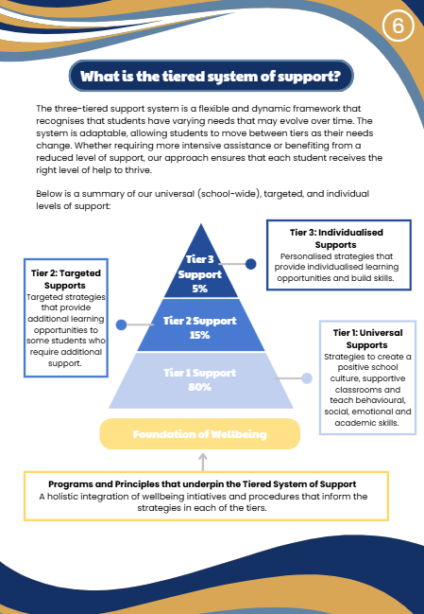
Supporting Your Childs
Wellbeing at School
Notes:
Sophia

Slide 18
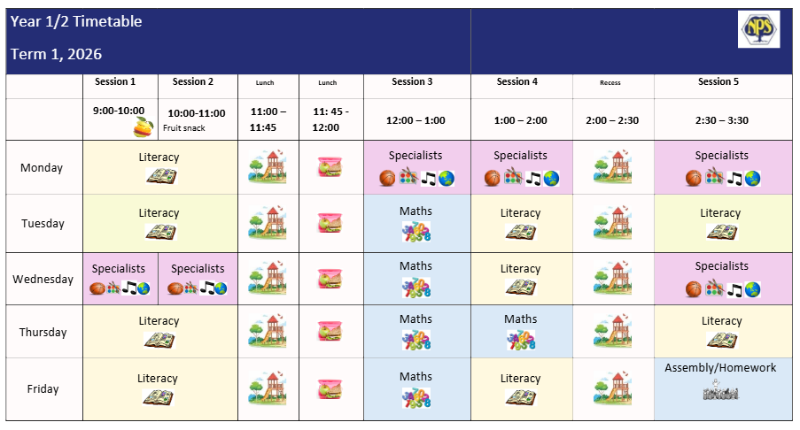
1/2 Term 1 Timetable
Notes:
Angelica

Slide 19



Fruit Snack
Every day at roughly 10am students will have a short 5 minute fruit snack.
Please check that all lunchboxes and drink bottles are clearly labelled with your child's name.
Notes:
Sophia

Slide 20
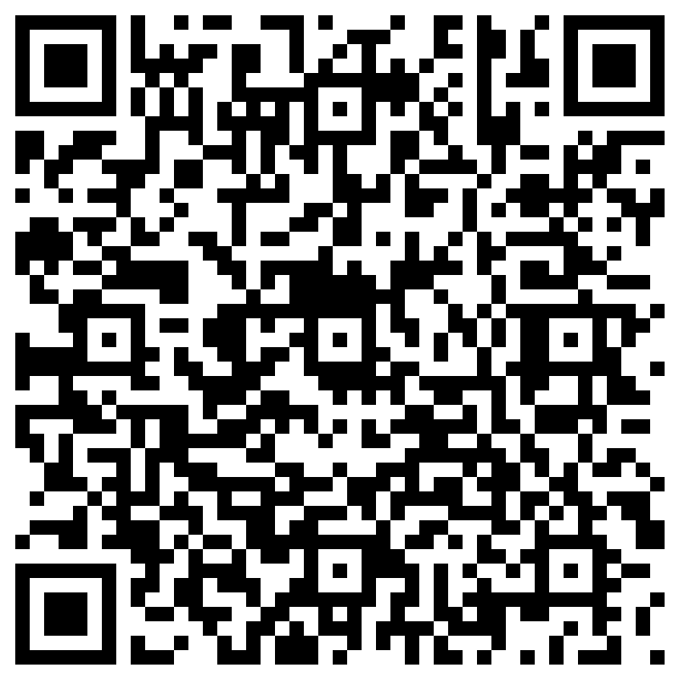
Further Questions
If you have a question that hasn't been addressed, please ask away in the QR code.
All responses will be published in next weeks newsletter.
Notes:
Sophia

