Slide 1
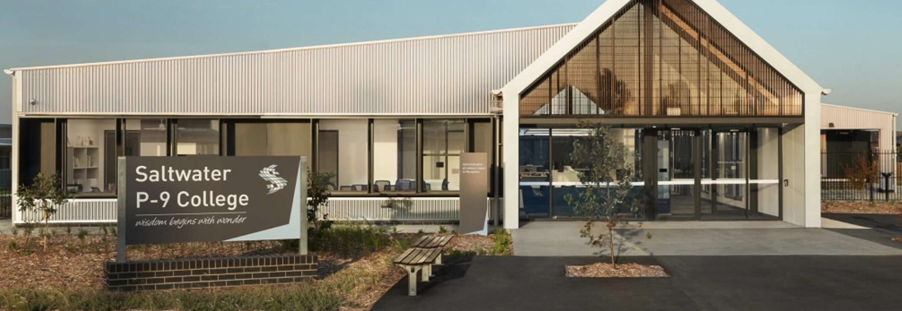
Saltwater P-9 College
2025 Parent Information Evening

Slide 2
Acknowledgement of Country
We acknowledge the traditional custodians of the land on which we work and live, the people of the Kulin Nations. We recognise their continuing connection to land, water and community. We pay respect to their Elders past, present and emerging and extend those respects to all Aboriginal and Torres Strait Islander community members.​

Slide 3
Saltwater P-9 College
2025 Parent Information Evening
Notes:
Music performance after this

Slide 4
Principal’s Message

Slide 5
2025 Leadership Structure
 | Year 7 | Year 8 | Year 9
Assistant Principal | Hayley Mann | Joe Doyle | Danielle Colling
Leading Teacher | Dylan Haeusler | Samantha Tolfo | Nesan Naidoo
Learning Specialist | Maria Nardo
Pastoral Care & Student Engagement | Mark McInerney (AP) & Chris Mernik (LT)

Slide 6
Coaching Parade – Site Overview

Slide 7
Daily Schedule
Time | Session
8:45am | Homeroom
9:00am | Session 1
10:00am | Recess
10:30am | Session 2
11:30am | Session 3
12:30pm | Lunch
1:10pm | Session 4
2:10pm | Session 5
3:10pm | Dismissal
Notes:
Music performance after this

Slide 8
Curriculum Allocation
Subject | Sessions Per Week
English | 5
Maths | 5
Science | 3
Humanities | 3
PE/Health | 2
LOTE (Mandarin) | 1
Electives | 4
4R’s Program | 1
Enrichment Program | 1

Slide 9
Elective Program
Students participate in two separate electives per week
Large focus on Arts & Technologies Curriculum
Year 7 Taster Program
Rotate each term
Participate in all across the year
Year 8/9 Elective Program
Rotate each semester
Participate in 4 across the year
2025 Electives
Art | Wood Tech
Music | Food Tech
Drama | Digital Tech
Visual Comm | Business

Slide 10
Saltwater Sporting Academies
Rugby and Cricket Academies commencing in 2025
4 contact hours per week, split into:
High performance training focus
Sport-related theoretical focus
Conducted by certified coaches
Connections with professional sporting organisations
Participation in excursions and tournaments
Overall focus on engagement, wellbeing and academic success
Notes:
Music performance after this

Slide 11
Student Wellbeing & Engagement
Universal Supports for students
Homeroom teacher, year level LT & AP
Rights, Resilience and Respectful Relationships Curriculum
Inclusive education practices
Student transition programs
On-demand supports for students
Attendance
Behaviour & engagement
Mental health & wellbeing
Learning
Forms of Intervention
Individual education plans (IEPs)
Student support groups (SSGs)
Social & emotional learning (SEL)
Liaising with external professionals and agencies
Disability Inclusion (DI) funding

Slide 12
Attendance
When a child misses just…​ | that equals…​ | which is…​ | and therefore, from Prep to Year 12, that is…​ | This means the best that child can achieve is…​
1 day a fortnight​ | 20 days per year​ | 4 weeks of school​ | Nearly 1 ½ years of learning at school​ | Equal to finishing Year 11​
1 day a week​ | 40 days per year​ | 8 weeks of school​ | Over 2 ½ years of learning at school​ | Equal to finishing Year 10​
2 days a week​ | 80 days per year​ | 16 weeks of school​ | Over 5 years of learning at school​ | Equal to finishing Year 7​
3 days a week​ | 120 days per year ​ | 24 weeks of school​ | Over 8 years of learning at school​ | Equal to finishing Year 4​
Every day counts!

Slide 13
Attendance Intervention Plan
Attendance Percentage | Intervention
80% and above | Homeroom Teacher
70-80% | Assistant Principal
Below 70% | Wellbeing Team

Slide 14
Uniform
Clothing
Academic and sport capsule
Footwear
Black shoes or runners
Jewellery
Studs or sleepers
Hair
Long hair tied back
No extreme colours/styles
Cosmetics
Clear nail polish only

Slide 15
Saltwater P-9 College
2025 Parent Information Evening
Notes:
Dance performance after this

