Slide 1
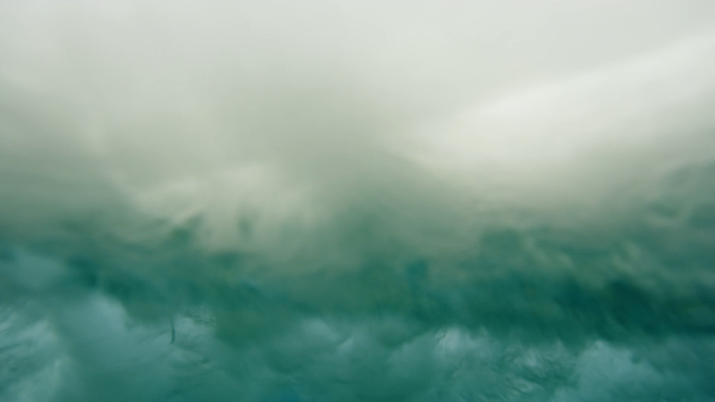
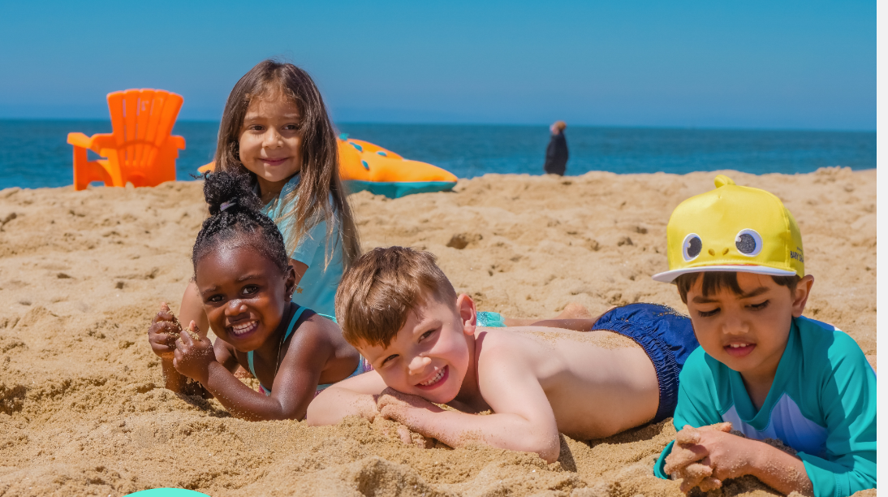
Surf Life Saving
Keep yourself Safe!

Slide 2
Surf Life Saving
Rip Currents - https://www.surflifesaving.com.au/beach-safety/rip-currents/
There is a multilingual section that gives this same information in multiple languages as well.

Slide 3
Surf Life Saving
NSW has a beach safe section on their site that has all sorts of information that can support learning as well. - https://beachsafetyhub.org.au/learn-&-play/beach-ocean-safety/what-is-a-rip-current/#

Slide 4
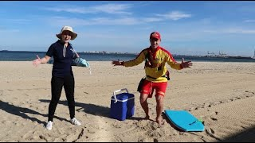
Surf Life Saving
Lets Watch this together:
https://www.youtube.com/watch?v=41hbynn8Hjs

Slide 5
Surf Life Saving
Kahoots:
https://create.kahoot.it/details/2f55d2e3-e6ab-40a1-87fd-1b77c152a0bf
https://create.kahoot.it/details/cd9f016c-937b-456e-a61a-2d27bf10bffd
https://create.kahoot.it/details/b428de04-2e32-4157-a8cd-7ac04d0cdd06

Slide 6
Surf Life Saving
Game
On Google Drive

Slide 7
Surf Life Saving
DOWNLOAD THE BEACH SAFE APP

