Slide 1
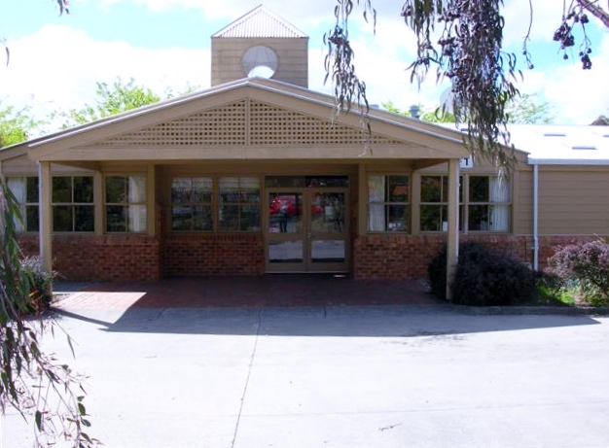
The CSDS Community Night.

Slide 2
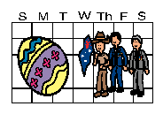
On Wednesday 5th April we are having a special event at our school.

Slide 3
At 5:00 o’clock I will come back to school
with my family.

Slide 4
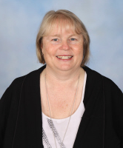
Parents and carers will have a meeting with
Christine and Judith in the library.

Slide 5
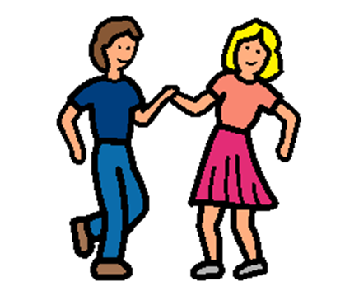
While my family is at the meeting, I will do some special activities with teachers and other students in the classroom. We will do some dancing and have an easter egg hunt! How many of the plastic eggs can we find ?

Slide 6
When I give my plastic easter eggs to the teacher I will get an Easter treat.

Slide 7
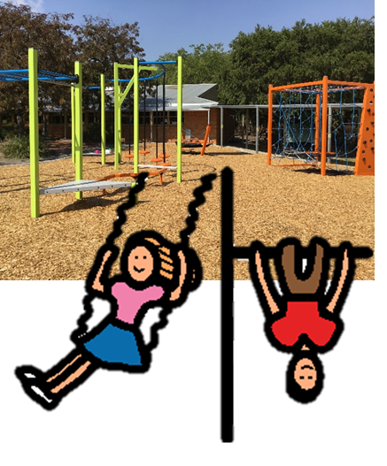
At 5:45 pm, we will go to the basketball court to eat dinner. I can have a sausage and a drink and play in the senior yard .

Slide 8
At 6:30 , when the Easter raffle has finished ,
it will be time to go home .

Slide 9
The Croydon SDS Community Night is a special event.
It is nice to do special events with our families at our school .

