Slide 1
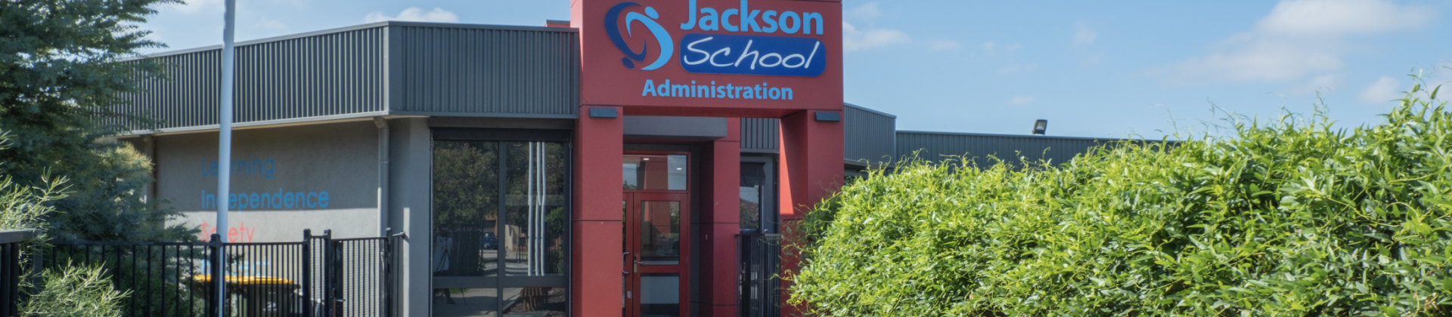
Term 2 at Jackson School

Slide 2

Term 2 will be different

Slide 3
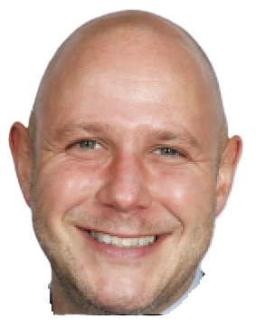

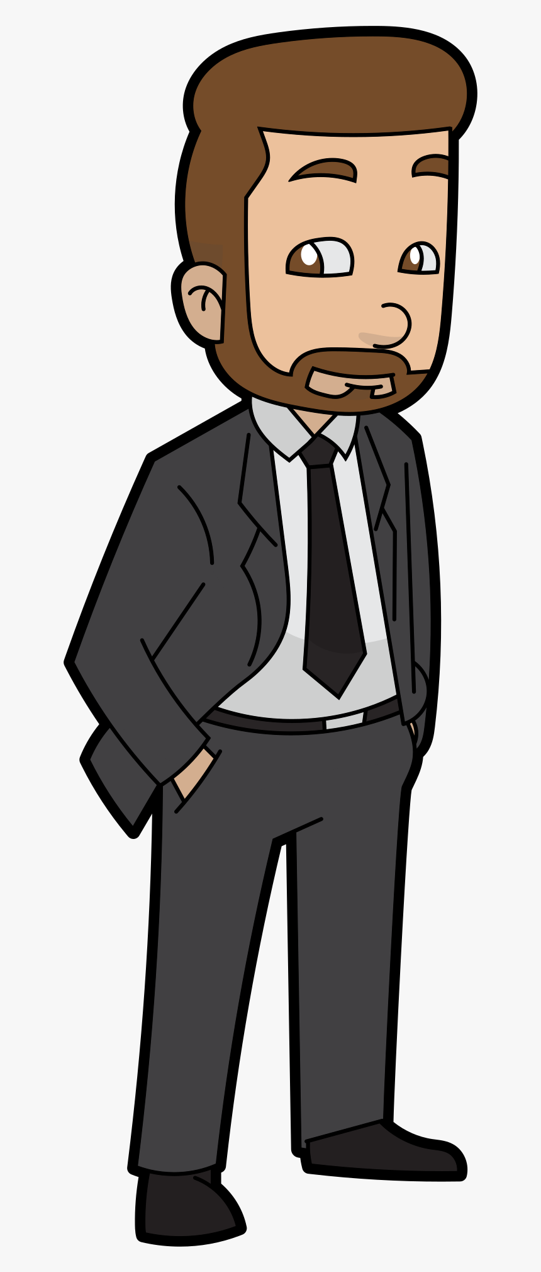
Anthony will take a

Slide 4
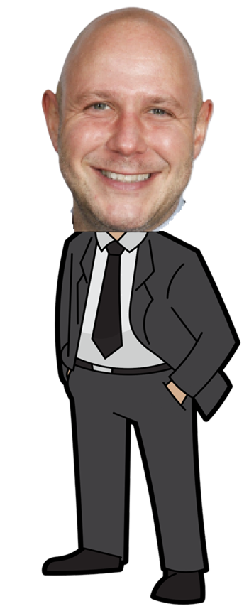

He will be back soon

Slide 5
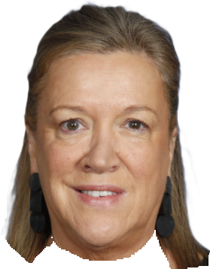

Bern will be principal in term 2

Slide 6

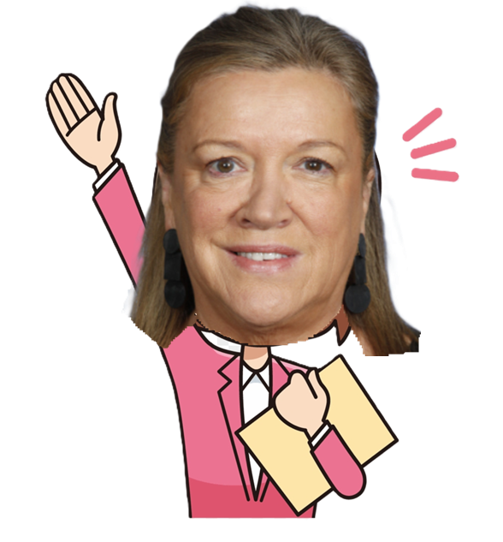
Bern will help Jackson School

Slide 7


I can talk to my teachers if I have questions

Slide 8
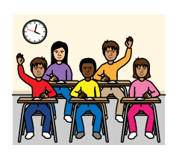

My class and teachers will be the same

Slide 9

Finished

