Slide 1
SPIRIT WEEK PRE-LESSON
Has anyone ever experienced or seen racial discrimination? Reflect on your experiences and try sharing it to the class if you are comfortable.

Slide 2
Acknowledgement of Country
The Wawarrawarry people have been walking on this land, teaching and learning for the past 60 000 years.
The land we now meet on, commonly known as the Eastern Creek area, was the home of the Wawarrawarry people and they were one clan of 30 that made up the Dharug Nation.
I would like to acknowledge the Dharug people who are the Traditional Custodians of this Land. I would also like to pay respect to the Elders both past, present and emerging of the Eora Nation and extend that respect to other Aboriginals present.
This Photo by Unknown Author is licensed under CC BY-ND

Slide 3
“Those who are silent in acts of injustice, take the side of the oppressor.”

Slide 4
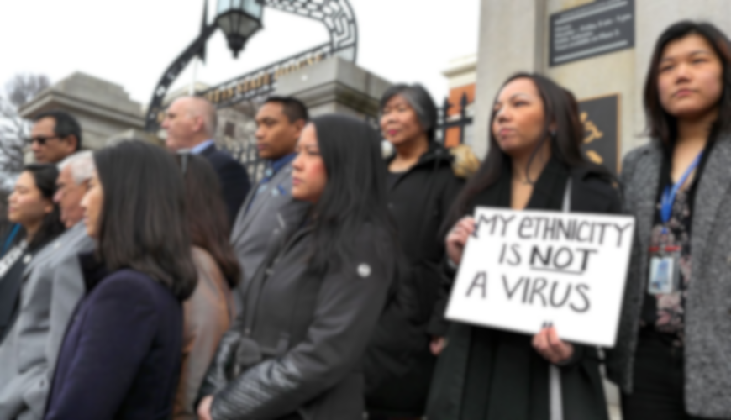
“NO ROOM FOR RACISM.”
A Racial Awareness Presentation`

Slide 5
What is Racism?
“Racism is the belief that a particular race is superior or inferior to another, that a person’s social and moral traits are predetermined by his or her inborn biological characteristics. Racial separatism is the belief, most of the time based on racism, that different races should remain segregated and apart from one another.”
In simple terms, racism is the belief that the colour of our skin determines our status in the world. It’s the belief that the colour of our skin defines our superiority or inferiority over one another.
It’s an issue nearly every country has faced for hundreds of years and is a prominent obstacle in our society.
Do you know any examples of racism?

Slide 6
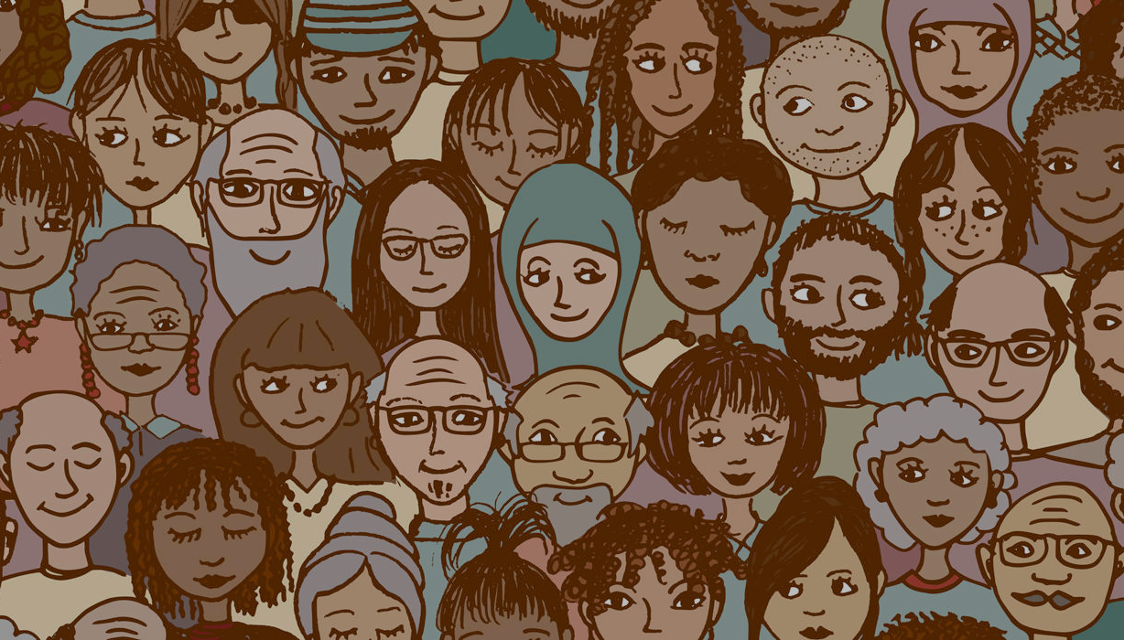
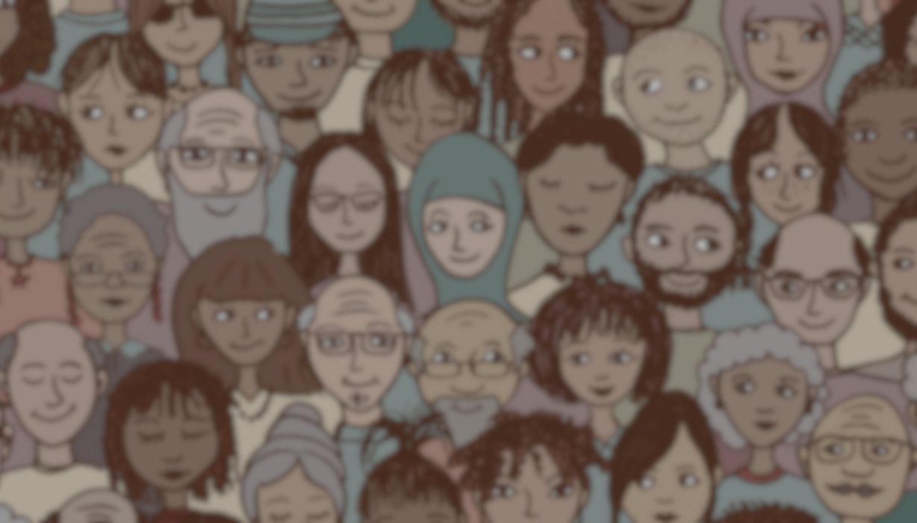
THE DRIVE BEHIND DISCRIMINATION
No race is superior or inferior to each other.
So, why is racism still a thing?
Why haven’t we moved past it? What really drives racism?
Well there’s a number of reasons why. For most people, the everyday folks you see on the streets or your peers right now, the idea of ‘racism’ comes from belonging. It’s 100% natural to want to socialise and hang out with people with similar interests, cultures and values. For most people, that also includes race. And that’s okay, the feeling of belonging is really important. But that’s where the issue can come from, because the differences between these groups can make us believe that we’re superior or inferior.
And the biggest issue is judging people without really knowing them. When people are frustrated, angry or looking to solve their problems, more often than not, they’ll place their problems on other people. And the biggest issue with this is that people judge and blame an entire race for the actions of individual people. It’s called generalising and stereotyping.
Imagine someone’s had a bad day and they’ve done something out of the ordinary. Can you really judge their own individual actions for the actions of their family? Their friends? So, why blame an entire race, religion or belief for the actions of one? A person’s race does not define and them and is only one component of their entire character.

Slide 7
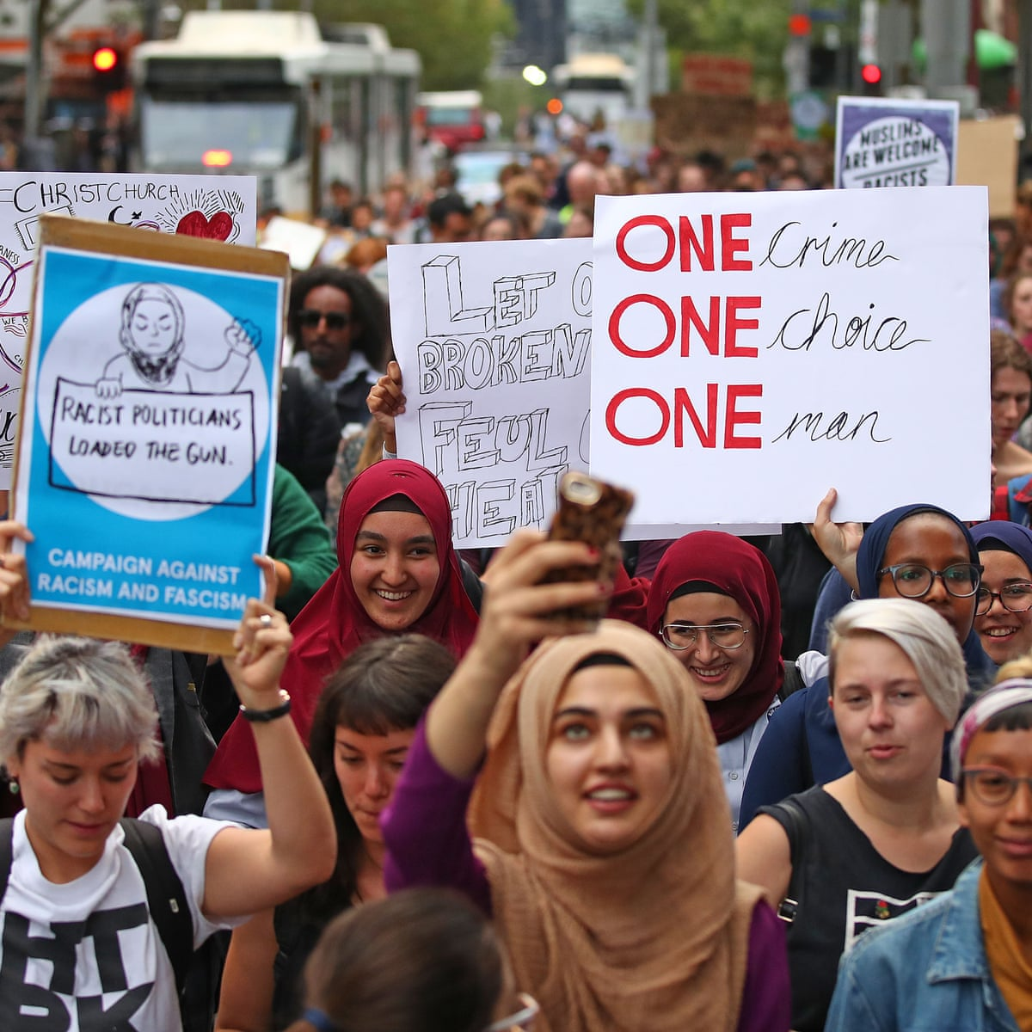
STEREOTYPING
Does anyone know any stereotypes?
I’m sure you’ve heard some. All Asians are smart, all brown people are terrorists, all black people are violent, all Islander’s are good at footy, or even, “all white people are racist”. Now, sometimes, they can seem funny or even acceptable. But that’s the issue, it’s this form of ‘acceptable racism’ that’s so prevalent in our society that it’s overlooked and become a twisted expectation of these people. The reality is, everyone is different, and their strengths and weakness will follow suite. Just because one person is good or bad at one particular thing, doesn’t mean everyone else of the same race or culture is the same.
It’s these small differences that make us who are and when we normalise the generalising of our individuality, then we lose our identity. daffy
https://www.youtube.com/watch?time_continue=44&v=2pPStKJ3OeQ&feature=emb_logo
Racial Awareness on Islamophobia; 2.5 minutes

Slide 8
DO NOW ACTIVITY:
Five Minute Reflection
Imagine you’re asked to form groups with the people in your class, team, etc. When you try to join or make a group, you are excluded because of the colour of your skin. You can’t join the groups and are forced to be on your own. Your teacher, coach or supervisor doesn’t help you.
How would you feel? Would you question why this is happening to you? What would you do about it?
You can talk to the person next to you, or on your own. You don’t have to share, but its encouraged. It’s a self-reflection about how YOU would feel.

Slide 9
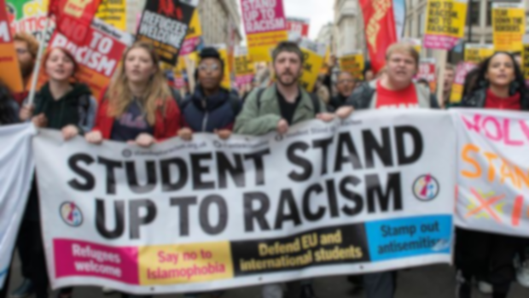
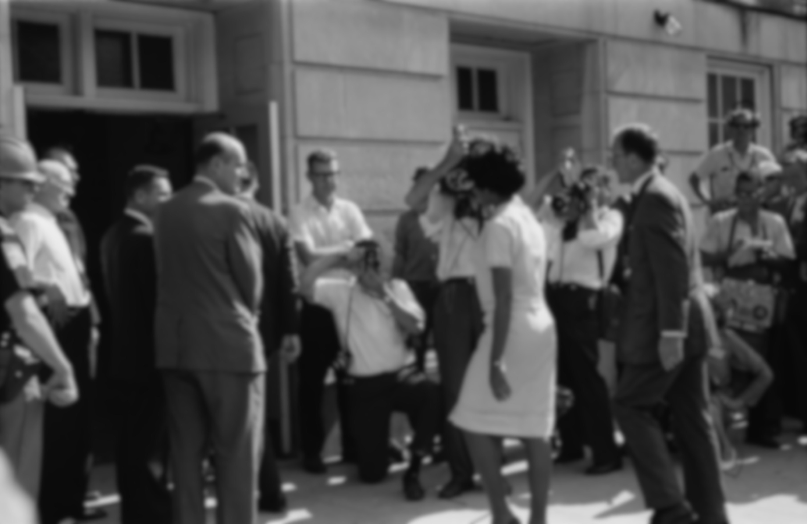
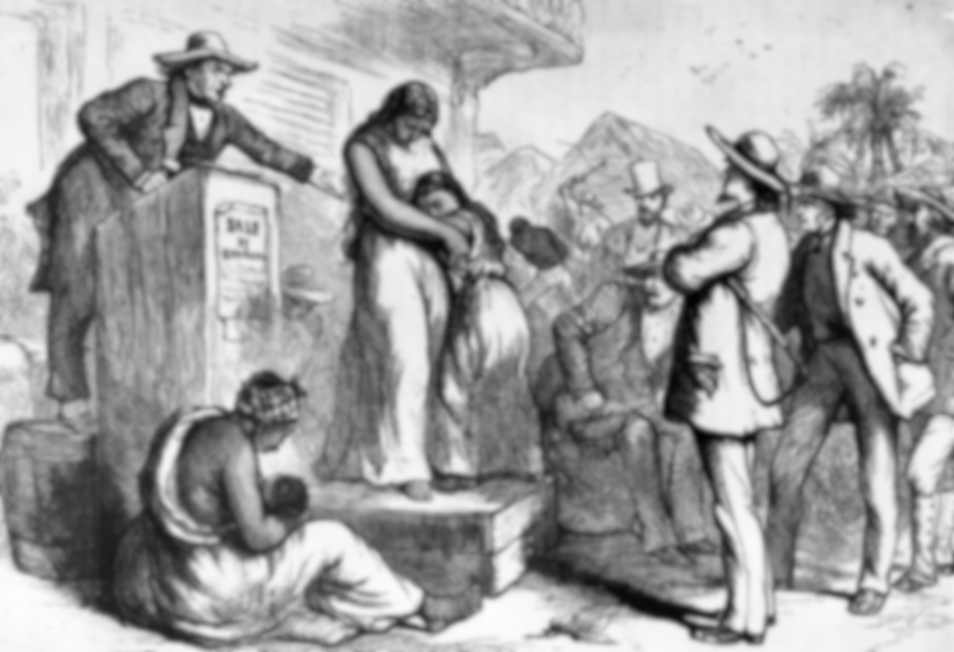
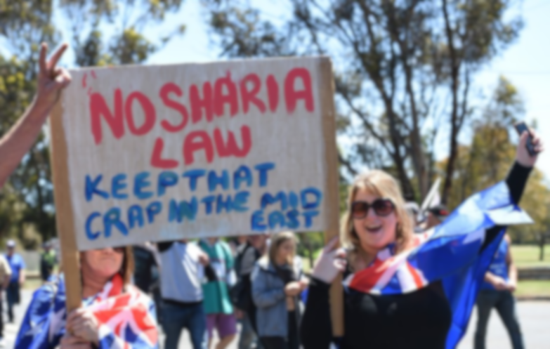
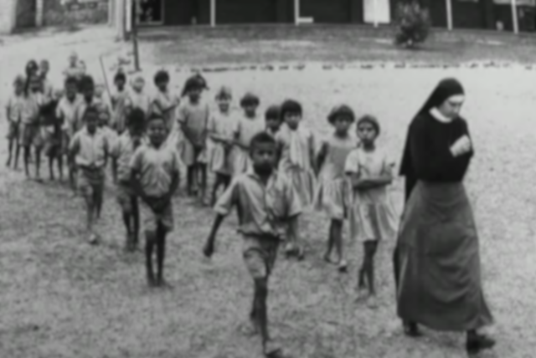
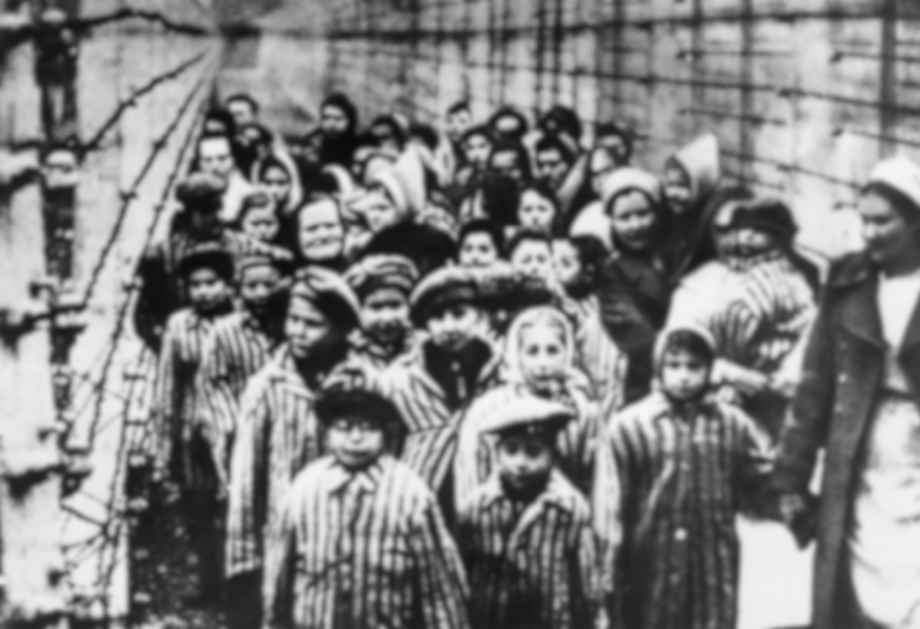
UNDERSTANDING RACISM THROUGHOUT HISTORY
Do you know any historical events of racism?

Slide 10
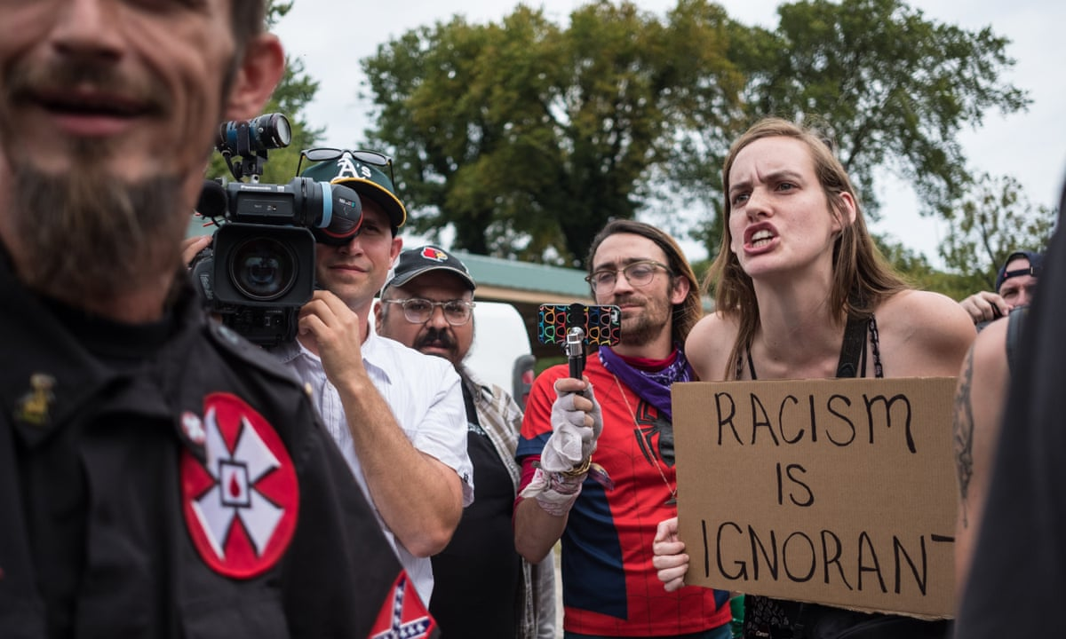
The aim is not to teach you about every historical event of racism. There’s a lot. It’s to help you understand that those issues of the past still exist throughout our modern society’s issues.
For example, the Stolen Generation of the Aboriginal people and the entire White-Australia policy against our Indigenous people is still a severe traumatic subject in our modern world.
Racism, cultural and religious discrimination. It’s not an isolated issue and it’s not a new issue. It’s been around for a thousand years. It’s taken hold of the roots of our history and grown into the society we know today.

Slide 11
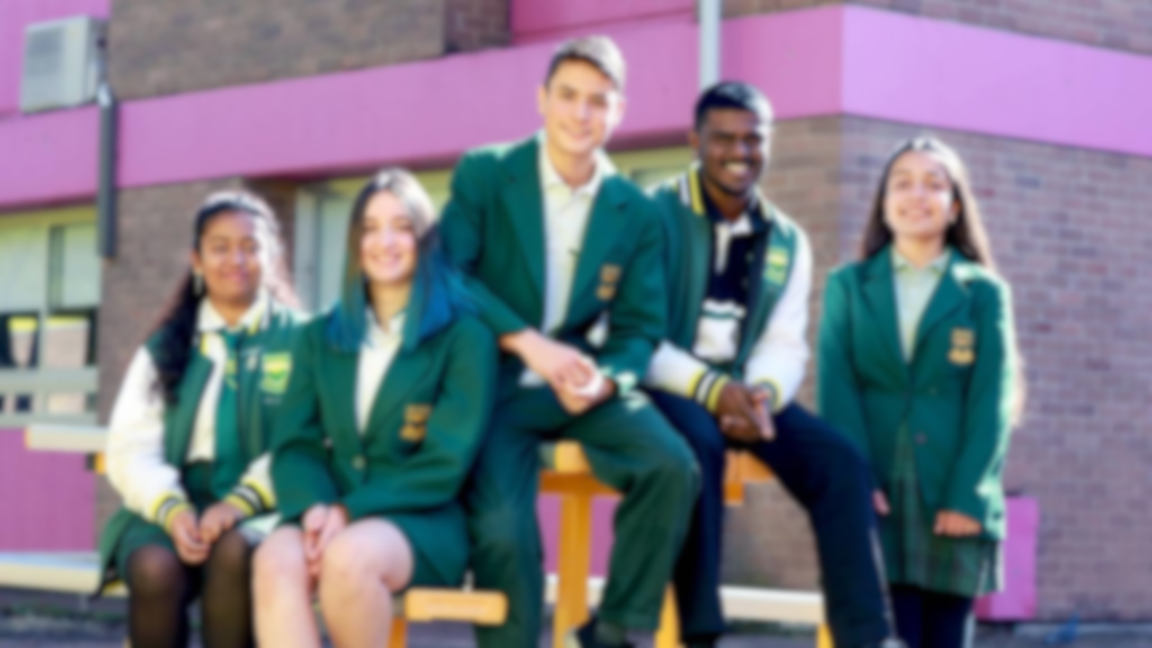
REPORTING RACISM
Remember, it’s important to speak up. Not just in class while you’re answering questions or even right now while you reflect. If you see discrimination in the streets, in your home, in your school, being transmitted online or in your local community, stand up and report it. For a lot of people, they believe that there are no repercussions or consequences for their actions and will commit crime and say what they want, when they want without any second thought.
If it happens to you, your friend or someone random at school. ALWAYS report it, never let it go unchecked. Standing together and uniting as a community is the way to overcome our differences while celebrating them at the same time.
YOU ARE RESPONSIBLE

Slide 12
Self-Examining
We need to self-examine what we say, what we do and how we view other people. We need to become aware of any accepted trends that we may be participating in. The unfortunate truth is that most us may have unknowingly conformed to stereotypes and have biased views on someone. The best way to end trends of racism in our community is to educate ourselves and the people around us.

Slide 13
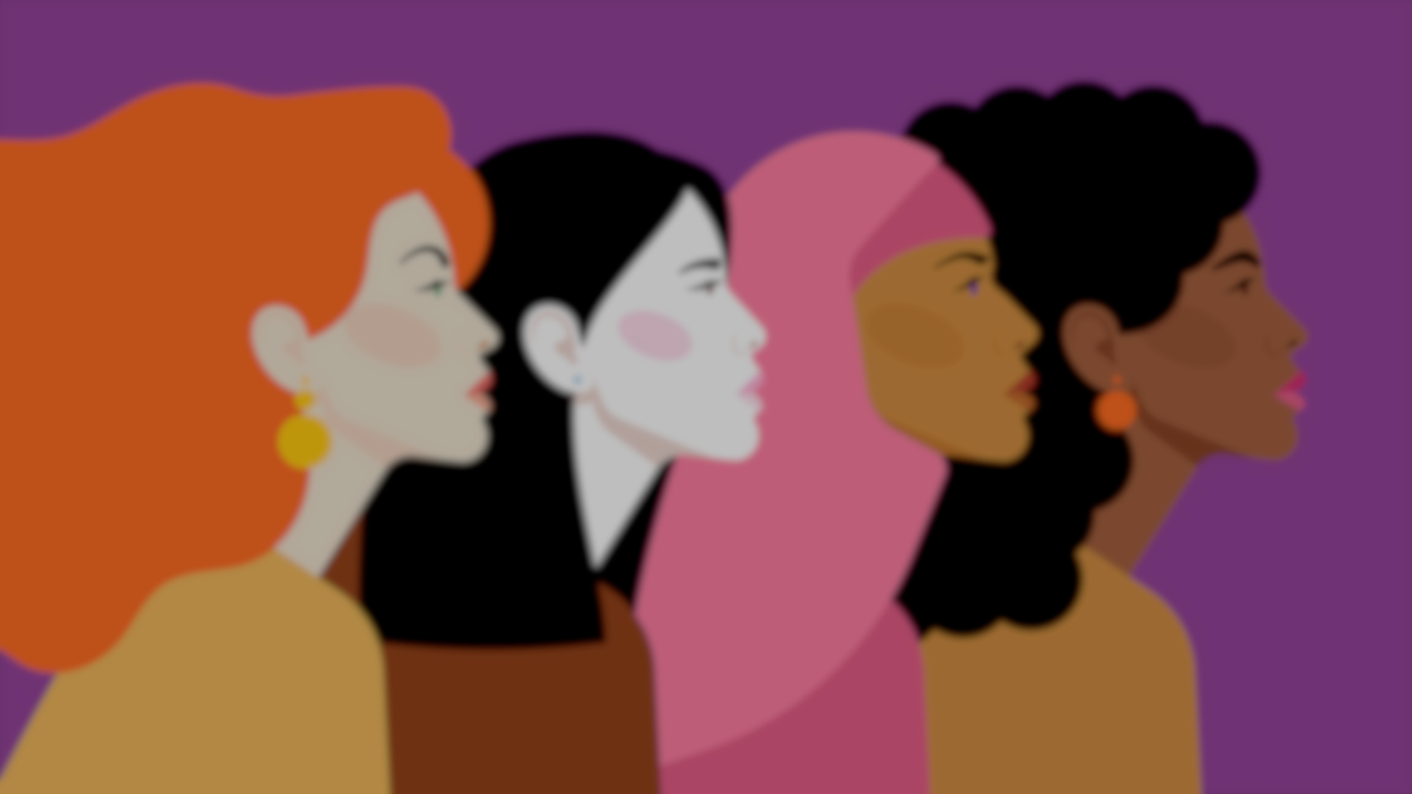
A Final Message
We are the future generation. We’re teachers, we’re leaders, we’re doctors, we’re presidents and prime ministers, we’re athletes, we are the ones that will build the morals, values and beliefs of the future.
An activity we all encourage you to complete is to go home and research about any movement you believe supports anti-racism. Follow your passions and your beliefs and stand up for what you believe is right.

Slide 14
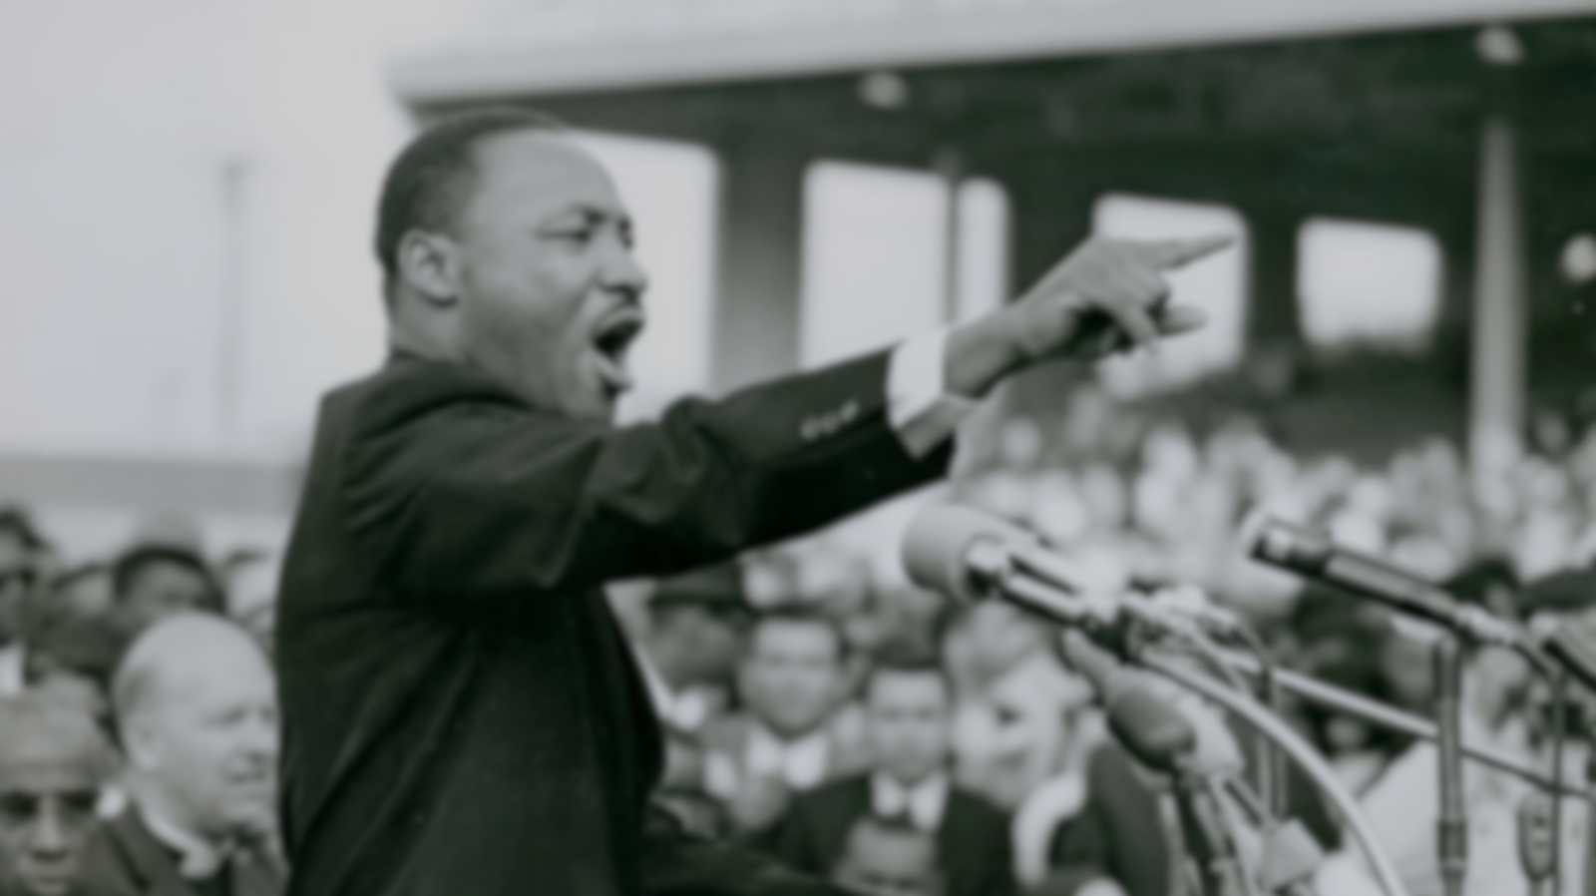
We end this presentation on a short snippet of Martin Luther King’s famous civil rights speech.
“I have a dream that my four little children will one day live in a nation where they will not be judged by the colour of their skin but by the content of their character."

Slide 15
Walk for a Thought
You will now walk down to the front of the hall and complete a self reflection slip. You will be asked to contribute a positive thought or explain a challenge you have overcome in 2020 on your slip.
You will then stick this on the hall walls which will eventually create a whole school mural.
Please take a pen with you to complete your slip.

