Slide 1
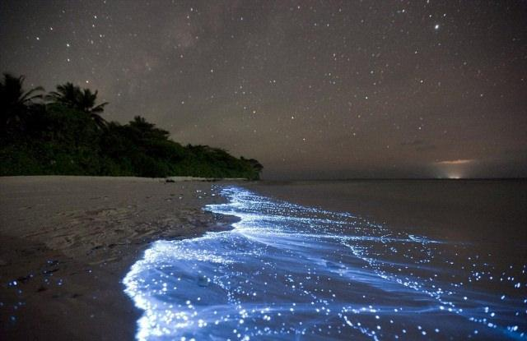
Tides
By Eloise and Sophie

Slide 2
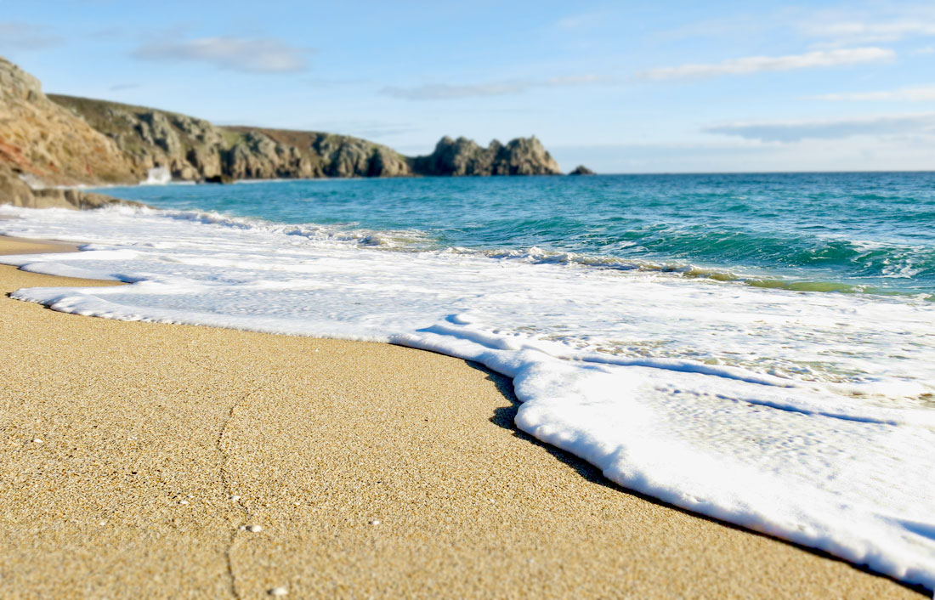
What is a tide?
I’m sure that you’ve all heard your parents say to you, “It’s time to head home now, the tides are coming in,” before. However did you ever actually know what a tide is? Picture you’re at the beach with your family. Your older sister is swimming in the deeper parts, your little brother is forcing you to make sandcastles with you and your parents are enjoying bathing in the sun. Picture those large waves coming towards you. You notice that as the day wears on, the waves are getting stronger and coming closer to the shore. This is called a flood tide, or the High Tide. However earlier in the day when the waves were far from the shore, that was an ebb tide or a low tide. Those waves are called tides.
← Tide

Slide 3
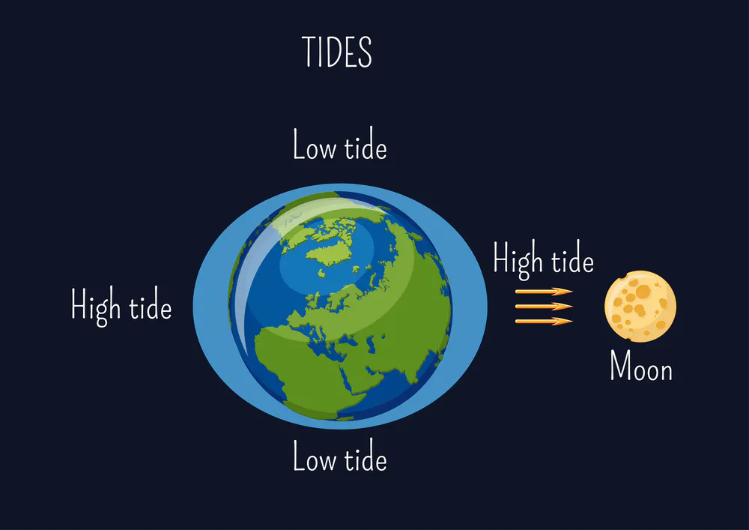
What causes tides?
I’m sure you’ve heard lots about the moon, but another cool fact is it also controls the tides. Now, everybody knows about gravity and how with low gravity, we begin to float. Well the moon and earth both have gravity. Gravity keeps every planet to continue to orbit the sun. The gravity on the moon, helps the moon orbit the earth. However, that gravity from the moon is pulling the water from earth. This causes the water to bulge up and pull to the direction of the moon. This is all because of the tidal force. This means, all of the water passing through the moons gravitational force is bulging towards the moon, which is known as a high tide. Therefore we have our first high tide each day. With this tidal force, the earth actually goes through a squeeze. That means that there are two water bulges on either side of earth. With every spin on its axis, different parts of earth experience a high tide. We go through a high tide, twice a day.

Slide 4
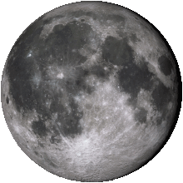
What difference does the Moon make to our Tides?
As mentioned before, the Tides are majorly impacted by the Moon. And to be honest, the Moon doesn’t make a single difference to our Tides: instead it creates them. The Moon is very important to the Tides because it is huge as well as being very nearby. Gravity depends on size and distance: the bigger and closer an object is, the stronger it will pull towards you, or in this case the Earth.
However, some parts of the Earth are closer to the Moon than others. So the Moon pulls on the closer parts more than it does on the further parts. Imagine that the Earth was completely covered by ocean. The strongest pull, causes the ocean surface to bulge outwards.

Slide 5
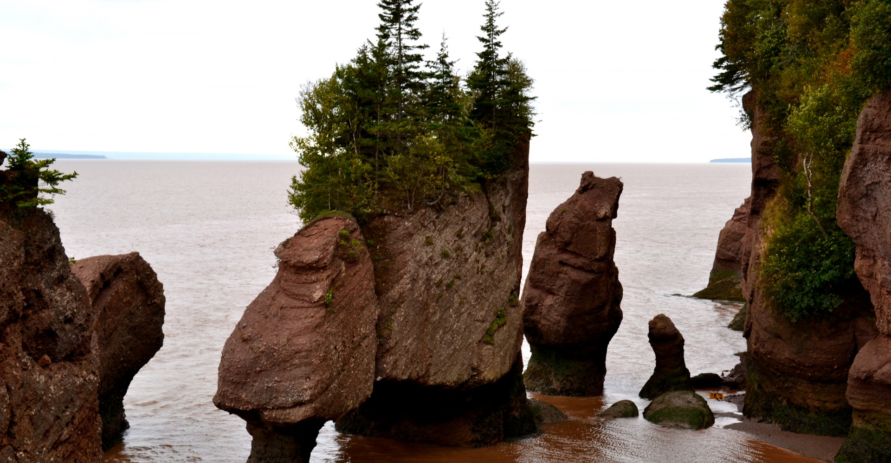
The Bay of Fundy
The Bay of Fundy is a bay in the Canadian areas between New Brunswick and Nova Scotia. And did you know that it has the biggest tides in the world?! A normal Tide that we would experience at the beach between High Tide (or a Flood Tide) and Low Tide (or a Ebb Tide) would be about 1 metre. But at the Bay of Fundy, that one metre becomes 14 metres!

Slide 6
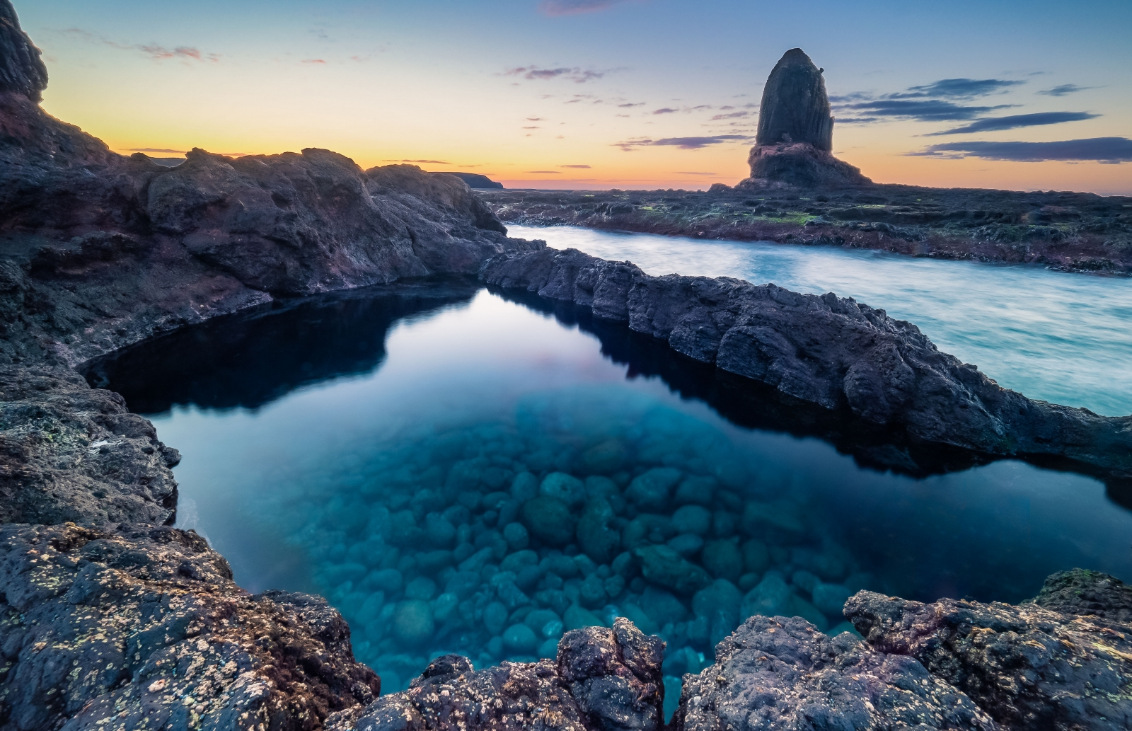
Animals that depend on tides
We all know our animals. Pig, Cows, Wombats, Kangaroos and so much more. However, did you know that if tides didn’t exist, some species would be extinct? In rock pools, there are hundreds of sea creatures which rely on the constant flow of high tides for protection and water nutrients. Without these rock pools, the creatures that live in them will cease to exist due to predators and an extreme decrease in their oxygen levels. With turtles however, it’s a little different, except they have the same outcome if tides don’t exist. Turtles put their trust in the tides for their babies to be safely hatched. You see, they put their eggs ashore, and when the high tide comes in it washes the hatched turtles out to sea.

Slide 7
Bibliography
Sciencing, 2019, Animals That Depend On Tides For Survival, https://sciencing.com/animals-depend-tides-survival-8075047.html
SciJinks, 2021, What Causes Tides?, https://scijinks.gov/tides/
Stile, 2021, What causes tides?, https://stileapp.com/au/KC-VIC-1269/subject-299005/lesson-2075335/worksheet-15742157
Wikipedia, 2019, Bay of Fundy, https://en.wikipedia.org/wiki/Bay_of_Fundy#:~:text=The%20Bay%20of%20Fundy%20(French,an%20extremely%20high%20tidal%20range.

