Slide 1
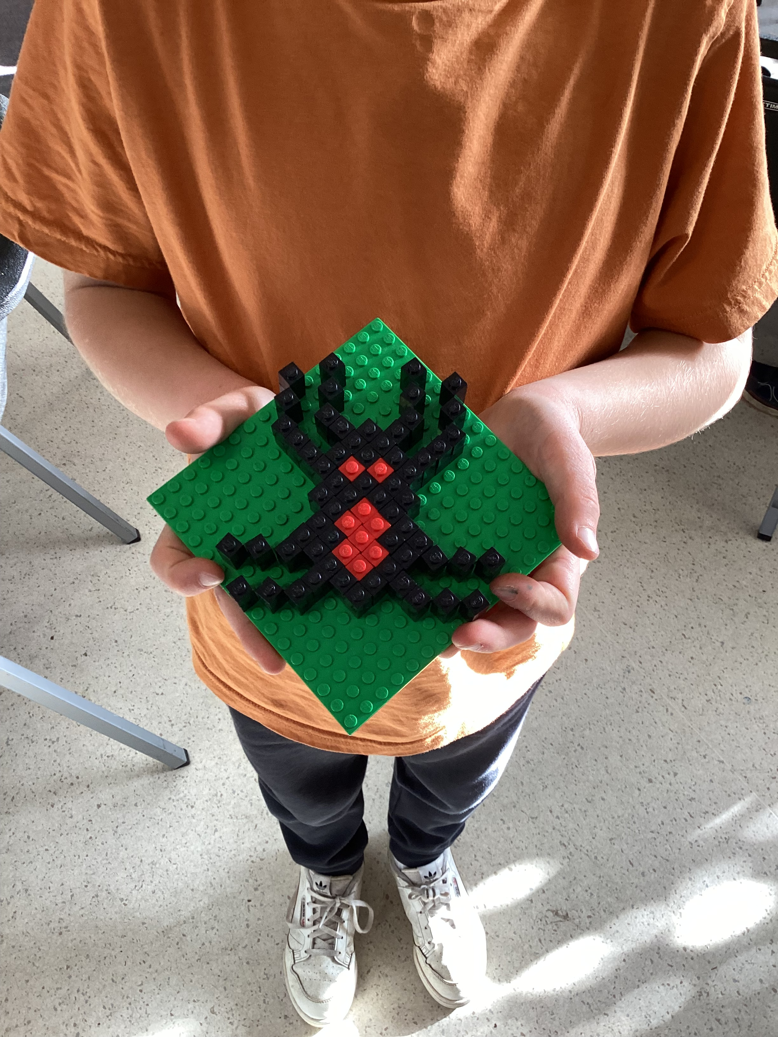
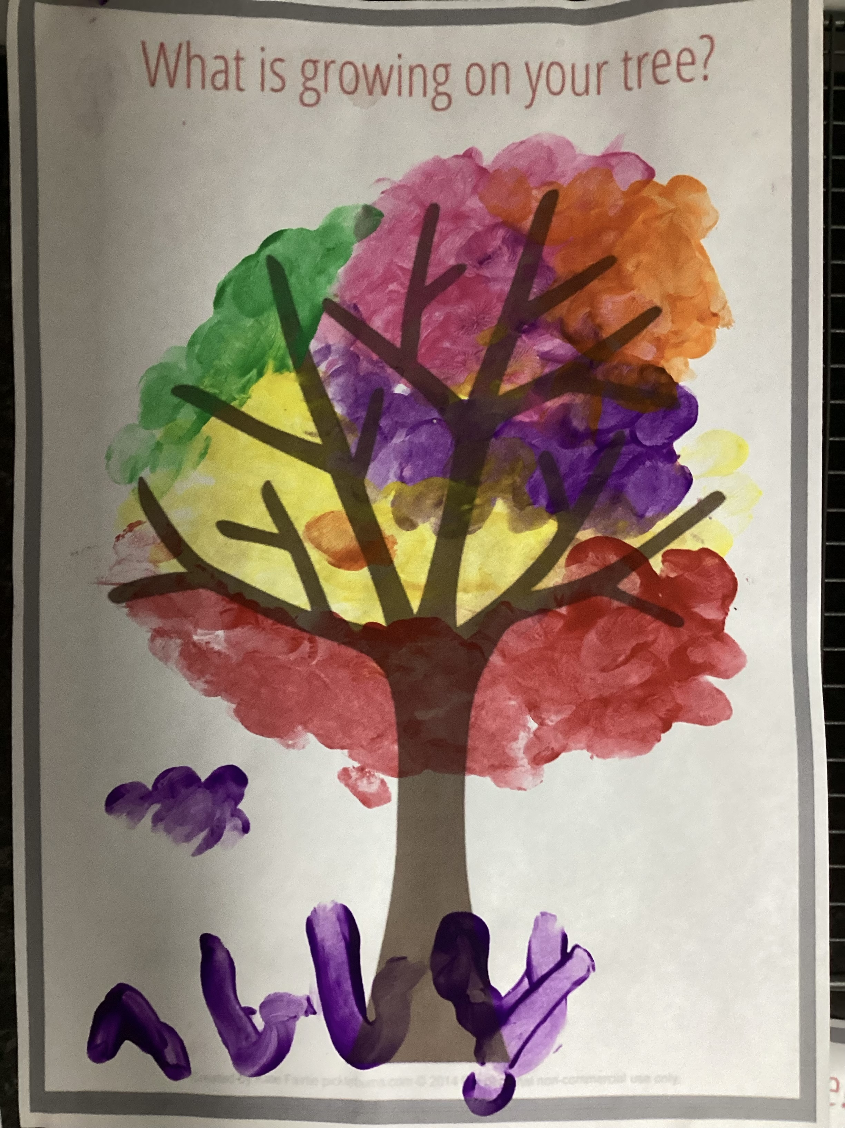
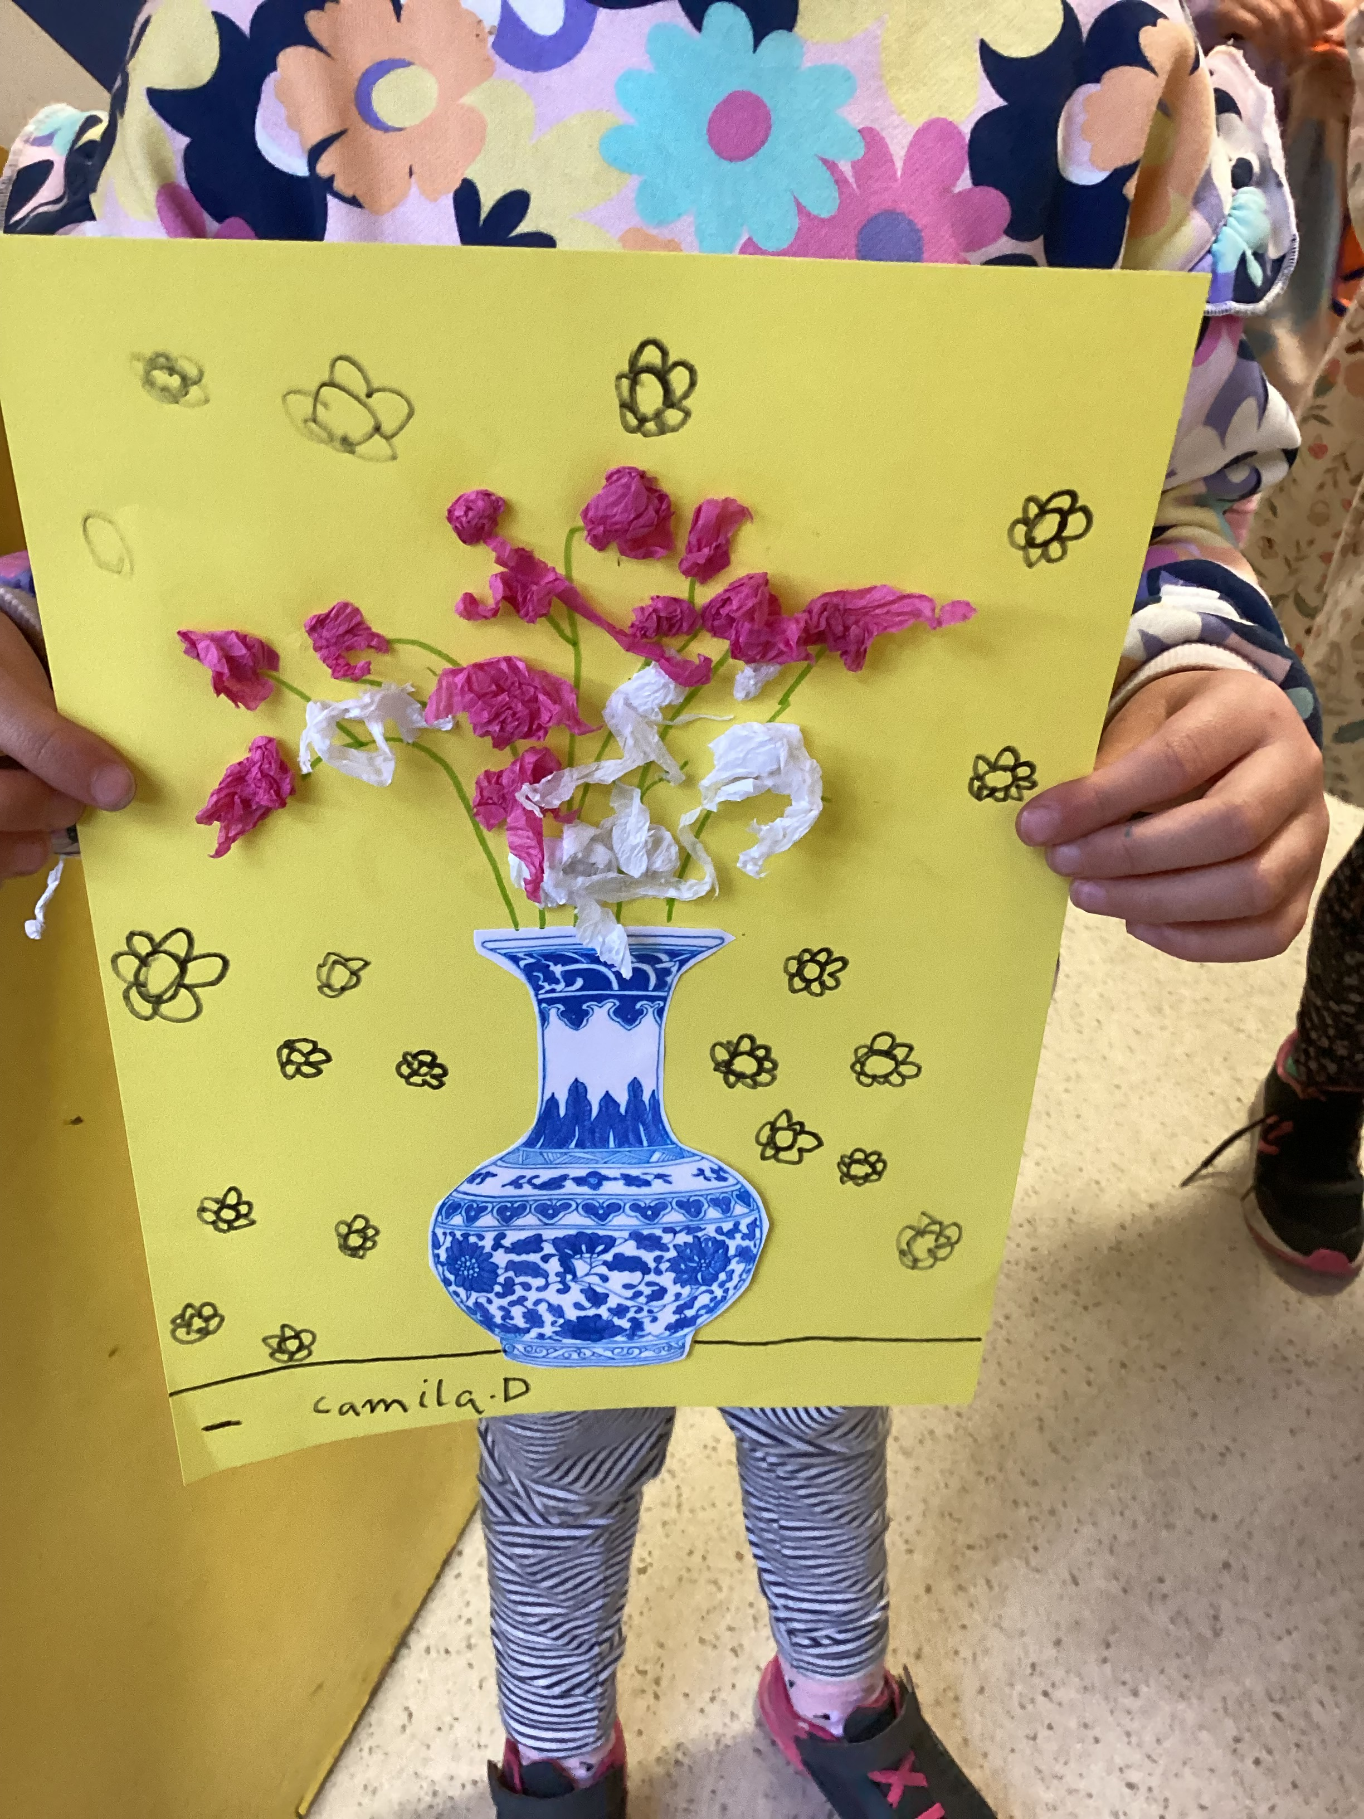
Cheltenham East Team Kids
Dear Parents and Guardians,
We hope this newsletter finds you well and that you had a fantastic winter break! We would like to express our sincere gratitude for your support during the winter school holiday program. It was an incredible success, and we couldn't have done it without your continued trust and involvement.
As we embark on a new term, we have some exciting updates and plans in store. Our team has been hard at work curating new and delightful experiences for the children. Here's a sneak peek at what's to come in Term 3:
1.Cooking Activity: We will be introducing new recipes for our cooking sessions. The children will have the opportunity to explore their culinary skills and create delicious treats under the guidance of our talented staff. Get ready for some scrumptious surprises!
2.Fun Activities: Term 3 promises to be filled with even more exciting and engaging activities. From arts and crafts to outdoor games, science experiments, and creative projects, there will be something for everyone. We aim to keep the children entertained, inspired, and eager to attend our program every day.
If you have any questions, suggestions, or concerns, please don't hesitate to reach out to us. We value your feedback and are always looking for ways to enhance our program. Thank you! ☺
Sincerely yours,
Eric
1
Cooking Club
Art Craft Club
Art Craft Club
Math Club
Art Craft Club
Fri 21st July
National Pyjama Day
Wed 26th July
OSHC Educator Day
Fri 28th July
Crazy Hair Day
0432 299 468
CheltenhamEastPS@teamholiday.com.au
1300 035 000
info@teamkids.com.au

