Slide 1
Big and Small
Y7

Slide 2
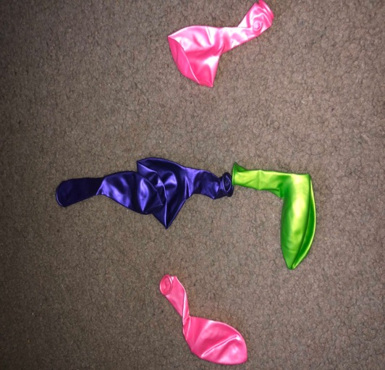
Aidyn

Slide 3
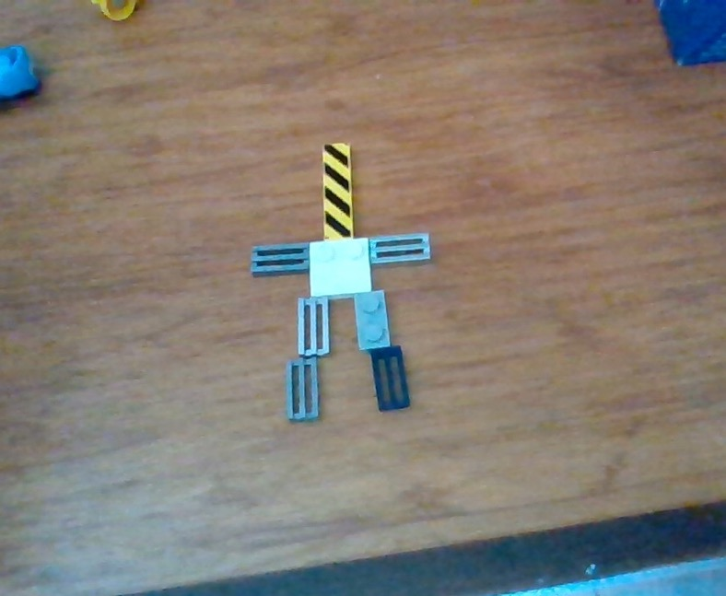
Jayden

Slide 4
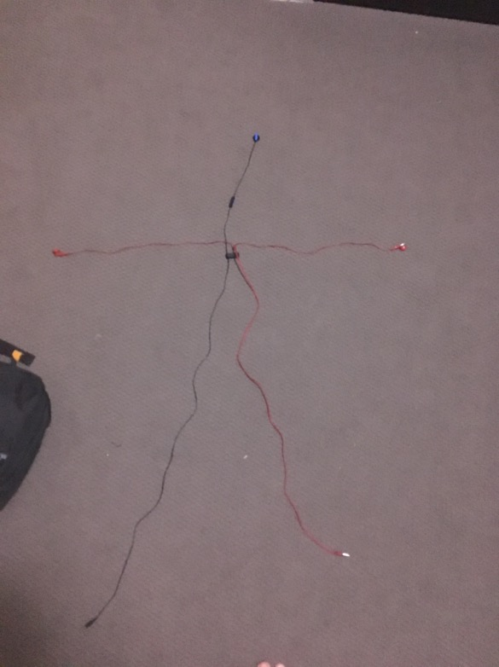
Lukas

Slide 5
Zach
Zach's BIG Kanji video
Zach's small Kanji video

Slide 6
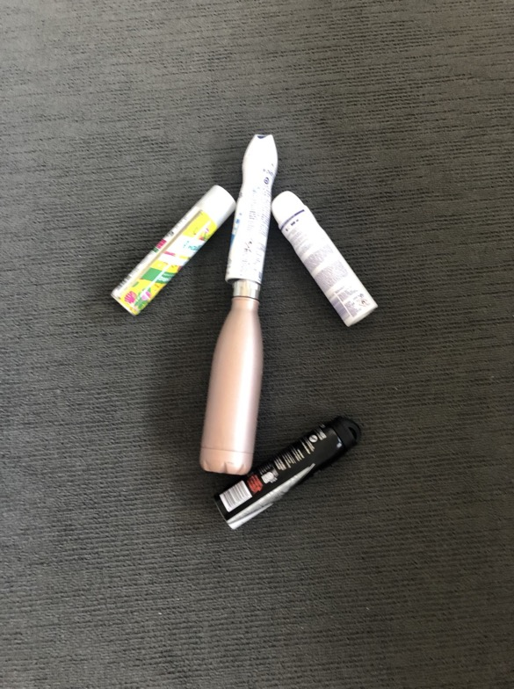
Havanna

Slide 7
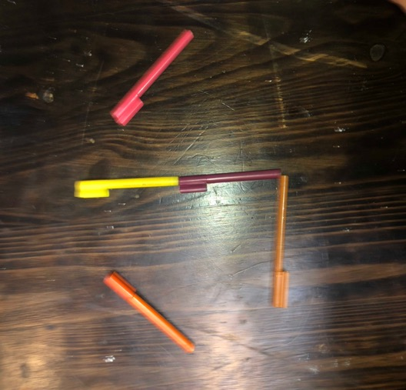
Heath

Slide 8
Lehansa

Slide 9
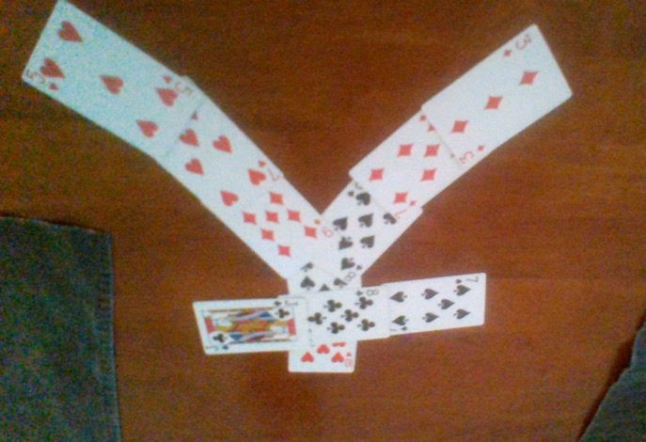
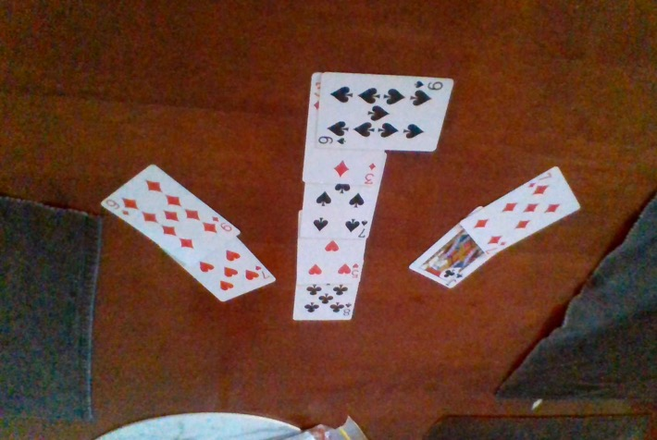
Jordana

Slide 10
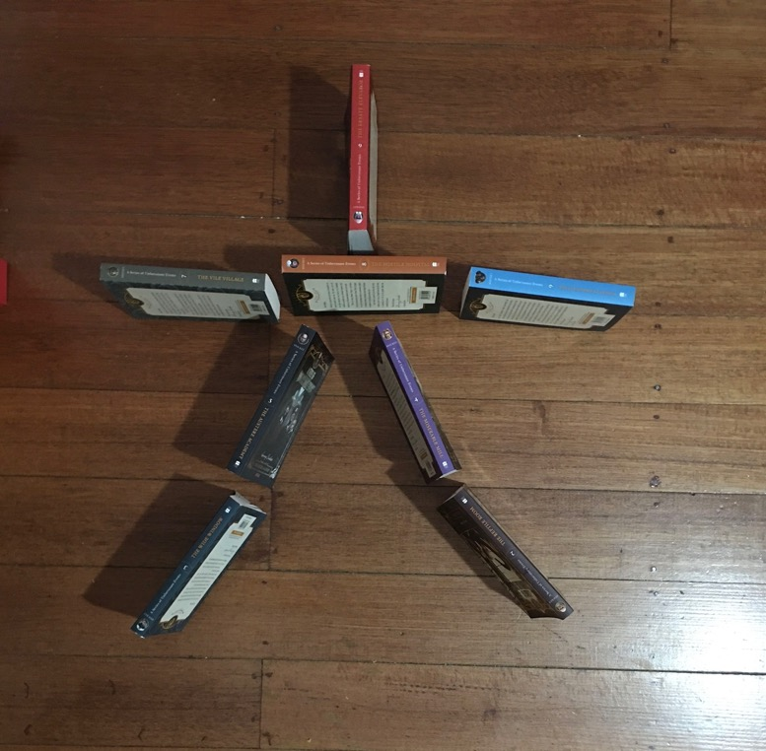
Paige

Slide 11
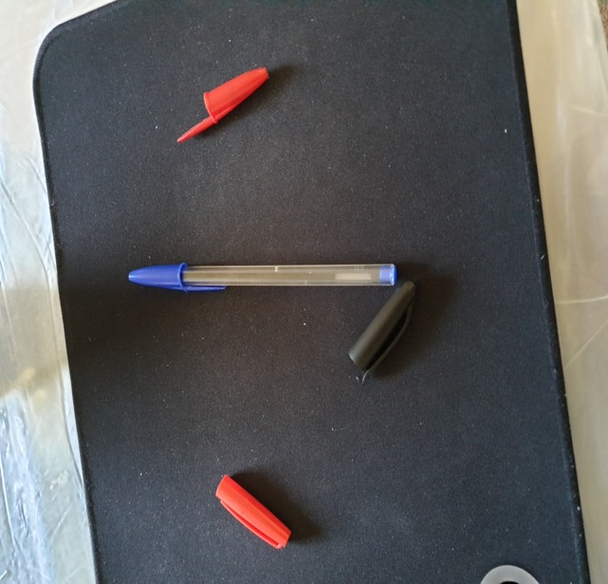
Jet

