Slide 1
New Child Safe Standards & Mandatory Reporting
Trigger Warning: This presentation includes explicit reference to abuse and may be distressing for some participants.

Slide 2


Acknowledgement of Country

Slide 3
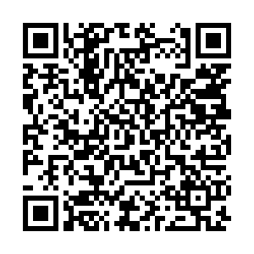
QR Code Check-in
Please scan the QR Code with your phone or iPad to check-in and log your attendance as part of the Child Safe Standards training.

Slide 4
Support for you
Employee Wellbeing Support Services provides free and confidential advice to support Victorian government school staff wellbeing. Phone 1300 291 071 or book online via the Converge International portal entering the organisational code mywellbeing.
Sexual Assault Crisis Line is a counselling service for people who have experienced both past and recent sexual assault available 5pm to 9am/7 days. Phone 1800 806 292
1800Respect is a domestic, family and sexual violence counselling service. Phone 1800 737 732
Lifeline is support for anyone experiencing a personal crisis or thinking about suicide available 24 hours/7 days. Phone 13 11 14
Blue Knot supports adult survivors of childhood trauma and abuse 9am to 5pm/7 days. Phone 1300 657 380
13 YARN is a culturally safe crisis support line for Aboriginal and Torres Strait Islander people available 24 hours/7 days. Phone 13YARN (13 92 76)
Qlife offers peer support and referrals for LGBTIQA+ 3 to 12pm/7 days. Phone 1800 184 527
Notes:
BACKGROUND NOTES FOR THE FACILITATOR
Time on this slide: less than 1 minute
SPEAKING NOTES
This training will include discussion of child abuse and harm.
Sometimes discussing this type of content can be triggering, confronting or just uncomfortable.
On the slide are details of support services in case you’d find it helpful to speak to someone after today’s session, including Employee Wellbeing Support Services (https://go.vic.gov.au/3YoSR1d) [government schools] and other specialised services.
If you need to step out, please do so, also noting that if someone steps out, this does not necessarily mean they are distressed.

Slide 5
In this presentation
Overview of the Child Safe Standards
  Why the Child Safe Standards are so important
  Victoria’s Child Safe Standards
Definitions of child safety, harm and child abuse
Signs of abuse
Our school’s child safety policies and procedures and staff responsibilities
  Child Safety and Wellbeing Policy
  Cultural Safety
  Child Safety Code of Conduct
  Child Safety Risk Register
    Responding to incidents, disclosures and suspicions of child abuse
Information sharing and record keeping obligations
Notes:
BACKGROUND NOTES FOR THE FACILITATOR
Time on this slide: 1 minute
In July 2021, the Victorian Government announced new Child Safe Standards to further strengthen child safe environments and protect children from abuse.
The purpose of this presentation is to ensure that school staff are equipped with the knowledge, skills and awareness to keep children and young people safe.
The presentation contributes to annual staff training requirements for Child Safe Standard 8 (https://go.vic.gov.au/3V9dFbd).
Be aware that talking about child abuse may cause distress for some staff.
The school should let staff know of support available.
For more information on how to support students and impacted staff members, refer to the Department of Education’s guidance: Providing Ongoing Support (https://go.vic.gov.au/3QbMEAT).
SPEAKING NOTES
The purpose of today’s presentation is to ensure that you are equipped with the knowledge, skills and awareness to keep children and young people safe at our school.
We’ll cover:
What the Child Safe Standards are, why they’re important and how they help to prevent harm and abuse.
Understanding some key definitions and recognising common signs of abuse.
Our school’s key child safety policies and procedures highlighting what you must be aware of and follow to keep children safe in our school environments and to meet your obligations.
Requirements relating to information sharing and record keeping
This training presentation is for teaching and non-teaching staff and contractors at our school who are engaged in child-related work.
It helps to ensure we meet our annual child safety training requirements.
This training session is complemented by the Protecting Children e-learning module which assists staff to understand their mandatory reporting and other legal obligations.
Our school is also providing child safety training for the school council and for volunteers engaged in child-related work.
[Add the following statement if your school also has responsibility for a school boarding premises] Please note that all references to schools in this presentation also refer to our school boarding premises.

Slide 6
Overview of the Child Safe Standards
Notes:
BACKGROUND NOTES FOR THE FACILITATOR
Time on this slide: less than 10 seconds
This slide is intended as a section break.

Slide 7
Why the Child Safe Standards are so important
Child Safe Standards aim to:
promote the safety of children
prevent child abuse
ensure effective processes are in place to respond to and report all allegations of child abuse
drive cultural change and embed safety in everyday practices
highlight we all have a role in keeping children safe from abuse
Notes:
BACKGROUND NOTES FOR THE FACILITATOR
Time on this slide: 1 minute
This slide provides an overview of what child safe organisations do and why the Child Safe Standards are so important.
SPEAKING NOTES
Schools, like all child safe organisations, need to take deliberate steps to create environments where children are safe and feel safe.
So, what do child safe organisations – including schools – need to do?
They need to:
promote prevent child safety and wellbeing
prevent child abuse
empower everyone to speak up, and
respond effectively to concerns.
Schools have policies, strategies and practices to prioritise the safety and wellbeing of students.
Schools also have processes in place to respond to and report all allegations of child abuse.
The Child Safe Standards work by further embedding a culture of child safety by clearly outlining the minimum standards for keeping children safe.
They are there to hold everyone to account for keeping children safe from abuse – and making sure children have a voice, can be safe in who they are and thrive.
To meet the Child Safe Standards, schools can build on existing child safety strategies, risk management, policies and practices to strengthen their culture of child safety and protect children from abuse.

Slide 8
Victoria’s Child Safe Standards
Child Safe Standard 1 – Establish a culturally safe environment in which the diverse and unique identities and experiences of Aboriginal children and young people are respected and valued.
Child Safe Standard 2 – Ensure that child safety and wellbeing are embedded in school leadership, governance and culture.
Child Safe Standard 3 – Children and young people are empowered about their rights, participate in decisions affecting them and are taken seriously.
Child Safe Standard 4 – Families and communities are informed and involved in promoting child safety and wellbeing.
Child Safe Standard 5 – Equity is upheld and diverse needs are respected in policy and practice.
Child Safe Standard 6 – People working with children and young people are suitable and supported to reflect child safety and wellbeing values in practice.
Child Safe Standard 7 – Ensure that processes for complaints and concerns are child focused.
Child Safe Standard 8 – Staff and volunteers are equipped with the knowledge, skills and awareness to keep children and young people safe through ongoing education and training.
Child Safe Standard 9 – Physical and online environments promote safety and wellbeing while minimising the opportunity for children and young people to be harmed.
Child Safe Standard 10 – Implementation of the Child Safe Standards is regularly reviewed and improved.
Child Safe Standard 11 – Policies and procedures that document how schools are safe for children, young people and students.
Ministerial Order 1359 provides the framework for child safety in schools.
Child Safe Standards action list: a quick reference list of compliance requirements for schools.
Notes:
BACKGROUND NOTES FOR THE FACILITATOR
Time on this slide: 3 minutes
This slide provides an overview of Victoria’s Child Safe Standards from 1 July 2022.
Standard 1 is unique to Victoria.
Standards 2 to 11 align with the National Principles for Child Safe Organisations (https://childsafe.humanrights.gov.au/national-principles).
Ministerial order 1359 provides the framework for Child Safe Standards in schools.
Each Standard on this slide links to further guidance on the department’s PROTECT website. This includes example actions that schools may take to comply with the standards.
An action list of the requirements for schools for each Standard is available on PROTECT (https://go.vic.gov.au/3VMQKD6).
SPEAKING NOTES
The 11 Standards taken together highlight the key strategies and actions that must be in place to support a culture of child safety.
Each standard focuses on a key feature that contributes to a child safe organisation and is supported by a range of compliance requirements.
Each Standard on this slide links to further guidance on the department’s PROTECT website.
Standard 1 is unique to Victoria. This Standard requires schools to make sure Aboriginal children and young people feel safe and are safe. It is important to note that:
the term ‘Aboriginal’ includes all Aboriginal and Torres Strait Islander peoples
this standard applies to all schools, even if there are no students who have identified themselves as Aboriginal
Our Child Safety and Wellbeing Policy [or other document] includes the actions our school will take to promote cultural safety in our school community. Staff have a key role in implementing our school’s strategies and actions to make our school culturally safe.
Standards 2 to 11 align with the National Principles for Child Safe Organisations developed by the Royal Commission into Institutional Responses to Child Abuse.
Staff have a vital role in implementing our school’s strategies and actions to keep our school safe.

Slide 9
Definitions
Child safety
protecting all children from child abuse
managing the risk of child abuse
providing support to a child at risk of child abuse
responding to suspicions, incidents, disclosures or allegations of child abuse
Source: Ministerial Order 1359
Harm
is damage to the health, safety or wellbeing of a child resulting from child abuse by adults or from the conduct of other children
includes physical, emotional, sexual and psychological harm
can arise from a single act or event or a series of acts or events over time
Source: A Guide for Creating a Child Safe Organisation
Child abuse
any act committed against a child involving a sexual offence (including grooming)
the infliction, on a child, of
  physical violence
  serious emotional or psychological harm
the serious neglect of a child
Source: Child Wellbeing and Safety Act 2005
Notes:
BACKGROUND NOTES FOR THE FACILITATOR
Time on this slide: 1 minute
For definitions used in the Victorian Child Safe Standards and Ministerial Order 1359, please see Child Safe Standards: Definitions (https://go.vic.gov.au/3TIB7cX).
SPEAKING NOTES
Before we get into the detail of this presentation, it’s important to review the definitions of child safety, harm and child abuse.
The Child Safe Standards require schools to protect children from harm or abuse caused by other children as well as adults. For example, student-to-student bullying is a harm that may not involve abuse.
Child safety is defined in Ministerial Order 1359. It includes matters related to protecting all children from child abuse, managing the risk of child abuse, providing support to a child at risk of child abuse, and responding to suspicions, incidents, disclosures or allegations of child abuse.
The Commission for Children and Young People defines harm as damage to the health, safety or wellbeing of a child, including as a result of child abuse by adults or the conduct of other children. It includes physical, sexual, emotional and psychological harm. Harm can arise from a single act or event. It can also be cumulative, that is, arise as a result of a series of acts or events over time.
Child abuse is defined in the Child Wellbeing and Safety Act (2005). It includes:
any act committed against a child involving a sexual offence or grooming
inflicting physical violence or serious emotional or psychological harm on a child
the serious neglect of a child
Child abuse can include things like physical child abuse, child sexual abuse, grooming, talking to a child in a sexually explicit way, family violence, emotional child abuse, or failing to provide a child with an adequate standard of nutrition, supervision or medical care.
It’s important to remember that:
Children and young people can be harmed by other children, students or adults
Child abuse doesn’t have to involve physical contact or force
We can usually respond to harms with our school’s existing policies and procedures, but child abuse involves reporting to a statutory authority like Victoria Police or Child Protection.

Slide 10
When is a child in need of protection?
A child may be in need of protection if they have experienced or are at risk of significant harm, and their parents have not protected, or are unlikely to protect them from that harm. Significant harm may relate to:
Physical injury / abuse
Sexual abuse
Grooming
Family violence
Emotional abuse
Neglect, abandonment or parental incapacity
Mandatory reporters are required to report in relation to significant harm as a result of physical injury or sexual abuse. They may choose, as can anyone, to report in relation to other types of significant harm.

Slide 11
Signs of abuse
Further information on child abuse, including physical and behavioural indicators of abuse, is available on the department’s PROTECT website at Identify child abuse
Notes:
BACKGROUND NOTES FOR THE FACILITATOR
Time on this slide: less than 10 seconds
This slide is intended as a section break.

Slide 12
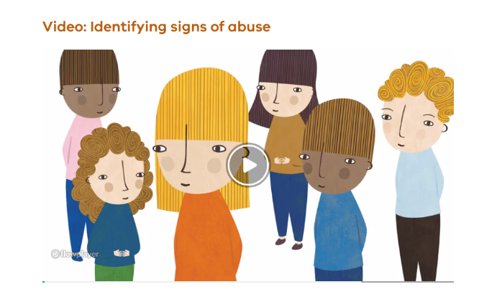
Signs of abuse to look out for (video)
Notes:
BACKGROUND NOTES FOR THE FACILITATOR
Time on this slide: 7 minutes (video takes 5.45 minutes)
This slide links to an optional video on PROTECT that discusses the common signs of child abuse for staff to look out for.
You may wish to show this video to new staff but otherwise skip it and focus on the slides.
For more information, refer to:
Spotting the Warning Signs of Child Abuse (https://go.vic.gov.au/4aj0qJW)
Identify child abuse (https://go.vic.gov.au/3W35Cxl)
Click on the video image in presentation mode to play the identifying signs of abuse video in your browser.
Alternatively, you can use this link: https://go.vic.gov.au/4aiuipJ or this url: https://vimeo.com/906221355?share=copy
SPEAKING NOTES
Let’s get a quick overview of the common physical and behavioural indicators of child abuse by watching this video.
[Watch the video and allow time for some comments, if desired.]

Slide 13
Common signs of abuse – children
Physical
Bruises, welts, cuts/grazes or burns
Internal injuries and bone fractures
Injury to the genital or rectal area (e.g. pain going to the toilet)
Wearing clothes unsuitable for weather conditions to hide injuries
STDs and/or frequent urinary tract infections
Consistently dirty and unwashed
Consistently hungry, tired and listless
Unattended health problems and lack of routine medical care
PROTECT: Identify child abuse
Behavioural
Disclosure and/or drawings or writing depicting violence/abuse
Habitual absences
Significant/unexplained developmental delay
Regressive or unusual changes to behaviour
Drug or alcohol misuse, suicide or self-harm
Harm to others or animals
Inconsistent or unlikely explanation for injury or inability to remember the cause
Reluctance to go home and/or a wariness or fear of a parent/carer
Unusual fear of physical contact with adults
Developmentally inappropriate sexualised behaviour
Withdrawal or excessive secrecy
Notes:
BACKGROUND NOTES FOR THE FACILITATOR
Time on this slide: 1-2 minutes
This slide shows some of the common physical and behavioural signs of abuse in children.
For more information, refer to:
Spotting the Warning Signs of Child Abuse (https://go.vic.gov.au/4aj0qJW)
Identify child abuse (https://go.vic.gov.au/3W35Cxl)
SPEAKING NOTES
[If you watched the optional video in the previous slide] We’ve just seen from the video that these are some of the signs that a child may be being abused
As school staff, we may be the only adults able to identify and respond to the common signs listed here.
We need to remember that some instances will fall across multiple categories (for example, family violence may involve physical, sexual, or emotional abuse)
If you identify physical or behavioural signs of abuse, regardless of the type of abuse, you must respond by following the Four Critical Actions (https://go.vic.gov.au/3VFXvGE).

Slide 14
Child sexual abuse – including grooming
Child sexual abuse is when a person uses power or authority over a child to involve them in sexual activity.
Grooming involves predatory behaviour by an adult to prepare a child under 16 for sexual abuse at a later time, either with the groomer or with another adult.
Perpetrators of child sexual abuse (including grooming) are usually:
  known to the child
  trusted by their families, communities, schools or other institutions.
Indicators of sexual abuse and grooming can be difficult to identify.
Parents, carers and other significant adults (including within organisations) may also be groomed by someone intending to abuse a child.
Any child can be victim of sexual abuse, however children who are vulnerable, isolated, or have a disability are much more likely to become victims and are disproportionately abused.
Notes:
BACKGROUND NOTES FOR THE FACILITATOR
Time on this slide: 1 minute
This slide focuses on identifying child sexual abuse, including grooming.
For more information, refer to:
Spotting the Warning Signs of Child Abuse (https://go.vic.gov.au/4aj0qJW)
Identify child abuse (https://go.vic.gov.au/3W35Cxl)
SPEAKING NOTES
Let’s focus now on identifying child sexual abuse, including grooming.
Child sexual abuse is when a person uses power or authority over a child to involve them in sexual activity.
Grooming is predatory behaviour to prepare a child under the age of 16 for sexual abuse at a later time, either with the groomer or with another adult.
Children are often 'groomed' before they are sexually abused. At first, they may be tricked into thinking they are in a safe and normal relationship so they may not know it’s happening or may feel they have no choice but to be abused.
It can be hard to identify when someone is being groomed until after they have been sexually abused, because it can be normalised to look like caring behaviour.
Perpetrators of child sexual abuse (including grooming) are usually known to the child and trusted by their families, communities, schools or other institutions.
Parents, school staff and community members can also be groomed so they build trust in the perpetrator.
Any child can be a victim of sexual abuse but children with particular vulnerability are at greater risk of abuse.
Teachers and school staff have significant responsibility to ensure schools are safe for all children and to be aware of particular risks for students in institutional settings like schools.

Slide 15
Common adult grooming behaviours
Targeting perceived vulnerabilities and relationship building | Fake loving ‘relationship’ or friendship which is progressively sexualised | Control, reinforcement and victimisation
Giving a child/student gifts. Preferential treatment (e.g. favouritism, flattery, making a child/student feel ‘special’). Being overly friendly (e.g. offering food or drink, someone to talk to for support). Meeting 1:1 away from others. Offering to drive a child/student to or from school or another service. Attempts by one parent to alienate their child from the other parent. | Out-of-hours contact or visits home with the student or their family. Bringing sexual material into conversations. Inappropriate: communication (e.g. social media befriending and messaging, calls, emails, texts) social/professional boundaries (e.g. sharing personal details and disclosures) touching (e.g. tickling, play wrestling) | Undermining the victim’s reputation so they won't be believed. Trying to get the child/student to do dangerous or illegal things and forcing them into sexual acts in return for not being hurt or exposed. Reluctance, fear or embarrassment by the child/student to be alone with an adult (parent/staff member/coach/carer). Overprotective or volatile relationship between the child and one of their parents or family members.
PROTECT: Identify child abuse, Child sexual exploitation and grooming
Notes:
BACKGROUND NOTES FOR THE FACILITATOR
Time on this slide: 2 minutes
For more information refer to:
Spotting the Warning Signs of Child Abuse (https://go.vic.gov.au/4aj0qJW)
Identify child abuse (https://go.vic.gov.au/3W35Cxl)
Child sexual exploitation and grooming (https://go.vic.gov.au/3U19xYM)
Reportable and Notifiable Conduct policy (https://go.vic.gov.au/4ejoM8E)
SPEAKING NOTES
As school staff we must be able to recognise the common signs of abuse in children as well as behavioural signs that an adult may be grooming a child to engage in sexual activity.
This slide lists behavioural signs that an adult in a child’s family or school community may be grooming them for sexual abuse.
Perpetrators can be any gender and may be a family member, school staff member, coach or other trusted carer in a child’s life.
Grooming can be conducted in person or online, including through social media,
Perpetrators try to build relationships with victims, including family members or other carers, to try and lower inhibitions and create situations where abuse could occur.
[talk through the points on the slide]
Staff must report any complaints or concerns about grooming behaviour (from within or outside the school) to school leadership regardless of concerns about risk to the reputation of the suspected perpetrator or the school.

Slide 16
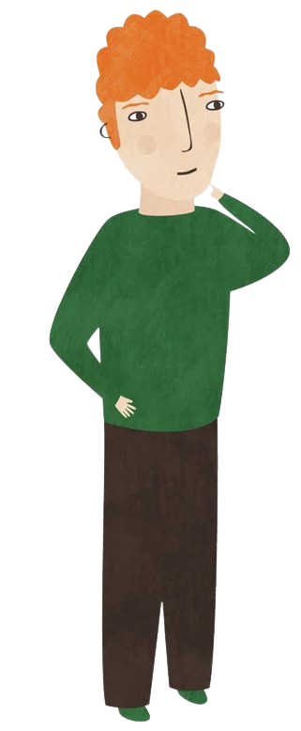
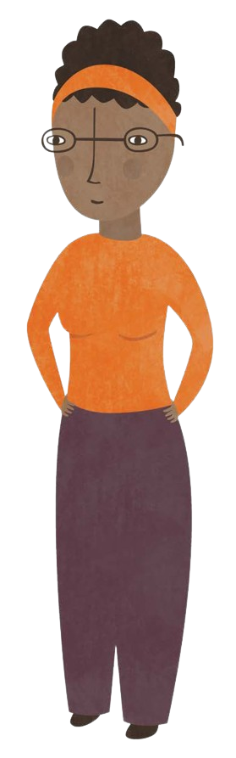

Case study and conversation starter on staff conduct
  Link to Child Safe Standards training resources page on PROTECT
Notes:
BACKGROUND NOTES FOR THE FACILITATOR
Time on this slide: 7 minutes
This slide is optional and hidden. If you want to present this slide
you need to ‘unhide’ it.
To do this, go to the view menu and select “Normal” from
Presentation views”. Then right click on the slide on the left of
screen and select “Hide slide” to switch between hidden and
unhidden as needed.
INSTRUCTIONS
Choose one of the 2 case studies available on PROTECT: (https://www.vic.gov.au/child-safe-standards-training-material)
Provide participants with a copy of your chosen case study.
Discussion could take place either in smaller groups that report back, or as a whole staff group.
Use the questions and prompts included in the case study to generate discussion.
Ensure staff are informed of the answers outlined in the case study before the end of the session.
SPEAKING POINTS
This activity helps us understand how to identify potential grooming behaviour and the steps we must take to report it.
Let’s discuss.

Slide 17
Our school’s child safety policies and procedures and staff responsibilities
Notes:
BACKGROUND NOTES FOR THE FACILITATOR
Time on this slide: less than 30 seconds
This slide is intended as a section break.
SPEAKING NOTES
In the next section of this presentation, I will be focussing on our school’s key child safety policies, statements and procedures.
These documents set out our school’s commitment and approach to keeping children, young people and students safe in our school environments.
As staff, it’s vital that you are familiar with the documents and your obligations.

Slide 18



Our school’s child safety policies and procedures
Victorian Child Safe Standards
Overarching child safety documents for our school
Child Safety and Wellbeing Policy
Child Safety Risk Register
Child Safety Code of Conduct
Child Safety Responding and Reporting Obligations Policy and Procedure
Connected policies for child safety at our school
Bullying Prevention
Complaints
Student Wellbeing and Engagement
Visitors
Volunteers
Yard Duty and Supervision
Department policies on the Policy and Advisory Library and department systems
For example, procurement, records management, recruitment, incident reporting, complaints/misconduct processes, eduPay.
Notes:
BACKGROUND NOTES FOR THE FACILITATOR
Time on this slide: 2 minutes
This slide is a way of visualising how the whole child safety policies and procedures fits together.
The policies in orange and blue are the school’s local child safety policies. The policies in orange are the overarching child safety policies.
At the bottom of the slide are department policies on the Policy and Advisory Library (PAL) (https://www2.education.vic.gov.au/pal) that have child safety protections built in and are policies that all schools must follow.
Note: You may wish to update the titles of the policies in the orange and blue tiles to reflect the titles of your local school policies.
SPEAKING NOTES
Our school takes the Child Safe Standards seriously. Our policies and procedures align with the Child Safe Standards.
This slide is a way of visualising how our school’s child safety policies and procedures fit together.
Starting at the top and highlighted in orange, are our school’s overarching child safety policies and procedures. These 4 policies and procedures are specifically child safety focussed and are directly related to the Child Safe Standards.
There are also a range of other policies and procedures that have important things to say about child safety at our school. The blue policies are the child safety related policies at our school. For example, you can see here our school’s Complaints Policy, Volunteers Policy, Student Wellbeing and Engagement Policy and Bullying Prevention Policy
At the bottom, are the department’s policies on the Policy and Advisory Library (PAL) (https://www2.education.vic.gov.au/pal) that have child safety protections built-in and these are policies that all schools must follow. PAL is a public site so you can also access these department policies.
Over the next few slides, we’ll discuss some of the key policies and procedures in our school and what this means for staff at our school.

Slide 19
New Policy Guidelines
New Code of Conduct
New Child Safety & Wellbeing Policy
New Child Safety Responding and Reporting Obligations Policy and Procedures
New Risk Register
Visit Jackson Policy Advisory Library: https://newsletters.naavi.com/i/pNpVrpM

Slide 20
Child Safety and Wellbeing Policy
Our school’s Child Safety and Wellbeing Policy:
demonstrates our commitment to providing environments where our students are safe and feel safe
tells our community about our strategies and governance arrangements to keep children safe
helps us create a shared commitment to keeping children safe
supports everyone in our school community to know their responsibilities for keeping children safe
is publicly available
Notes:
BACKGROUND NOTES FOR THE FACILITATOR
Time on this slide: 1 minute
This slide raises staff awareness of the school’s Child Safety and Wellbeing Policy.
It identifies the intent of the school’s policy.
Note: Your school may have called this policy another name such as Child Safety Policy.
We suggest that you provide links or copies of your school’s current Child Safety and Wellbeing Policy.
SPEAKING NOTES
Let’s start with our school’s Child Safety and Wellbeing Policy.
You have a copy [or link to] our school’s Child Safety and Wellbeing Policy.
This policy demonstrates our school’s commitment to providing environments where our students are safe and feel safe, where their participation is valued, their views respected, and their voices are heard about decisions that affect their lives. In particular, our policy states:
We are a child safe organisation which welcomes all children, young people and their families
We are committed to providing environments where our students are safe and feel safe, where their participation is valued, their views respected, and their voices are heard about decisions that affect their lives
We have no tolerance for child abuse and take proactive steps to identify and manage any risk of harm to students in our school environments
Every person involved in our school has an important role in promoting child safety and wellbeing and promptly raising any issues or concerns about a child’s safety.
It tells our community about our strategies and arrangements to keep children safe.
It summarises the actions we will take across all the Child Safe Standards to ensure a child safe culture is championed and modelled across the school. It covers all 11 Child Safe Standards.
Our policy supports everyone in our school community to know their responsibilities.
It sets out the responsibilities of leaders and adults engaged in child-related work, including:
the principal, assistant principal and school [or school boarding premises] leaders
school staff and volunteers
school councils and school council members.
Our policy is publicly available on our school website [and at reception].

Slide 21
Establishing culturally safe environments and responding to diverse needs
Our staff can support every student to have a positive experience in a safe environment
This includes supporting Aboriginal cultural safety and understanding the diverse circumstances of children and students.
Everyone can:
  promote cultural safety in our school community by recognising the link between Aboriginal culture, identity and safety.
  pay particular attention to the needs of students with disability, students from culturally and linguistically diverse backgrounds, students who are unable to live at home, international students, lesbian, gay, bisexual, trans and gender diverse, intersex, queer and questioning and asexual (LGBTIQA+) students and Aboriginal students.
Notes:
BACKGROUND NOTES FOR THE FACILITATOR
Time on this slide: 2 minutes
This slide focuses on the school’s commitment to create culturally safe environments and respect and respond to the diversity of children and young people’s circumstances and needs.
Child Safe Standard 1 (https://go.vic.gov.au/4aG3zTU) requires schools to develop strategies to promote cultural safety. This applies even if there are no students who have identified themselves as Aboriginal.
Child Safe Standard 5 (https://go.vic.gov.au/3xpi9AO) requires that staff and volunteers understand the diverse circumstances of students, provides support, and responds to vulnerable students.
Schools can document their strategies in their Child Safety and Wellbeing policy.
Amend these notes align with your school’s Child Safety and Wellbeing Policy if needed.
SPEAKING NOTES
Our staff can support every student to have a positive experience in a safe environment. This includes supporting Aboriginal cultural safety and understanding the diverse circumstances of children and students.
For Aboriginal children, cultural safety includes being provided with a safe, nurturing and positive environment where they:
feel comfortable being themselves
feel comfortable expressing their culture, including their spiritual and belief systems
are supported by carers who respect their Aboriginality and encourage their sense of self and identity.
All schools must promote cultural safety, even if there are no students who have identified themselves as Aboriginal.
We also need to understand the diverse circumstances of children and students. Everyone can pay attention to the needs of:
students with disability
students from culturally and linguistically diverse backgrounds
students who are unable to live at home and international students
lesbian, gay, bisexual, trans and gender diverse, intersex, queer and questioning, and asexual (LGBTIQA+) students
Aboriginal students.
This is important to ensure all students understand their right to feel safe at school and how to raise any concerns.
Our Child Safety and Wellbeing policy includes actions our school will take to promote cultural safety and to respect and respond to the diversity of children and young people’s circumstances and needs.
[Add examples from your local policy to demonstrate how staff support cultural safety and diverse needs and outline staff responsibilities for these processes.]

Slide 22
Empowering students and families to express their views and raise concerns – example strategies
School policies
Identify ways to involve students, families and community members in reviews of child safety policies and practices.
Communicate policies social media posts, newsletters, website and staff circulars).
Invite feedback (e.g. via surveys, focus groups).
Report on outcomes of relevant reviews with the school community to show transparency and accountability.
Complaints policy
Informs students, parents and members of the community how they can raise complaints or concerns about issues arising at our school
Confirms that complaints relating to child abuse are managed in accordance with our Child Safety Responding and Reporting Obligations Policy and Procedures
School practice
Provide opportunities for families to discuss their children’s experiences at school
Invite student feedback on school-wide decisions and consider their views
Be aware of discriminatory barriers and any overreliance on student leaders
Give students a variety of ways to raise concerns (e.g. anonymous suggestion box and posters/guidance on who to talk to)
Notes:
BACKGROUND NOTES FOR THE FACILITATOR
Time on this slide: 3 minutes
This slide lists examples of strategies the school can put in place to ensure students and families are engaged in reviews of the school’s child safety policies and practices.
The strategies are based on example strategies in the PROTECT guidance (https://go.vic.gov.au/3VMQKD6) on the Child Safe Standards.
Further guidance on empowering students and families is available at Child and student empowerment guidance (https://go.vic.gov.au/3U3St5t) and Family engagement guidance (https://go.vic.gov.au/3U4iP7q).
SPEAKING NOTES
Over the last few slides, we’ve focused on the policies and procedures that we must follow to keep children safe in our school environments.
As we further develop and review our school policies, we need to engage our students and families and seek their input on what can be further improved.
This helps create an open and transparent child safe culture for students, families and our communities and promotes a greater understanding of child safety.
Children, young people and their families are more likely to speak up when they feel respected and confident that they will be heard.
On this slide, you can see some strategies that our school can consider to ensure that students and families are empowered to express their views during policy reviews.
We also want to make sure we talk to students and families more generally about the school’s child safety and wellbeing practices and encourage them to raise concerns.
[Optional question: Does anyone have any reflections or comments to share on the strategies our school has in place to engage with students and families on child safety, or ideas of improvements we could make going forward?]
Complaints are more likely to be raised when there are clear, well-communicated policies and procedures for concerns or allegations.
Our school’s Complaints Policy provides an outline of our school’s complaints process – and how students, parents and members can raise concerns arising at our school. Our policy is publicly available on our school website [and at reception]
It states that we value open communication with our families and are committed to understanding complaints and addressing them appropriately. It sets an expectation that all complaints and concerns are managed in a timely, effective, fair and respectful way.
There may be circumstances where a student’s sibling, parent or carer raises concerns about abuse or discloses abuse. Our policy informs the community that if complaints and concerns relate to child abuse, we will manage these in accordance with our school’s Child Safety Responding and Reporting Obligations Policy and Procedures.

Slide 23
Child Safety Code of Conduct
Our school’s Child Safety Code of Conduct provides adults with a clear guide on the behaviour that is expected of them in our school environments, and:
  lists acceptable and unacceptable behaviours
  identifies professional boundaries and ethical behaviour
  applies to all school activities, including school camps, using digital technology and social media
  is publicly available
Who has to follow it?
Staff, volunteers, contractors, and any other member of our school community involved in child-connected work, including school council members
Notes:
BACKGROUND NOTES FOR THE FACILITATOR
Time on this slide: 1 minute
We suggest that you provide links or copies of your school’s current Child Safety Code of Conduct to staff.
Note: Refer to the definition of ‘school environment’ in the child safety definitions resource on PROTECT (https://go.vic.gov.au/3TIB7cX)
SPEAKING NOTES
Our school has a Child Safety Code of Conduct.
It details acceptable and unacceptable behaviours to give a clear guide for all adults working in the school on the behaviour that is expected of them in school environments.
It applies to all school activities, including school camps, using digital technology and social media.
The Child Safety Code of Conduct applies to staff and all other adults who work or volunteer in our school environments.
All staff must be familiar with our Child Safety Code of Conduct and understand the behaviour that is expected of every adult working in our school environments.

Slide 24
Acceptable and unacceptable behaviours
Acceptable behaviours
upholding our commitment to child safety and following our Child Safety and Wellbeing Policy
treating students and families in our school community with respect
listening and responding to the views and concerns of students
promoting the cultural safety, participation and empowerment of Aboriginal students
ensuring, as far as practicable, that adults are not alone with a student
reporting any allegations of child abuse or other child safety concerns
if child abuse is suspected, ensuring as quickly as possible that the student(s) are safe and protected.
Unacceptable behaviours
ignore or disregard concerns, suspicions or disclosures of child abuse
develop a relationship with a student that could be seen as favouritism or amount to ‘grooming’ behaviour
display behaviours or engage with students in ways that are not justified by the educational or professional context
ignore an adult’s overly familiar or inappropriate behaviour towards a student
communicate directly with a student through personal or private contact channels
have contact with any student outside of school hours except when needed to deliver the school curriculum.
Notes:
BACKGROUND NOTES FOR THE FACILITATOR
Time on this slide: 3 minutes
This slide lists examples of acceptable and unacceptable behaviours in the Child Safety Code of Conduct template on PROTECT (https://go.vic.gov.au/3TIB7cX).
You may need to amend this slide to match the wording in your revised school’s Child Safety Code of Conduct.
SPEAKING NOTES
You have a copy of our school’s Child Safety Code of Conduct.
On this slide, you can see a summary of some of the examples of acceptable and unacceptable behaviours that are in our school’s Code.
The Code includes a clear expectation on staff to report any allegations of child abuse or other child safety concerns and, if child abuse is suspected, to act as quickly as possible to ensure the student is safe and protected.

Slide 25
Child Safety Risk Register
Our school has developed a Child Safety Risk Register, and we:
  have considered risks for each of the 11 Child Safe Standards and have developed and recorded our risk controls
  have taken risk causes and consequences into account
All staff play an important role in identifying and reporting child safety risks in our physical and online environment. Ask yourselves:
  How do our school structures, attitudes and practices affect the risk of harm or child abuse?
  What are some of the current and emerging online safety issues?
  Are there opportunities for adults to be alone with students, unseen by others?
  Are students, parents and the school community empowered to raise concerns? How do we know?
  Are there barriers that might stop students from raising concerns?
Notes:
BACKGROUND NOTES FOR THE FACILITATOR
Time on this slide: 1 minute
This slide raises staff’s awareness of the school’s Child Safety Risk Register and highlights some key considerations that the school has taken into account.
You may wish to share your school’s risk register in whole or part with the staff.
SPEAKING NOTES
The Child Safe Standards require all schools to develop and implement risk management strategies that:
focus on preventing, identifying and mitigating risks to child safety and wellbeing in the school environment
take into account the nature of the school environment, the activities expected to be conducted in those environments, and
the characteristics and needs of all children and students expected to be present at the school
We have developed a Child Safety Risk Register which considers risks for each of the 11 Child Safe Standards and records controls to mitigate those risks.
All staff play an important role in identifying and reporting child safety risks in our physical and online environments, including school camps, excursions, work experience placements and other school-authorised events.
We need to consider:
How do our school structures, attitudes and practices affect the risk of harm or child abuse?
What are some of the current and emerging online safety issues?
Are there opportunities for adults to be alone with students, unseen by others?
Are students, parents and the school community empowered to raise concerns? How do we know?
Are there barriers that might stop some students from raising concerns?
You also have a responsibility to alert school leadership to any emerging risks you become aware of, in the school’s physical and online environments.

Slide 26
Our role in responding to incidents, disclosures and suspicions of child abuse
We must not ignore or disregard any concerns, suspicions or disclosures of child abuse or harm
We have an important role to protect any child under our care and supervision from reasonably foreseeable harm
As a staff member, you have a critical role in protecting children and must meet a range of legal obligations to identify, respond and report child abuse
This includes abuse that has or is suspected to have taken place within or outside of school grounds and hours
Notes:
BACKGROUND NOTES FOR THE FACILITATOR
Time on this slide: 1 minute
This slide focuses on staff obligations to respond to any concerns, suspicions or disclosures of child abuse or harm.
For more information on signs of abuse refer to:
Spotting the Warning Signs of Child Abuse (https://go.vic.gov.au/4aj0qJW)
Identify child abuse (https://go.vic.gov.au/3W35Cxl)
SPEAKING NOTES
Our school’s Child Safety Code of Conduct and our Child Safety and Wellbeing policy make clear that we must not ignore or disregard any concerns, suspicions or disclosures of child abuse or harm.
As a staff member, you have a vital role in protecting children from harm and are well placed to observe signs or behaviours that may indicate risks of child abuse.
You may be the best-placed or only adult in a position at that time to identify and respond to suspected abuse.
If you have any concerns about a child’s safety or any inappropriate behaviours in the school community, even if you’re not sure, you must treat these seriously.

Slide 27
Responding to incidents, disclosures and suspicions of child abuse
Staff should follow the Four Critical Actions for Schools when responding to incidents, disclosures and suspicions of child abuse. Staff should follow the Four Critical Actions: Student Sexual Offending when responding to incidents involving harmful student-to-student sexual behaviour.
Respond to the emergency
  If a child is at immediate risk of harm,
  you must ensure their safety.
Report to authorities/Refer to services
  As soon as immediate health and safety concerns are addressed you must report your concerns to the principal or school leadership
  (as per our school’s Child Safety Responding and Reporting Obligations Policy/Procedures).
  You must report, or ensure your school leadership has reported, to the relevant authorities based on whether the source of the suspected abuse is in the school, family or community (the next slide addresses the different reporting obligations).
Contact Parents/Carers
  The principal and school must determine who needs to be contacted.
Provide ongoing support
  The school must determine the support for children impacted by abuse.
  For more information, see:
  Protecting Children – Reporting and Other Legal Obligations
  Report child abuse in schools | schools.vic.gov.au
  Our school’s Child Safety Responding and Reporting Obligations Policy and Procedures
Notes:
BACKGROUND NOTES FOR THE FACILITATOR
Time on this slide: 1 minute
PROTECT Identifying and responding to all forms of abuse in Victorian Schools (https://go.vic.gov.au/3PQnBD3) includes the Four Critical Actions for Schools when responding to suspicion or allegation of child abuse.
Schools must also respond to allegations and instances of student sexual offending.
For more information on how to support students and impacted staff, refer to:
Providing Ongoing Support (https://go.vic.gov.au/3VJUZ1W)
Identify child abuse (https://go.vic.gov.au/3W35Cxl)
SPEAKING NOTES
Our school’s Child Safety Responding and Reporting Obligations Policy and Procedures outlines the procedures we will follow to respond to any incidents, disclosures and suspicions of child abuse.
We follow the:
Four Critical Actions for Schools (https://go.vic.gov.au/3Suh3vd) when responding to incidents, disclosures and suspicions of child abuse.
Four Critical Actions: Student Sexual Offending (https://go.vic.gov.au/49mqa6W) for incidents, disclosures and suspicions of harmful student-to-student sexual behaviour.
You can see the Four Critical Actions for Schools on this slide. Action 2 steps out different reporting pathways based on the source of the suspected abuse.
School leadership will work with you to report to the relevant authorities, based on whether the source of the suspected abuse is in the school, family or community.
Further information about how the source of abuse impacts reporting obligations is set out on the next slide.
A link to each Four Critical Actions resource is in our school‘s Child Safety Responding and Reporting Obligations Policy and Procedures. [Add information relevant to your school about who reports about concerns relating to child abuse should be made to.]
A poster of each Four Critical Actions resource is displayed in our staff room [Amend this statement for your context.]
The easiest way to comply with your obligations is to remember that you must report any concern that a child has been abused, or is at risk of being abused, by following the relevant Four Critical Actions (https://go.vic.gov.au/3Suh3vd).
[Remind staff here about who reports should be made to within your school]

Slide 28
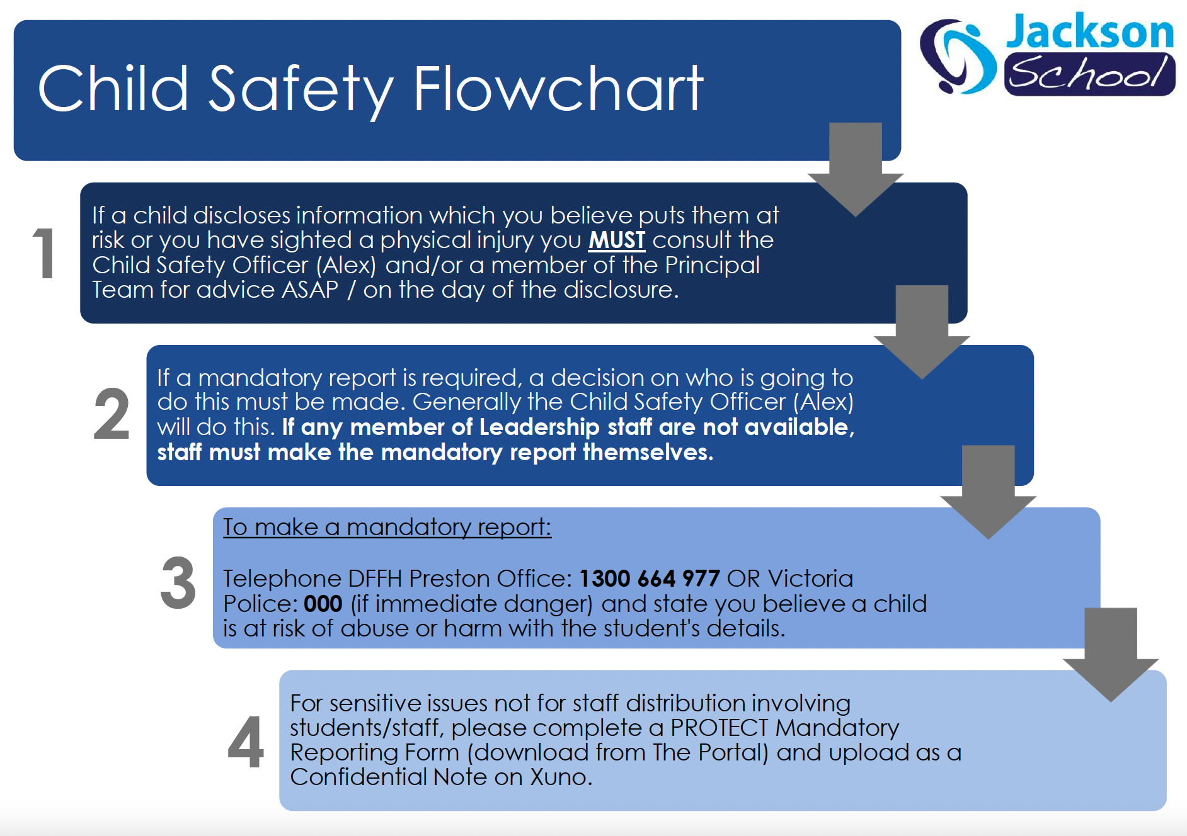
Child Safety Flowchart

Slide 29
EMERGENCY NUMBERS
EMERGENCY SERVICES: 000 (Urgent)
POLICE: 131 444 (Non-Urgent)
DFFH: 1300 598 521 (Mandatory Reporting)
DE: 1800 126 126 (Incident Support)
SSSO: 9356 0500 (Keilor-St Albans)

Slide 33


Slide 34
A reminder about your reporting obligations
Mandatory Reporting to Child Protection
(if the source of abuse is within the family or community)
Mandatory reporters must report to Child Protection as soon as practicable if in the course of practicing their profession or carrying out their duties, they form a belief on reasonable grounds that:
  a child has suffered, or is likely to suffer, significant harm as a result of physical and/or sexual abuse and
  the child’s parents have not protected or are unlikely to protect the child from harm of that type
School staff must also report all instances of suspected sexual abuse (including grooming) to Victoria Police.
Reportable Conduct Scheme
(if the source of abuse is an adult involved with the school)
Reportable conduct includes sexual misconduct, sexual offences, physical violence, significant neglect and behaviour causing significant emotional or psychological harm caused by an adult involved with the school.
This includes employees, contractors, volunteers (including parents) allied health staff, school council employees, agency casual relief staff, labour hire workers and pre-service teachers.
Allegations of potentially criminal conduct, family violence or concerns for someone’s safety must be reported to Victoria Police before any other action is taken.
Staff must immediately report any potential or alleged reportable conduct (including grooming) to the Principal
Principals must notify the department's Conduct and Integrity Division as soon as possible after becoming aware of an allegation of reportable conduct.
Conduct and Integrity will:
  assess the allegations and report reportable allegations to the Commission for Children and Young People
  advise on next steps including working with Victoria Police.
Responding to harmful student to student sexual behaviours
For student-to-student incidents, government school staff should refer to the Student Sexual Offending and Problem Sexual Behaviour policy and Identify and respond to student sexual offending guidance.
Notes:
BACKGROUND NOTES FOR THE FACILITATOR
Time on this slide: 1 minute
SPEAKING NOTES
The Reportable Conduct Scheme applies where an adult involved with the school is alleged to have engaged in sexual misconduct, sexual offences (including grooming), physical violence, significant neglect and behaviour causing significant emotional or psychological harm.
Staff must report any potential or alleged reportable conduct to the Principal.
Under the Reportable Conduct Scheme [amend for your school context/sector]:
[government school principals must notify the department’s Conduct and Integrity Division] as soon as possible after becoming aware of a reportable conduct allegation against any adult engaged by the department, school or school council in any capacity. This includes employees, contractors, volunteers (including parents) allied health staff, school council employees, agency casual relief staff, labour hire workers and pre-service teachers.
[Catholic school principals/leadership must notify the Diocesan education office…]
[Independent school principals/leaders must notify the Commission for Children and Young People…]
Separate to the Reportable Conduct Scheme, Mandatory Reporting imposes a legal obligation on school staff who are mandatory reporters to report to Child Protection as soon as practicable if:
in the course of their duties, they form a reasonable belief that a child has suffered or is likely to suffer physical or sexual abuse and
the child’s parents have not protected or are unlikely to protect the child from the abuse.
Mandatory reporters do not need to report abuse to Child Protection if the parents are acting protectively (for example, in instances of institutional abuse where the child’s parents are taking steps to protect the child from the abuse).
You must also report all instances of suspected child abuse (including grooming) to Victoria Police. Failure to do so may amount to a criminal offence.
These schemes do not change or replace other reporting obligations including to the Victorian Disability Worker Commission under the Disability Workers Regulation Scheme.

Slide 35
Who is Mandated?
The following are mandatory reporters in Victoria:
Victorian Institute of Teaching (VIT) registered teachers, including principals
School staff who have been granted permission to teach by the VIT
School councillors (Mental Health Staff)
Registered doctors, nurses and all members of the police force
Registered psychologists
People in religious ministry
Staff who provide direct support to students for mental, emotional or psychological wellbeing, including (but not limited to) school health and wellbeing staff, primary welfare officers, student wellbeing coordinators, mental health practitioners, chaplains, and Student Support Services staff (Speech Pathologists & Social Workers)

Slide 36
What is a belief on reasonable grounds?
A belief is a belief on reasonable grounds if a reasonable person, doing the same work, would have formed the same belief on those grounds.
Grounds for forming a belief are matters of which you have become aware, and any opinions in relation to those matters.
A thinking process, when a person is more likely to accept than reject the notion that there is harm. If the mandated professional or other staff member is more likely to believe than not, than he or she has formed a belief
Do you suspect the child is at risk of harm? If yes, NOTIFY CHILD PROTECTION
It is Department of Families, Fairness and Housing (Child Protection) responsibility to find evidence and investigate

Slide 37
Best Interests Principle
Section 10, Children Youth and Families Act 2005
(1) for the purposes of this Act the best interests of the child must always be paramount
(2) When determining whether a decision or action is in the best interests of the child, the need to protect the child from harm, to protect his or her rights and to promote his or her development (taking into account his or her age and stage of development) must always be considered.
What to do at Jackson School if I believe a child is suffering from abuse? (Jackson Flowchart)
If a child discloses information about there circumstances which you believe puts them at risk or you have sighted a physical injury you MUST consult the Child Safety Officer and/or a member of Leadership for advice ASAP.
If after this consult a mandatory report is required a decision on who is going to do this must be made. Generally the Child Safety Officer will do this.
To make a mandatory report: Phone DHHS Preston Office: 1300 664977 and state you believe a child is at risk and sumarrise your concerns in a Confidential Note asap either attaching the PROTECT formor using it as a guide to follow the Four Critical Actions

Slide 38
Staff training eLearning module: protecting children:
All teaching staff must complete the Protecting Children — Mandatory Reporting and Other Obligations eLearning module.
The training covers important child safety content including:
  Indicators of harm
  Failure to disclose and failure to protect
  Reportable conduct scheme
The training is available via LearnEd on eduPay.
School staff who are:
  mandatory reporters must complete the module once per calendar year
  non-mandatory reporters are strongly encouraged to complete the module once each calendar year.
Notes:
BACKGROUND NOTES FOR THE FACILITATOR
Time on this slide: 2 minutes
This slide reminds staff of their obligations to complete the Protecting Children — Mandatory Reporting and Other Obligations eLearning (https://go.vic.gov.au/3J2qtsG).
School staff who are:
mandatory reporters must complete the module once per calendar year
non-mandatory reporters are strongly encouraged to complete the module once per calendar year.
[Government schools:]
For more information refer to Protecting Children — Reporting and Other Legal Obligations (https://go.vic.gov.au/3POuzIL)
If an incident or allegation involves an employee, volunteer or contractor at the school, staff must also follow the department policy on Reportable and Notifiable Conduct (https://go.vic.gov.au/43SckrF) and report the incident to the department’s Conduct and Integrity Division on 03 7022 0005 or employee.conduct@education.vic.gov.au.
SPEAKING NOTES
We must ensure that we can respond in the best interests of students and children when complaints or concerns relating to child abuse are raised.
To do this, all staff must understand how to identify signs of child abuse and behavioural indicators that may indicate harm.
We must also understand our various legal obligations in relation to reporting child abuse to relevant authorities.
As discussed, school staff must follow the Four Critical Actions where there is an incident, disclosure or suspicion of child abuse.
The Protecting Children — Mandatory Reporting and Other Obligations eLearning module supports staff to build their knowledge and capacity in these areas.
If you are a mandatory reporter, you must complete the module once each calendar year.
All other staff are also strongly encouraged to complete the module once each calendar year.
[Add any further information about your school processes for completion of the eLearning module].

Slide 39
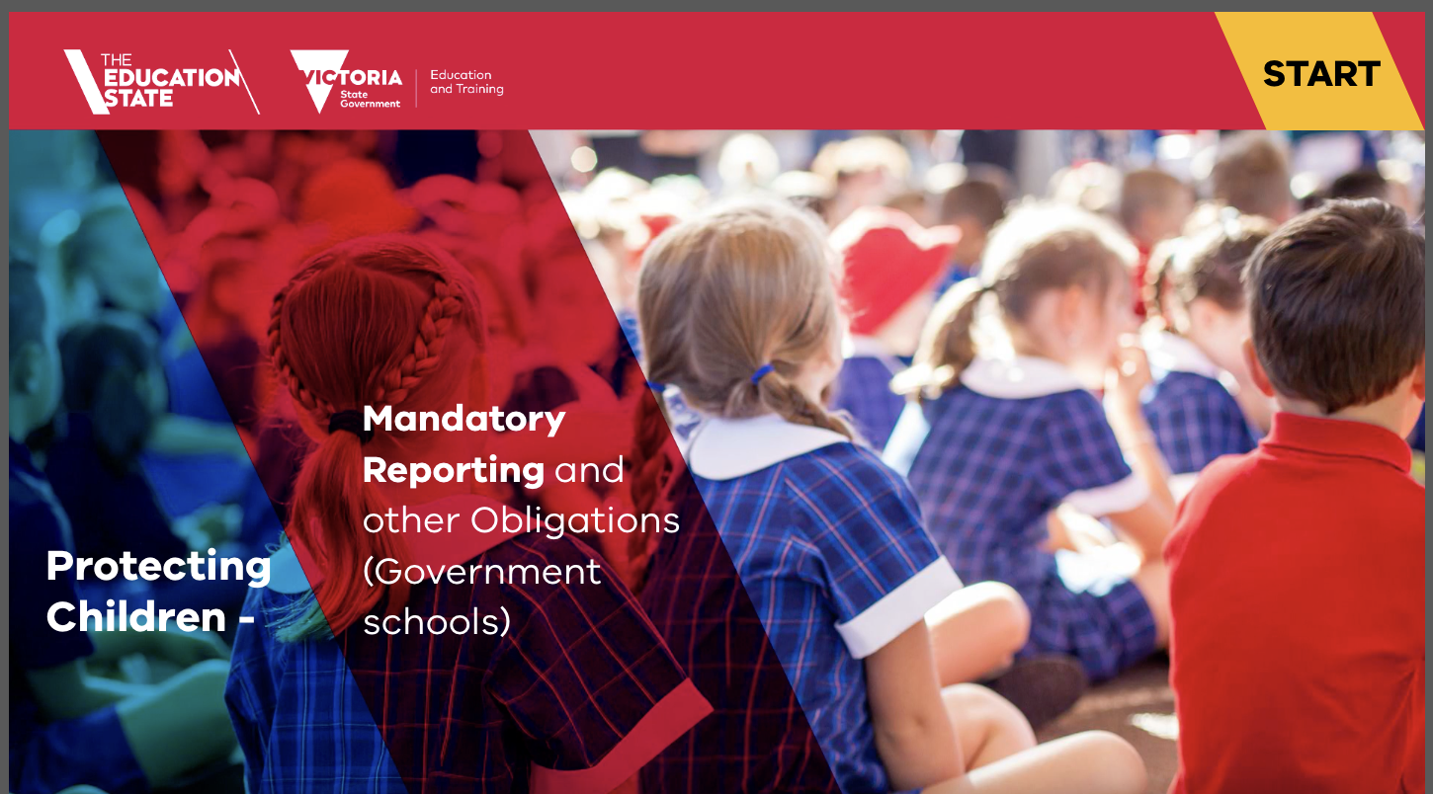
EduPay LearnED Module

Slide 40
Information sharing and record keeping obligations
Notes:
BACKGROUND NOTES FOR THE FACILITATOR
Time on this slide: less than 30 seconds
This slide is intended as a section break.
SPEAKING NOTES
In the next section of this presentation, I will be focussing on our school’s information sharing and record keeping obligations.
These procedures set out our school’s commitment and approach to keeping children, young people and students safe in our school environments.
As staff, it’s vital that you know your obligations.

Slide 41
Information sharing obligations for staff
Our school follows the department’s Privacy and Information Sharing Policy
Personal and health information of students, staff and others can be shared to carry out school and Department functions or for other related purposes and in other limited circumstances such as where there is a risk to health and safety.
Information is shared on a ‘need to know’ basis.
There are occasions where the school may lawfully share information with other parties outside the school or the department, for example to:
  report suspected child abuse to DFFH Child Protection or Victoria Police
  to request and share confidential information under the Child and Family Violence Information Sharing Schemes
Notes:
BACKGROUND NOTES FOR THE FACILITATOR
Time on this slide and the next slide: 2 minutes
Government schools must follow the Privacy and Information Sharing Policy (https://go.vic.gov.au/49qAN8u) and Records Management — School Records Policy (https://go.vic.gov.au/4aASRha) when collecting, using, and disclosing information about children and their families.
The policy includes information about when schools are allowed to share student’s personal and health information with other school staff and relevant members of the department.
In addition, there are occasions where the school may lawfully share information with other parties outside the school or the department, for example Child and Family Violence Information Sharing Schemes (https://go.vic.gov.au/3J3DOkr)
[Insert the name of your school’s staff member(s) trained in the information sharing responsibilities at the school. Also insert the name of the initial point of contact for information sharing requests.] All schools should have at least 1 leader and 2 professionals trained in the information sharing schemes. Training is available at: Information Sharing and MARAM Online Learning system (https://go.vic.gov.au/3A4xi95).
SPEAKING NOTES
Our school follows the department’s Privacy and Information Sharing Policy (https://go.vic.gov.au/49qAN8u) and the Schools' privacy policy (https://go.vic.gov.au/3PPcKZU) when collecting, using, disclosing and managing personal and health information.
Schools can share information with other school staff and relevant members of the department to enable the school to carry out school and department functions, for related purposes and in limited circumstances such as where there is a risk to health and safety.
All staff should share information about students on a ‘need to know’ basis, to allow staff to perform their primary function (or for a secondary purpose that would be reasonably expected by the individual whose information is being shared)
In addition, there are occasions where the school may lawfully share information with other parties outside the school or the department, for example to:
report suspected child abuse to DFFH Child Protection (https://go.vic.gov.au/3TmmE4d) or Victoria Police (https://go.vic.gov.au/3A4xi95)
to request and share confidential information under the Child and Family Violence Information Sharing Schemes (https://go.vic.gov.au/3J3DOkr)
These information sharing schemes enable Victorian schools to share confidential information with other organisations to promote the wellbeing or safety of children or to assess or manage family violence risk.

Slide 42
Record keeping obligations for schools and staff
Good records management practices are a critical element of child safety and wellbeing
Our school follows the department’s Records Management- School Records Policy
The policy addresses requirements for creating, storing and disposing of school records
Information is always recorded
Staff must create full and accurate records
Schools must keep all records relating to child safety, health and wellbeing. These records must not be disposed of or destroyed
Records must be kept in designated school storage areas
Staff must always follow our school’s records management procedures
Notes:
BACKGROUND NOTES FOR THE FACILITATOR
Time on this slide and the previous slide: 2 minutes
Government schools must follow the Records Management — School Records Policy (https://go.vic.gov.au/4aASRha) when collecting, using, and disclosing information about children and their families.
For more information, refer to the department’s privacy and information sharing guidance and records management Records Management Policy (https://go.vic.gov.au/4aASRha).
SPEAKING NOTES
Good records management is an important element of child safety and wellbeing.
Our school manages records by following the department’s: Records Management – School Records (https://go.vic.gov.au/4aASRha).
Schools must keep all records related to child safety and wellbeing. The school principal has responsibility for meeting record-keeping and information sharing obligations.
Staff must always follow our school’s records management procedures. [Insert information about your school’s records management procedures for staff].
Staff must:
ensure student and family information is recorded, kept accurate and secure at all time
record decisions made, actions taken and notes of meetings and important conversations
make sure records are complete, accurate and can be understood in the future by those who were not directly involved.
keep records in our school’s designated storage areas
protect records from unauthorised access and disclosure.
Child safety and wellbeing records at our school are kept [insert information about your school’s storage process]
If you need any clarification about your information sharing and record–keeping obligations, reach out to [insert name] or a member of school leadership.

Slide 43
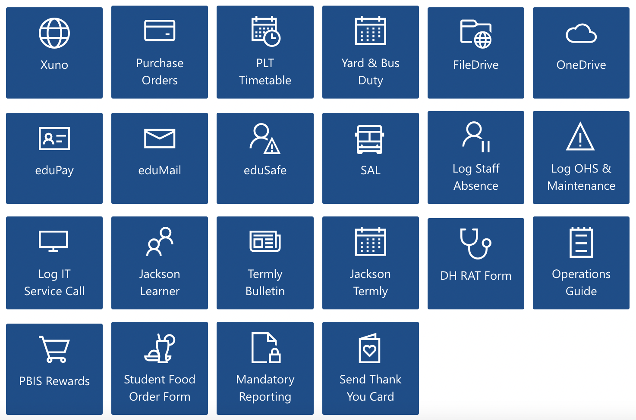
PROTECT Mandatory Reporting Form

Slide 44
Zero tolerance for child abuse
Our school has zero tolerance for child abuse
Follow the school’s child safety policies at all times
You must follow the Four Critical Actions when responding to incidents, disclosures and suspicions of child abuse
If you ever have any questions or feel unsure about what to do, please speak to the school leadership team
Notes:
BACKGROUND NOTES FOR THE FACILITATOR
Time on this slide: 1 minute
In July 2021, the Victorian Government announced new Child Safe Standards to further strengthen child safe environments and protect children from abuse.
The purpose of this presentation is to ensure that school staff are equipped with the knowledge, skills and awareness to keep children and young people safe.
The presentation contributes to annual staff training requirements for Child Safe Standard 8 (https://go.vic.gov.au/3V9dFbd)
SPEAKING NOTES
These are the key take aways for this training presentation.
Our school has zero tolerance for abuse.
Follow the school’s child safety policies at all times.
If you have any concerns or suspicions that a child has been or is at risk of abuse, you must act by following the Four Critical Actions.
If you ever have any questions or feel unsure about what to do, please speak to the school leadership team.

Slide 45
Restraint & Seclusion

Slide 46
Restraint & Seclusion
Physical restraint and seclusion are only permitted within Victorian government schools in exceptional circumstances where it is immediately required and reasonably necessary to protect the safety of a student or another person. Physical restraint and seclusion are not permitted at any other time.
No person – including a parent/carer, clinician, practitioner, or student – can authorise, consent to, or approve the use of physical restraint or seclusion in a school.
Every instance of physical restraint and seclusion must be reported as an incident on eduSafe Plus, the department’s online incident reporting and hazard management system, or by calling the Incident Support and Operations Centre (ISOC) on 1800 126 126.
Every instance of physical restraint and seclusion require schools, regions, and central office to undertake specified actions according to the severity rating of the incident.
Current DE Policy Guidelines are available on DET Policy Advisory Library (PAL): https://www2.education.vic.gov.au/pal/restraint-seclusion/policy
Including: Locks, coded locks, and door handles guidance (DOCX)

Slide 47
Restraint & Seclusion
School staff must never use physical restraint and seclusion as behaviour management techniques, for convenience, as retaliation, or to discipline or punish a student.
Physical restraint must never be used where it has the effect of:
covering a student’s mouth or nose, or in any way interferes with breathing
taking a student to the ground into the prone or supine position
putting stress on a student’s joints
applying pressure to the neck, back, chest or joints
deliberately applying pain to gain compliance
intentionally causing a student to fall
having a person sitting, lying, or kneeling on a student.
The following behaviours are prohibited:
headlocks, choke holds, basket holds, bear hugs, therapeutic holding or wrestling holds (inc full / half nelsons)
using a hog-tied position
straddling any part of a student's body
dragging a student along the ground.

