Slide 1
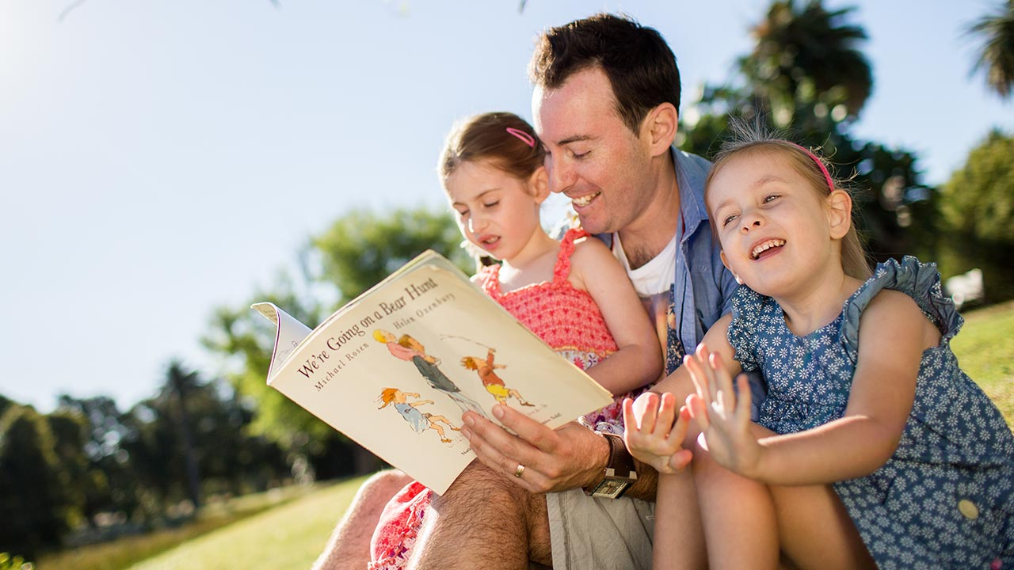

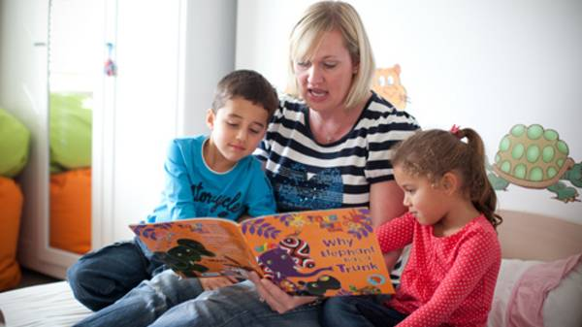
Welcome to
Reading With Your Child
Parent Information Night

Slide 2

Acknowledgement of Country
We would like to acknowledge the traditional custodians of this land, the Anaiwan people and pay our respects to the Elders both past, present and future, for they hold the memories, the traditions, the culture and the hopes of indigenous Australia.

Slide 3


PRAYER
Let us remember that we are in the presence of our God:
Dear Lord, our teacher and guide,
You have blessed us all, here present tonight,
With the mission to guide and counsel our students.
We place our trust and faith in you.
That you will embrace us with your wisdom and love to encourage our students to meet their fullest potential in their spiritual, social and academic lives.
Help us to work together as a team: parents and teachers,
To seek out in our students
The extraordinary rather than the ordinary,
The best rather than the average,
The possible rather than the probable,
And to accept the challenges rather than look for the easy way out.
Bless our partnership as we journey together this year, that we, both;
Parents and educators, may work as one, as you are One.
In the name of the Father, the Son and the Holy Spirit. Amen.

Slide 4

Welcome
to all parents and carers and
thank you for coming!
Introduction to Staff

Slide 5
AGENDA:
The Balanced Reader
Reading At School
Reading At Home - the “How”
Hints to Help
Teacher Conversations
Reading & Homework
Resources

Slide 6
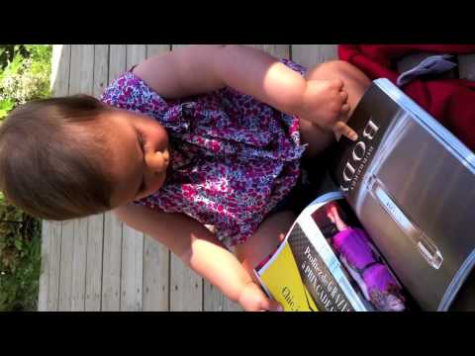
THE YOUNG READER

Slide 7
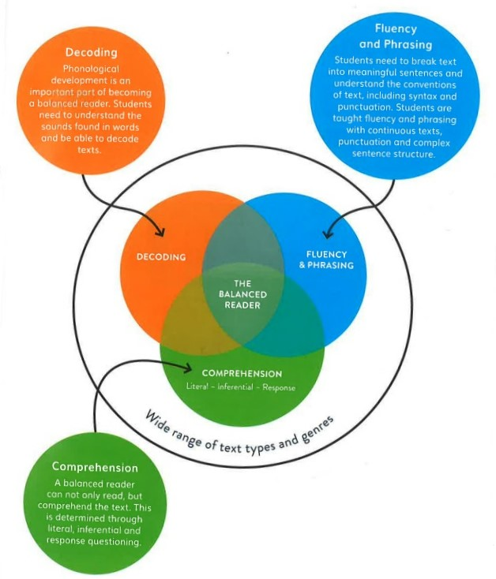
THE BALANCED READER

Slide 8

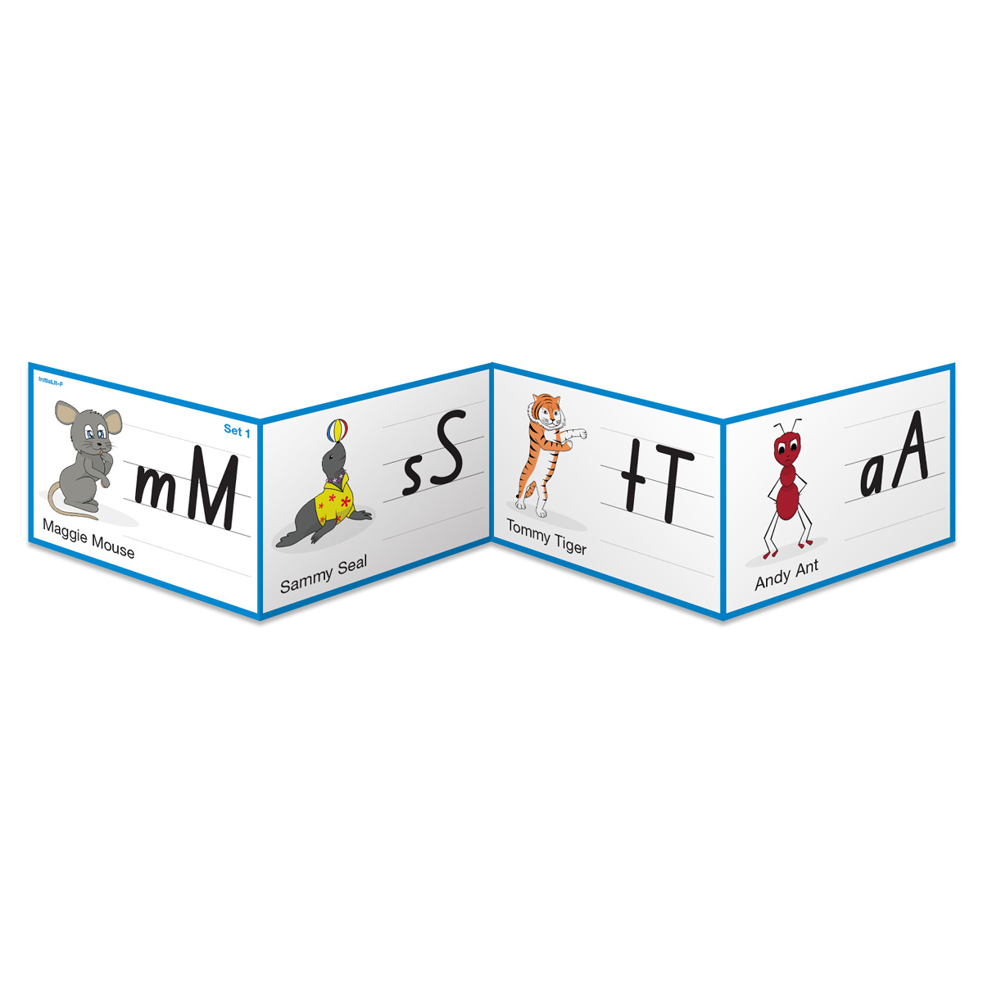
READING AT SCHOOL
Structured and uninterrupted Literacy Block
InitiaLit Program in K-2
MiniLit Program in Year 1
Guided Reading (Decodables and Levelled Texts)
Tricky words

Slide 9
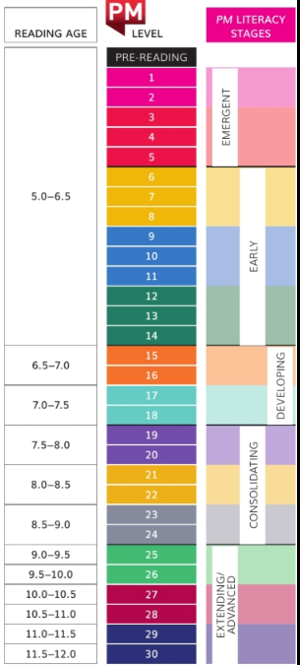
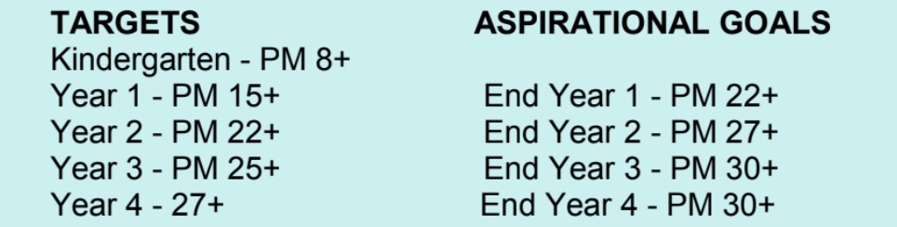
READING AT SCHOOL (Levelled Texts)
Reading Levels and Reading Age
Reading Goals
Reading Targets
PM Reader Resource

Slide 10

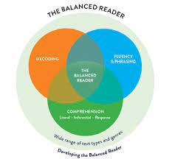
Why hasn’t my child moved up a reading level?
“Books at home are easy!”
Books sent home are supposed to be at the child’s
independent reading level. The books should be achievable and should be building their confidence and enjoyment.

Slide 11
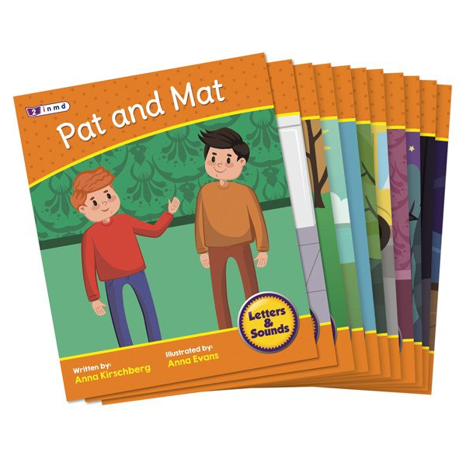
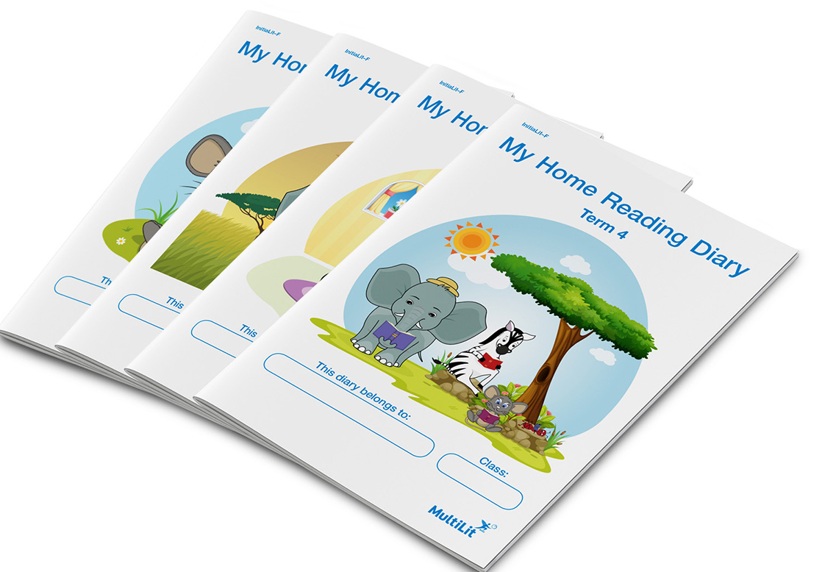


Infants Home Reading
Readers
Tricky Words,
Reading Log,
PM Bookmark

Slide 12

READING AT HOME
It is as much about the child reading to you as it is about you reading to your child.
When you model reading enjoyment the children will develop reading enjoyment.
If you model persistence in reading the children will develop persistence.

Slide 13

HOW TO READ TOGETHER
Talk about the book before reading - what do you know about the topic?
Look through and pick out any words that may be tricky such as names or unusual words.
ECHO READING Once per week
You read one line, your child reads the same line after you. Increase to number of lines you each read as your child grows in confidence. Encourage them to follow along with their finger.
CHORAL READING - Twice per week
You and your child read the same text aloud together.
PARTNER READING - Once per week
You and your child take turns reading. You start by reading one sentence then ask your child to read the next sentence. As fluence and confidence improves increase the amount you each read in a turn.

Slide 14

HOW TO READ TOGETHER
REPEATED READING - Read the same book or story more than once in a week.
EXPRESSION - Have fun! Bring out the actor in you!
COMPREHENSION - ask questions, retell story

Slide 15

WHAT TO READ
PM eReaders
Library Books
Books at Home
Recipes
Shopping Lists
Environmental

Slide 16


HELPING YOUR CHILD AT HOME
Helping your child at home by establishing a:
Routine
Have a quiet place for reading (quiet, good lighting)
Limit small screen time
Read to your child, read with your child, listen to your child read, discuss what has been read.
Help your child at home by emphasising the importance of reading!

Slide 17

HELPING YOUR CHILD AT HOME
PAUSE - don’t jump in - wait 3-5 secs
PROMPT - give a clue or 2.
- still not sure - ask if they need help or if they would
like you to tell them the word.
PRAISE - try and be specific
RETELL - Retell what happened FIRST, NEXT, THEN…
- Ask WHO, WHAT, WHY, WHERE, WHEN questions

Slide 18

Reading & Homework
St Mary’s Homework Expectations
All students at St Mary’s are expected to read every night. We do not set regular homework instead parents are encouraged to talk to their children regarding their learning at school.
Reading
Big Writes - Talk Homework
INFANTS STAGE 2 STAGE 3

Slide 19

2022 A Successful Year
Attendance = 90% of the time
A Multi-Tiered System of Support for Academic, Wellbeing and Positive Behaviour Support
Reading & Homework
Partnership home & school

Slide 20
Any QUESTIONS?
Thank you for coming!
We have enjoyed talking about reading with you.
We look forward to meeting with you again.

Slide 21



