Slide 1
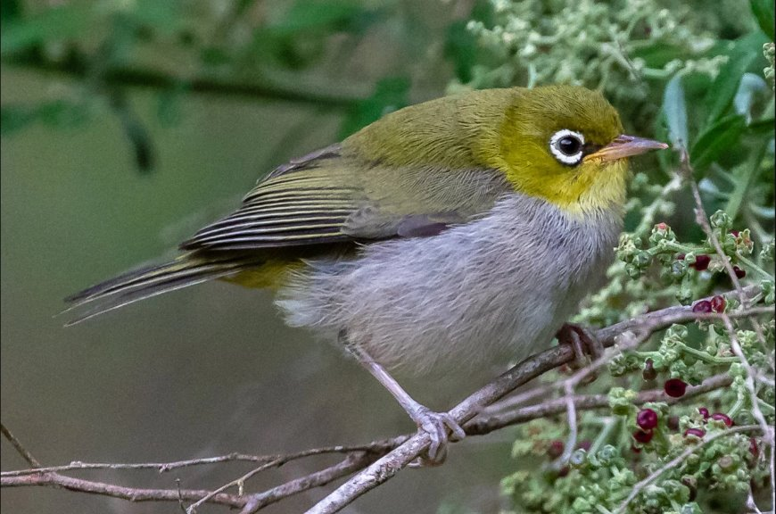
Silvereye
We chose the
Silvereye
because
it is a
fascinating bird

Slide 2
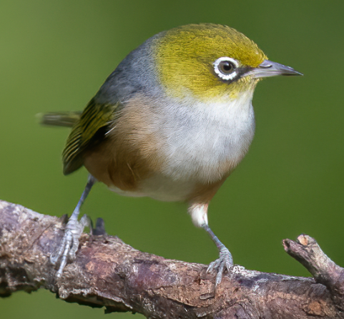
What it looks like
Small
Olive-green head, back and wings
Grey belly.
White eye rings
Move in small flocks

Slide 3
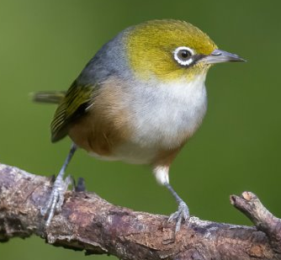
What it needs to thrive
Silvereyes thrive in environments with:​​
​
Native shrubs that bear flowers and fruit.
Spiders and insects
Clean water
Dense shrubs to shelter, feed, and nest.

Slide 4
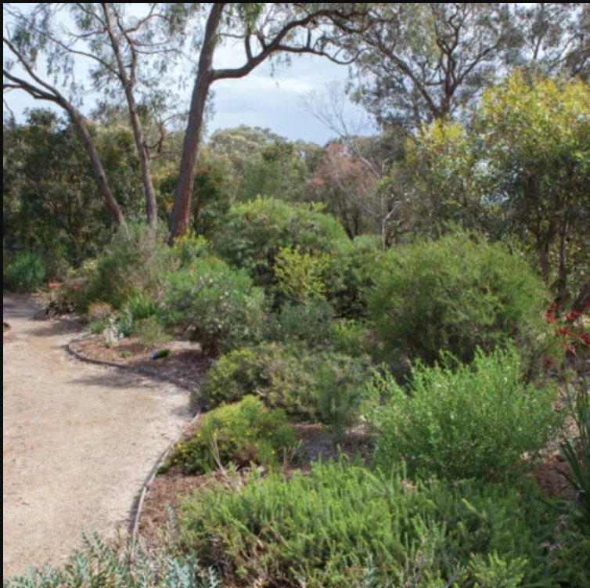
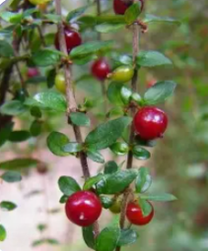
What is missing in our school
Things we could improve in our school include
Plant more fruit bearing plants
Increase dense shrubs for shelter, feeding and nesting.

Slide 5
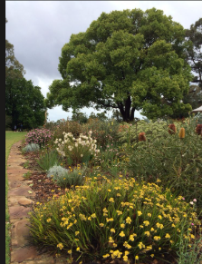
Our solution
We plan to increase areas of dense vegetation around the school grounds by
creating new gardens
enhancing existing gardens

Slide 6
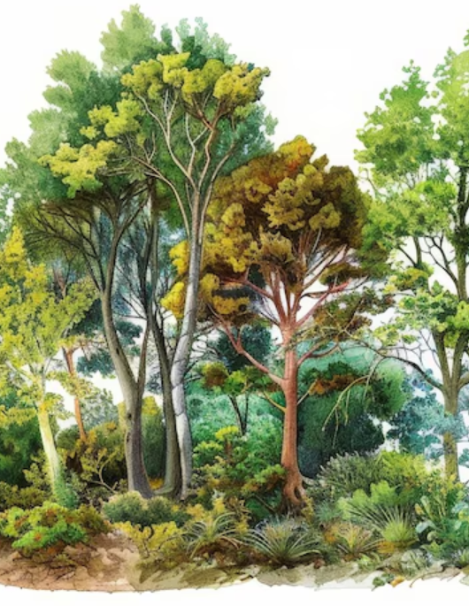
Our solution
New gardens
Will be in areas of low disturbance
Will be planted with plants that are
  Winter flowering
  Fruit bearing
  Spikey
  Multi-layered

Slide 7

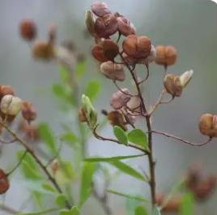
Our solution
Existing gardens
  Create multi-layers for insect diversity
  Include plants that
    flower in winter
    bear fruit
    Spikey habit for protection.
Prickly currant bush Sweet bursaria ​
(Coprosma quadrifida) Bursaria spinulosa).

Slide 8
Our solution
Plant species to be added
Hakea sericea (spikey)
Bursaria spinulosa (fruit/spikey)
Coprosma quadrifida (fruit)
Billardiera scandens (fruit)
Grevillea victoriae (winter flowering)
Grevillea juniperina (winter flowering/spikey)
Leptospermum polygalifolium (winter flowering)

Slide 9
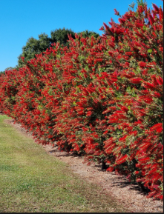
Our solution
Enhancing existing gardens by
Lightly prune shrubs after flowering to encourage dense growth
Avoid nesting periods
Insert picture of bottle brushes in playground

Slide 10
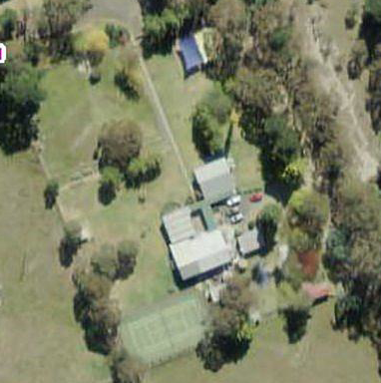
Our solution
Location of new gardens
  New garden
  Existing garden

Slide 11
Resources and references
Birdlife Australia
Australian Natural Museum
Backyard Buddies

