Slide 1
Term 1 Induction Session 2: Planning Teaching
& Learning/
Excursions

Slide 2
Term 1 Induction Planner
Week 2 - JSA Background/IT Systems/Teaching and Learning/Excursions
Weeks 3-5 - Term 1 SSGS
Week 6 - Understanding Autism Practices
Week 7 - Facilitating Student Communication
Week 8 - Facilitating Student Regulation and Sensory Needs
Week 9 - Tier 1 ASD Practices - Environment
Week 10 - Tier 1 ASD Practices – Schedules, PBS Rewards

Slide 3
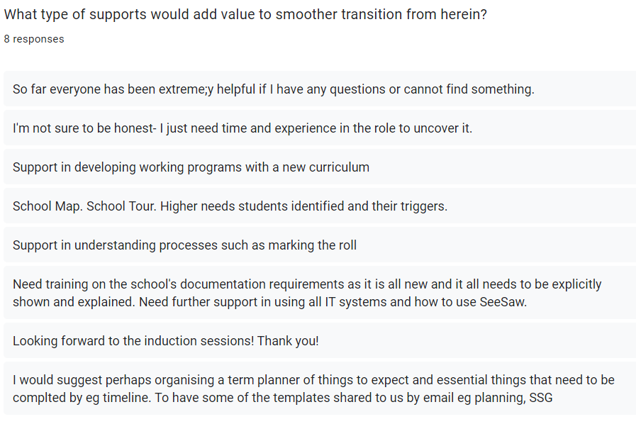
Term 1 Induction Survey Feedback Summary
Your feedback has highlighted the need to better familiarise yourself with our processes, use of documentation to feel more connected with your current role.

Slide 4
Who we are..
SCHOOL VISION
Jacana School for Autism fosters resilience and lifelong learning enabling students to be active participants in family and community life.
MISSION STATEMENT
Students are supported by a committed professional multi-disciplinary team, working towards developing their personal and educational potential.
The school strives to continually develop highly customised teaching and learning programs in line with evidence-based practice in a safe and supportive environment.

Slide 5
Our Pedagogical Philosophy
Jacana School for Autism provides:
A curriculum that supports the individual needs of students, using specific teaching strategies that cater to students with an Autism Spectrum Disorder.
Individual Learning Plans to cater for specific learning needs and styles, focusing on communication, social /interpersonal skills, personal learning and academic skills.
A safe and secure environment that enhances students’ self-esteem and respects students’ dignity.
School wide implementation of the Positive Behaviour Support program.
Regular participation in the wider community.

Slide 6
Our Pedagogical Philosophy
Jacana School for Autism believes that to succeed in the world, students need to develop the capacity to:
Manage themselves as individuals and in their relations to others.
Understand the world in which they live and act effectively in their wider community
Jacana School for Autism provides:
A curriculum that supports the individual needs of students, using specific teaching strategies that cater to students with an Autism Spectrum Disorder.
Individual Learning Plans to cater for specific learning needs and styles, focusing on communication, social /interpersonal skills, personal learning and academic skills.
A safe and secure environment that enhances students’ self-esteem and respects students’ dignity.
School wide implementation of the Positive Behaviour Support program.
Regular participation in the wider community.

Slide 7
Our Pedagogical Philosophy
Jacana School for Autism includes:
Individual and small group instruction.
Speech therapy consultation.
Occupational therapy consultation.
Psychology consultation.
Ongoing professional development for staff.
Programs that are informed by current research and evidence-based practice.

Slide 8
Victorian Curriculum
JSA provides a Primary, Middle, Secondary and Senior Secondary Curriculum that is presented in an inquiry based approach that incorporates experiential learning opportunities.
The Primary, Middle and Secondary curriculum is based on the Victorian Curriculum F-10 and includes the following:
English -
Reading and Viewing
Writing
Speaking and Listening
Mathematics -
Number and Algebra
Statistics and Probability
Measurement and Geometry
Curriculum Areas -
Science
The Humanities
Technologies
The Arts -
Music
Visual Arts
Media Arts
Drama
Dance
Visual Communication and Design
Capabilities -
Personal and Social
Critical and Creative Thinking
Notes:
Dan

Slide 9
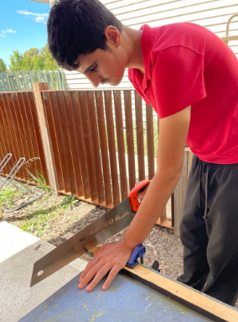
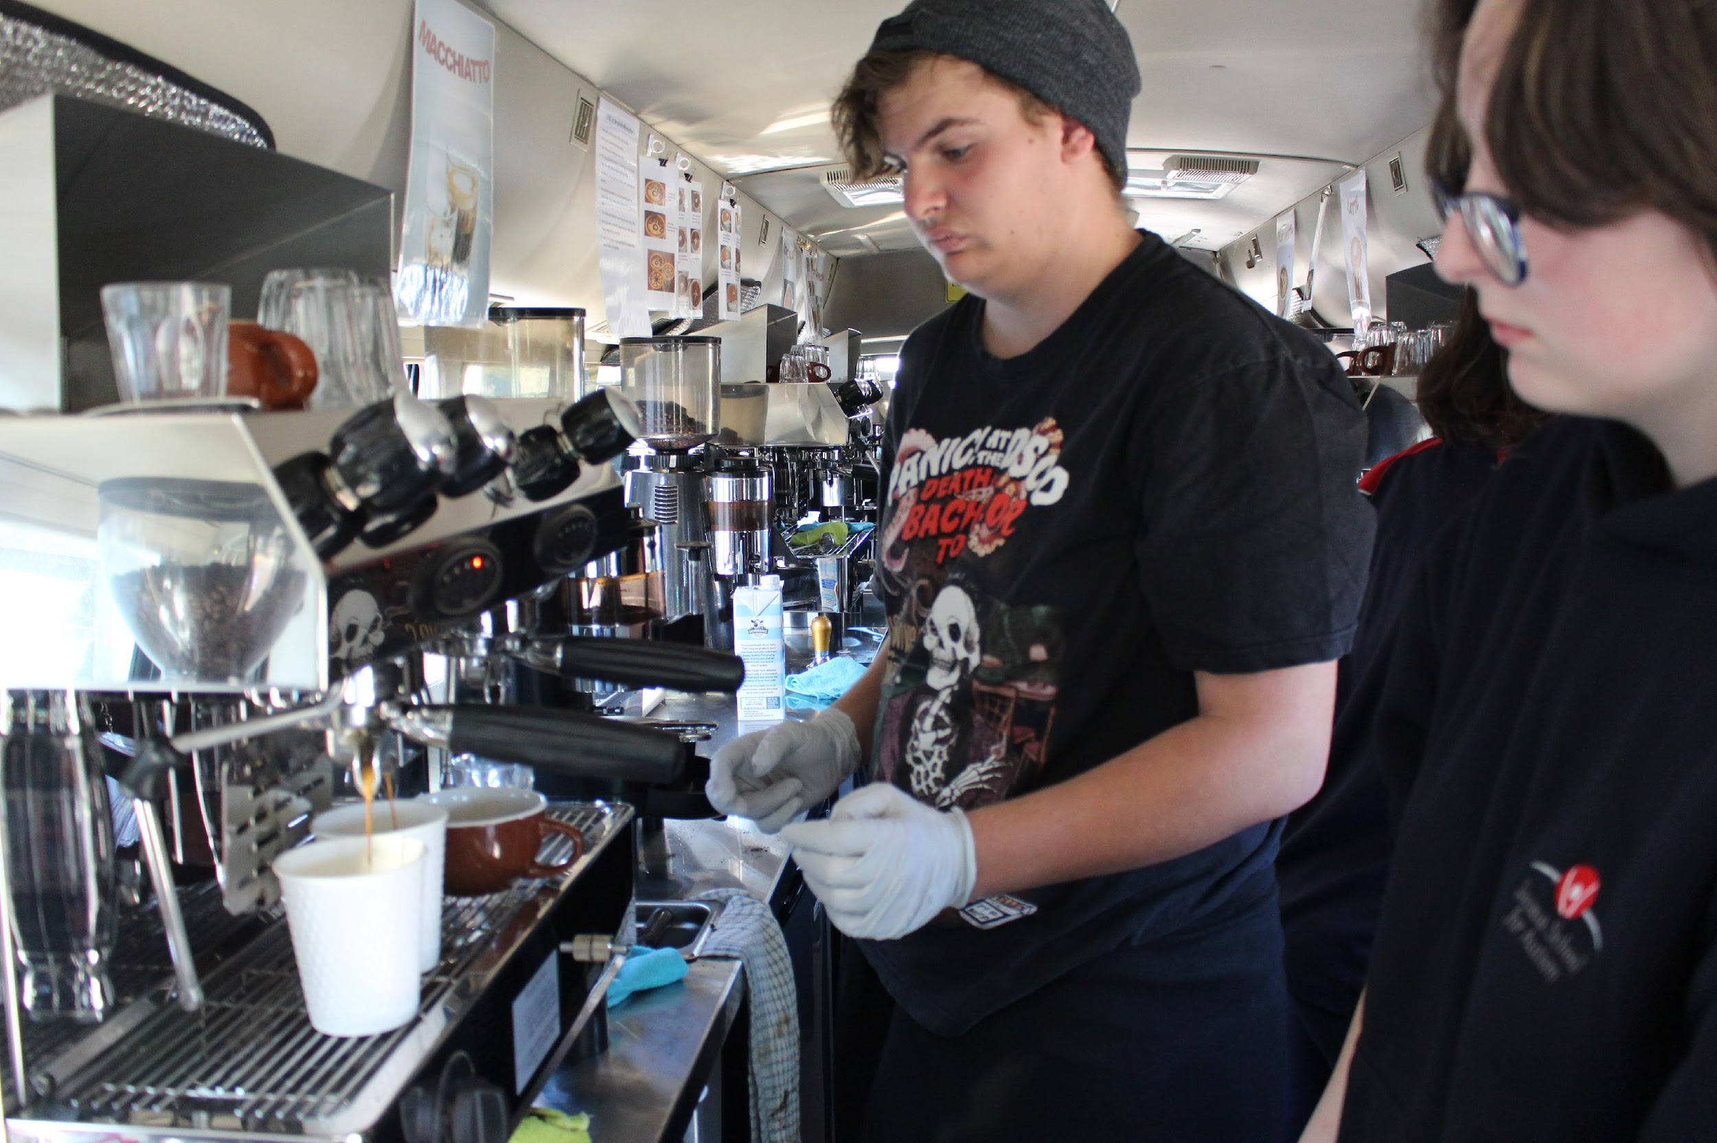
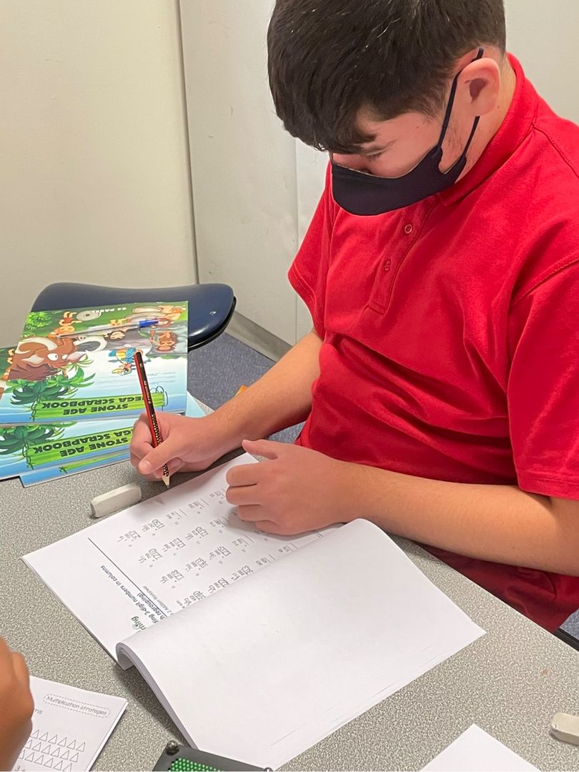
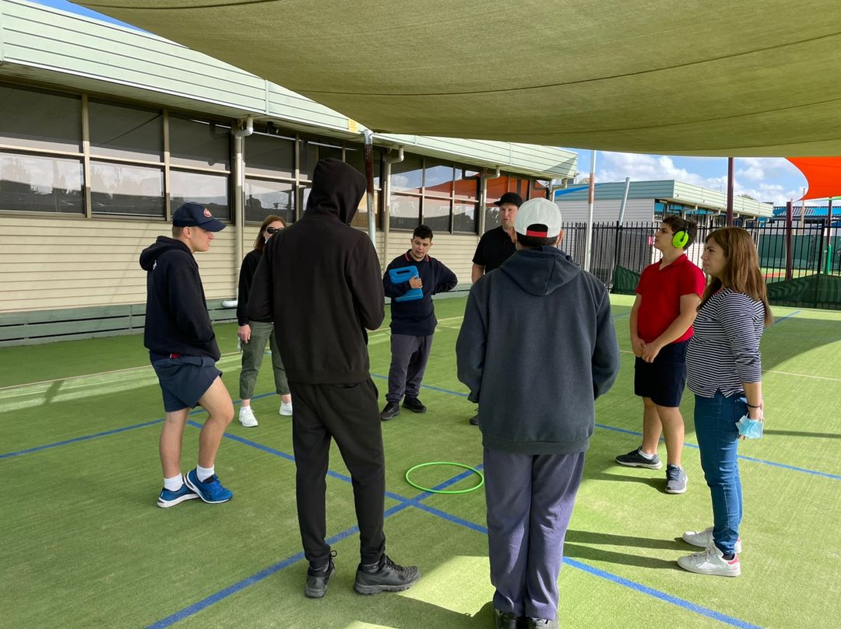
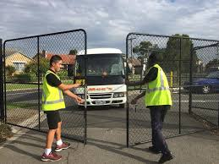
The Senior Secondary Curriculum
Victorian Pathways Certificate (VPC)
The Pathways Certificate of Individual Achievement (CIA)
Vocational Education and Training (VET)
School-Based Apprenticeships & Traineeships (SBAT)
Specialist programs provide students with the opportunities to explore and learn in the areas of:
Personal & Social Capabilities
The Arts: Visual Arts and Performing Arts (Music)
Hands On Learning: Build and Café Programs
Health & Physical Education
Notes:
Dan

Slide 10
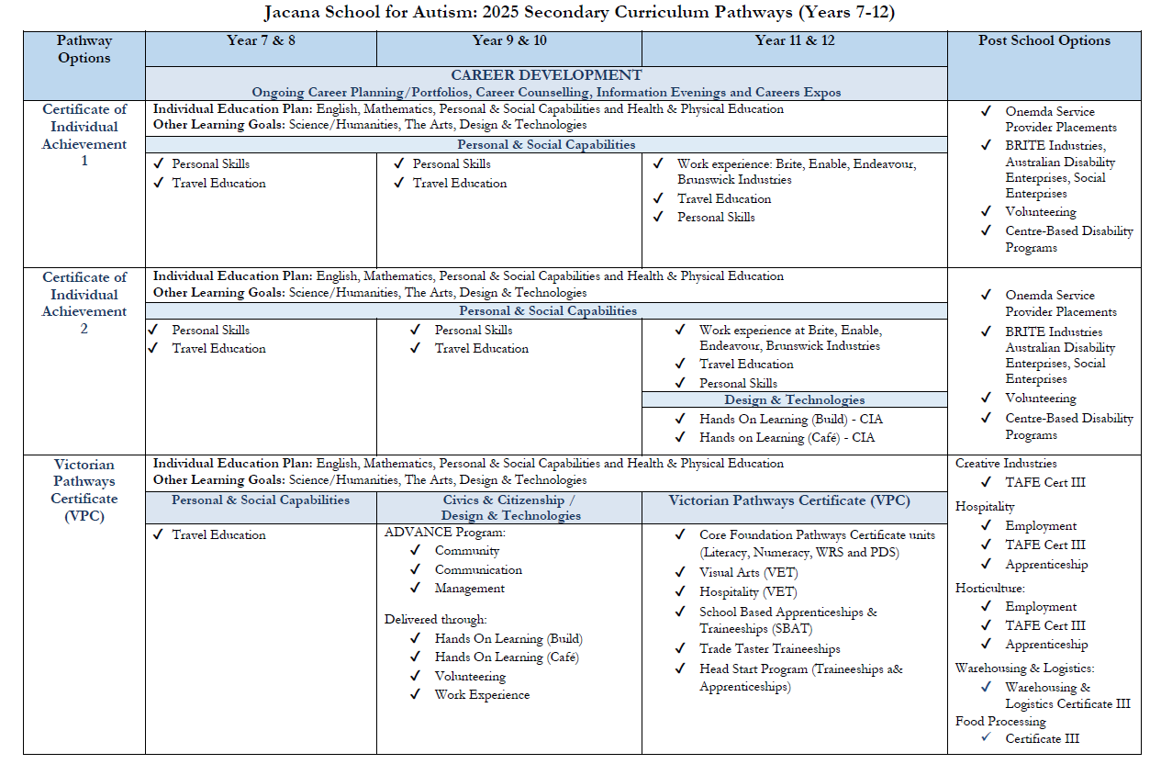
Year 7-12 Secondary Curriculum Pathways
Notes:
Dan

Slide 11
Tier 1
Tier 1 Strategies at JSA
Autism specific strategies (visuals, scheduling, processing time, First/Then, timers, one more minute, finish boxes etc.)
JSA Teaching and Learning Pedagogy
Structure and predictable routines
Co-regulation strategies
Positive reinforcement of appropriate behaviours
Clearly communicated behaviour expectations
Environmental structures
Movement breaks
Consistent approach
Modelling
Choices built into the day
Engaging and meaningful activities that incorporate student interests
Notes:
Steph

Slide 12
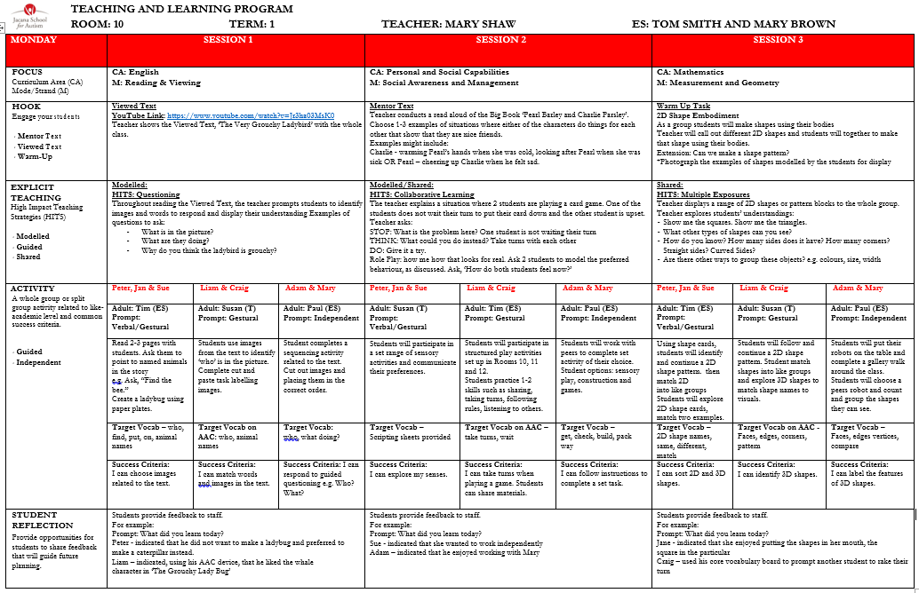
Tier I Data
Tier 1 Checklist
Teaching and Learning Program
Student Profiles
ABC Data Chart
Notes:
Steph

Slide 13
Adapting the Curriculum as a Tier I Intervention
Differentiation of tasks that include student’s interests
IEP Goals
Multiple ways for students to express their skills and knowledge
Multiple ways for information to be presented to students
Notes:
Steph - This model may assist you to identify how the curriculum can be adapted to meet the student’s learning needs. Using this model will ensure that your teaching practice is using a Universal Design for Learning (UDL) model, whereby teachers are planning for all learners in the classrooms.

Slide 14
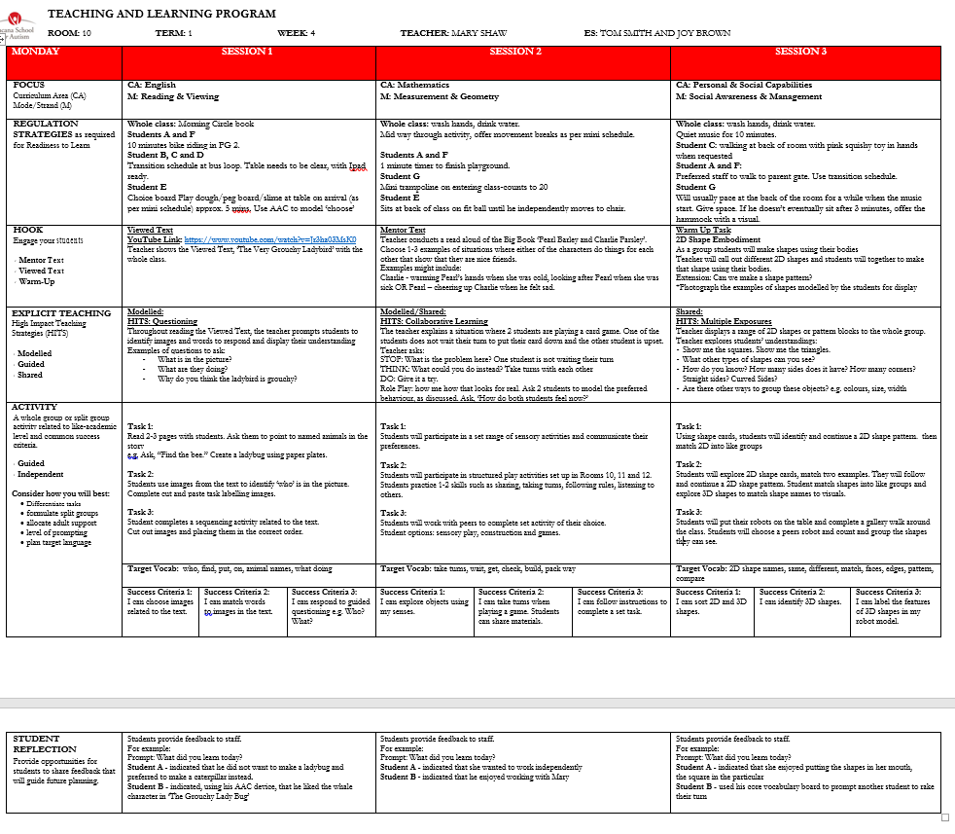
SharePoint>School Documents>Teaching and Learning Documentation>Teaching and Learning Program with regulation Strategies example/template
Notes:
Shared Drives has the areas of the curriculum planned by teachers: if suits your students, use without modification. You can adapt.

Slide 15
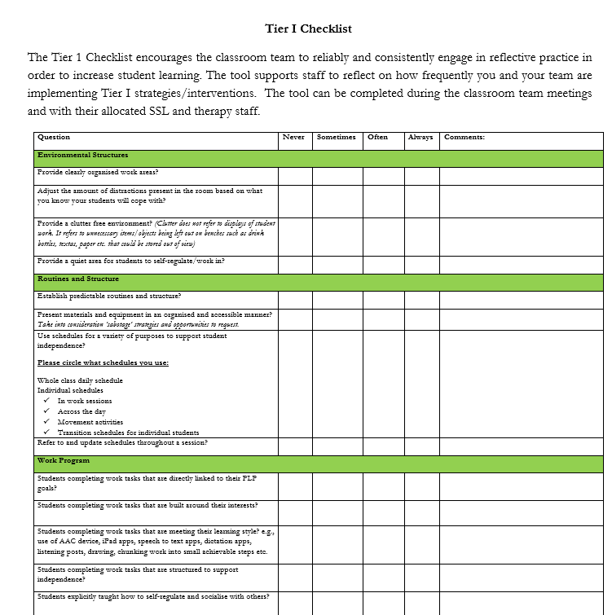
Teaching and Learning

Slide 16
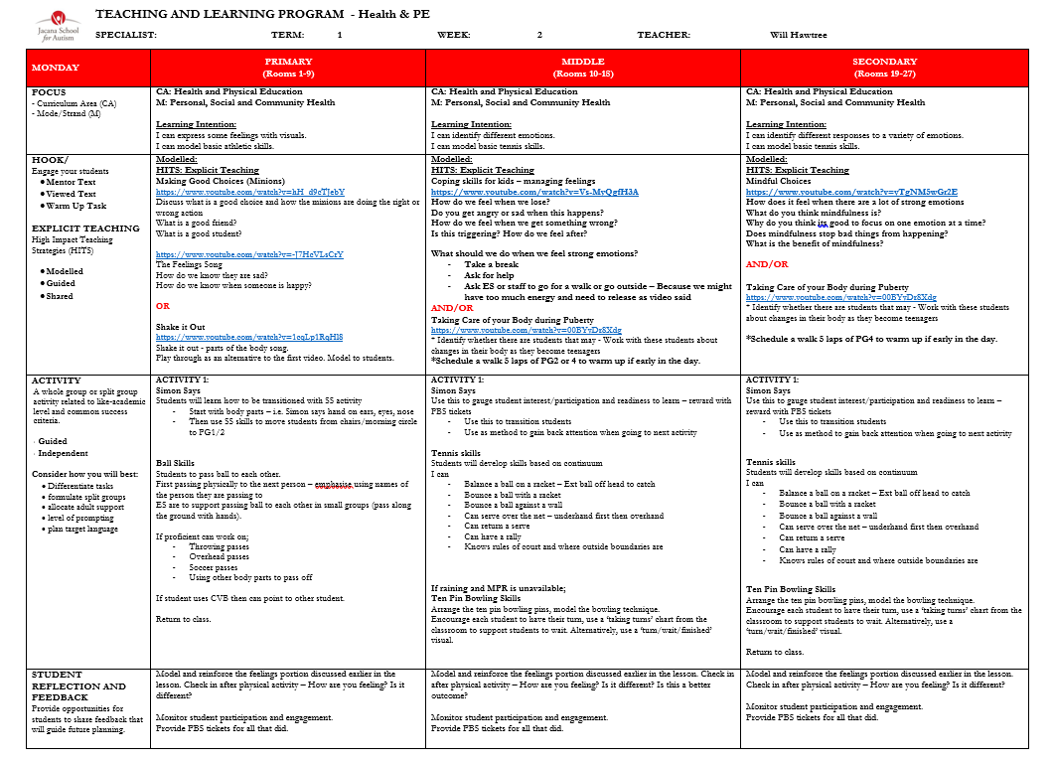
Teaching and Learning: Specialists
A weekly one page planner is developed with a set lesson structure for classrooms in each sub school.

Slide 17
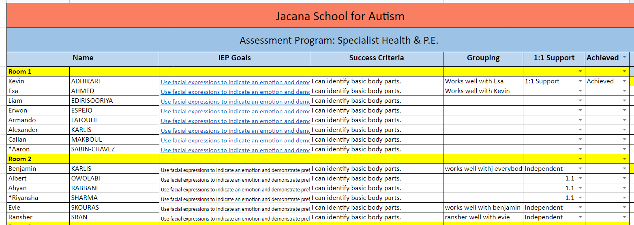
Teaching and Learning: Specialists
Alongside the T&LP, the specialists use a common checklist to cater to each student’s learning adjustments and record IEP Goal progress week to week

Slide 18
Planning JSA Excursions
Ensure that you have completed the Excursions E-Learning Module available via EduPay/eLearning each year.
Familiarise yourself with our JSA Excursions Policy (saved on SharePoint: School Documents/All JSA Policies/Curriculum Policies
Consider if your excursion involves any water based or adventure-based activities, a further checklist will need to be completed to monitor any additional risks involved, i.e. school camps, swimming program, etc.
Notes:
Steph - This model may assist you to identify how the curriculum can be adapted to meet the student’s learning needs. Using this model will ensure that your teaching practice is using a Universal Design for Learning (UDL) model, whereby teachers are planning for all learners in the classrooms.

Slide 19
Planning JSA Excursions
When planning an excursion, we need to consider a range of factors to ensure a safe and successful time off-site:
Record your set of excursions on your Classroom Excursion Planner (determine whether they have/do not have documented curriculum links) and submit to your SSL ASAP
Establish a JSA Evidence of Risk Assessment (Local and Day) to predicting/assess potential risks and to determine strategies to manage these one by one
Record your excursion details on the JSA Excursion Notification form, including travel plans, costs, first aid support, student medical needs
Submit your 2 forms (in hard copy) to the sub school leader to check/sign off (who will hand it onto Corinne and Leigh (Finance Manager) for final approval
Ensure all steps of the Excursion Checklist are undertaken, including Sharepoint communication and uploading your excursion on the Student Activity Locator
Notes:
Steph - This model may assist you to identify how the curriculum can be adapted to meet the student’s learning needs. Using this model will ensure that your teaching practice is using a Universal Design for Learning (UDL) model, whereby teachers are planning for all learners in the classrooms.

Slide 20
Planning JSA Excursions
- Excursion Notification Template -
The Excursion Notification Template is located on SharePoint:
School Documents/All Blank Proformas/Excursions
Key information:
Location summary
Costings (Curriculum or User Pay Basis)
What to bring
Transport
Planning and Budget
Staff/Volunteers and Students (including First Aiders/CPR/WCC)
Excursion Checklist Items
Signing off
Notes:
Steph - This model may assist you to identify how the curriculum can be adapted to meet the student’s learning needs. Using this model will ensure that your teaching practice is using a Universal Design for Learning (UDL) model, whereby teachers are planning for all learners in the classrooms.

Slide 21
Planning JSA Excursions
- Evidence of Risk Assessment (L/D) -
The Evidence of Risk Assessment (Local/Day) template is also located on SharePoint:
School Documents/All Blank Proformas/Excursions
Key Information:
Excursion Details: dates, times, student and staff numbers, educational objective
Risk Categories with suggested strategies (treatment): supervision, transport, student behaviour, health and wellbeing, first aid, weather/emergency warnings, communication, location, consent, external providers, emergency management, COVID-19, other
Signing off
Notes:
Steph - This model may assist you to identify how the curriculum can be adapted to meet the student’s learning needs. Using this model will ensure that your teaching practice is using a Universal Design for Learning (UDL) model, whereby teachers are planning for all learners in the classrooms.

Slide 22
Planning JSA Excursions
- Don’t forget -
BEFORE THE DAY
Have you confirmed your booking for our JSA buses in the Resource Booking Tab via Sharepoint?
Do you have an allocated trained bus driver to transport you to and from your location?
Have you developed a plan for your yard duty coverage back at school when you are not onsite?
Do you have an emergency Plan B if one of your staff are away?
Does your first aid person have their excursion kit ready to go before the day?
Notes:
Steph - This model may assist you to identify how the curriculum can be adapted to meet the student’s learning needs. Using this model will ensure that your teaching practice is using a Universal Design for Learning (UDL) model, whereby teachers are planning for all learners in the classrooms.

Slide 23
Planning JSA Excursions
- Being ready -
ON THE DAY
Ensure staff attending are aware of behavioural strategies, medical needs
Have a student list for all staff to use with all medical needs highlighted
Share each other’s mobile phone details
Always make our DUTY OF CARE our greatest priority of the excursion: routinely count all students before you leave, when you arrive and before you leave the location
Sustain clear communication between staff on the day, address any significant concerns for discussion upon your return
Remember: the buck always lies with the Teacher in Charge
Notes:
Steph - This model may assist you to identify how the curriculum can be adapted to meet the student’s learning needs. Using this model will ensure that your teaching practice is using a Universal Design for Learning (UDL) model, whereby teachers are planning for all learners in the classrooms.

Slide 24
JSA Teaching and Learning/Excursions
Questions??
Please feel free to forward any questions to our Assistant Principals:
Curriculum, Assessment and Reporting - Dan
Welfare - Stephanie
OHS and Transitions - Eva

