Slide 1
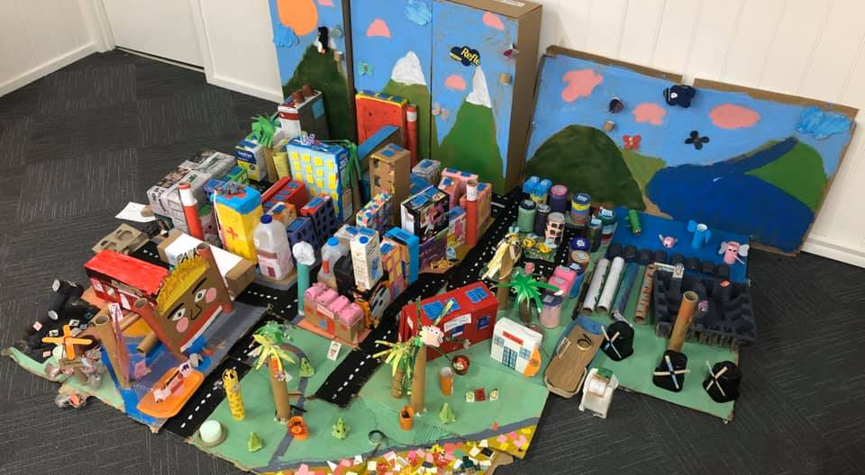
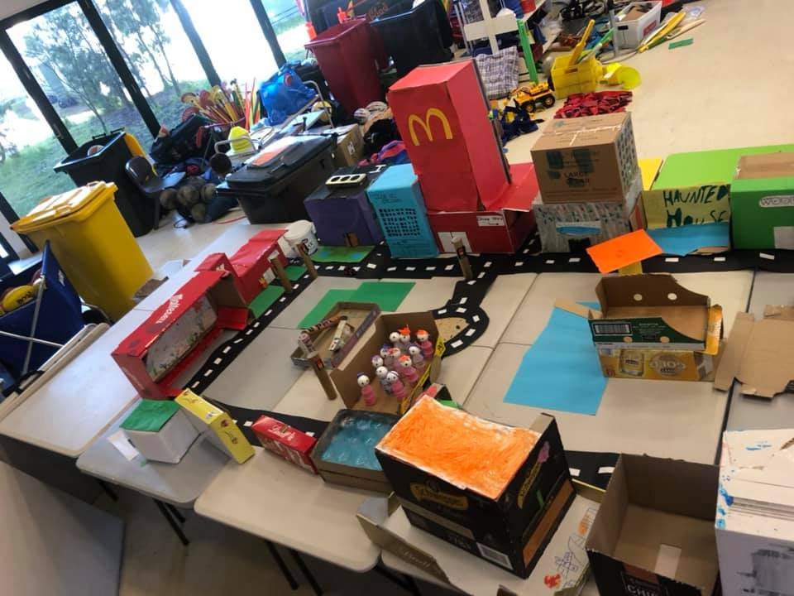
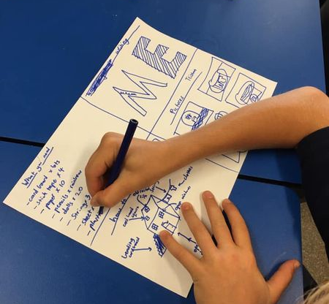
Cheltenham East Team Kids
3
Dear parents and guardians,
We are thrilled to announce our upcoming Term Challenge, the EcoEngineers JunkCity Challenge! This exciting challenge is designed for all Team Kids children, and it will provide them with an opportunity to learn about sustainability, engineering, teamwork, and community involvement.
The EcoEngineers JunkCity Challenge will take place till 5pm on Friday, 9th June, and it will challenge our children to design and build a sustainable city using recycled materials. To ensure that our students have the guidance they need to create their own JunkCity, we have set the following criteria for the challenge:
Engineering: Children will be encouraged to use their creativity and problem-solving skills to design and build functional buildings and structures using only recycled materials.
Participation: Children will be working in teams, which will allow them to develop their communication and collaboration skills as they work towards a common goal.
Team Effort: Teamwork is encouraged. Children work together to create their own JunkCity. This will require teamwork, cooperation, and compromise to achieve a shared vision.
Community: The JunkCity must serve the needs of its residents, which will encourage students to think about the importance of creating communities that are supportive, inclusive, and safe.
Sustainability: Students will be encouraged to consider the impact of their design choices on the environment and to incorporate sustainable practices, such as recycling.
We believe that the EcoEngineers JunkCity Challenge will be a fun and engaging way for our students. If you have any questions or concerns about the challenge, please do not hesitate to contact us.
Best regards,
Eric
Reading Club
Musical Theatre Club
Super Sports Club
Reading Club
Super Sports Club
World Mental Health Week
08/05 – 12/05/2023
Mother’s Day Coffee Van
12/05/2023
Lunch Time Legends
19/05/2023
0432 299 468
CheltenhamEastPS@teamholiday.com.au
1300 035 000
info@teamkids.com.au

