Slide 1
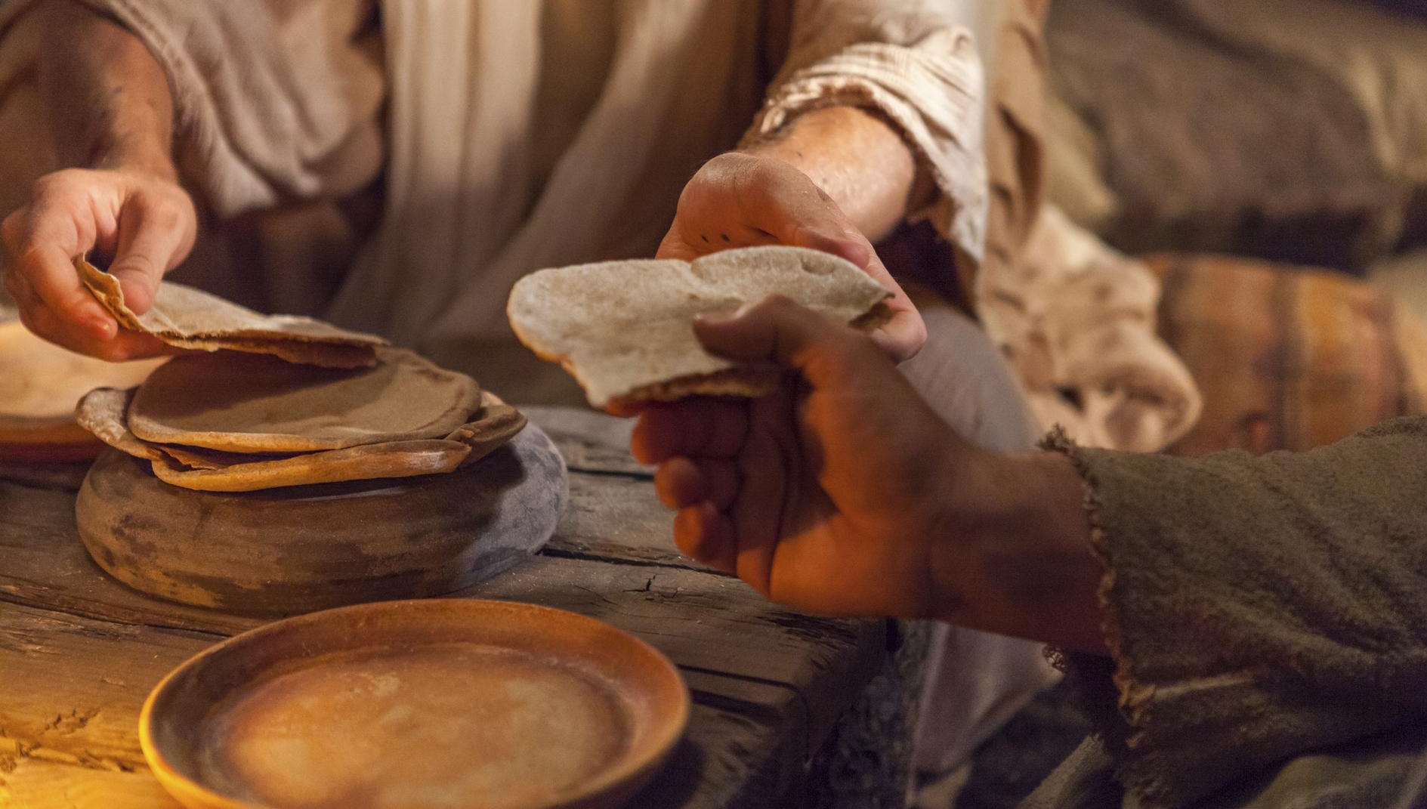
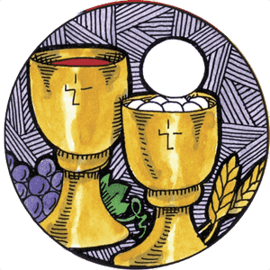
Sacrament of Eucharist
Family session

Slide 2
Agenda
Welcome
Sacraments
Grouping of Sacraments
EUCHARIST
Parts of the Mass-Meal
Ceremony
Questions
Conclusion

Slide 3
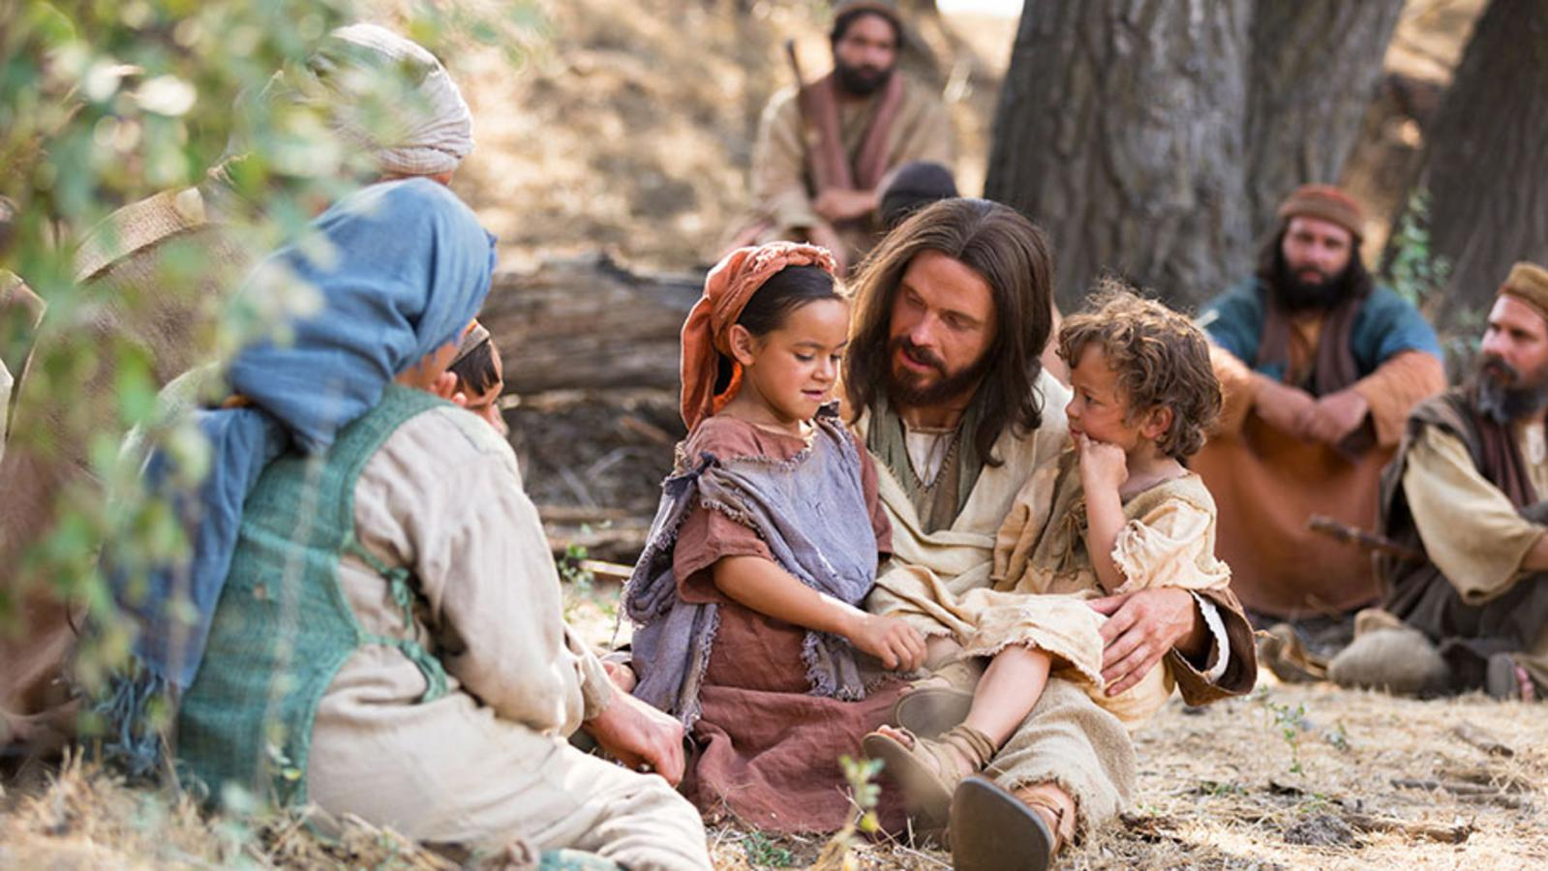
Jesus gave us signs to show us that he loves us.
He gave these signs to the Church.

Slide 4

These signs are called sacraments.

Slide 5
What is a SACRAMENT?
A sacrament is a visible sign of God’s invisible Grace
Can you remember how many sacraments there are?

Slide 6
There are seven sacraments
Can you name them?

Slide 7

Baptism, Eucharist,
Reconciliation, Holy Orders, Confirmation, Healing of the sick, Matrimony,
These are grouped into three categories

Slide 8







THE SEVEN SACRAMENTS
SACRAMENTS OF INITIATION
Baptism
Eucharist
Confirmation
SACRAMENTS OF HEALING
Reconciliation
Healing of the sick
SACRAMENTS OF
Commitment
Matrimony
Holy Orders

Slide 9
SPECIAL CELEBRATIONS
Turn and talk (parent/child)
Share a special celebration that involved a meal at your house
-Who was invited?
-How did your family prepare for it?
-Where did you all gather together to share the meal?
-Was there any special food?
-Did you share any stories during the meal or time together?
-How did the event end? Did you hug and say goodbye an thanks for coming
-Any promises to catch up soon etc

Slide 10
SPECIAL CELEBRATIONS
When we gather in the company of others to celebrate, we share not only the food but also stories as we retell events of our lives
We gather.
We share stories.
We share in a meal.
We leave with messages of love and a commitment to reconnect

Slide 11

Where do we see this happening today?
Who says take this all of you and eat it? What role is the priest taking on in the Mass?

Slide 12
The EUCHARIST
How do we prepare?
We gather,
We prepare ourselves (Penitential Rite) to be ready to receive our Lord
We listen to stories about Jesus’ life and the message from the story
We share in a meal
We go forth with a mission to make a difference in our lives
We gather together for the Eucharist at Mass to hear the stories of Jesus and come together for spiritual nourishment. As Catholics we believe that Christ is truly present body, blood and soul in the Eucharist.

Slide 13
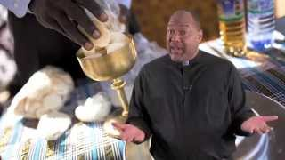

Slide 14
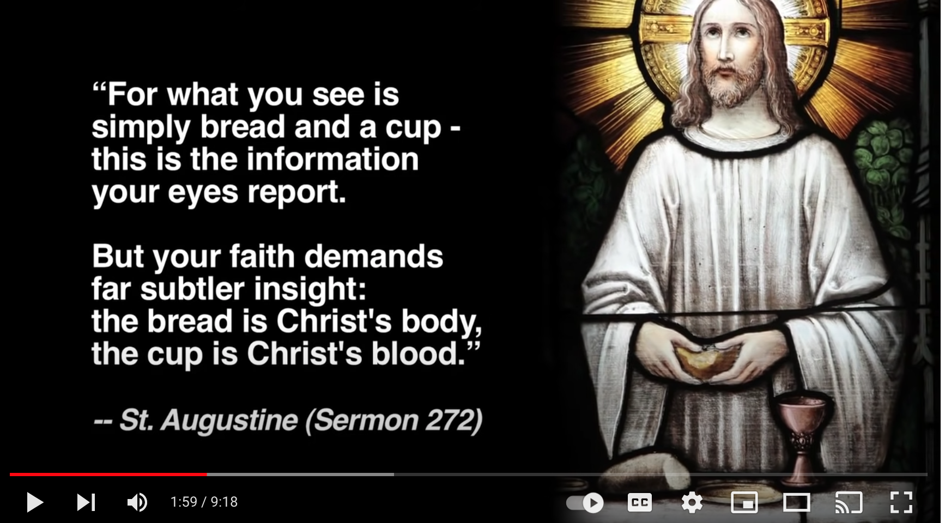
Eucharist - Busted Halo stop 1.59 (see scene below)
Stop when this scene is finished
1.59mins

Slide 15
ACTIVITY
You will need:
1 pair of scissors per family,
1 glue stick per family
the 4 sections of the book
YOUR TASK:
Working together read each section and decide which heading would match that description (we gather, we listen , we share a meal, we go forth.
Cut and glue the correct heading on each of the four sections
Cut and sort the pages of the book into the correct order
Add the cover and staple

Slide 16
Eucharist sessions
There are 4 parent/child sessions that are be completed together at home as part of your homework over the next few weeks. Each session takes around 20 mins to complete each session.
We ask that the completed sessions be returned to school by the end of August
Go to
JOURNEYING TOGETHER TO EUCHARIST
https://sacramens.melbournecatholic.org/

Slide 17
First Eucharist Mass
Sunday 10th August will start at 9.00am sharp
We would like all families at the church by 8.40 so stoles and pins can be given out and to line up ready to come in with candles
AS IT IS BIG DREAMS MARKET, THERE WILL BE LIMITED PARKING
.

Slide 18
First Eucharist Mass
Dress code smart attire for Eucharist Mass.
Please do not wear:
HOODIES with prints on them
OR RUNNERS that light up
It is purely your choice if you chose to wear a white dress or suit but not an expectation
Please consider not wearing a veil, as it does become a fire hazard near candle/flames.
You may choose to wear flowers or head band instead.

Slide 19
Run through at the Church
There will be a run through at the church on Thursday night at 3.30.
A parent must attend this with their child so that we can have a practice on where to stand and where to move etc ready for Sunday. This helps calm nerves.
Parts to the Mass will be given out at this time
READINGS, PRAYERS OF THE FAITHFUL, OFFERTORY PROCESSION etc
Parents discuss with your child what part they would like to participate in
and let us know at tonight’s meeting
WE URGE families to have a few practices with any readings at home prior to the day

Slide 20
Any Questions?
Thank you for coming today to share your faith journey with your child.

