Slide 1
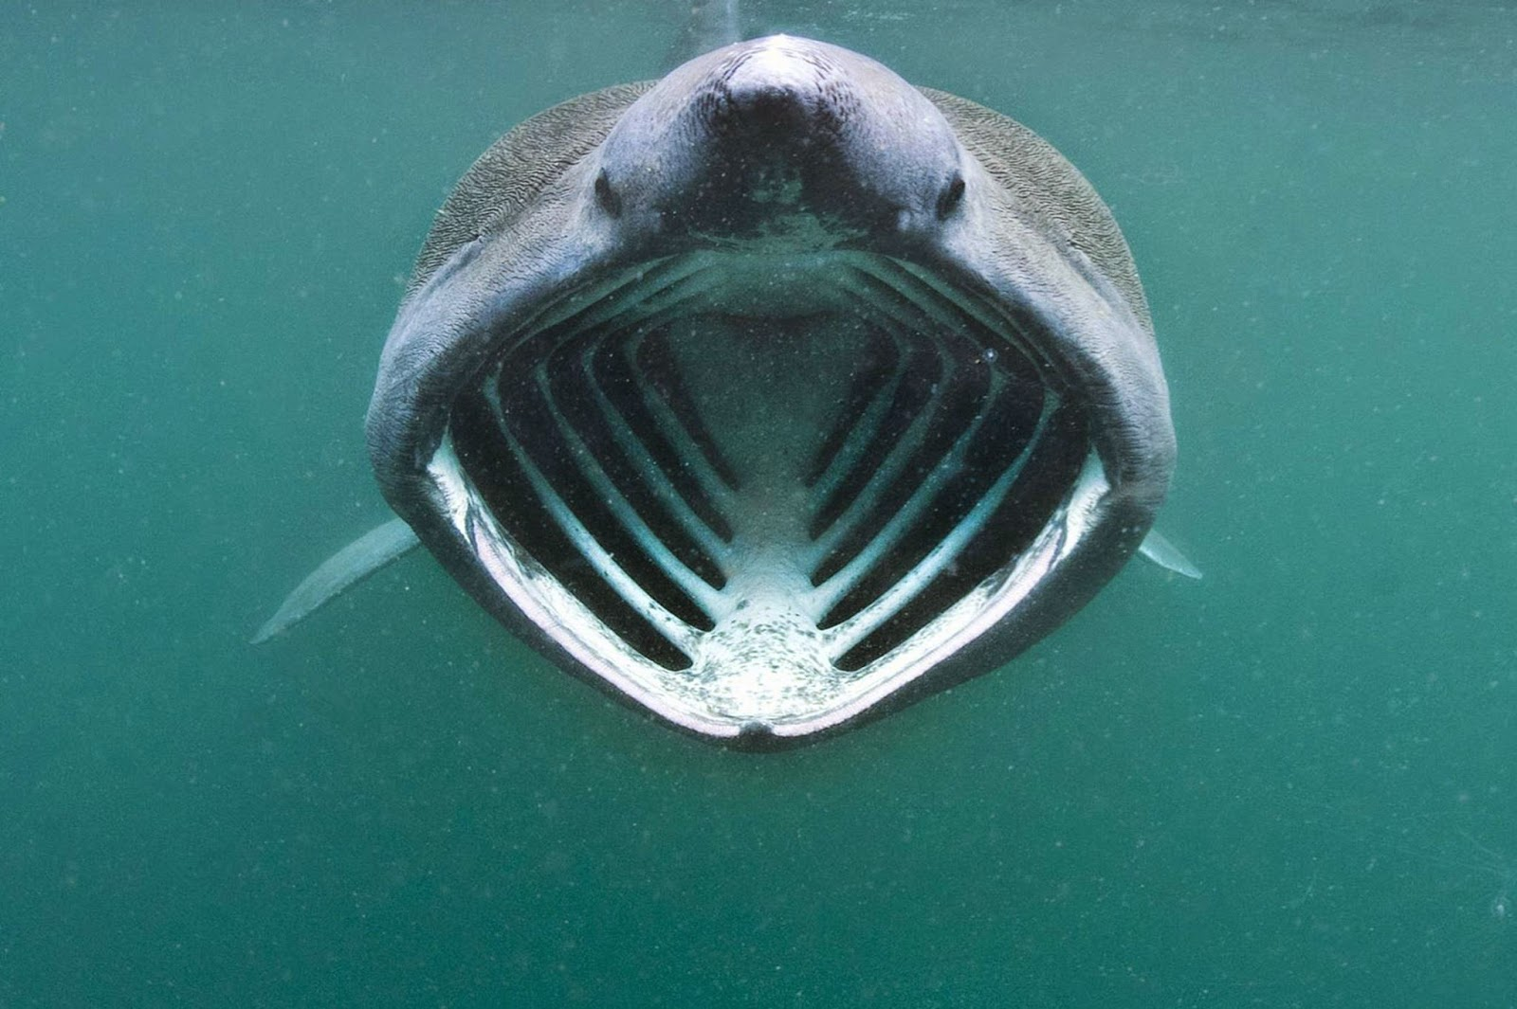



























Basking Shark
Scientific Name-
Cetorhinus Maximus
By Bill Callow 3C
This Photo by Unknown Author is licensed under CC BY-SA

Slide 2
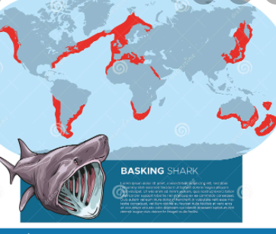
Where does the Basking Shark live.
The Basking Shark lives in the North and South of the Atlantic Ocean the Sea of Japan, off southern Australia and around New Zealand.

Slide 3
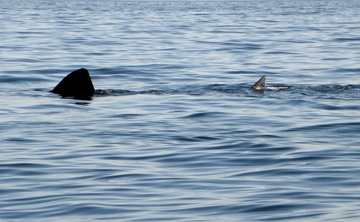
Habitat
Its habitat is the Atlantic ocean were it has warm waters and is very deep making it suitable for the Basking Shark.
This Photo by Unknown Author is licensed under CC BY-NC-ND

Slide 4
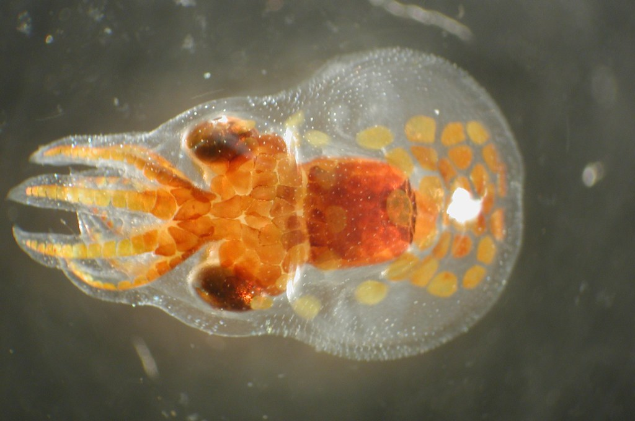
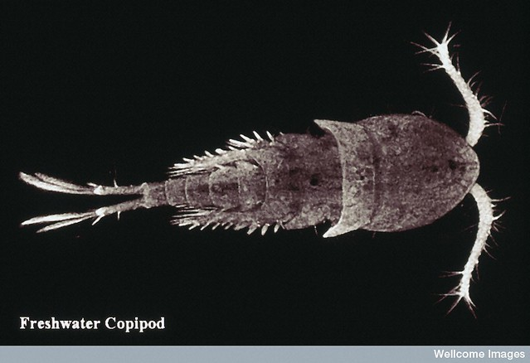
How does the Basking Shark survive.
The Basking Shark needs zooplankton , copipods (they are little crustaceans found in every water way) .
This Photo by Unknown Author is licensed under CC BY
This Photo by Unknown Author is licensed under CC BY-NC

Slide 5
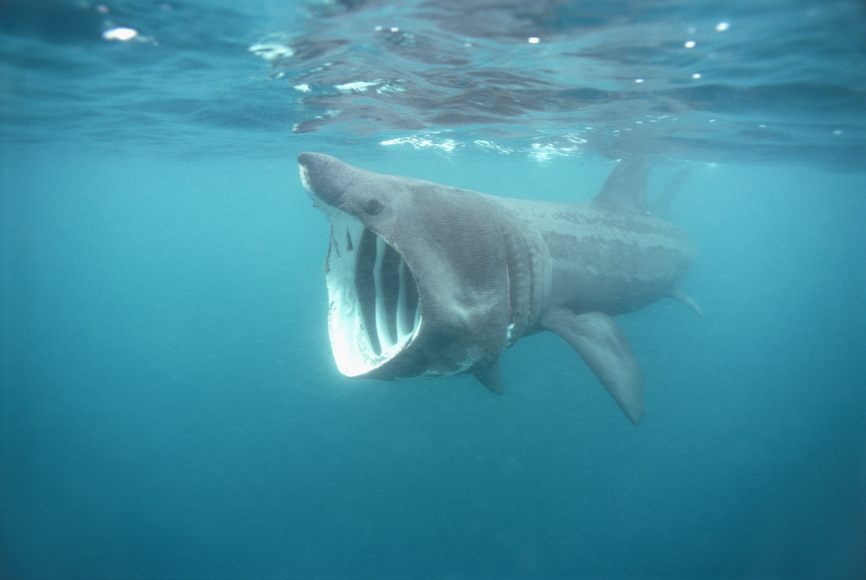
Features
The Basking Shark is 7.9 meters long . It weighs 4535 kg . It has a dorsal fin that can reach up to 2 meters . It’s mouth can open up to 1 meter wide . It has a conical body with a layer of mucus . Grey or brown is on its black belly.
This Photo by Unknown Author is licensed under CC BY-NC-ND

Slide 6
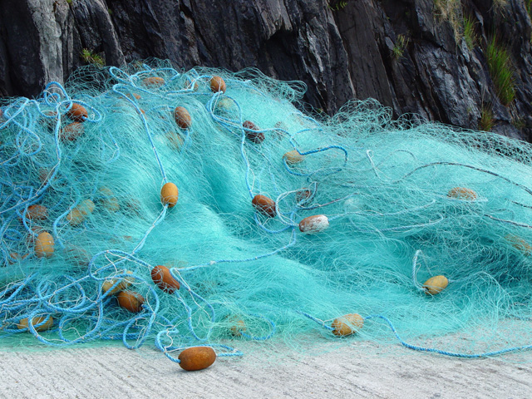

Threats.
Entanglements (getting caught in fish nets). Boat Strike( getting hit by boats and having BIG injuries) Harassment(Basking sharks are very sensitive to harassment).
This Photo by Unknown Author is licensed under CC BY-SA
This Photo by Unknown Author is licensed under CC BY-SA

Slide 7
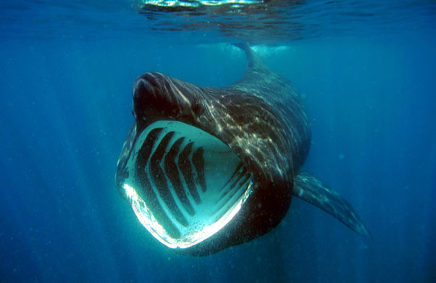
How You Can Help.
By adopting a Basking shark and recording its sightings. Don’t invade in a Basking Sharks habitat/life.
This Photo by Unknown Author is licensed under CC BY-SA

Slide 8
References
https://www.activewild.com/basking-shark/
Endangered Animals 2022: List Of Endangered Animals - Pictures & Facts (activewild.com)

