Slide 1
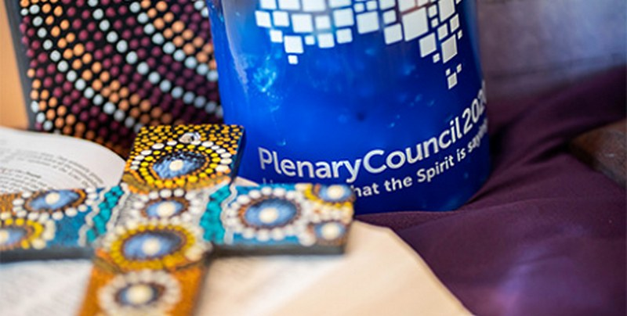

Continuing the Dialogue:
Observations and reflections on the First Assembly of the Plenary Council
The members are Dr Angela McCarthy, Catherine Nguyen, Mary Ryan OP, Eva Skira AM, Gemma Thomson, and Lucy van Kessel PVBM.
Dr Pina Ford, a Plenary Council facilitator will provide an overview and explain the Assembly process.
The first Assembly of the Plenary Council concluded on October 10 after an intense week of prayer, discussion and discernment.
The Council for Catholic Women Perth warmly invites you to hear Perth's women members share their experience of the first Assembly of the Plenary Council
There will be an opportunity to ask questions and to contribute to this dialogue. Men and women are all welcome.
When: Thursday 18 November, 5.30pm - 8.30pm Venue : James Nestor Hall ,Catholic Education Office 50 Ruislip St West Leederville; refreshments served 5.30pm - 6pm.
RSVP: Tuesday 16 November by email kerrymacfarlane2@gmail.com or mobile 0400 886 835

Slide 2
Continuing the Dialogue:
Observations and reflections on the first Assembly of the Plenary Council
The members are Dr Angela McCarthy, Catherine Nguyen, Mary Ryan OP, Eva Skira AM, Gemma Thomson, and Lucy van Kessel PVBM.
Dr Pina Ford, a Plenary Council facilitator, will provide an overview and explain the Assembly process.
The First Assembly of the Plenary Council concluded on October 10 after an intense week of prayer, discussion and discernment.
The Council for Catholic Women Perth warmly invites you to hear Perth's women members share their experience of the first Assembly of the Plenary Council
There will be an opportunity to ask questions and to contribute to this dialogue. Men and women are all welcome.
When: Thursday 18 November, 5.30pm - 8.30pm Venue : James Nestor Hall ,Catholic Education Office 50 Ruislip St West Leederville; refreshments served 5.30pm - 6pm.
RSVP: Tuesday 16 November by email kerrymacfarlane2@gmail.com or mobile 0400 886 835
Notes:
Please join us again to hear six female members of the Plenary Council talk of their experience of the first session.
The members are Dr Angela McCarthy, Catherine Nguyen, Mary Ryan OP, Eva Skira AM, Gemma Thomson, and Lucy van Kessel PVBM.
Dr Pina Ford will explain the Plenary Council process and provide a context.
THURSDAY 18 November 5.30-8.30pm - Continuing the Dialogue: Observations and reflections on the First Plenary Council Assembly
The First Assembly of the Plenary Council concluded on October 10 after an intense week of prayer, discussion and discernment.
The Council for Catholic Women Perth warmly invites you to hear Perth's women members share their experience of the first assembly of the Plenary Council.
There will be an opportunity to ask questions and to contribute to this dialogue. Men and women are all welcome.
Venue : James Nestor Hall ,Catholic Education Office 50 Ruislip St West Leederville
When: Thursday 18 November, 5.30pm - 8.30pm (Light refreshments served 5.30pm - 6pm)
RSVP: Tuesday 16 November by email kerrymacfarlane2@gmail.com or mobile 0400 886 835

