Slide 1
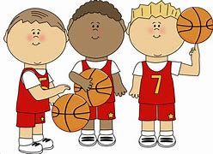
MINI Dribblers 2023
Mini Dribblers is a Program for 5-10 year olds that focuses on children having fun and meeting new friends whilst teaching the fundamentals of basketball
Term 1 – 2023
Sessions:
Wednesday
Ages 5 – 7 Years
4.00 pm – 4.40 pm
Ages 8 – 10 Years
4.50 pm – 5.30 pm
Thursday
Ages 5 – 7 Years
4.00 pm – 4.40 pm
Ages 5 – 7 Years
4.50 pm – 5.30 pm
Make sure you bring a Basketball !
REGISTRATIONS
Got to our Website – Doncaster Basketball Association
Click on Mini Dribblers Tab
Choose Registration Link
Or email doncleeds_st@bigpond.com for details
Doncaster Basketball Association - Leeds Street Basketball Stadium

